Slide 1
Chemical Reactions
Formation of new substances caused by the breaking of bonds (reactants) and the forming of new bonds (products)
Ca(OH)₂ + 2HCl → CaCl₂ + 2H₂0
The stoichiometry of a reaction means that the overall reaction gains or loses no mass (conservation of mass)
The use of coefficients in a chemical reaction is essential to give information on the molar ratio
Equations for reactions should include the symbols indicating the state of matter
  (s) = solid
  (l) = liquid
  (g) = gas
  (aq) = aqueous

Slide 2

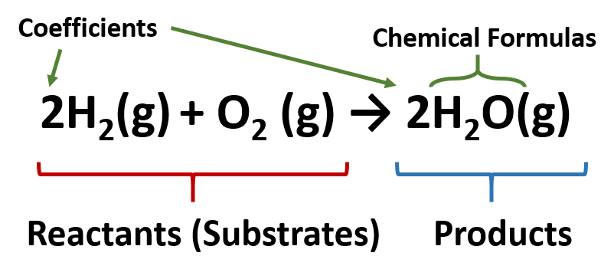
Chemical Reactions
Reactants on the left, products on the right.
For complete reactions, the one directional arrow is used
For reversible reactions, this arrow is used:
Coefficients are used to balance equations
Western Oregon University (2023)

Slide 3
Chemical Reactions: Ionic equations
Ionic equations are balanced equations that focus on cations and ions in a reaction:
Removing the so-called spectator ions:
Mg(s) + 2 HCl(aq) MgCl₂(aq) + H₂(g)
Mg(s) + 2 H⁺(aq) + 2 Cl⁻(aq) Mg⁺²(aq) + 2 Cl⁻(aq) + H₂(g)
Mg(s) + 2 H⁺(aq) Mg⁺²(aq) + H₂(g)

Slide 4
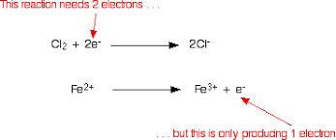
Chemical Reactions: Half equations
Half equations allow us to observe what occurs to different species especially in reduction-oxidation (redox) reactions
ChemGuide (2023)

Slide 5
Chemical Reactions
Define the following: theoretical yield, experimental yield, percentage yield, limiting reagent
Keep in mind that one reactant will in practice be in excess whereas the other reactant(s) will be completely consumed in a reaction
Chemists will attempt to maximize experimental yields
  What factors will allow for this?
  What can be done to a system to maximize yields?
  A means of reducing wastes, cutting down on costs

Slide 6
Atom Economy
A way to test efficiency of reactions and industrial processes:
% atom economy= (molecular mass of atoms of desired products / molecular mass of atoms in reactants) x 100
100 % = no waste

Slide 7
Atom Economy: How to Calculate
Balance the equation
Calculate relative molecular masses of products and total mass of products (equal to that of reactants)
Consider the same for desired products
% atom economy= (molecular mass of atoms of desired products / molecular mass of total products) x 100

