Slide 1
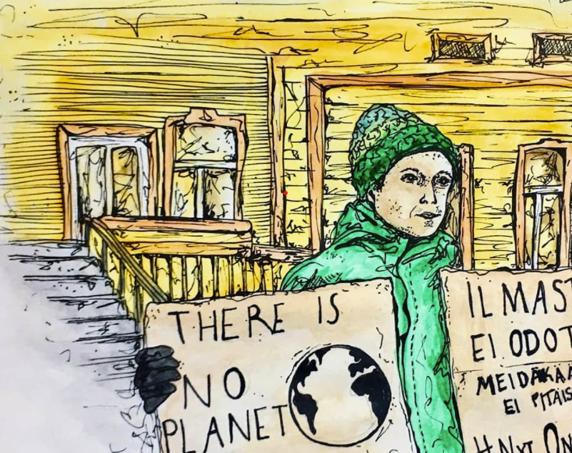
Interview
Atte Ahokas, Climate striker and -activist

Slide 2
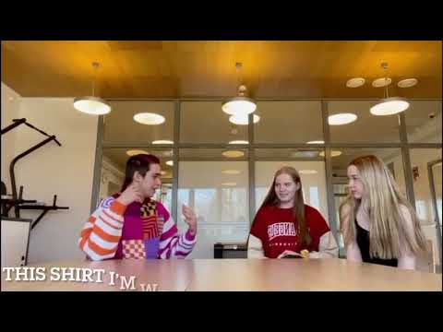

Slide 3
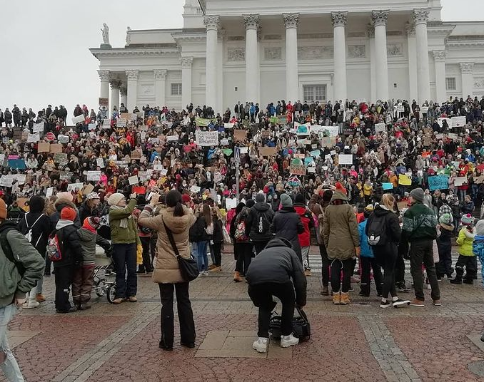
So what do you do? What your job description includes?
- Taking part to national movement what is about climate change
- Fridays For Future is an international climate movement made by Greta Thunberg
- Especially before corona school striking in parliament houses stairs
- Organizing different sorts of climate strikes, events and demonstrations
- Also social media things, different conversations and interviews

Slide 4
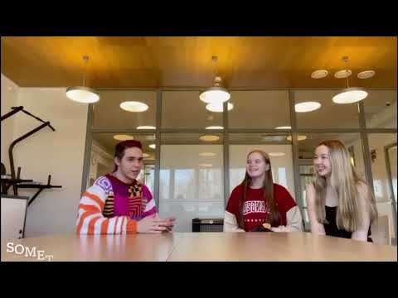

Slide 5
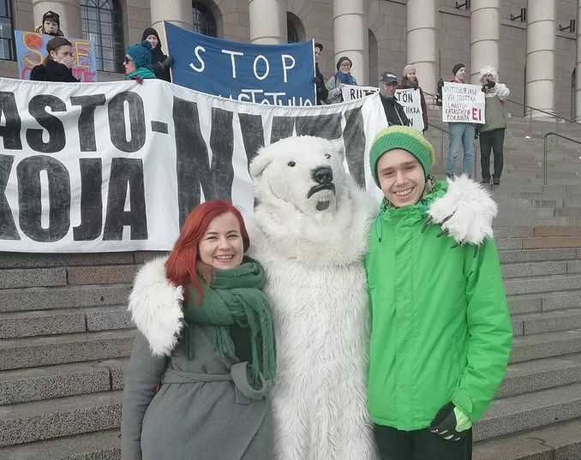
Do you want your future career to somehow include this? Or just keep it like a hobby/ thing what you do in your free time?
- In future probably going to study something that associates with climate things.
- Very interested of the job as a naturalist, where you can study climate crisis and luontokato??? and how it affects to people.
- also might go for the politics.

Slide 6
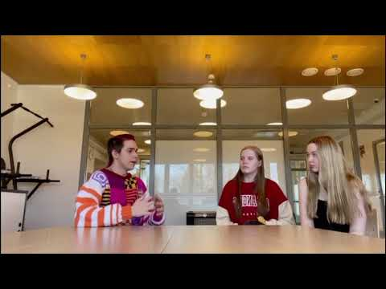

Slide 7
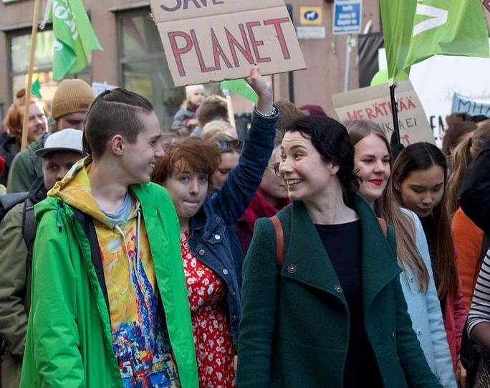
Have this affected you as a person? Is your scheme of things more wider?
- "Very much, It has made me more social, I can work better in the crowd and I can handle situations better"
- "Friends and people I know are more different than before and I know people around the world"

Slide 8
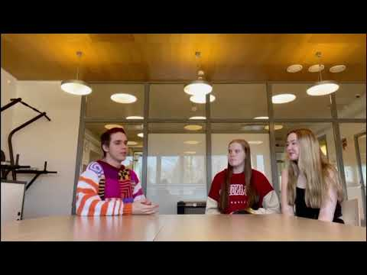

Slide 9
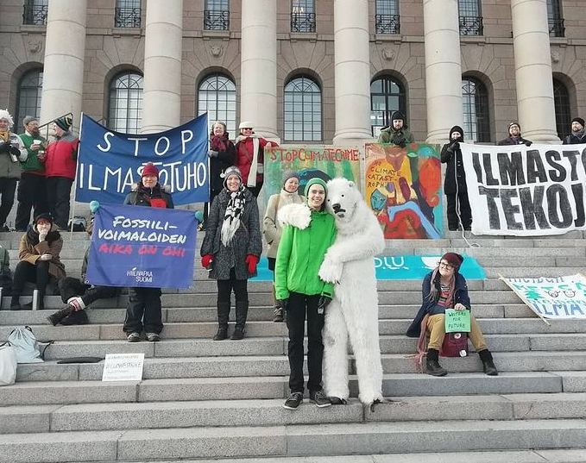
Is there something, we all can do to slow down the climate change? Give us some tips!
- Every time you are buying something think "Do I really need this?"
- Nowadays people buys and consume too much
- remember that single person does not solve the climate crisis
- The society is based on consuming and fossil capitalism
- Living ecological life can be hard

Slide 10


