Slide 1
Topic 10: Genetics and Evolution
Three main patterns of natural selection: directional, stabilizing and disruptive
Three main types of reproductive isolation: temporal, behavioral or geographic

Slide 2
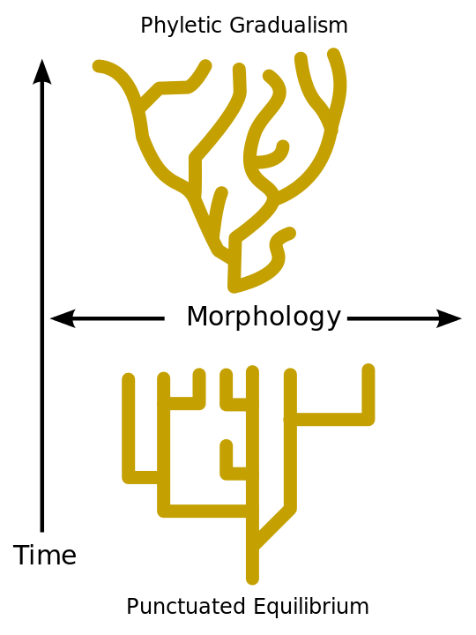
Punctuated Equilibrium
the hypothesis stating that evolutionary development is characterized by isolated episodes of rapid speciation taking place between long periods of little or no change.

Slide 3
Polyploidy
Having a chromosome number that is more than double the basic or haploid number
Can lead to speciation
Tympanoctomys barrerae, the mammal with the highest number of chromosomes, is thought to be an example of polyploidy in animals

