Slide 1

Career Counselling Program
The bachelor of Education in Career Counselling
Three years, 180 ects

Slide 2
Career Counselling Program,
Social Science, 15 ECTS*
Behavioral Science, 15 ECTS
Workinglife and Industri 22,5 ECTS
Free choice course, 7,5 ECTS
Career Counselling I-V, 90 ECTS
Career Development and Career Counselling, 30 ECTS
* 7,5 ECTS = 5 weeks of studies

Slide 3
Career Counselling Program
Career Counselling courses
Sociological perspectives on career choice and development
Education Politics
Education System
Research theory
Academic paper

Slide 4
Career Counselling Program
Career Counselling courses
Career choice and development
Career communication
Practical training

Slide 5

Career Counselling Program
90 students/ year
Campus studies ( 30)
Distans studies ( 60 )

Slide 6
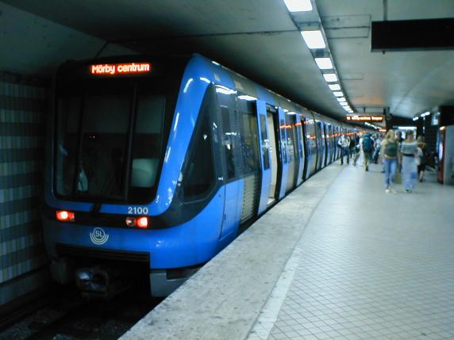
Career Counselling Program
Campus Studies:
Students live in/around Stockholm
At the university
3-4 days a week
Practical training in/around Stockholm

Slide 7
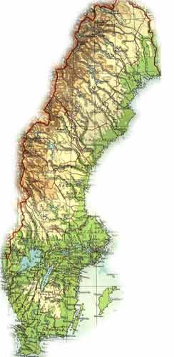
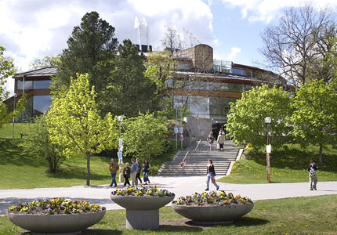
Career Counselling Program

Slide 8

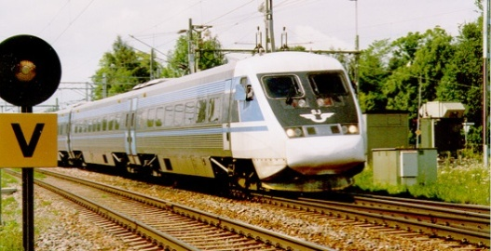
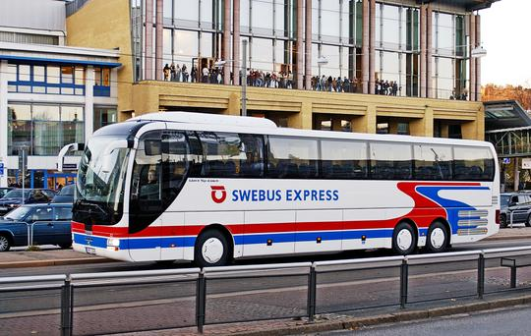
Career Counselling Program
Distance Studies:
Students from all over the country
In Stockholm 1 week at a time
4 times/semester
Between sessions in Stockholm-homestudies
Practical training at home

Slide 9
Career Counselling Program
Practical training:
I Linked to Career choice and development
(micro counseeling) ground level; 5 weeks
II Linked to Career communication
( macro counselling/career education); 5 weeks
III Linked to Career choice and development
(micro counseeling) deepening level; 5 weeks

Slide 10
Career Counselling Program
Practical training- preparing at the university
Theoretical studies
Seminars
Methological training
Small groups of students with teacher
Feedback
Record- video/audio

Slide 11
Career Counselling Program
Practical training- field based
5 weeks
Supervisor- Feedback
F. i. Secondary, Upper secondary, Adult education, Immigrant education, Higher education, Employment services
Tasks
Examination –Teacher from departement

Slide 12
Career Counselling Program
Practical training-examination
Examinating seminar
Teacher fr. departement, supervisor, student
Campus students – on placement
Distance students with telephone
Criterias
Narrative
Questions

Slide 13



Career Counselling Program
Practical training-examination, distance

Slide 14
Career Counselling Program
Practical training II -Criterias To pass:
Show that he/she has aquiered knowledge and has got ability to remake it in terms of information and teaching from the point of the reciepients needs and understanding.
Show leadership and ability in planning and performing in classroom

Slide 15
Career Counselling Program
Practical training II -Criterias To pass:
Show that he/she is able to communicate and cooperate
Show self knowledge and awareness of her/his own attitudes and values against individs, groups and society
Show that he/she is able to pay attention to his/her communication and how it effects on groups and individuals

Slide 16
Career Counselling Program
Practical training III-Criterias To pass:
The student shows that he/she is able
both to plan, realize, and analyze conselling conversations as well from individual- as from group perspective. All this on the basis of context and theories concerning Career Development and Career counselling

Slide 17
Career Counselling Program
Practical training III-Criterias To pass:
The student shows that he/she is able to
identify and analyze counselling based on an ethical point
from a professional perspective reflect upon his/her basic outlook and values and analyze
his/her counselling from the points of the
clients needs

Slide 18
Career Counselling Program
Practical training III-Criterias To pass:
The student shows that he/she is able to
distinguish, value and discuss counselling activities based on its prerequisites, substance, mandate and goal.

