Slide 1
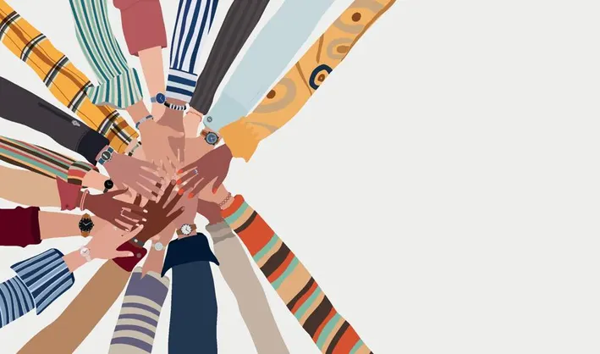
Inclusion
Aino, Saimi ja Oskari

Slide 2
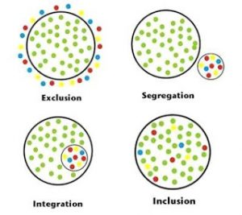
What is inclusion (Aino)
Inclusion means ensuring that everyone, regardless of their background, abilities, or differences, is welcomed, valued, and given equal opportunities to participate and contribute.
To be included in a community means being accepted, welcomed, and actively involved in its activities, relationships, and decision-making. It means having equal opportunities to contribute, share, and belong.
On the other hand, to be excluded in a community means being left out, ignored, or not given the same opportunities to participate. It often involves feeling isolated, undervalued, or disconnected from the group's activities or decisions.

Slide 3

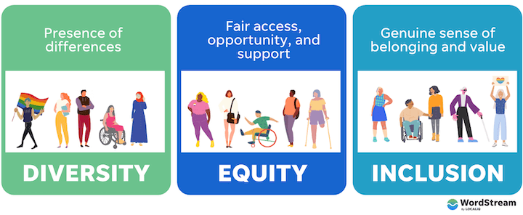
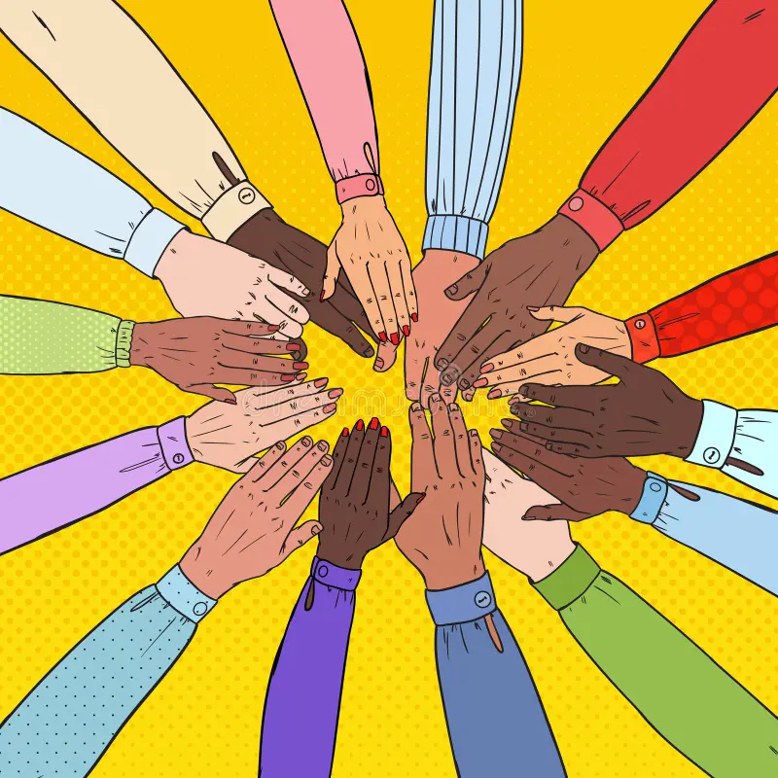
Examples of inclusion in school and society (Aino)
In schools: In society:
-Diverse Classroom Participation -Workplace Diversity
-Inclusive Activities and Clubs -Accessible Public Spaces
-Anti-bullying Policies -Cultural Awareness Campaigns

Slide 4
Why is inclusion important? (Aino)
Why is it important to feel included?
-Sense of Belonging
-Emotional Well-being
-Equal Opportunities
-Encourages Personal Growth
How does inclusion benefit schools?
-Encourages Diversity & Understanding
-Improves Academic & Social Growth
-Boosts Confidence & Participation
Prepares Students for the Real World

Slide 5
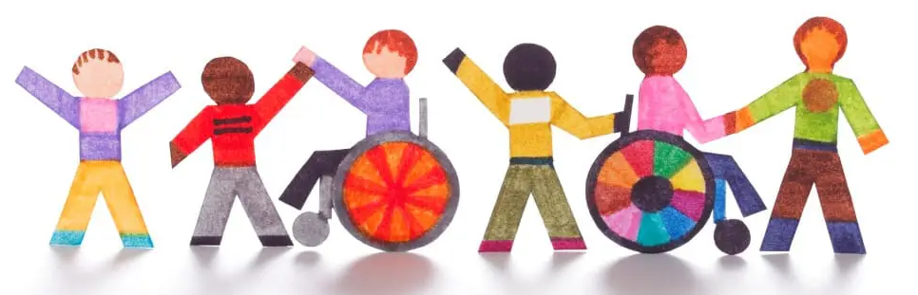
How can we promote inclusion in our school? (Saimi)
Inclusive school environment supports the diversity of all learners
Everyone is being respected and listened to
Everyone has the right to get support for their own development and learning
Inclusive environment in schools is being built by the adults

Slide 6
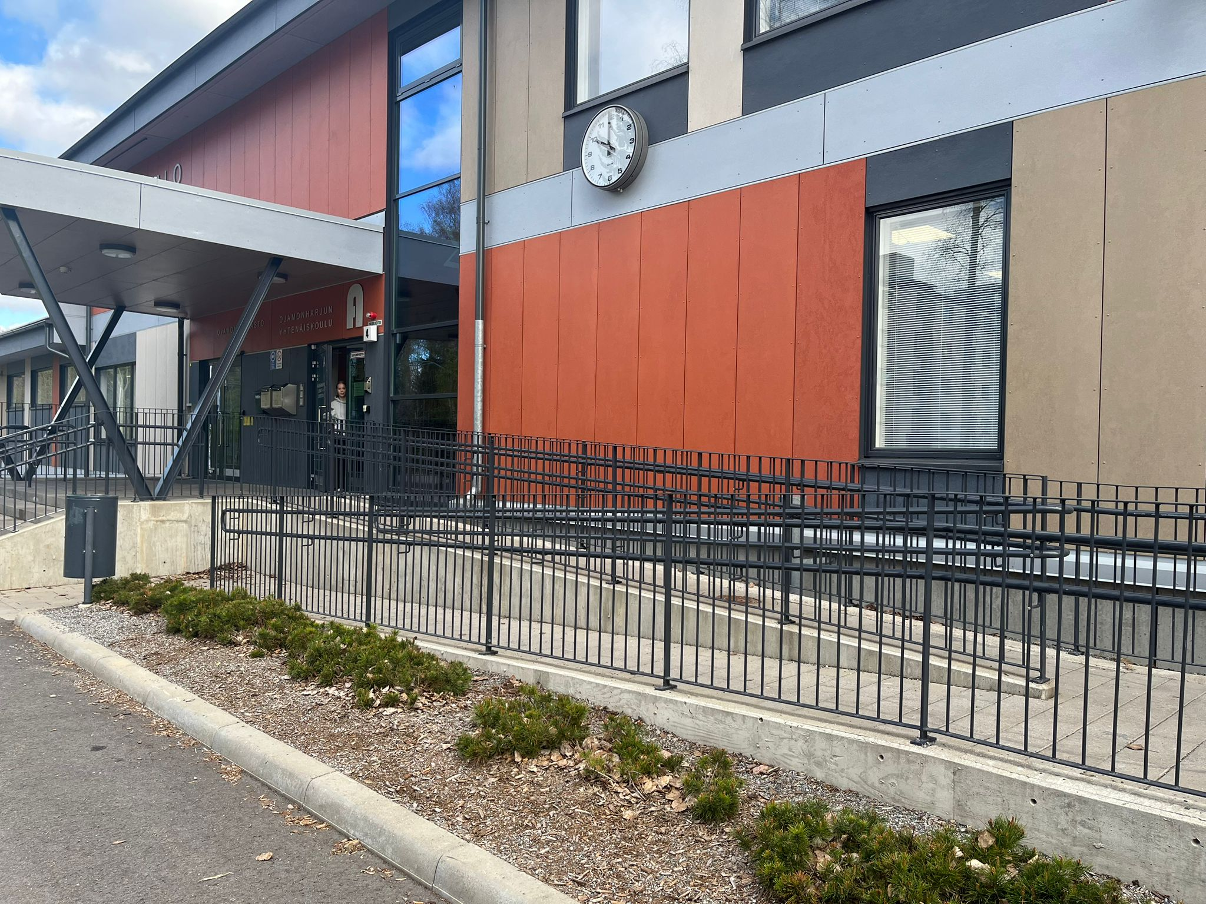
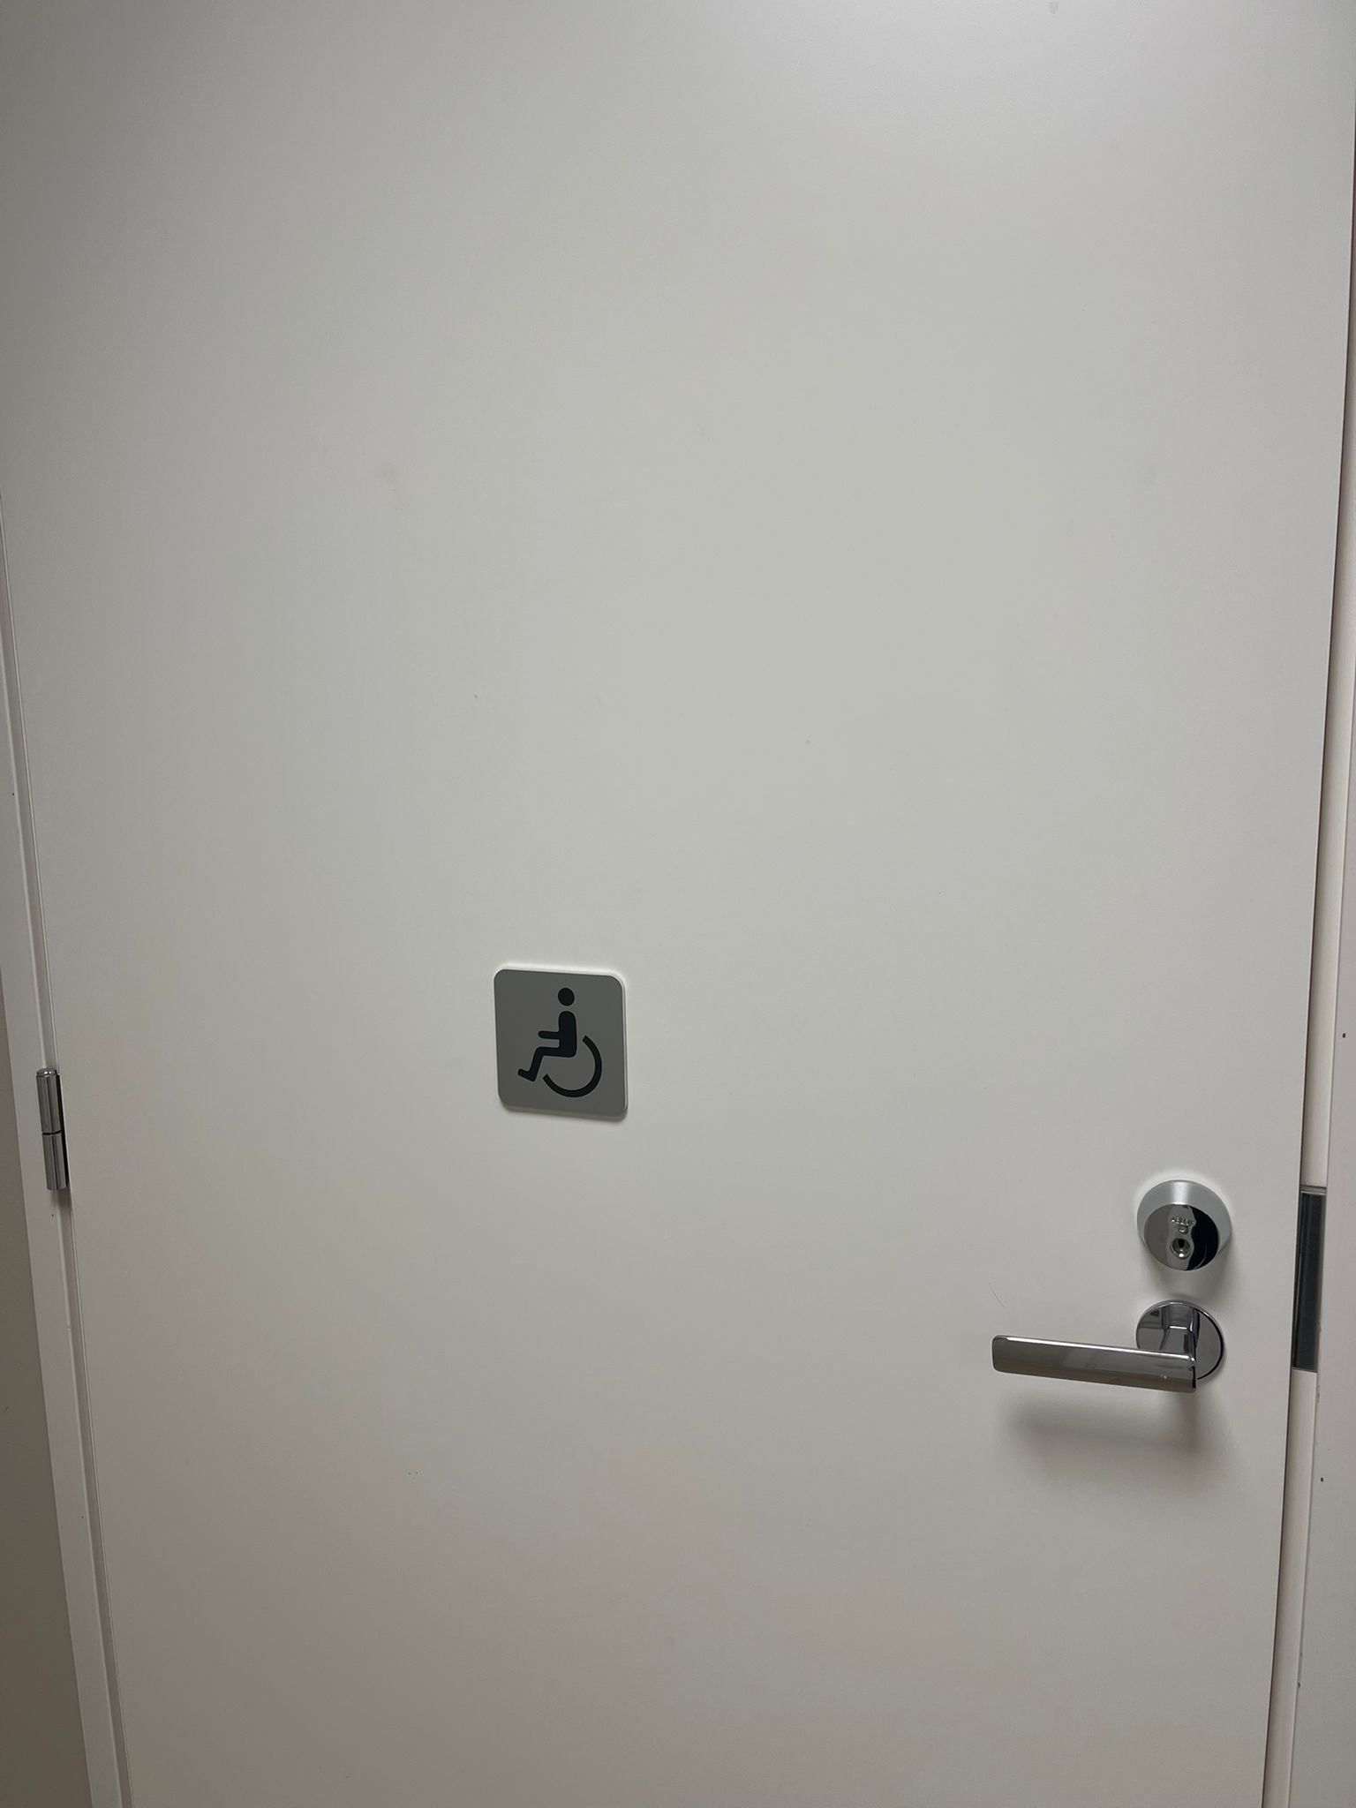
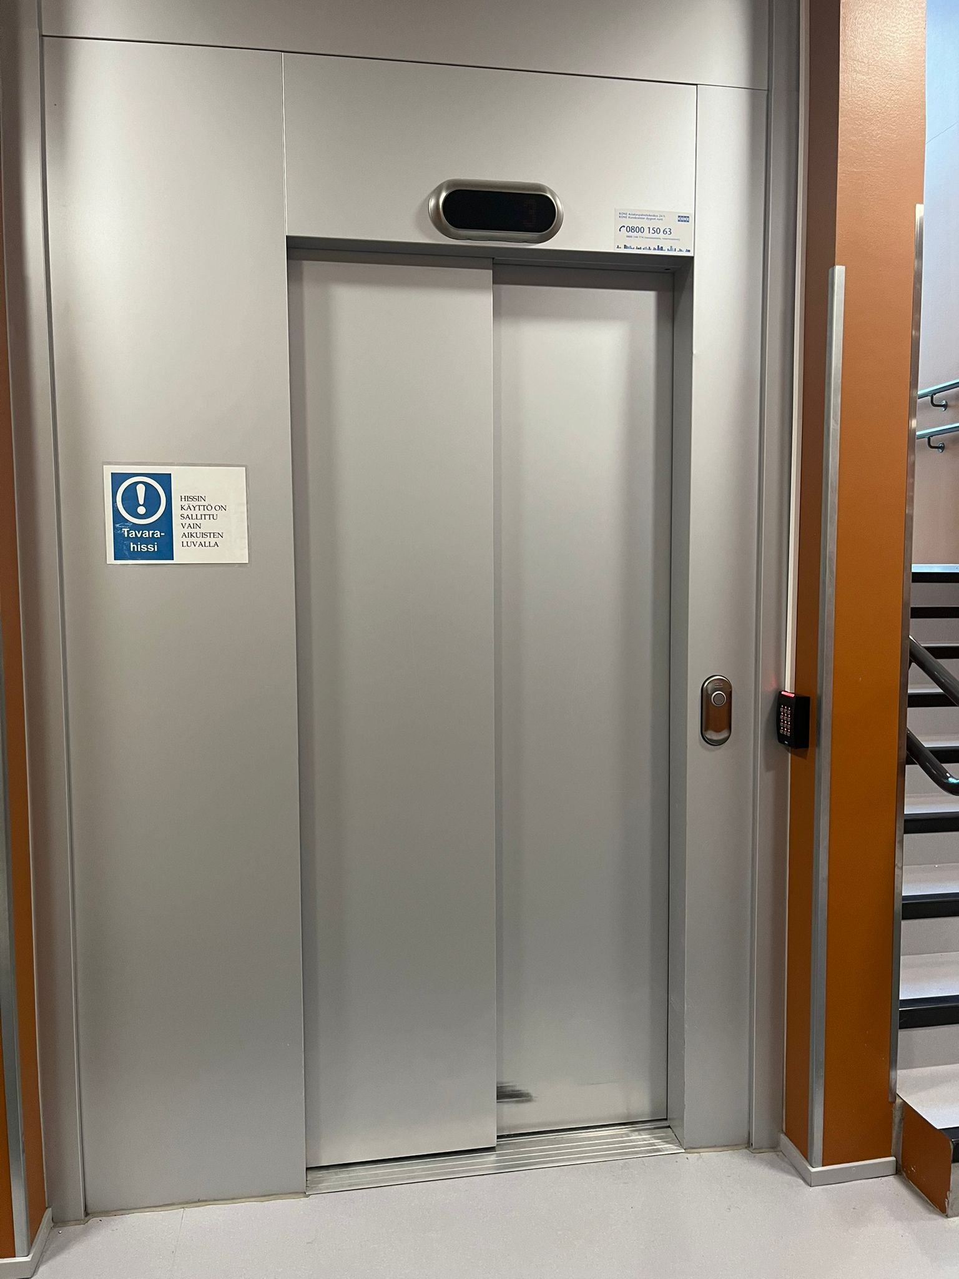
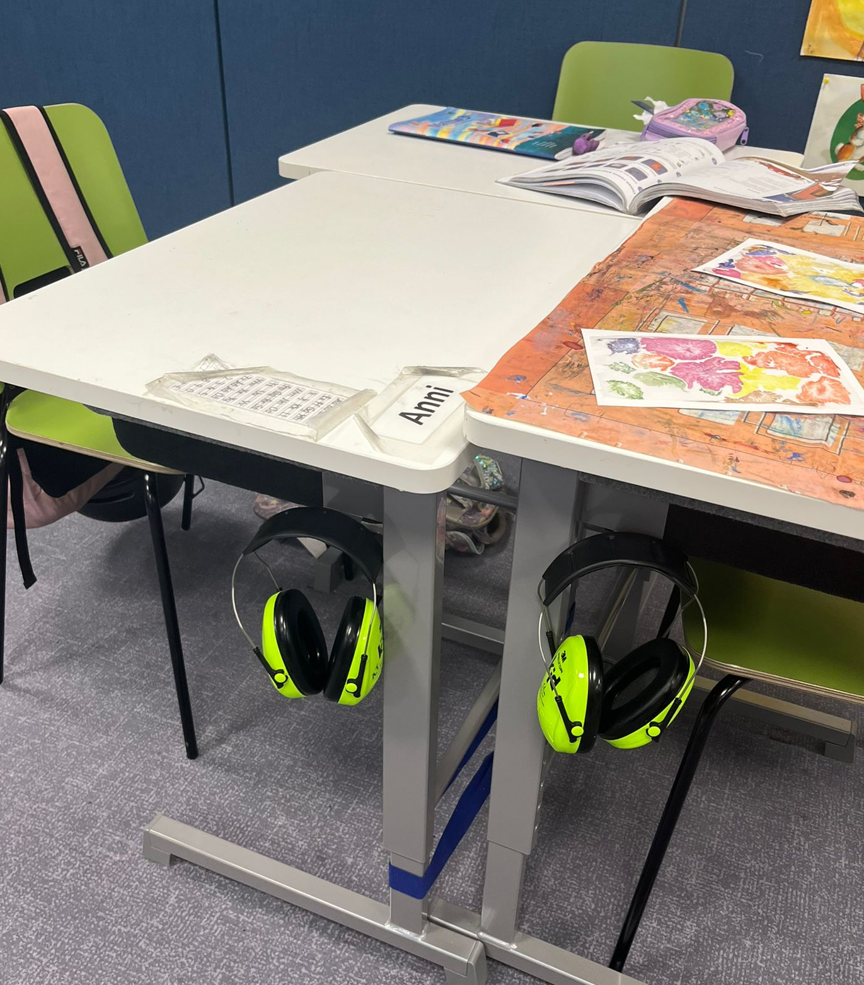
Accessible Public Spaces
in our school.

Slide 7

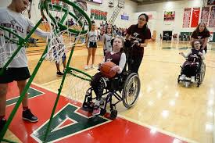
Real-life examples of inclusion (Oskari)
One powerful real-life example of inclusion making a difference is Unified Sports by Special Olympics.
What is Unified Sports?
Unified Sports is a program where students with and without intellectual disabilities play together on the same teams. It helps bring people together by letting them share experiences in sports. Schools and communities around the world use this program to build friendships, break down stereotypes, and promote teamwork

Slide 8

Challenges of inclusion (Oskari)
Inclusion means making sure everyone feels welcome, respected, and able to join in. But sometimes there are problems that stop people from being included. Here are some of the common challenges:
If someone speaks a different language or has trouble with speaking, hearing, or reading, they might not be able to take part easily.
If buildings or spaces aren’t built to include people with disabilities, it can stop them from joining in.
How Can we fix these problems?
Create places where people feel comfortable being themselves and sharing their thoughts.
Create rules that protect everyone and make sure no one is treated unfairly.
Make sure buildings, websites, and events are easy for everyone to use, including people with disabilities.

