Slide 1
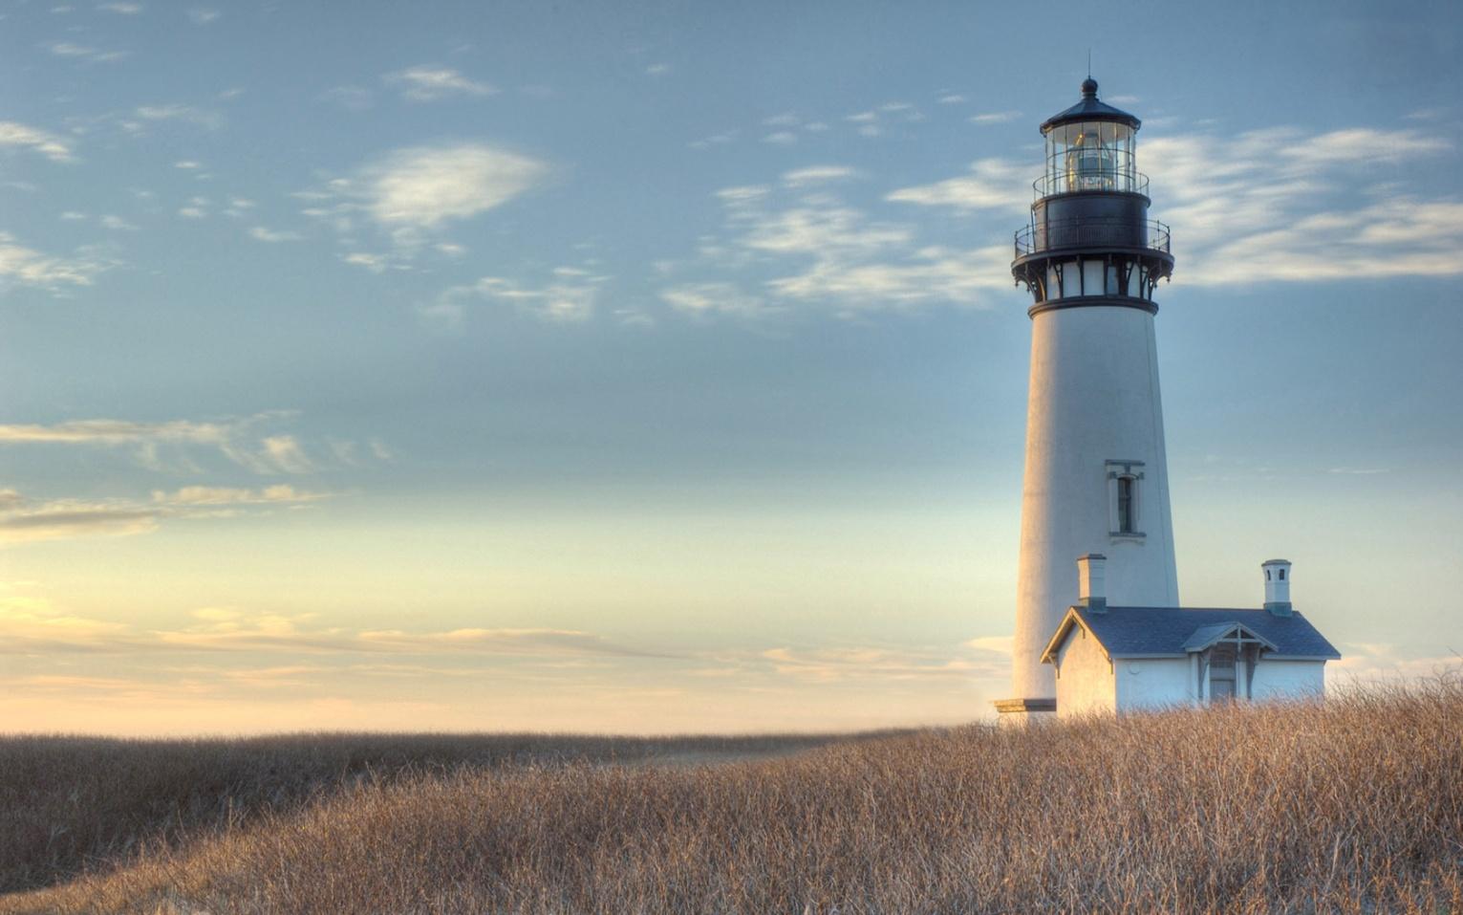
LIGHTHOUSE
BY KONSTANTINOS MITRALEXIS
5th grade pupil
3rd primary school
agii anargyri
athens
This Photo by Unknown Author is licensed under CC BY-SA

Slide 2
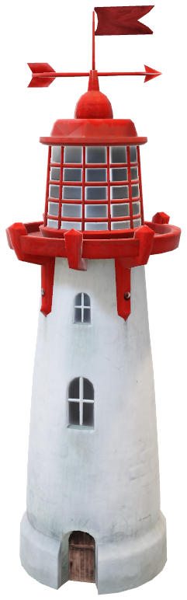
WHAT IS THE LIGHTHOUSE ?
Lighthouse is a building with a big light on the top of it . The light helps the sailors to understand where is their position and destination .
This is a lighthouse

Slide 3
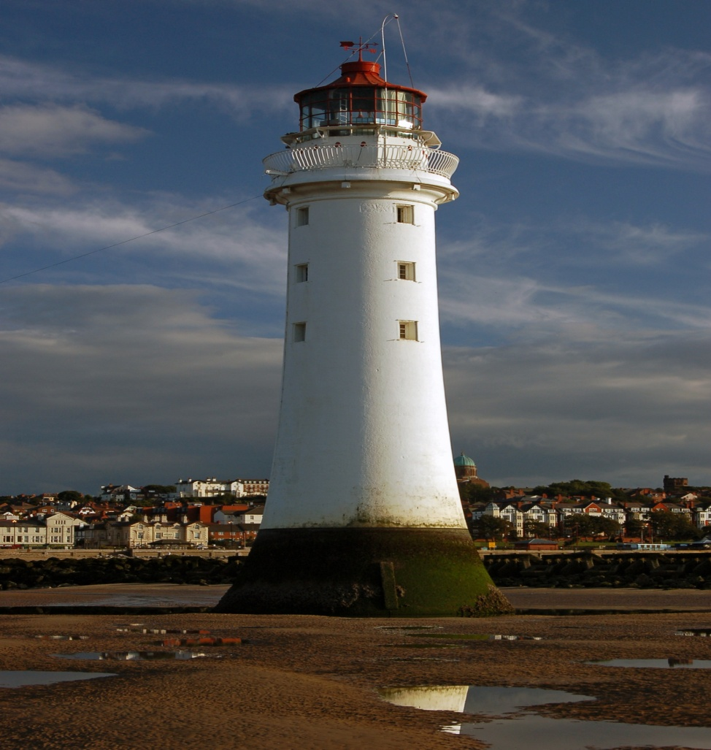
Where are there the lighthouses?
The lighthouses are on islands.
Big or small islands .
In the entrance of the ports .

Slide 4
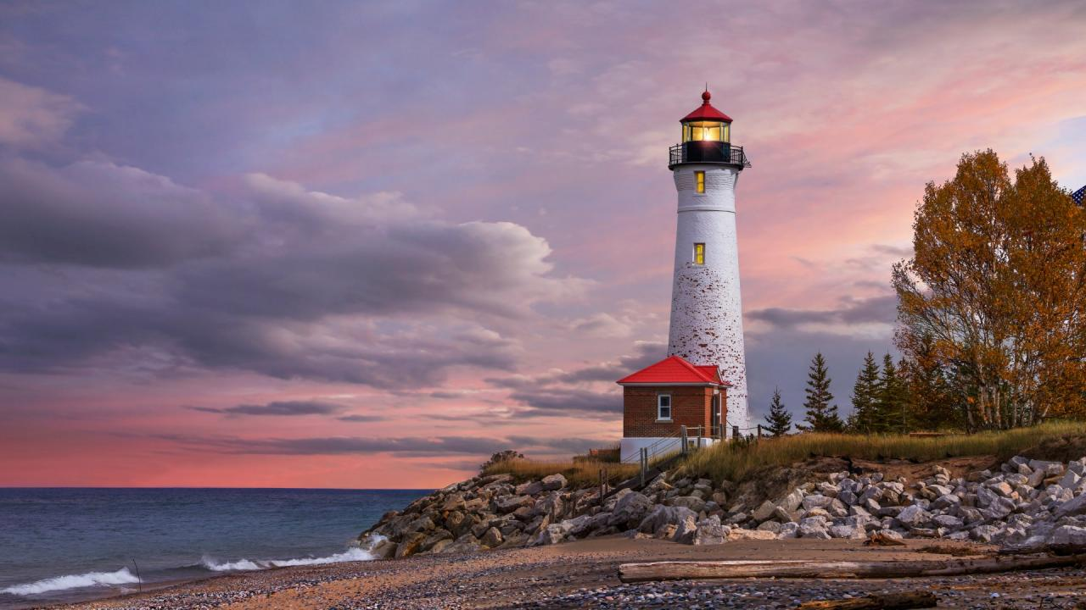
The first lighthouse was built in Alexandria in the 3rd century B.C. and it is considered one of the seven wonders of the world.

Slide 5
Lighthouses: the protectors of the seamen standing bravely against time!
The lighthouses keep a special place in people’s hearts. It is the light of hope and promise, the light of life in the dark seas.
Their existence has got a symbolic character for the sailors who want to find land and see their family again after a long and dangerous voyage.
Lighthouses still save lives even though modern technology has replaced the lighthouse keepers.
In Greece there are 120 traditional lighthouses today and they are an integral part of the Greek naval tradition and one of the most important modern monuments in the country.
It couldn’t be otherwise in a country with such a long coastline and thousands of islands.

Slide 6
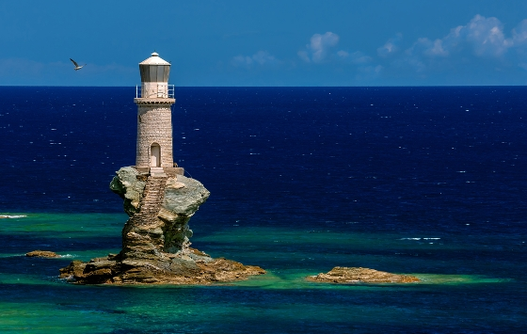
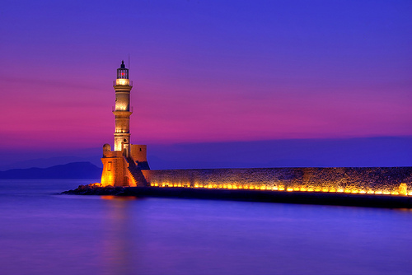
Let’s see some of the most beautiful lighthouses of my country

Slide 7
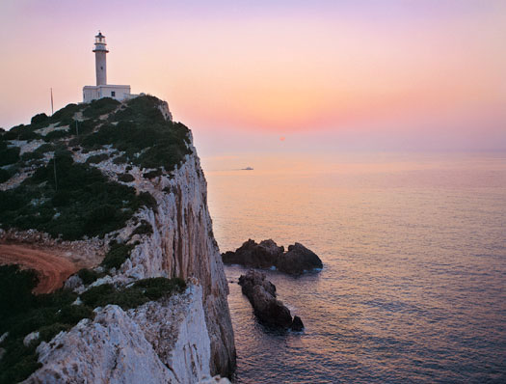
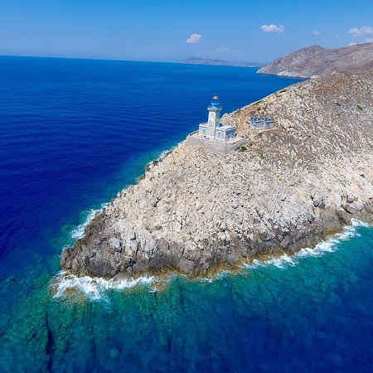
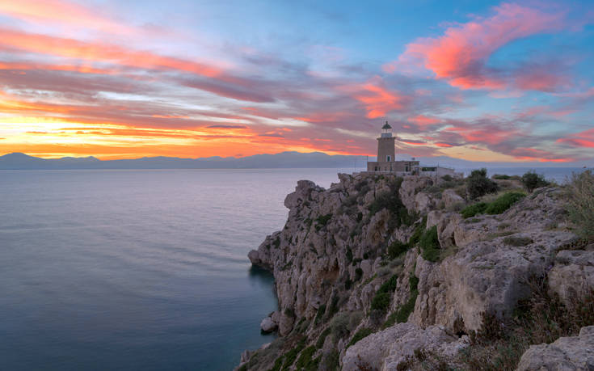
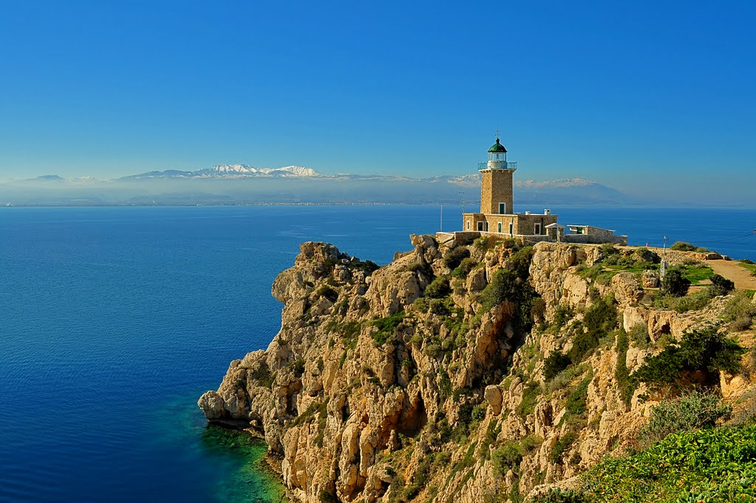

Slide 8
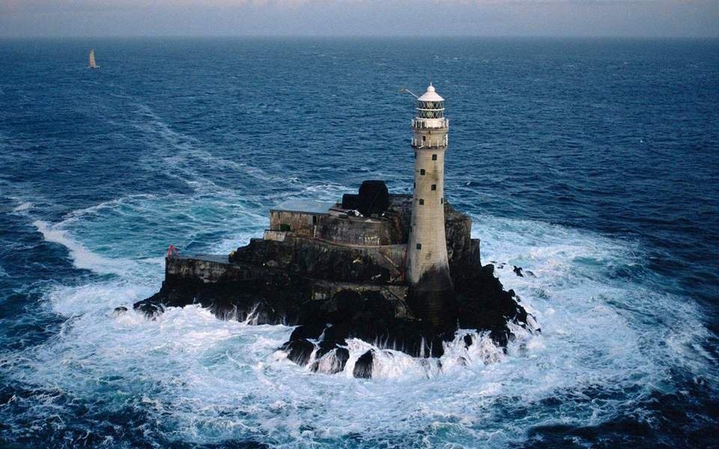
connections: “The tear of Ireland”

Slide 9
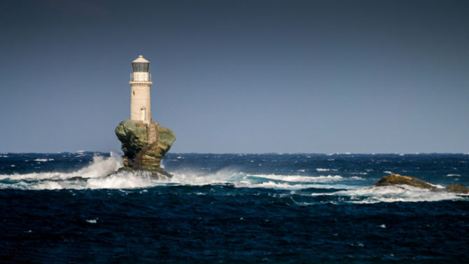
and … “tourlitis” a greek lighthouse on the island of andros
They say that it is the most beautiful lighthouse in the world

Slide 10
