Slide 1
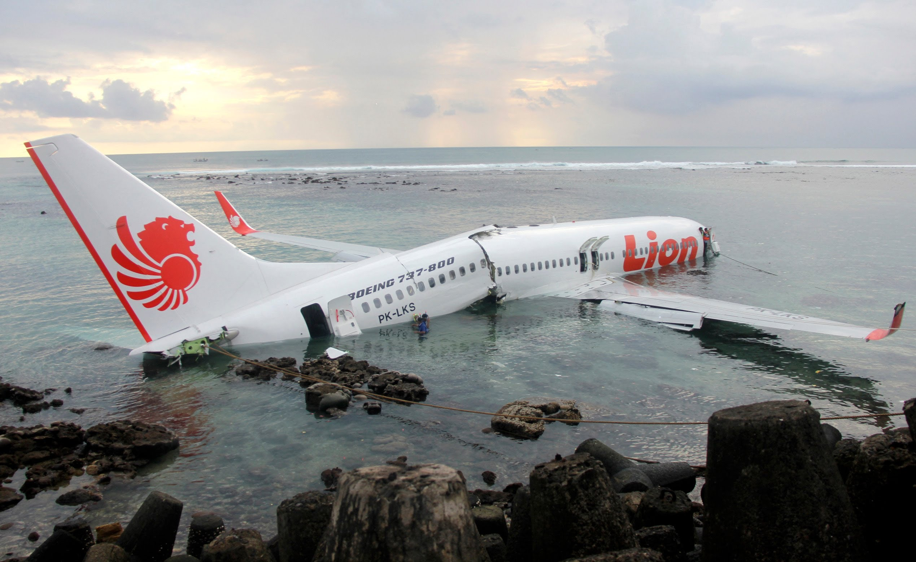

Slide 2


After our plane crashed on a desert island…
…fortunately, all the passengers survived…
However, there are no contacts between us and the civilized world…
What are the problems to be solved…
ASAP?
In the long run?
How SHOULD deCisIONS be made?

