Slide 1
eTwinning and little kids!
Sari Auramo – Mäntsälä – Finland
eTwinning ambassador

Slide 2
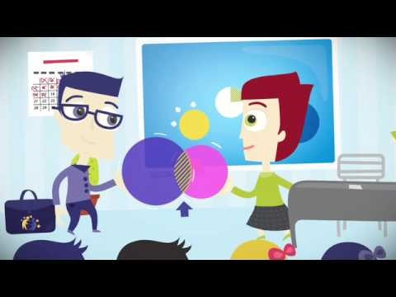
What is eTwinning?

Slide 3

https://etwinning.net

Slide 4
Different levels:
homepage
www.etwinning.net
registration
eTwinning live
project registration
Twinspace

Slide 5
What kind of projects for the little ones?

Slide 6
What can they do?

Slide 7
Sing!

Slide 8
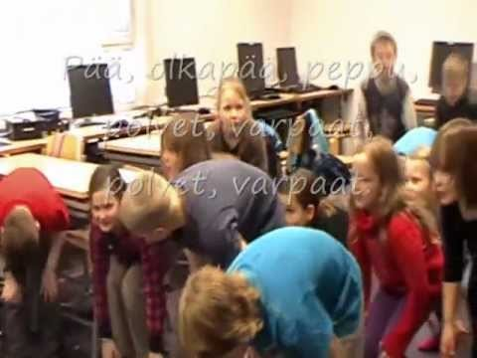
http://bit.ly/2d4Vg6E

Slide 9
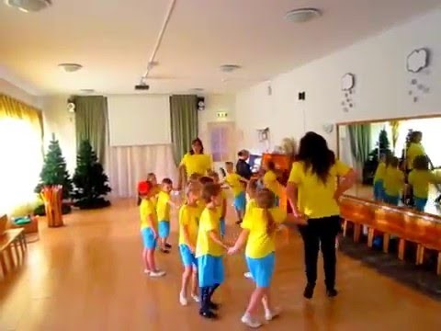
http://bit.ly/2dDnxrt

Slide 10
Draw, cut, clue!

Slide 11
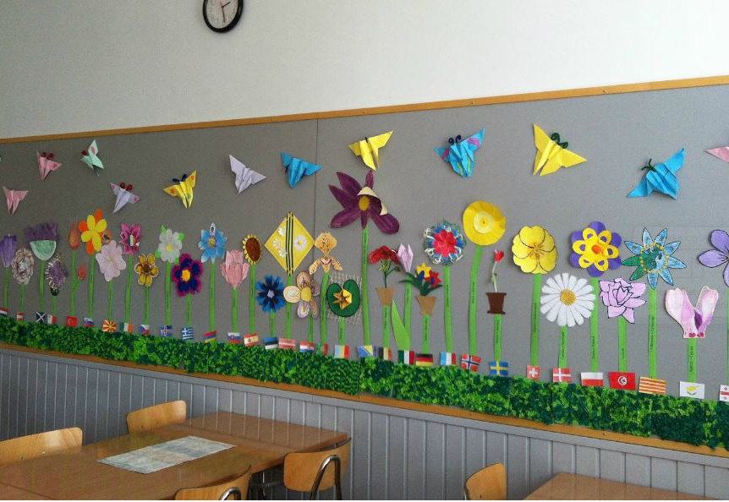

Slide 12
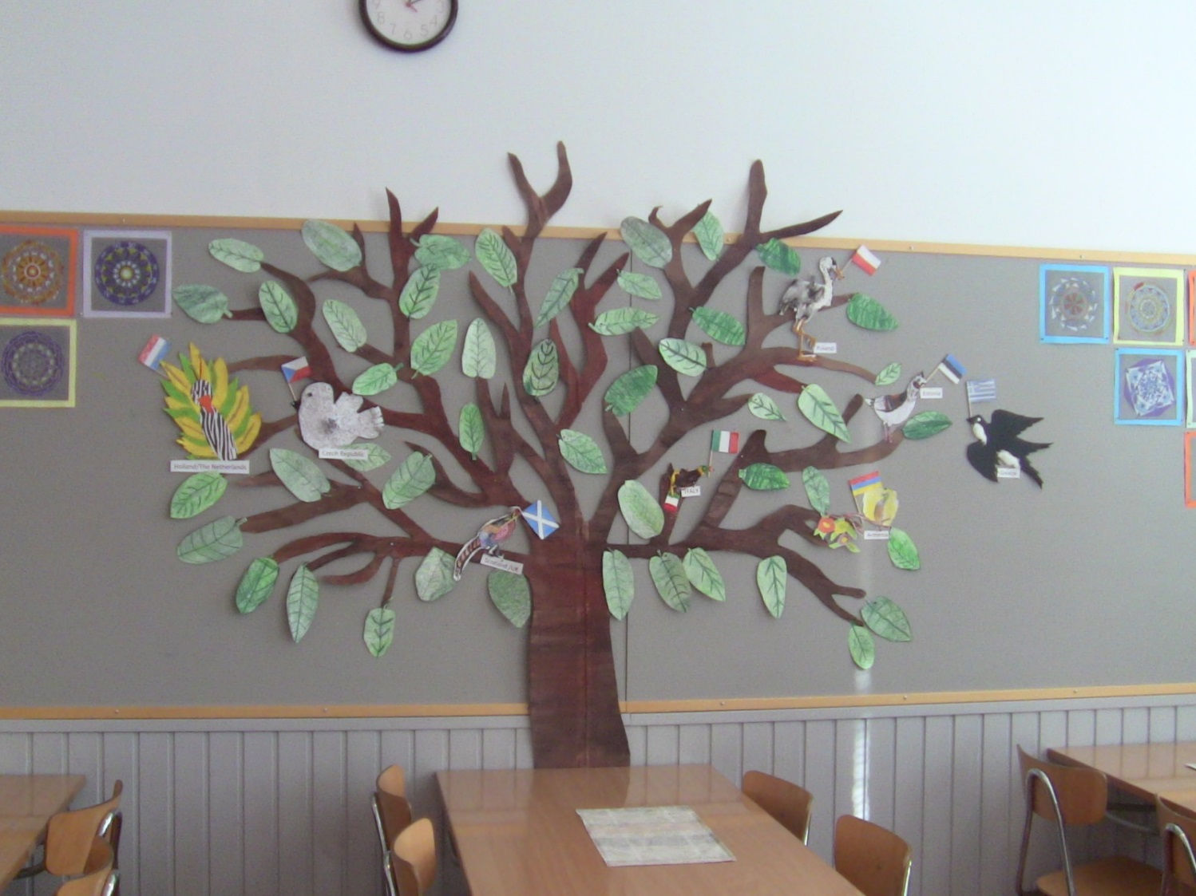

Slide 13
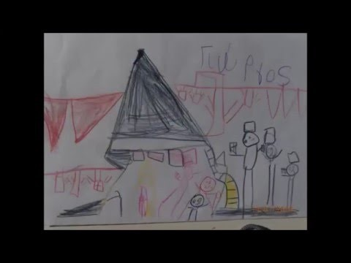
Christmas cards
http://bit.ly/2dPqEdP

Slide 14
Count?

Slide 15
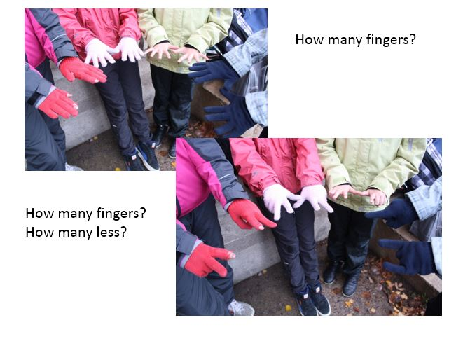
Simple math?
With photos?

Slide 16
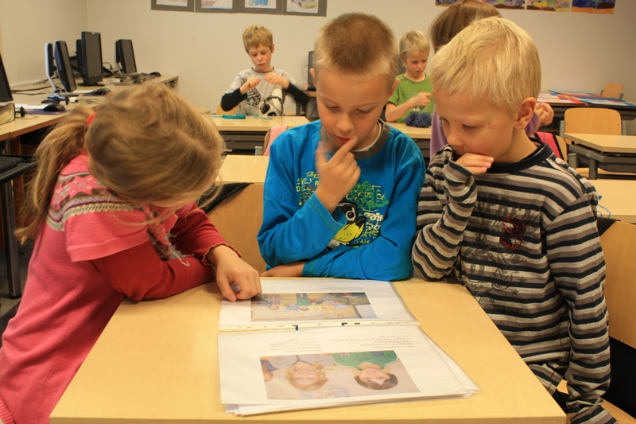
Simple math?
With photos?

Slide 17
Speak another language?

Slide 18
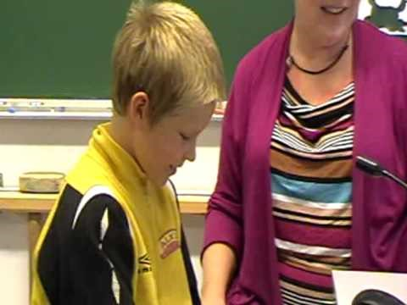
http://bit.ly/2egzTVa

Slide 19
Take pictures?

Slide 20
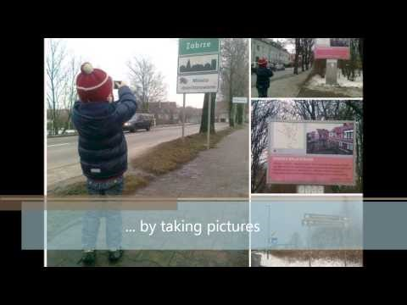
Talking pictures
http://bit.ly/2dohCBn

Slide 21
Science?

Slide 22
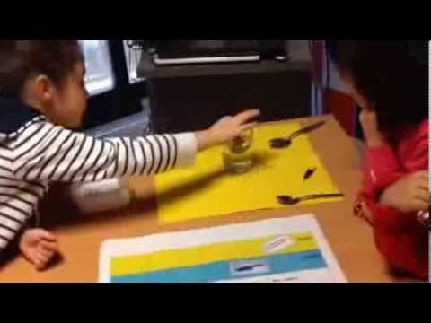
Will it sink or float?
http://bit.ly/2dd17tV

Slide 23
Share!

Slide 24
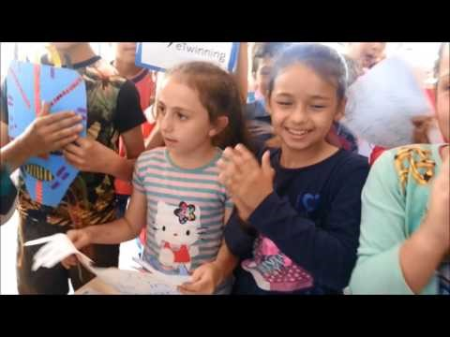
http://bit.ly/2dGTaxh

Slide 25
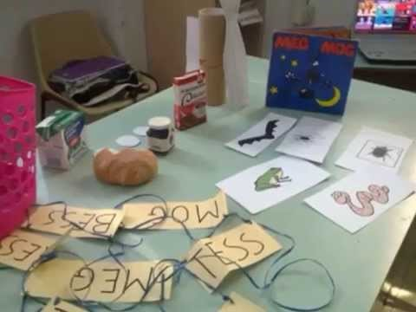
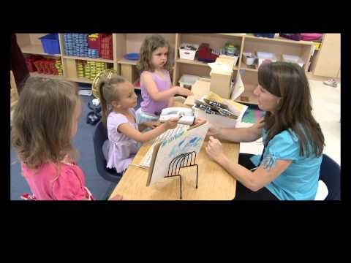
A day in Preschool
http://bit.ly/2dDNDXA
http://bit.ly/2eg1mGz

Slide 26

https://www.etwinning.net/

Slide 27
