Slide 1
WELL-BEING OF 29 MODERN NATIONS
Nordics and others compared – A Multi Dimensional Approach
By Stefán Ólafsson
Nordplus net Work Shop,
University of Iceland, 1. November, 2012

Slide 2

Well-Being Data Bank 29 modern nations; 69 variables See the data here: http://ts.hi.is/gagnagrunnur/

Slide 3
Multi-Dimensional Approach Welfare inputs Well-being outputs

Slide 4
Multi-Dimensional Approach
How to measure Quality of life?
Economic growth and affluence only?
Pioners: Social indicators movement
Scandinavian Level of Living approach
Eric Allardt’s approach 1970s
Changing approaches now
Stiglitz, Sen and Fitouzzy approach fashionable
OECD (2009, 2011) etc.
What to include?
Does the choice of variables determine outcome?

Slide 5
Composition of the WB Index Nine Dimensions and number of variables in each
Data mainly for 2005-2008

Slide 6
Total Well-Being Rankings (2 versions)
Based on
37 variables
Based on
69 variables

Slide 7
Reliability and Validity of the WB index
r=0.9
“On the whole, my life is close to how I would like it to be”

Slide 8
Reliability and Validity of the WB index Correlations with other well known indexes
 | Pearson Correlation to Well-Being Index (WBI)
Human development Index 2005 | 0.79
OECD Headline social Indicators 2009 | 0.89
WE Forum Gender Gap Index 2006 | 0.71
WE Forum Competitiveness Index 2005-7 | 0.78
Gallup Satisfaction with Life Today 2009 | 0.84
Legatum Prosperity Index 2007 | 0.81
OECD Child Well-Being Index | 0.76
Bradshaw Child Well-Being Index | 0.85
Veenhoven Happy Life-Years Index | 0.86

Slide 9
Outcomes Groups of Nations

Slide 10
Cluster analysis: 69 well-being variables
Dendrogram using Ward Method
Rescaled Distance Cluster Combine
C A S E 0 5 10 15 20 25
Label Num +---------+---------+---------+---------+---------+
Belgium 13 ─┐
France 14 ─┼─┐
Germany 15 ─┘ ├─┐
Austria 12 ─┐ │ │
Switzerland 18 ─┼─┘ │
Luxembourg 16 ─┘ ├───┐
Australia 1 ─┐ │ │
New Zealand 4 ─┤ │ │
Canada 2 ─┤ │ │
UK 5 ─┼───┘ ├───────────────────────────────────────┐
Ireland 3 ─┘ │ │
Denmark 7 ─┐ │ │
Netherlands 17 ─┼─┐ │ │
Norway 9 ─┤ │ │ │
Sweden 10 ─┤ ├─────┘ │
Finland 8 ─┘ │ │
Iceland 11 ───┘ │
Portugal 21 ─┐ │
Spain 22 ─┼─┐ │
Italy 20 ─┘ ├─────┐ │
Greece 19 ───┘ ├─────┐ │
Japan 28 ─┬─────┐ │ │ │
South Korea 29 ─┘ ├─┘ │ │
USA 6 ───────┘ ├─────────────────────────────────┘
Hungary 24 ─┬─┐ │
Slovakia 26 ─┘ │ │
Czech Republic 23 ───┼───────┐ │
Poland 25 ───┘ ├───┘
Turkey 27 ───────────┘
NW-Continental
English-Speaking (-USA)
Nordic (+Netherlands)
South-European
Asian (+USA)
East-European

Slide 11
“Families
of Nations”
types of
clusters

Slide 12
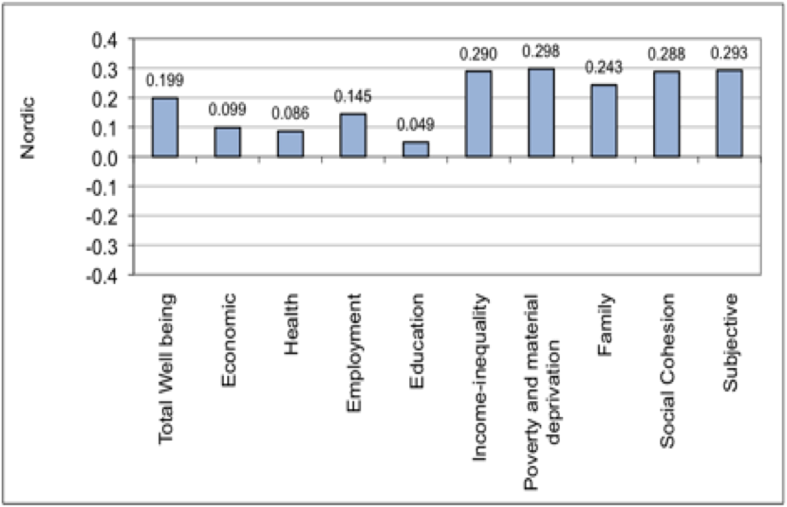
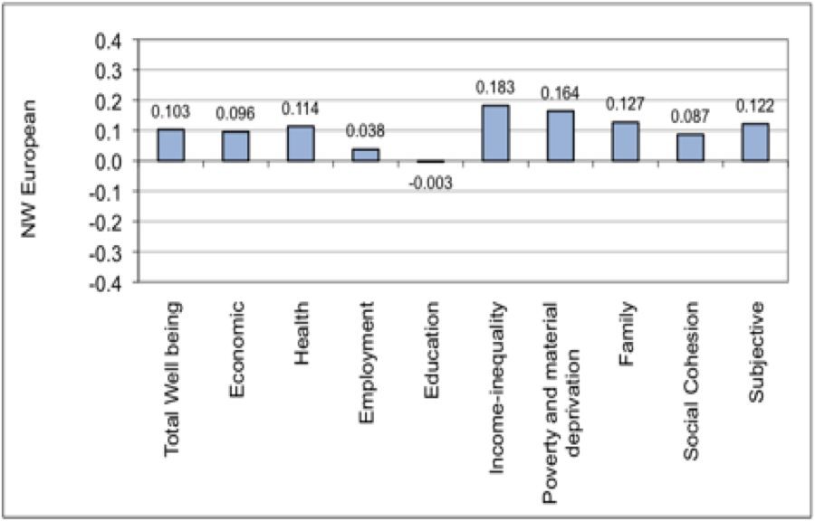
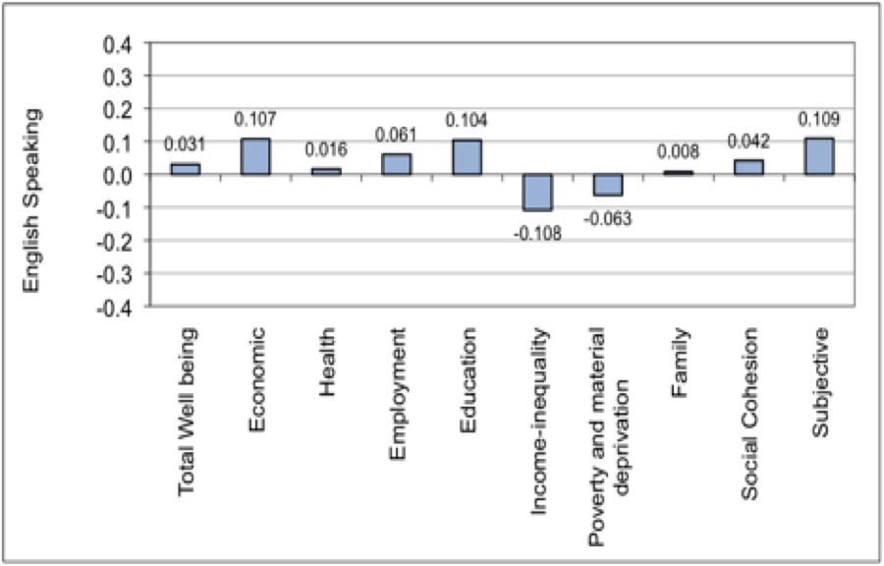
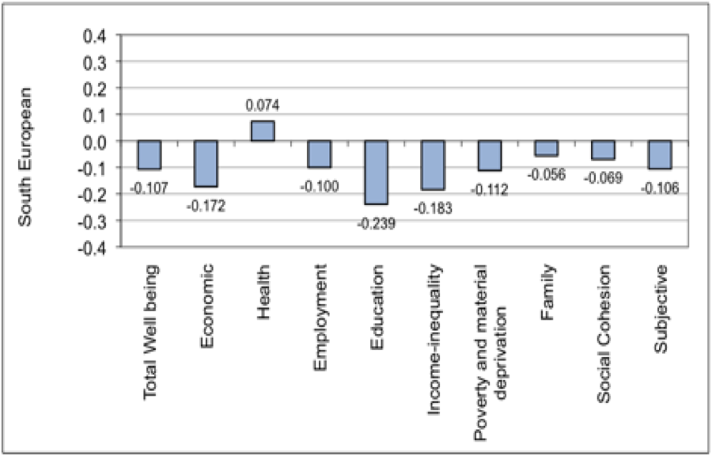
4 Cluster Profiles – Nordics and others compared Scores: Deviations from means of sub-indexes
Nordics
English-speaking
NW Continentals
South Europeans

Slide 13
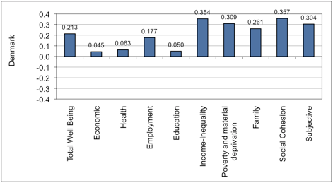
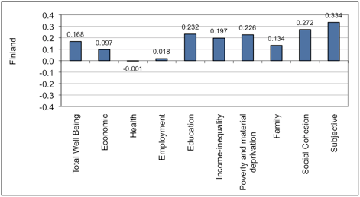
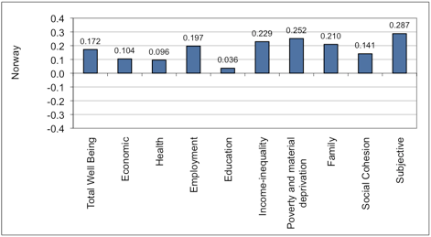
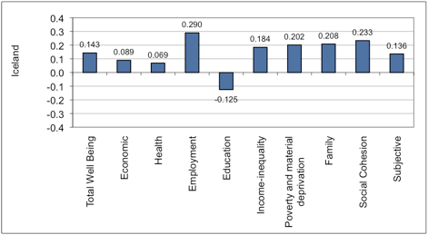
Nordic Cluster: Intra-Nordic Comparison Scores: Deviations from means of sub-indexes

Slide 14
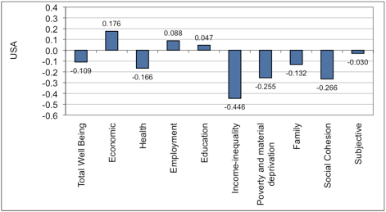
Nordic cluster and USA compared Scores: Deviations from means of sub-indexes
Nordics
USA
USA: Eonomically strong but high inequality and poverty lower outcomes on other measures

Slide 15
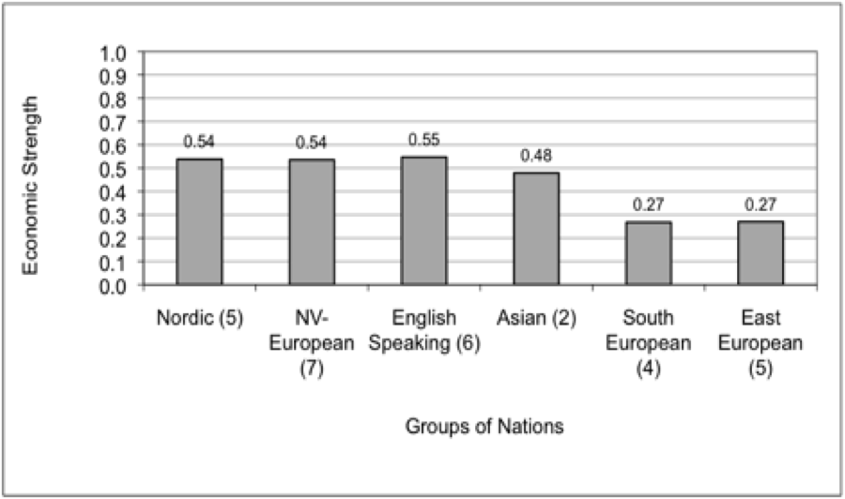
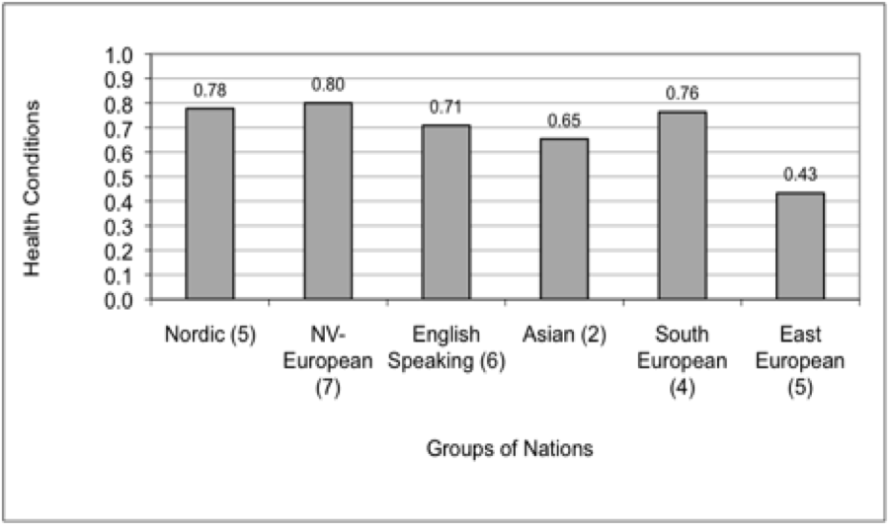
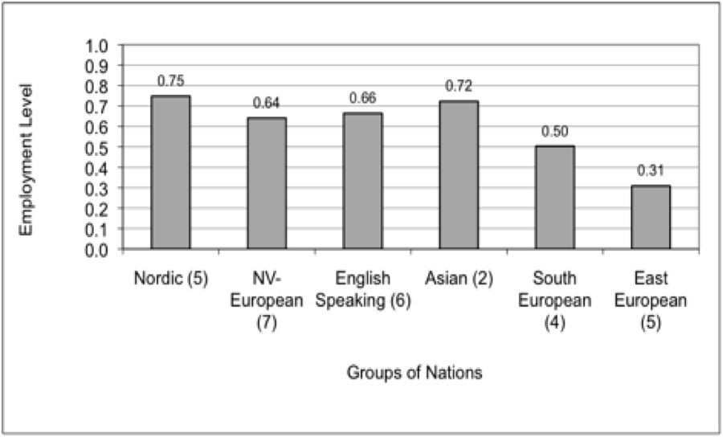
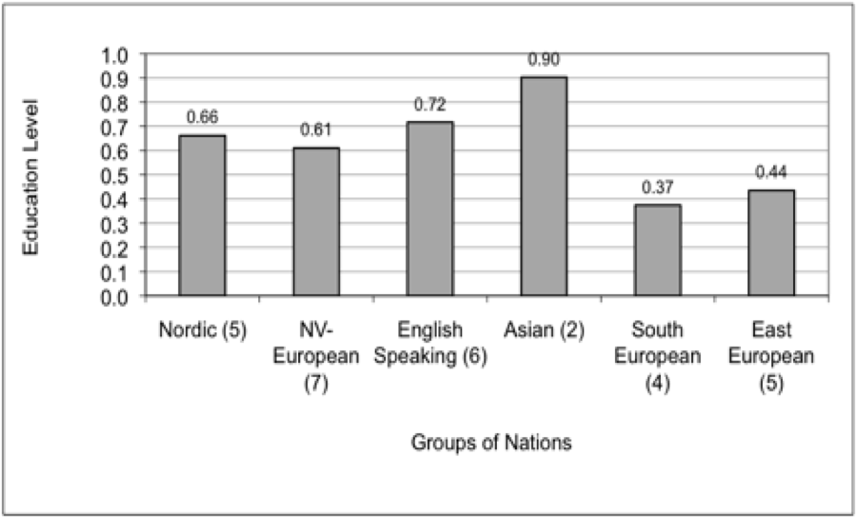
Comparisons of well-being dimensions... (Sub-Indexes, by clusters)
Economic strength
Health
Employment level
Educational level

Slide 16
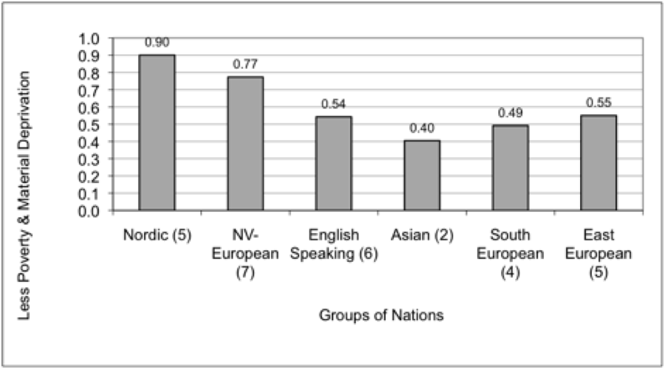
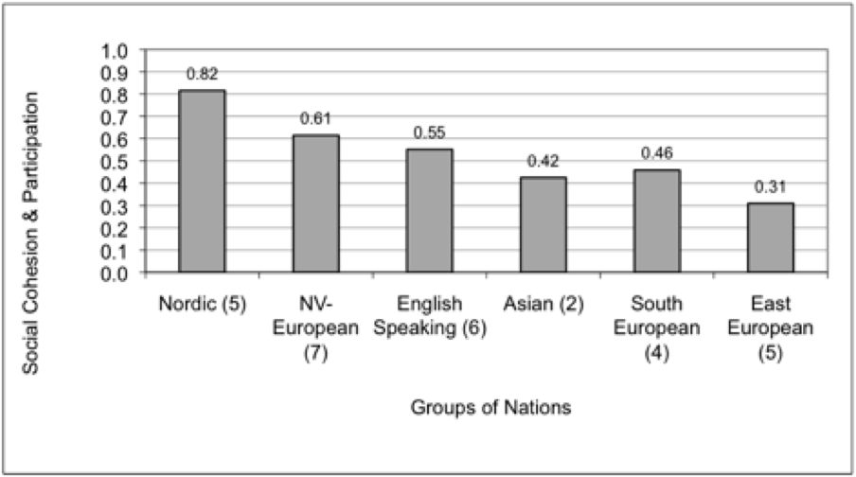
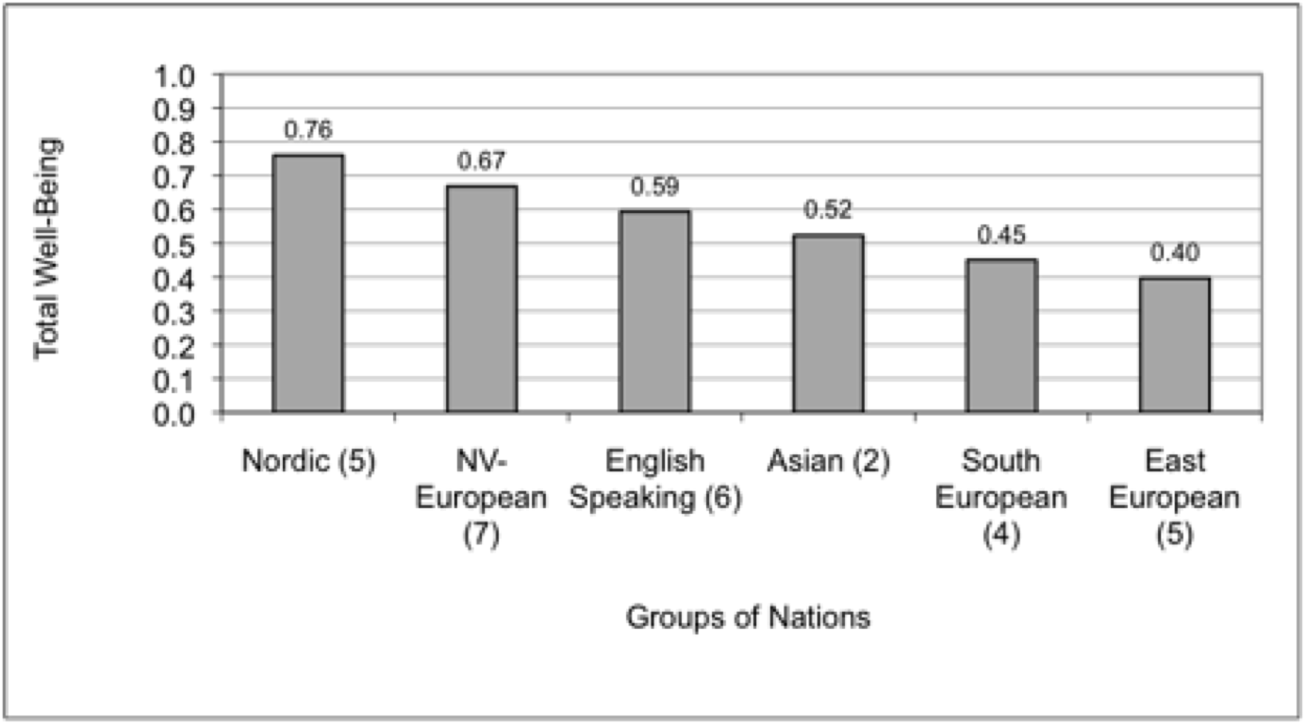
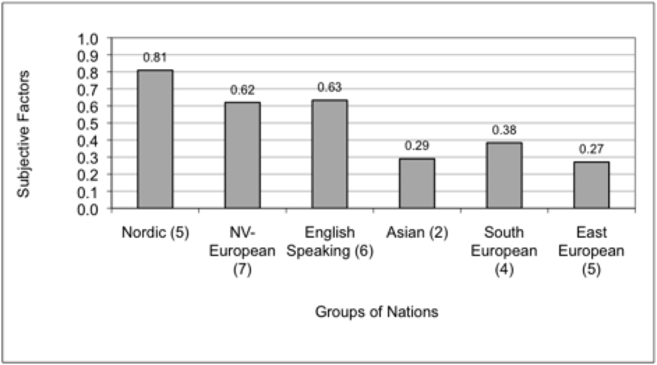
Comparisons of well-being dimensions (Sub-Indexes, by clusters)
Poverty alleviation
Social cohesion and participation
Subjective well-being
Total Well-Being (69 v’bles)

Slide 17
What Shapes Good Outcomes?

Slide 18
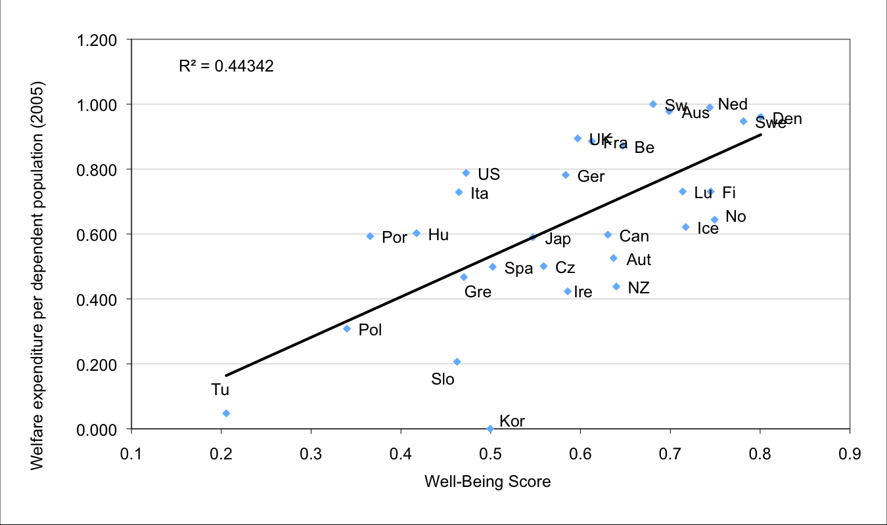
Welfare generosity

Slide 19
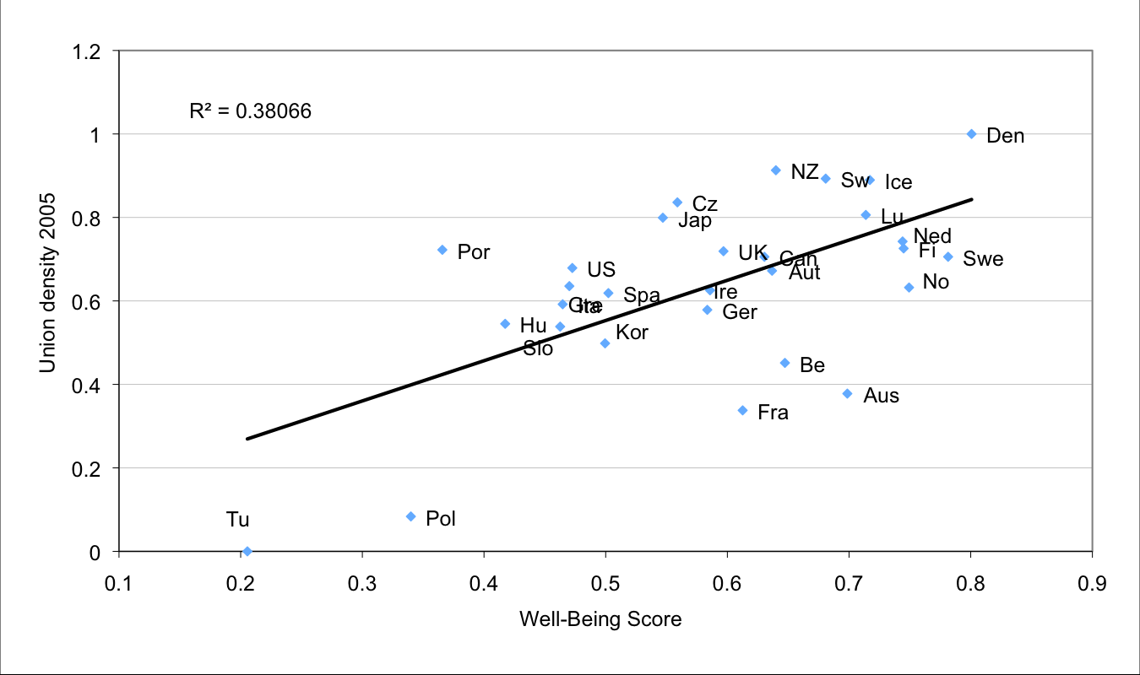
Union Density

Slide 20
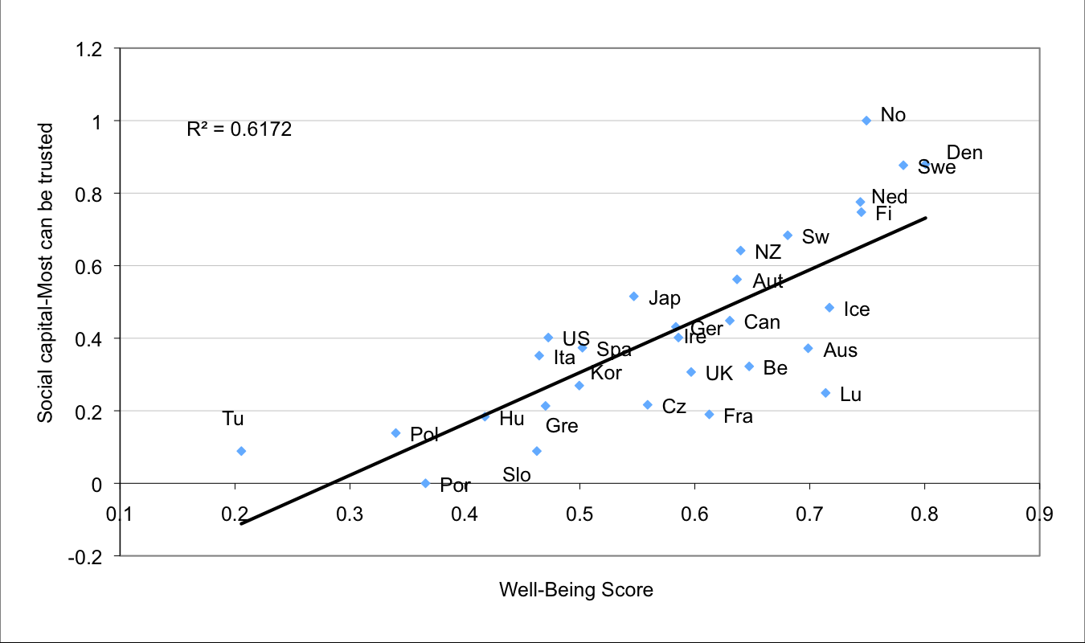
Social Capital

Slide 21
Strength of Democracy
Source: Economist: Index of Democracy 2010

Slide 22
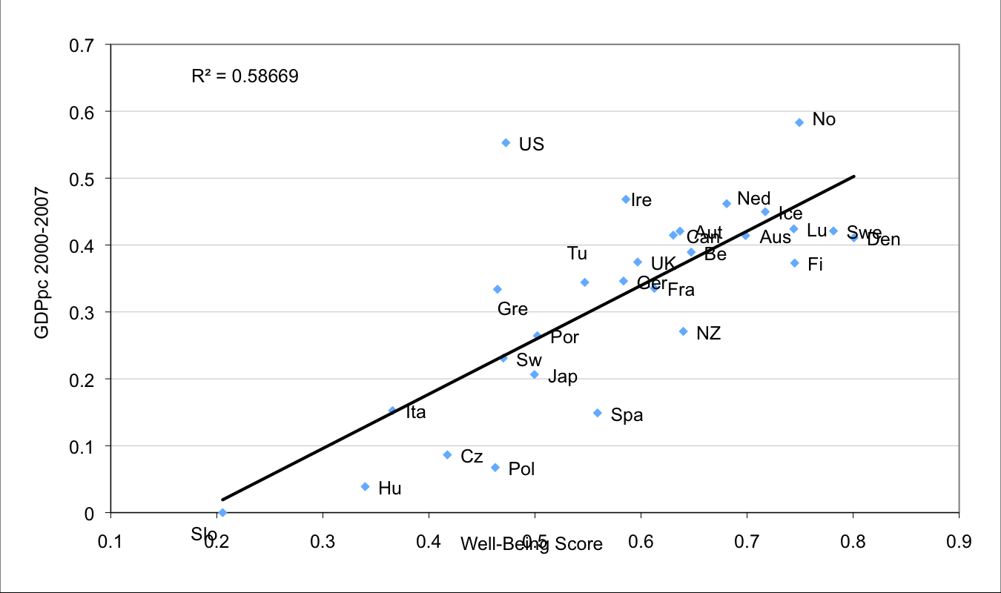
Affluence level

Slide 23
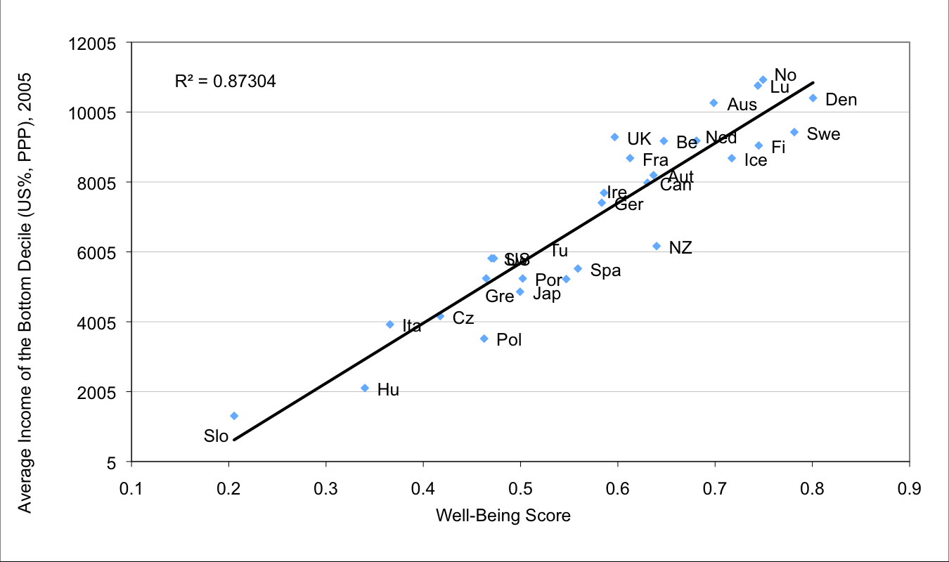
Real Earnings of Lowest Decile
Source: OCED 2005 data – Growing Unequal?

Slide 24
Multivariate analyses

Slide 25
Some regressions

Slide 26
Theory...
Affluence
level
Distribution
character
Strong
democracy
Well-Being
of the public
Welfare
Provisions
Social capital

Slide 27
Thank You!

