Slide 1
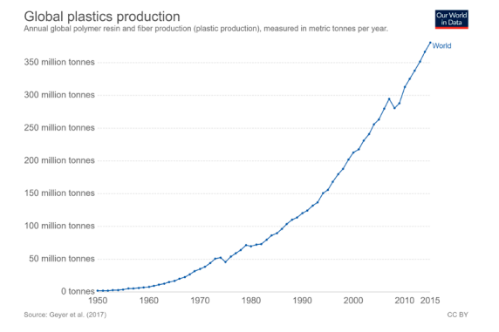
Littering problem
Littering of oceans and inland waters is a growing worldwide enviromental problem. We live in disposable culture and that's something which produces a lot of garbage.
Specially plastic garbage is a growing problem. Because most of the plastic we use is disposable.

Slide 2
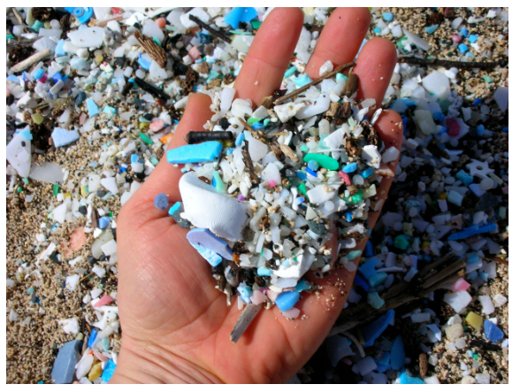
When world population grows and quality of life is getting better, pressure of using plastic rises.
Plastic is a very resistant material, which decomposition in nature is very slow. Therefore, the effects of plastic waste which ends up in the environment are long term.

Slide 3
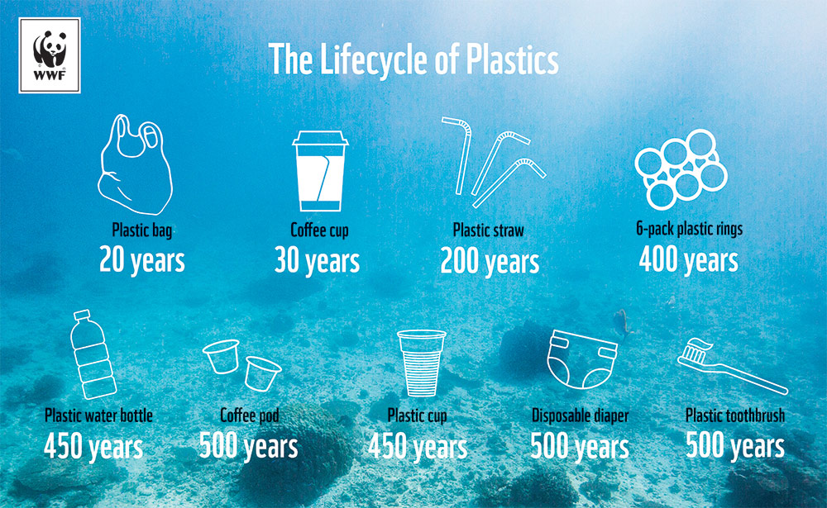

Slide 4
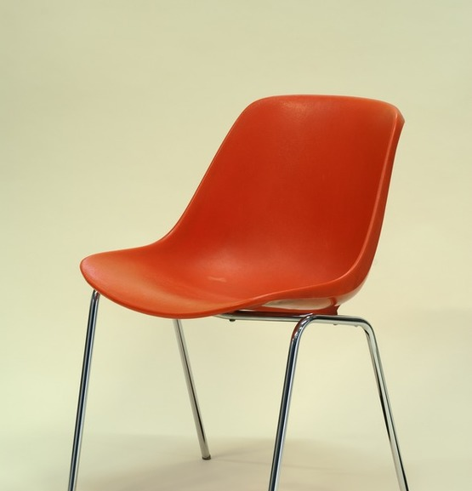
Discussion (group division)
1. What was the use of plastic like when your grandparents were young?
2. What objects made of plastic or containing plastic can be found in the classroom?
3. What would a classroom look like if all things containing plastic were removed from it?
4. What material your clothes are made of?

