Slide 1

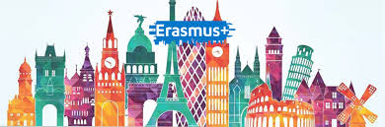

Digitalization: Lotta, Lumi, Saku, Emmi

Slide 2
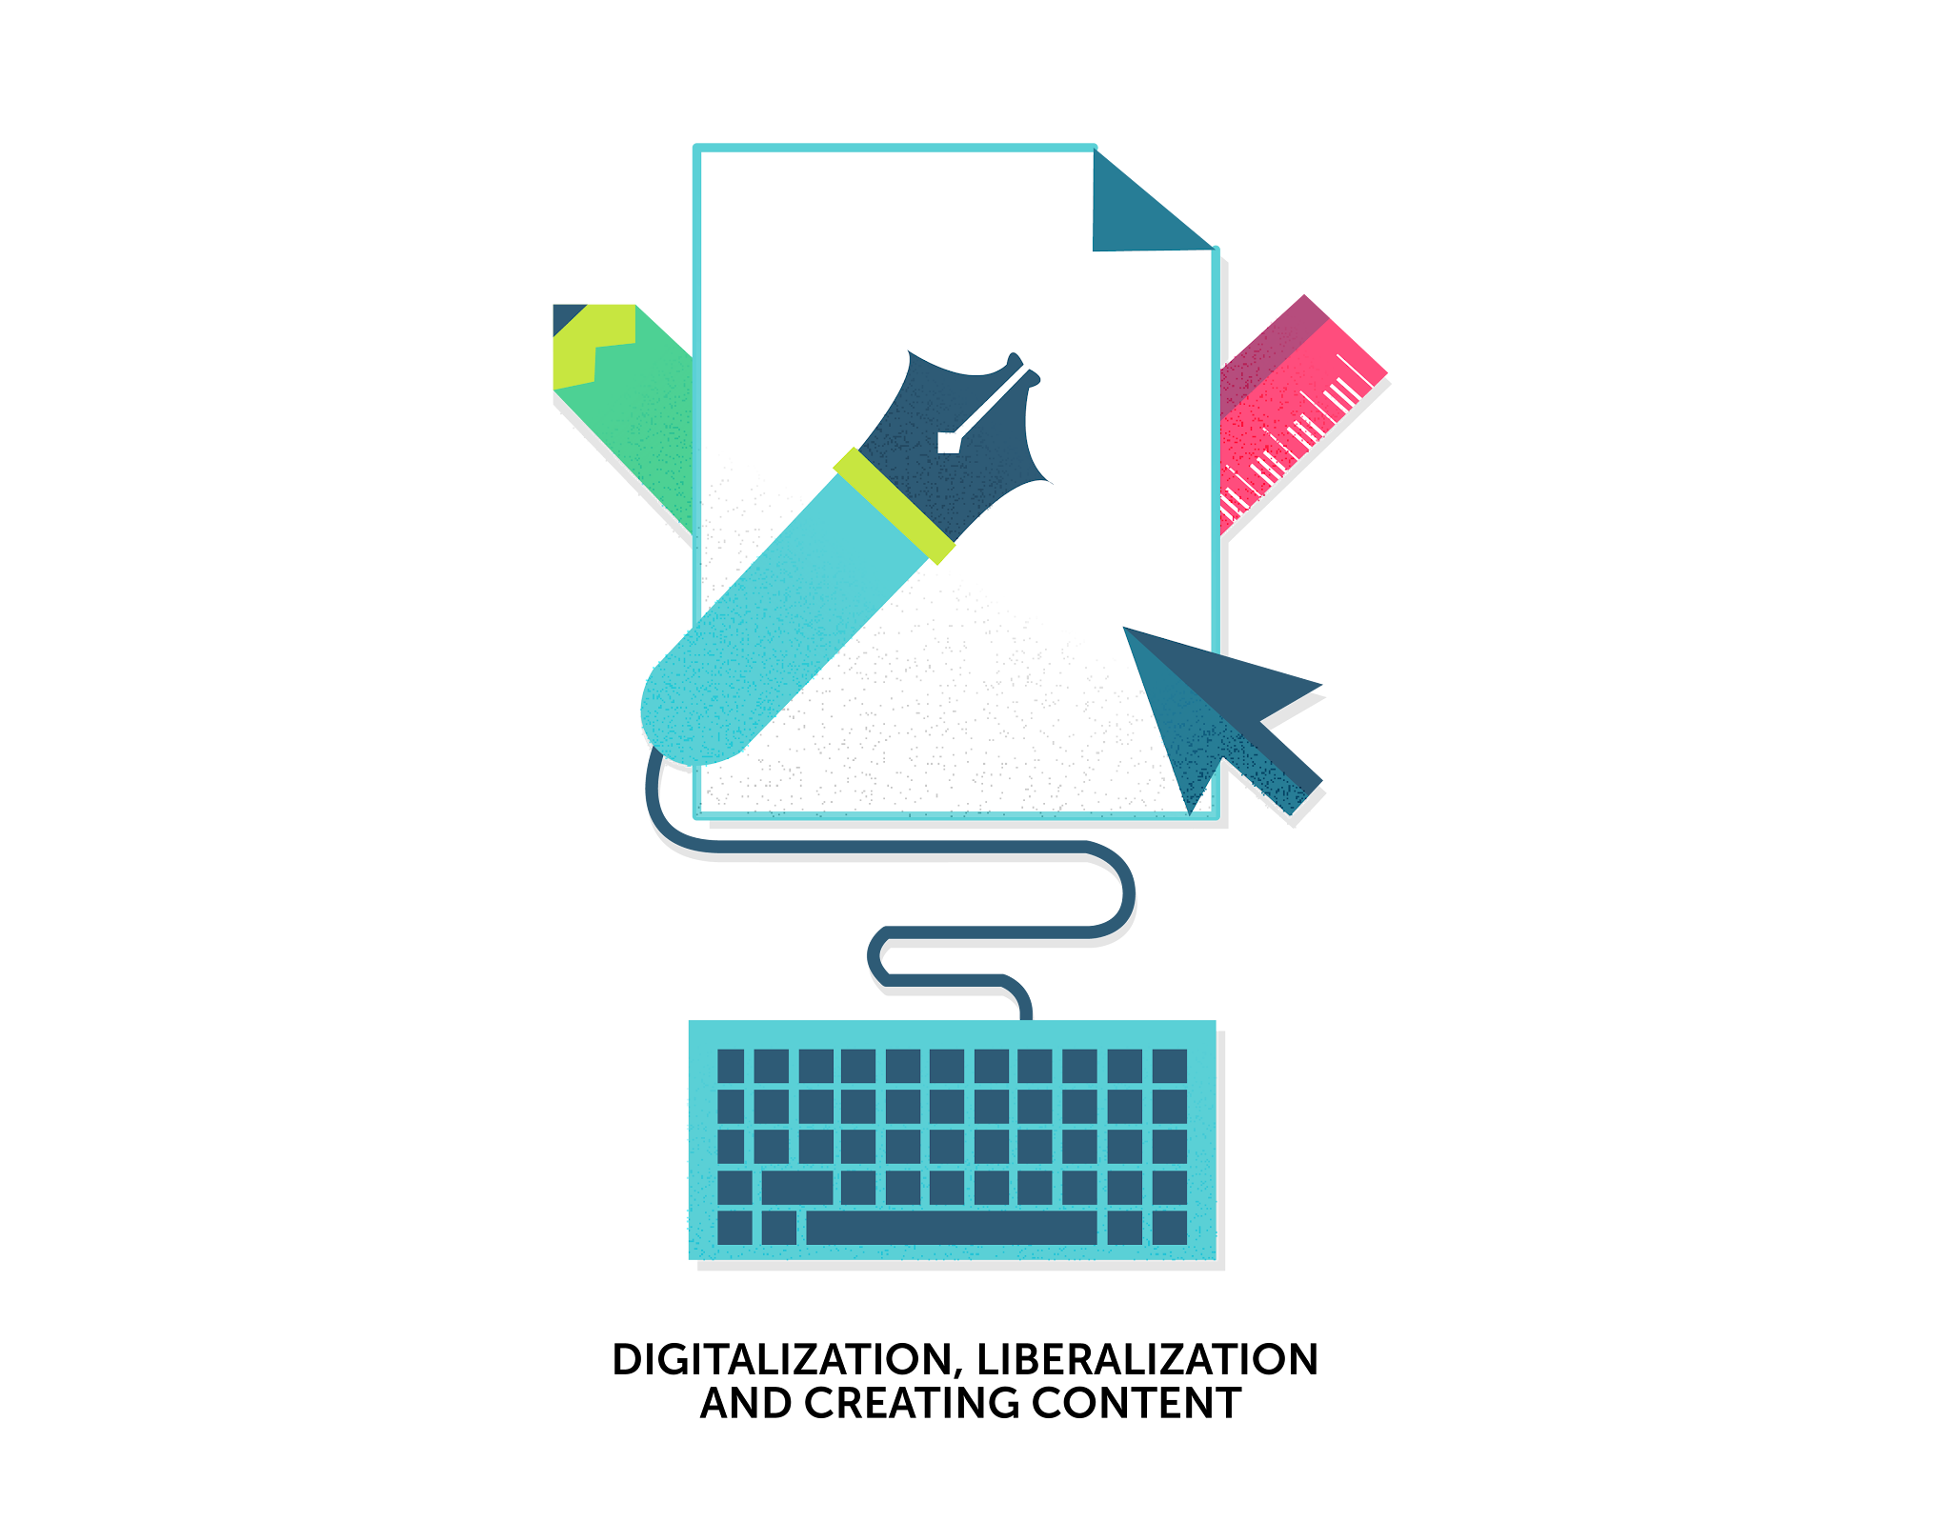



What is digitalization?
Digitalization is the process of using digital technology to change or improve things. It means turning information or activities that used to be done with paper or in person into digital forms that can be done on computers or online.

Slide 3
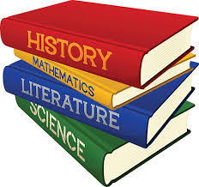
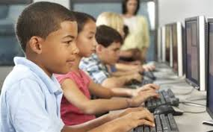
Books, do we need them?

Slide 4


Slide 5
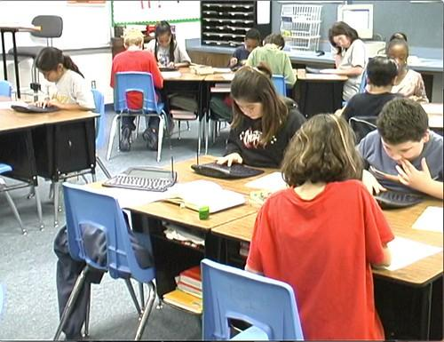
Digitalization in Schools
Technology is evident in the school atmosphere nowadays in many ways. For example, students use smart devices and computers for learning which can make learning more interactive and interesting.
Technology provides teachers with more ways to create interactive materials and students have more ways to access those.
Nowadays you can use many apps to support learning for example kahoot and blooket. Those are so good for students to learn individual words.

Slide 6
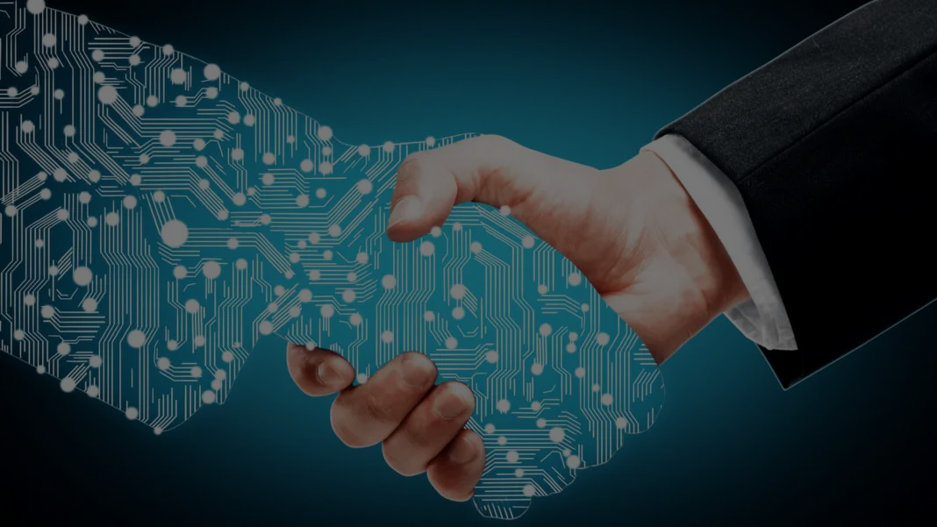
The benefits and challenges of digitalization
Challenges:
Screen Time & Mental Health
Privacy & Data Security
Job Displacement
Social Isolation
Benefits:
Accessibility
Speed & Efficiency
Global Connectivity
Innovation

Slide 7
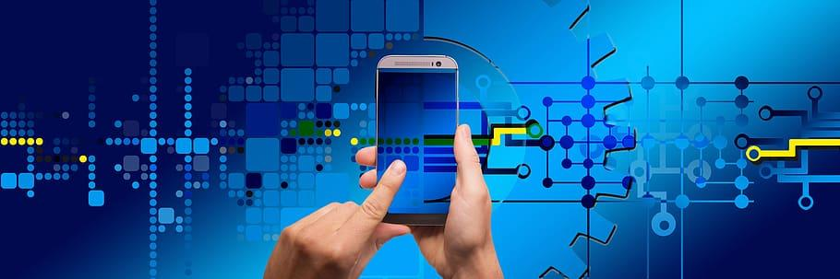
How has digitalization changed our lives?
Emmi Kiviniemi

Slide 8
How digitalization has impacted education, communication or entertainment?
Plus +
Technology has also enhanced communication by making it faster, more efficient, and more accessible.
Technologies have profoundly impacted creativity and innovation, enabling new forms of storytelling, interactive experiences, and immersive technologies like virtual reality and augmented reality.

Slide 9
Minus -
Is the digitalization going to chance world too fast?
Can old people follow digitalization?
Use and need of electricity can have negative impact to climate change.
If everything realy on electricity or computers, we might have a BIG problems if we have powercuts like it was in Spain last month.
Is it possible that cameras, robots, computers start to control people, not other way around?

Slide 10

How the internet, apps and social media has changed the way we live? Vision how life can be in 2050.

Slide 11
