Slide 1
Early History and Roman Rule
Before English, the people of the British Isles spoke Celtic languages (Brittonic).
With the Roman Conquest in 43 AD came the first written records of England’s history. The Romans quickly established control over the tribes of present day southeastern England, ruling England until the year 409.
In the south and east, Latin became the language of most of the townspeople, of administration and the ruling class, the army and the church. Brittonic remained the language of the peasantry, which formed a large part of the population.
In the northern and western parts of the country, there were only limited attempts at Romanisation, and Brittonic always remained the dominant language.

Slide 2
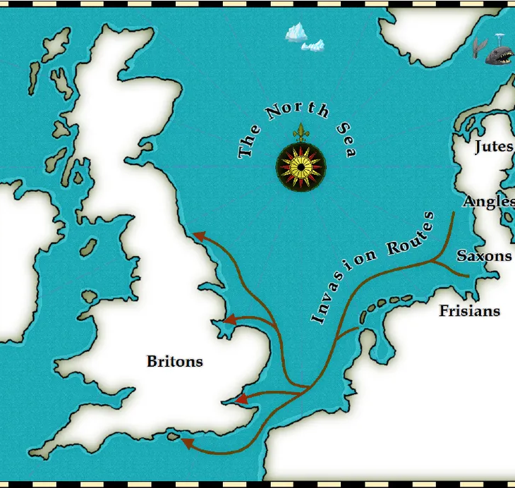
Old English
During the 5th century AD three tribes, the Angles, the Saxons and the Jutes, crossed the North Sea from what today is Denmark and northern Germany.
Most of the Celtic speakers were pushed west and north by the invaders - mainly into what is now Wales, Scotland and Ireland.
The invaders’ languages developed into what we now call Old English. It did not sound or look like English today. Nevertheless, about half of the most commonly used words in Modern English have Old English roots.

Slide 3
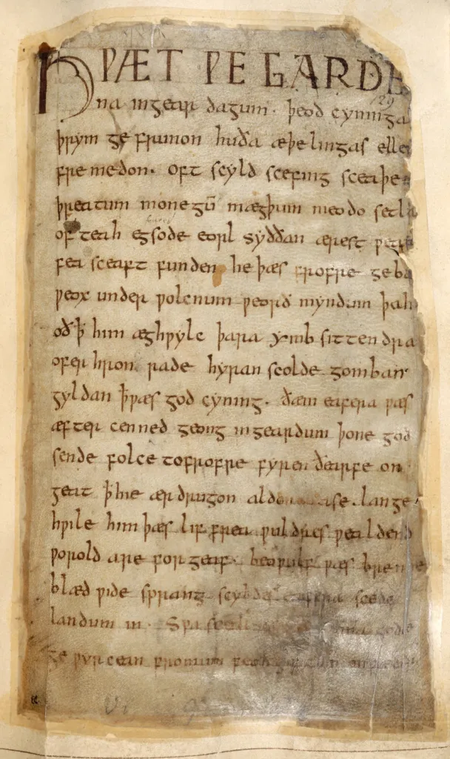
Beowulf
Beowulf, heroic poem, is the highest achievement of Old English.
The work deals with events of the early 6th century, and, while the date of its composition is uncertain, some scholars believe that it was written in the 8th century. Although originally untitled, the poem was later named after the Scandinavian hero Beowulf, whose exploits and character provide its connecting theme.
There is no evidence of a historical Beowulf, but some characters, sites, and events in the poem can be historically verified. The poem did not appear in print until 1815.

Slide 4
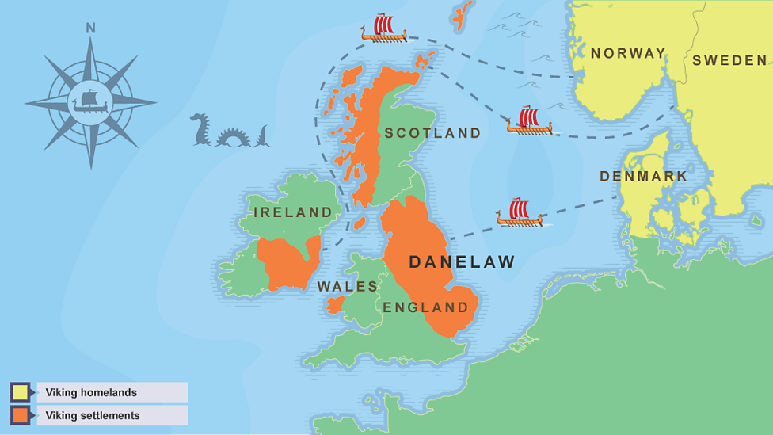
Viking Invasion
The Vikings from Scandinavia invaded the British Isles during the late eighth century. They prevailed there for the next 300 years, until the Normans arrived.
The Vikings spoke a language called ‘Old Norse’, which today is an extinct language. Old Norse and Old English were in many ways similar since they belonged to the same language family, Germanic. Therefore, the Old Norse constituents were easily integrated into Old English. These borrowings were not noticed for centuries but exist in the language up to the present-day.
It is estimated that there are around 400 Old Norse borrowings in Standard English.

Slide 5
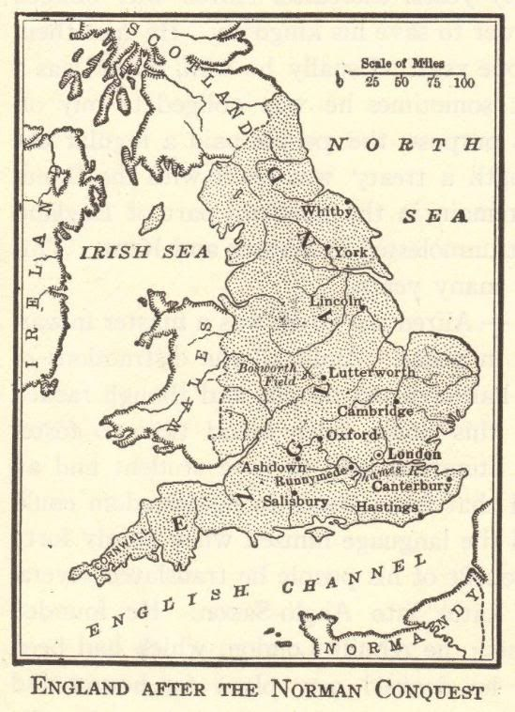
Norman Conquest
Battle of Hastings, battle on October 14, 1066, that ended in the defeat of Harold II of England by William, duke of Normandy, and established the Normans as the rulers of England.
These “Normans” brought with them a kind of French, which became the language of the Royal Court, and the ruling and business classes. For a period the lower classes spoke English and the upper classes spoke French.
In the 14th century English became dominant in Britain again, but with many French words added (many of these had Latin roots).

Slide 6
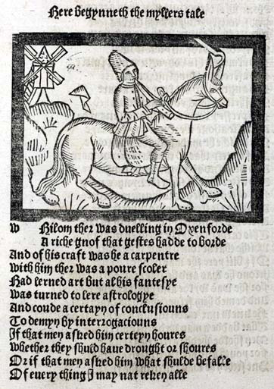
Middle English
During Middle English period, English language changed its grammar, pronunciation and spelling and borrowed words from French and Latin.
‘Middle English’ (from around 1150 CE to around 1450) is a time of change between two eras: Old English and Modern English.
Before this period the language is mainly Old Germanic in its character – in its sounds, spellings, grammar and vocabulary.
Middle English texts (such as Geoffrey Chaucer’s famous “Canterbury Tales” in the 14th century) feel much closer to Modern English in their grammar and vocabulary.
English started using word order and prepositional constructions rather than word endings to express meaning relationships. The pronunciation system also experienced a major change.

Slide 7
Early Modern English
Modern English is often dated from the Great Vowel Shift, which took place mainly during the 15th century.
The pronunciation of all Middle English long vowels was changed. Some consonant sounds changed as well.
The spelling of words changed much less, partly because the invention of printing press and standardization of written language.

Slide 8
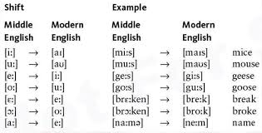
The Great Vowel Shift
The main difference between Chaucer's language and our own is in the pronunciation of the "long" vowels. The consonants remain generally the same, and the short vowels are very similar in Middle and Modern English. But the "long" vowels are regularly and strikingly different. This is due to what is called The Great Vowel Shift.
Old and Middle English were written in the Latin alphabet and the vowels were represented by the letters assigned to the sounds in Latin. For example, Middle English "long e" in Chaucer's "sheep" had the value of Latin "e" (and sounded like Modern English "shape" [/e/] in the International Phonetic Alphabet [IPA]).
The Great Vowels Shift changed all that; by the end of the sixteenth century the "e" in "sheep" sounded like that in Modern English "sheep" or "meet" [IPA /i/]. To many it seemed that the pronunciation of English had moved so far from its visual form that a new alphabet was needed, and in the 16th century we have the first attempts to "reform" English spellings, a movement still active today.

Slide 9
Modern English
The first authoritative and full-featured English dictionary, the Dictionary of the English Language, was published by Samuel Johnson in 1755. The dictionary had a big role in standardizing both English spelling and word usage.
Early Modern English and Late Modern English differ essentially in vocabulary. Late Modern English has many more words.
Colonial times helped to spread English all over the world and created different local variants of the language.
International connections along with new inventions and influences have continued to change the language.

Slide 10
Esitelmä / Diaesitys
n. 5-6 diaa
voit hyödyntää kuvia ja tekstiä
kerro lyhyesti aikakaudesta, sen historiasta ja kielen kehitykseen vaikuttaneista tekijöistä
mikä muuttui kielessä?
muutama esimerkki nykykieleen päätyneistä sanoista
lyhyt esimerkki kirjoitetusta kielestä, lause?

