Slide 1
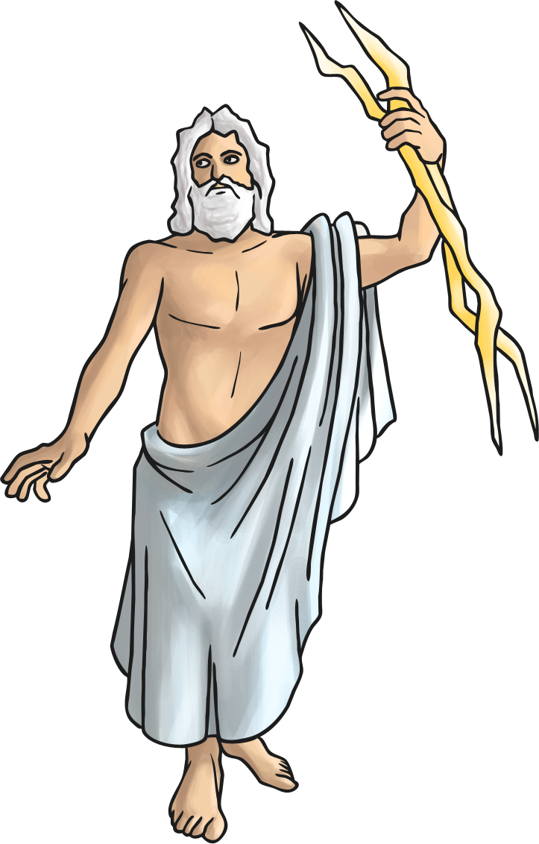
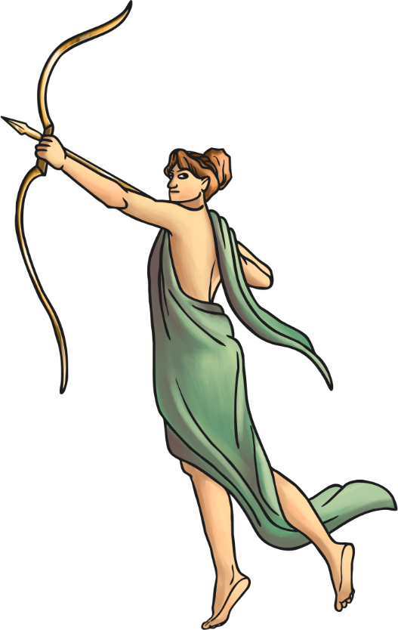
Roman Facts
The modern calendar, 12 months and 365 days,
was created by the Romans.
Romans believed in Gods and Goddesses who ruled over different areas of life. They built temples for them and took them offerings.

Slide 2
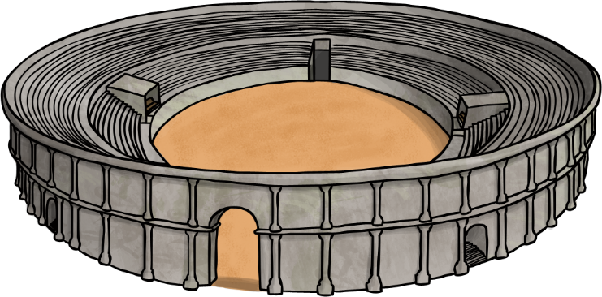
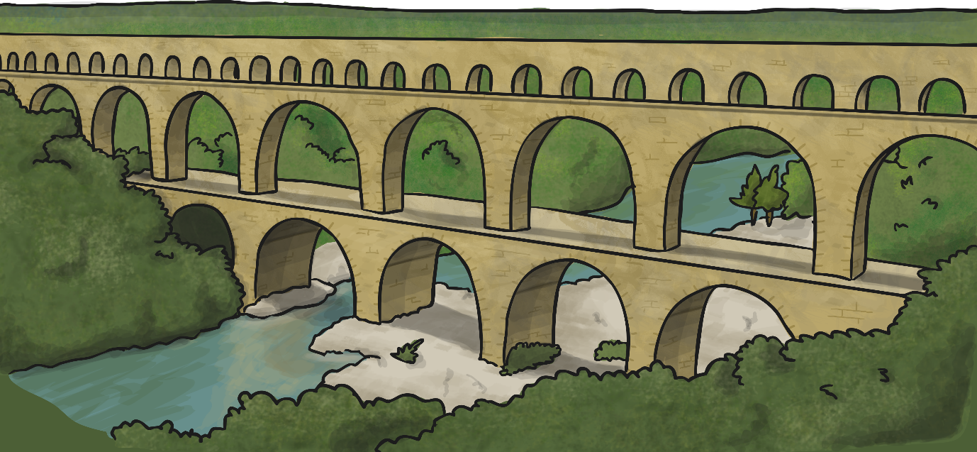
Roman Facts
Rome was founded in 753BC and quickly became a rich and powerful city.
The Romans were amazing architects and engineers. They built roads and walls.

Slide 3

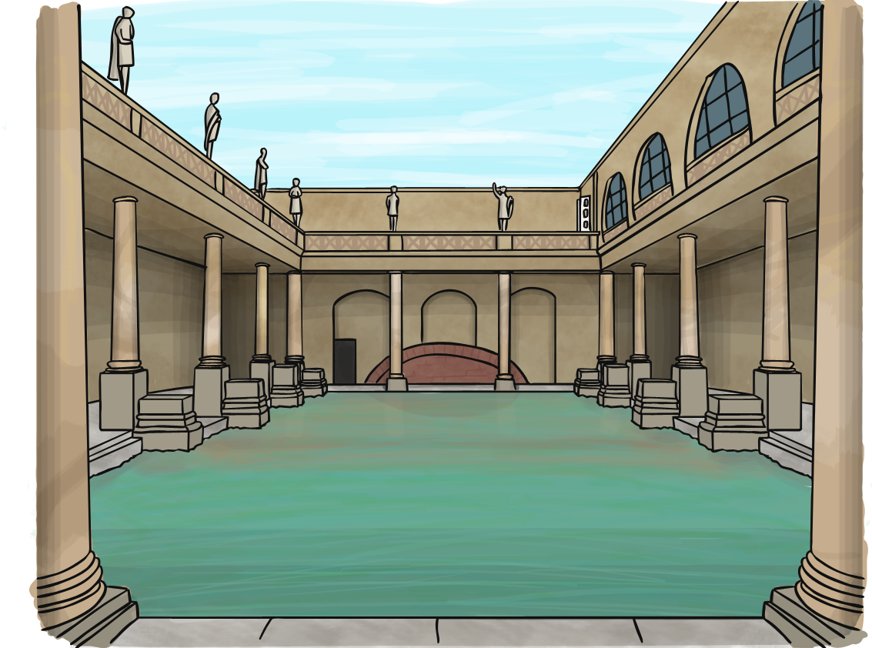
Roman Facts
Urine was collected from the bathhouses to be used for laundry and medicine.
Instead of toilet paper, the Romans used a wet sponge on the end of a stick.

Slide 4

Roman Facts
Education was very important and all children were taught to read and write. Children were taught through fear of being beaten if they got something wrong.

Slide 5
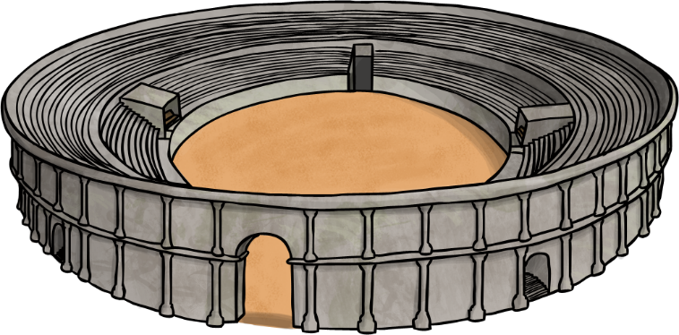

Roman Facts
Gladiators were both professional and amateur fighters. They fought to entertain Roman citizens.
Gladiators would fight each other as well as wild animals, such as lions and bears.

Slide 6


Slide 7


Roman Numerals

Slide 8
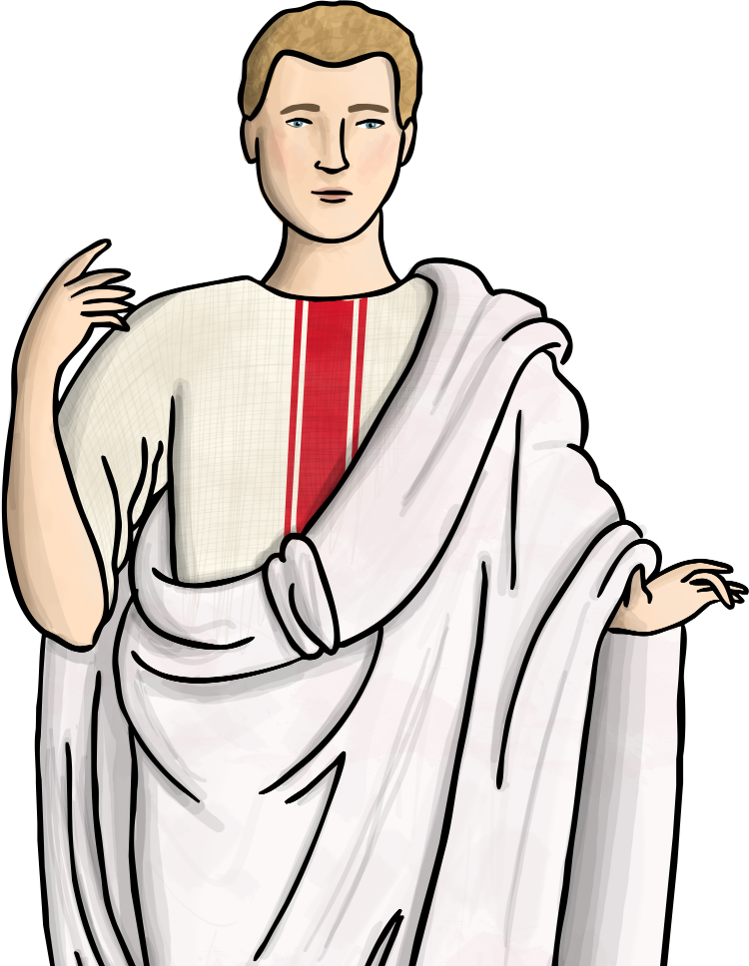
Roman numerals have survived for thousands of years and are still used today.
Roman numerals can be found on clocks, watches, sun dials, film dates, book chapters and numbering, as bullet points and as the titles of Kings, Queens or Popes.

Slide 9

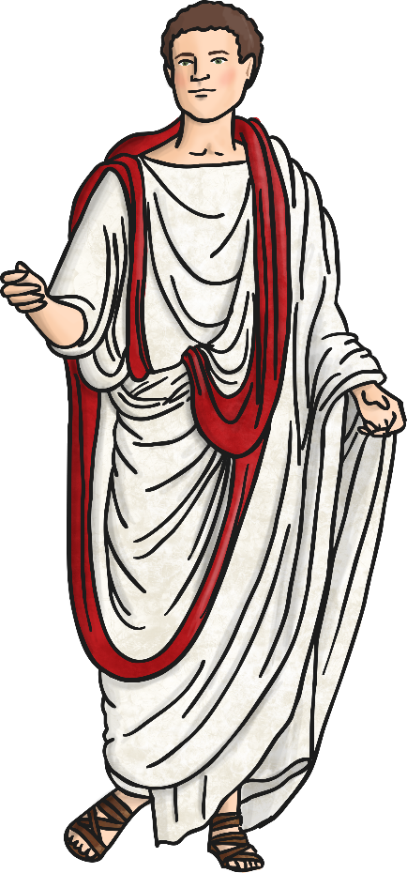
Roman Numerals use 7 different letters to indicate numbers. 0s (zeros) are not used. Bigger numbers are made by combining the letters in different ways.
The letters used are:
I | 1
V | 5
X | 10
L | 50
C | 100
D | 500
M | 1000

Slide 10
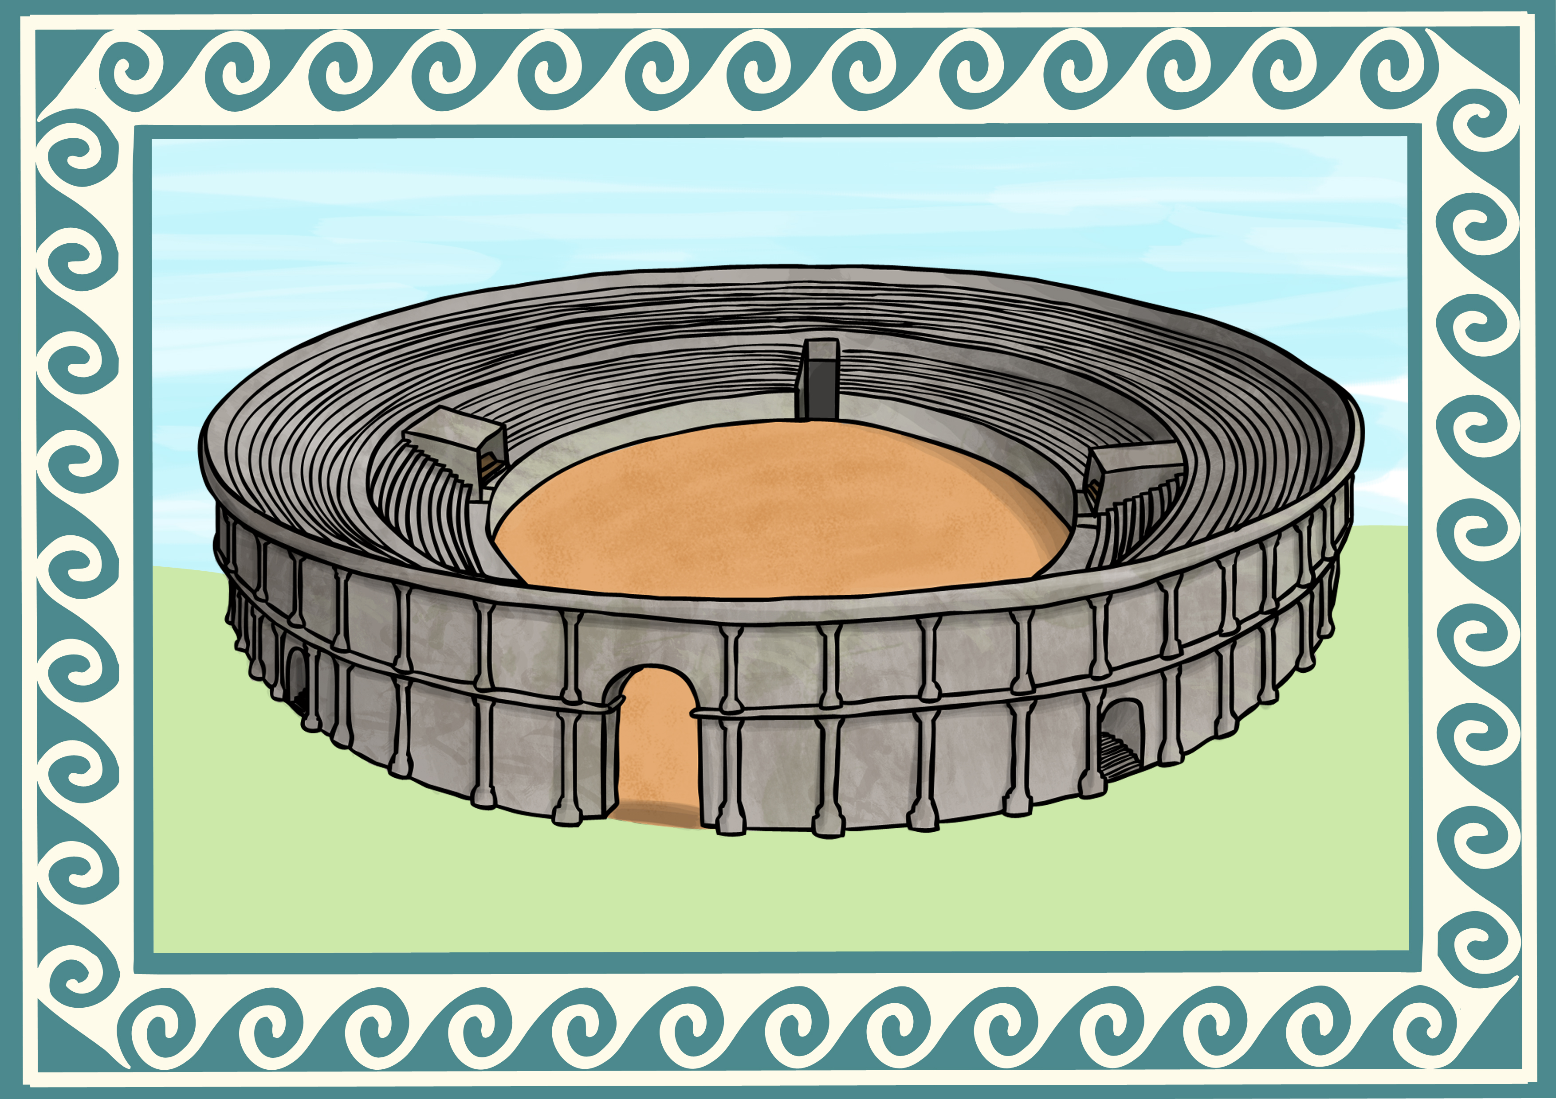

If the larger number symbol is followed by a smaller number symbol you must add the two together. You also add if the two symbols are the same.
Number List
I | 1
V | 5
X | 10
L | 50
C | 100
D | 500
M | 1000
For example:
XI = 10 + 1 = 11
VIII = 5 + 3 = 8
XIX = 10 + 9 = 19
What are these numbers?
MC
1100
DC
600
LV
55

Slide 11


If a smaller number symbol is followed by a larger number symbol you must subtract the small number from the large one.
Number List
I | 1
V | 5
X | 10
L | 50
C | 100
D | 500
M | 1000
For example:
9 = 10 – 1 = IX
40 = 50 – 10 = XL
CD (500 – 100 = 400)
What are these numbers?
IV
4
XC
90
XL
40

Slide 12
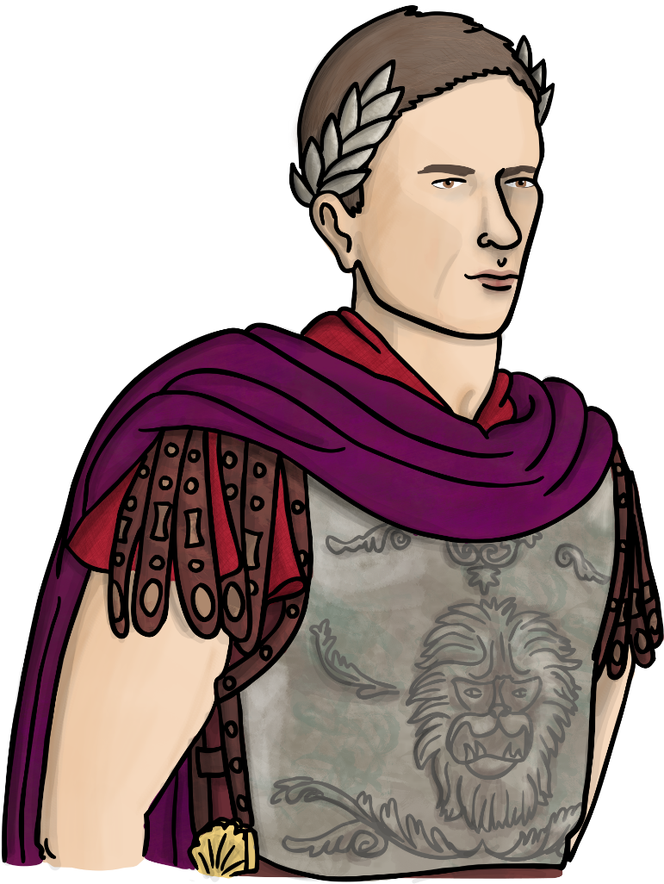
Don't forget: Sometimes numbers are formed by addition but other numbers are formed by subtraction.
Can you make these numbers?
Number List
I | 1
V | 5
X | 10
L | 50
C | 100
D | 500
M | 1000
86
LXXXVI
49
XLIX
120
CXX
1900
MCM
2000
MM

Slide 13

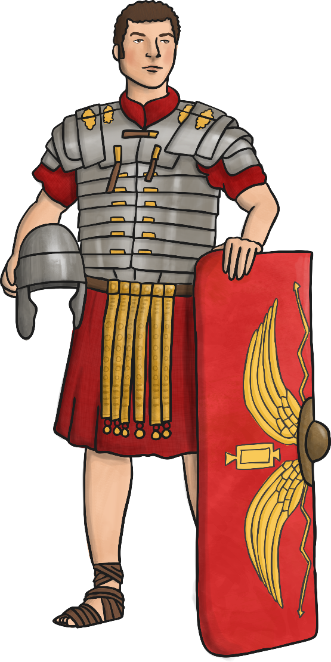
Now you are a Roman numeral converter, try this task!
Write the following numbers:
Your age
Your birthday
Today’s date
Christmas this year
New year's day next year
Number List
I | 1
V | 5
X | 10
L | 50
C | 100
D | 500
M | 1000

