Slide 1

-Kiitos, että saan tulla luoksenne puhumaan uskontojen rajat ylittävästä työstä.
Maria Kjellsdotter Rydinger, Helsinki 12/11 2025
Notes:
I am a priest in the Church of Sweden. I work part-time at the Church Office with ecumenical and interreligious relations, and part-time as the Director of the Interreligious Council of Sweden .
There is much I would like to share, and I’m not sure what you need.

Slide 2
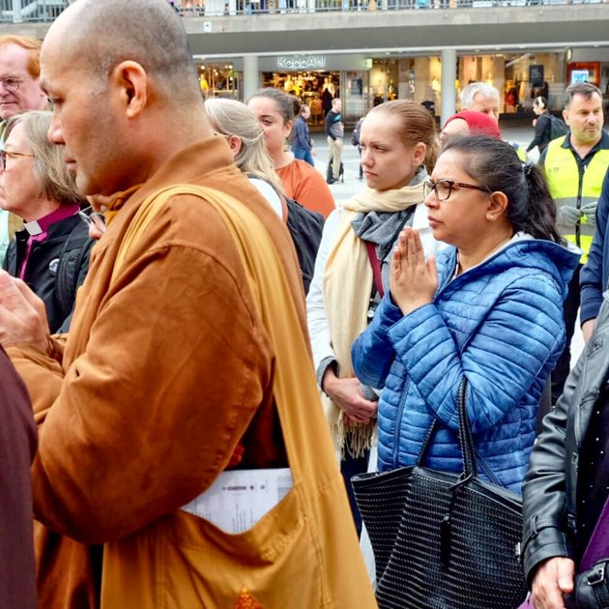
I will focus on three areas…
Our societal context – where do we stand today?
An overview of the interreligious landscape in Sweden
The Church of Sweden’s approach and theological perspective
Notes:
After speaking with Juha, I’ve decided to focus on three areas today.
Our societal context – where do we stand today?
An overview of the interreligious landscape in Sweden
The Church of Sweden’s approach and theological perspective
Think of it as a small smorgasbord – and then we can see what you’d like to explore further.
To help me manage in English, I’ll be using support text and PowerPoint:

Slide 3
Societal and Personal context
Our personal story, theology matters
Rapid change from rule-based –to power pased society
October 7:th and the war in Gaza –with increased antisemitism, Islamophobia, and growing hatred and threats against religious congregations.
Strict migration policy-Migration pact in EU
Right wing parties affecting legislation and polarization.
Civil society is shrinking and new democratic conditions introduced for state support to religious communities
Notes:
I’d like to begin by sharing a bit about my background.
In the early 2000s, I worked as a priest in a newly built, posh district of Stockholm. We had a large confirmation program and active members — but something felt off. I came from a theological background and experiences where liberation theology, inclusion, and multireligious engagement were natural guiding principles. Yet here, I met young people who had almost never had a Muslim friend or visited some one from a different religious background — although they where living next door to Stockholm’s largest mosque and Fryshuset a large multireligious school and youth center.
I began to wonder: How can we as a church help reduce prejudice and create encounters across religious boundaries? I initiated an exploratory project and spent three years investigating what it means to be church in a multireligious and global context.
During this time, I met Imam Othman Al Tawalbe, who from his perspective also asked: Why do my young people so rarely meet others from a Swedish-Christian middle-class background? We did lectures, visited schools and congregations –but we also decided to organize a journey with 30 young people from various religious backgrounds to Ethiopia — the cradle of religions. We all learned so much, challenged by living together and seeing things from different perspectives.
Like when we were on a bus trip far out in the countryside on a Friday: the Jewish participants were anxious about getting back before Shabbat, the Muslims needed to stop for Friday prayers, and some insisted we stop every hour for smoke breaks… To me, that’s a picture of what interreligious work often involves — figuring out how we live together with our differences and care for our shared space of life.
When we returned, we launched the youth-led project Together for Sweden. It was 2010, and the right wing party Sweden Democrats had just entered parliament for the first time, with xenophobic rhetoric becoming more visible. That’s why Othman wanted our project to be called Together for Sweden — to show that Sweden belongs to everyone, with the goal of fostering dialogue among young people from diverse religious, cultural, and socioeconomic backgrounds.
Much has happened since then. I’ve continued working with interreligious issues. And when Sweden, starting in 2015, received many refugees, our former Archbishop Antje Jackelén initiated the program A World of Neighbours to support practitioners across Europe working for and with refugees - I had the opportunity to be part of the team that build that program.
So where do we stand now — what does the societal context look like today?
We are living in a time of rapid change. The Swedish historian Henrik Berggren describes how we are shifting from a rule-based to a power-based society — where international norms and institutions such as the UN and the Geneva Conventions are being questioned.
The October 7 and the war in Gaza also affect us — and have led to increased tensions, rising Islamophobia, and antisemitism.
We see the EU erecting fences at its borders, keeping refugees out.

Slide 4
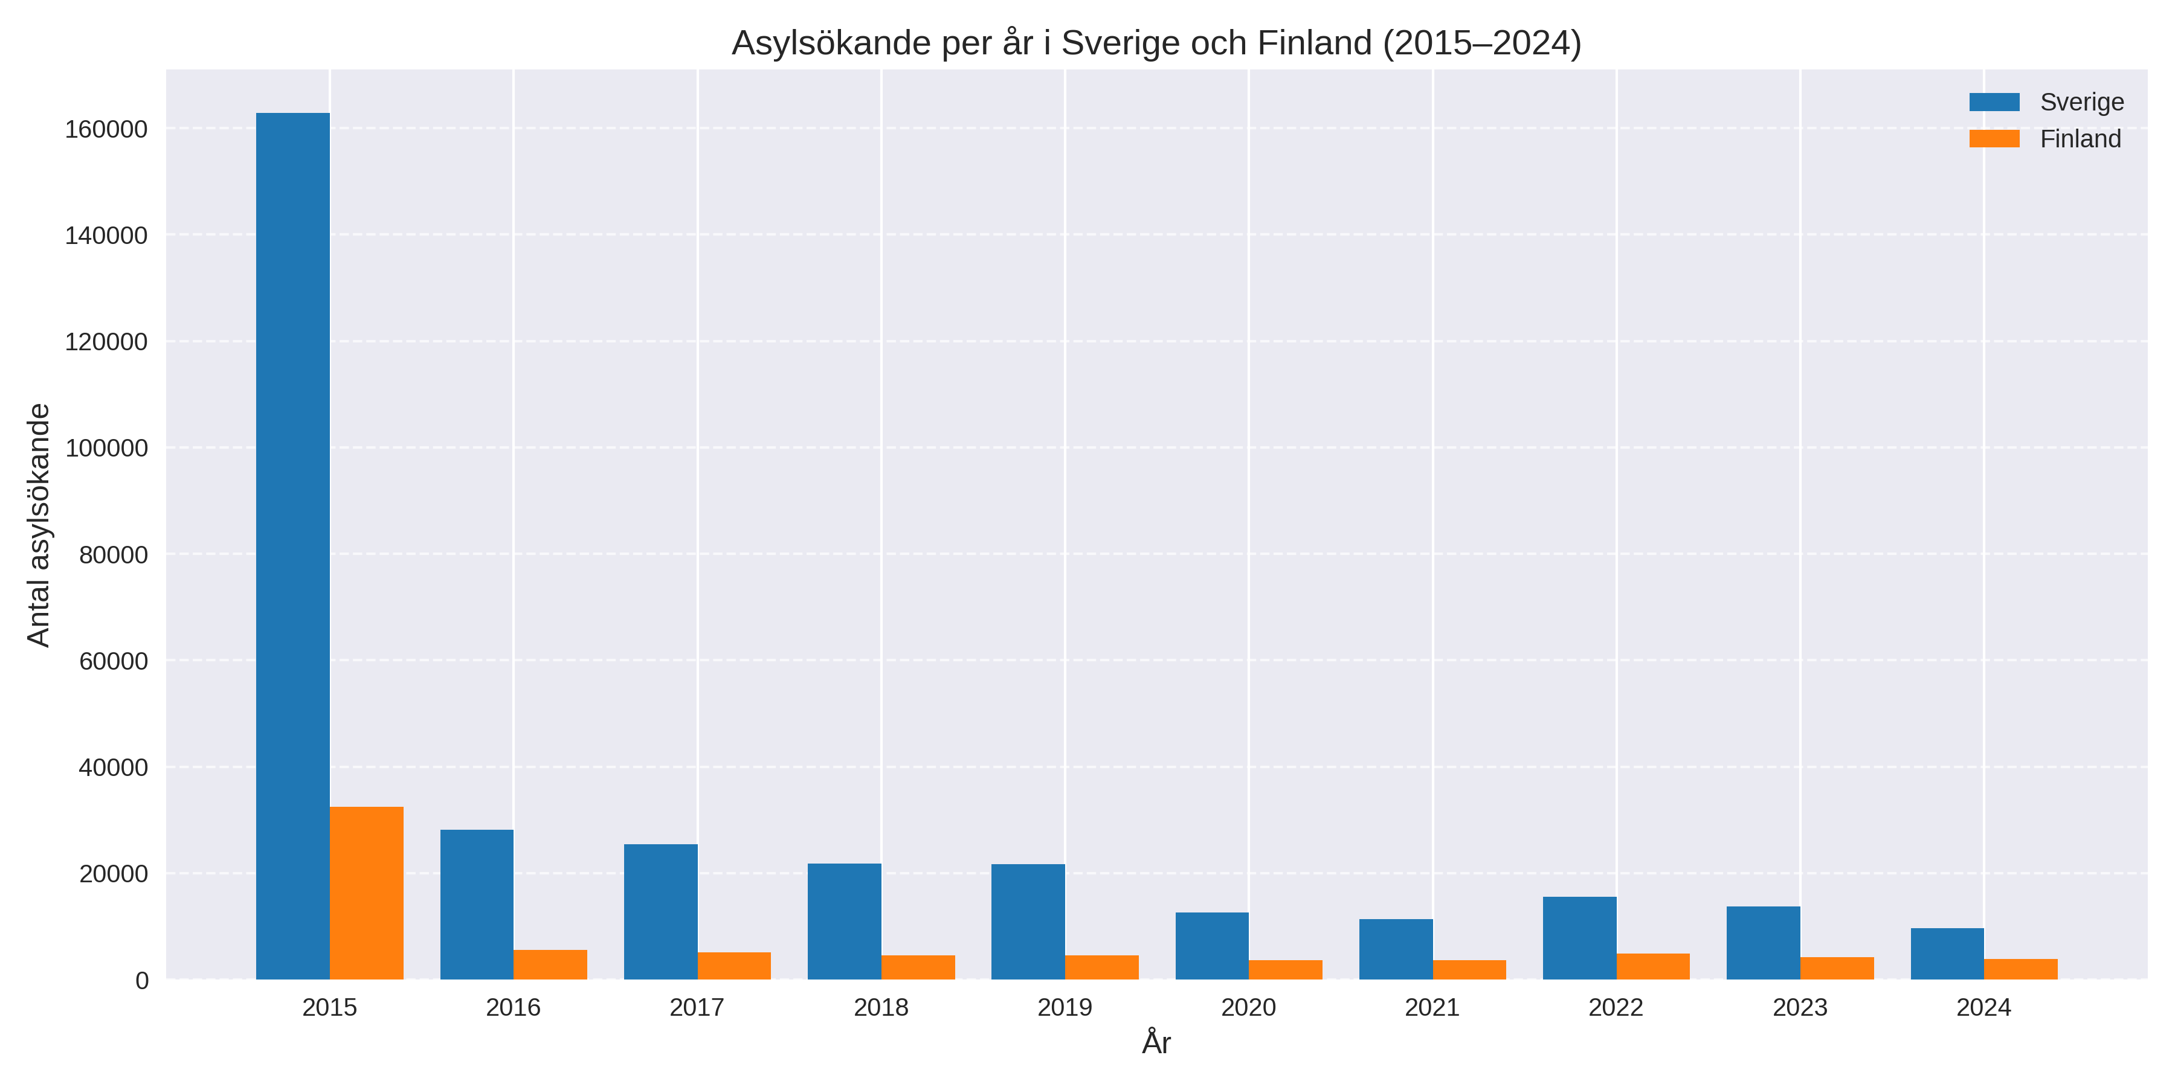
Comparison Sweden–Finland
Notes:
Sweden and Finland share similar societal structures but have different experiences with migration. Sweden has received more refugees over a longer period, while Finland has taken a slower approach — though today, the situation in major cities is not so different from that in Sweden.
In 2015, Sweden received 163,000 asylum seekers — Finland 32,000.
Since then, both countries have tightened migration policies regarding asylum, family reunification, and labor migration -and in both, right-wing parties have gained increased influence, affecting both legislation and the overall social climate
In Sweden, we now see a development where legislation and proposals are introduced at such a rapid pace that civil society barely has time to respond.
There is talk of aligning with the EU’s lowest level of reception. Stricter requirements, the dissolution of permanent residence permits, and return of migration. This affects our view of humanity, our willingness to engage in dialogue — our ability to see the other as a fellow human being.
In Sweden we see how civil society receives less funding and is shrinking. This threatens its ability to support vulnerable groups and uphold democratic values. New democratic conditions have also been introduced for state support to religious communities — which is fundamentally positive, but also raises questions: What happens if a pastor or imam expresses themselves carelessly? Will funding be withdrawn? Will issues concerning religious communities be marginalized — will freedom of religion be called into question?

Slide 5
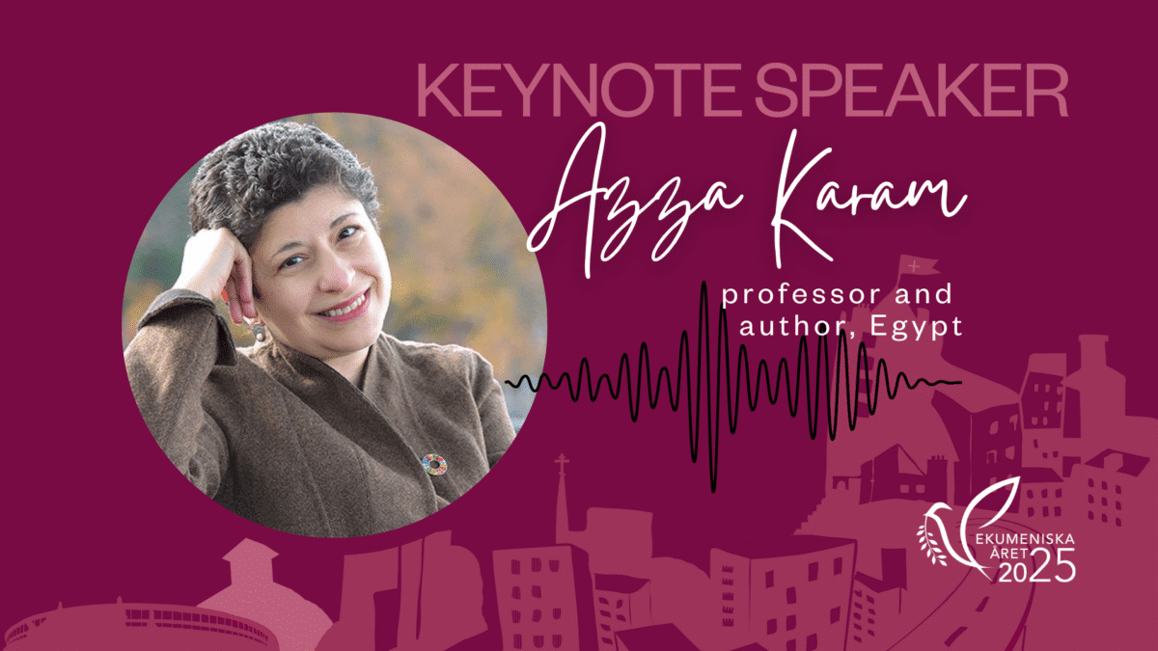
…”I understand why it’s important to celebrate 100 years of Christian ecumenism — but it didn’t stop another world war. If we are to seek peace, we must work together across religious boundaries.”
Notes:
All of this affects how we view interreligious engagement. Is it needed? Is it worth investing in?
Professor Azza Karam, who became the first female Muslim leader of Religions for Peace, visited us during our celebration of 100 years of ecumenism in Sweden. She said:
“I understand why it’s important to celebrate 100 years of Christian ecumenism — but it didn’t stop another world war. If we are to seek peace, we must work together across religious boundaries.”
That’s where we stand. In a time of polarization, fear, and uncertainty — but also with opportunities for collaboration, dialogue, and shared responsibility.

Slide 6
The Interreligious Landscape in Sweden
We can divide it into four main areas:
Interreligious councils – both national and local
Local initiatives – emerging from specific needs
Youth work – where relationships are built in everyday life
International networks – such as A World of Neighbours

Slide 7
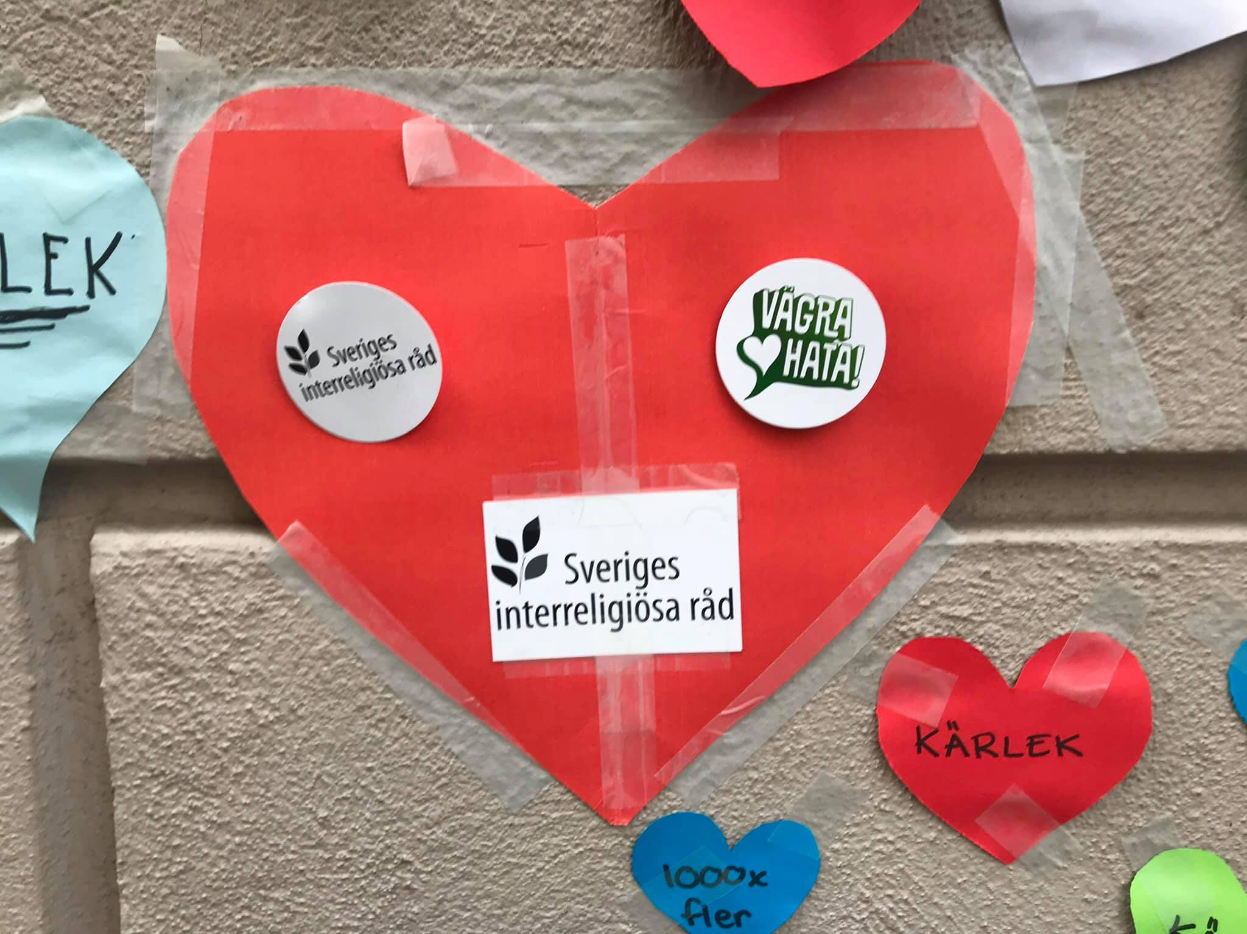
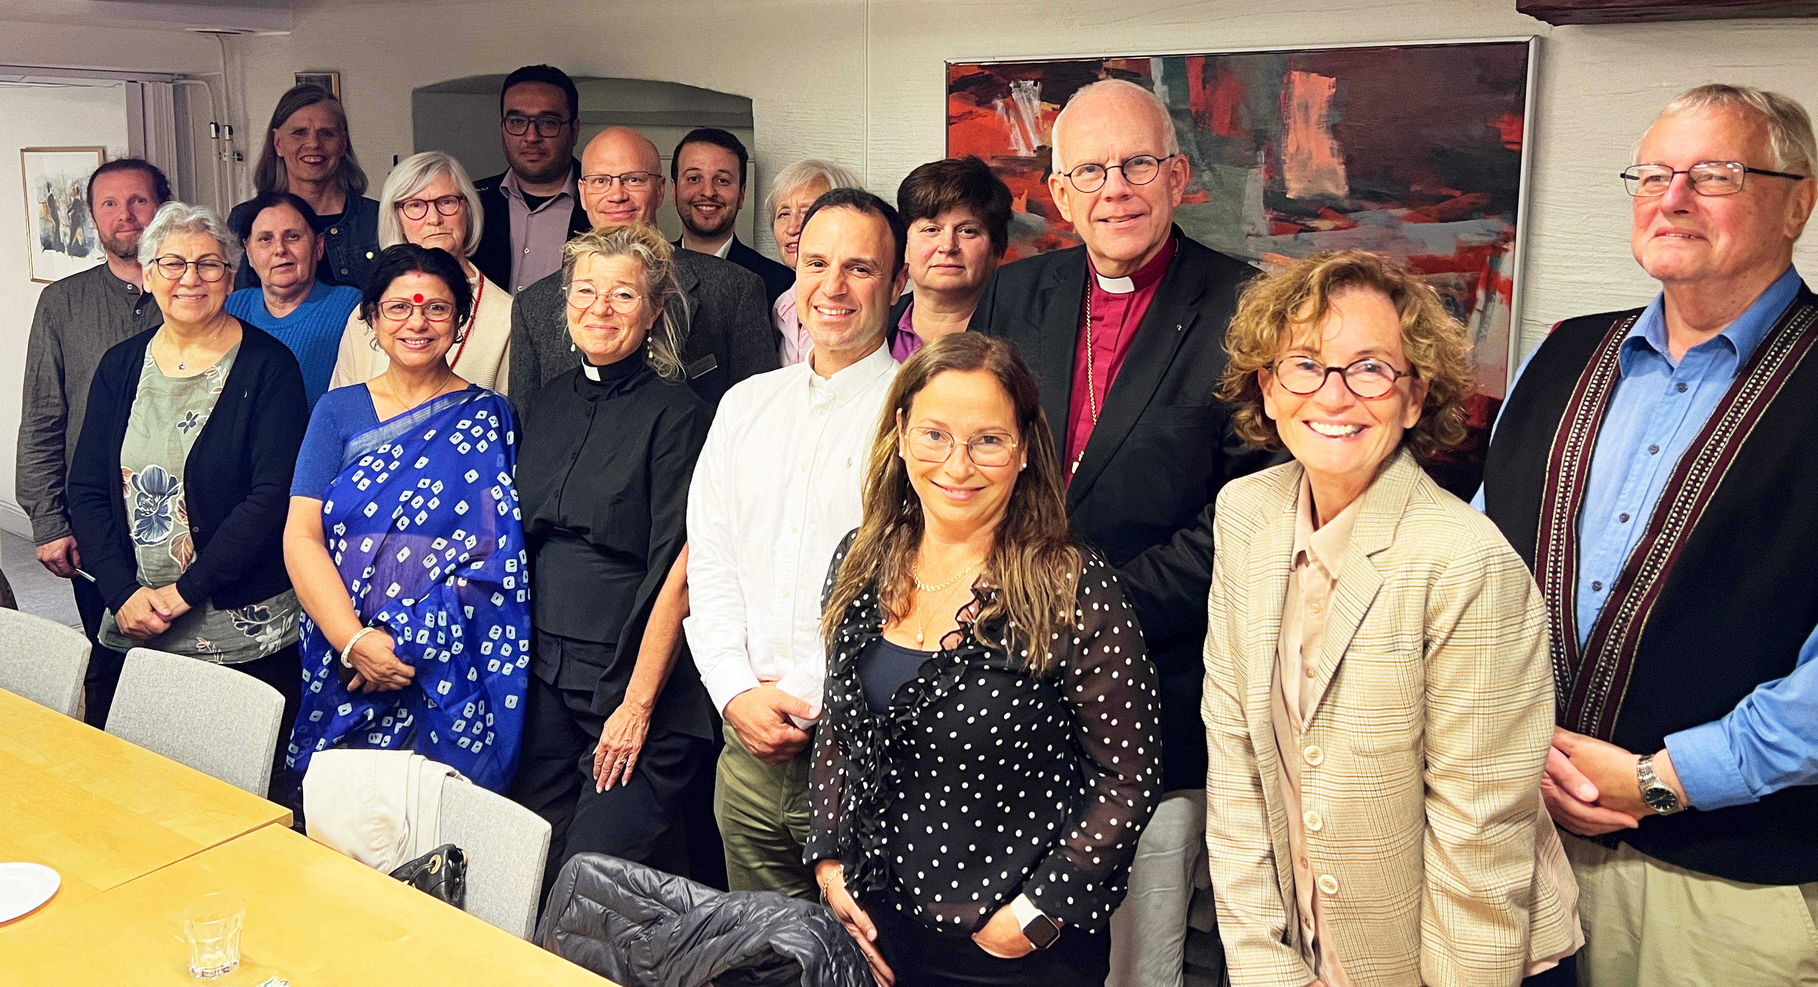
1. The Interfaith Council of Sweden
Promote and create conditions for interreligious cooperation in Sweden.​
Highlight the role of religion in creating peace and understanding in society.​
Be a voice in the public discourse on ethics and spirituality.
​
Serve as a unified voice against antisemitism, anti-Muslim racism, other forms of racism, and religious intolerance.​
Strengthen the freedom of religious belief and practice — both individually and in community.​
Notes:
SIR is a national platform where religious communities meet, build trust, and take joint action — similar to Finland’s USKOT or the RESA Forum.
Through dialogue and collaboration, we strengthen social cohesion and serve as a conversation partner to public authorities.
We work with projects, training programs, and joint statements — and in 2026, we have chosen to focus on three key areas:
Women’s leadership
Countering hate and threats — including antisemitism and Islamophobia
Crisis preparedness and response
We will re-launch a campaign called Refuse to Hate, and we will engage researchers and experts, highlighting their work through articles, interviews, and podcasts.
Together with USKOT/RESA, we have also applied for EU funding for a joint project addressing hate and threats against religious communities.
Local councils also exist — often initiated by municipalities as part of their security, safety and protection plans.
But sometimes the initiatives come directly from the religious communities themselves. These may be councils formed to get to know one another, or they may emerge from a specific need — and that’s where things get truly exciting. Here are a few examples:

Slide 8
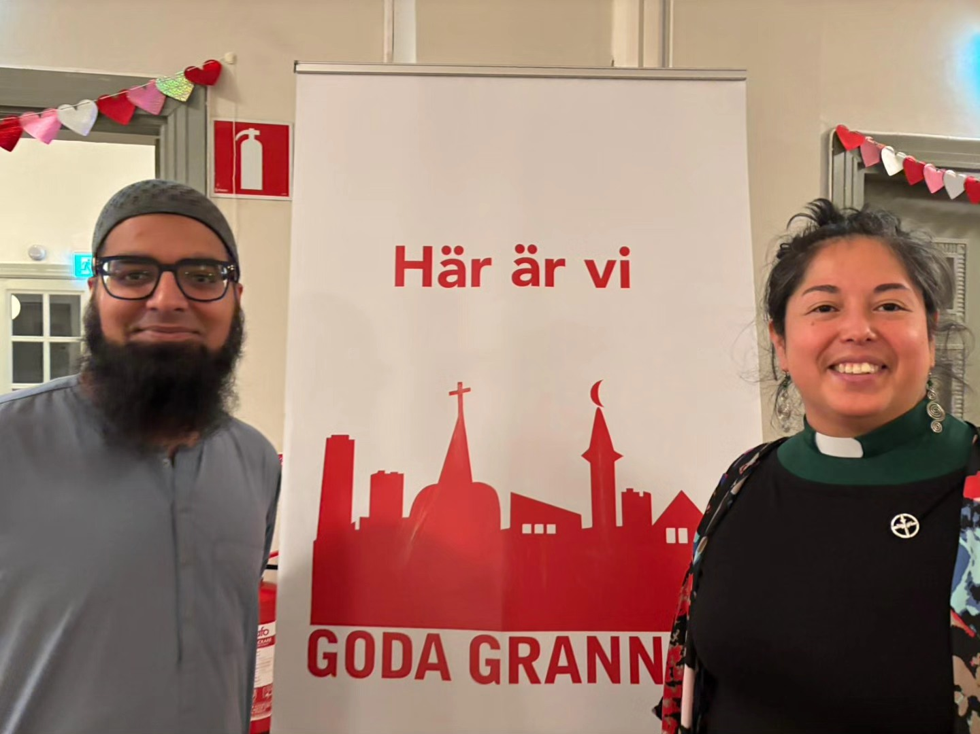
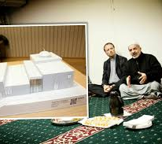
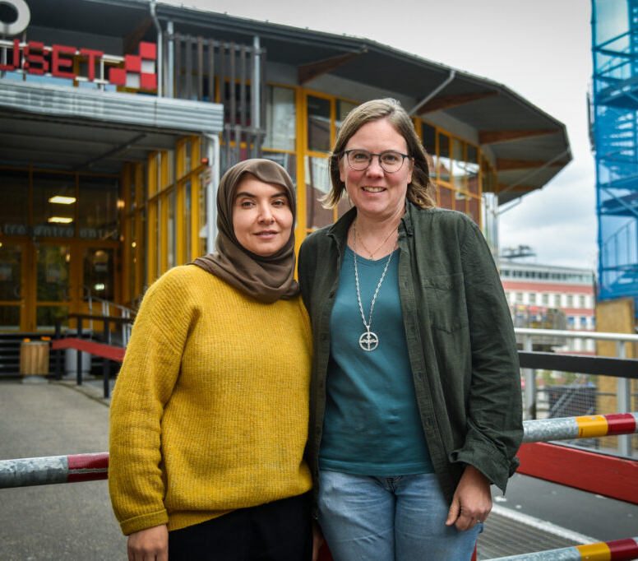
2. Local initiatives
-As a deacon, I am passionate about the church standing on the side of the vulnerable and giving people the opportunity for restoration," says Agnes Callewaert. "At the same time, I learn a lot from my Muslim colleagues – it strengthens both my faith and my approach to my own tradition."
Notes:
Local Initiatives
One such initiative is Goda Grannar (“Good Neighbours”), which began in 2015.
Stockholm Mosque and Katarina Parish collaborated to provide overnight shelter for 4,000 transit refugees. As they got to know each other and learned to work together, joint activities began to grow organically.
Today, they support newly arrived individuals through language cafés, assistance with government contacts, and social projects — and they host joint baby music sessions for parents who want to meet across class and religious boundaries.
🟣 – God’s House, Fisksätra
In Fisksätra, Christians and Muslims have been cooperating for many years.
It began in 2003 with a shared prayer on a football field — today, they are planning a joint God’s House: two separate buildings, but with a shared community space.
They do a lot together: counseling, festivals, and activities for the whole community.
🟣 – Project Trust, Malmö
In Malmö, the Muslim network reached out to the Church of Sweden in 2022.
Many Muslims turn to imams with their problems — but imams often lack knowledge of Swedish society and don’t have the relevant training.
They wanted to collaborate around psychosocial health — and learn from the Church’s diaconal work.
This became Project Trust (Projekt Tillit) — with joint training for priests, deacons, and Muslims with therapeutic backgrounds.
The focus: sharing resources, expertise, and building trust.
The next step is a methodological toolkit aimed at two audiences:
Parents — to explain the role and services of social welfare
Social workers — to explain the significance of religion and its potential as a resource in psychosocial work

Slide 9
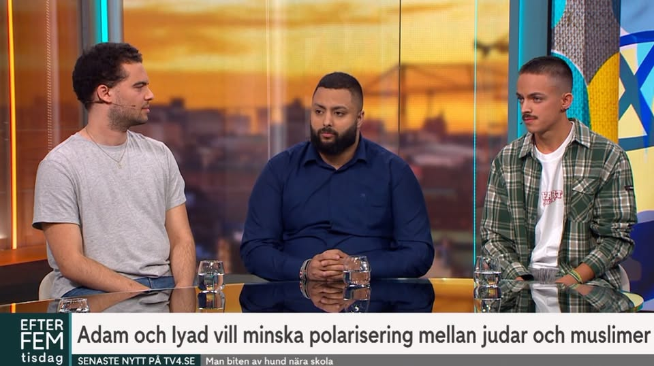
3. Youth engagement
Notes:
Together for Sweden has existed for 15 years – and young people have built relationships and grown as a youth organization.
They give lectures in schools, run leadership training programs, launch podcasts – and are often highlighted in the media. Here a few weeks ago in national TV.
They also collaborate with Norway and Finland – I was involved when we started Together for Finland in partnership with Ad Astra – and I recently heard that they have jointly applied for funding for a Nordic project involving young people from Sápmi.

Slide 10
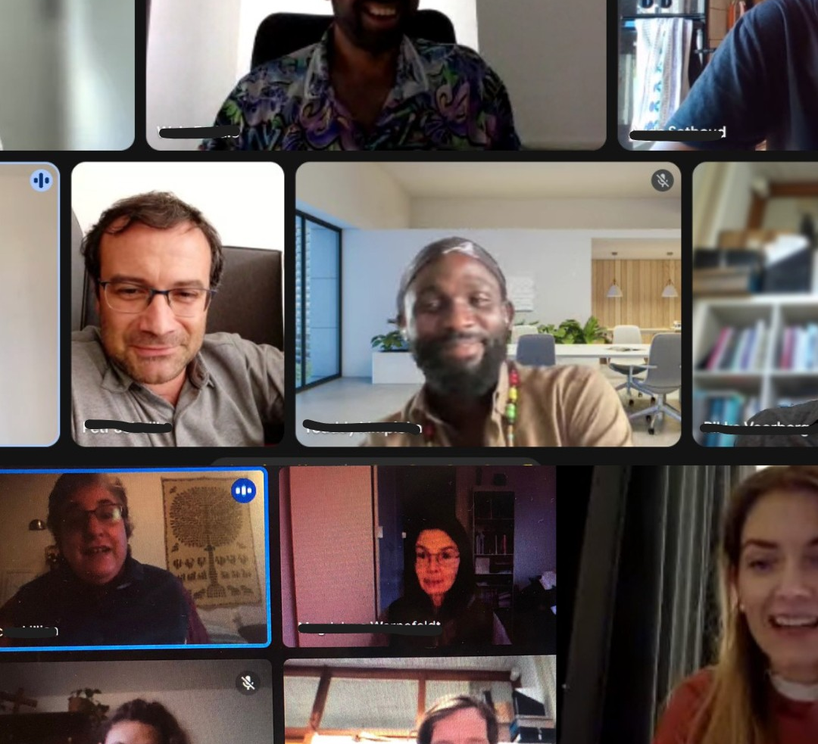

4. International
Notes:
Several international organizations work to promote interfaith dialogue — among them Religions for Peace, KAICIID, and A World of Neighbours.
A World of Neighbours was initiated by Archbishop Antje Jackelén to support practitioners and migrants across Europe. Migration practitioners often work under immense pressure: high emotional demands, limited resources, and increasingly hostile environments. Many experience burnout and isolation.
When the Church of Sweden’s program ended, I took the task of kicking it out from the nest and transforming it into an independent European organization.
Today, A World of Neighbours operates as a vibrant, stand-alone network with three core areas of activity:
Home Groups – small online communities offering support and exchange for migration practitioners
Lectures and research – connecting knowledge and practice
Annual gatherings – most recently in Poland, supporting those helping refugees at the Belarusian bordes who are subjected to repeated pushbacks -we never here of.

Slide 11
Church of Sweden:
We shall be a church for all who live in and visit our parish.
From our Church Order:
"Based on the Church's faith in God as Creator, Restorer, and Giver of life throughout the world, the broader ecumenical calling is to work for the unity of the Church, the fellowship of humanity, and the healing of the world, as well as to seek God's voice in the encounter with every person, regardless of religious tradition."
— Church Order (Introduction to Chapter 59)
Notes:
Interreligious work is, in fact, not something that should be questioned – it is our foundation- part of the Church’s core mission.!
The Church Order states:
“We shall be a church for all who live and stay in our parish – regardless of faith or religion.”
And further:
“…to seek God’s message in the encounter with every person, regardless of religious tradition.”

Slide 12
🏛 Elections and Church Assembly
Motions are submitted to the Church Assembly are both in favor for the interreligious work –and not.
🏞 Diocesan Level
Cutbacks and re-prioritizations are taking place across several dioceses.
Despite this, the Archbishop chooses to join the board of SIR.
🏘 Parish Level
Some parishes and practitioners are being questioned in terms of their direction and activities.
Others are finding new ways to collaborate and strengthen their community.
🗣 Critics' Voice
"We must be clear and not compromise our values."
"We cannot trust the 'brotherhood'."
"We should not mix religions.
🤝 Practitioners' Response
"Everything changes, but we remain -and we have each other.“
Multiple Truths at Once
Notes:
But working with migrants and engaging in interreligious efforts is not without controversy and is increasingly being questioned and at the same time defended
.This year, the Church of Sweden held its national elections. In Nacka, where the House of God (Guds Hus) is located, some nomination groups campaigned to end the collaboration — but lost their mandates.
At the national Church Assembly, motions are regularly submitted to shut down interfaith work or prohibit cooperation with Muslim communities. Yet the motions that actually pass focus on strengthening continuing education and supporting interreligious councils.
At the diocesan level, we’ve seen reductions in staff.
But on the national level, Archbishop Martin joined the board of the Swedish Interreligious Council (SIR) — a clear signal that we stand together in difficult times.
At the parish level, we hear from deacons who speak of growing loneliness and despair — witnessing how more and more people are being dehumanized and excluded from society’s safety nets. At the same time, these practitioners face criticism for collaborating with Muslim organizations or “mixing religions.”
Yet we also see creativity, resilience, and mutual learning.
And that gives hope — for all of us — that people who are meeting on a dayly basis, the practitioners -are not giving up.

Slide 13
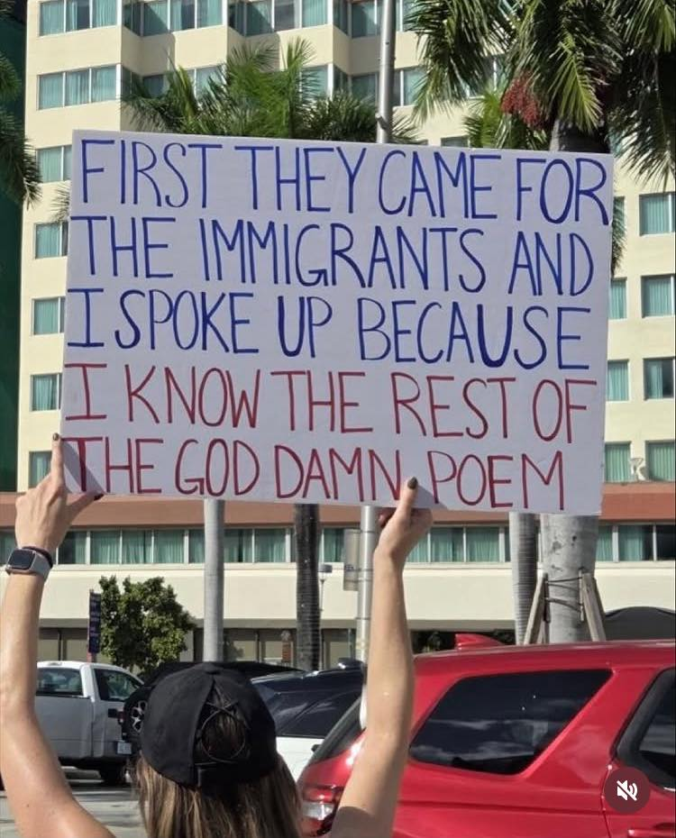
Humanity is being re-negotiated
The Church need to stand up when human dignity and rights are threatened
Notes:
I believe our view of humanity is being re-negotiated.
Many feel that something is wrong – but can’t quite put their finger on it.
We have much to contribute, because the Church has a clear view of humanity:
We are all equal before the face of God.
This is a cornerstone of Christian ethics – and a matter of status confessionis.
We are no longer part of the state – and unlike many other civil society organizations, we still have financial resources, which means we’re not dependent on bending to seek funding – and therefore we must stand up when human dignity is threatened.
We must go into opposition when needed – something unfamiliar for the Church of Sweden.
Maybe “interreligious” has become a loaded term — politicized, even divisive- and maybe we need to let it go. Some congregations argue it’s not central to our mission, just a side concern, or activity within the church.
But the heart of our mission is not a label -but a commitment: to meet every person with compassion and respect, no matter who they are.

Slide 14
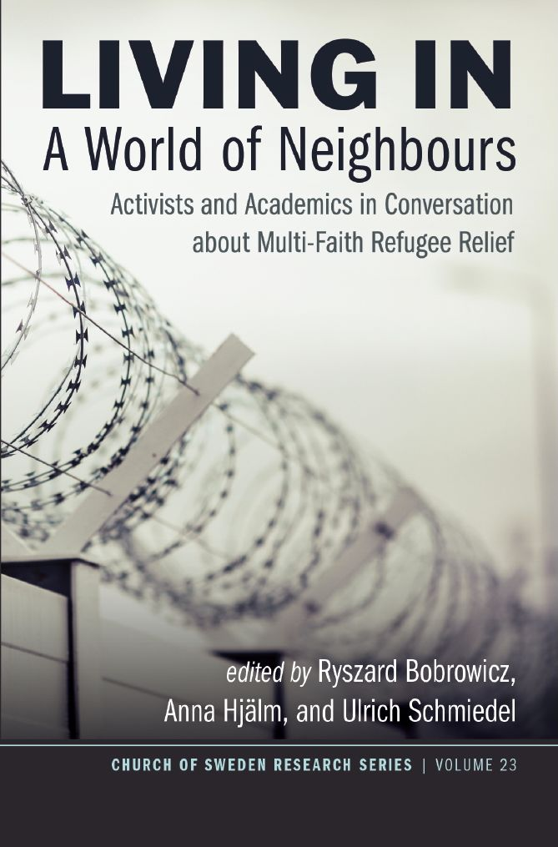
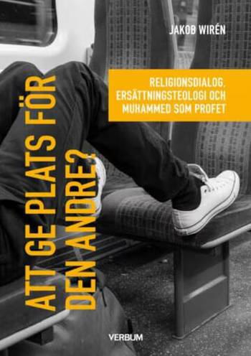
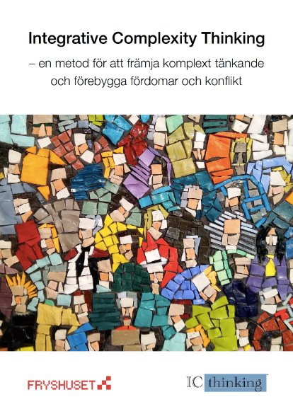
"How are questions and situations processed theologically?"
Notes:
What happens to all these questions – how are they handled and processed theologically?
If you ask me – far too little research.
I often hear from practitioners that while they are actively engaged in interreligious encounters in language cafés or activities, they don’t perceive themselves as theologians—and this puts them at a disadvantage. Yet action itself is a form of theology. I believe practitioners would benefit from reflection and training to recognize this, because having a theological language not only strengthens credibility within the church, it empowers practitioners to claim their rightful place, rather than feeling overlooked or unheard
Within A World of Neighbours, we’ve brought in researchers – in the book, scholars and practitioners reflect together.
IC Thinking has been helpful – for gaining understanding, methods for how we can work, what happens when we become afraid, when we get tunnel vision.
Jakob Wirén’s book begins with an image: a bus journey.
It’s about how we give each other space – a seat, room – a bit like I began with the bus trip to Ethiopia… about making space for each other’s stories about God.
He addresses a crititique of replacement theology –and emphasizes the importance of viewing Jewish faith as parallel to Christian faith—and applies the same reasoning to Islam. Wirén asks: 'If we can acknowledge that Judaism has a valid covenant with God, why not Islam?'"
It’s theologically challenging – but also necessary that we continue to reflect, to find spaces and theologies for what is happening now.

Slide 15
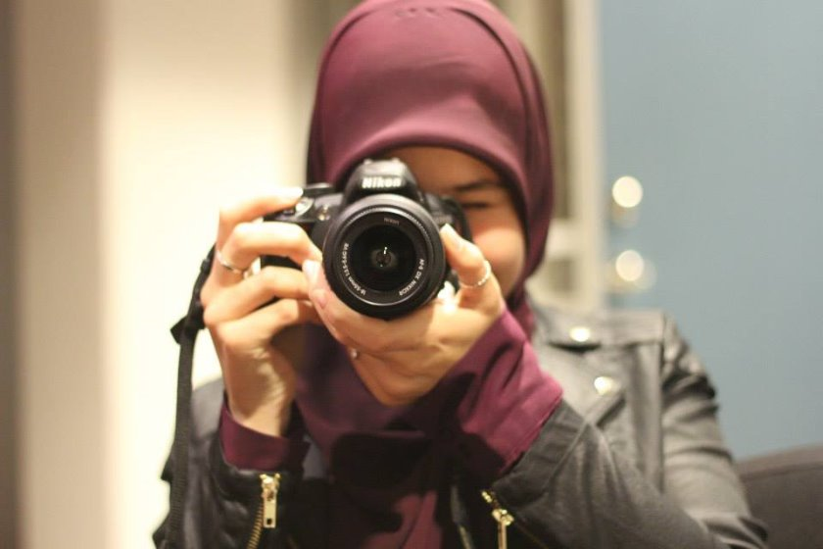
Through interreligious encounters..
“I see my religion through different eyes- and
I see how my religion is perceived through the eyes of others.”
Notes:
The final slide and the final word comes from a young girl in Together for Sweden…

