Slide 1
METHODS AND TOOLS OF KNOWLEDGE
TOK Jyväskylän Lyseon lukio

Slide 2

TASK
How do we acquire knowledge?
What kind of methods and tools can be used in the production of knowledge?
Engage in conversation and write down your ideas

Slide 3

How to justify knowledge?
Reasoning
Inferences
Immediate insight, intuition
Sensory perceptions
Evidence
Sources

Slide 4
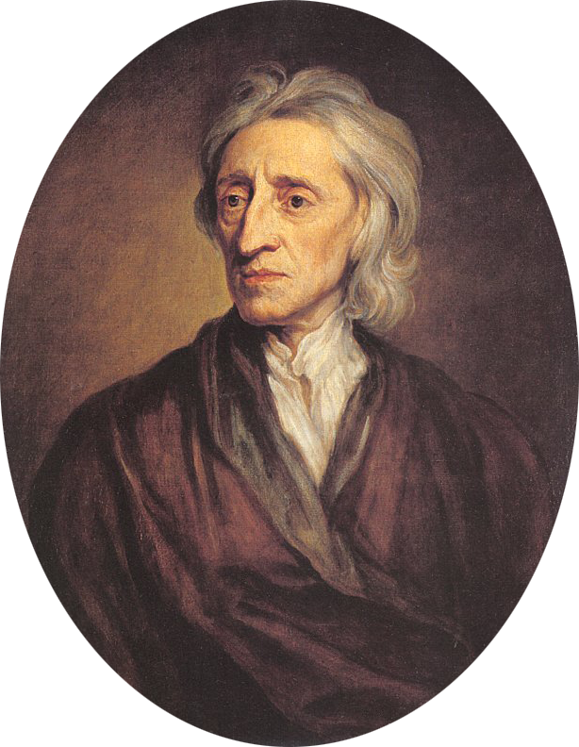
Some Schools of Thought
(1) Empiricism
All knowledge is ultimately based on perceptual experience

Slide 5
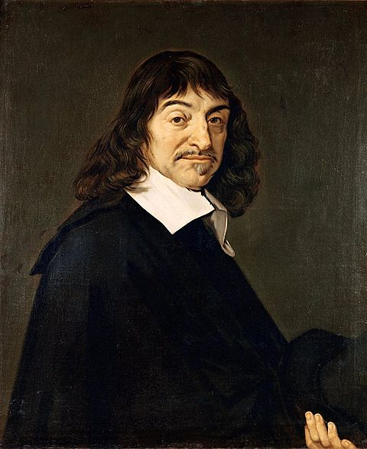
Some Schools of Thought
(2) Rationalism
Reason is the most important source of knowledge

Slide 6
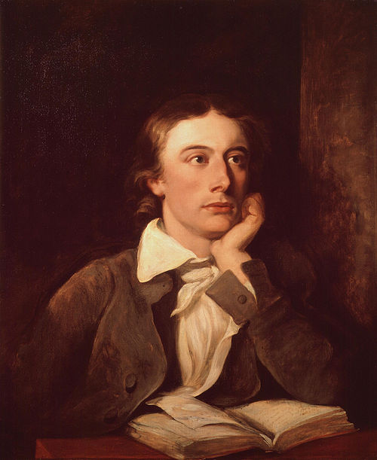
Some Schools of Thought
(3) Romanticism
Emphasizes the importance of intuitions, emotions and imagination for making sense of the world

Slide 7
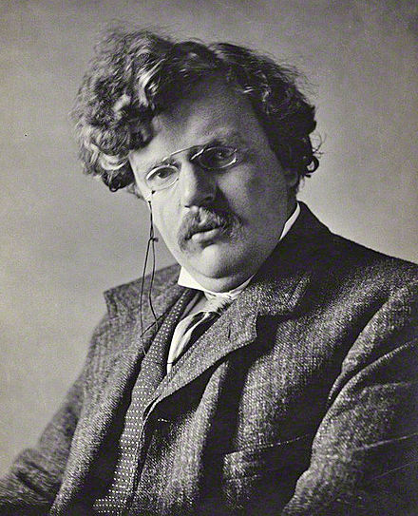
Some Schools of Thought
(4) Fideism
Knowledge is ultimately based on faith and trust

Slide 8
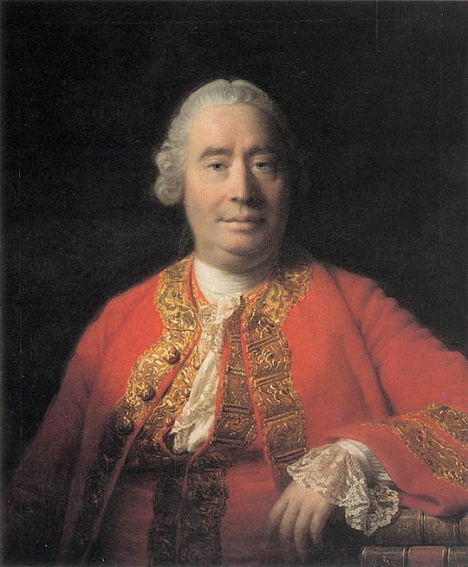
TASK
Which one of these schools of thought is most plausible?
Can you give any reasons for and against these schools of thought?

Slide 9
TASK
Teacher divides you into five groups
Each group gets one area of knowledge
Each group answers two sets of tasks related to the area of knowledge and prepares to present the responses to others
Areas of Knowledge
Mathematics
The natural sciences
The human sciences
The arts
History

Slide 10

TASK
Compare your answers to the ”correct” answers provided by the IBO
How similar or different were your answers in comparison to the official answers?
Are the official answers well justified?

Slide 11
Methods in history
Use of contemporary documents as fixed points of historical theory
Historical theory being constructed out of the available evidence by reason and imagination
Issues of selection and interpretation of source material
Issues of reliability of first-hand accounts—memory and observation are affected by interests and expectation
History seems to presuppose a theory of human action. For example, the view of history as being shaped by the action of individuals as opposed to the idea of history as the playing out of class struggles or of a zeitgeist
An explanation in history is a plausible theory that explains the relevant source material and fits other accepted theories

Slide 12
Methods in the human sciences
Experimental method
Use of questionnaires, polls
Direct observation of human behaviour
Use of models
Use of reason to construct plausible theory consistent with other accepted knowledge in the field
Some assumptions of human rationality (economics), or law-like behaviour (psychology)
Use of statistical methods—on what basis to choose things like significance levels of tests

Slide 13
Methods in the natural sciences
Measurement involves interaction with the world, but this interaction can sometimes change the aspect of the world we are trying to measure
Models are important in most areas of the natural sciences
Classification is a central idea in many of the natural sciences
Among the methods employed by the natural sciences are: hypothesis-deduction and induction—use of reason and sense perception

Slide 14
Methods in the arts
Artistic creation is often a result of personal knowledge requiring imagination and creativity
Creativity requires imagination taking place within a framework, often using reason
Art often requires a (possibly emotional) interaction with an audience
New technologies spawn new art forms, for example, film, computer art, computer music

Slide 15
Mathematics
Uses pure reason from axioms* to produce proofs of mathematical theorems**
Mathematics does not have to rely on sense perception of the world
A statement in mathematics is true if and only if it is proved
Mathematicians require intuition and imagination in order to prove theorems
*a rule or principle that most people believe to be true
** a rule or principle, especially in mathematics, that can be proved to be true, e.g. Pythagoras’ theorem

Slide 16
TASK
What assumptions underlie the methods of inquiry used in the five areas of knowledge?
Engage in conversation and try to compile a comparative and holistic response
Areas of Knowledge
Mathematics
The natural sciences
The human sciences
The arts
History

Slide 17
Picture sources
Wheel head <http://www.integrityks.com/about-us/> Accessed 4th of May 2016.
Knowledge head <http://philosophy.talons43.ca/2014/12/08/5832/> Accessed 15th of August 2015.
John Locke <https://en.wikipedia.org/wiki/Empiricism> Accessed 5th of September.
René Descartes <https://en.wikipedia.org/wiki/René_Descartes> Accessed 5th of September.
John Keats <https://en.wikipedia.org/wiki/John_Keats> Accessed 5th of September.
G. K. Chesterton <https://en.wikipedia.org/wiki/G._K._Chesterton> Accessed 5th of September 2016.
David Hume <https://fi.wikipedia.org/wiki/David_Hume> Accessed 5th of September 2016.
Areas of knowledge © Christine Stevenage, 2020.
IBO logo <http://www.ibo.org/digital-toolkit/logos-and-programme-models/> Accessed 23rd of September 2016.

