Slide 1
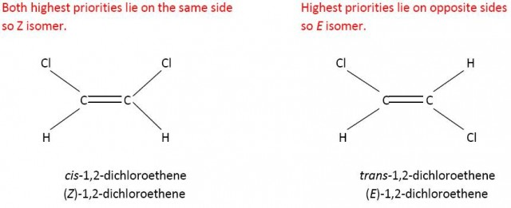
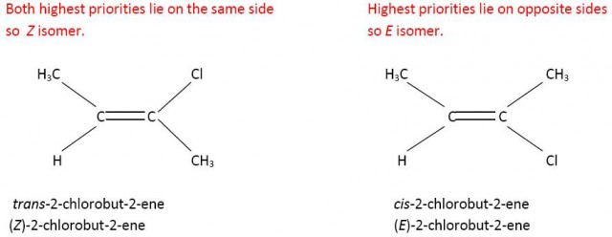
Sterioisomers

Slide 2
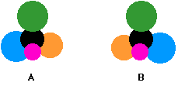
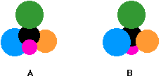
OPTICAL ISOMERS
Stereoisomers have the same structural formula but different spatial arrangement
An asymmetric or chiral carbon atom is one that contains four different groups attached to it.
All 2-amino acids besides glycine have a chiral carbon
Compounds with a chiral carbon atom may exist as mirror images of one another and the isomers are optically active with light that is polarized
They are referred to as optical isomers or enantiomers
  Mixtures will be optically inactive when the enantiomers are present in equal amounts = racemic mixture aka racemate (the rotations cancel each other out)
Could you get the molecules to
align the same way?
Rotating B would have this
effect

Slide 3
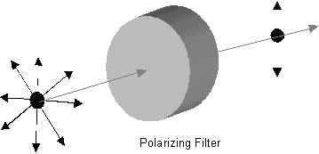
OPTICAL ISOMERS
When light is passed through a polarizing filter the waves will only vibrate in one optical plane
Two enantiomers will rotate the plane of polarized light in opposite directions
Besides this, they are identical in their physical properties and nearly so in chemical properties
However, in the body the different enantiomers may have completely different physiological effects (bitterness and sweetness of asparagine’s enantiomers)
Be able to identify a chiral carbon
Non-polarized light
Polarized

