Slide 1
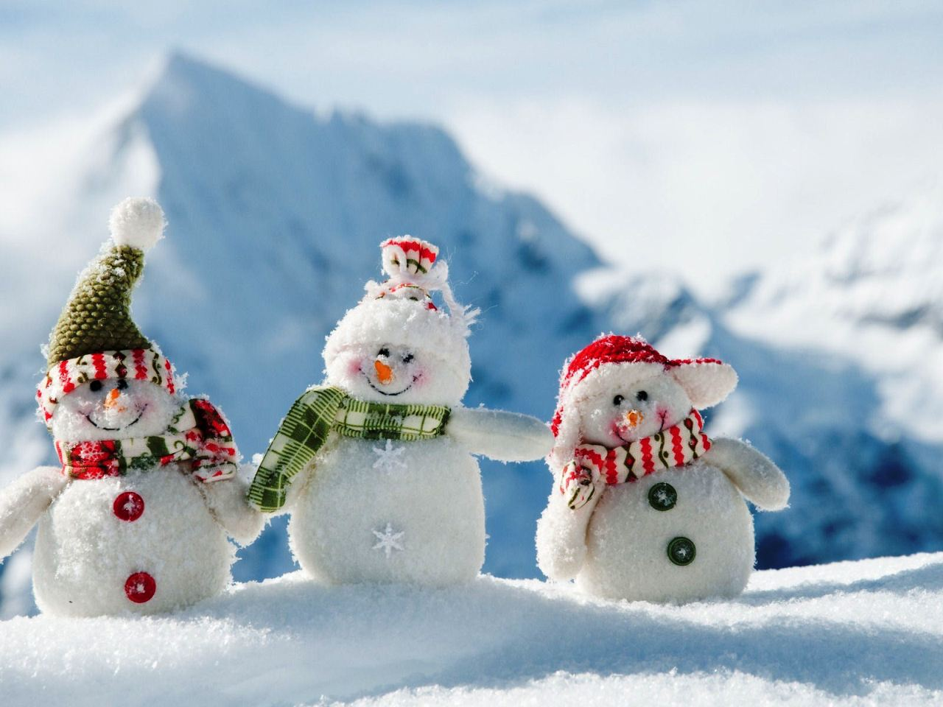
Finnish Christmas
Janina, Jonna, Saana ja Ilona

Slide 2
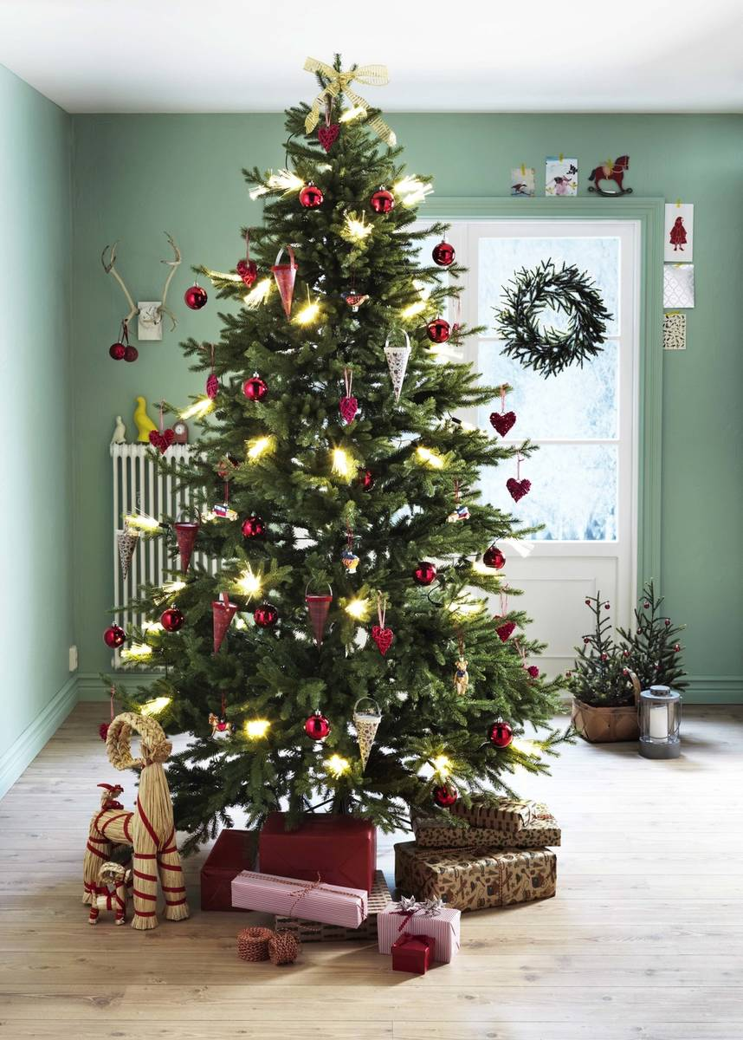
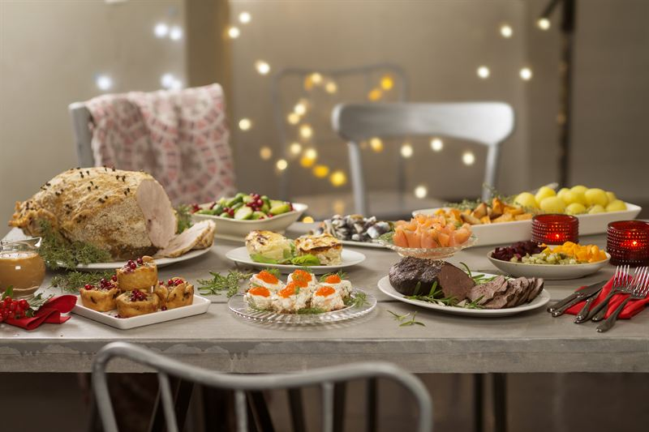
In Finland we spend Christmas on Christmas Eve (24th December)

Slide 3
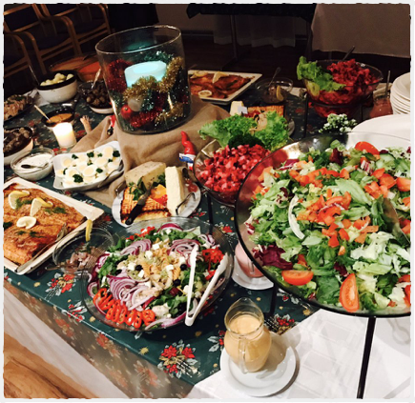
Christmas food
In the morning we eat porridge.
At about five o'clock we eat the Christmas meal with the family at the table.
Christmas food in Finland is ham and different kinds of casseroles, peas aside and rosolli salad or whatever everyone likes.
In the evening we eat Christmas cookies, which the kids have usually done and we also like to drink glogg.

Slide 4
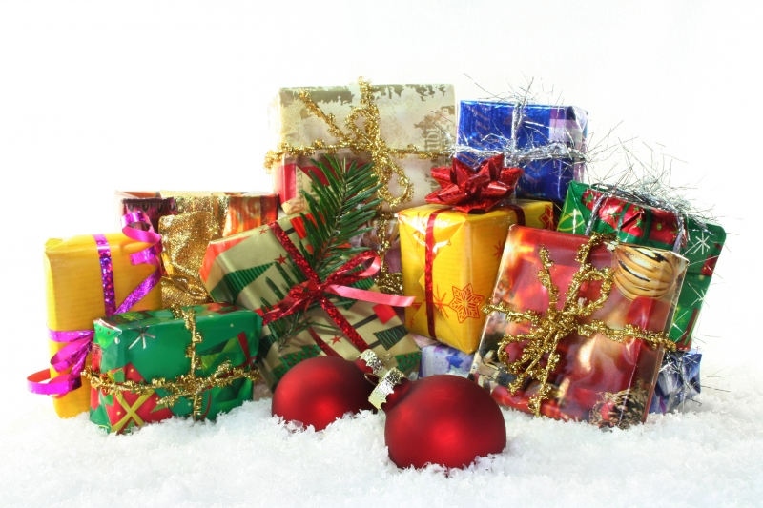
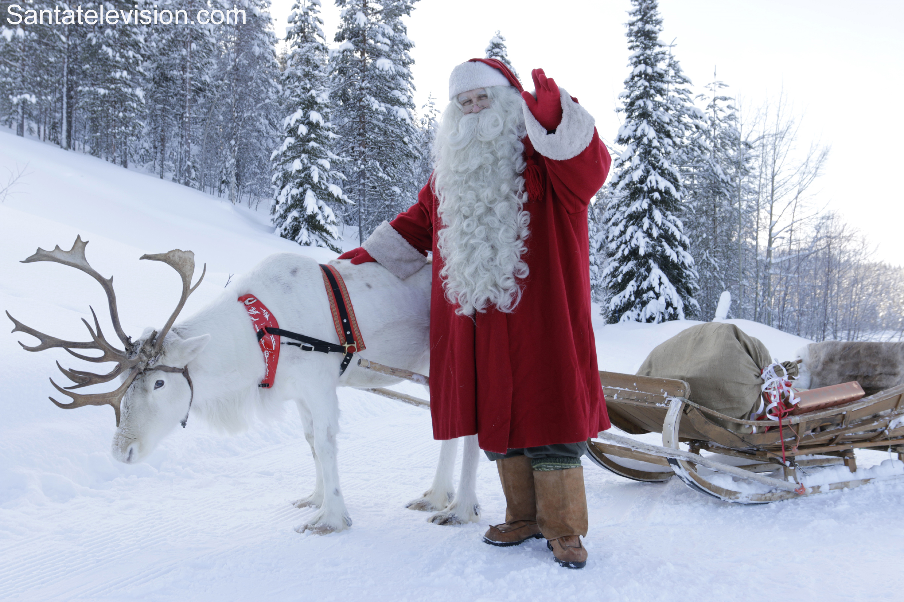
SantaClaus
Santa Claus comes with his reindeer from Korvatunturi, Lapland.
When Santa Claus has given the gifts to us you can just open those.
When you have opened your gifts you can just spend the rest of the evening with your family.

Slide 5
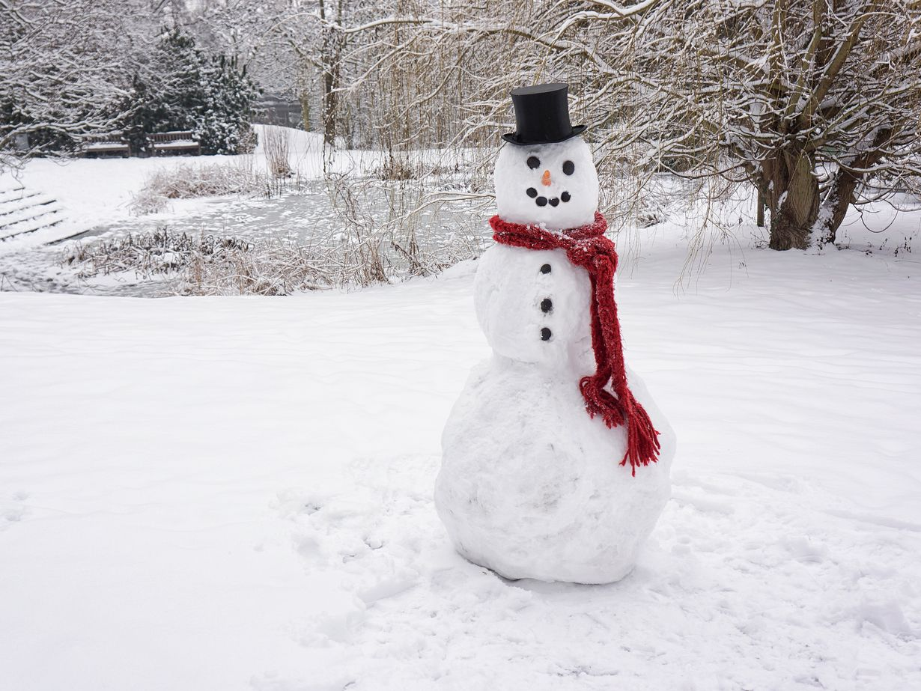
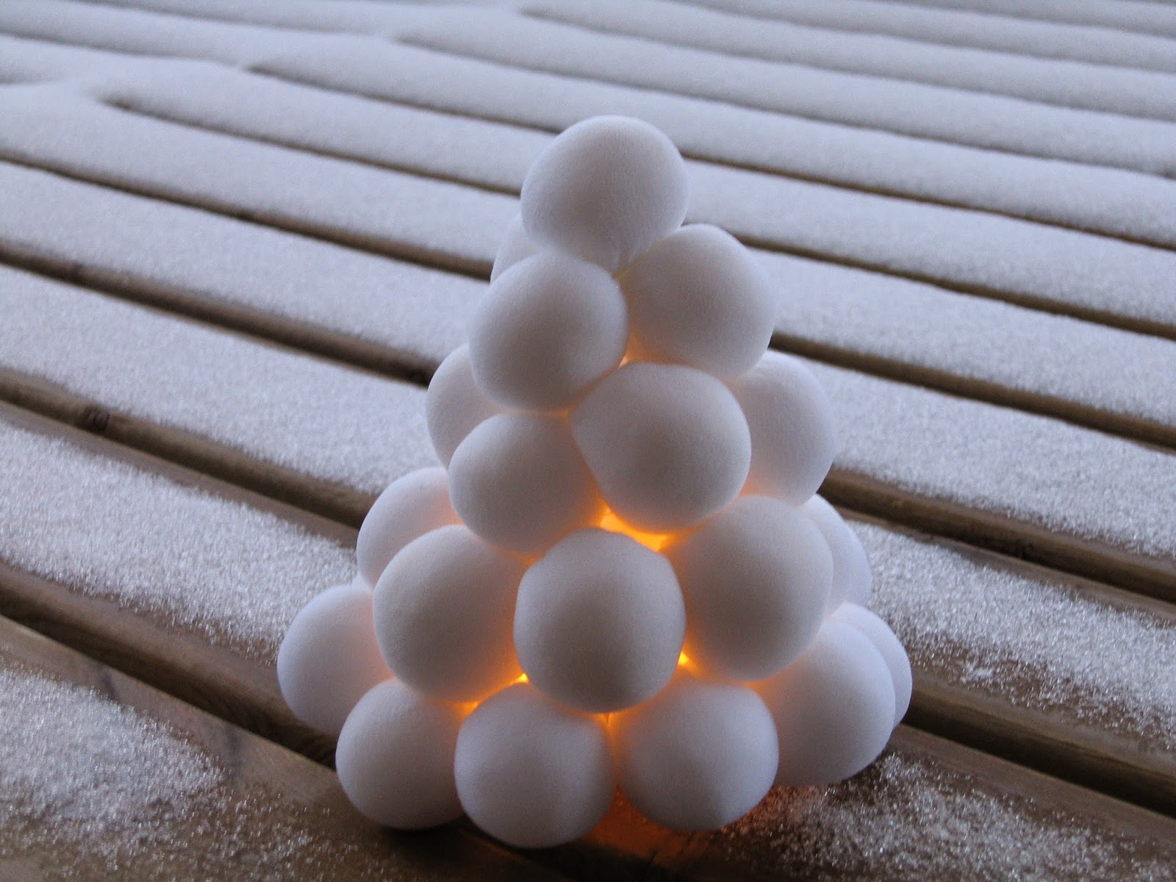
SNOW!!!
Snowmen, snow lanterns and snow caves also belong to Finnish Christmas, because we usually have snow in December.

Slide 6
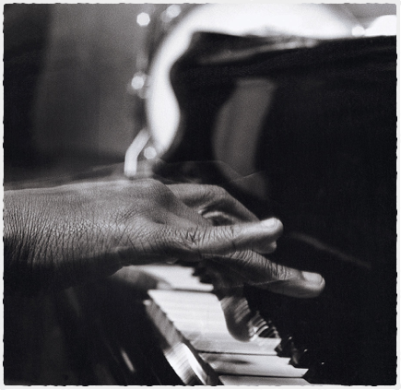
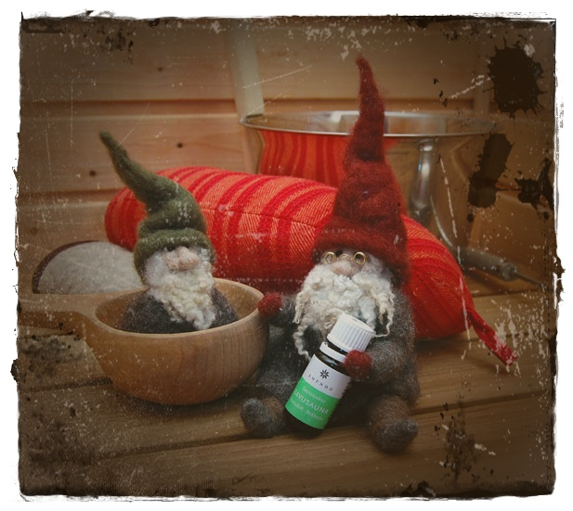
Finnish sauna
The families usually go to sauna on Christmas Eve.

