Slide 1

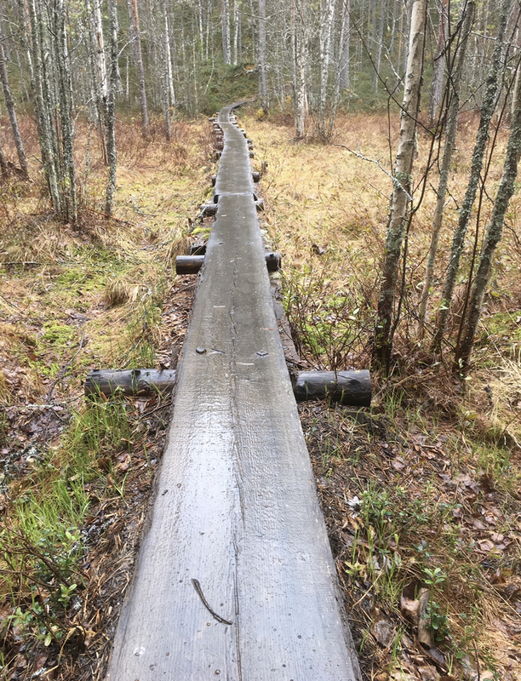
ON OUR PATH
4TH GRADERS
HEINÄVAARA ELEMENTARY SCHOOL

Slide 2
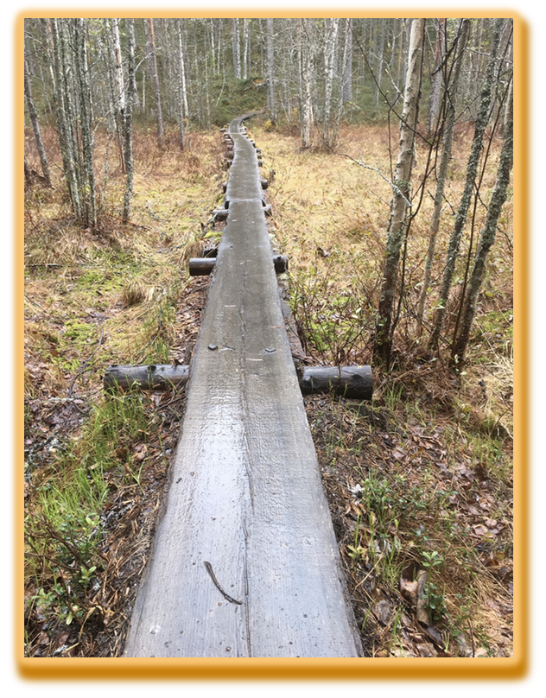
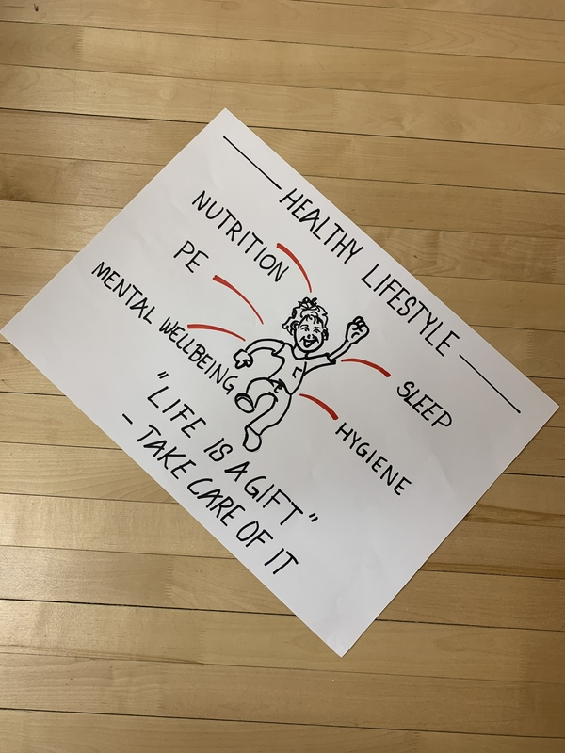
FINDING OUT THE GOAL
LEARNING THE ELEMENTS OF HEALTHY LIFE
INTERESTED ABOUT THE CONCEP OF
SUPERFOOD

Slide 3
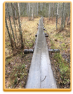
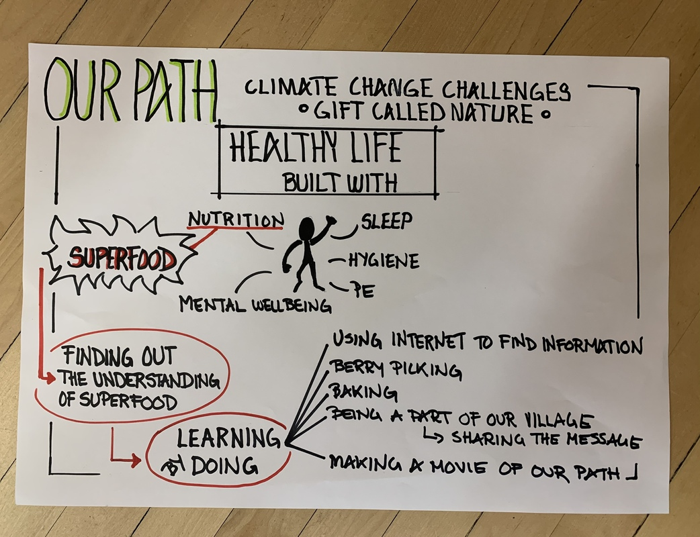
A MAP FOR OUR PATH

Slide 4
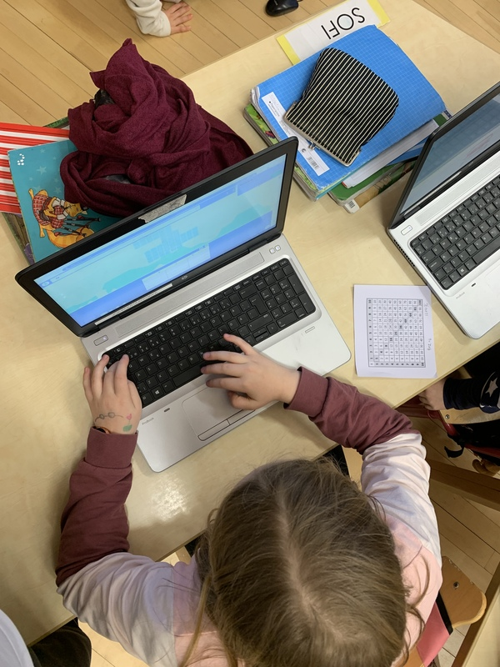
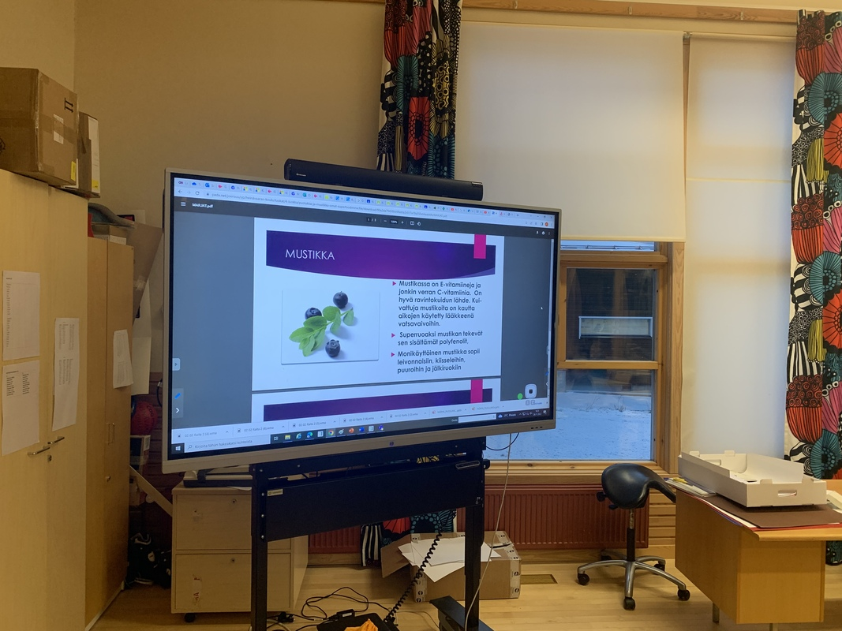
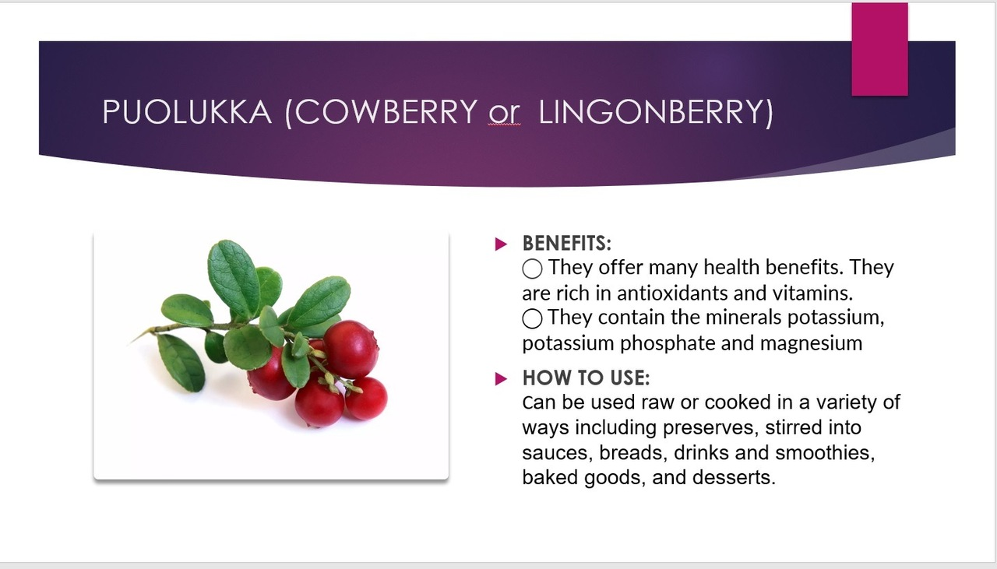
FINDING OUT THE UNDERSTANDING OF SUPERFOOD

Slide 5
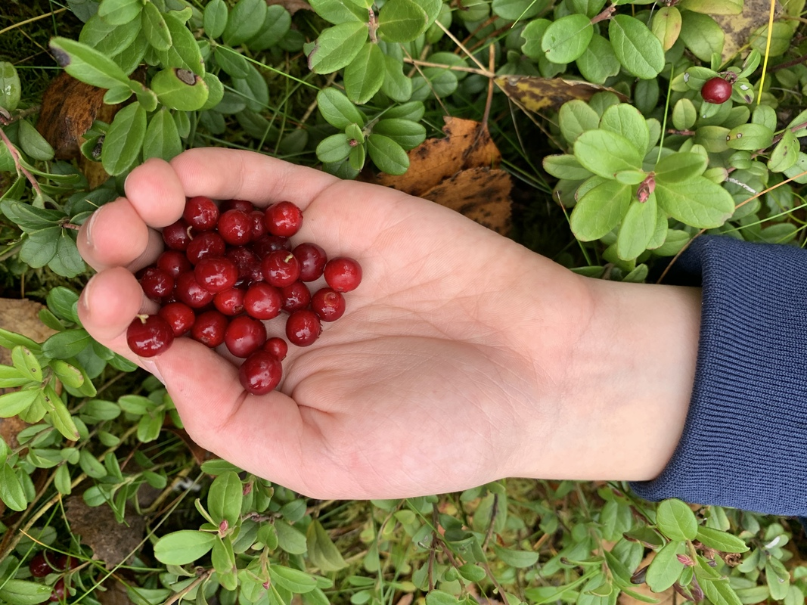
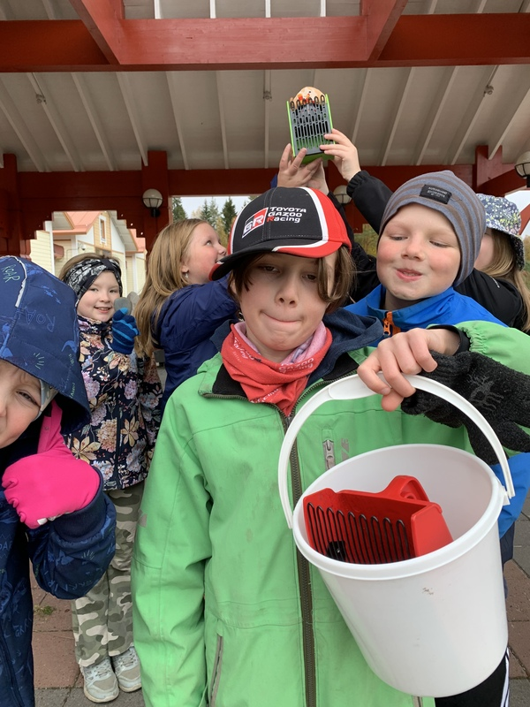
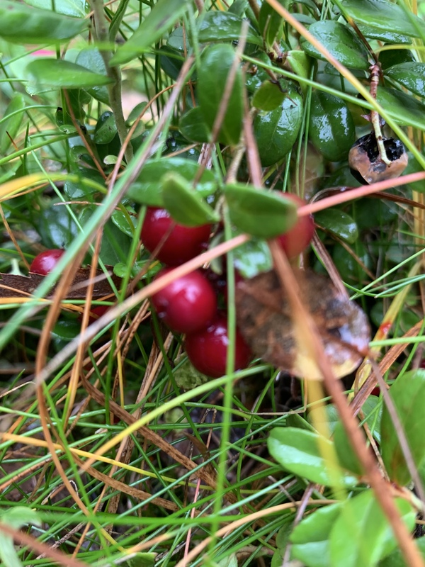
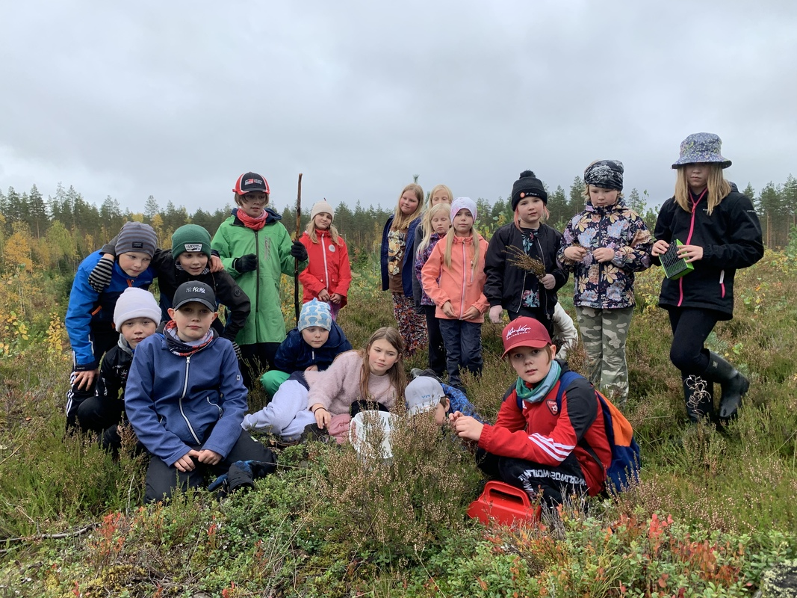
GOT TO GET SOME SUPERFOOD

Slide 6
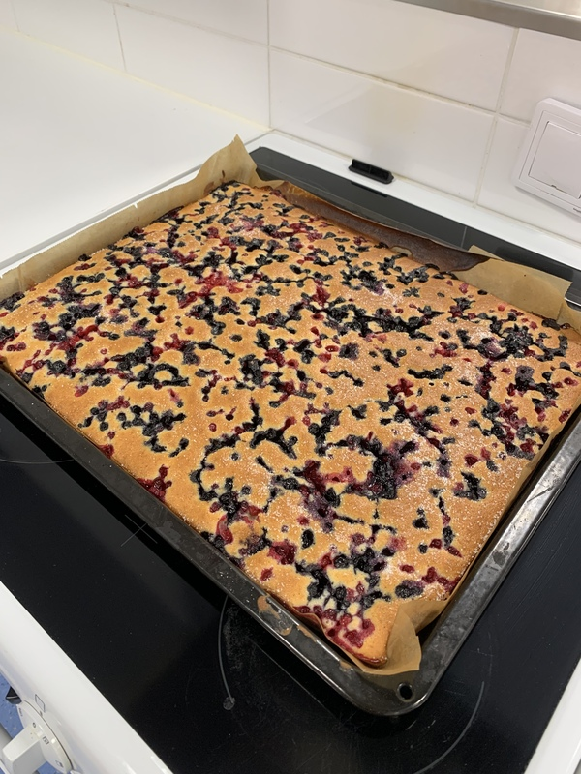
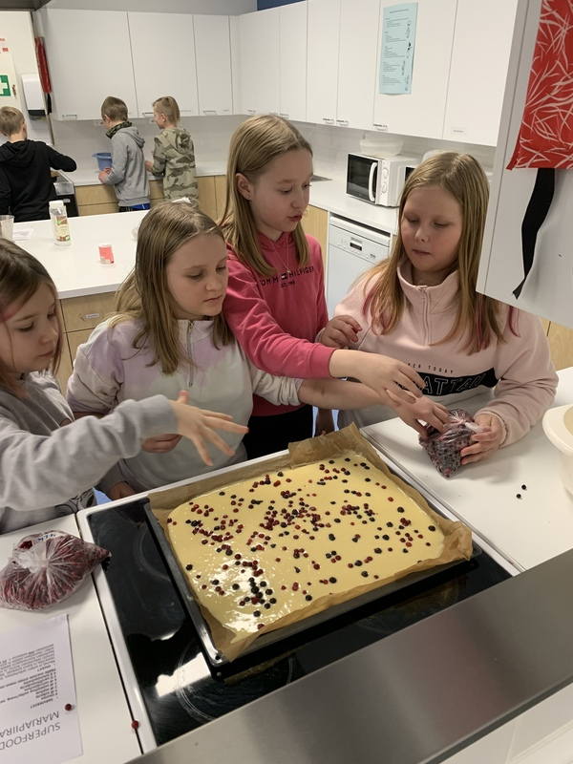
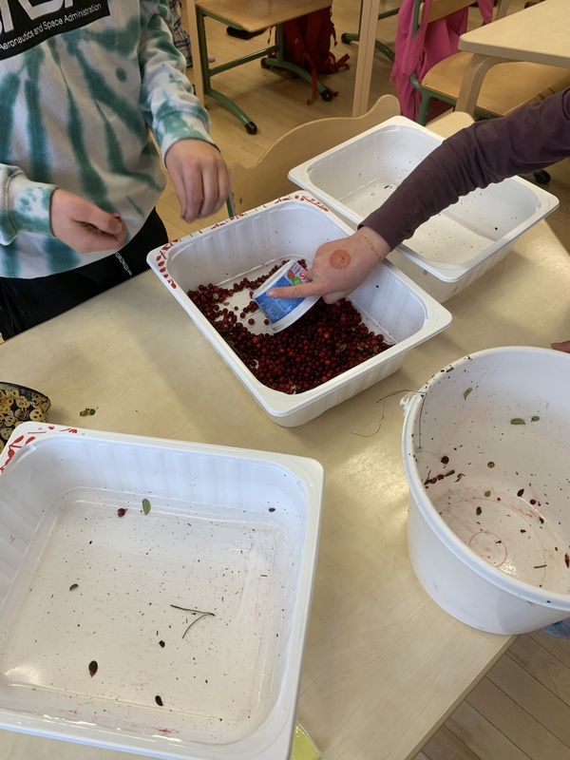
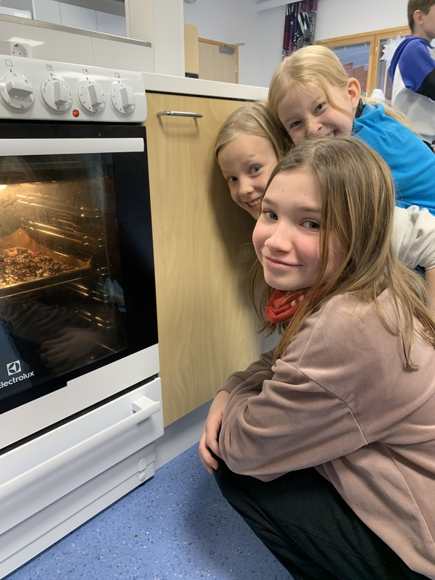
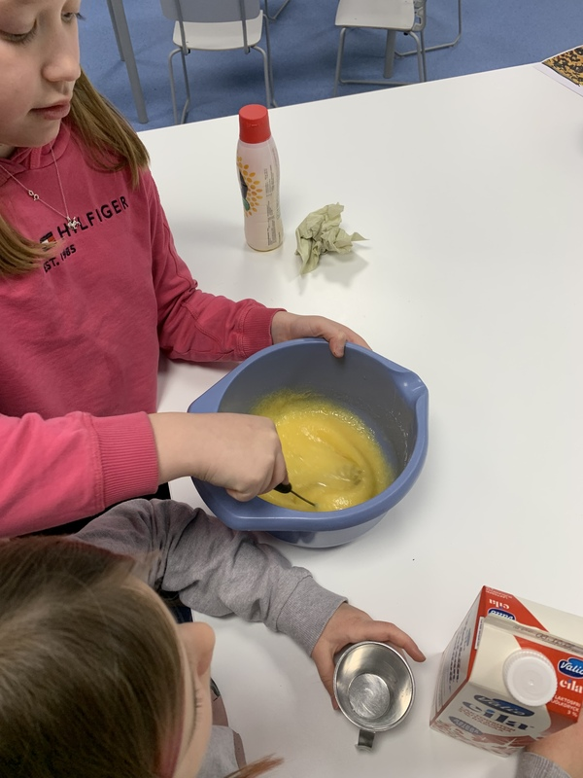
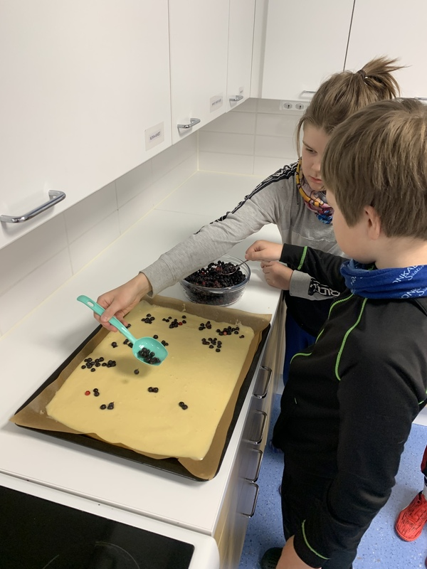
MAKING SUPERFOOD CAN BE BAKING

Slide 7
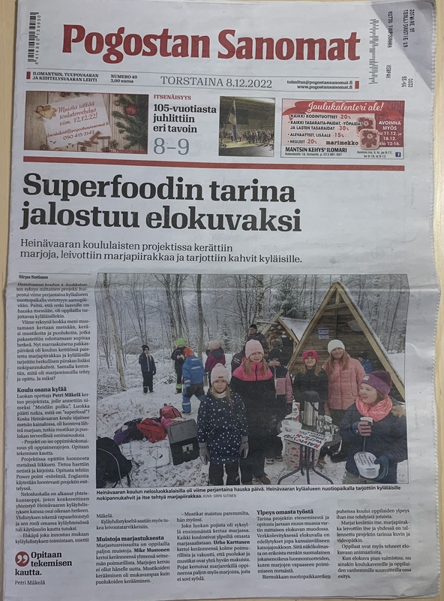
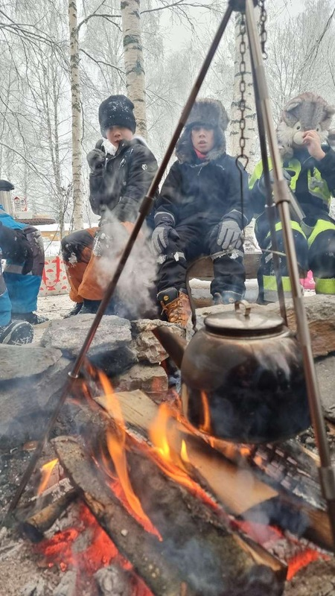
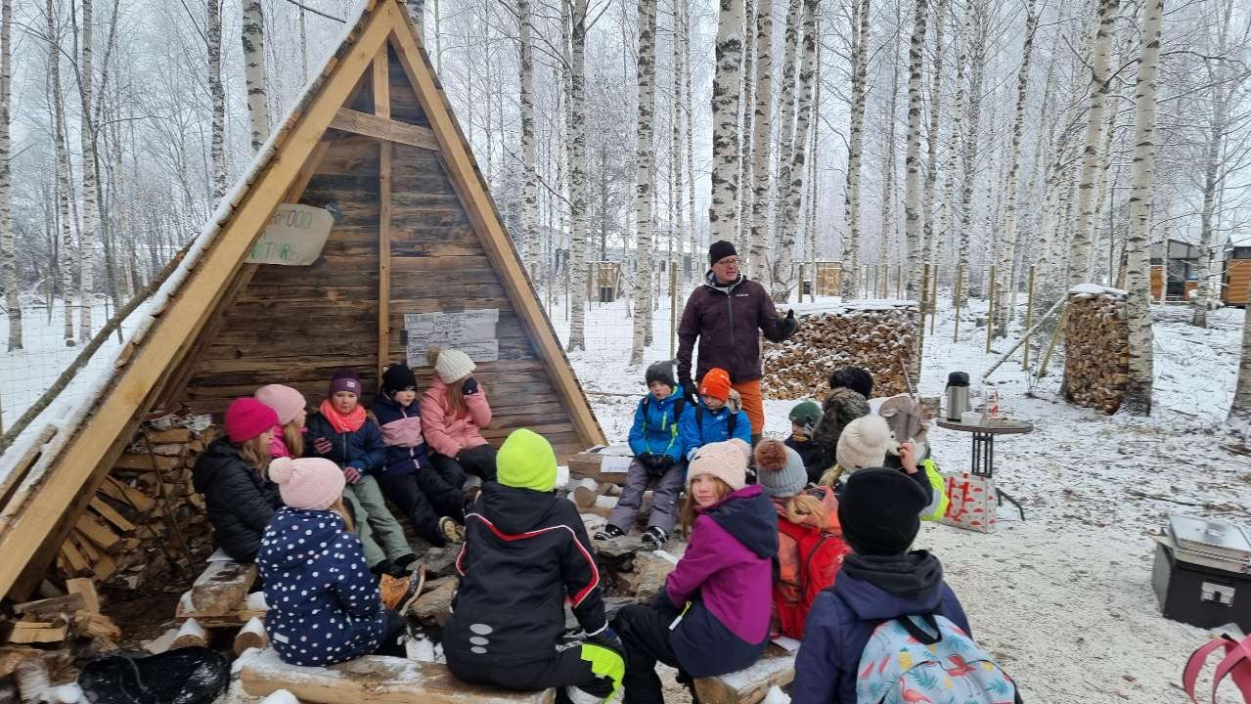
SHARING THE MESSAGE OF SUPERFOOD

Slide 8
JOIN OUR PATH
ENJOY OUR TRIP BY WATCHING THE WHOLE STORY: OUR PATH

