Slide 1
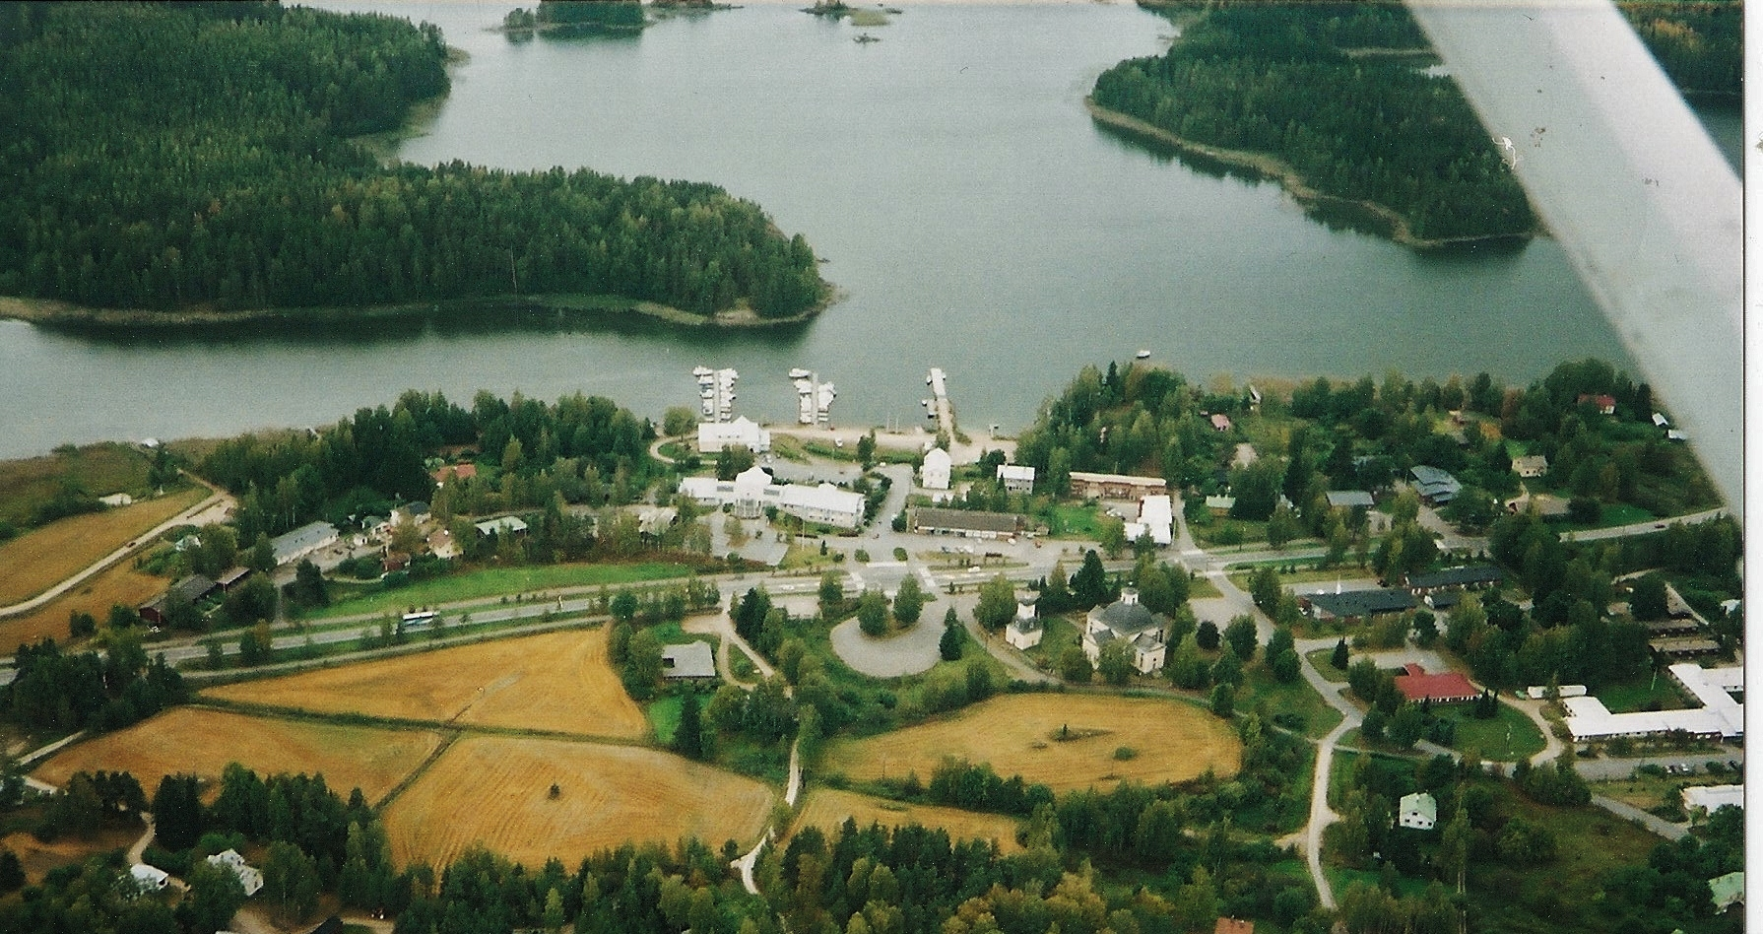


Science together at Taipalsaari Finland

Slide 2
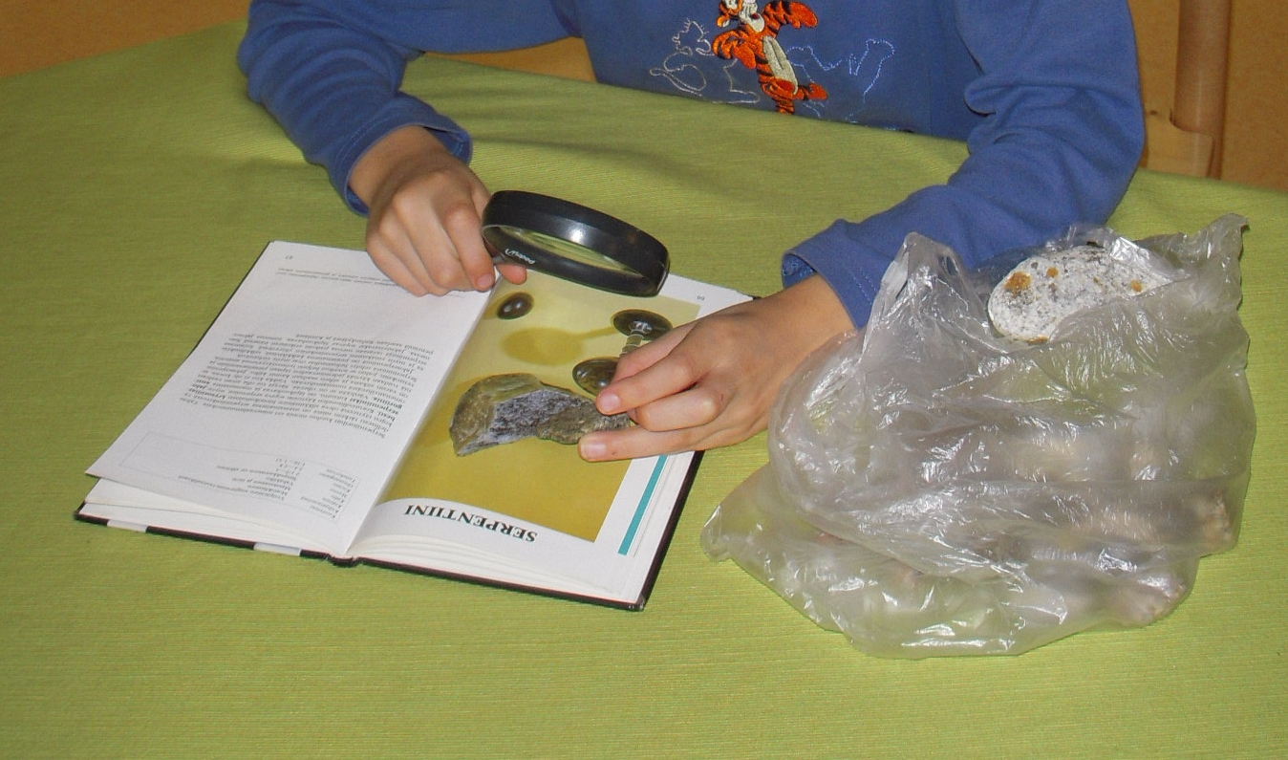
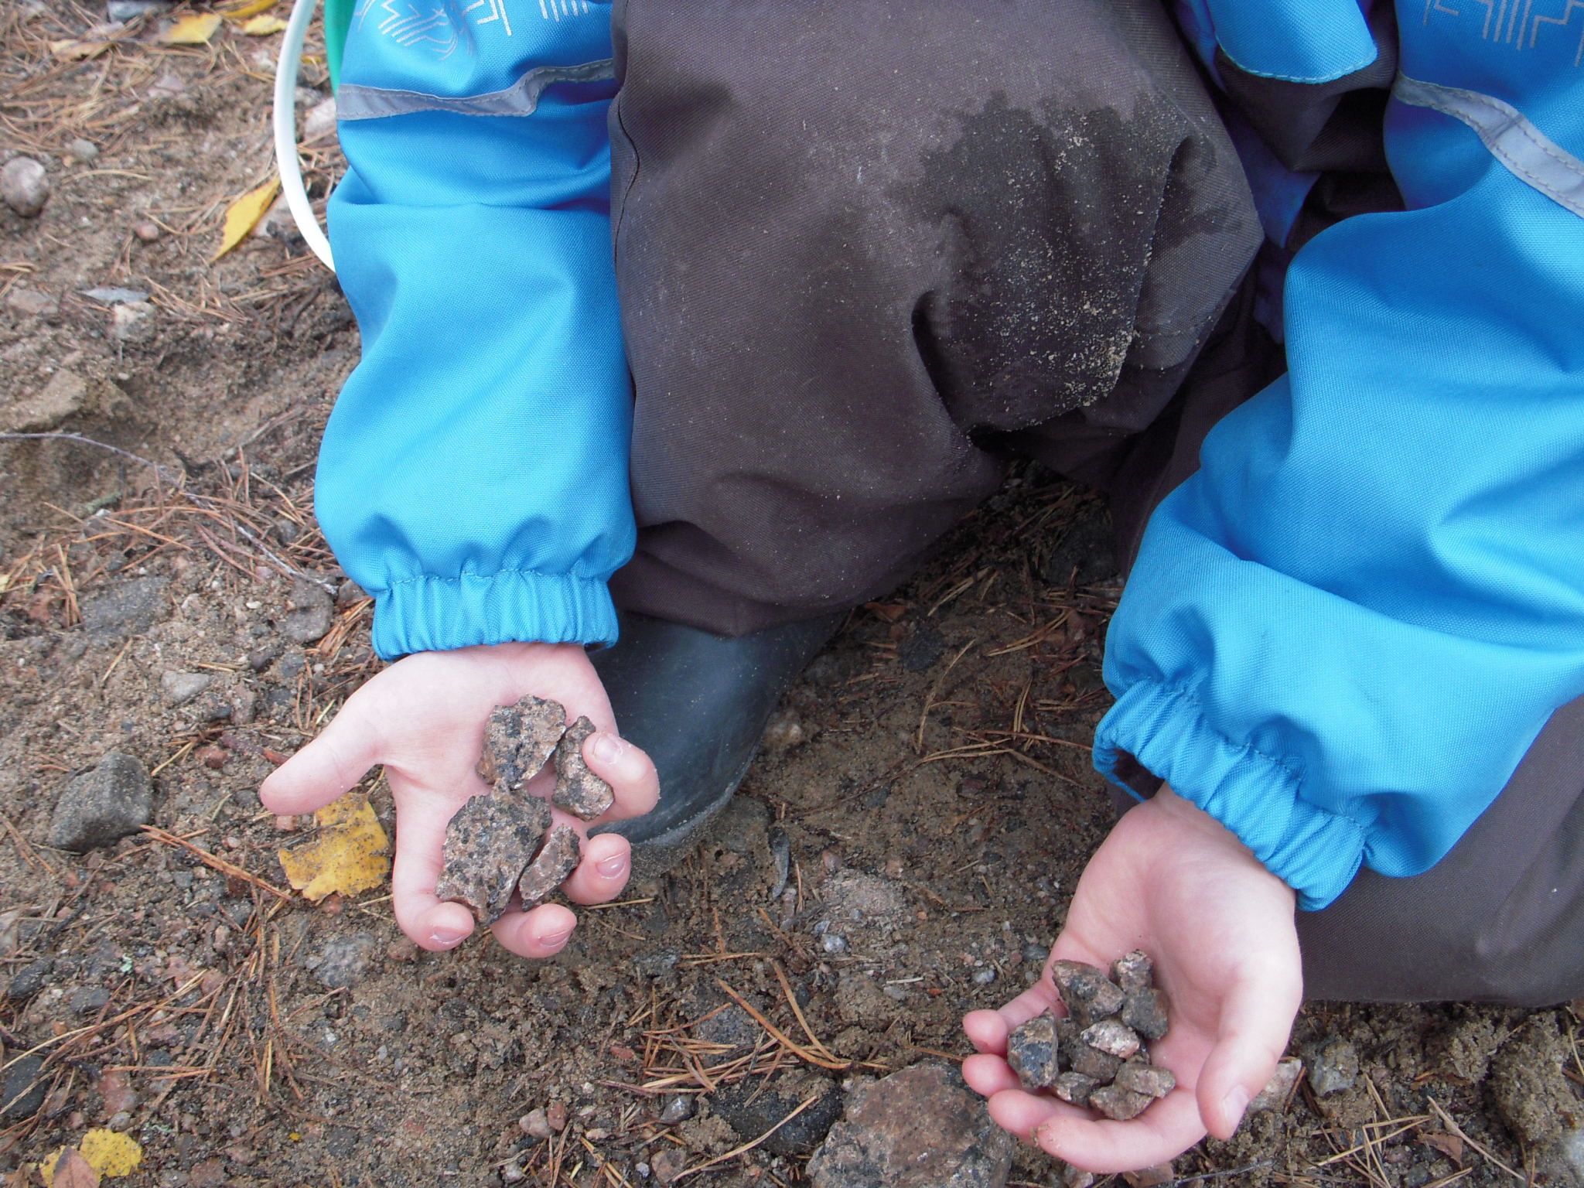
Stone studies
A 6- year old boy was holding a stone in his hand, thinking whether or not to throw the stone?
Please do not throw the stone I said, it can be a treasure.
he started to look for interesting stones.
we discussed about stones in classroom. Next day many children started to do the same: trying to find really interesting stones.

Slide 3
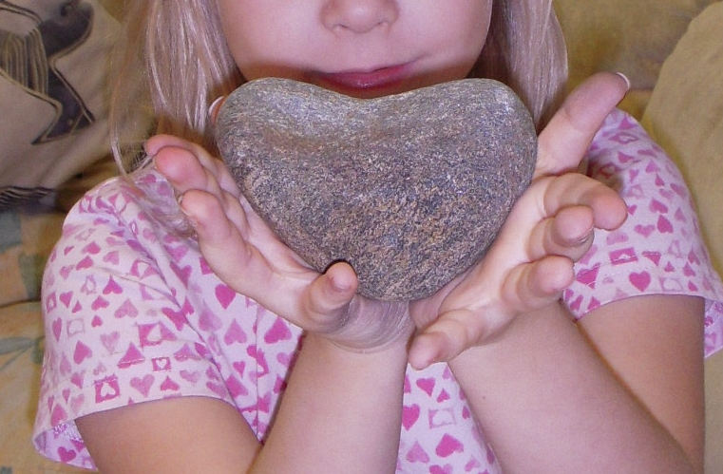
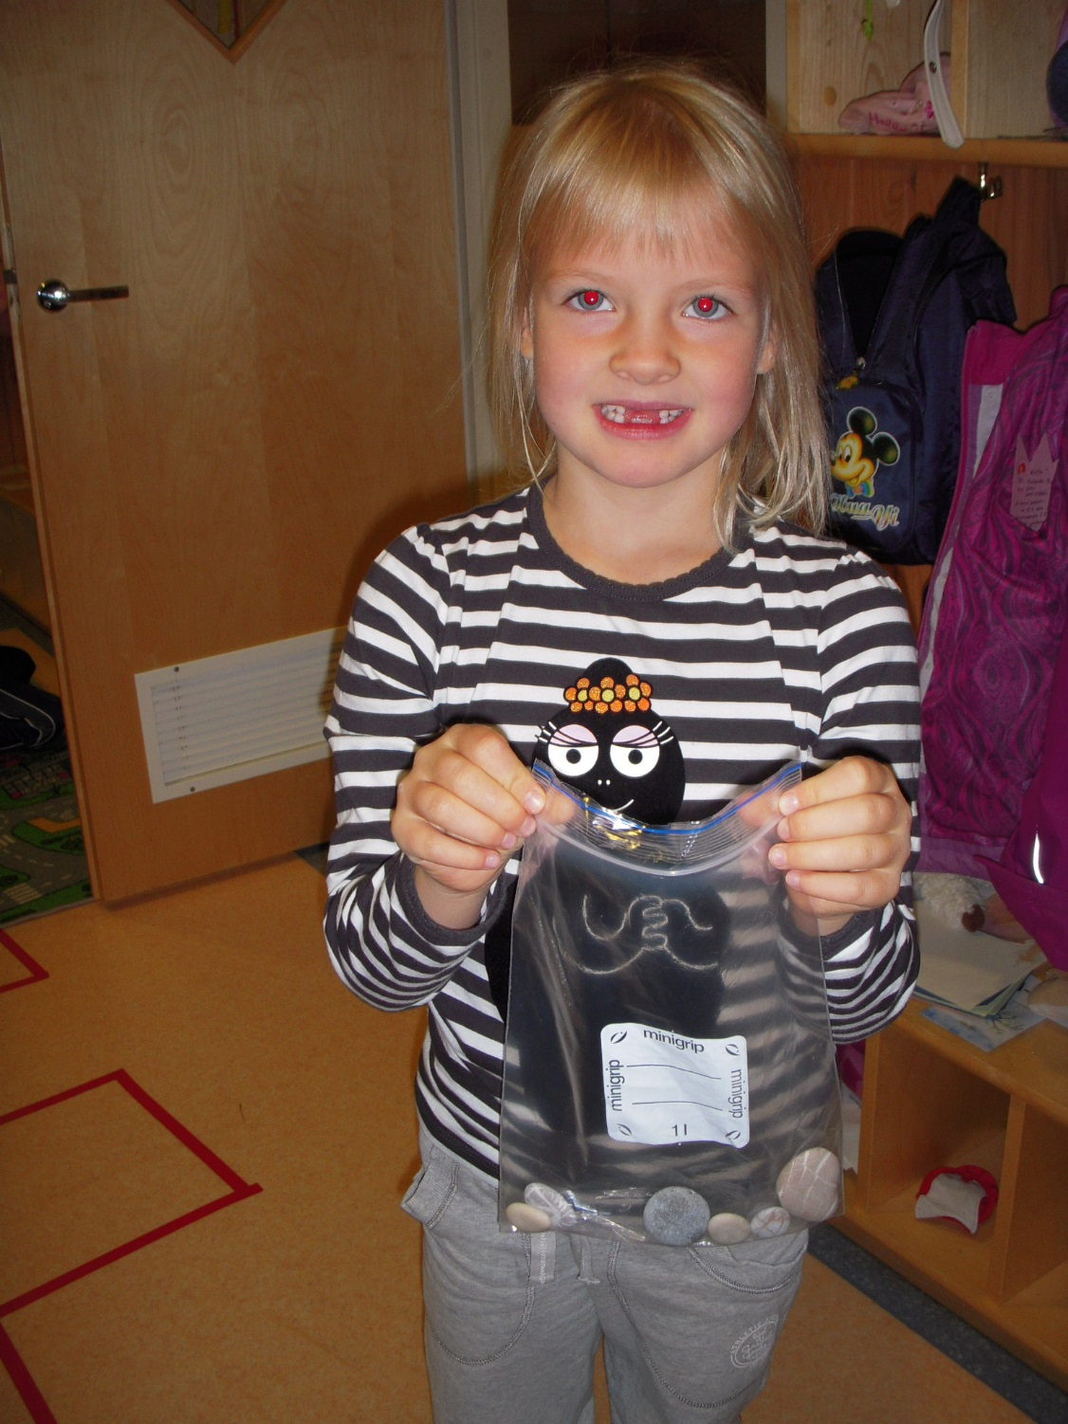
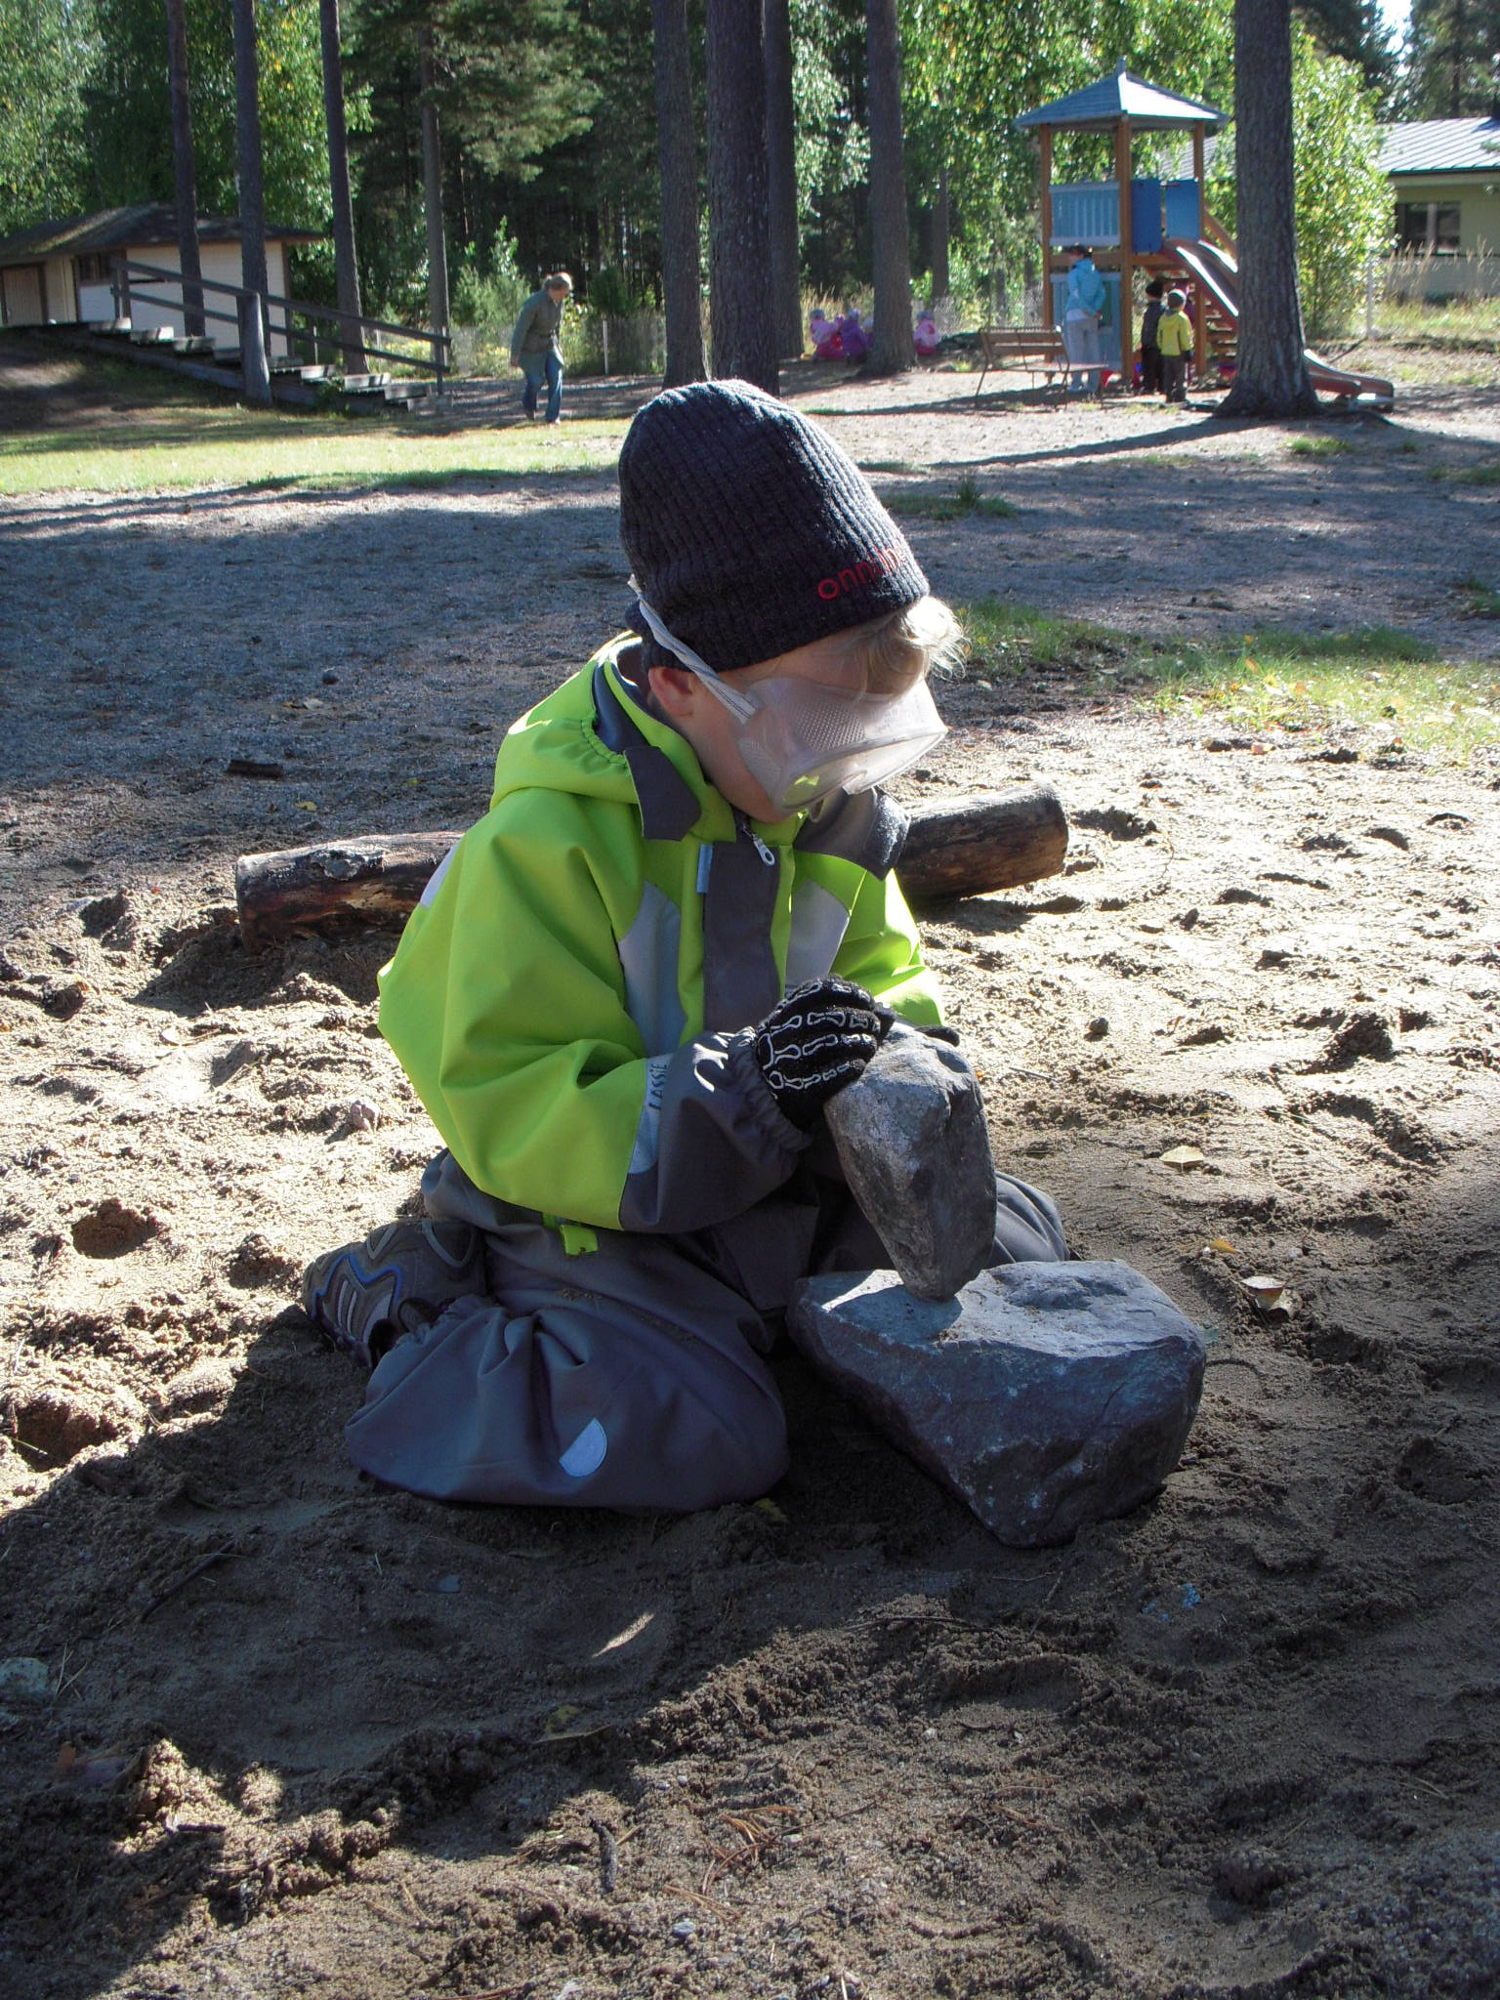
Children gave ideas what to do next. And we also had really many stones inside the classroom, it was sometimes little bit chaotic. We needed boxes and every child brought a box to their treasure stones. Also teacher learned every day!

Slide 4
Some of our adults said that it is not allowed to dig a hole to the ground, someone may get hurt.
But it was too late because the children had decided to build a mine already.
They asked me what we need to warn adults and especially the young people who might come to the Kindergarten yard at night

Slide 5
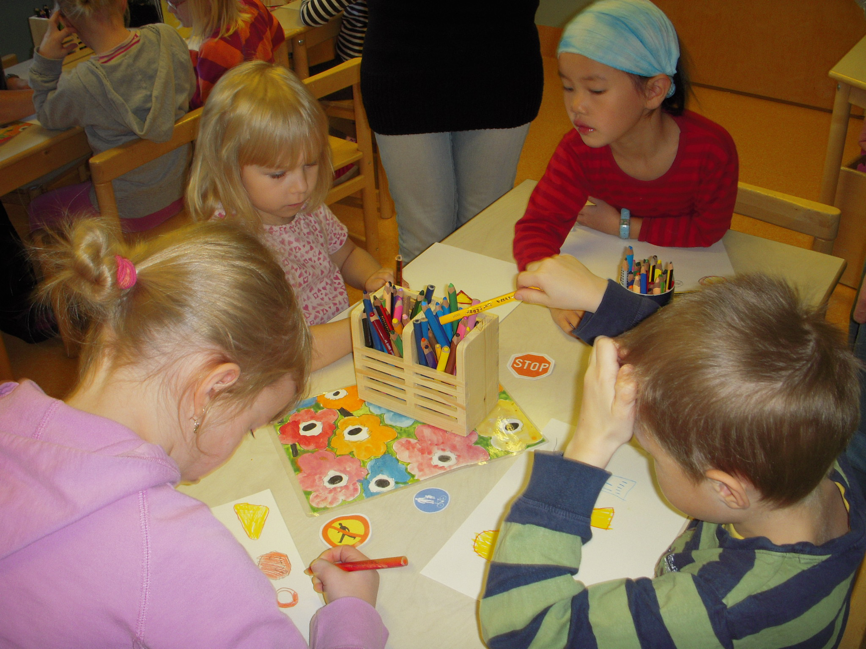
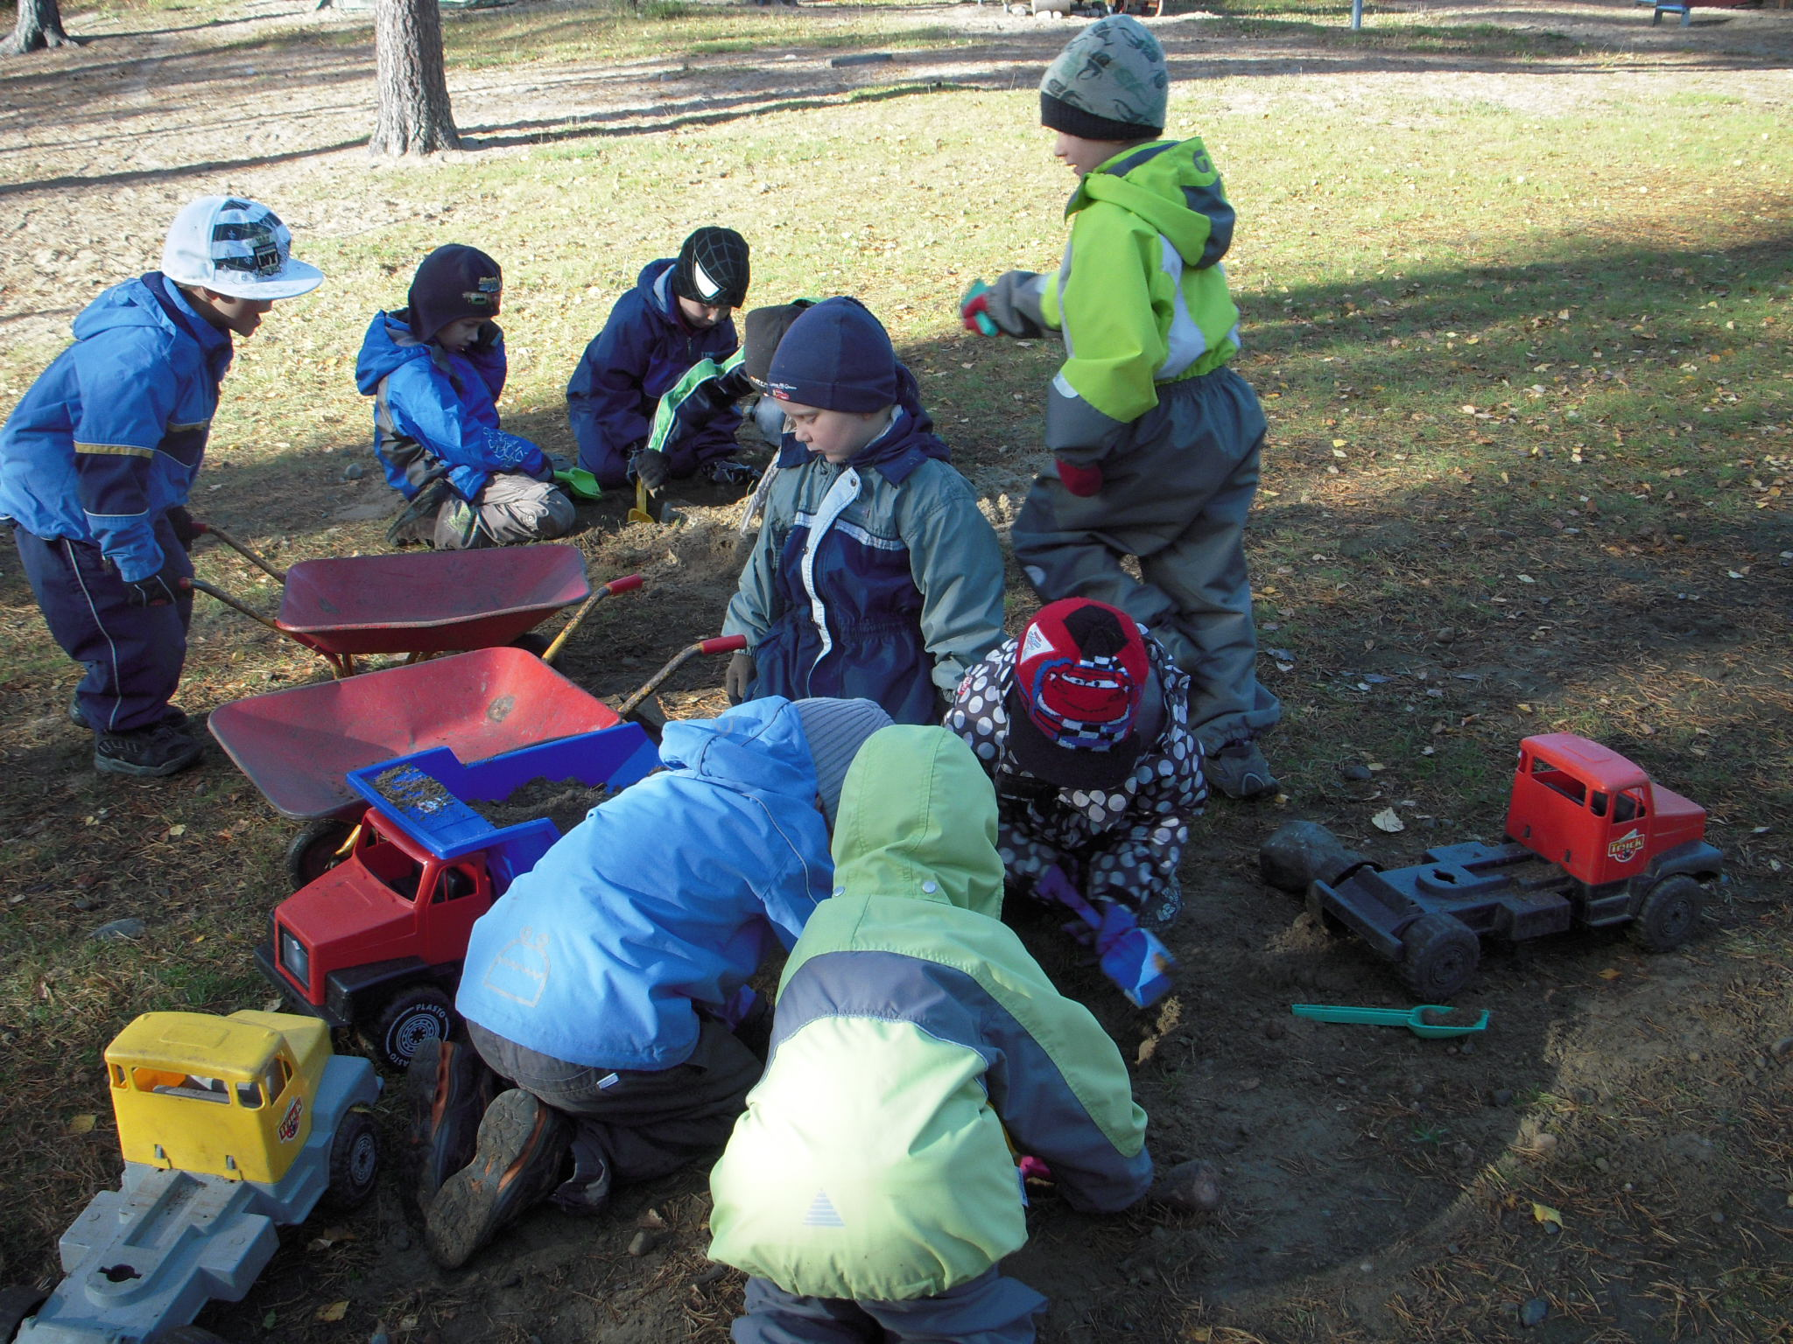
Fostering scientific learning.The children can suggest experts, to whom we can ask for consultation. Sharing expertise creates new knowledge and understanding that no child in pre-school can gain by his or herself. I asked policeman about warning the people with signs.

Slide 6
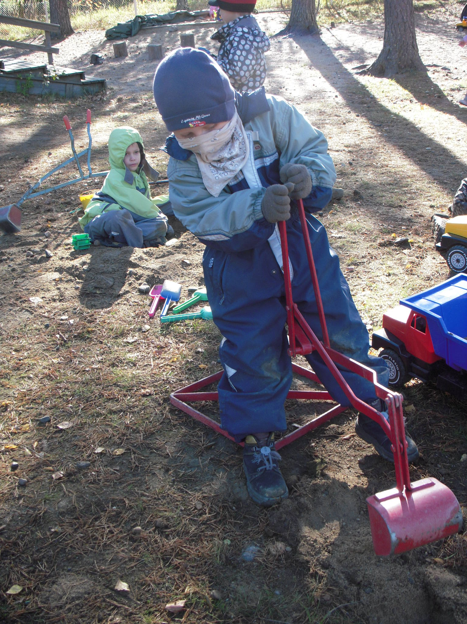
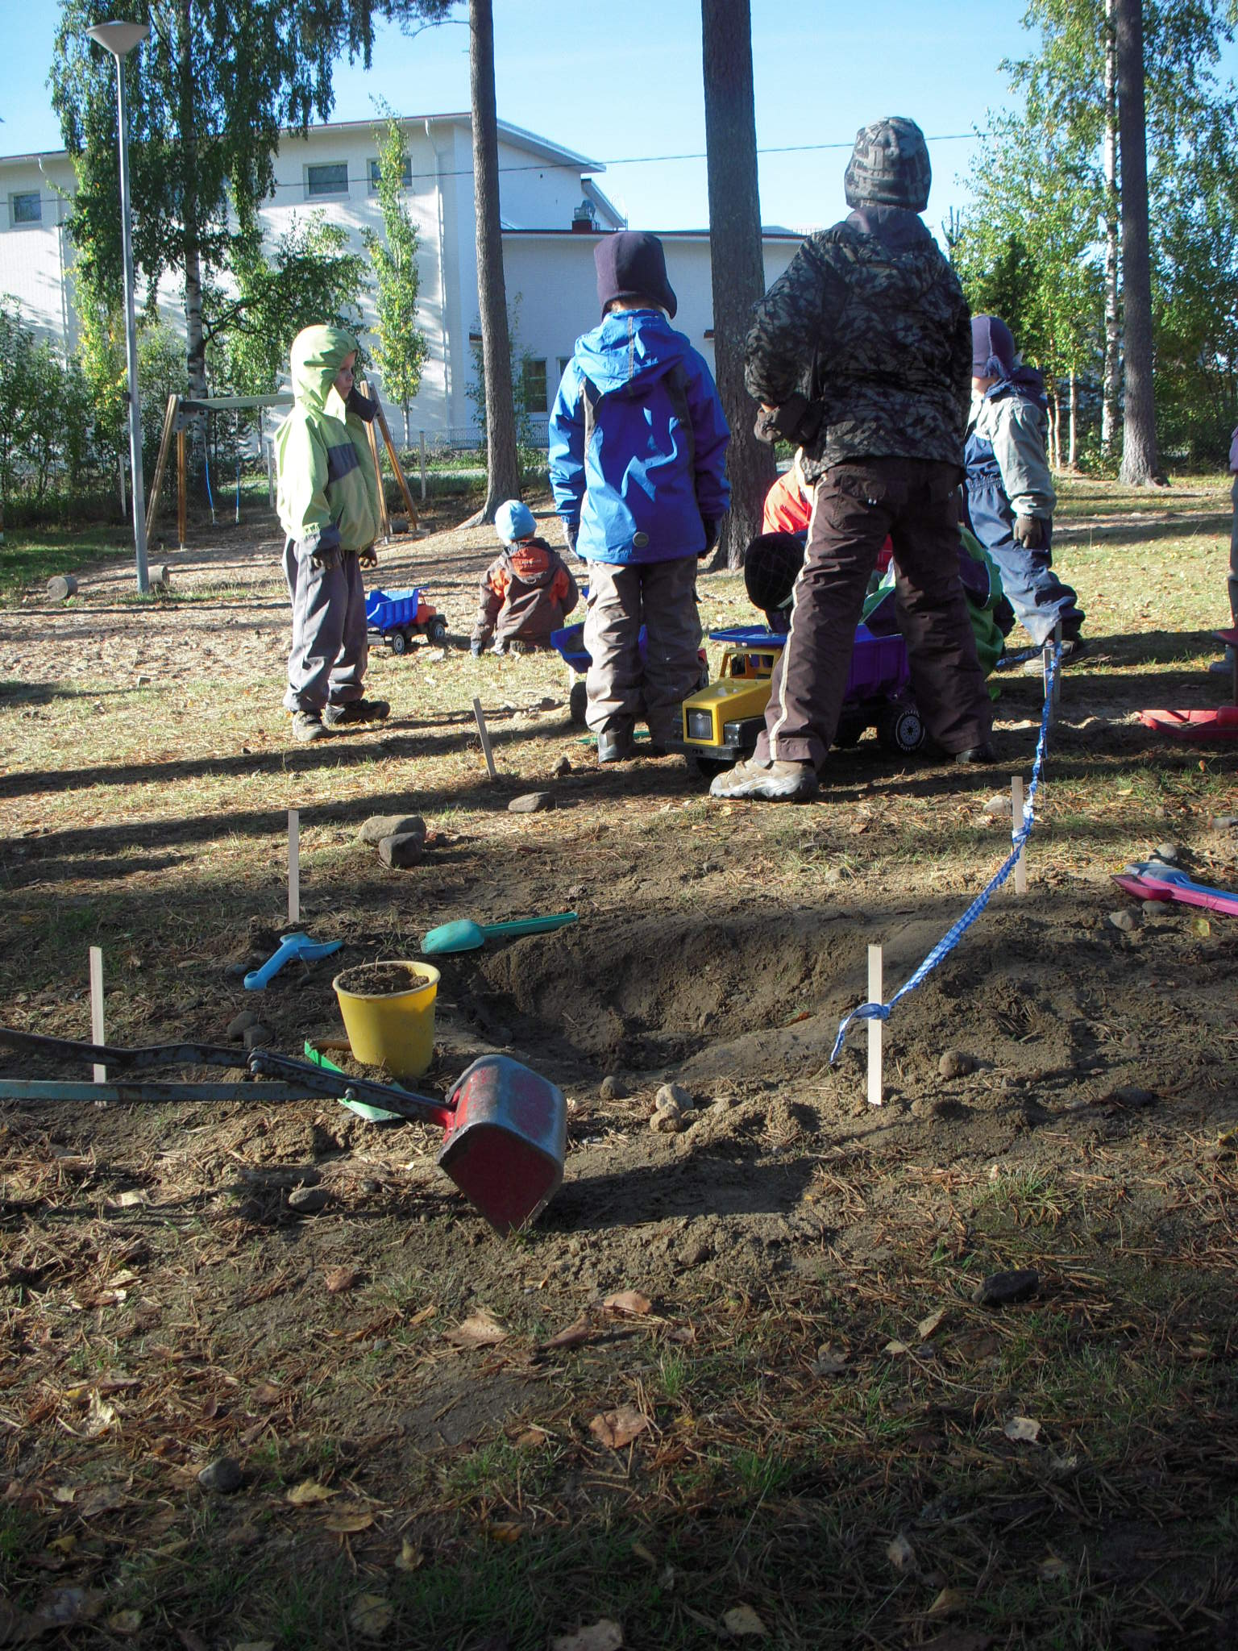
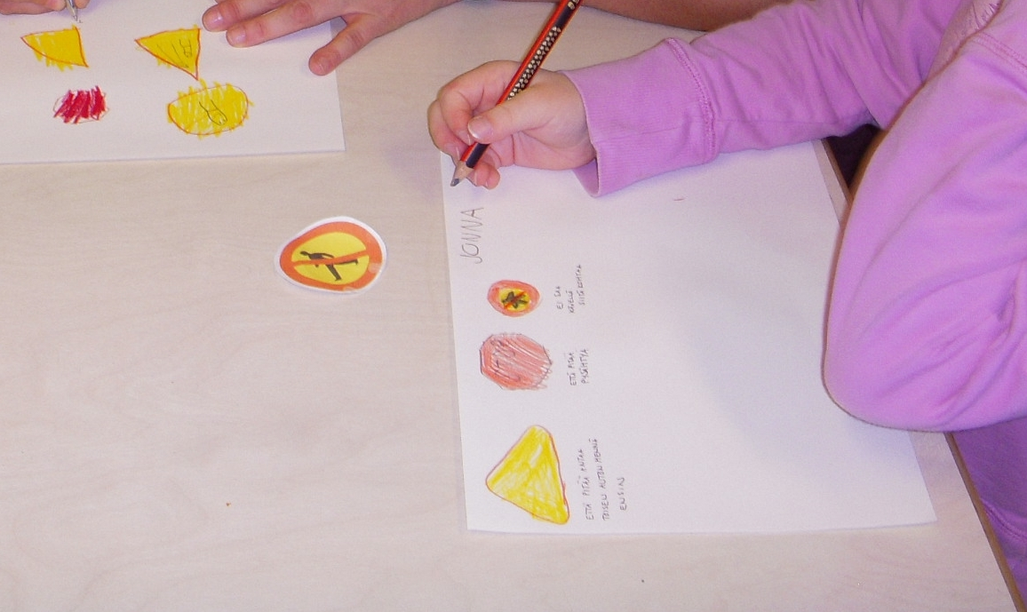
Children were thinking:”We should ask policeman/does someone work at mine/ Lets ask grandfather”. We asked and soon our “stone scientists” got answers. They need security fence, road signs, so let’s make them!

Slide 7
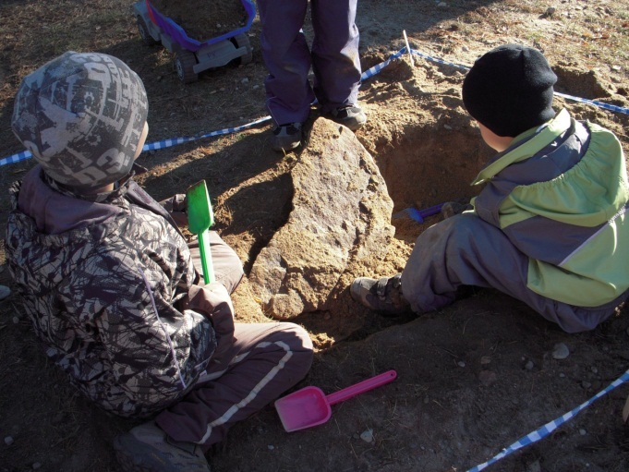
When a child asks
“could I?”,
and refers to research,
doing by hand, positive chores,
we say Yes!
We build knowledge together in a community,
and we share the results. Knowledge
is constructed by the children. By asking questions
and looking for
the answers
children need to discover or construct their own ideas.

Slide 8
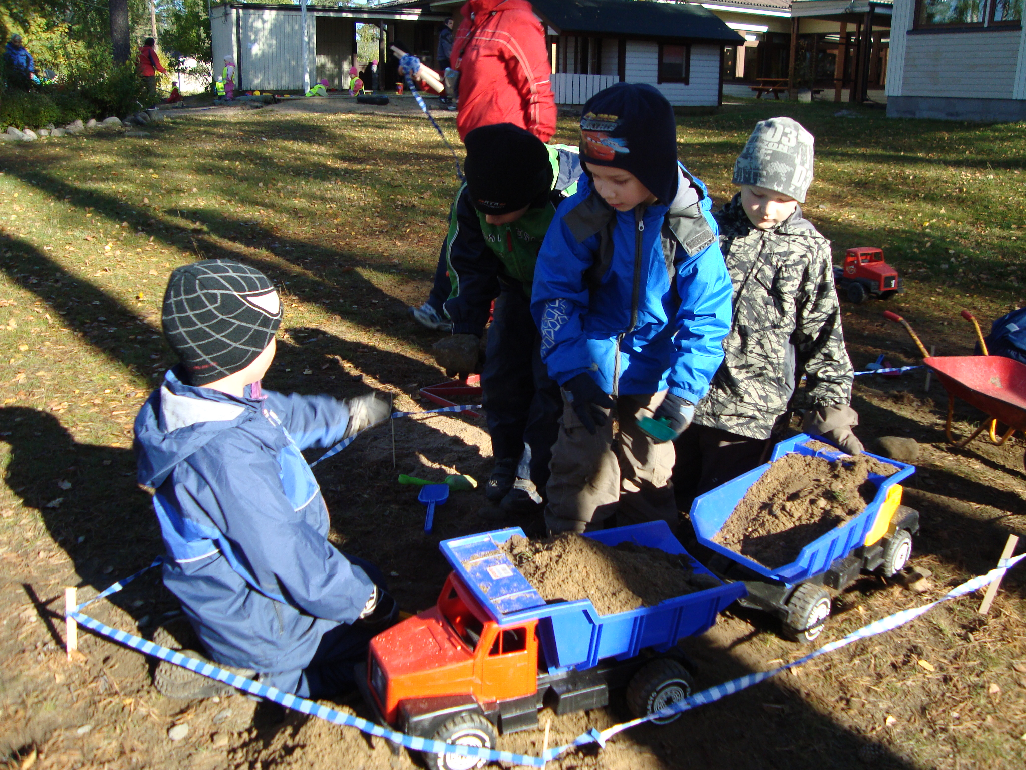
Adults begin to observe, listen and monitor the interesting opinions and questions and observations of each child in a diary. The preschool children who were able to write wrote down intersting things..

Slide 9
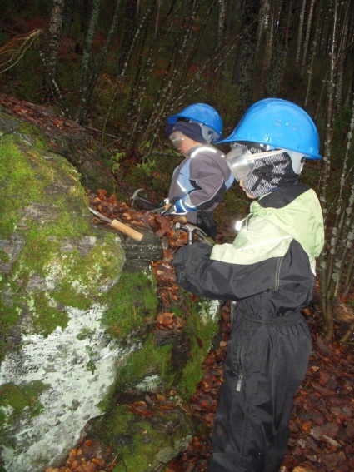
The digging the ground was the most popular thing, but children said they also needed trackman and woman, someone was looking for ore, someone tried to find stones of certain shape, someone tried to make stones smooth. Someone was sure that she is going to set up a mining and she promised that the other children can come to work at her mine. I thought it was up to me to say: Yes, it is possible! I am sure that it is going to happen!

Slide 10
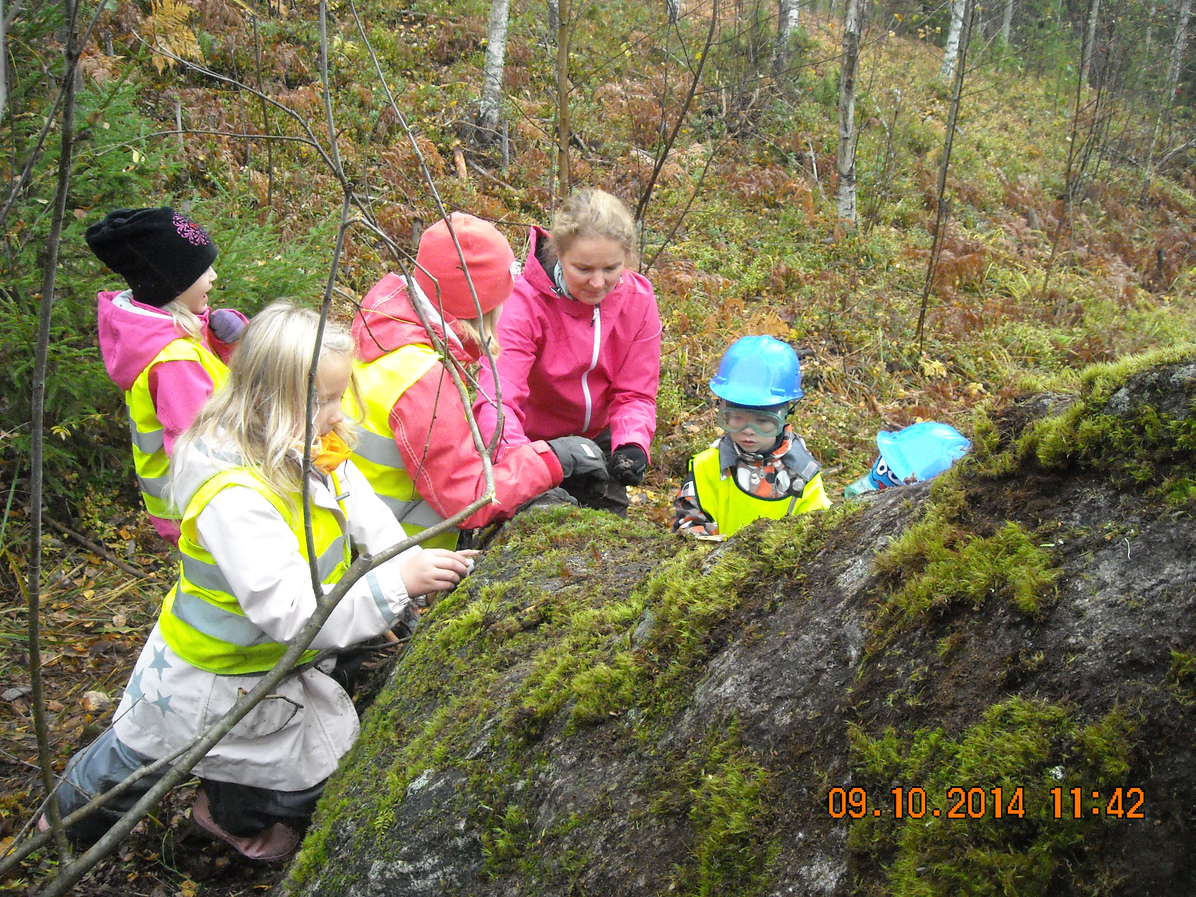
Phtos by children

Slide 11
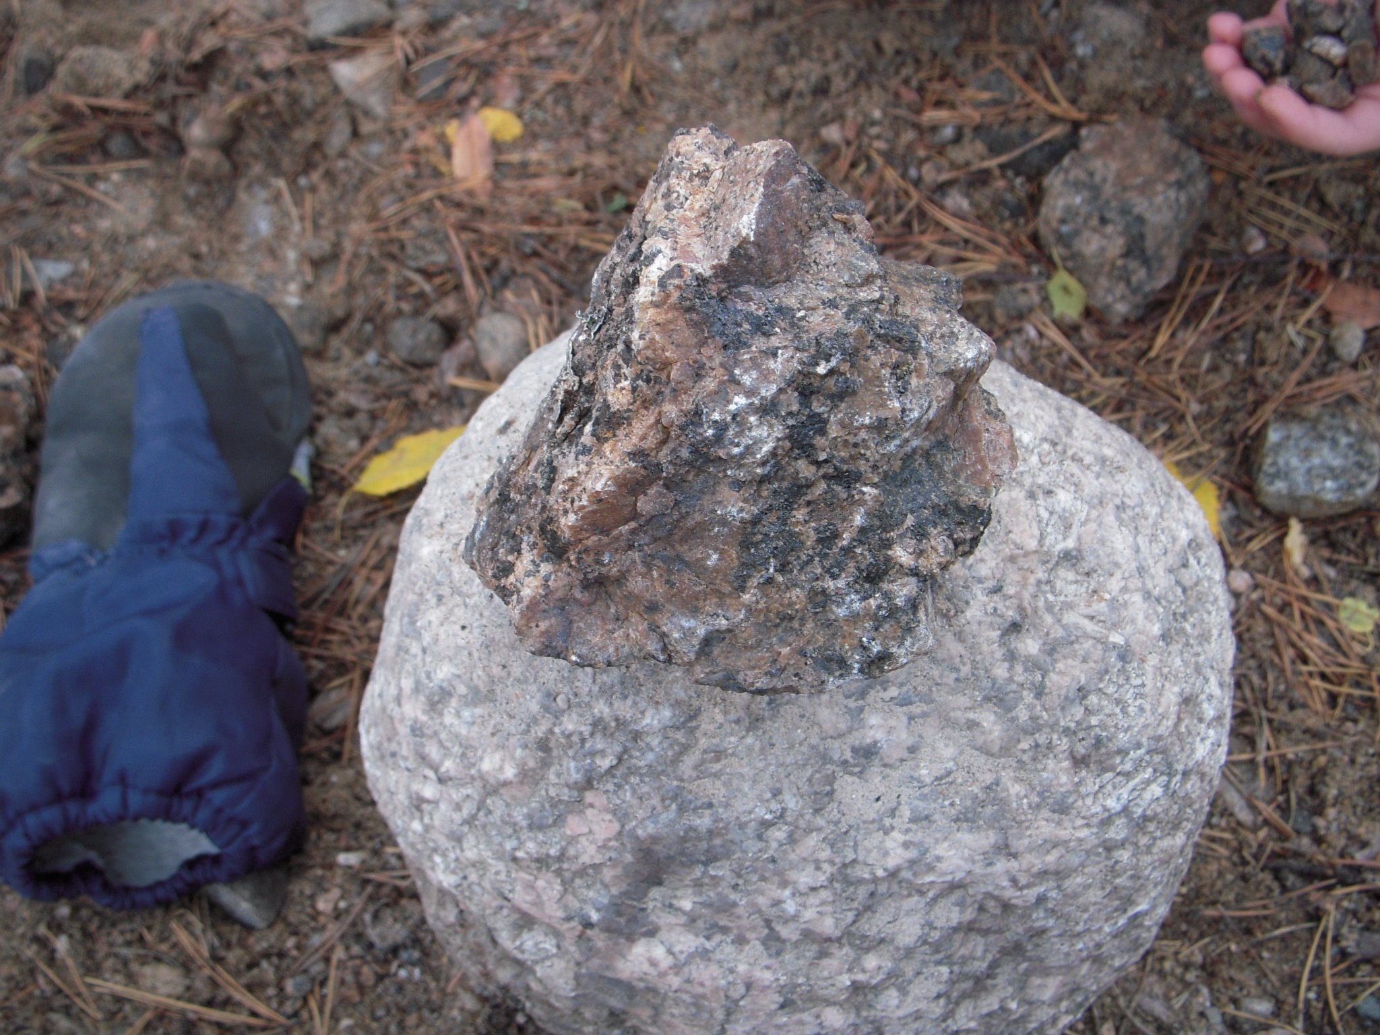
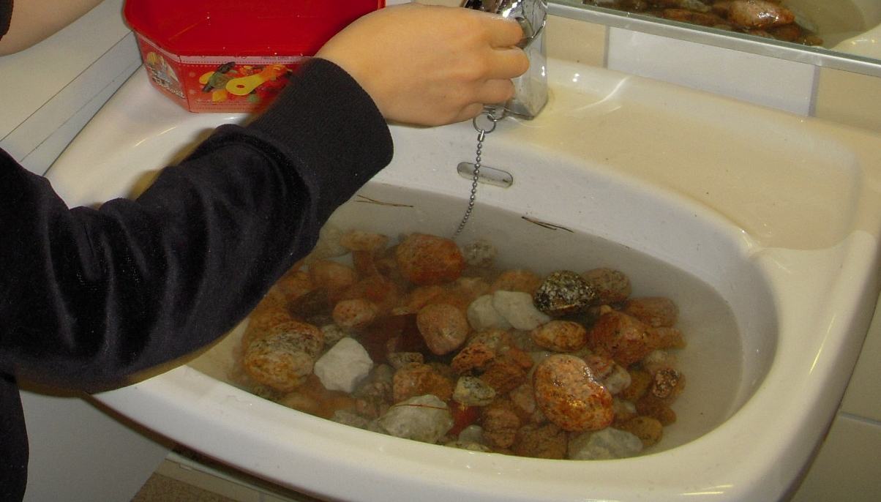
Some of the stones got easily broken but some of them not,
The colours of the stones were beautiful under the water.
Oh I wish we would have a UV light!

Slide 12
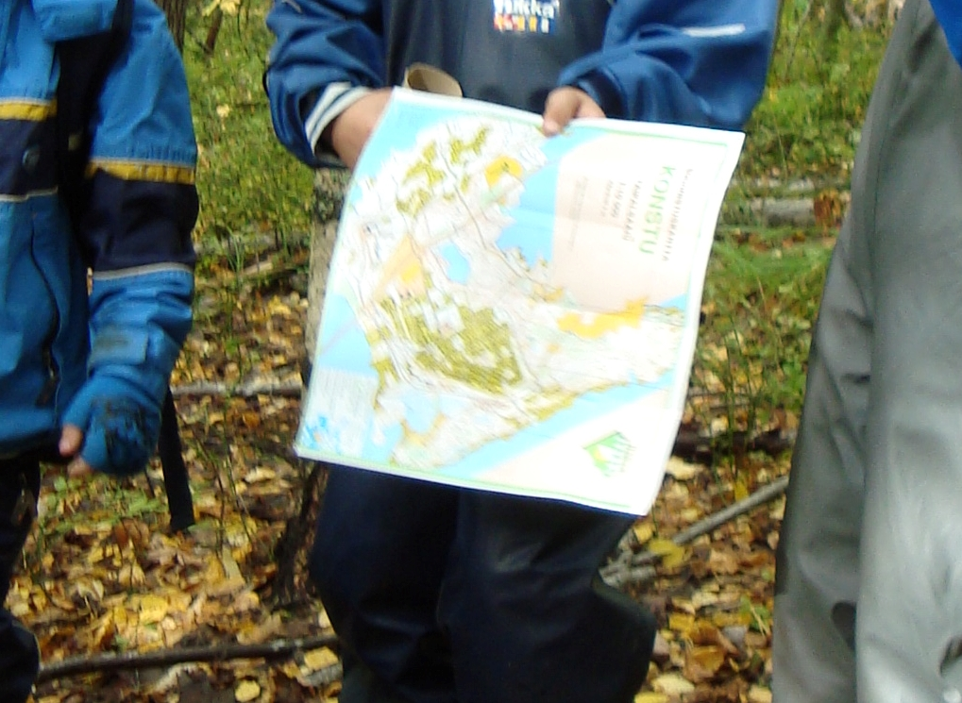
We looked how the stone is marked on the map and wandered at forest looking for the stone with a map.
We found two big stones. How the stones came here? That lead us to think what is the ridge and what the Ice Age did to our home area.

Slide 13
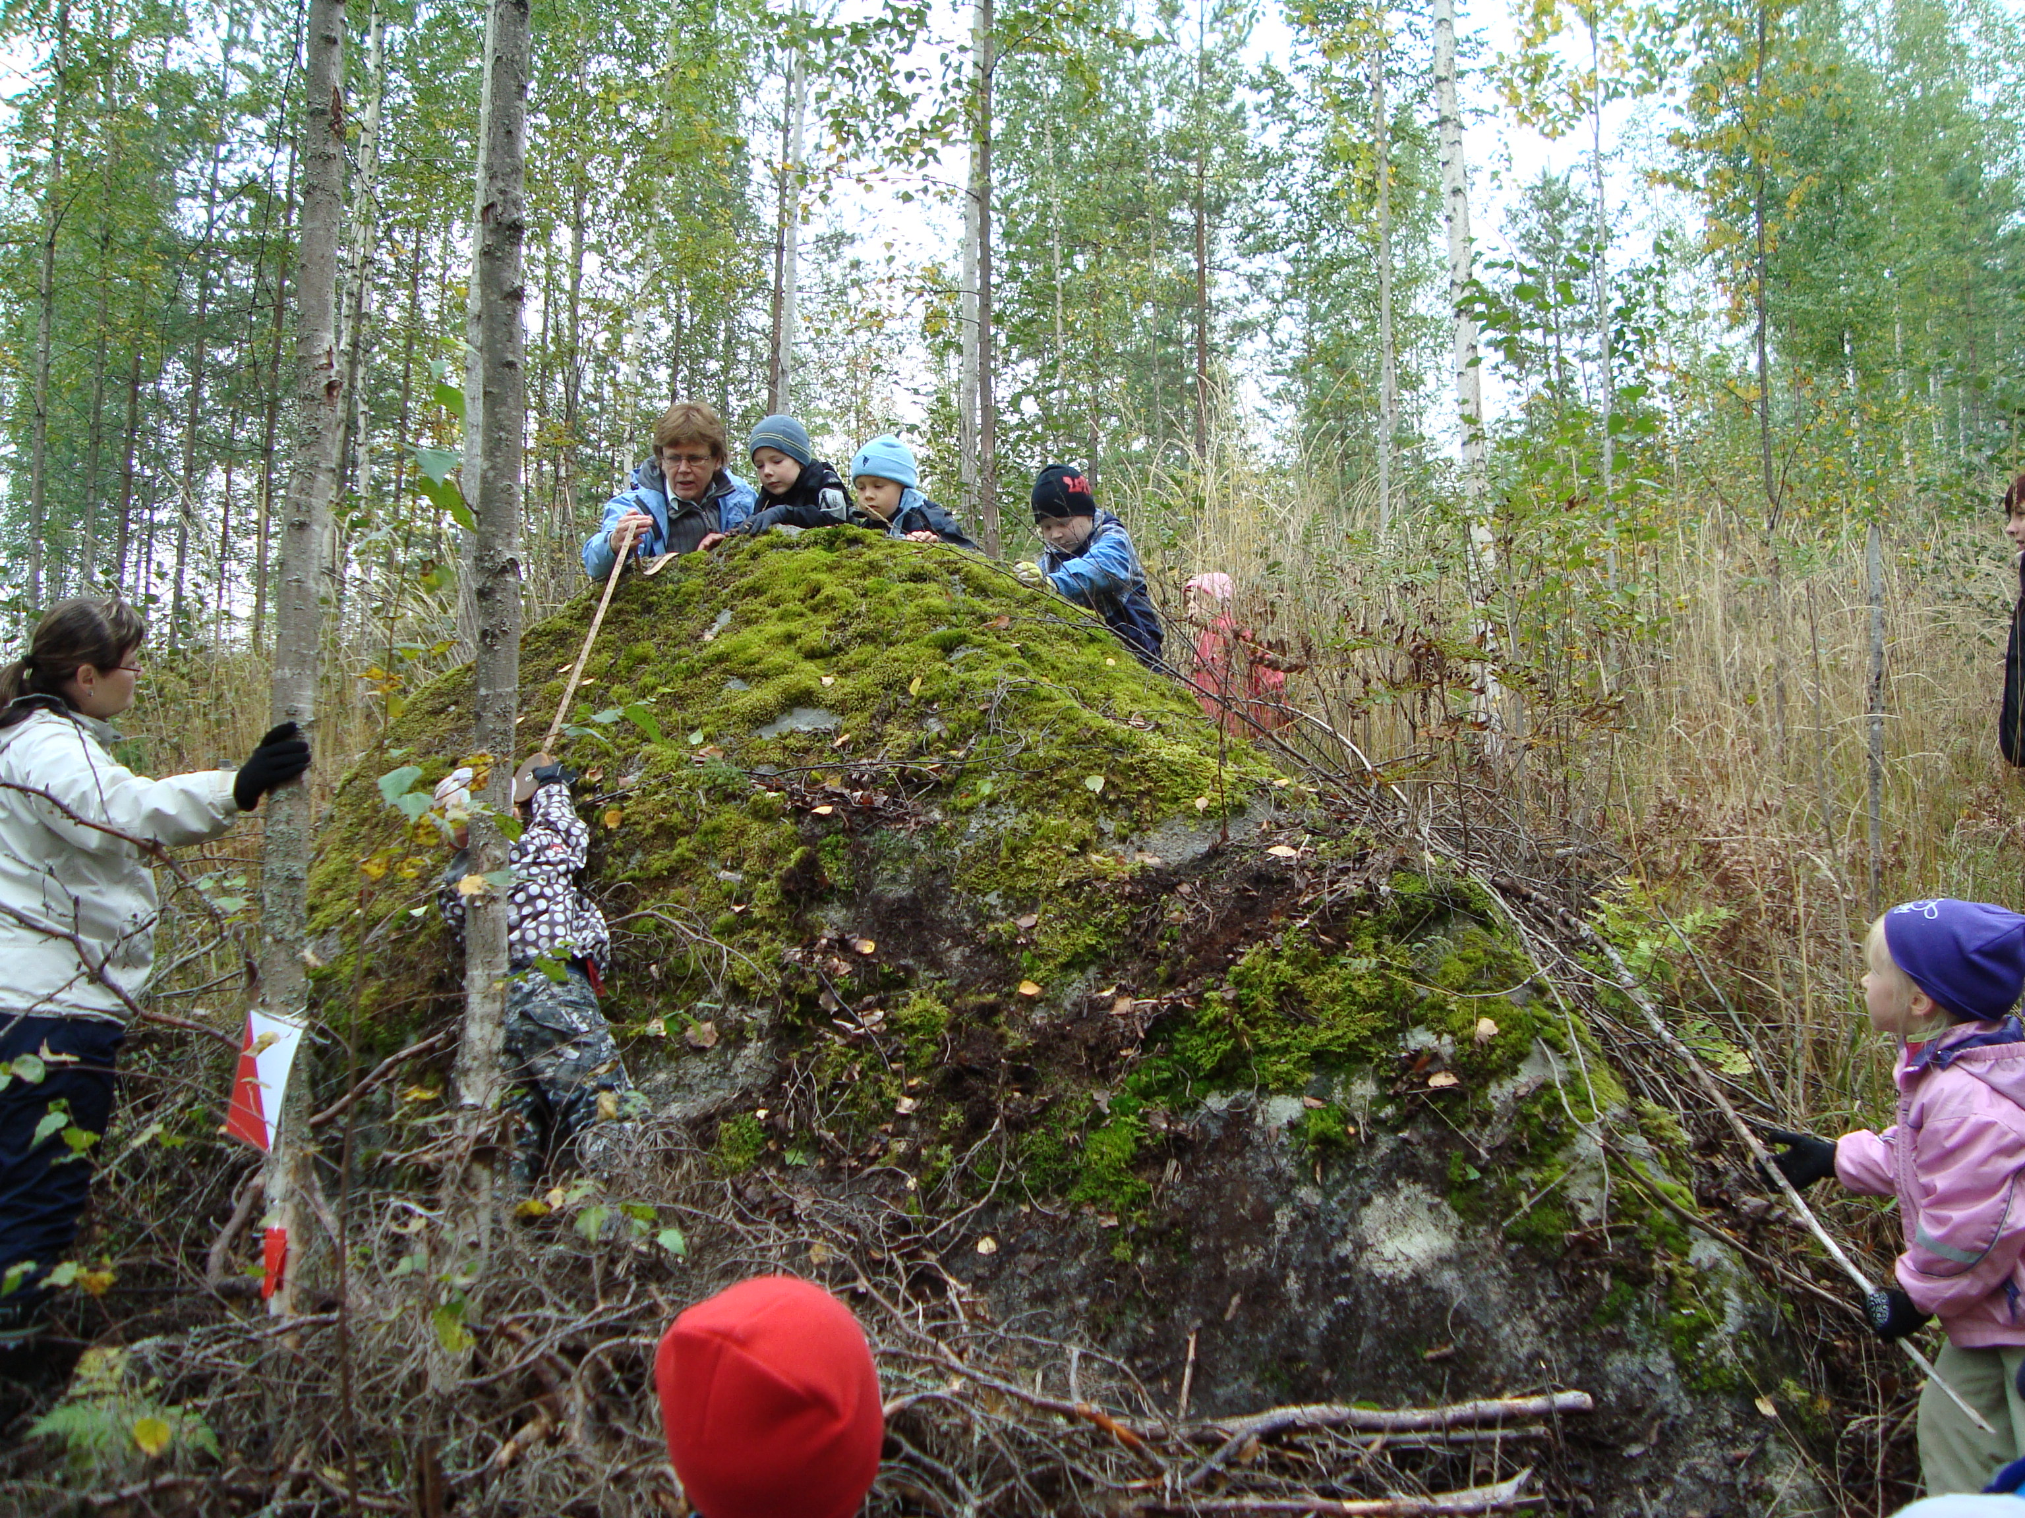
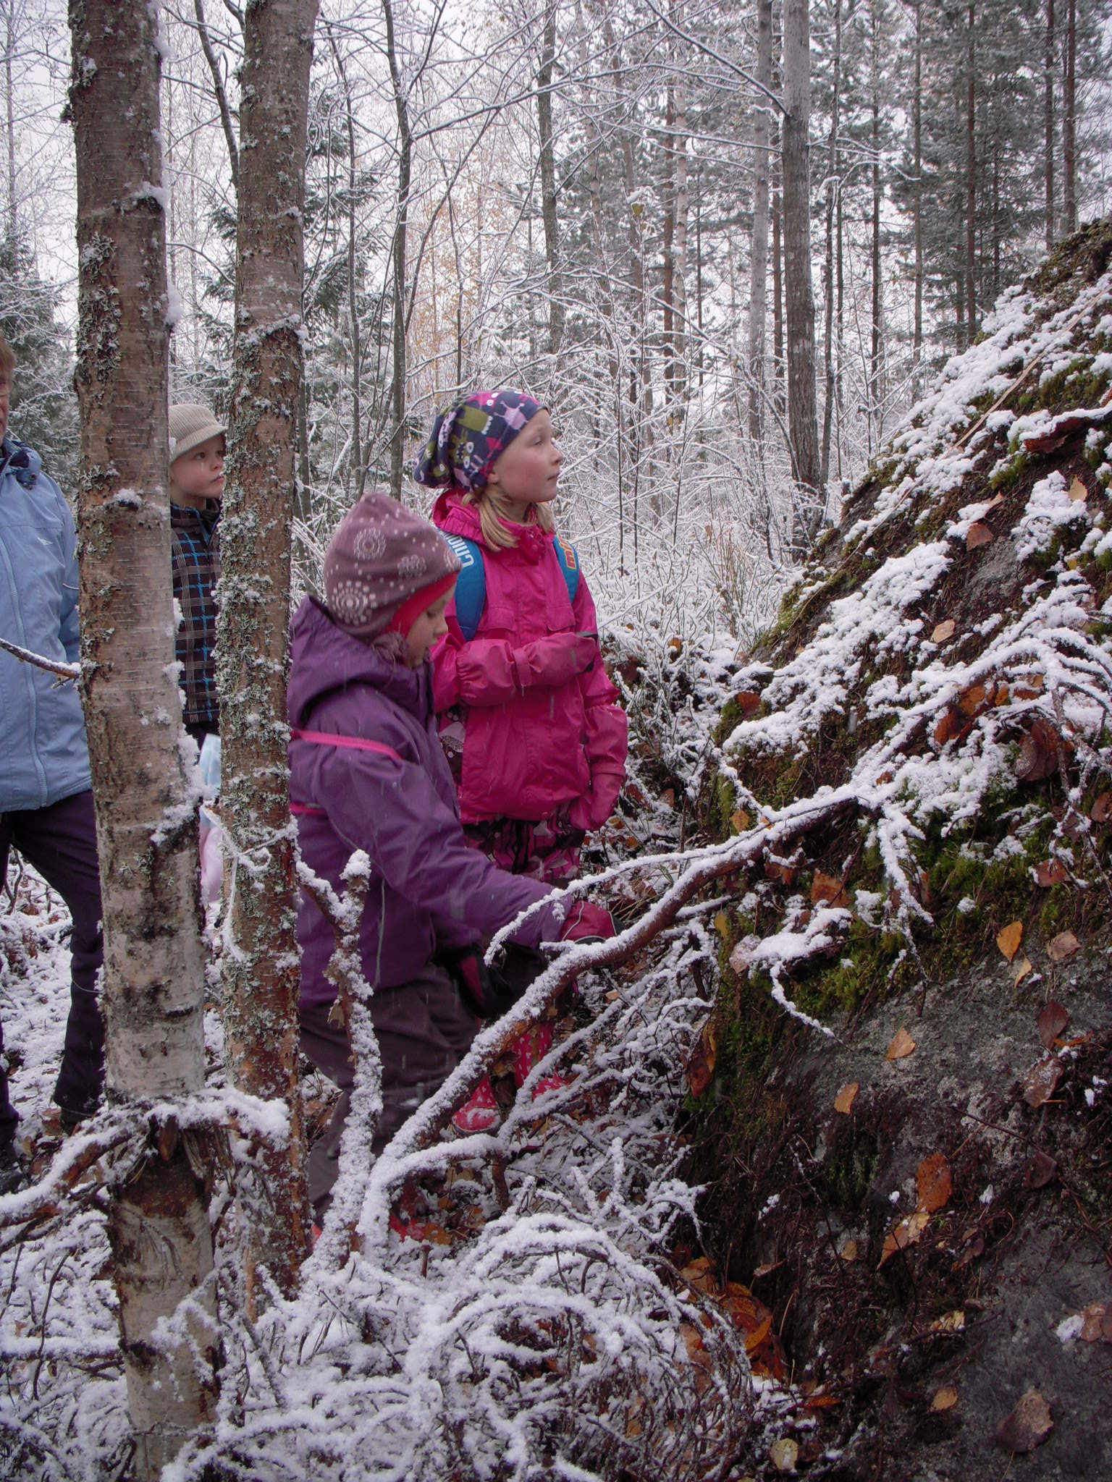
MEASURING
THE STONE

Slide 14
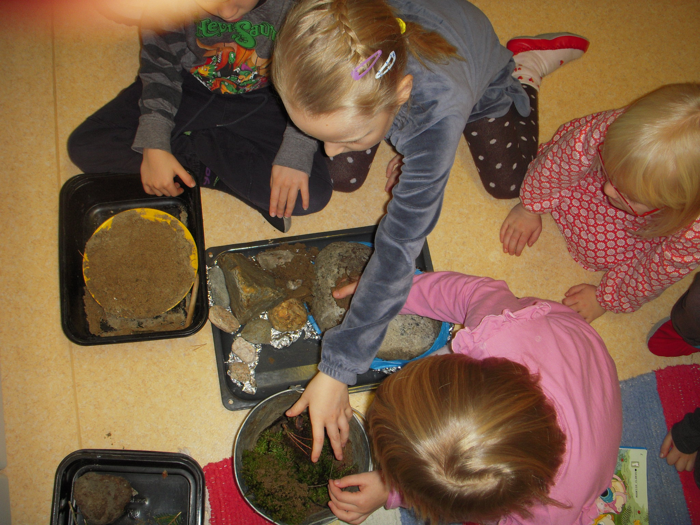
To make our
Land Finland
We need
Swamp,
The bedrock, sand, soil.
Then comes
The
Ice Age!
And
Builds the ridge
of our home
Area.

Slide 15
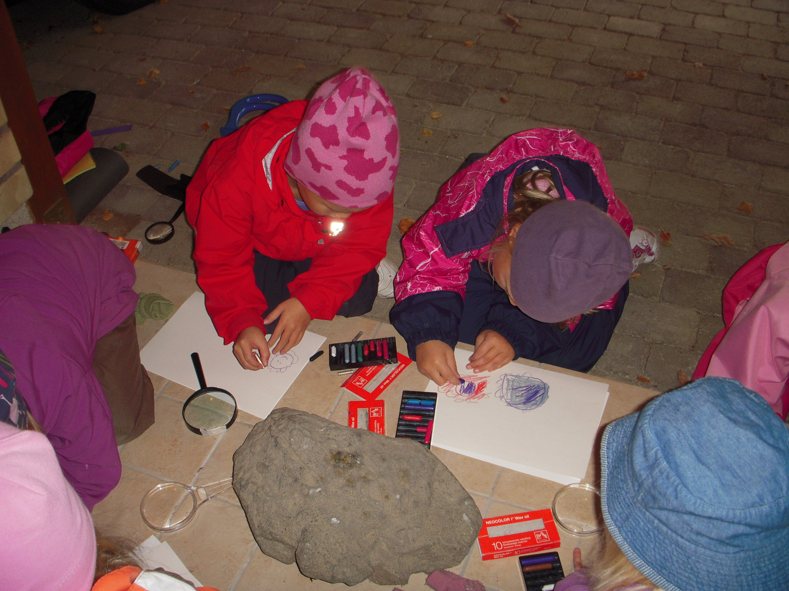
IS THIS STONE A METEORITE? How do we find it out?

Slide 16
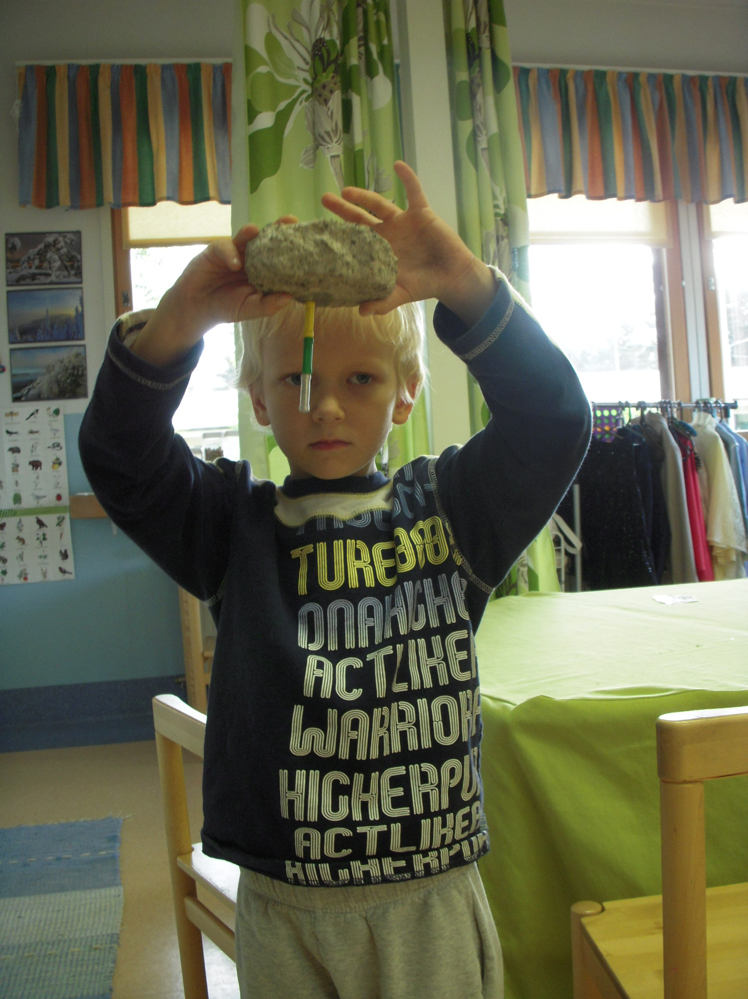
I have noticed:
Scientific project helps
child to child interaction/ making friends
It’s important
how children get involved together in classroom.
Preschool classroom
is a little society
with its rules made together with children.
Leevi found a magnetic stone. He told the other children about magnetism.

Slide 17
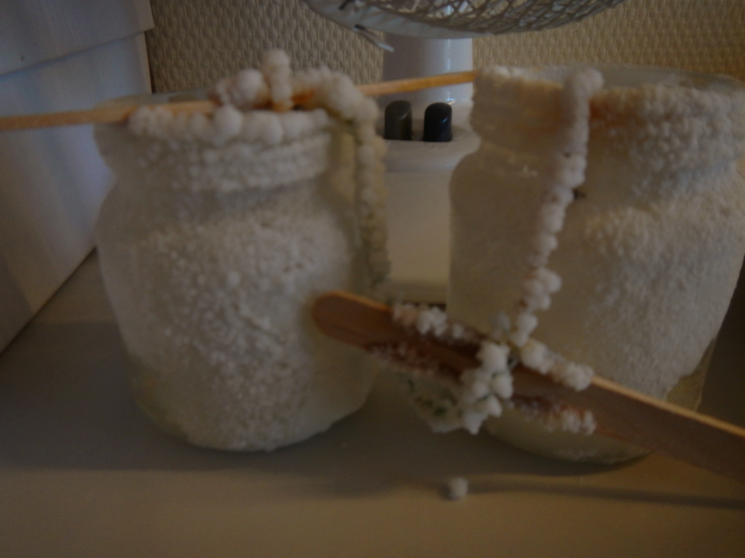
crystallization every morning children hurried to see what has happened. How can I try this at home-> sharing with parents

Slide 18
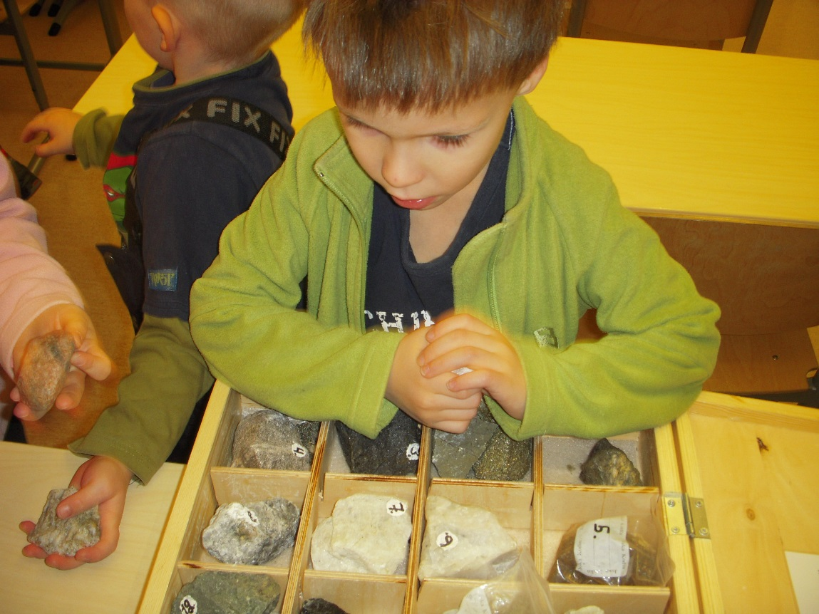
the stone collection of the school
The stone researchers compared they own stones to those at school. What is similar, what is different?

Slide 19
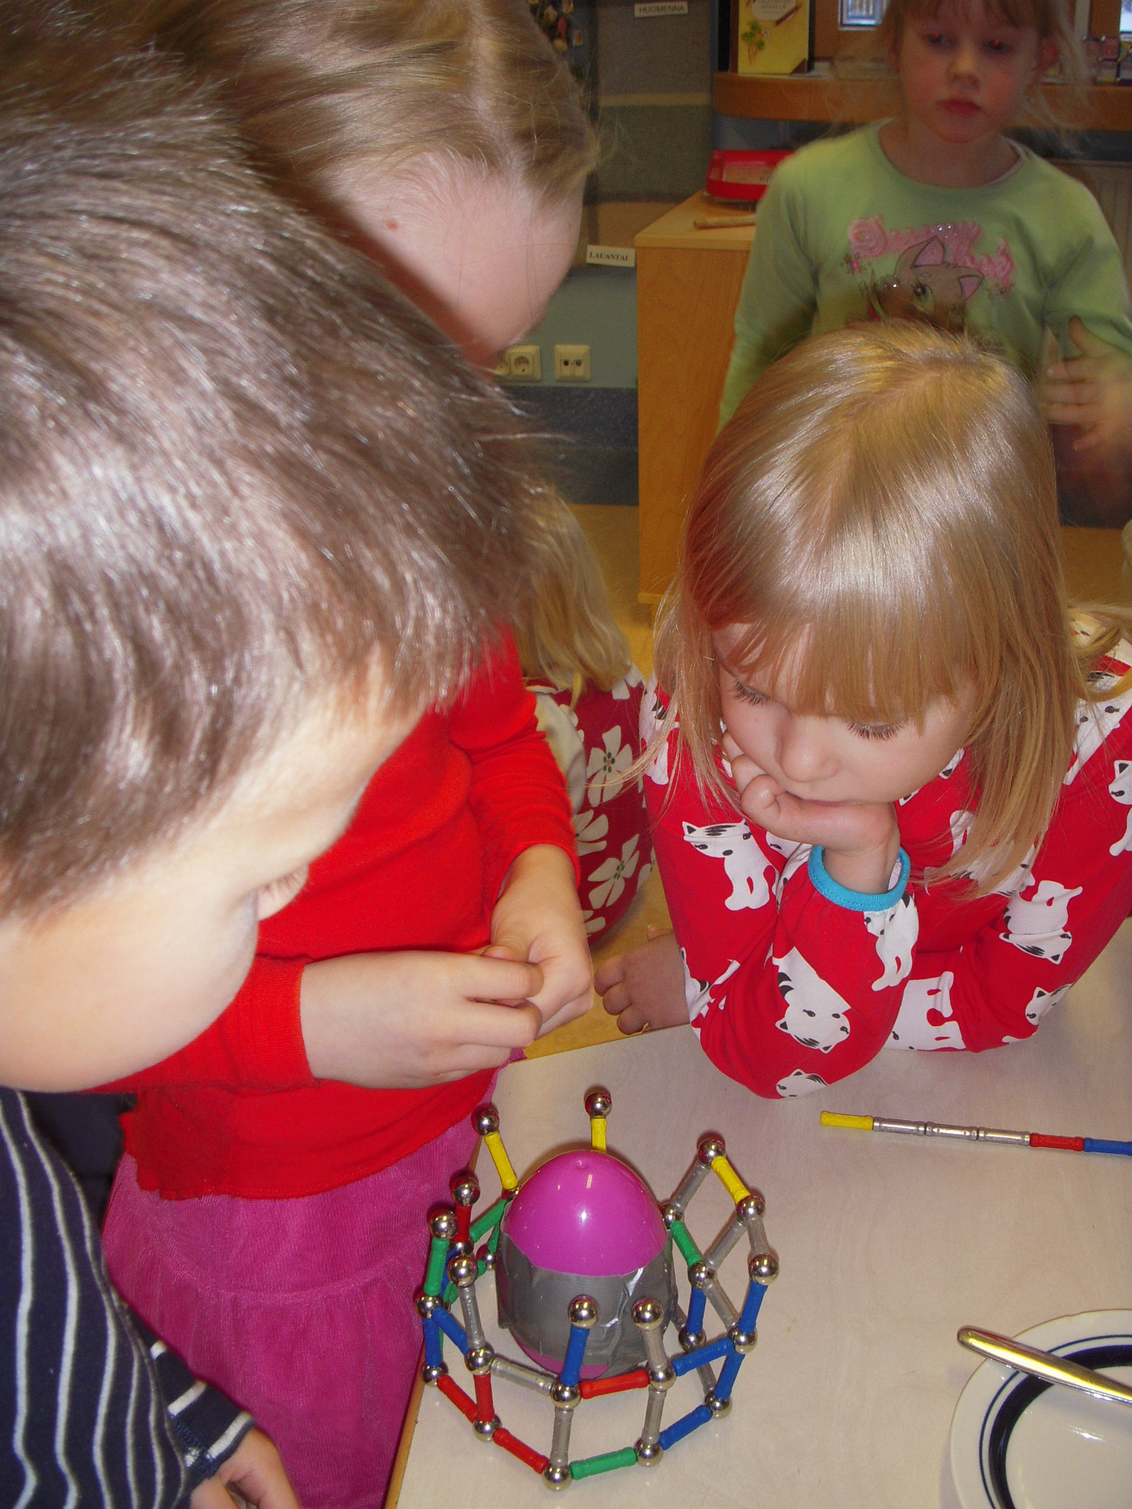
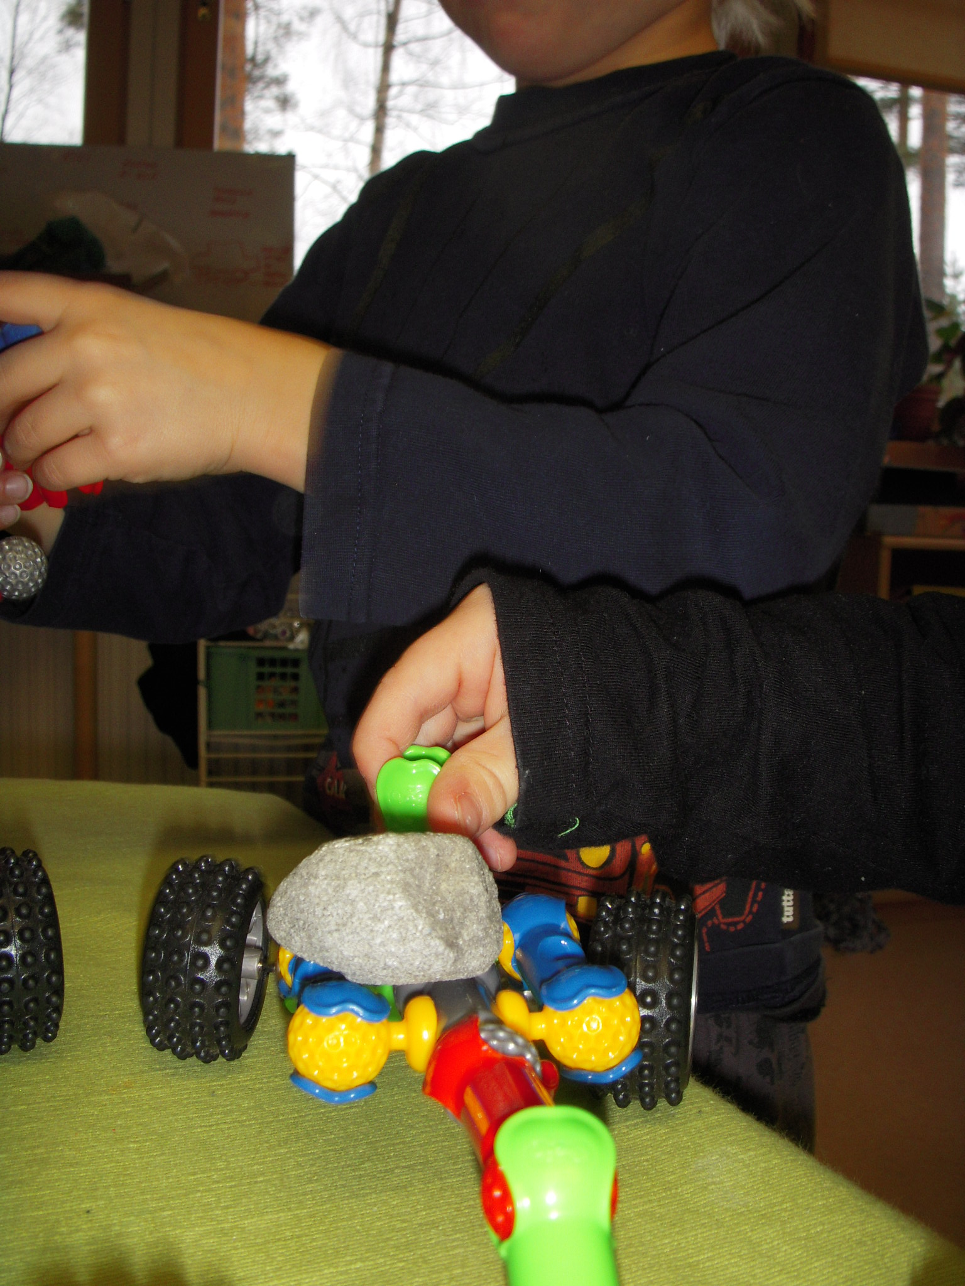
Developing of science thinking in children let them make questions as much as possible and support their own skills to find out answers. By doing scientific thinking together in a classroom children learn a lot and also I learded a lot!

Slide 20
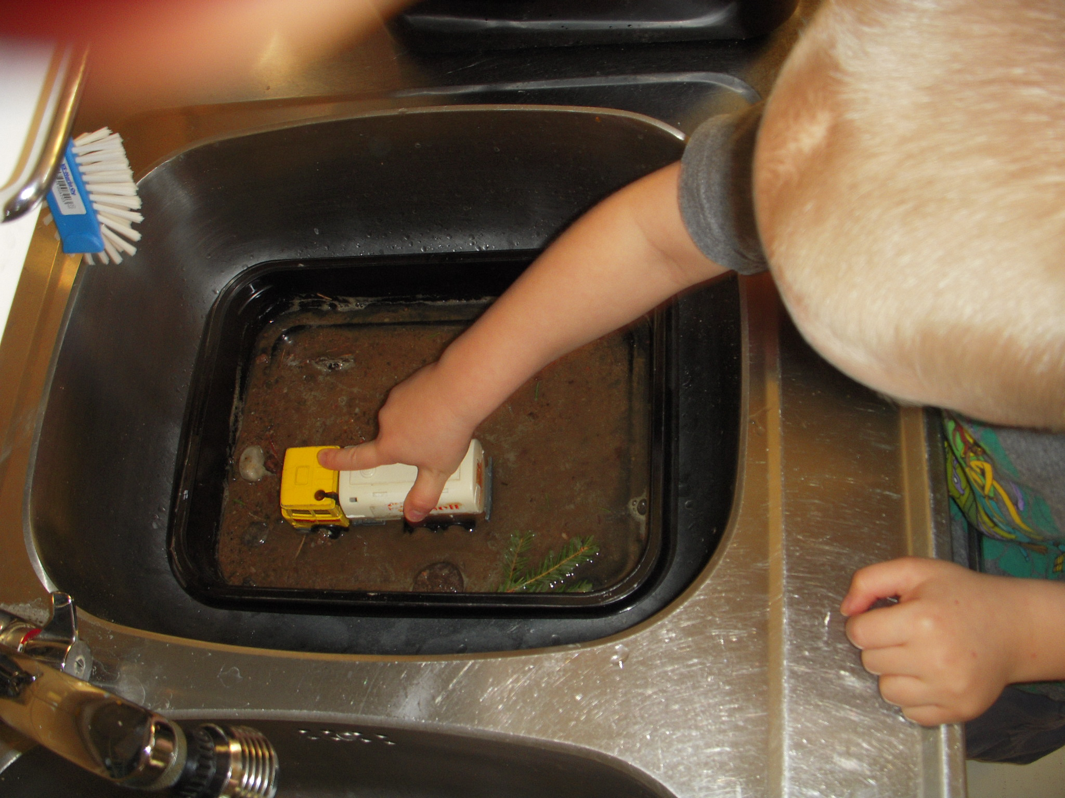
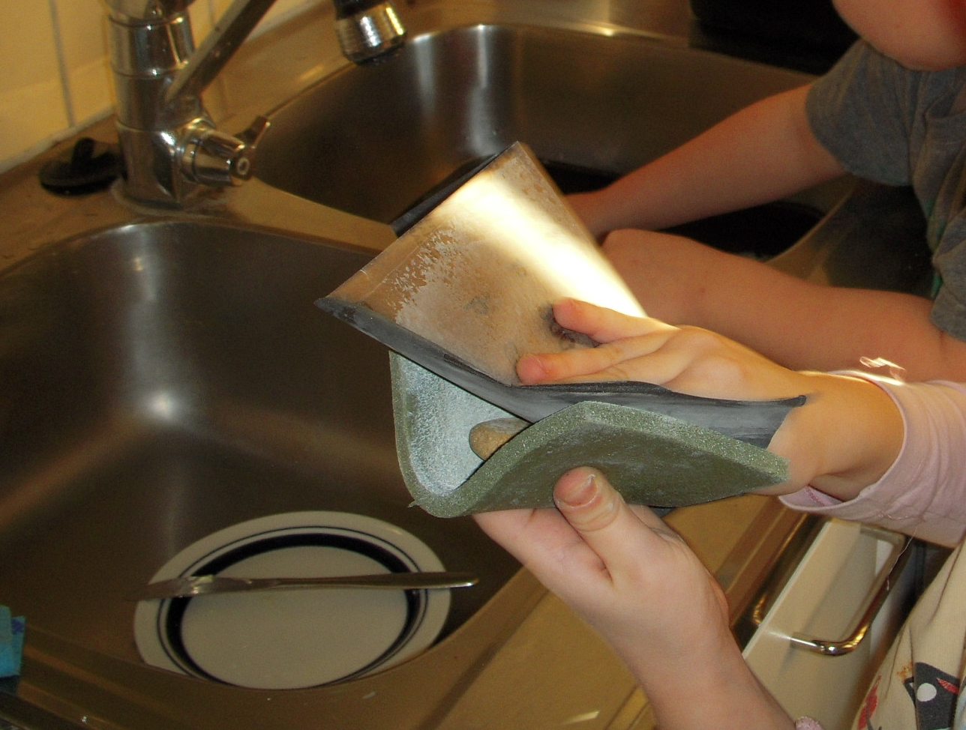
HOW TO MAKE A SMOOTH STONE? Near the big lake Saimaa stones were smooth, near the sea stones were smoothest.
The wheels of Joni`s car, water and sand coul they make smooth stone?
Sara used the abrasive paper trying to get the stone smoother.

Slide 21
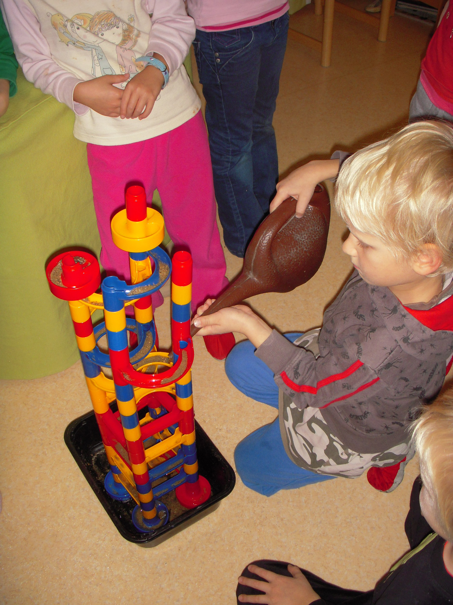
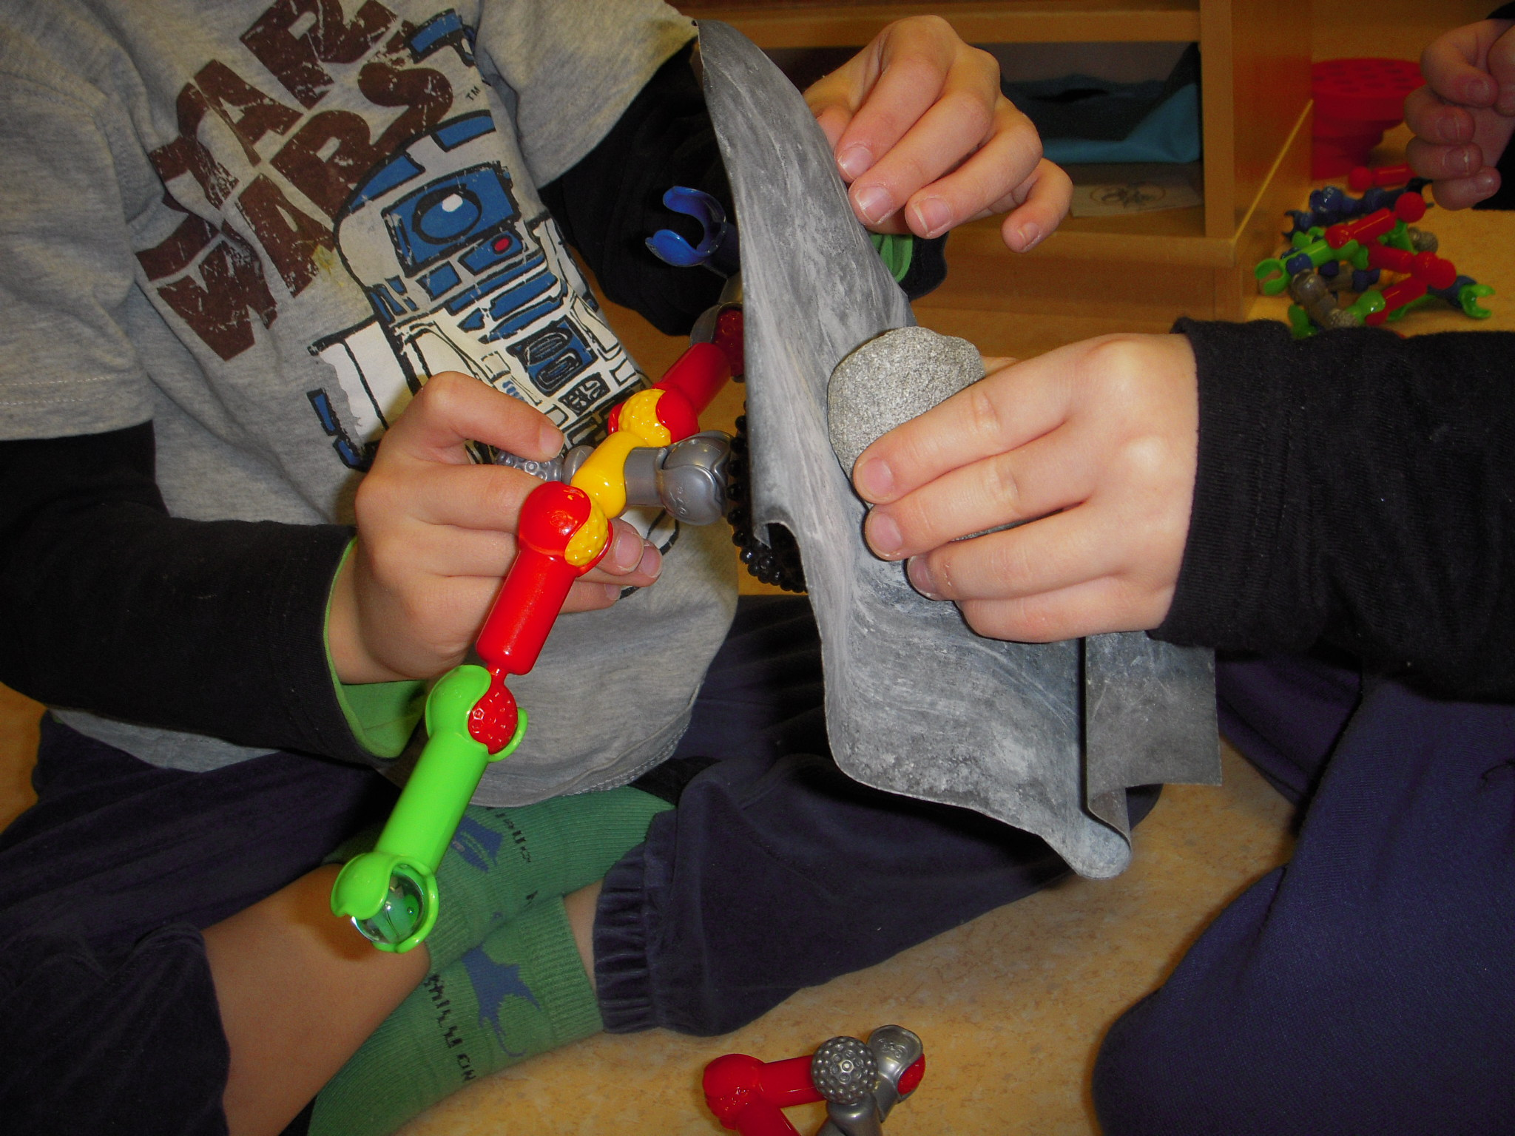
HOW TO MAKE A SMOOTH STONE?
YOU NEED WATER
SAND
AND YOU HAVE TO
MAKE A WATERFALL
OR DOES THIS WORK MAKING SMOOTH
STONE?
children are creative and positive when they managed to learn trough their strengths. One of them knows something, they discuss and share the information, someone knows a little more and they realize that together they are wiser than alone, we complement and strength each other.

Slide 22
”If Sara does this 20 years the stone is smooth” thinks Julia.

Slide 23
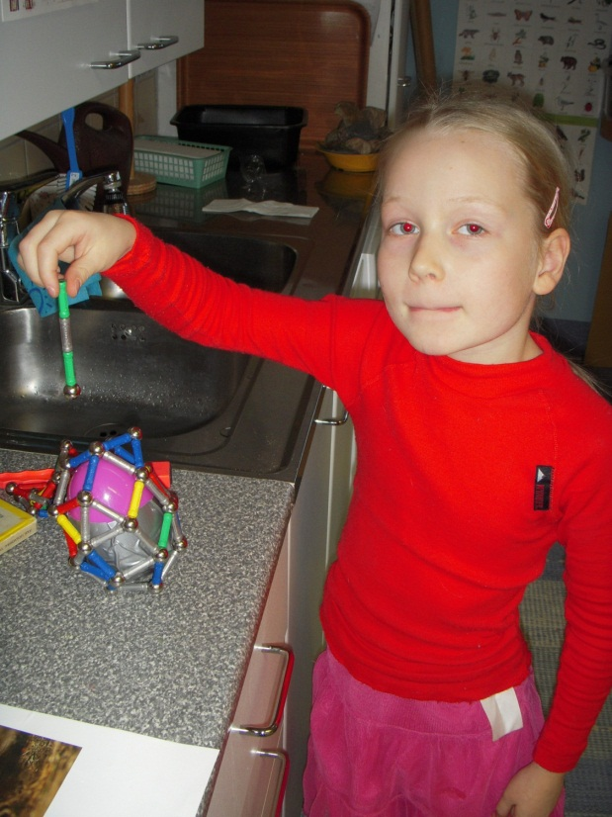
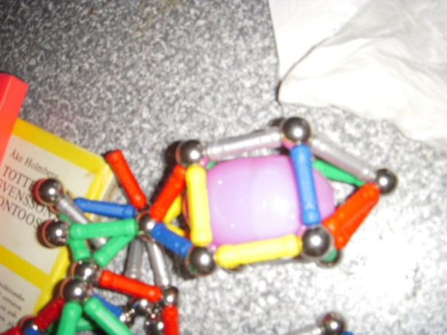
Making smooth stones with sand and water inside the egg, Magnets are the machine to rotate .
Too heavy
Works!

Slide 24
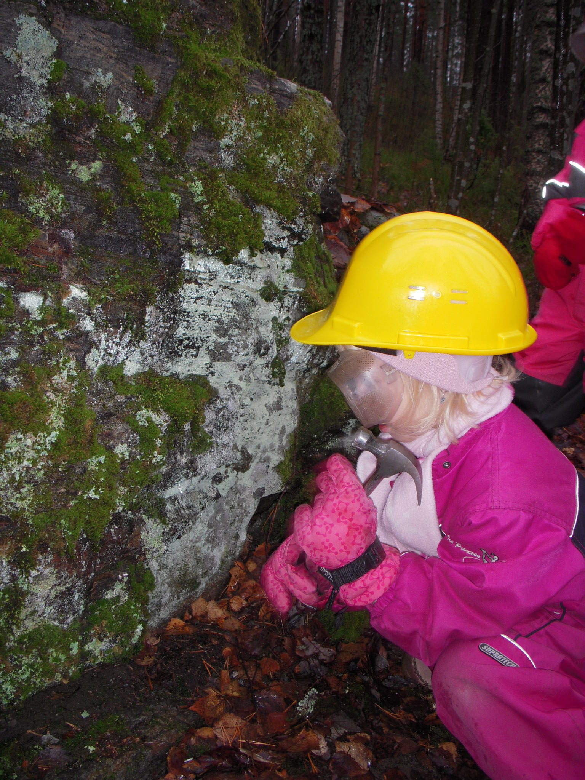
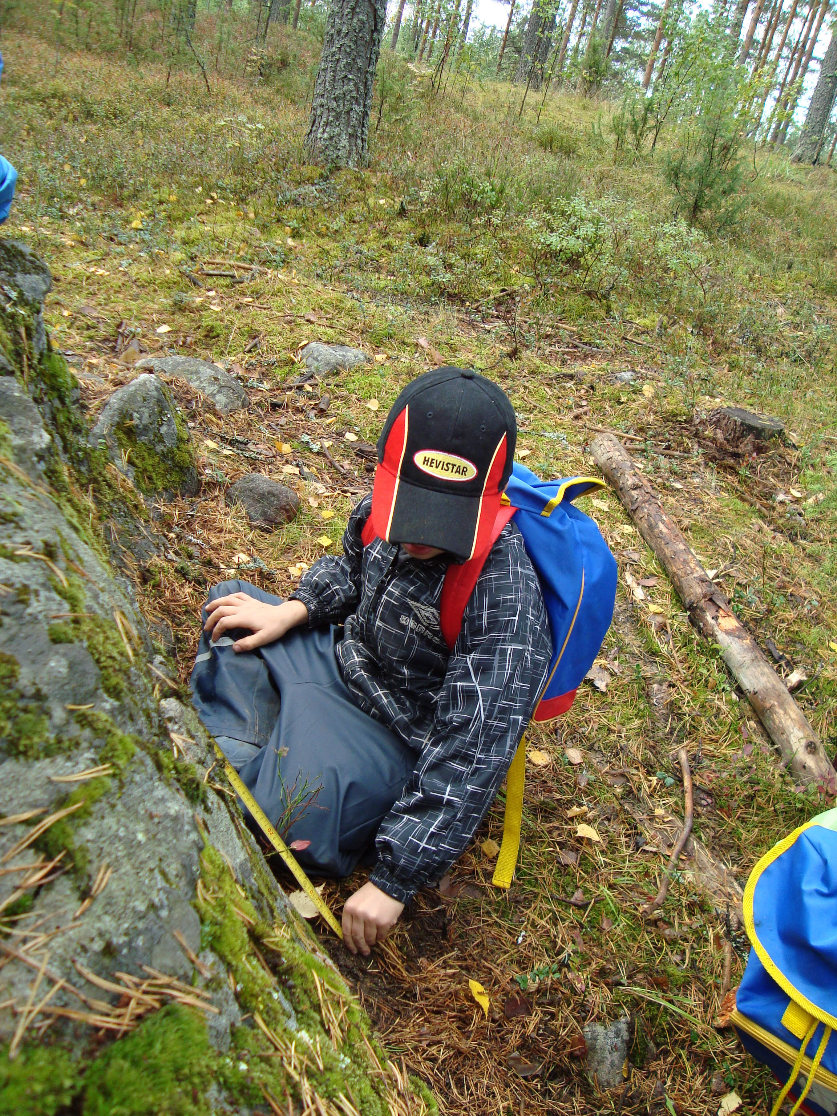
We report the research results and research problems to the parents school- internet connection system and the kids also research at home.
We support children to tell their parents about projects and parents can support scientific thinking to taking part of project.

Slide 25
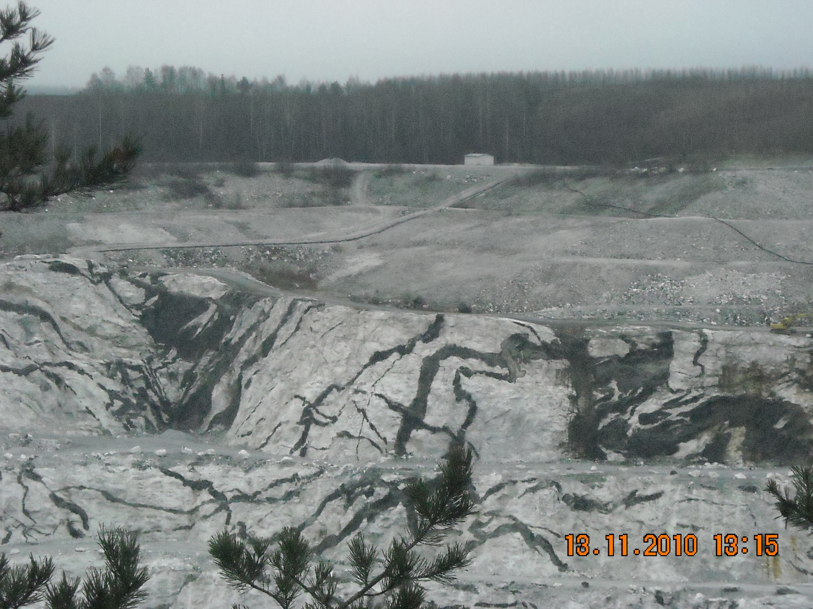
We informed every child’s family about open doors at Nord Kalk mine
and asked them to visit the mine.
I visited also the mine with my family, and next Monday there were smiling children at classroom who showed pictures

Slide 26
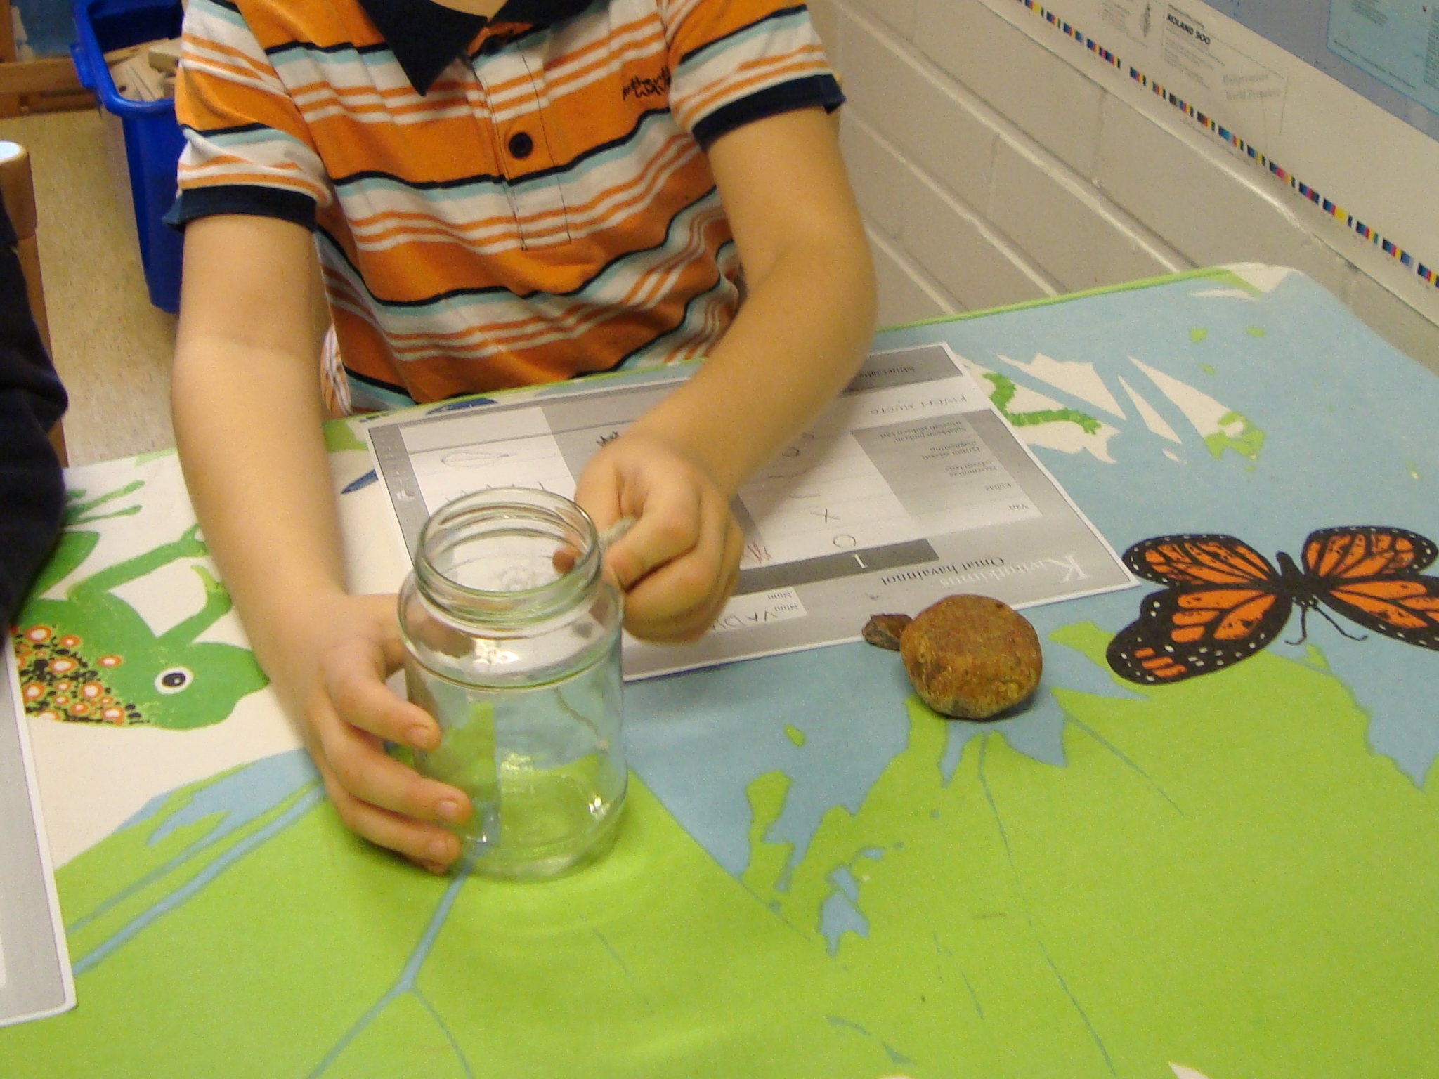
:”Dear stone scientists I have invited you here to find out what kind of stones you have collected.”
We strted to look the stones and everyone started to act like scientist while they tried to find out answers to their problems: Can they make a mark to the glass? Are stones magnetic? What shapes and colours they can find?

Slide 27
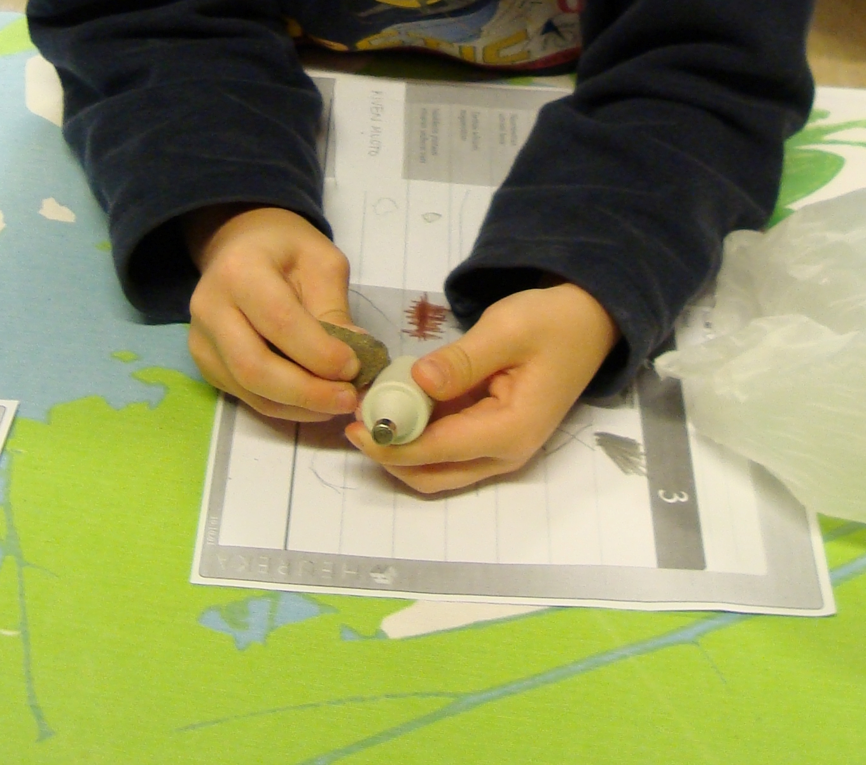

Slide 28
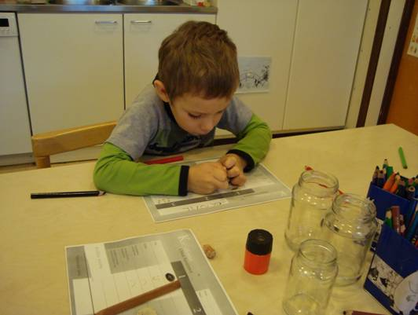

Slide 29
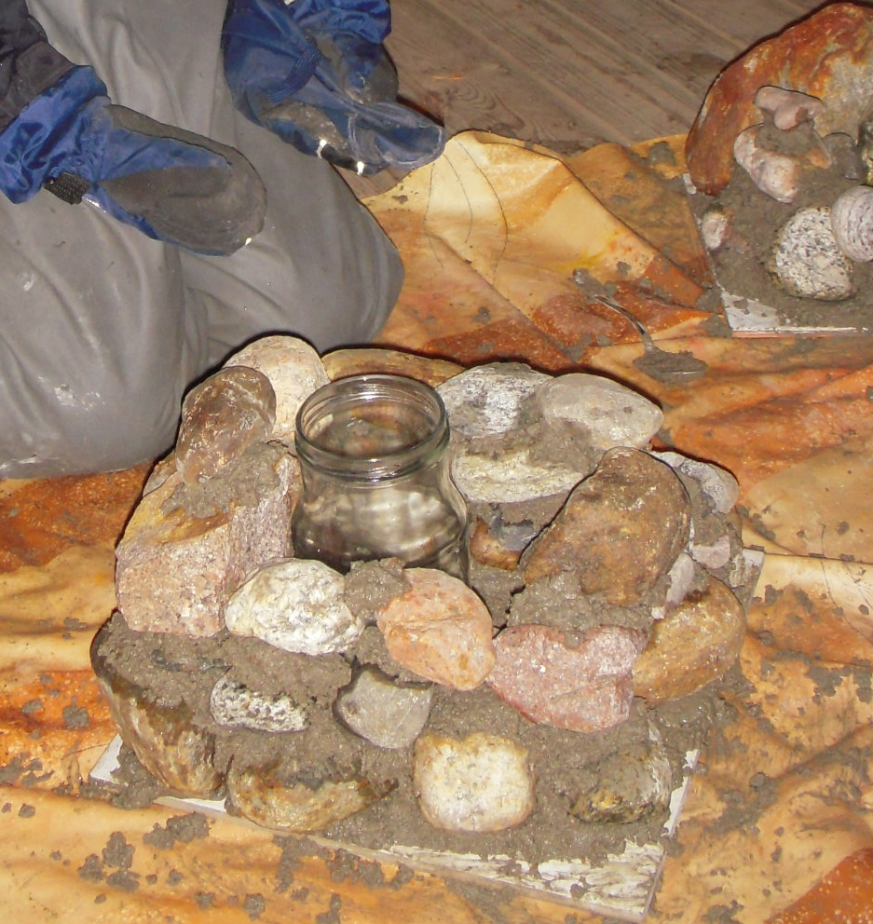
Concrete and stones, children built lanterns.
Stone and hammer-→ spark

Slide 30
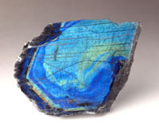
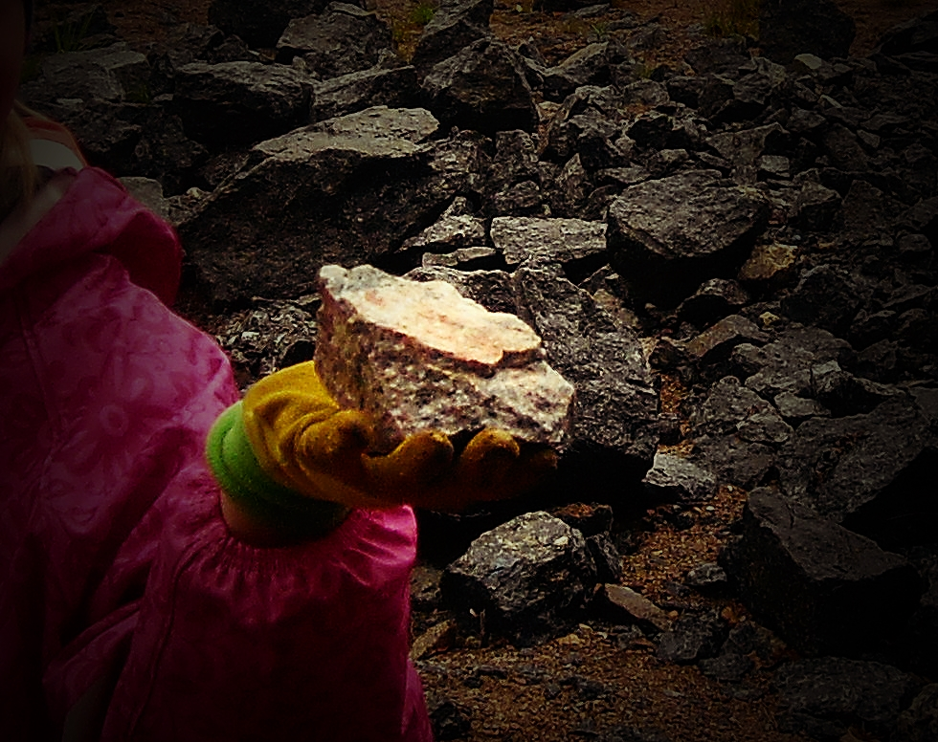
Spectrolite from Ylämaa Finland

Slide 31
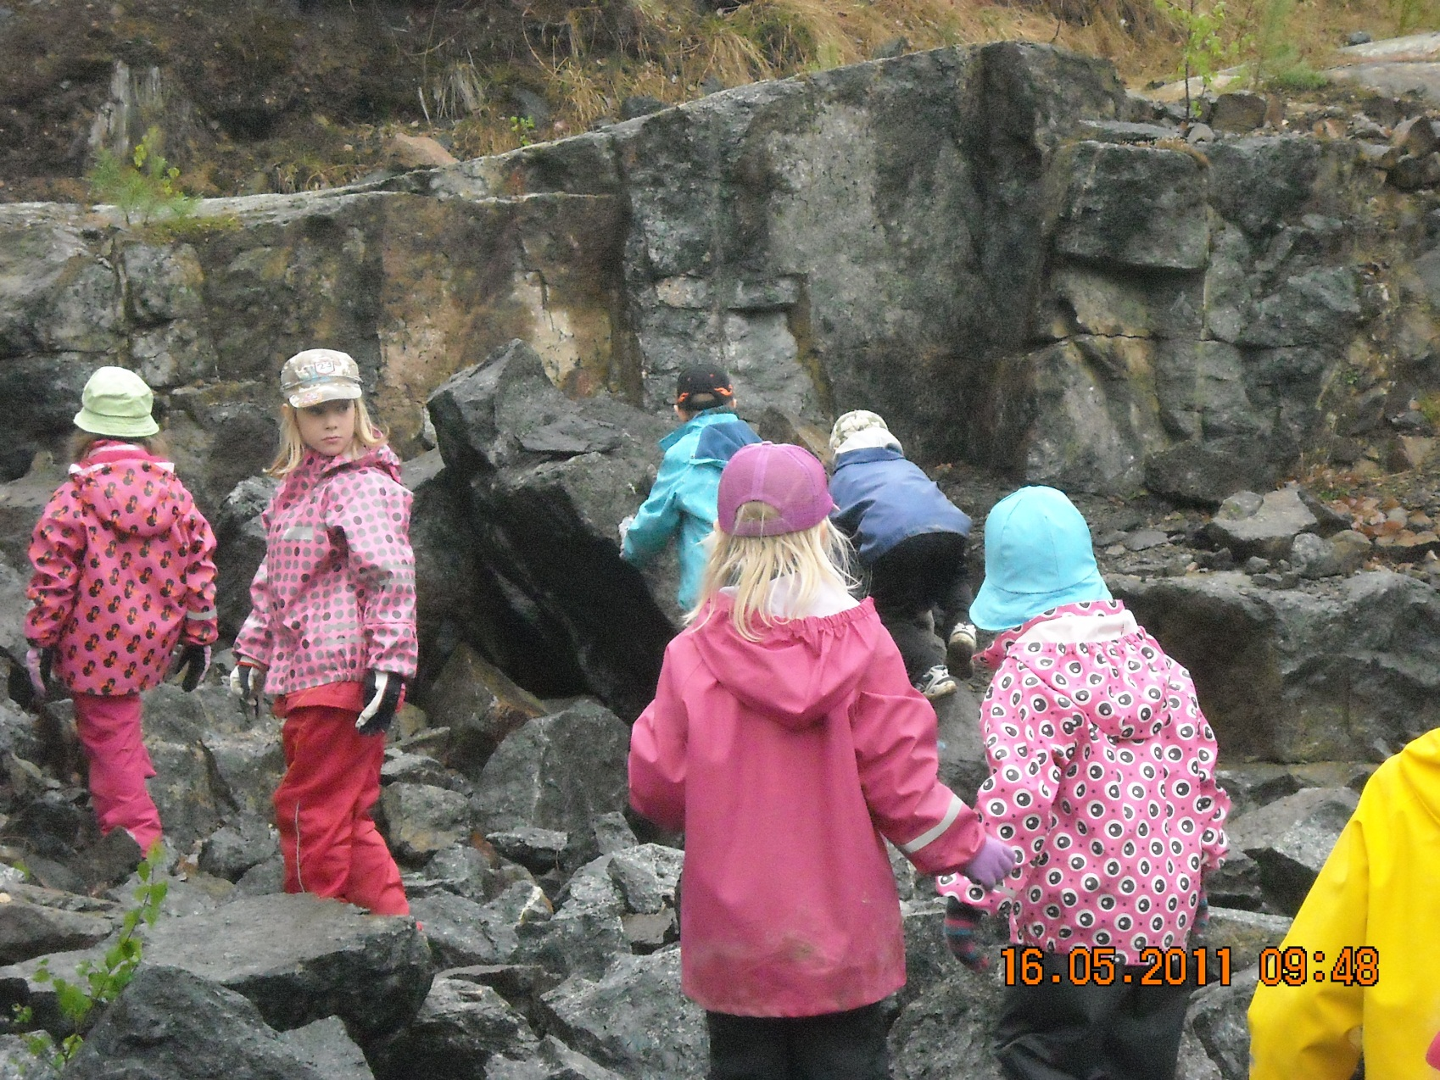
Looking for spetrolites. They are easier to find when it is raining. You can see the rainbow colours at wet stone.

Slide 32
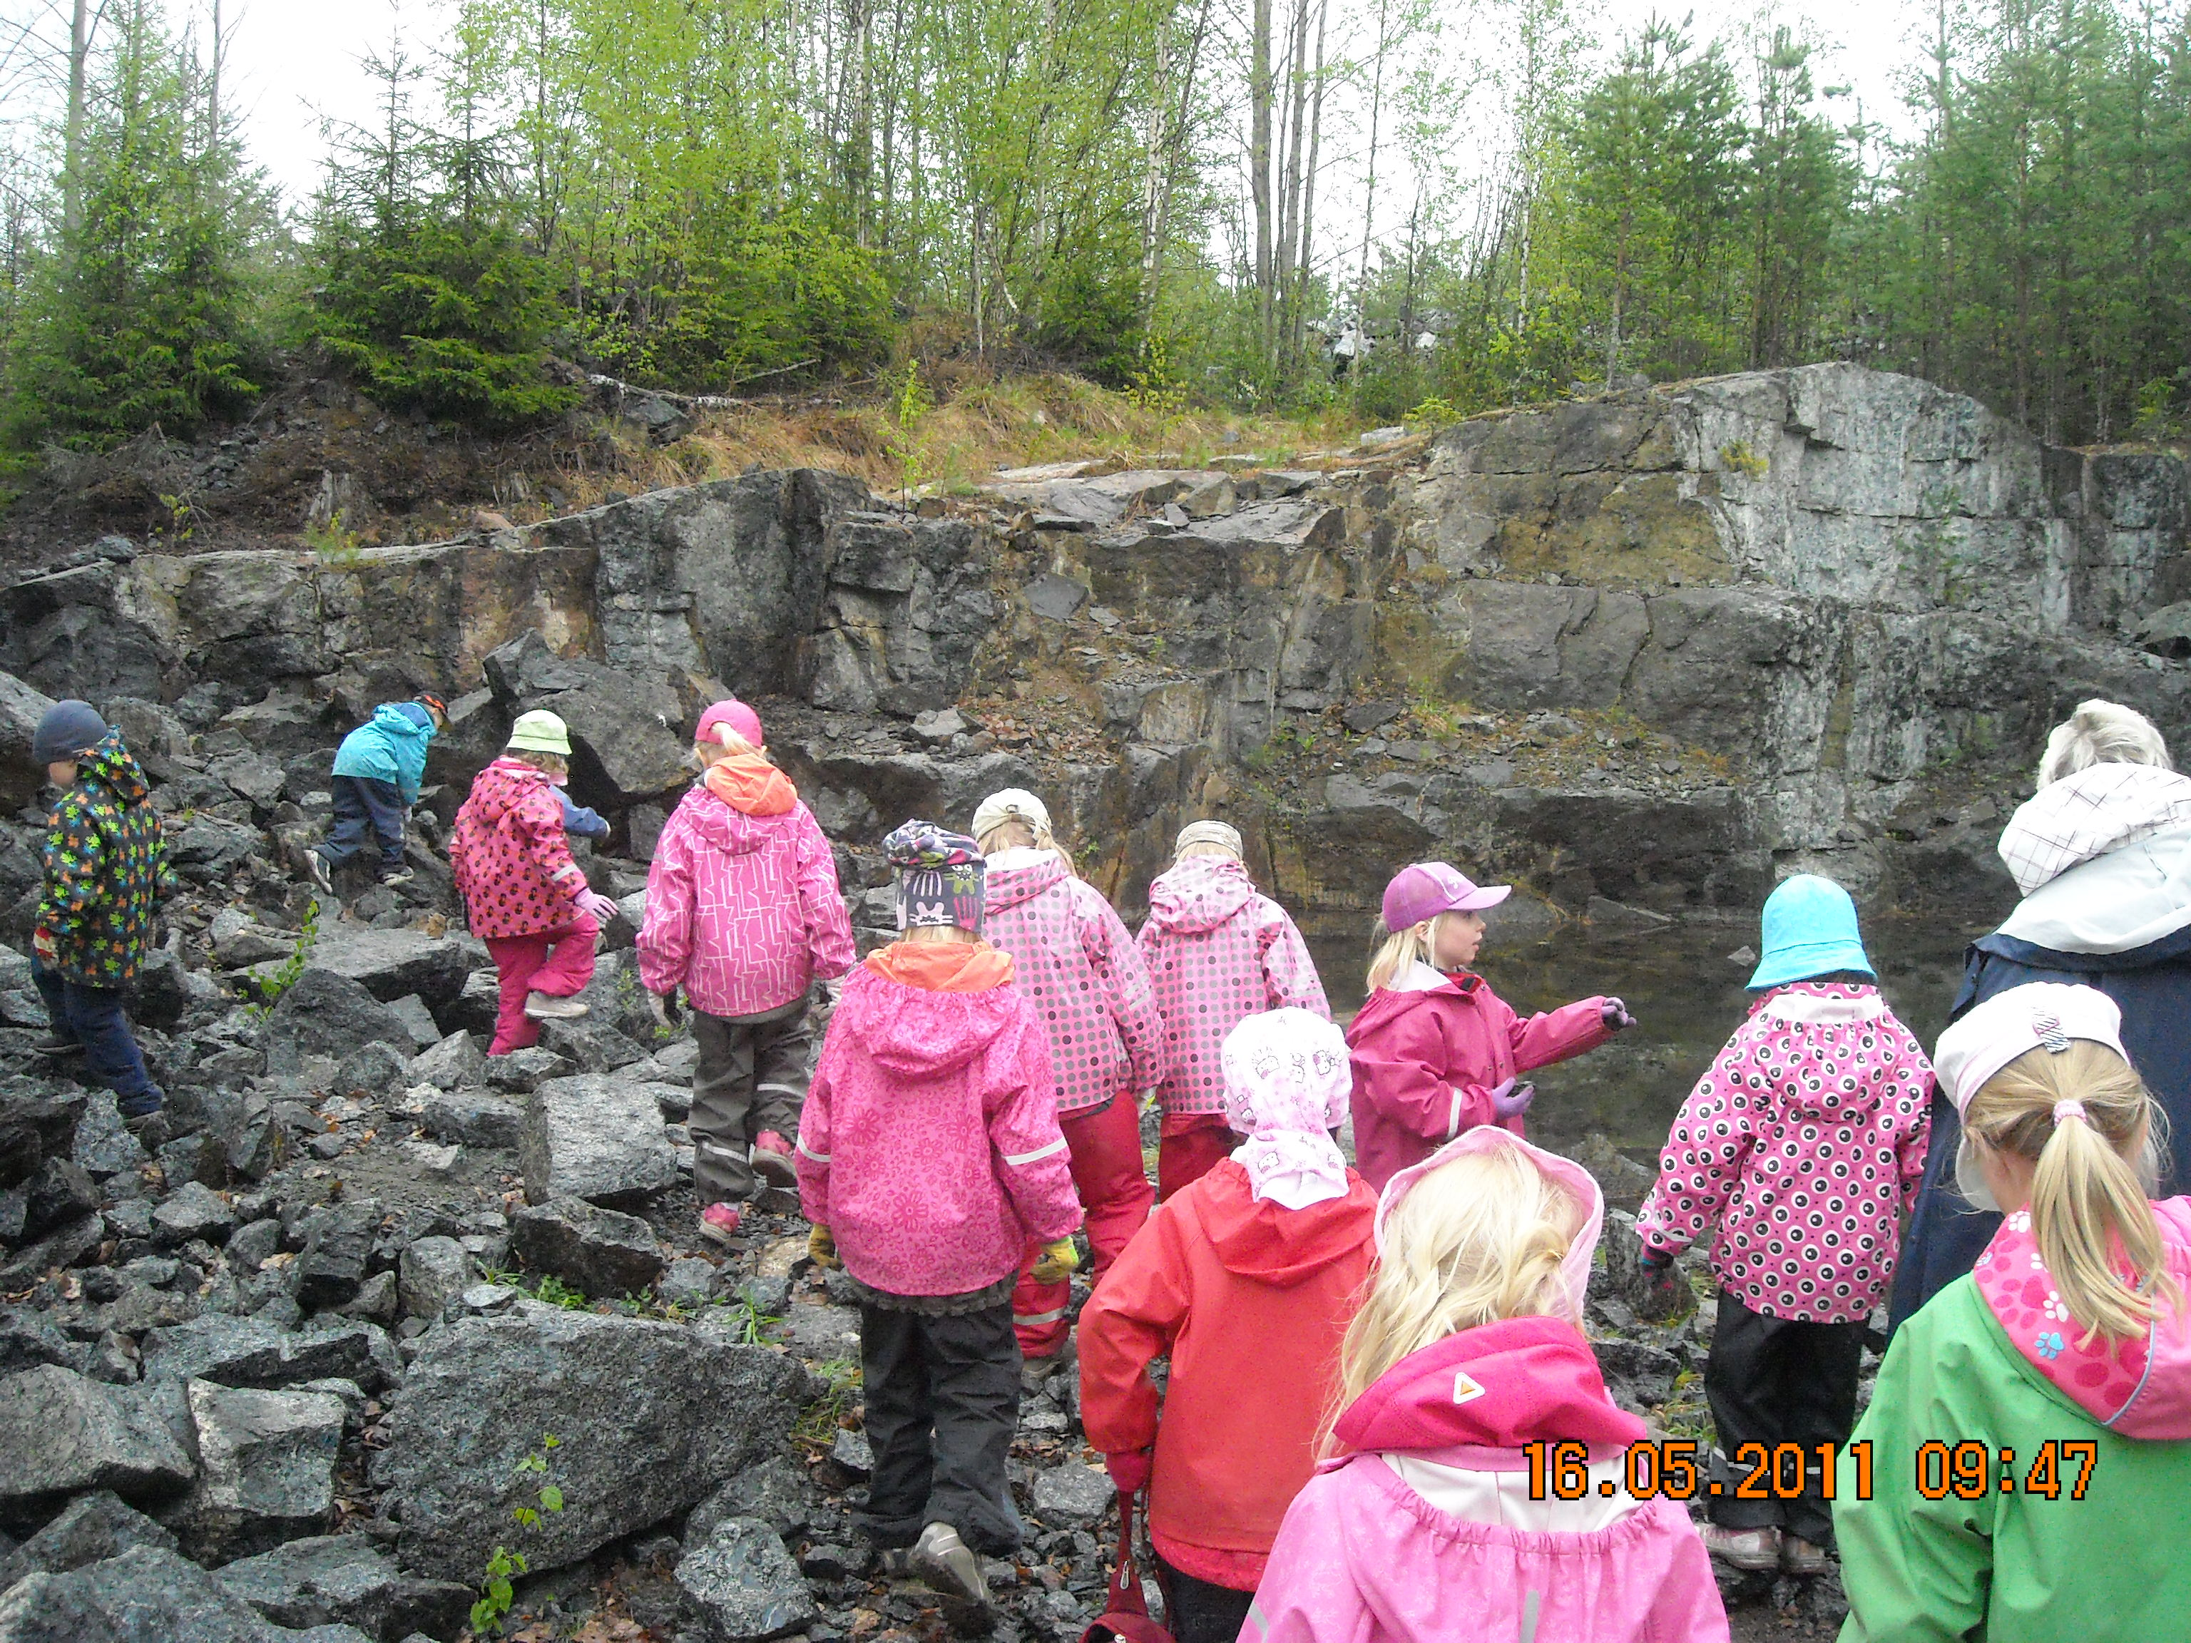
Fostering scientific learning.The children can suggest experts, to whom we can ask for consultation. Sharing expertise creates new knowledge and understanding that no child in pre-school can gain by his or herself. We visit school classes for 15 minutes to present our research through animations, constructions and photos. Everyone shares the responsibility over the success of classroom.

Slide 33
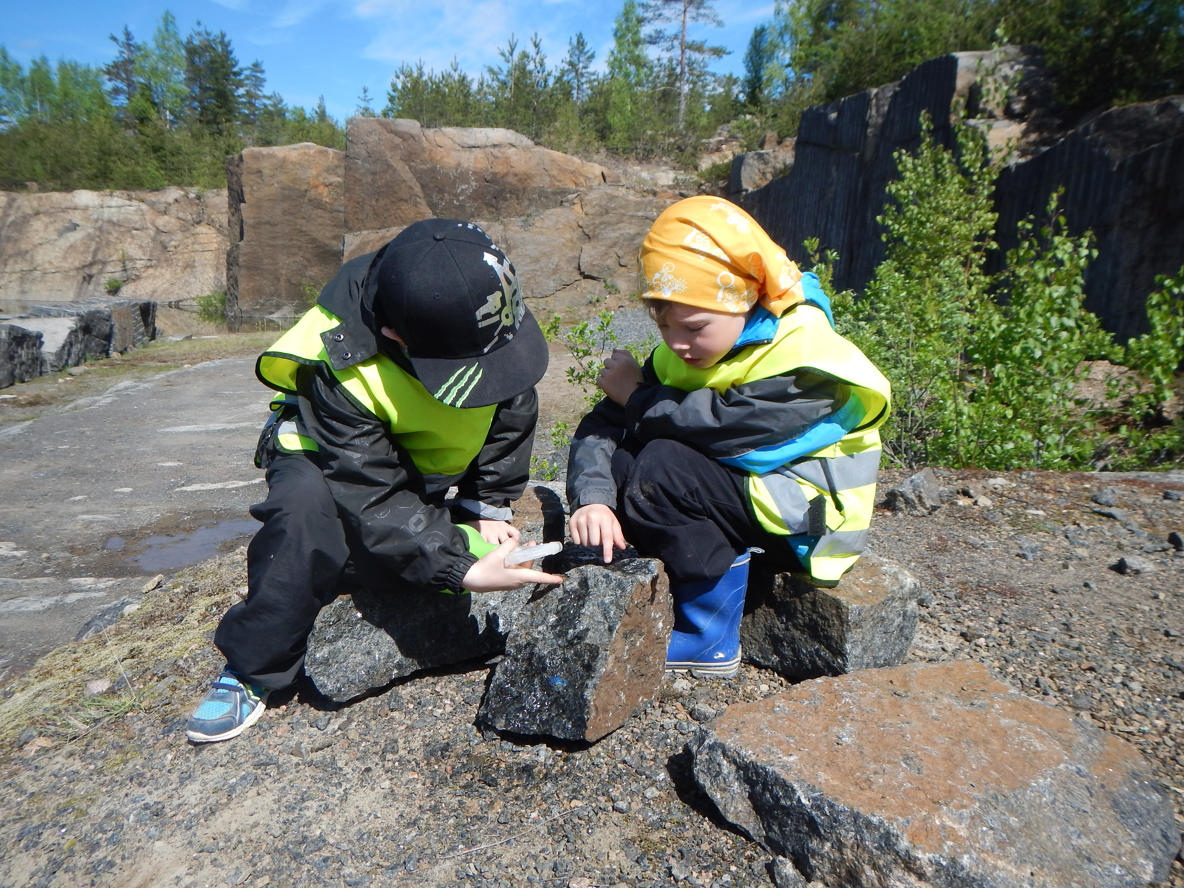
ylamaamystique.fi

Slide 34
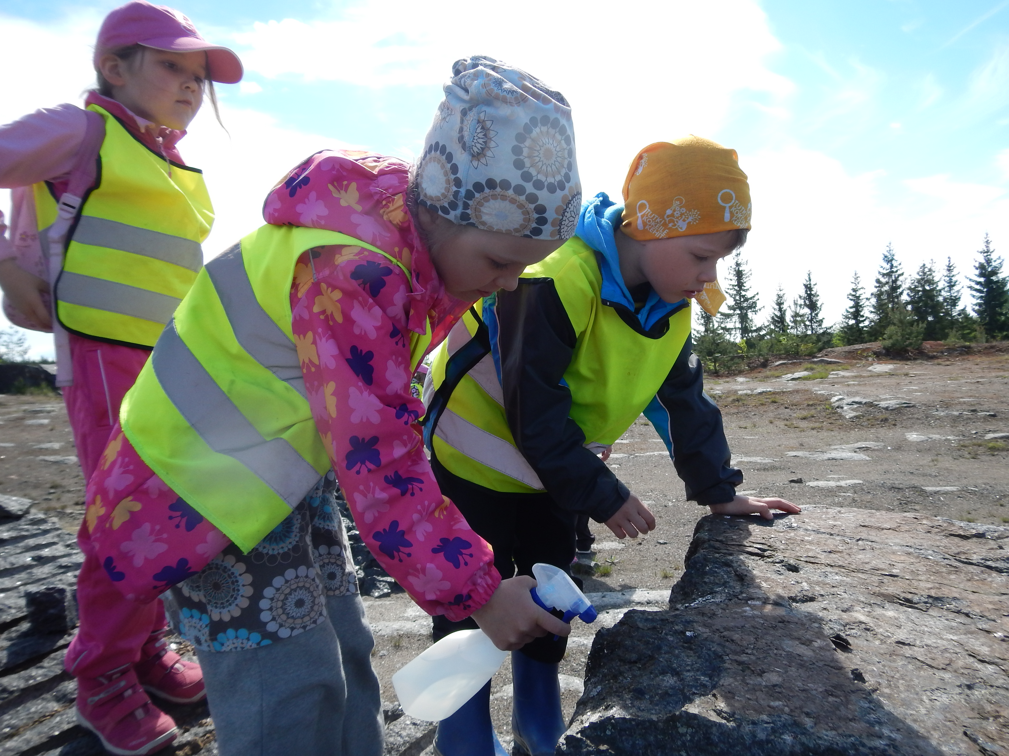
With water you can find the most beautiful stones, you can see
a rainbow kind colours of spectrolite

Slide 35
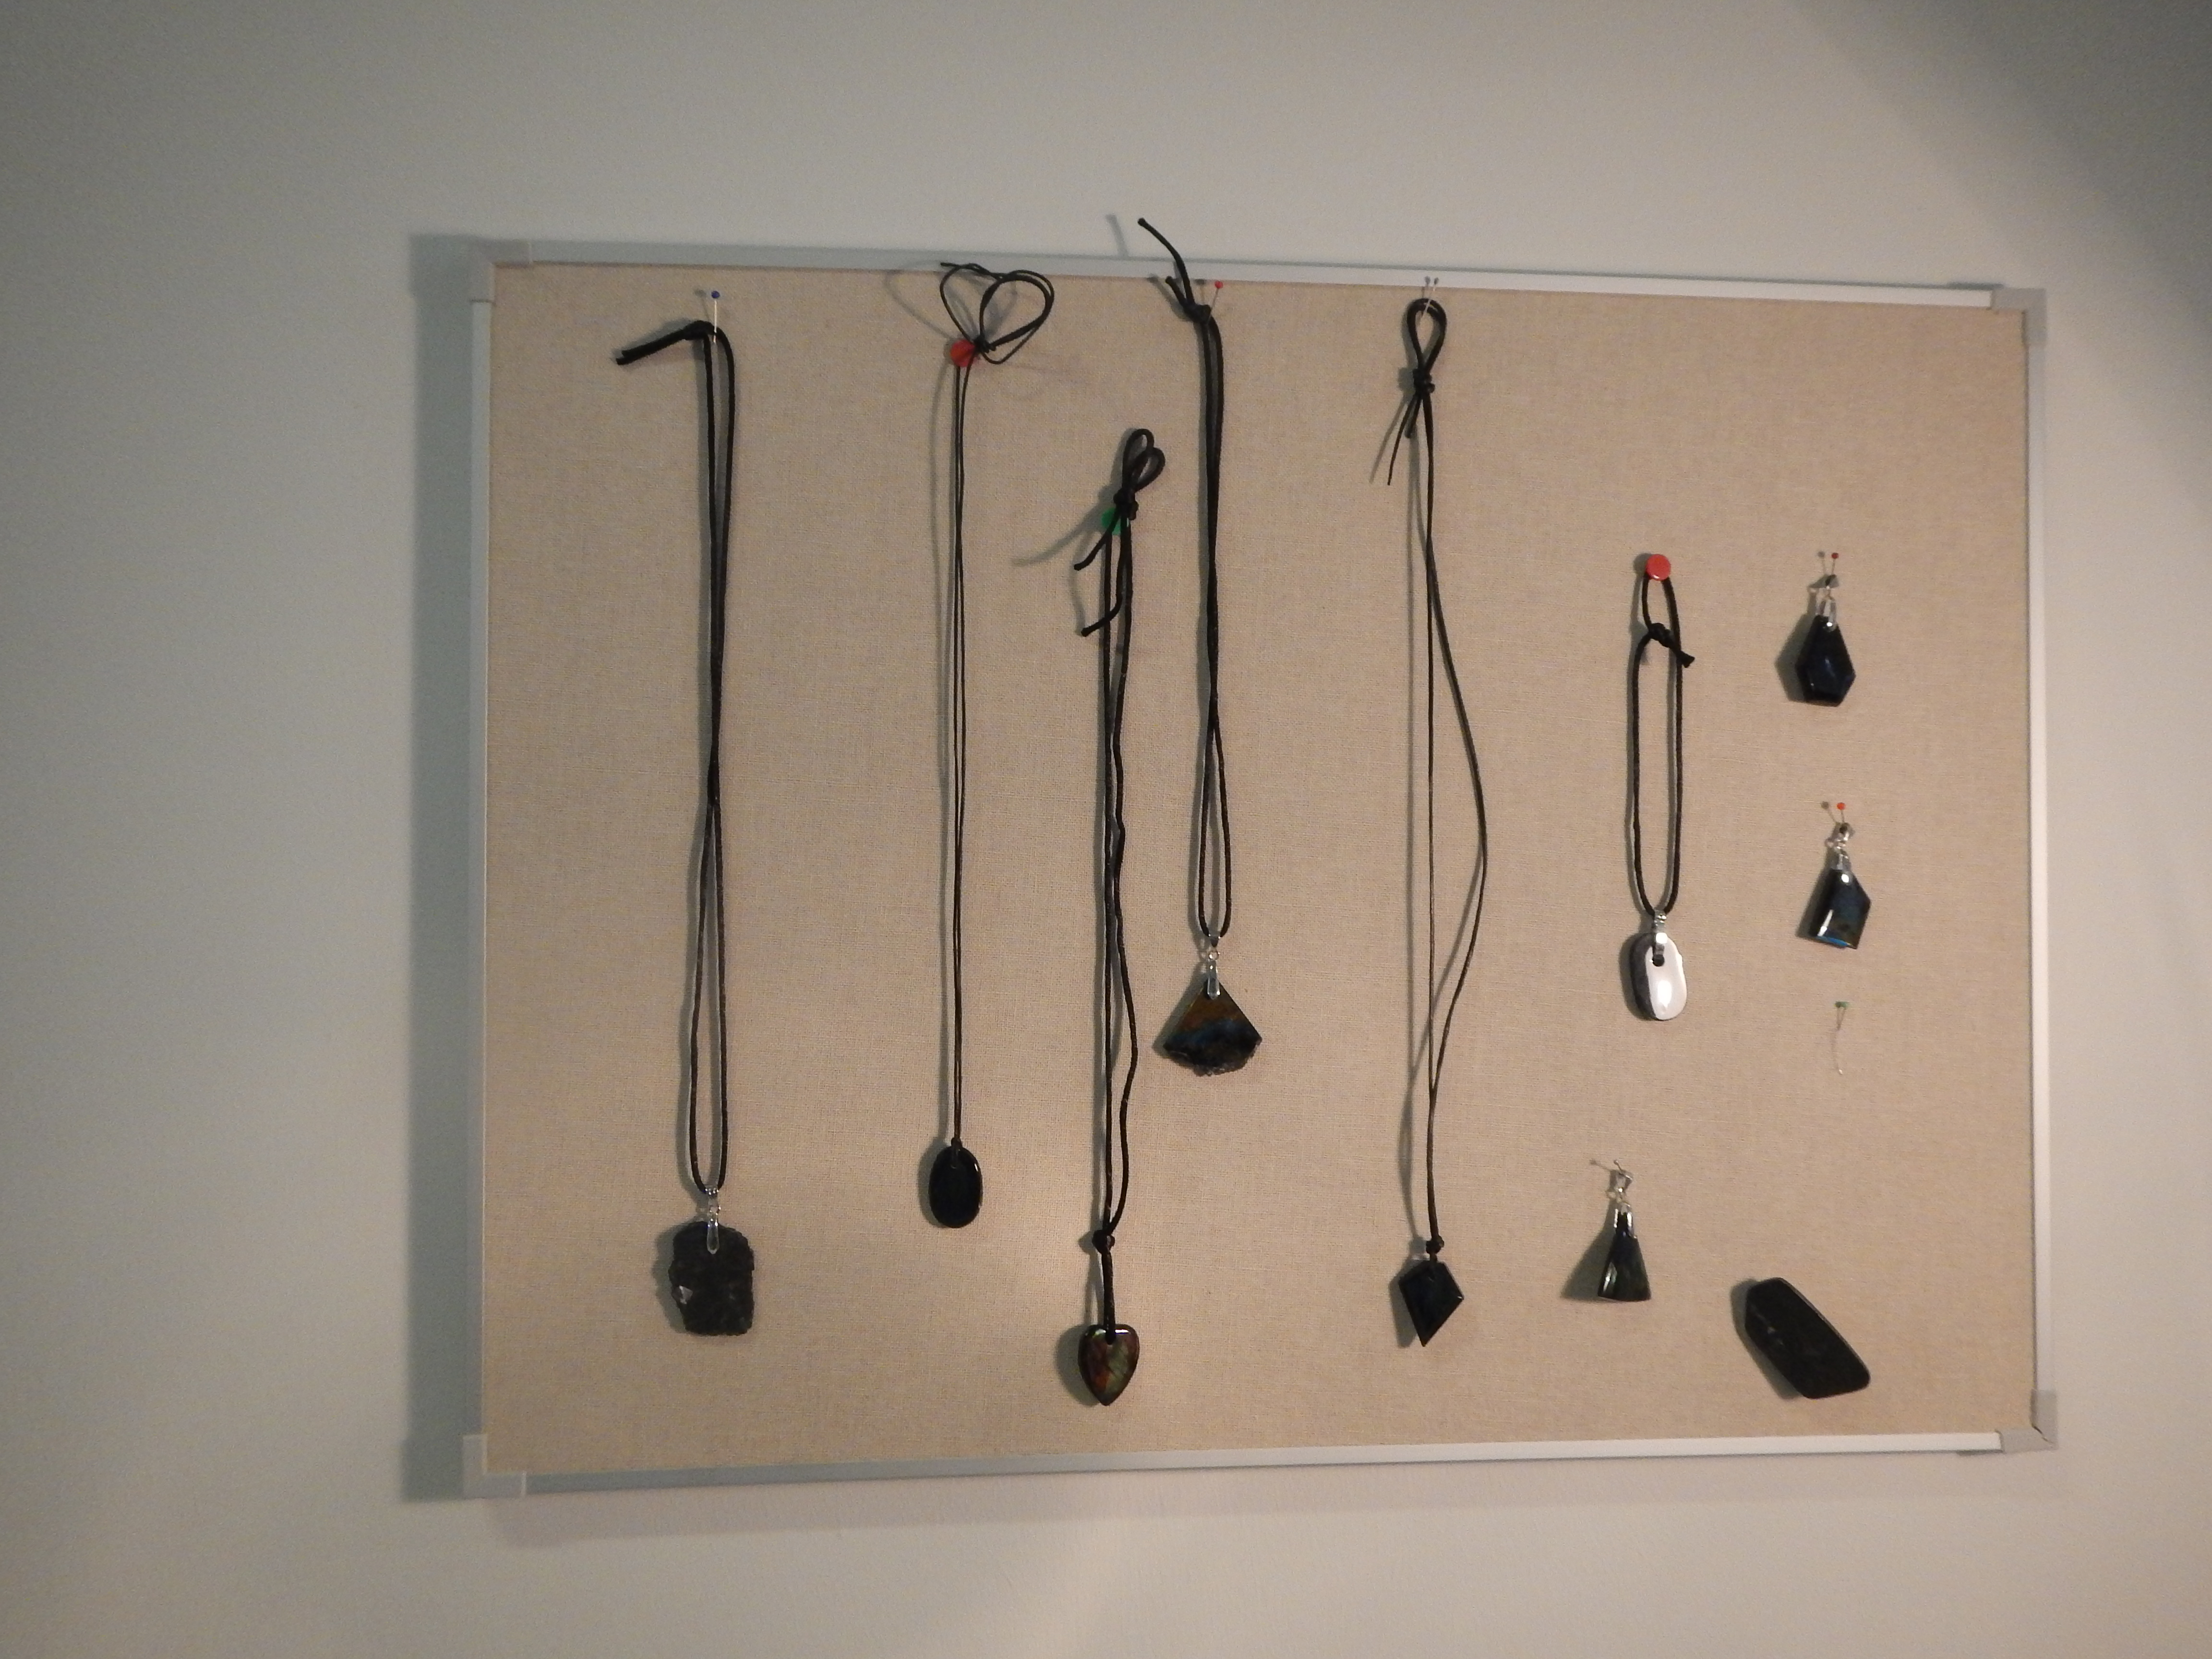
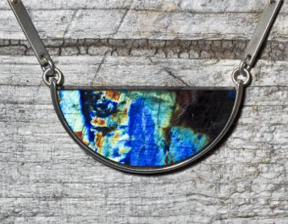

Slide 36
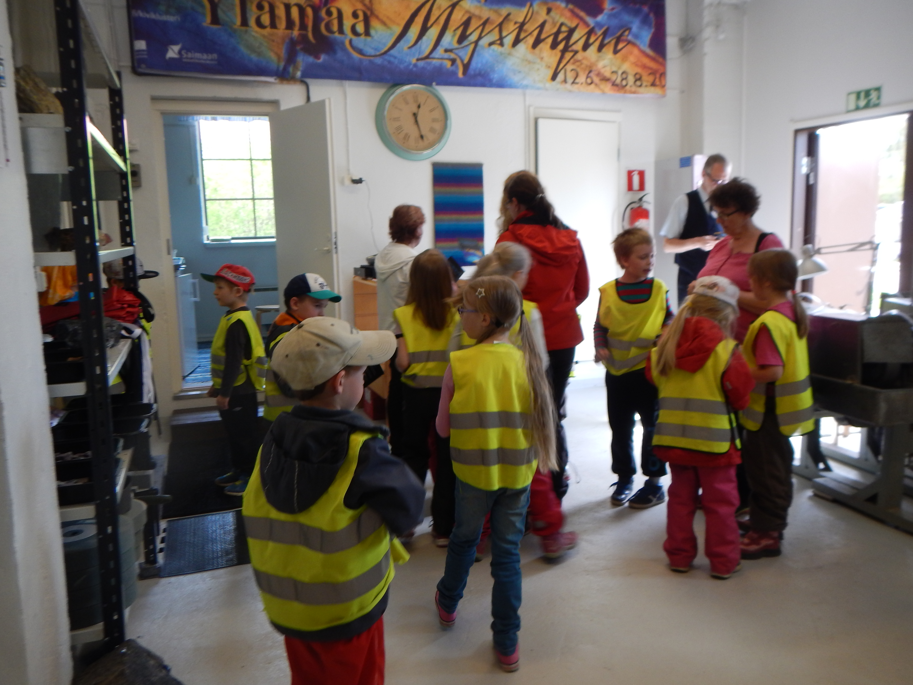
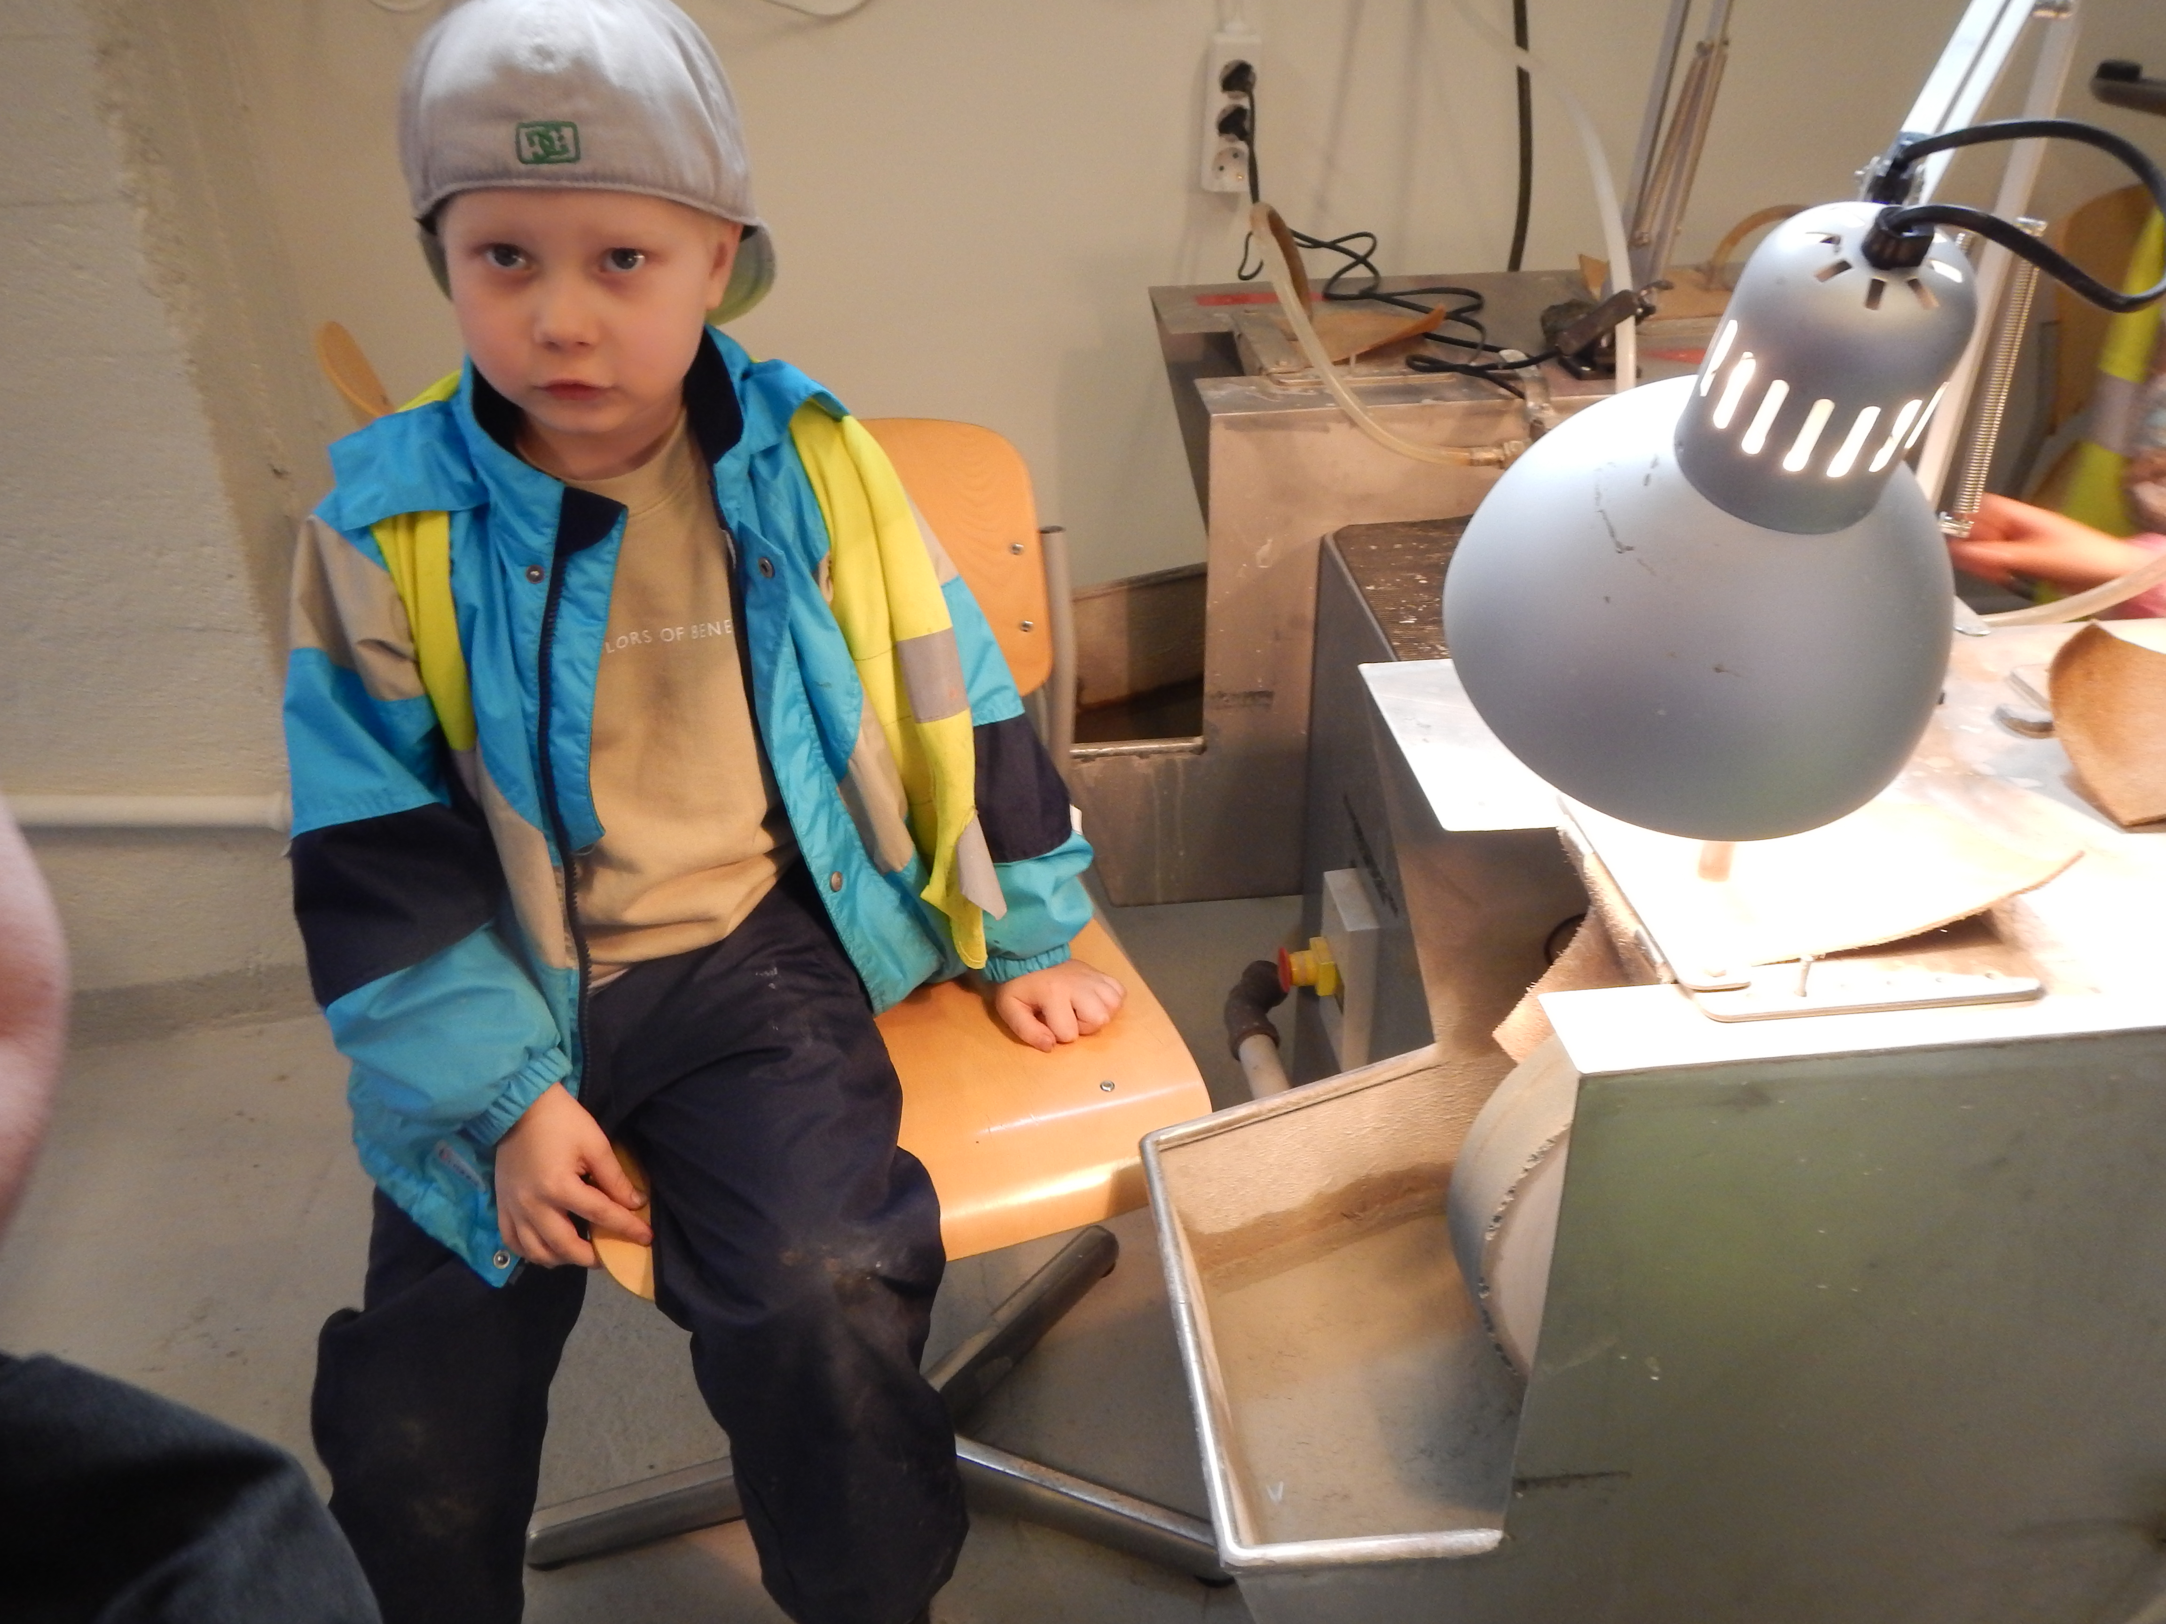
I would like to work here

Slide 37


I want to see the colours

Slide 38

Working
With ipad
Own treasures
In the middle:
Everytime we sat and listen Petra
Had this plastic bottle with sand, water and little stone
Mooving.

Slide 39


