Slide 1
Topic 1.3 Electron configurations

Slide 2
Electron Configuration: Important Vocabulary
First ionization energy Ionization energy
Second ionization energy Shielding
S, p, d, f orbitals Ground state & excited state
Aufbau principle
Hund’s rules
Pauli exclusion principle
Electron configuration (not arrangement)
Heisenberg’s uncertainty principle
Planck's equation
Waves & Photons
Wave equation
Wavelength & frequency
Emission spectrum
Convergence limit

Slide 3
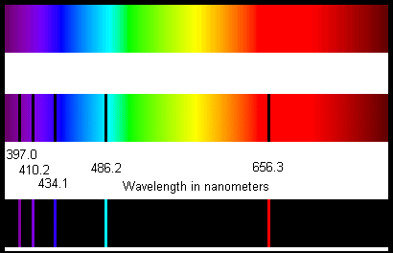
ATOMIC EMISSION SPECTRA
The image on the right shows the emission spectrum for hydrogen
A convergence of lines at the high energy (short wavelength, violet) end can be observed
Lines also converge (you see more of them) at one point in the ultraviolet region

Slide 5
ATOMIC EMISSION SPECTRA: an explanation
Electrons become excited when atoms are supplied with energy
Electrons can only be found at certain energy levels
The excited electrons will jump from a lower (ground) state to a higher (excited) state
Energy cannot be created or destroyed; it only changes form
In order to return to original energy level, the excited electrons must release energy in some form: light

Slide 6
ATOMIC EMISSION SPECTRA: an explanation
Hydrogen can absob or emit energy at certain frequencies; this means they can only absorb certain radiation
This suggests a limited amount of energy levels within the hydrogen atom
Electrons falling back to the n= 2 level constitute visible light
Convergence happens because the energy levels themselves converge

Slide 7
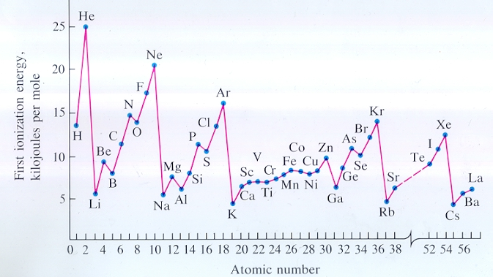
THE ARRANGEMENT OF ELECTRONS
First ionization energy: The energy required to remove one electron from an atom in its gaseous state
Measured in kJ mol⁻¹
What is the noticeable trend occuring here?
Ana Sayfa

Slide 8
THE ARRANGEMENT OF ELECTRONS
Energy levels can become full of electrons
When they are full, the first ionization energy is greater
Level 1: 2 electrons, Level 2: 8 electrons, Level 3: 8 electrons
Ana Sayfa

Slide 9
THE ARRANGEMENT OF ELECTRONS
How electrons are arranged (in what level) is called electron configuration
Those electrons in the highest energy level are termed valence electrons
Be able to determine electron configuration for up to Z= 36!
Ana Sayfa

Slide 10
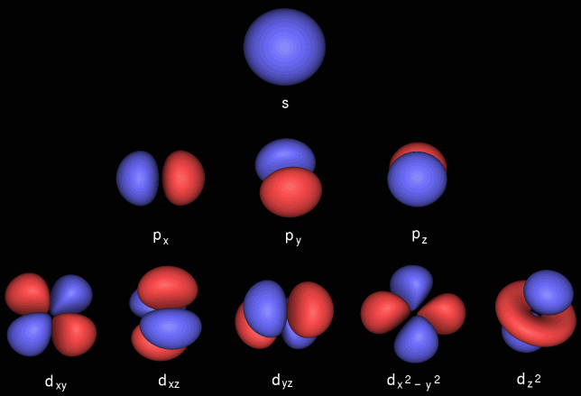
Electron configuration
Electrons are arranged in energy levels which contain sub-levels, which contain different orbitals of different shapes.
Distribution of electrons:
Each orbital may contain a maximum of 2 electrons
These electrons will have opposite spin
The shapes of electron orbitals: s is spherical, p is a figure 8, and d a series of more complicated shapes (Source: Chemical Computing Group 2018)

Slide 11
Electron configuration
Electrons in each orbital will have opposite spin (Pauli exclusion principle) and will not occupy the same space at the same time
The shapes of electron orbitals: s is spherical, p is a figure 8, and d a series of more complicated shapes (Source: Chemical Computing Group 2018)

Slide 12
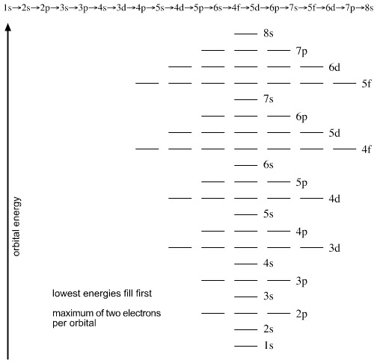
Electron configuration
A minimum of two electrons per orbital (Pauli exclusion principle), filled in a specific order (Afbau principle)
1st energy level: 1 s orbital
Second energy level: 1 s orbital and p sub-level with 3 p orbitals
Third energy level: s, p, and d sub-levels
Fourth energy level: s, p, d, and f sub-levels
Source: Chemogenesis web book (2018)

Slide 13
Electron configuration: How the electrons arrange themselves
Rule of thumb:
Lowest energy configuration possible
Orbitals in sub-levels are filled singly first (Hund’s rule)
4s level is lower than 3d?
Source: Chemogenesis web book (2018)

