Slide 1
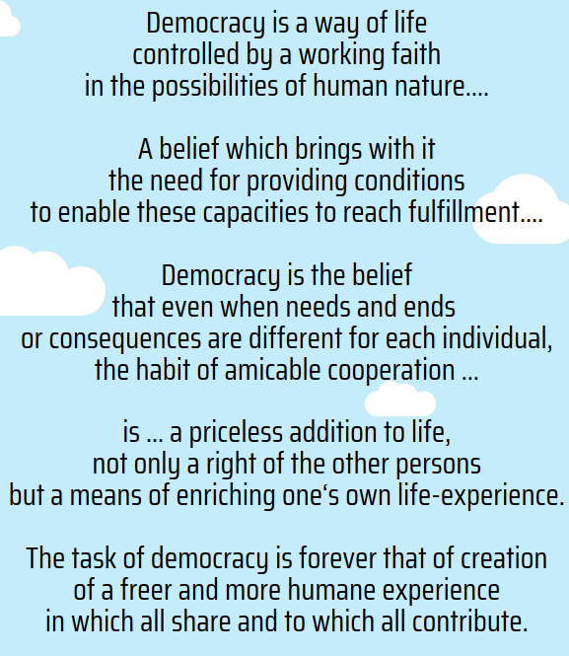
Education for democracy
KTKP020
Extracts from John Dewey’s 1939 text
– Creative Democracy: Task before Us

Slide 2
Aims:
To explore how education for democracy and democracy as part of education has taken shape within Finland
To bring together insights from different readings and Matti Rautiainen’s lecture
To critically consider how democracy can be strengthened as part of education in Finland

Slide 3
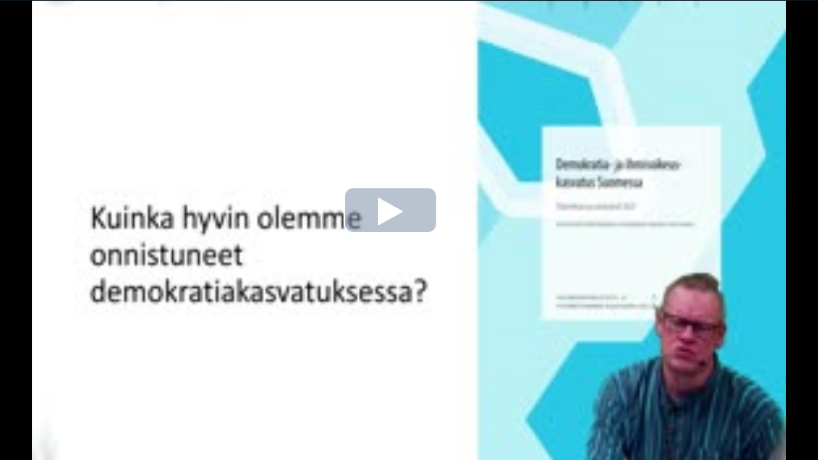
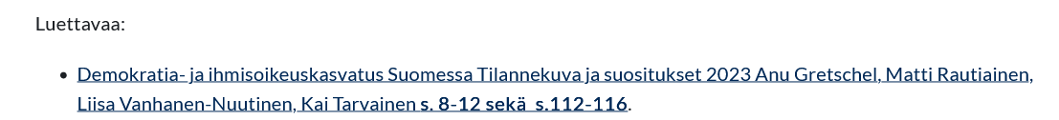
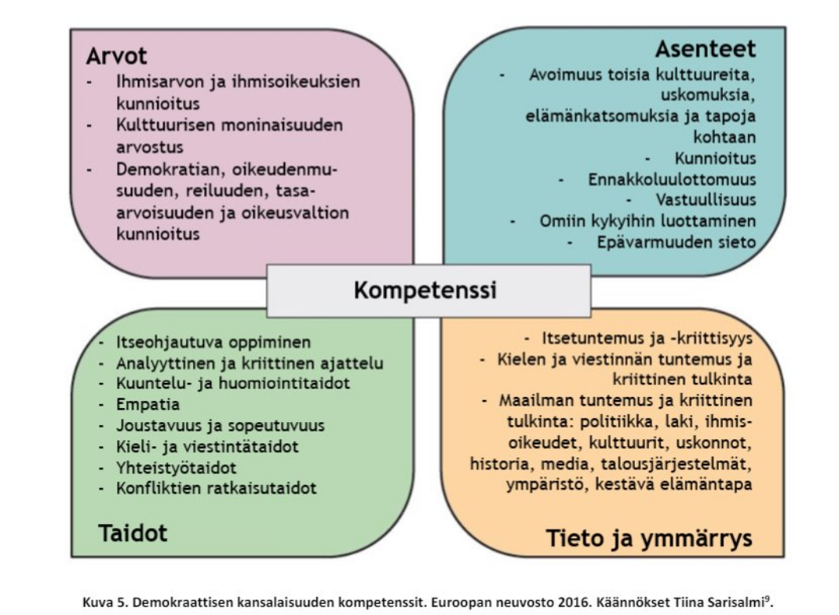
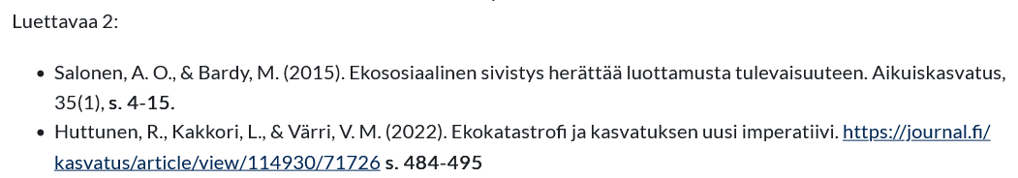
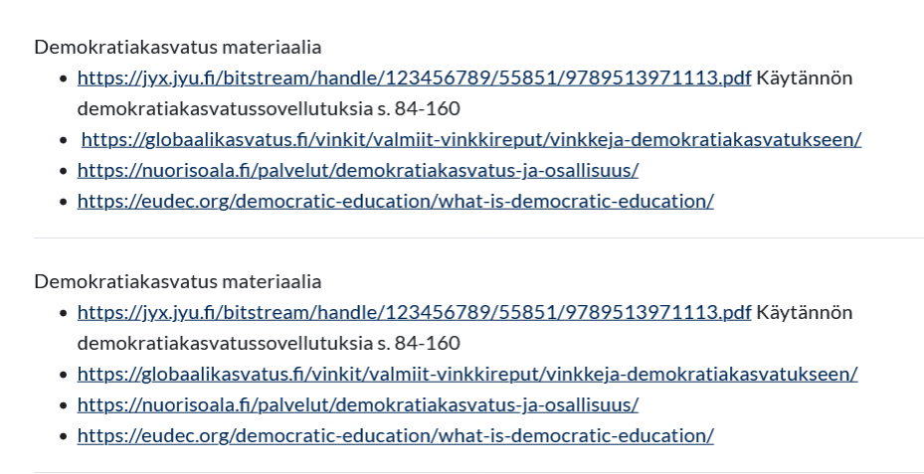
Managing the course & materials for today:

Slide 4
Orientation: What do you think – agree, disagree?
Democracy is the freedom of individuals to decide on their own on actions to pursue their own purposes
Democracy means working together towards the common good – compromising, sharing, debating.
Democracy is a process whereby individuals and government partner each other as they work toward optimal conditions for societal growth
Moate, et al. 2017

Slide 5
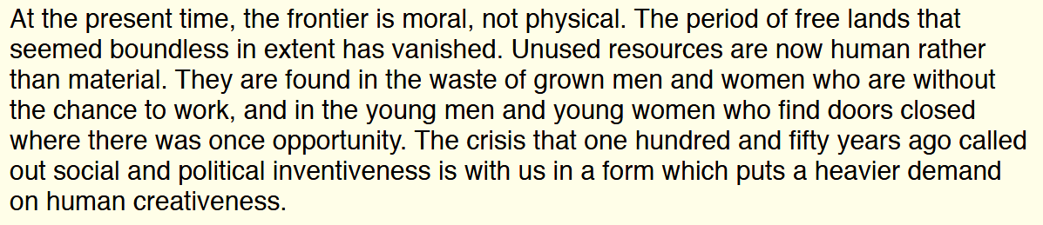
Another extract from Dewey (1939)
But / and:
  A democratic society is precisely one in which the purpose of education is not given but is a constant topic for discussion and deliberation… [however] the current political climate in many Western countries has made it increasingly difficult to have a democratic discussion about the purposes of education (Biesta, 2007:18).

Slide 6
How does the practice of education connect with democracy?
In the sayings - shared ways in which language is used within
and about education
In the doings - mutual actions and resources that belong to and are available for education.
And, in the relatings - the relationships that surround and connect education as a practice and that influence the provision and normative function of education
Kemmis, 2014

Slide 7
In small groups – what have we gleaned so far:
Why?
What?
Education for democracy
Where, when?
How?

Slide 8
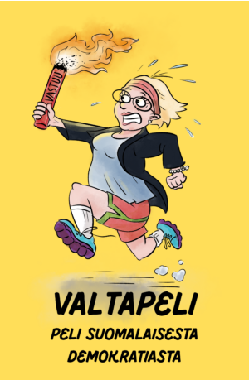

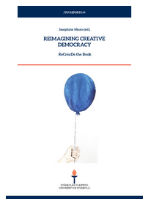
Resources & further explorations

Slide 9
Follow up task
In your observations – what sayings, doings, relatings have been present that either promote, maintain, undermine or prevent education for democracy?

Slide 10
References
Kemmis, S. (2014) ‘Education, educational research and the good for humankind’ in Heikkinen, H.. L.. T., Lerkkanen M-K. and Moate, J. (Eds.) Enabling Education: Proceedings of the annual conference of Finnish Educational Research Association FERA 2013. FERA.
Moate, J., Cousins, S., Cunnah, W., & Ruohotie-Lyhty, M. (2017). Educational research for democracy. In A. Raiker, & M. Rautiainen (Eds.), Educating for Democracy in England and Finland: Principles and Culture (pp. 127-139). Routledge. Routledge Research in International and Comparative Education.
Nikolakaki, M. (2015) ‘Critical Pedagogy and Democracy (Greece) in Darder, A., Mayo P. & Paraskeva, J. (Eds.) International Critical Pedagogy Reader. London: Routledge, pp. 86-96.

