Slide 1
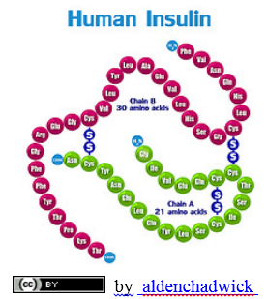
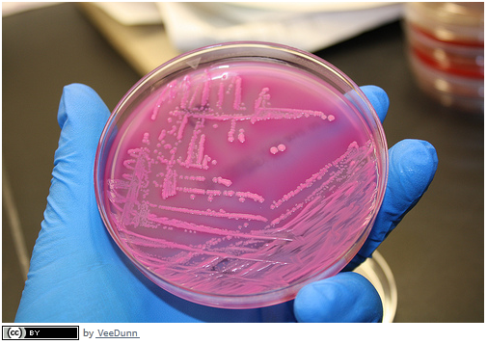
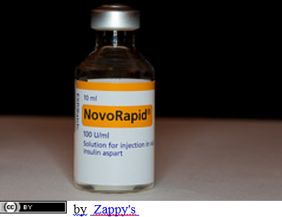
Producing human insulin using a human gene inserted into a bacteria plasmid "Gene Transfer"
© David Faure, InThinking www.biology-inthinking.co.uk

Slide 2
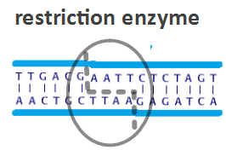
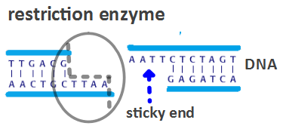
Restriction Enzymes
Restriction enzymes (DNA scissors) Bind to specific DNA sequences Cut the DNA at a specific place Leave 'sticky ends‘ (There are many types of restriction enzyme.)

Slide 3
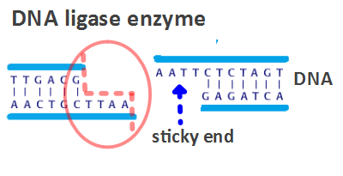
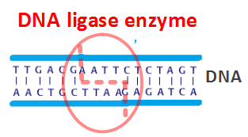
DNA ligase enzyme
Joins together DNA strand Connects the sticky ends together Splices the new gene into DNA

Slide 4
How to produce insulin - step by step
The DNA for insulin is first isolated. A plasmid made of DNA is removed from a bacterial cell. A restriction enzyme cuts the plasmid DNA open, leaving sticky ends. The insulin gene, with complementary sticky ends is added. DNA ligase enzyme splices (joins) together the plasmid DNA and the Insulin DNA. The plasmid (now genetically modified) is inserted back into the bacterium. The bacterium host cell, divides and produces copies of the plasmid? The Bacterium makes human insulin using the gene in the plasmid. The insulin is extracted from the bacterial culture.

Slide 5
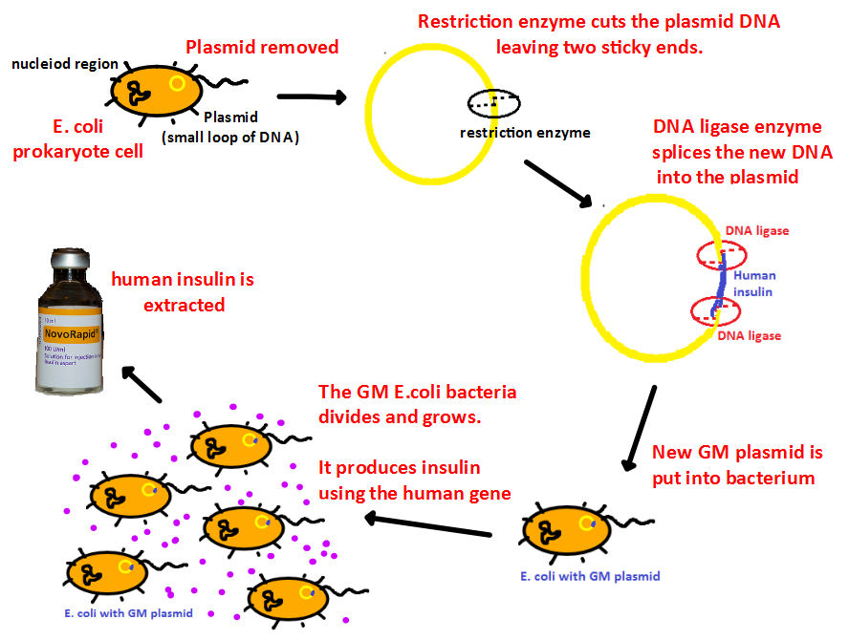
Outline of insulin production

