Slide 1
Knowledge in POlitics

Slide 2
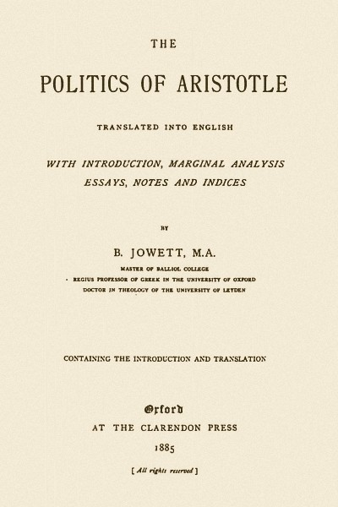
What is Politics all about and how to know that?

Slide 3
Political perspectives and knowledge
Awareness of political perspectives demands conscious engagement AND UNDERSTADING OF THE CONCEPTS
The need to follow news and views critically with awareness of media leanings and the importance of alternative sources of information : OPVL- what was that?
Political perspectives in liberal democracies: “LEFT” AND “RIGHT” : CHOOSE YOUR SIDE ; DISCUSSION ACTIVITY

Slide 4
POLITICAL PERSPECTIVES
Political perspectives ARE closely allied with different kinds of government: How to organize a society ( values & assumptions)
1) monarchy ( or chiefdom of emirate)- someone rules because of hiS OR HER SOCIAL POSITIONS OF BIRTH
2) THEOCRACY- AN ELITE RULES BECAUSE OF HTEIR GREATER KNOWLEDGE OF RELIGION AND THEREBUY THE WILL OF GOD FOR SOCIETY
3) DEMOCRACY- PEOPLE HAVE THE VOTE RULE THEMSELVES THROUGH THEIR ELECTED REPRESENTATIVES

Slide 5
Political perspectives
What assumptions in each case are made about human equality?
What assumptions are made about who knows the best how to govern a society?
What are the likely sources of the values to guide the society?
AUTHORITARIAN SYSTEM: PUBLIC POLITICAL DEBATE ON HOW TO EXERCISE POWER IS LIMITED OR NON-EXISTENT
DEMOCRACY: GOVERNMENT DOES NOT USUALLY EXERCISE DIRECT CONTROL OF KNOWLEDGE

Slide 6
Key concepts to understand knowledge in politics
POWER, SOVEREIGNTY, LEGITIMACY, INTERDEPENDENCE, HUMAN RIGHTS, JUSTICE, LIBERTY , EQUALITY, DEVELOPMENT, SUSTAINABILITY, GLOBALIZATION, INEQUALITY, PEACE, CONFLICT, VIOLENCE, NON-VIOLENCE

Slide 7
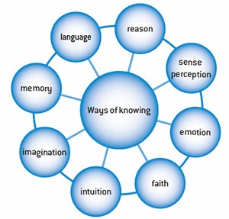
How do you know politics
Which ways of knowing to use? Give examples and explain

Slide 8
No one sees the world just “ as it is”; that is why we need theories
All of us look at the world through a veil of theories, presuppositions and assumptions.
observation and interpretation are bound together: when we look at the world we are also engaged in imposing meaning on it.
theory is important: it gives shape and structure to an otherwise shapeless and confusing reality
Aristotle, Machiavelli, Thomas Hobbes, John locke, John Mearsheimer, Joseph Nye…

Slide 9
Knowledge in POlitics
What lies behind political decisions?
What are the motivations of the various political actors?
On which assumptions do these actors base their beliefs, policies and behaviours?
How do the power dynamics of a situation influence motivations, assumptions and outcomes?
the role of emotions in politics?

Slide 10
How to define Political knowledge?
the study of political knowledge is rooted in democratic theory: people should be informed if they are to participate in a democratic society.
Political knowledge : political sophistication? or political expertise? knowledge is generally defined as ”holding correct information”
Scholars often examine political knowledge as a dependent variable—for example, by examining media effects on political knowledge
political knowledge may lead to political discussion, or it may moderate the relationship between media use and political participation.
Which ways of knowing are useful in acquiring political knowledge? Give Examples!

Slide 11
Knowledge in POlitics
How does knowledge in the social sciences differ from knowledge in other areas?
How does knowledge in politics differ from knowledge in some other social science disciplines, such as economics?
How do nature of political beliefs and biases affect the acquisition of knowledge politics?
How is political science distinct from the practice of politics?
What are the benefits and difficulties of examining political issues?
Why might the value of case studies as a method of acquiring knowledge be considered questionable?

Slide 12
Knowledge in poLitics
Can we have political beliefs or knowledge that are independent of our cultures?
Why do some individuals believe that they know what is right for others?
How do we decide between the opinions of experts when they disagree? Who are the experts in politics?
What is the role of communication and media in shaping people’s perception of issues in politics?
Is it ever justifiable to act without having good grounds or evidence for doing so?

