Slide 1
The French School System and Saint-Joseph High School

Slide 2

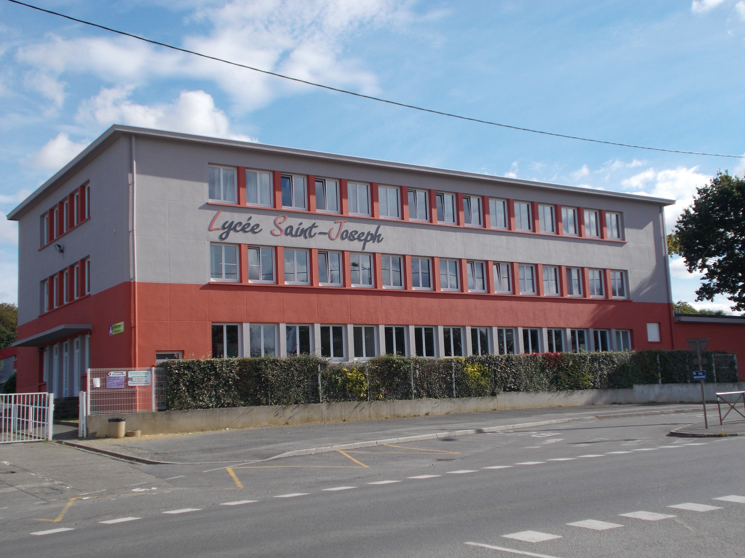
French pupils
1 - “L’École Maternelle” = Preschool in France = 3 to 5 years old
2 - “L’École Primaire” = French Elementary School = 6 to 10 years old
3 - Le Collège = French Middle School = 11 to 16 years old
4 - Le Lycée – High School = 16 to 18 years old at Saint-Joseph!
5 - “L’Enseignement Supérieur” –
Higher Studies in France.
You need to pass "le baccalauréat"
to enter these schools.

Slide 3
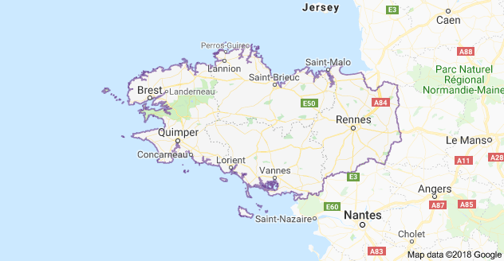
Saint-Joseph High School in Lamballe, in Brittany

Slide 4
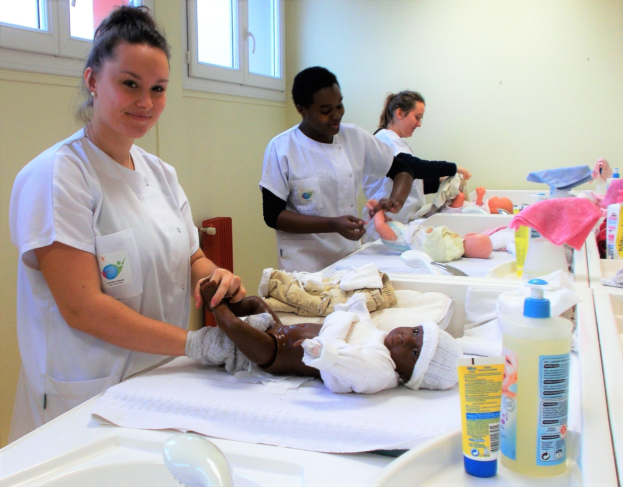
St Joseph High School
750 pupils
About 70 teachers and staff
Training: general/ technological/ professional
Technological
° ST2S= health and social fields
° And soon STMG= management and marketing
Professional = ASSP = health care

Slide 5

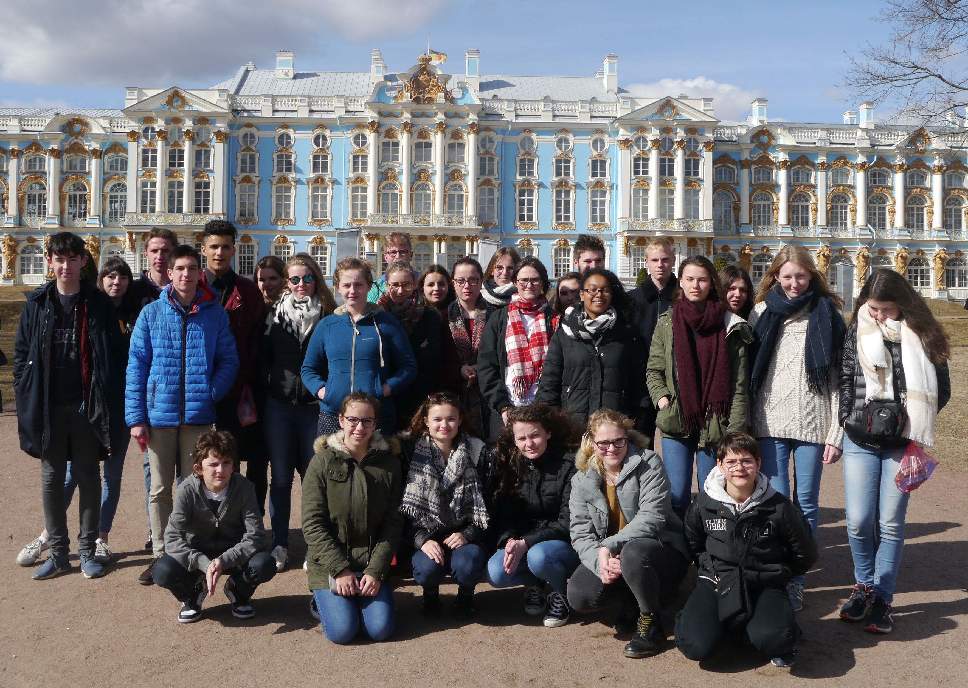
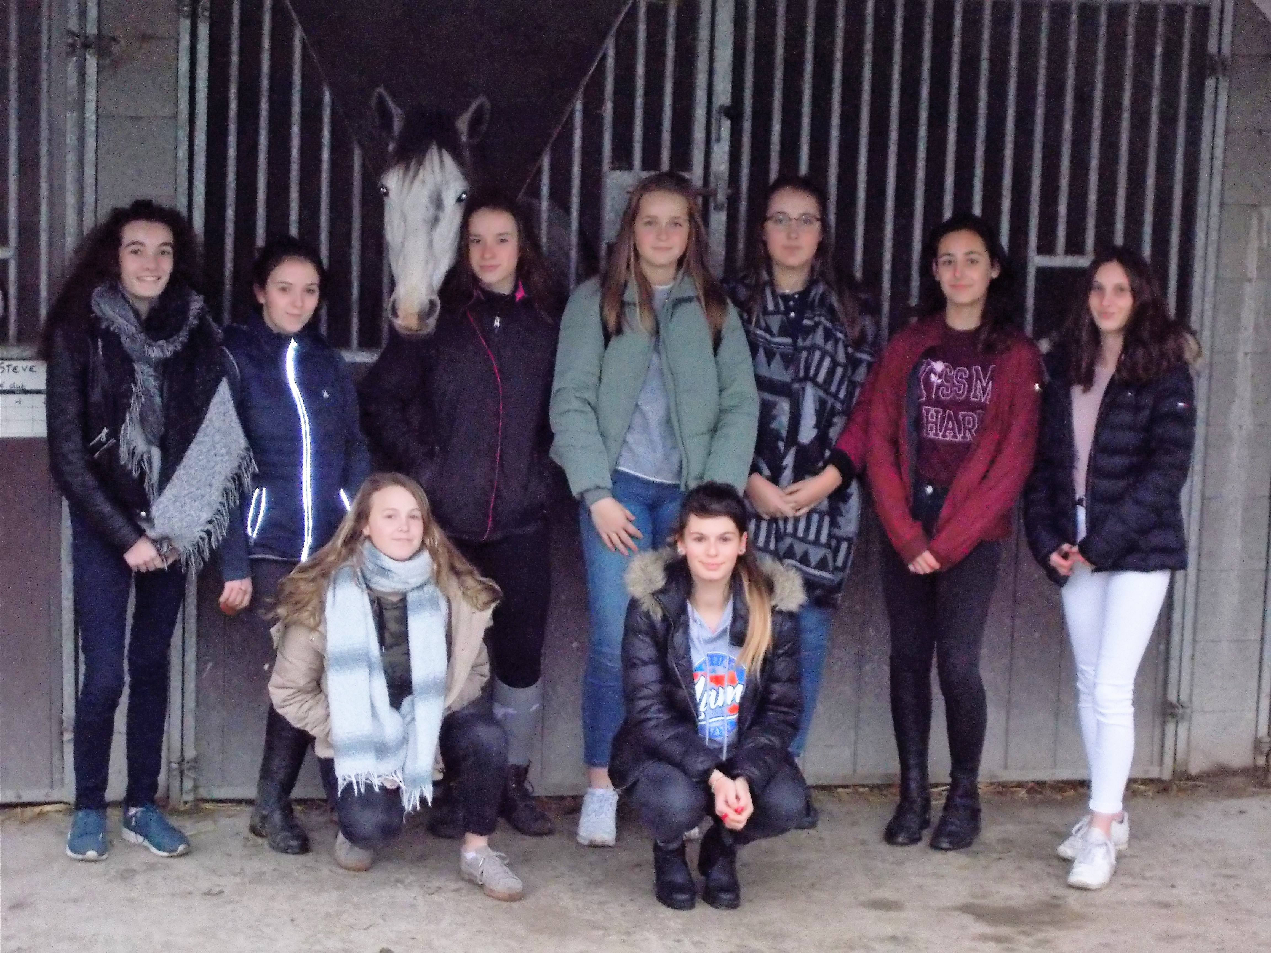
St Joseph High School
- a horse riding section
- an eco friendly school
- Chinese and Russian as third foreign languages

Slide 6
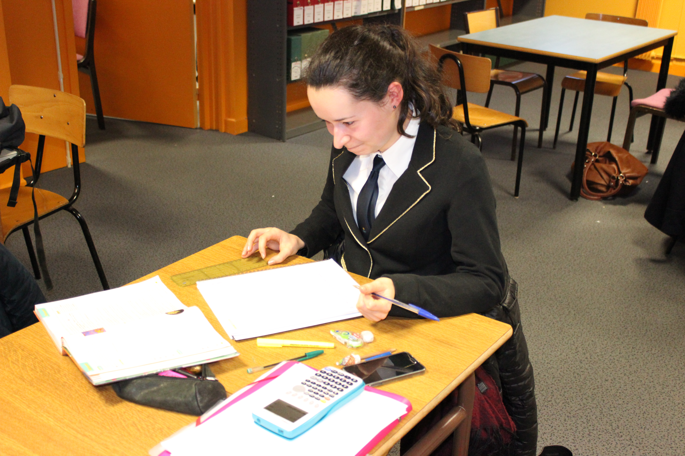
Teaching English as a first language
It starts in primary school.
In secondary school = 4 hours per week, then 3 hours per week.
In high school = 3 and sometimes only 1h30
per week!
In L – the literary series = 6 or 7 hours a week, including literature in English.

Slide 7
Teaching English as a first language
The actional approach.
Tables in groups of 4 pupils.
No translations but various technics = synonyms, antonyms, key words, mime, etc.

Slide 8
Teaching English as a first language
We teach 5 competences which are the listening and the written comprehensions/ the written expression and the oral expressions (EOC and EOI).
The listening comprehension is not guided: the students must listen, take notes and recap in French (10 mn).
The oral exam is also early in the year compared to the written exams, in June.

Slide 9
Teaching English as a first language
Pupils study 4 notions in the school year:
° 'The idea of progress'
° 'Spaces and exchanges'
° 'Locations and forms of power'
° 'Myths and heroes'
and they must find an issue for each notion.

Slide 10
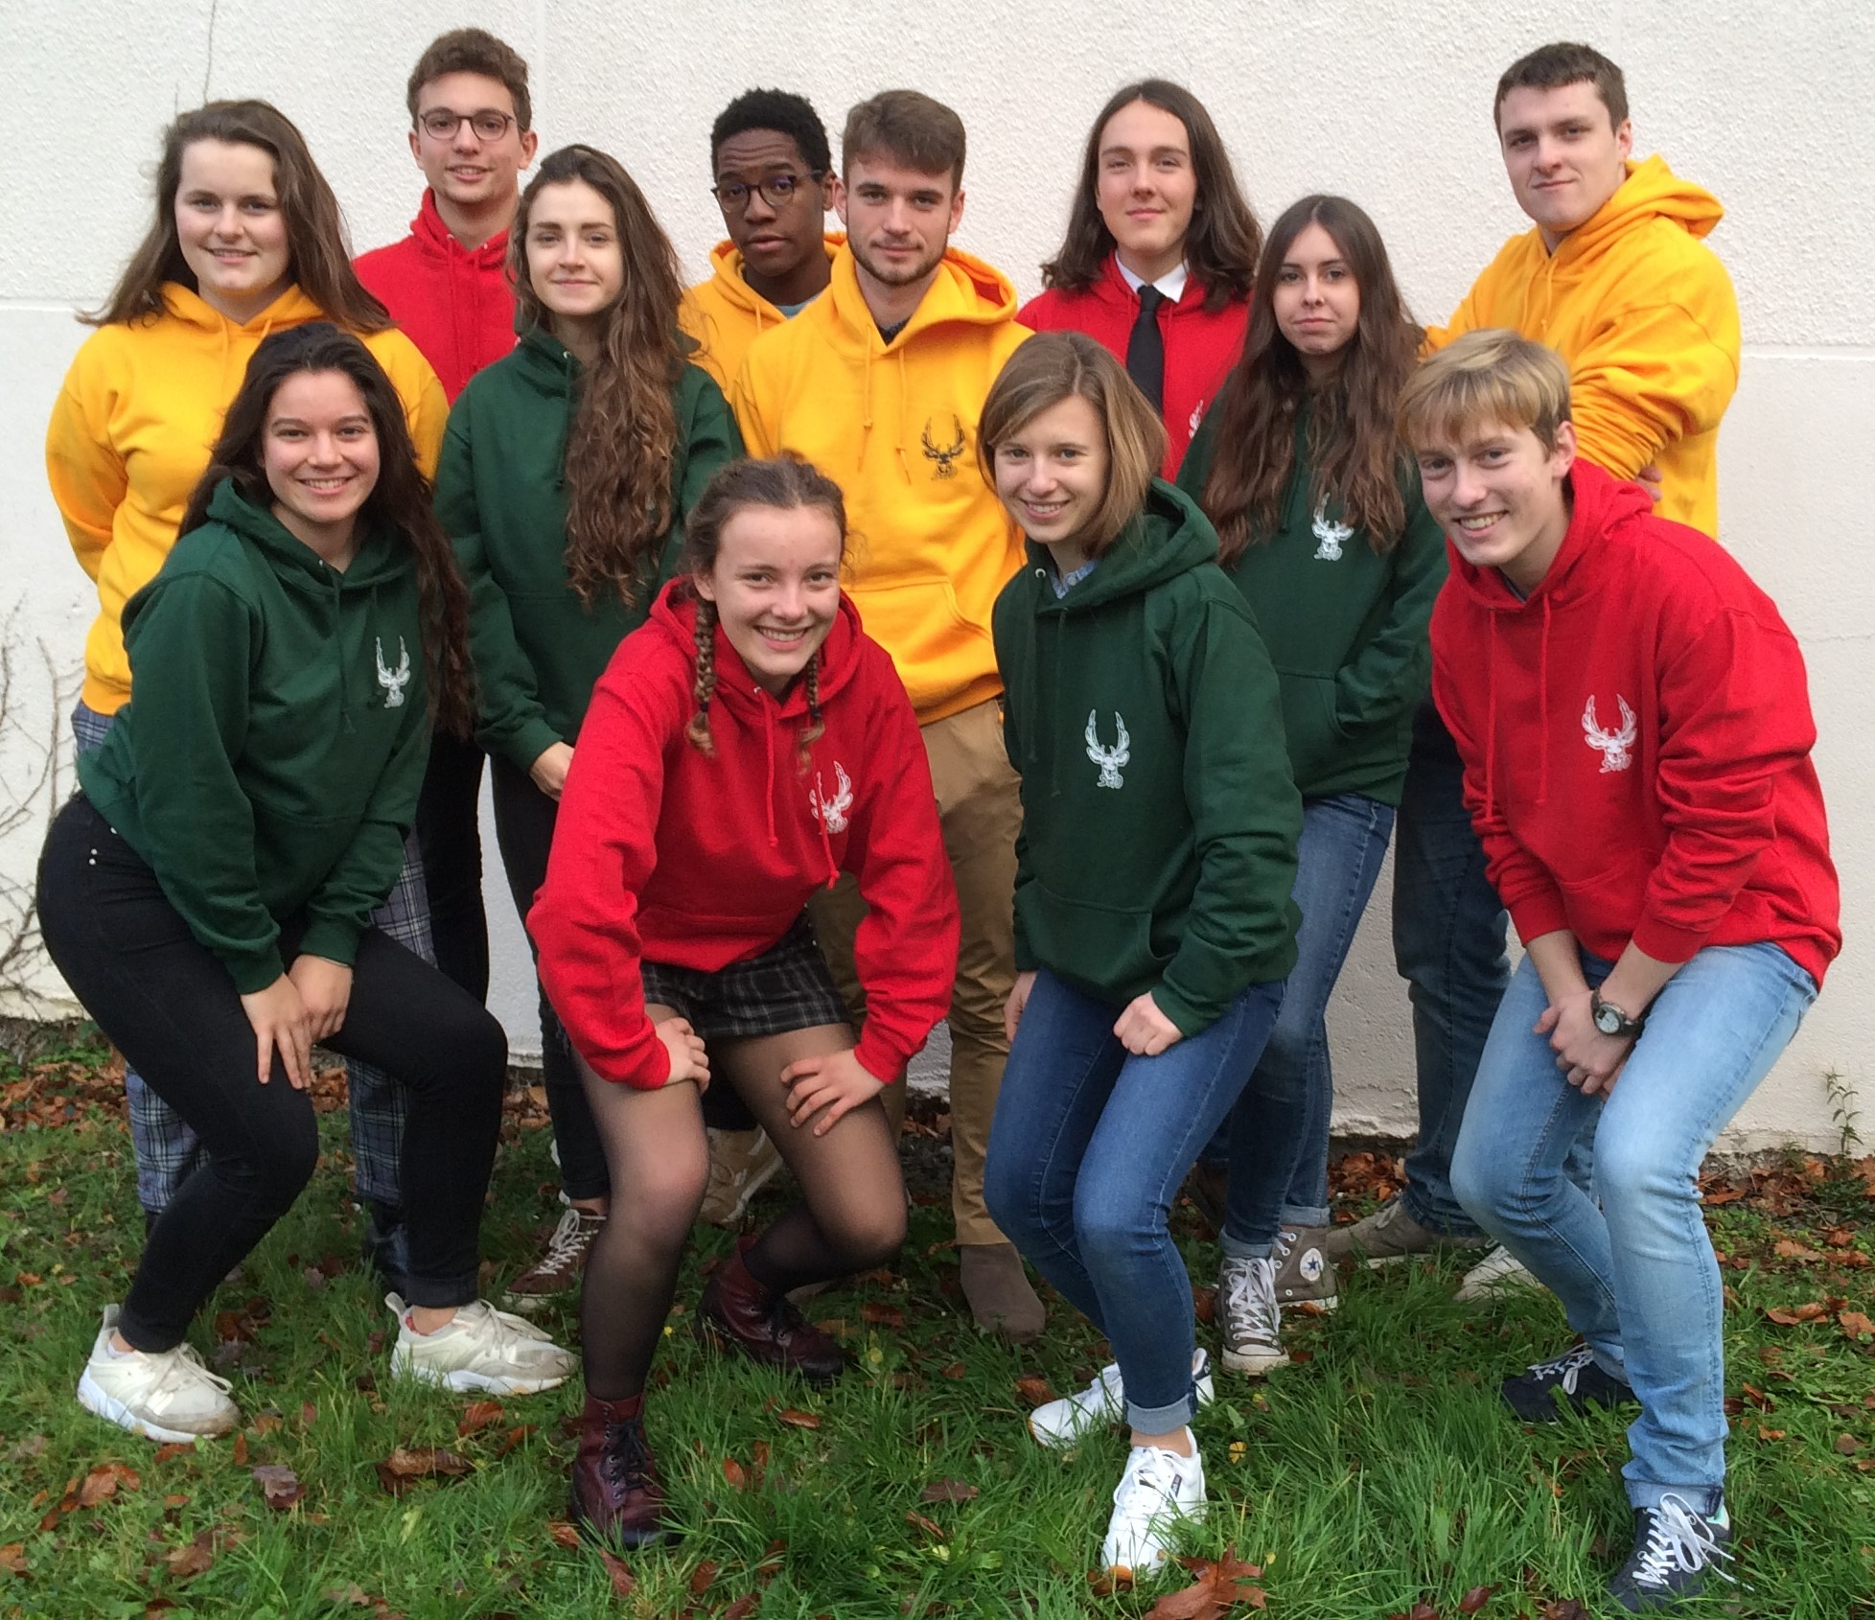
Teaching English as a first language
Pupils are tested in their own school.
A national grid is used for marking.
The orals last for 10 mn (+ 10 mn preparation).
The last 2 written competences are tested in June, with the other subjects.

