Slide 1


Part of D6.1 State of the Art in Personal Learning Environments;
Lang, M. Lounaskorpi, P. Pardo, A

Slide 2
LEARNING SCENARIO
-
USER CASE

Slide 3


Slide 4
TABLE OF CONTENTS
1. INTRODUCTION
1.1. Trends in Technology enhanced learning
1.1.1. Cloud Computing
1.1.2. Wearable Technology
1.1.3. OER
1.1.4. BYOD
1.1.5 Blended Learning
1.1.6. Gamification
1.1.7. Learning Analytics
1.1.8. Automated online assistant
2. PERSONAL LEARNING ENVIRONMENT (PLE) - DEFINITION
2.1. Personalising Learning: A Common Understanding
2.2. PLE and Related Concepts
2.2.1. Hybrid Personal Learning Environment
2.2.2. Lifelong Learning
2.2.3 Learning Analytics and pedagogy
3. FUTURE SCENARIOS FOR LEARNING
3.1. Scenario 1 (Students)
3.2. Scenario 2 (Teachers)
3.3. Scenario 3 (Other Stakeholders)
3.4. Scenarios and design processes
4. PERSONAL LEARNING ENVIRONMENT IN IMAILE PROJECT
4.1. Overview of current PLE technology solutions
4.2. Future Trends in PLE technology solutions
4.3. How PLE solutions should be evaluated
2.4. Challenges of PLE
2.4.1. Learner’s point of view
2.4.2. Teachers point of view
2.4.3. Parent’s (Guardian’s)point of view
5. RECOMMENDED KEY ELEMENTS FOR PLEI
Final words
Notes:
proﬁle

Slide 5
1.1. Trends in Technology enhanced learning
1. Potential impact of Cloud Computing
Cloud computing is commonly used for supporting collaboration, file storage, and access to computing cycles. Large number of available applications rely on cloud technologies. Cloud computing has become the unifying factor among content and applications on the many devices people use in everyday life. The ability to access services and files from any location and on any device offers considerable promise for extending learning beyond the boundaries of the school day.
2. Potential impact of Wearable Technology
Wearable technology may support learning at many levels, but it creates many challenges, including the privacy concerns that are already receiving abundant attention among those writing about Google Glass and concerns about how it might interfere with the learning process. As wearable technology consumes less space than current devices, it will have a big impact in PLE designing.
Wearable Technology may also improve collaboration, allowing users to stay engaged in the same space, while accessing online content. Wearable Technology can also have a important role in Teachers User Interface Design of PLEI. For example Optical head-mounted display (OHMD) can help teacher in many way.
Notes:
proﬁle

Slide 6
1.1. Trends in Technology enhanced learning
3. Potential impact of OER
With OER (Open educational resources) teacher can, for example, browse online photo galleries, select appropriately licensed images, and use them as a learning resource. The advantages of OER extend beyond remixing existing resources. PLE with interface for shared educational resources saves time, since educators do not need to generate components from scratch. Some OER, especially those which provide complete courses, can compensate for teacher shortages, provided learners are sufficiently self-directed and have enough prior knowledge about the subject. Learners also have the benefit of being able to customize their learning experiences with OER
4. Potential impact of BYOD
The BYOD movement in education institutions is being driven by a major challenge that many institutions face — a lack of funds to support one-to-one learning, which is a systemic solution in which every student is provided a laptop or mobile device that can be used to support learning in and outside of the classroom. BYOD makes one-to-one more accessible and it is easier to put into use devices that students already have.
BYOD movement personalizes the learning environment automatically, because device includes usually also personal factors (virtual communities and networks). Next version of BYOD may be WYOD (wear your own device).
Notes:
proﬁle

Slide 7
1.1. Trends in Technology enhanced learning
5. Potential impact of Blended Learning
Blended learning is a formal education program in which a student learns at least in part through online delivery of content and instruction with some element of student control over time, place, path or pace. The engagement of students prior to the interactive sessions can now be formally included as part of their PLE. Learning analytics can provide a detailed account of the effectiveness of these preparatory activities. Requiring students to prepare for certain activities is not a new strategy; it has been used regularly by instructors. However, what is now new is the capacity to monitor the level of engagement and provide a personalized set of resources so that the effectiveness of in-class activities is maximized.
6. Potential impact of learning Analytics
The combination of learning analytics and PLEs offer an ideal platform to observe and foster self-regulated learning. There are numerous psychological theories that have studied aspects such as motivation and self-determination. There are detailed descriptions of the possible stages through which an individual may transition from total disengagement to intrinsic motivation. This trajectory is of the utmost importance in the context of learning. A self-motivated student is capable of regulating the process and taking the experience in her own hands. Learning analytics and PLEs offer the possibility of a nuanced analysis of the current state of the student
Notes:
proﬁle

Slide 8
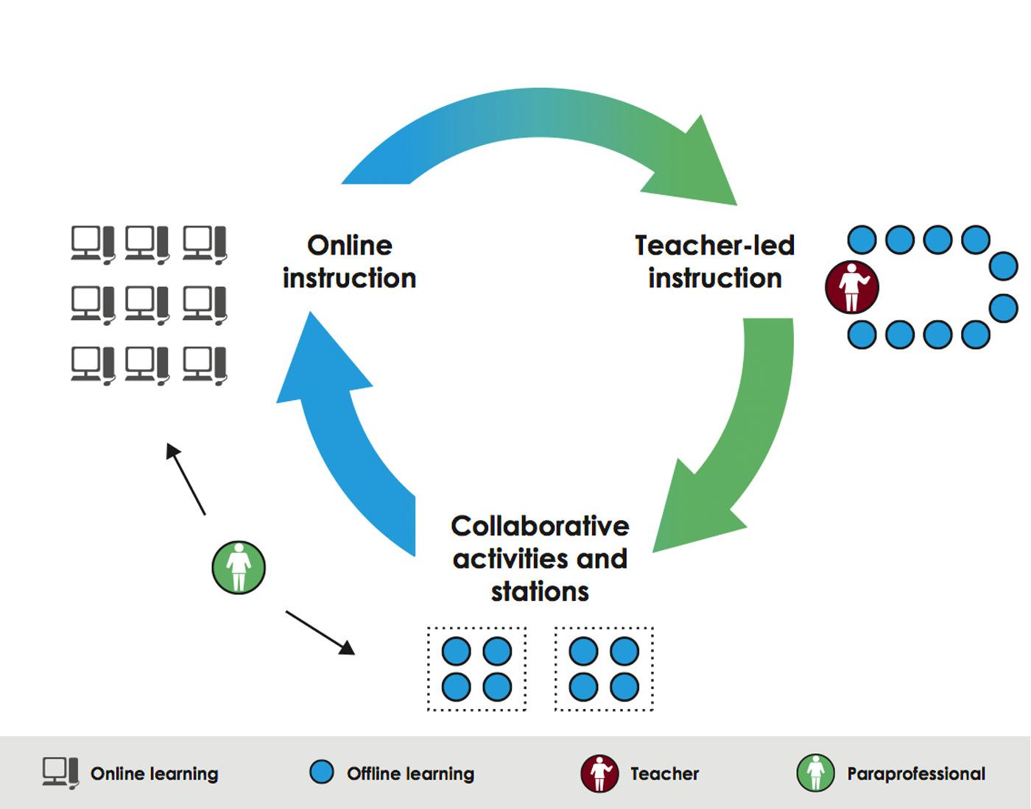
1.1. Trends in Technology enhanced learning
Station-Rotation model of Blended Learning
Notes:
proﬁle

Slide 9
1.1. Trends in Technology enhanced learning
Hybrid Personal Learning Environment (HPLE)
Notes:
proﬁle

Slide 10
1.1. Trends in Technology enhanced learning
7. Potential impact of Gamification
Gamification in learning and Game-based learning are terms easy to mix up. Gamification includes the use of game mechanics not necessarily games. Game mechanics can be used in Learning Environments and them are for example:
Achievements (are a virtual or physical representation of having accomplished something)
Blissful Productivity (is the idea that playing in a game makes you happier working hard)
Bonuses (are a reward after having completed a series of challenges)
Combos (are used often in games to reward skill through doing a combination of things)
Community Collaboration (is game dynamic wherein an entire community is rallied to work together)
Countdown (is the dynamic in which players are only given a certain amount of time to do something)
Discovery (also called Exploration, players love to discover something, to be surprised)
Epic Meaning (players will be highly motivated if they believe they are working to achieve something great)
Free Lunch (a dynamic in which a player feels that they are getting something for free due to someone else having done work)
Levels (are a system, or "ramp", by which players are rewarded)
Ownership (is a powerful Game Dynamic that creates Loyalty)
Progression (a dynamic in which success is granularly displayed)
Status (the rank or level of a player)
Notes:
proﬁle

Slide 11
1.1. Trends in Technology enhanced learning
8. Potential impact of automated online assistant
“An automated online assistant (OA) is a program that uses artificial intelligence to provide customer service or other assistance on a website. Such an assistant may basically consist of a dialog system and an avatar. Automated online assistants have the ability to provide customer service during 24 hours a day and 7 days a week.”
Wikipedia
The dialog systems of many automated online assistants have integrated chatterbots, giving them more or less ability of engaging in small talk or casual conversations unrelated to the scope of their expert systems, or simply making the dialog feel more natural. Avatar of an automated online assistant may be called an interactive online character or automated character. It makes the automated online assistant a form of embodied agent.
If an virtual avatar (automated online assistant teacher) have a possibility to use learning analytics and e-mentoring tools, it can provide an ideal learning assistant service to observe and foster self-regulated learning.
Notes:
proﬁle

Slide 12
3.4. Scenarios and design processes
Teachers' work has become easier and learning processes have become more transparent.
My teacher said that the PLEI will be my teaching assistant and my virtual mother from now on.
Petri has guided me in when and how I should work.
A lot of things I would certainly have forgotten, if Petri was not there reminding and guiding me.
My first task was to tell to Petri what kind of timetable i have.
One of the best things in PLEI has been the fact that I can travel in time.
Automatic timelining has helped me especially in preparing for exams.
On a parallel timeline I have been able to see lessons, guidance of my teachers, comments and questions.
Working with PLEI gives you credits and points.
If we are having a team work, we can send a time capsule of our group or team.
As a senior student I have also been able to study courses in other schools.
I used my PLEI and employer saw that I have been working hard at school and I can express myself in many ways
PLEI can be opened and edited using any device that is online and has a web browser.
Through the use of PLEI teachers have noticed that students are more active and engaged in designing their own learning strategies.
PLEI has also been supporting better contact between student and teachers.
PLEI has a surprising important role in the formation of learning landscape of the 21st century education.
Notes:
proﬁle

Slide 13
PLE- PLATFORM
Lang & Lounaskorpi

Slide 14
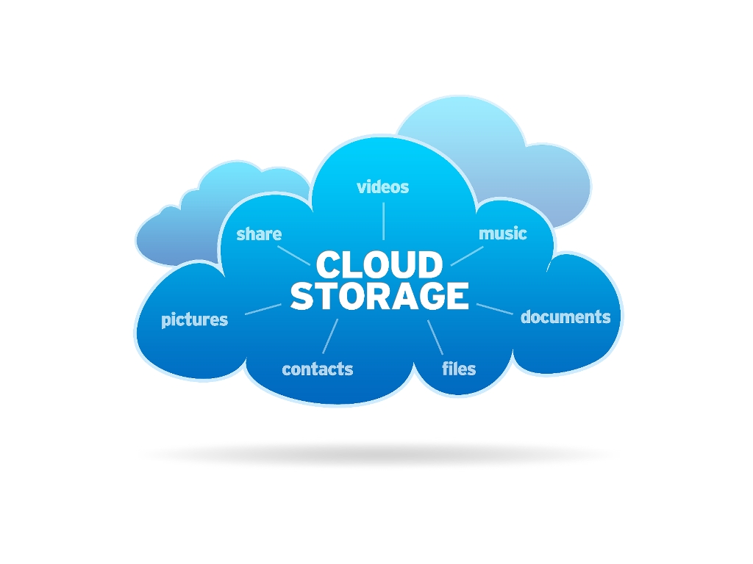
STUDYING IN THE CLOUD
What one needs?

Slide 15
STUDYING IN THE CLOUD
What one needs?
DropBox
ICloud
IlonaIT cloud
Moodle
IT*s Learning
Blackboard
Fronter

Slide 16

STUDYING IN THE CLOUD
What one needs?
DropBox
Icloud
IlonaIT cloud
Office 365
Google Drive
Moodle
IT*s Learning
Blackboard
Fronter
Online Tools
Ethernet

Slide 17

STUDYING IN THE CLOUD
What one needs?
DropBox
Icloud
IlonaIT cloud
Office 365
Google Drive
Moodle
IT*s Learning
Blackboard
Fronter
Online Tools
Ethernet
-SanomaPro
Learning
E-Materials
- eBooks
Dicaios
OER

Slide 18
STUDYING IN THE CLOUD
What one needs?
DropBox
Icloud
IlonaIT cloud
Office 365
Google Drive
Student
Moodle
IT*s Learning
Blackboard
Fronter
Online Tools
School
Parents
Ethernet
-SanomaPro
Learning
E-Materials
- eBooks
Dicaios
OER

Slide 19
STUDYING IN THE CLOUD
What one needs?
DropBox
Icloud
IlonaIT cloud
Office 365
Google Drive
Student
Moodle
IT*s Learning
Blackboard
Fronter
Online Tools
Teacher
School
Parents
Ethernet
-SanomaPro
Learning
E-Materials
- eBooks
Dicaios
OER

Slide 20
STUDYING IN THE CLOUD
What one needs?
DropBox
Icloud
IlonaIT cloud
Office 365
Google Drive
Student
Moodle
IT*s Learning
Blackboard
Fronter
Online Tools
Teacher
School
Parents
Ethernet
-SanomaPro
Learning
= PLE
E-Materials
- eBooks
Dicaios
OER

Slide 21
Own Space PLE
The lifespan of orientation, school autonomy. formal and informal learning reunion, free installation, follow-up to ensure the development
Personalized learning platform and proﬁle, their own tools, their own learning networks
Their own learning goals, manage their own learning processes of their own learning identification, evaluation and visualization of
The extension of the learning environment. mobilius and Playfulness
Notes:
proﬁle

Slide 22
Learners, Parents, Teachers, Administration,
School, Home, Free time, Hobbies
Own Space PLE
The lifespan of orientation, school autonomy. formal and informal learning reunion, free installation, follow-up to ensure the development
Personalized learning platform and proﬁle, their own tools, their own learning networks
Their own learning goals, manage their own learning processes of their own learning identification, evaluation and visualization of
The extension of the learning environment. mobilius and Playfulness
Notes:
proﬁle

Slide 23
Learners, Parents, Teachers, Administration,
School, Home, Free time, Hobbies
Environmental
and device
independence
Own Space PLE
The lifespan of orientation, school autonomy. formal and informal learning reunion, free installation, follow-up to ensure the development
Personalized learning platform and proﬁle, their own tools, their own learning networks
Their own learning goals, manage their own learning processes of their own learning identification, evaluation and visualization of
The extension of the learning environment. mobilius and Playfulness
Notes:
proﬁle

Slide 24
Learners, Parents, Teachers, Administration,
School, Home, Free time, Hobbies
Environmental
and device
independence
Own Space PLE
The lifespan of orientation, school autonomy. formal and informal learning reunion, free installation, follow-up to ensure the development
Personalized learning platform and proﬁle, their own tools, their own learning networks
Their own learning goals, manage their own learning processes of their own learning identification, evaluation and visualization of
The extension of the learning environment. mobilius and Playfulness
The interfaces
Login interfaces
Study materials
Interfaces to other e- learning platforms and gaming environments
The interface of social services
Notes:
proﬁle

Slide 25
Learners, Parents, Teachers, Administration,
School, Home, Free time, Hobbies
Environmental
and device
independence
Own Space PLE
The lifespan of orientation, school autonomy. formal and informal learning reunion, free installation, follow-up to ensure the development
Personalized learning platform and proﬁle, their own tools, their own learning networks
Their own learning goals, manage their own learning processes of their own learning identification, evaluation and visualization of
The extension of the learning environment. mobilius and Playfulness
The interfaces
Login interfaces
Study materials
Interfaces to other e- learning platforms and gaming environments
The interface of social services
The school's learning
platform
School’s learning
platform
E- learning materials
Leisure facilities
Leisure facilities
Web pages, information and communication
Work of subjects, classes and categories, projects
Online courses
Parents
Home-School co-operation
Learning environment, customisation of learning materials
Publishers, learning materials, learning games, e-books
OER
Teachers sharing materials
Clubs
Associations
Or similar
Notes:
proﬁle

Slide 26
Learners, Parents, Teachers, Administration,
School, Home, Free time, Hobbies
Environmental
and device
independence
Community Service
Content sharing and public management
Community and learning networks
Identification of the roles of the learner, the teacher and parent
Own Space PLE
The lifespan of orientation, school autonomy. formal and informal learning reunion, free installation, follow-up to ensure the development
Personalized learning platform and proﬁle, their own tools, their own learning networks
Their own learning goals, manage their own learning processes of their own learning identification, evaluation and visualization of
The extension of the learning environment. mobilius and Playfulness
The interfaces
Login interfaces
Study materials
Interfaces to other e- learning platforms and gaming environments
The interface of social services
The school's learning
platform
School’s learning
platform
E- learning materials
Leisure facilities
Leisure facilities
Web pages, information and communication
Work of subjects, classes and categories, projects
Online courses
Parents
Home-School co-operation
Learning environment, customisation of learning materials
Publishers, learning materials, learning games, e-books
OER
Teachers sharing materials
Clubs
Associations
Or similar
©Jarkko Lampinen, University of Jyväskylä
Notes:
proﬁle

Slide 27
TRYING TO VISUALIZE THIS

Slide 28


Slide 29
RECOMMENDED KEY ELEMENTS FOR PLEI
Lang & Lounaskorpi

Slide 30
5. RECOMMENDED KEY ELEMENTS FOR PLEI
After analysing Trends and Scenarios we can found features PLEI (Personal Learning Environment in IMAILE project) should have.
PLEI has a Cloud Computing supporting interface.
PLEI makes it faster to create learning materials and easier to tailor the learner environment.
PLEI supports usage of resources with different standards.
PLEI is independent of the operating systems and can be used with different devices.
PLEI supports different models of Blended Learning.
PLEI uses innovatively different game mechanics.
PLEI uses effectively learning analytics.
PLEI takes automated online assistance to the next level
PLEI is also a tool for Lifelong learning.
PLEI has an innovative UID for visualizing and helping processes in learning and in teaching.
Notes:
proﬁle

