Slide 1
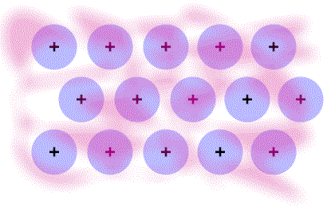
BONDING OF METALS
In metals, the valence electrons become detached from atoms
These electrons are delocalized; they basically surround a very closely-packed lattice of positive ions
This closeness of the cations allows metals to have the properties they do; the cations can slide over one another without breaking more bonds than they make
Metals are both malleable (they can be bent and reshaped under pressure) and ductile (they can be drawn out into a wire
Alloys are impure metals that disturb the pure lattice. They are harder than pure metals.
Sea of delocalized electrons

