Slide 1
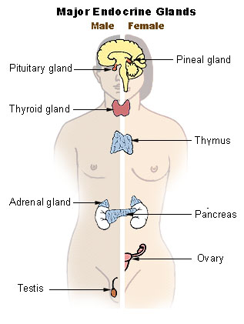
OPTION D: HORMONAL CONTROL
Endocrine glands secrete hormones directly into the blood, via which, they travel to targeted cells
Steroids: estrogen, testosterone, progesterone
Peptides: insulin, antidiuretic hormone or vasopressin(ADH), Thyroid releasing hormone(TRH)
Tyrosine derivatives: thyroxin

Slide 2
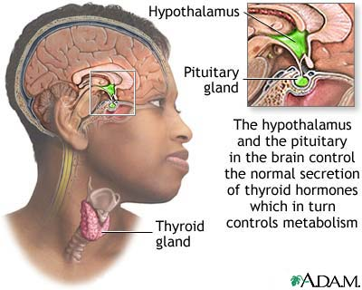
HYPOTHALAMUS AND PITUITARY
Hypothalamus acts as a link between endocrine and nervous systems
Controls the secretion of hormones by the pituitary
These hormones released by the pituitary control hormone release of other endocrine glands
Growth
Developmental changes
Reproduction
Homeostasis
Anterior and posterior lobes of the pituitary are controlled in different ways
Anterior synthesizes its own
Posterior stores hormones that have traveled via neurosecretory cells
Pages 697-698

Slide 3
HORMONES
Two main types of hormones: steroid (insoluble in H₂O) and peptides (H₂O soluble)
Steroid and the other insoluble hormones (a few amines) enter cells that they target
Bind to receptor proteins (hormone-receptor complex is formed)
This complex regulates gene transcription (binds to certain genes), promoting and inhibiting
This is a means of controlling the activity of a target cell
cell
Steroid hormone
Steroid hormone

Slide 4
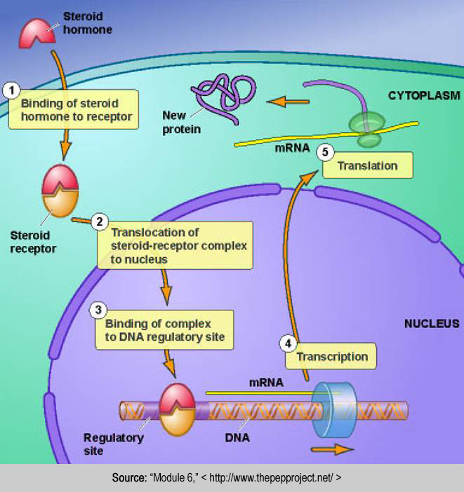
The receptor-hormone complex promotes the transcription of specific genes

Slide 5
SECRETION OF ADH, A PEPTIDE HORMONE
Aka vassopressin
A diuretic is something that causes urination (e.g. caffeine)
ADH works on the kidneys to prevent formation of urine
Neurosecretory cells in the hypothalamus synthesize ADH
Travels down axons and stored in pituitary gland (posterior lobe)
Osmoreceptor cells in hypothalamus monitor ADH levels
If H₂O level in blood is too low, ADH is secreted(hypertonic urine formed)
If osmoreceptor cells detect low concentration of plasma, neurosecretory cells are not stimulated to release ADH
Pages 697-698
Thank
You,
ADH!

Slide 6
HORMONES
Peptide hormones bind to receptors in the plasma membrane
This binding causes release of a messenger inside the cell
This messenger changes the cell activity via activation or inhibition of an enzyme
Calcium ions and cAMP are common
Receptor site on cell membrane
Peptide hormone
Messenger molecule

Slide 7
When hormones bind to receptors, a messenger inside the cell mediates a series of events

Slide 8
THYROXIN
Increase in metabolic rate as well as strength and frequency of heart beats
Neurosecretory cells in the hypothalamus secrete thyrotropin releasing hormone into capillaries
TRH arrives at the anterior lobe of the pituitary via the portal vessel
TSH (thyroid stimulating hormone) is secreted by gland cells in anterior pituitary
Some of this TSH reaches the thyroid gland
TSH stimulates the release of thyroxin…levels are monitored by cells in the anterior pituitary
Body cells are stimulated to increase metabolic rate (heat generation rises)
If blood thyroxin levels are too high, secretion of TSH is reduced
Hypothalamus monitors body temp. By increasing or decreasing TRH secretion
Correct functioning of the thyroid requires iodine in the diet
Lack of sufficient iodine results in a goiter (p. 695)

Slide 9
Hormones
Task: Form pairs. Each member will research either regulation of milk secretion (p.698) or injection of growth hormone by athletes (699) and then teach their partner about the subject.

