Slide 1
5.2.3 BIOLOGICAL BASE OF MEMORY
IB Psychology LAJM

Slide 2
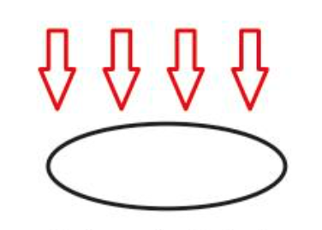
RESEARCH: Holism
An attempt to explain human behaviour in all its complexity
All factors need to be taken into consideration
WHAT PROBLEMS ARISE?

Slide 3
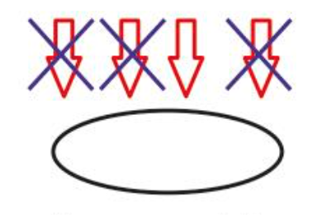
RESEARCH: Reductionism
(1) An attempt to reduce the factors influencing human behaviour
(2) An attempt to reduce complex higher-level phenomena into simpler lower-level phenomena
WHAT PROBLEMS ARISE?

Slide 4
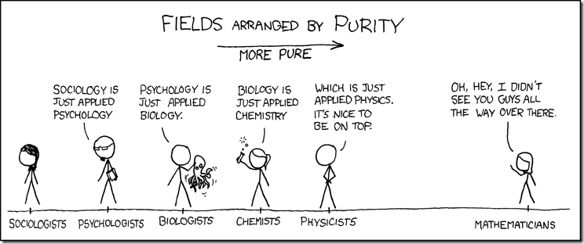
RESEARCH: Reductionism
IS EVERYTHING JUST APPLIED PHYSICS?
OR SOMETHING ELSE?

Slide 5
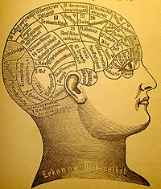
TASK
To what extent are holistic and reductionistic explanations of human behaviour valid?
Provide opposing and supporting arguments for both holism and reductionism

Slide 6
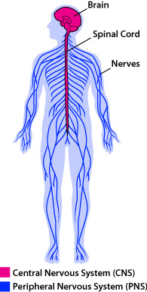
Neuron
Neuron = nerve cell
Neuron ≠ nerve
Our nervous system consists of circa 86–100 billion neurons (estimates vary)

Slide 7
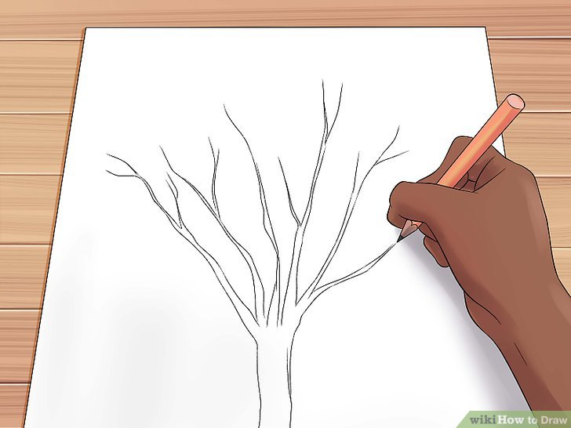
TASK
Draw a neuron with the help of the teacher

Slide 8
TASK
Read the teacher’s handout
What are the functions of neuron’s parts?
Write the functions down on your drawing of a neuron
Find out what sensory neurons, motor neurons and interneurons are
What are the main functions of these types of neurons?
Where can we find these neurons?

Slide 9
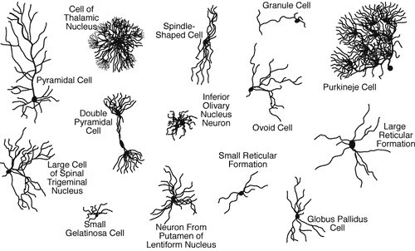
Neuron

Slide 10
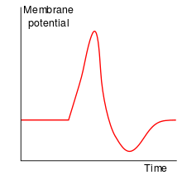
Action Potential
Nerve impulse, a function unique to nerve cells
Information within a neuron is conveyed electrically in the form of action potentials

Slide 11
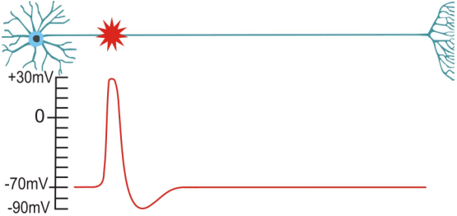
Action Potential

Slide 12
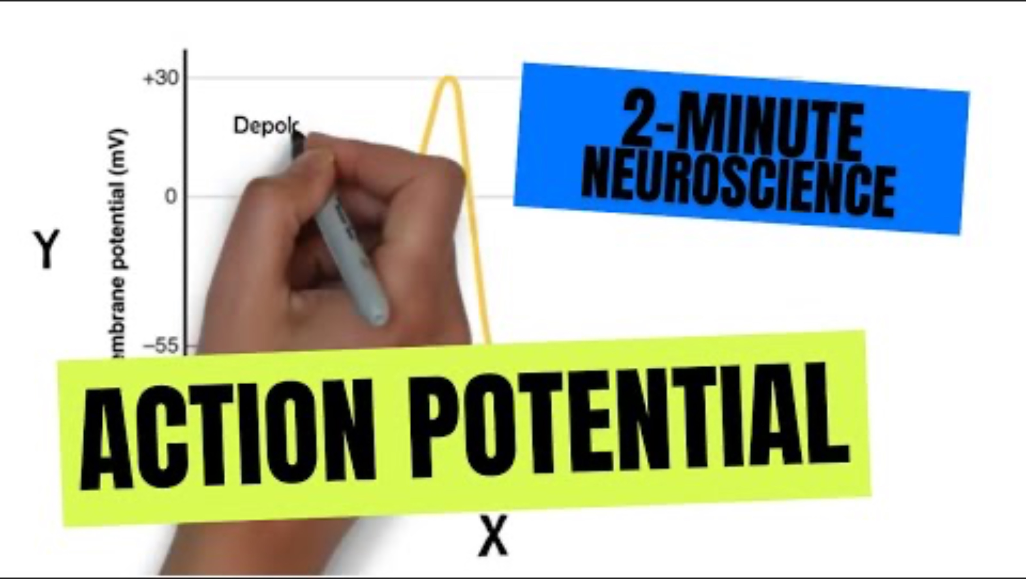
Action Potential

Slide 13
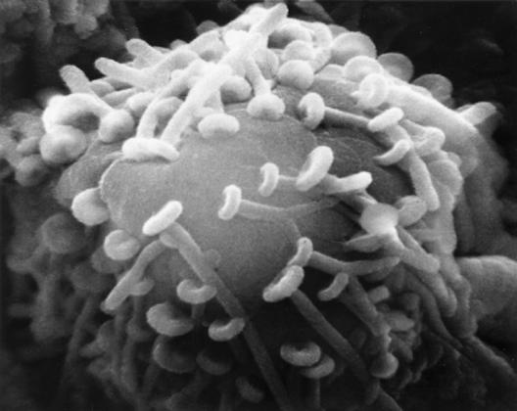
Synaptic transmission
Synapse is a junction between the axon terminal and the receiving neuron
Information between neurons is conveyed chemically through synapses

Slide 14
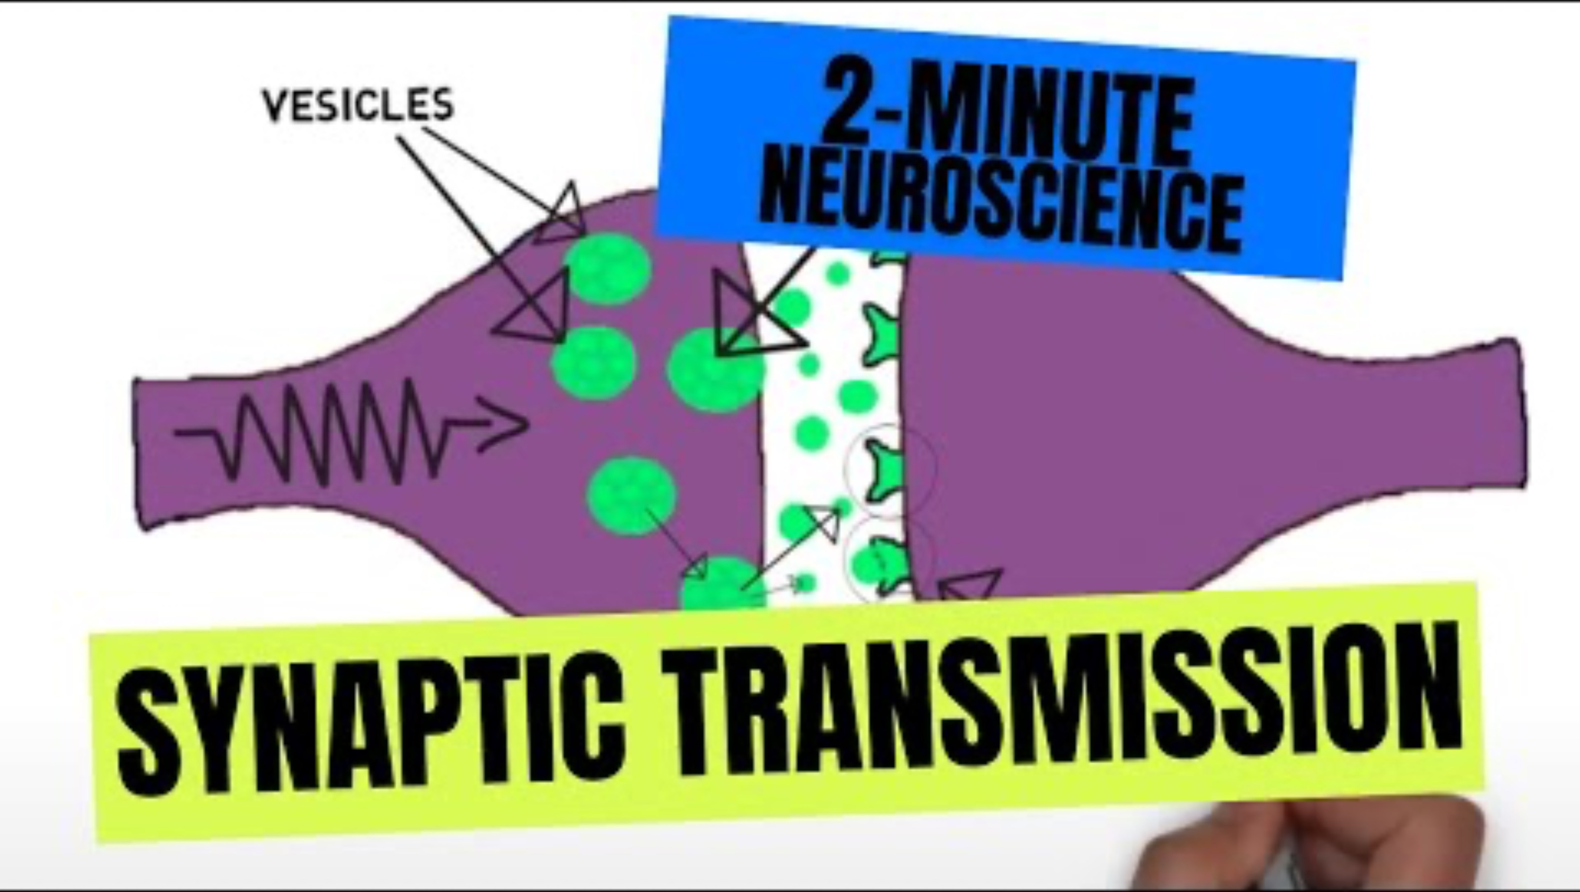
Synaptic transmission

Slide 15
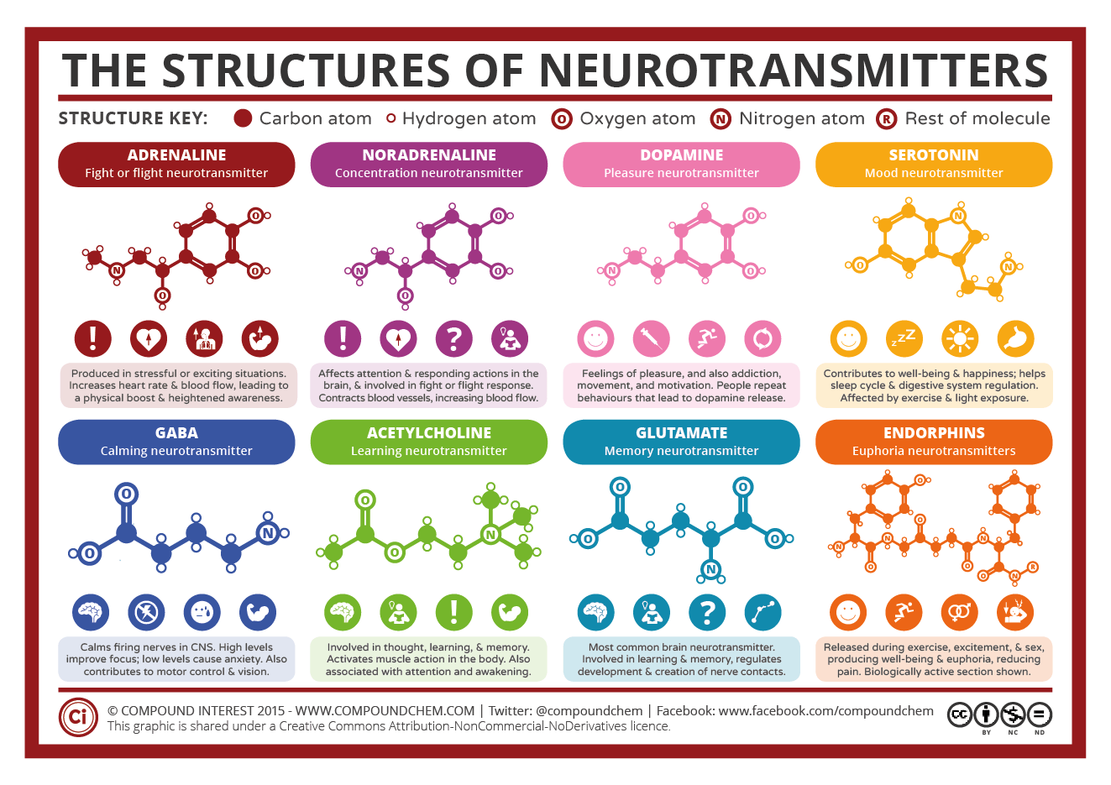

Slide 16
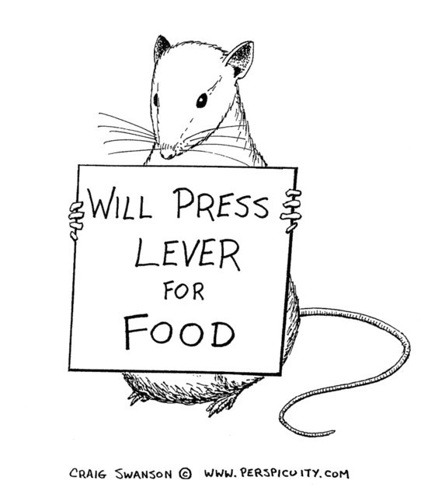
TASK
Read the teacher’s supplementary material on Rogers and Kesner (2003)
What kind of evidence does it provide for the role of neurotransmission in memory functions?

Slide 17
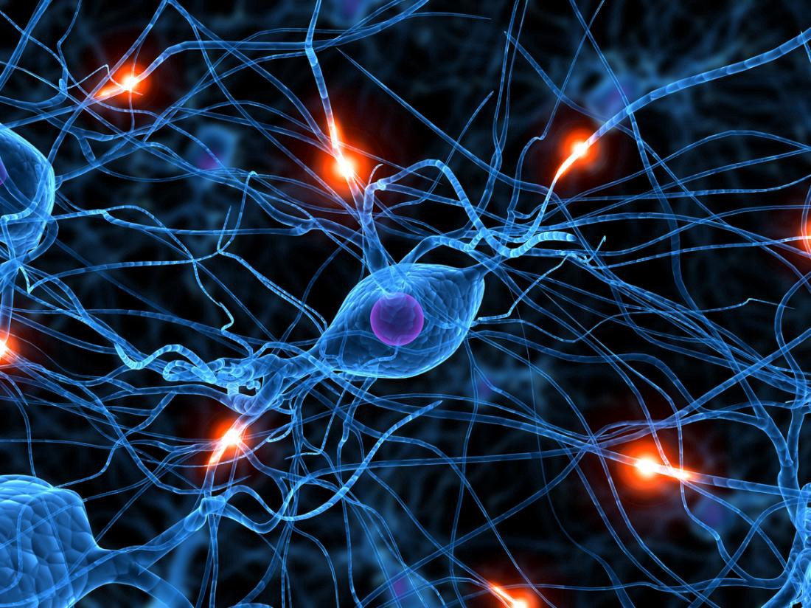
Neuroplasticity
Synaptic connections between neurons form neural networks
Changes in neural networks is termed neuroplasticity

Slide 18
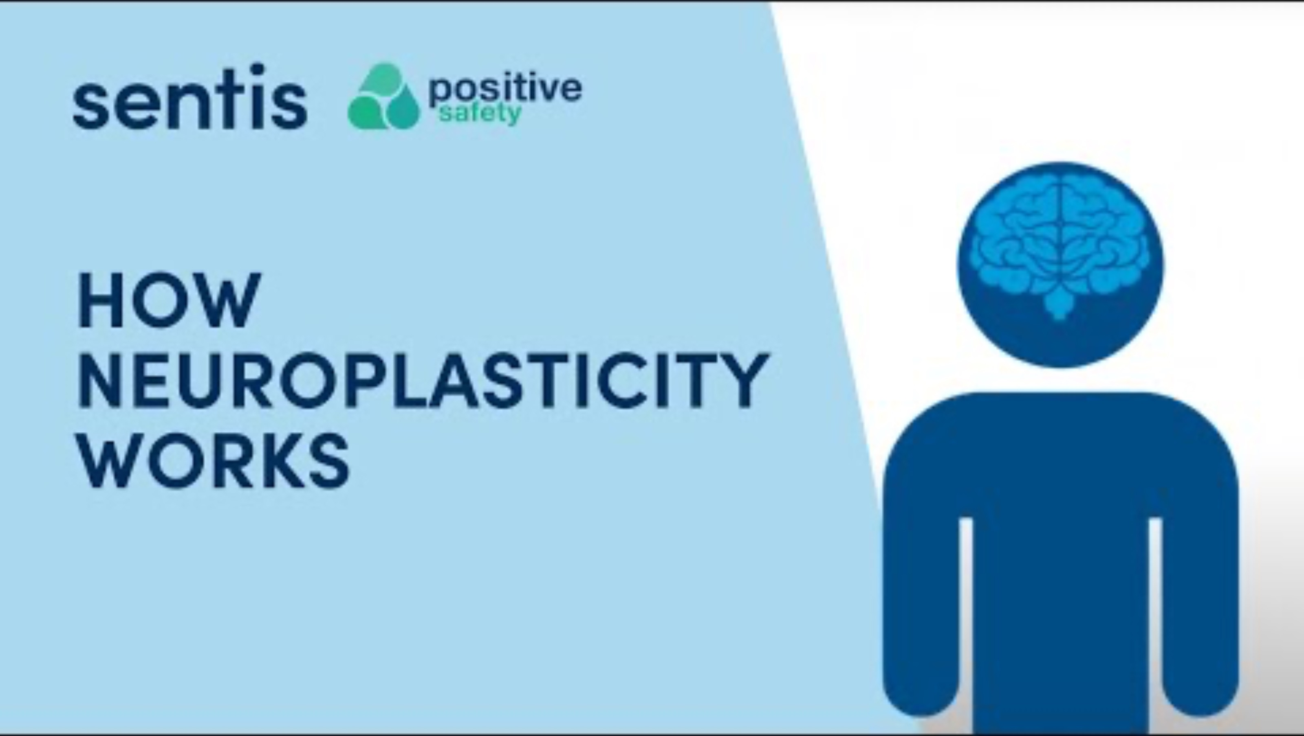
Neuroplasticity

Slide 19
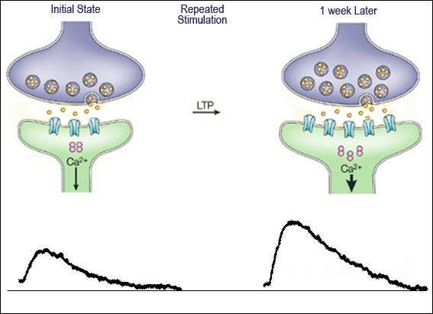
Neuroplasticity
Long-term potentiation
Strengthening of synapses based on frequent activation
Produces a long-lasting increase in information transmission between neurons

Slide 20
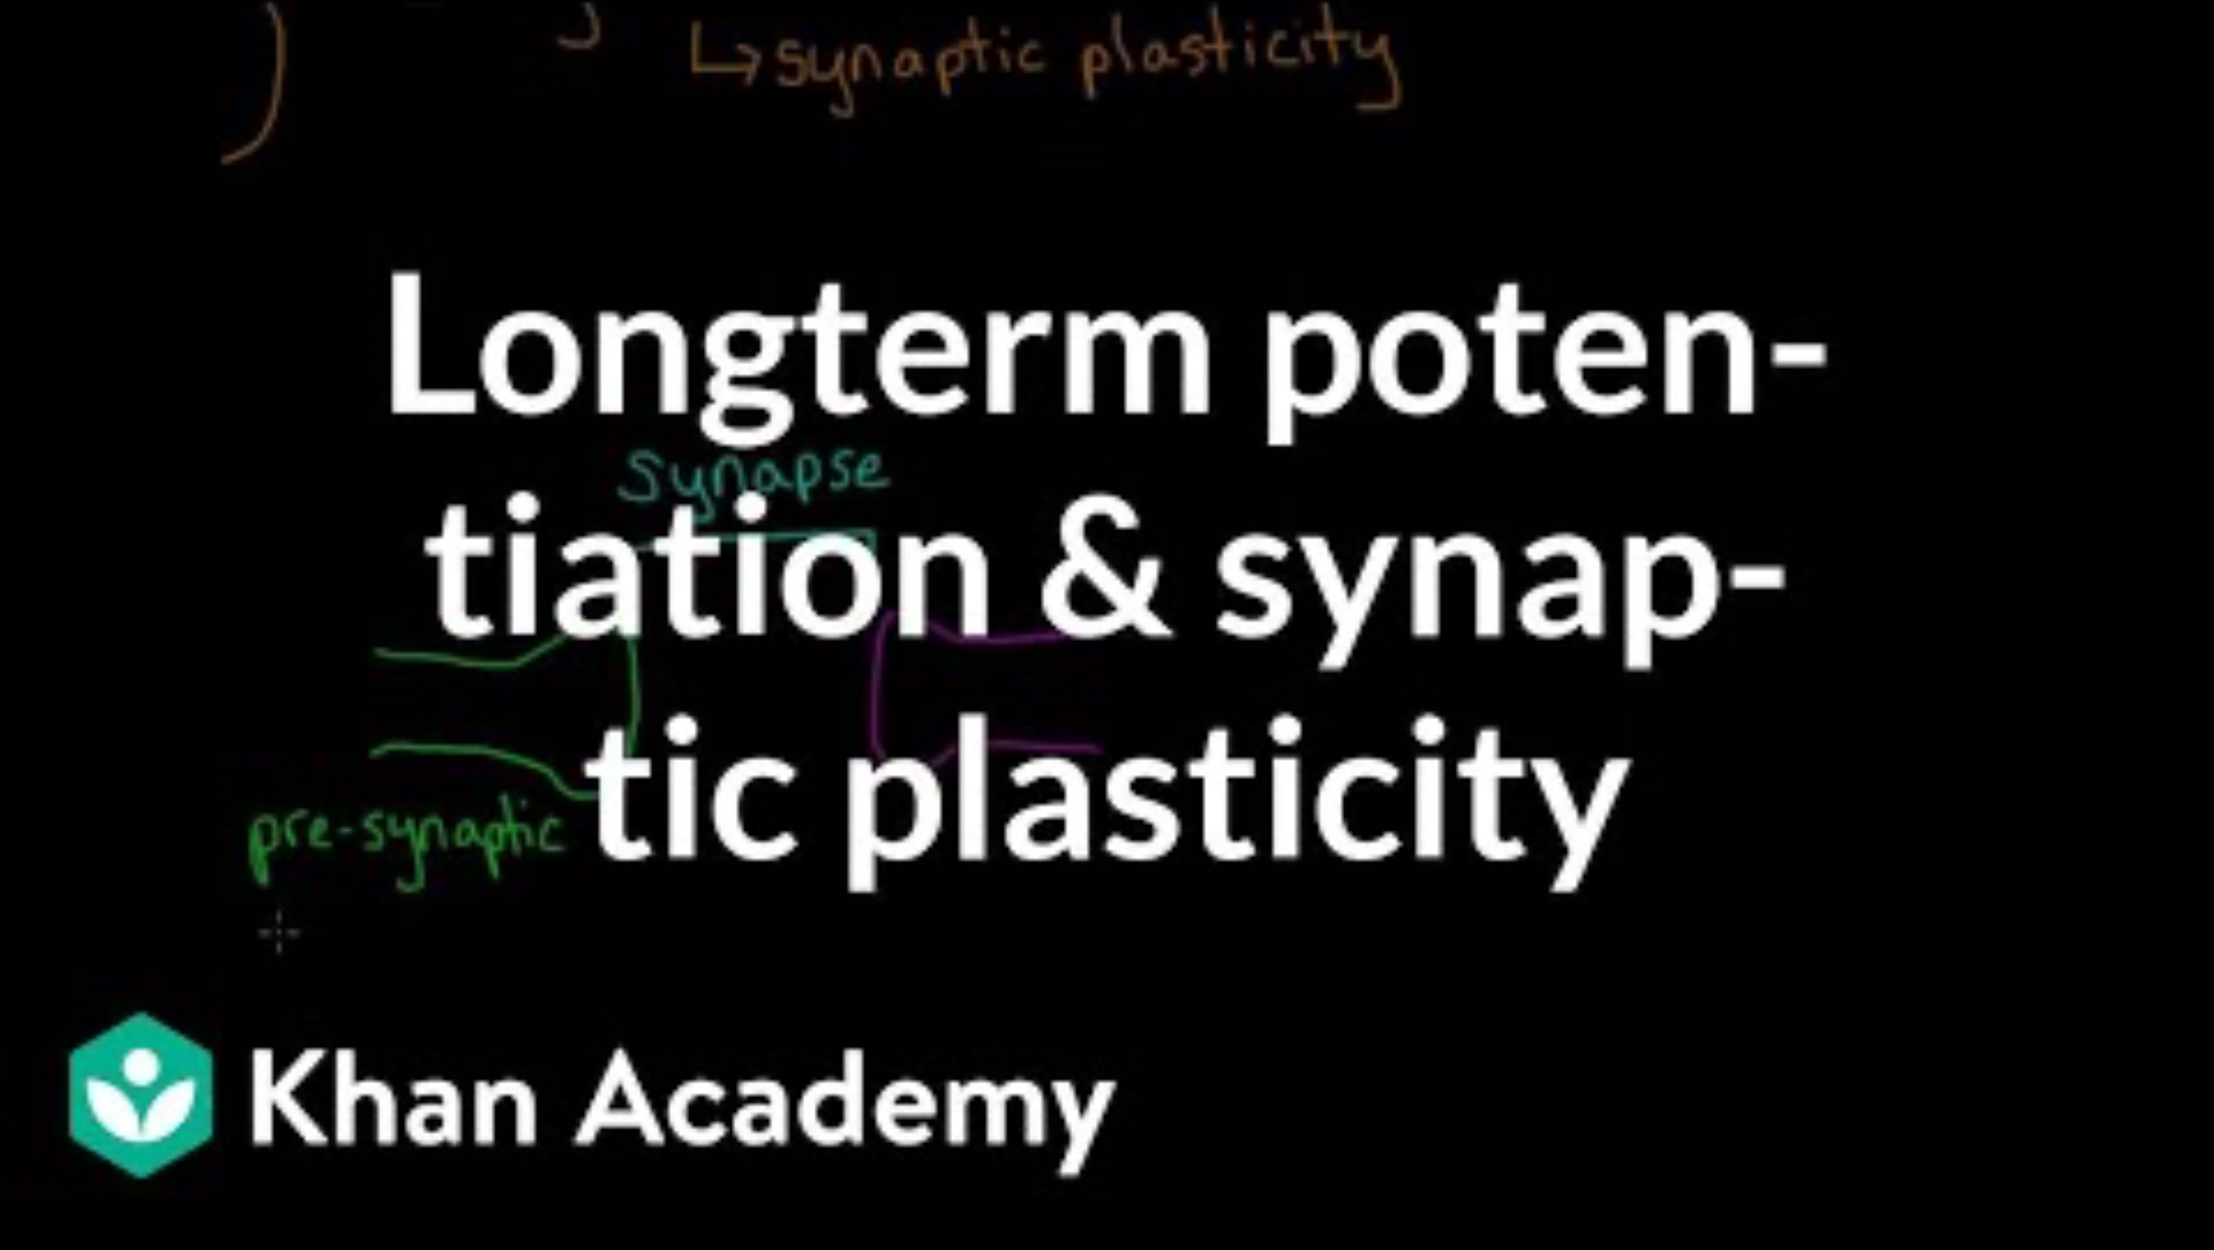
Neuroplasticity

Slide 21
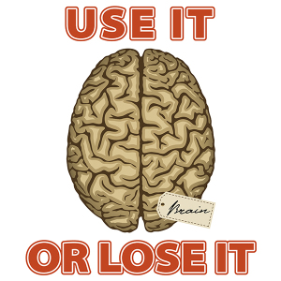
Neuroplasticity
Long-term potentiation leads to dendritic branching
When a synapse is not used, it may undergo synaptic pruning

Slide 22
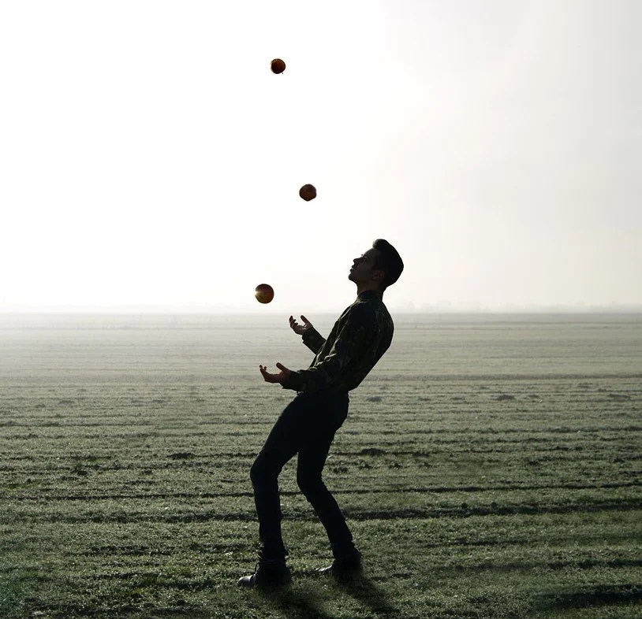
TASK
Read the teacher’s supplementary material on Draganski et al. (2004)
What kind of evidence does it provide for neuroplasticity?

Slide 23
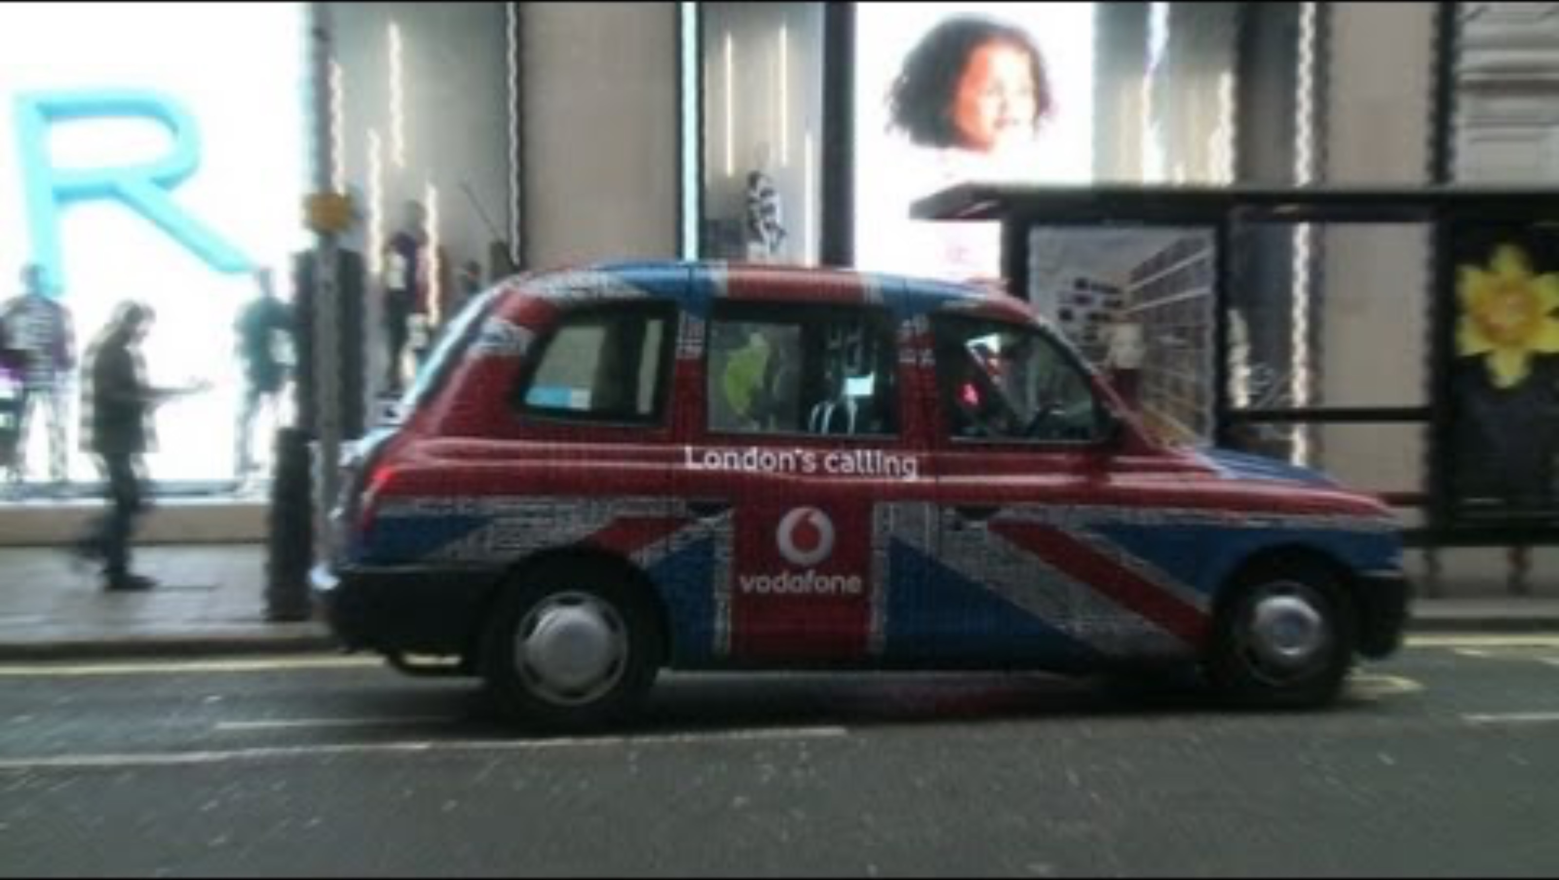
Neuroplasticity

Slide 24
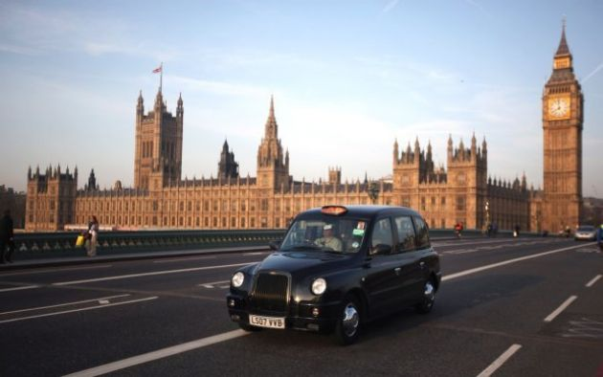
TASK
Read the summary of Maguire et al. (2000) from Kognity 5.2.11
What kind of evidence does it provide for neuroplasticity?
How is Maguire et al. (2000) different from Draganski et al. (2004)?

Slide 25
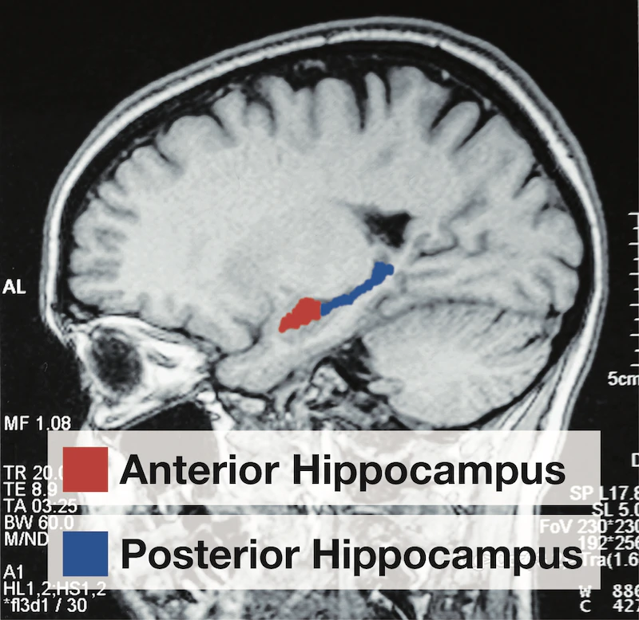
RESEARCH: Types of Experiments
Quasi-experiment
Allocation into groups is done on the basis of pre-existing differences
Researchers do NOT manipulate the IV
Weak cause-effect inferences can be made
True experiment
Allocation into experimental groups is done randomly
Researchers manipulate the IV
Strong cause-effect inferences can be made
HOW IS QUASI-EXPERIMENT DIFFERENT FROM
TRUE-EXPERIMENT

Slide 26
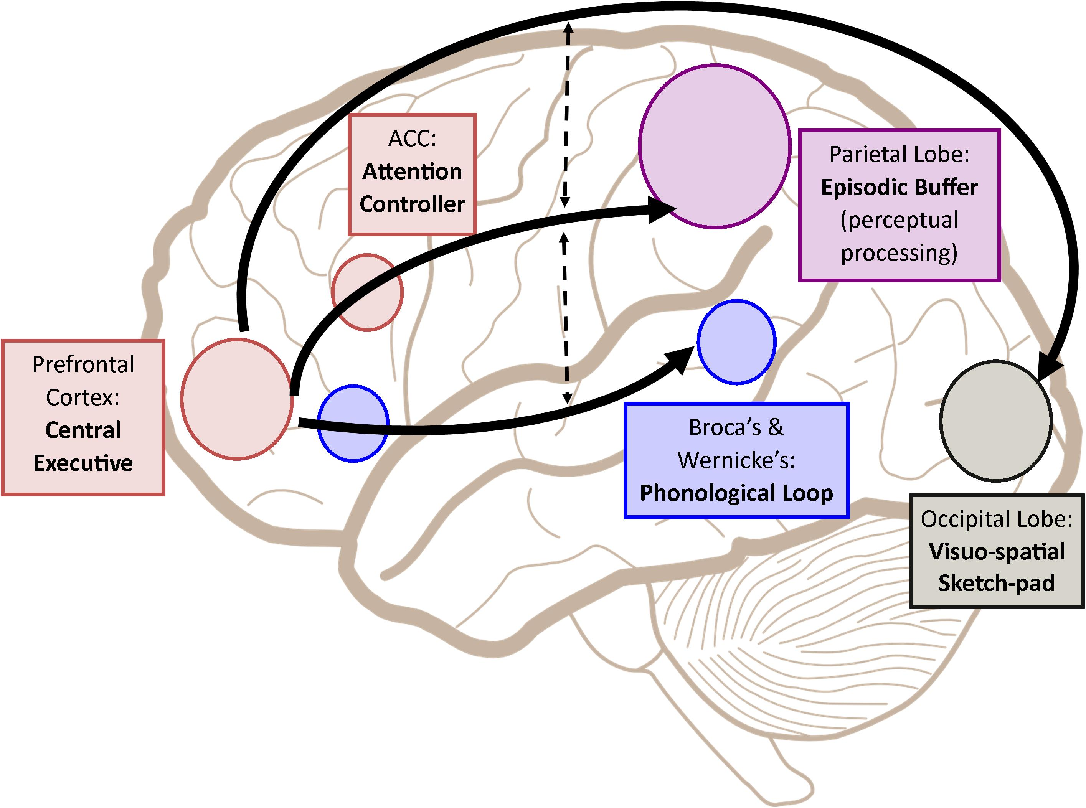
Localization of Functions
Specific parts of the brain are responsible for specific behaviour or cognitive process

Slide 27
TASK
Four expert groups are formed:
(1) Hippocampus
(2) Cerebellum
(3) Basal ganglia
(4) Amygdala
Each expert group creates a brain gallery output based on Kognity 5.2.3 and uploads it to ManageBac
What is the role of your assigned brain region in relation to memory?
What happens if there is damage to this part of the brain?
Include a summary of one research study related to your brain part

Slide 28

TASK
When outputs are ready, mixed four person groups are formed
Present, teach each other and engage in conversation!

Slide 29

TASK
Do the ”Activity sheet: To what extent is memory a valid source of knowledge?” in Kognity 5.2.5
Do the ”Key terms” task in Kognity 5.2.9

Slide 30
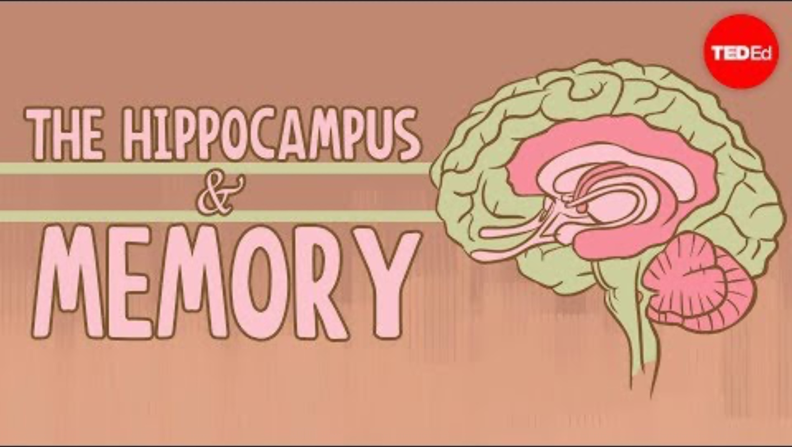
Localization of Functions

Slide 31
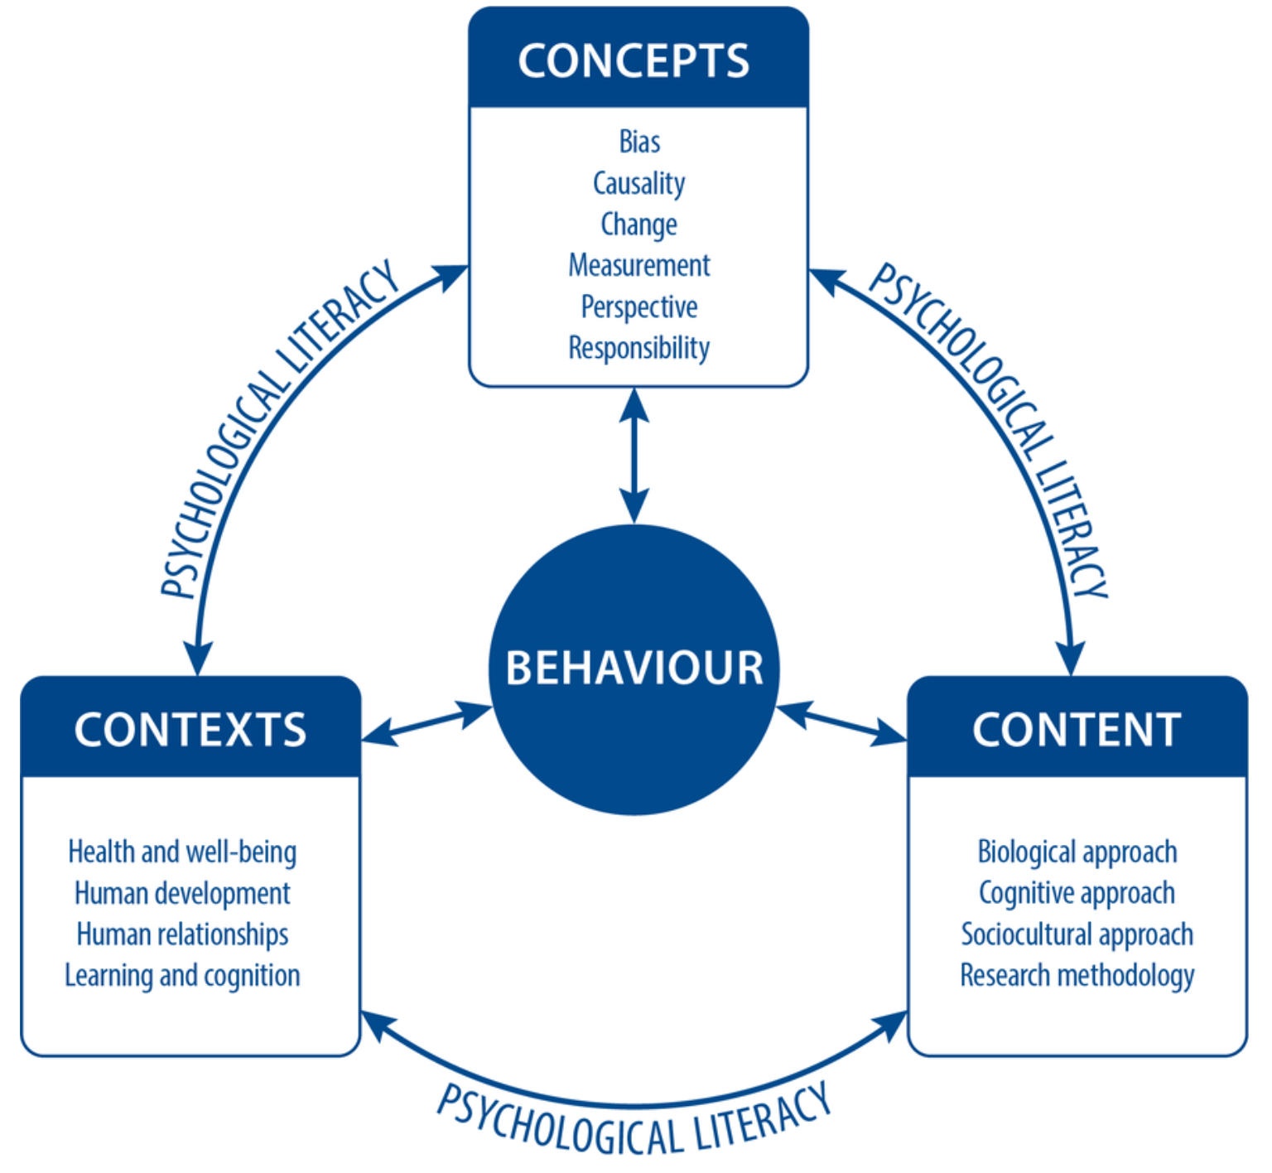
TASK
Teacher divides you into six groups and gives each group a topic from learning and cognition
Each group makes a concept map based on the syllabus

Slide 32
Picture sources
Purity of sciences <https://www.millennialstar.org/what-is-science-is-science-about-reductionism-or-holism-2/> Accessed 4th of Augusto 2018.
Phrenology head <https://en.wikipedia.org/wiki/Mind> Accessed 4th of August 2018.
Central and peripheral nervous systems <https://askabiologist.asu.edu/parts-nervous-system> Accessed 29th of August 2017.
Drawing a tree < http://www.wikihow.com/Draw > Accessed 29th of August 2017.
Types of neurons <http://www.mind.ilstu.edu/curriculum/neurons_intro/neurons_intro.php> Accessed 29th of August 2017.
Action potential 1 <http://www.apstherapy.co.nz/action%20potentials.html> Accessed 26th of October 2015.
Action potential 2 <http://www.apstherapy.co.nz/action%20potentials.html> Accessed 26th of October 2015.
Synapse <http://163.178.103.176/CasosBerne/1aFCelular/Caso4-2/HTMLC/CasosB2/Receptor/Ch6.html> Accessed 30th of August 2017.
Structures of neurotransmitters <http://www.compoundchem.com/2015/07/30/neurotransmitters/> Accessed 31st of August 2017.
Test rat <http://www.fanpop.com/clubs/psychology/images/1361799/title/skinner-rat-fanart> Accessed 5th of January 2018.

Slide 33
Picture sources
Blue brain cells 1 <https://medium.com/predict/artificial-neural-networks-mapping-the-human-brain-2e0bd4a93160> Accessed 10th of February 2020.
LTP <https://sites.google.com/site/mcauliffeneur493/home/synaptic-plasticity> Accessed 23rd of November 2017.
Use it or lose it <https://languageattrition.org/use-or-lose/> Accessed 23rd of November 2017.
Juggler <https://joehart.com.au/blog/2019/04/14/are-you-a-master-juggler-or-do-you-keep-dropping-the-ball> Accessed 10th of August 2025.
London taxi <http://www.cityam.com/blog/1402483881/which-londons-taxi-app-offers-best-fares> Accessed 30th of November 2017.
Anterior and posterior hippocampus <https://www.tutor2u.net/psychology/reference/maguire-2000> Accessed 11th of August 2023.
STM brain structures <https://www.frontiersin.org/articles/10.3389/fpsyg.2018.00401/full> Accessed 28th of October 2020.
Group of three <https://www.freepik.com/free-icon/group-of-three-men-standing-side-by-side-hugging-each-other_717992.htm> accessed 13th of November 2017.

