Slide 1
COVALENT BONDING
Covalent bonds involves the sharing of electrons, so that each atom is configured like an inert gas.
  Electrostatic attraction between electrons and nuclei
Hydrogen is the simplest example
Generally formed by atoms with little differences in electronegativity
Be able to draw the electron distribution of single and multiple bonds in molecules
  E.g. O₂, N₂, CO₂, C₂H₄, C₂H₂

Slide 2





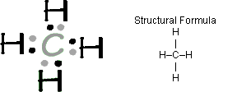
LEWIS STRUCTURES
aka the electron dot structure
All valence electrons are shown
Various methods of depicting electrons (dots, crosses, combinations).
http://chemsite.lsrhs.net/d_bonding/flashLewis.html

Slide 3





SINGLE AND MULTIPLE COVALENT BONDS
Carbon: 4 bonds, generally speaking
Nitrogen: 3
Oxygen: 2
Halogens: 1
Strength of attraction that two nuclei have for shared electrons affects the length and
strength of the bond
Triple bonds are the strongest and shortest
Coordinate covalent bonds are characterized by both electrons in a shared pair coming from one species

Slide 4
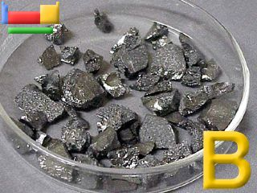



COVALENT BONDS
When determining the number of bonds formed:
  Nonmetal atoms form one bond for every electron needed to
  complete the ”octet” on the atom
Generally speaking, Group 4 will form 4, Group 5—3, Group
6—2, etc.
Boron has 3 valence electrons.
  It technically has space for 5 electrons
  But it is a small atom and 5 nonmetal atoms cannot pack around it
  Boron has strange properties as it is technically electron short. (considered a metalloid)

Slide 5
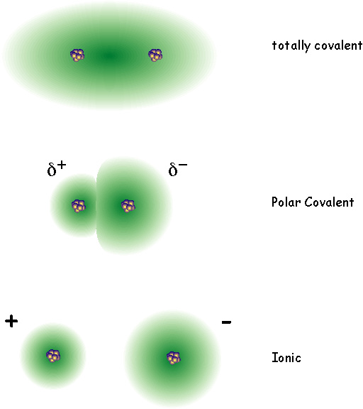
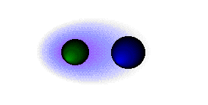
COVALENT BONDS & POLARITY
In diatomic molecules of the same element, the electron pair is shared equally
If bonding electrons are not shared equally in a covalent bond, it will be polar
The more electronegative atoms exerts a greater attraction for an electron pair
One end of the molecule is considered to be ”electron rich”
The greater the difference in electronegativities, the more polar the bond
The green atom is more electronegative

Slide 6




SHAPE AND BOND ANGLES
The shape of a molecule with four electron pairs depends on the number of lone pairs
Lewis structures are used as a simple way of showing valence electrons
Predicting the electron geometry and molecular shape is also important
Valence-shell electron pair repulsion model (VSEPR) provides a way to predict the shapes of molecules
Electron geometry is the arrangement of all electron pairs around the central atom.
Valence Shell Electron Pair Repulsion
Trigonal planar | Tetrahedral | Trigonal bipyramidal | Octahedral

Slide 7
VSEPR THEORY
Pairs of electrons arrange themselves around a central atom so that they are as far apart from each other as possible
Greater repulsion between non-bonded pairs of electrons than between bonded pairs
Multiple bonds lie in the same direction and therefore are counted as one pair of electrons
Five basic shapes depending on the number of pairs¨(see next slide)
  Linear being the most basic (180 degrees)
  O-----C-----O
Valence Shell Electron Pair Repulsion
Trigonal planar | Tetrahedral | Trigonal bipyramidal | Octahedral

Slide 8
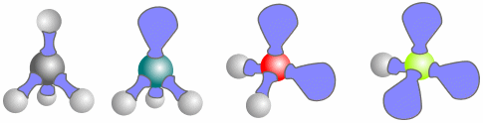
FINDING THE ACTUAL SHAPE
By calculating the number of pairs of electrons around the central atom, one can work out the shape of a molecule.
One must also find out how many are bonding and non-bonding pairs(remembering greater repulsion between non-bonded and bonded pairs of eletrons)
All electrons in a multiple bond lie in the same direction, so they count as only one pair of electrons
Be able to identify shape and bond angles for species with 2 & 3 negative charge centers
Molecules of Methane, CH₄, ammonia, NH₃, water, H₂O and hydrogen fluoride, HF

Slide 9
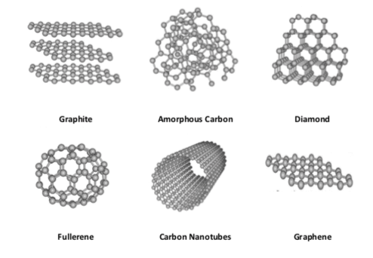
Carbon and its Allotropes
Compare and contrast the physical and chemical properties of Graphite, Graphene, and Diamonds
How does fullerene differ from these?
Compare and contrast the physical and chemical characteristics of SiO₂ and CO₂
Cheaptubes.com (2019)

Slide 10
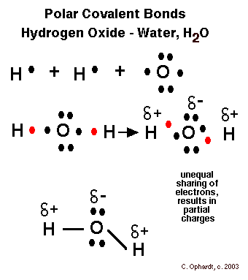
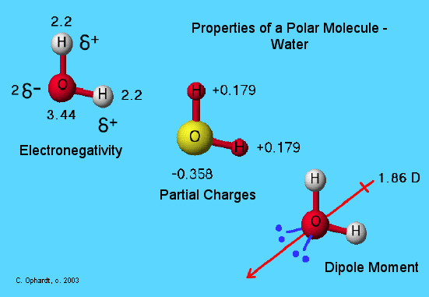
MOLECULAR POLARITY
The polarity of a molecule depends on its shape and on the electronegativities of its atoms
Atoms high in electronegativity tend to have partial negative charges (O, N, halogens)
Others (H, C) tend to be neutral or have partially positive charges
Electrons in polar covalent bonds are unequally shared
Separation of partial charges (pos & neg) creates a dipole
A polar molecule results when a molecule has polar bonds in an unsymmetrical arrangement
Symmetrically arranged polar bonds will result in non-polar molecules

Slide 11
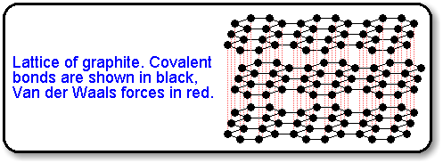

INTERMOLECULAR FORCES
Other forces are at work that are weaker than covalent bonds
Even in non-polar molecules electrons can be unevenly spread(at moments: temporary dipoles)
An instantaneous dipole in one molecule can induce another one in a neighboring particle---London’s forces
This is constantly occuring: Fleeting attractions between molecules(not just two, but many)
Non-polar molecules!

Slide 12
London’s forces: slightly uneven charges on a molecule/atom at any moment. During this moment there might be temporary attraction between opposite charges
Instanta-neous dipole
Not charged
Increase as mass increases, and as distance between molecules/atoms decreases
Relatively weak attraction

Slide 13

DIPOLE FORCES
Polar molecules are attracted to each other by electrostatic forces
Relatively weak attraction, but stronger than London’s forces
Butane (C₄H₁₀) and Propanone (C₃H₆O) have the same molecular mass, but the polar propanone has a much higher boiling point.
H H H H
| | | |
H - C - C - C - C - H
| | | |
H H H H

Slide 14
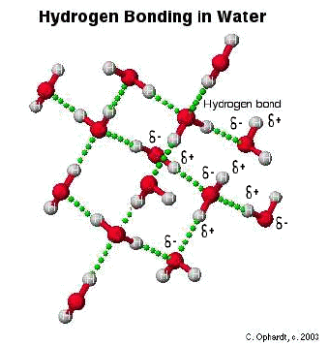
HYDROGEN BONDING
Occurs when hydrogen is bonded directly to a small highly electronegative element (F, O, N), a very strong dipole is formed
As the electron is drawn away from the hydrogen, all that remains is the lone proton in the nucleus
The proton attracts a non-bonding pair of electrons from the highly electronegative element, creating a very strong dipole
Hydrogen bonding quite strong in water(relatively high boiling point)
Stronger than dipole forces and van der Waal’s forces

