Slide 1
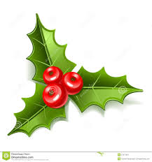

Christmas in Greece

Slide 2


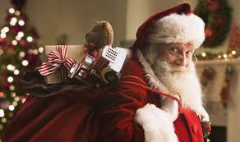
I
Hello my friends! My name is Vassilis and I am coming from Greece. I am going to present you how do we celebrate Christmas in Greece.
Are you ready ?
In Greece Merry Christmas is ‘ Kala Christougenna’.
In Greece, presents are often brought to children by Aghios
Vassilis (Saint Basil) or Santa Claus on the 1st January.
On the 1st January it is also my name day!

Slide 3
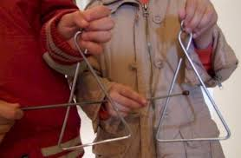
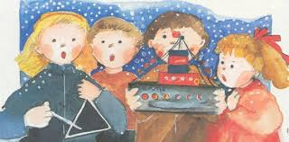
On Christmas Eve, children often go out and sing christmas carols ‘ Kalanta’ from door to door. The host of the house will give money to the children or things to eat like nuts, sweets and Christmas deserts. They play the triangles as they sing.

Slide 5
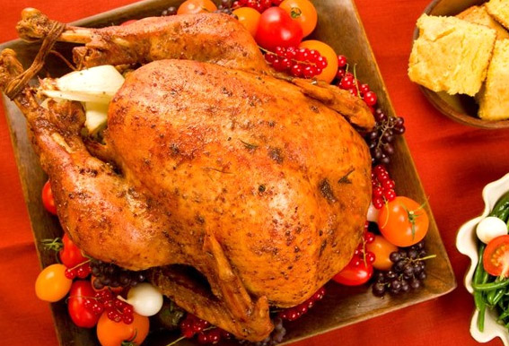
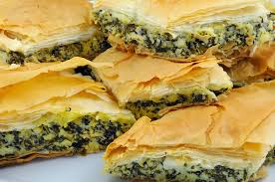
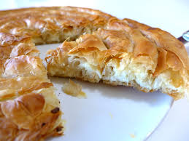
The main Christmas meal is often stuffed Turkey ,lamb or pork, roasted in an oven. It’s often served with a spinach and cheese pie and various salads and vegetables. Another popular Christmas dessert is melomakarono , egg or oblong shaped biscuit/cakes made from flour, olive oil, and honey and rolled in chopped walnuts.

Slide 6
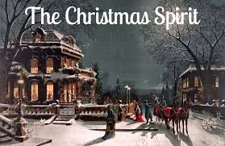
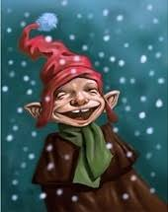
Christmas Trees are popular in Greece. But an older and more traditional decoration is a ship.
There is a story about some magical creatures which are called Kallikantzaroi and are coming to Greece during Christmas time. They are supposed to come from the middle of the earth and get into people's house through the chimney! The kallikantzaroi do things like putting out fires and making milk go off. Having a fire burning through the twelve days of Christmas is also meant to keep the kallikantzaroi away.

Slide 7
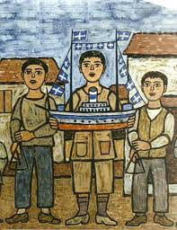
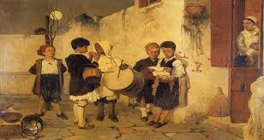
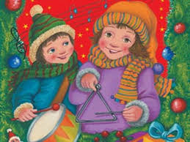
Here you can see children who sing the Christmas carols and playing drums and triangles as they sing. Carrying a boat is a very old custom in the Greek islands.

Slide 8
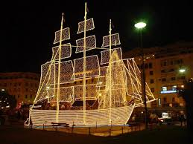
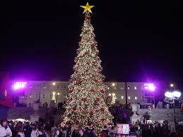
Christmas decorations in Syntagma square in Athens (the capital) and in Aristotelous square in Thessaloniki (the second biggest city in Greece)

Slide 9
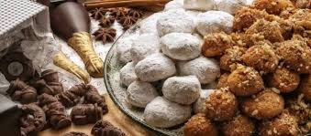
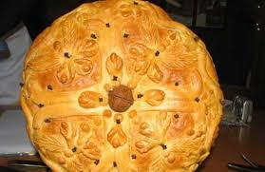
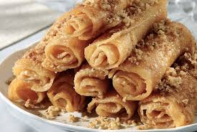
Here you see the traditional Christmas desserts: Κourabiedes, Melomakarona and diples.
A traditional table decoration is 'Christopsomo' (Christ's Bread or Christmas bread). It's a round sweet bread which is flavored with cinnamon, orange and cloves. The top is decorated with a cross. The bread is made on Christmas Eve ready to be eaten on Christmas Day.

Slide 10
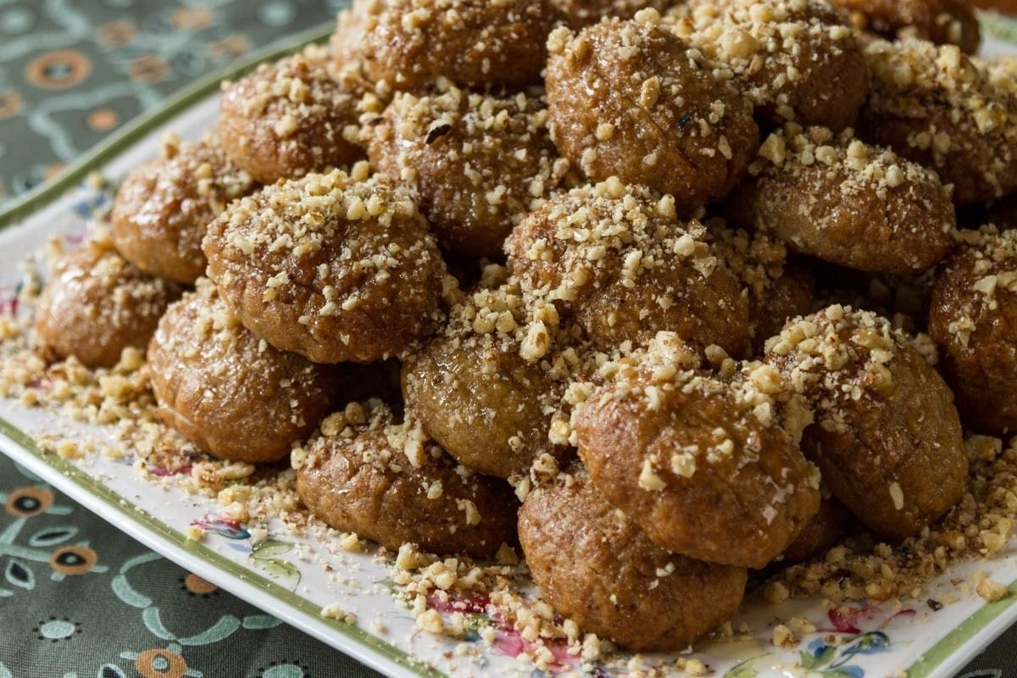
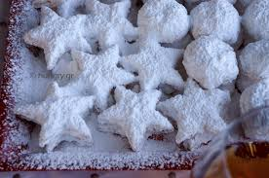
These look yummy don’t they ?

Slide 11
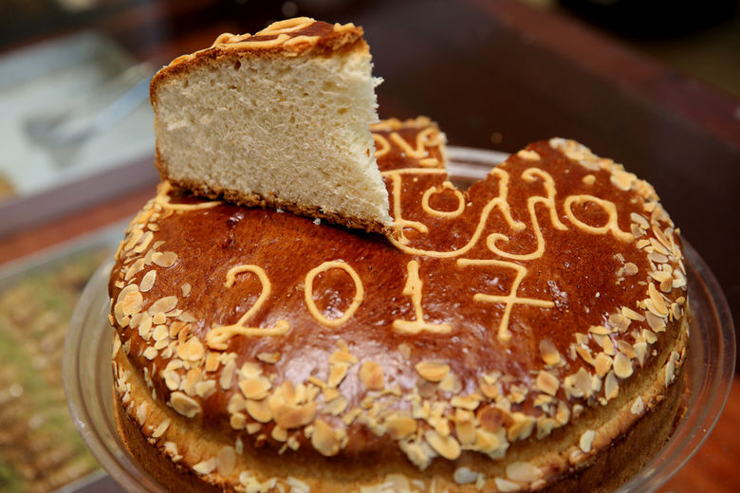
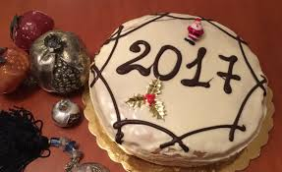
In the 1st day of January we are eating the special cake which is called Vassilopita! This cake has a gold coin inside. The one who will have the piece with the coin will be fortunate and will have a good luck the new year!

Slide 12
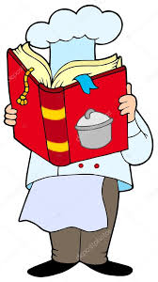
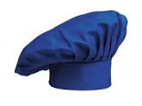
Melomakarona recipe
For the Melomakarona
150g thin semolina
500g flour (soft)
1/2 tbsp baking powder
100g orange juice
3 tbsps cognac
100g sugar
1 flat tbsp powdered cinnamon
1/3 tsp clove (powder)
1/3 tsp nutmeg (powder)
1 tsp vanilla extract
½ tbsp baking soda
90g water
125g olive oil
125g vegetable oil
50g honey
Zest of 2 oranges
For the syrup
300g water
600g sugar
90g glucose
2 cinnamon sticks
3 whole cloves
1 orange, cut in half
180g honey
To garnish
200g chopped walnuts
Powdered cinnamon (optional)
Powdered clove (optional)

Slide 13
Let’s listen to some greek Christmas songs and the Christmas carols that children sing on Christmas and New Year’s Eve!
Christmas greek songs
https://www.youtube.com/watch?v=_IpBOFW0Gg8
https://www.youtube.com/watch?v=6YedhRJ0Hiw
https://www.youtube.com/watch?v=P-4HI0v9OMc
https://www.youtube.com/watch?v=9dqIlIoi7zA
https://www.youtube.com/watch?v=OLsEDiAQt9g

Slide 14
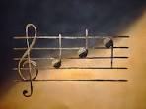
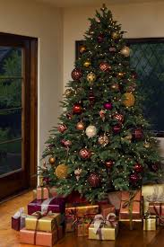
We could even try to learn a greek Christmas song! Let’s give it a try !
Oh elato…
Oh elato…
Maresis pos maresis!
Ti orea tin Protohronia
Mas fernis dora sta kladia
Oh elato …
oh elato…
Maresis pos maresis!
Oh Elato…
oh elato…
Ti didagma I stoli sou!
Elpida ebnei statheri
Ke tharos panta sti Zoe
Oh Elato
oh elato
Ti didagma I stoli sou!

Slide 15

Oh elato…
Oh elato…
Ta prasina sou fila!
Ta vgazeis me kalokeria
Ke ta foras me to xionia
Oh elato…
Oh elato…
Ta prasina su fila

Slide 16
How do they celebrate Christmas time in:
Finland
Tsekki
Romania
Kreikka
Espanja
Puola
Italia
Kroatia
How do they say Merry Christmas ?
What is the traditional meal and dessert for Christmas day?
Are they waiting for Santa Claus ?
What are the main traditions that they do during Christmas time?

