Slide 1
2.3 HEALTH PROBLEMS
IB Psychology LAJM

Slide 2
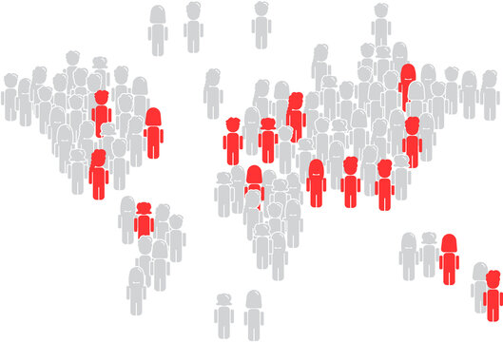
Prevalence of health problems
Prevalence
The proportion or percentage of a population experiencing a specific condition

Slide 3

REVIEW
Quickly review the what you learned about prevalence rates in Kognity 2.1

Slide 4

Prevalence of health problems
Cultural factors influencing prevalence
Stigmatisation
Acculturation – immigrating into a new culture (e.g. Atkins et al., 2008)
Individualism and collectivism (e.g. Zhang & Shrum, 2009; Du et al., 2014)

Slide 5
TASK
Form pairs/small groups and do the activity box “Critcally thinking about prevalence rates” in Kognity 2.3.2
Try to utilze the WHO data to the fullest

Slide 6
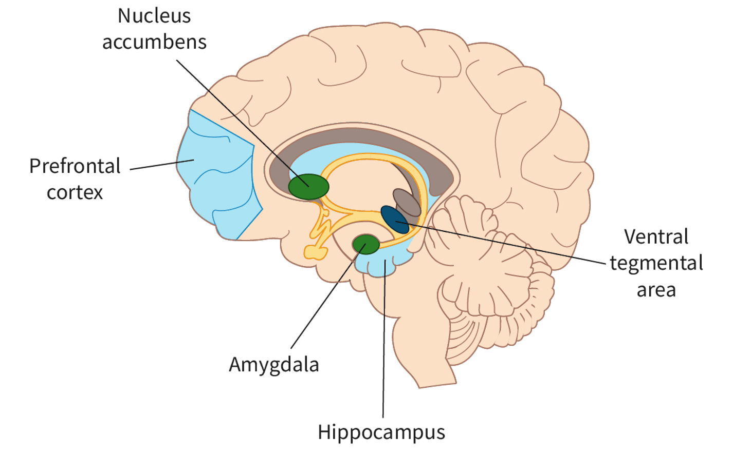
Biology and addiction
Key neurotransmitter in addiction is dopamine
Crucial to experiences of reward and motivation
Brain’s reward system

Slide 7

Biology and addiction
Ventral tegmental area (VTA) connects with both nucleus accumbens and prefrontal cortex
Amygdala and hippocampus may contribute to craving and relapse
Mesolimbic and mesocortical pathways

Slide 8
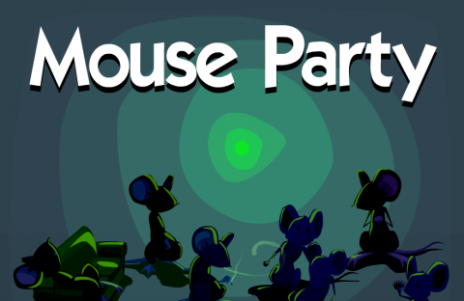
TASK
Familiarise yourself with the Mouse party interactive and do the ”Mouse party!” Activity box in Kognity 2.3.3
Focus on alcohol

Slide 9
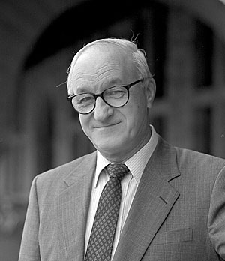
REVIEW
What was meant by social learning theory?
Learning is primarily based on observational learning, reinforcement and imitation

Slide 10
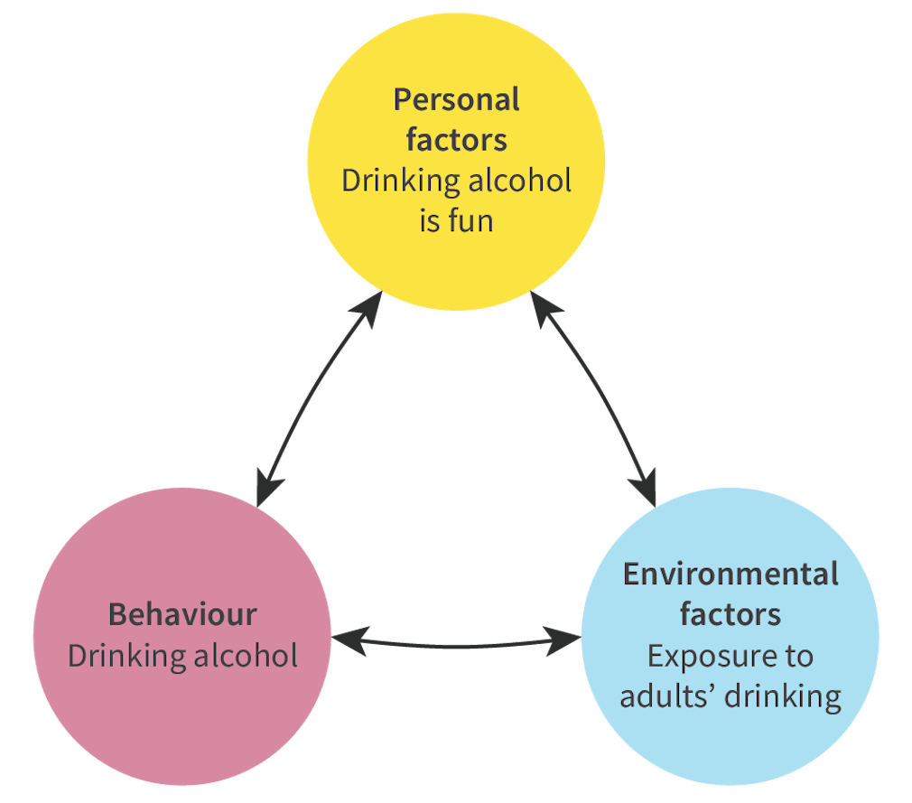
Social learning and addiction
Behaviours that are rewarded are more likely to be imitated, and those that are punished, less likely
Vicarious reinforcement

Slide 11

Social learning and addiction
Berglund et al. (2022)
Parental alcohol usage is correlated with adolescent alcohol consumption

Slide 12

Social learning and addiction
Durkin et al. (2005)
Students who associated with peers who binge drank were more likely to engage in binge drinking themselves

Slide 13

Social learning and addiction
Peer support and positive role models can change behaviour
Can be used to overcome addictions

Slide 14

Social learning and addiction
What role does social media play in creating an addiction?

Slide 15
TASK
Read “Operant conditioning and addiction” and “Classical conditioning and addiction” from Kognity 2.3.5 and summarize the main points in your own words

Slide 16
Cognition and addiction
Theory of planned behaviour, TPB (Ajzen, 1991)
Aims to explain the relationship between intentions and behaviours in decision-making
Behavioural intention will lead to a particular behaviour and desired outcome
Behavioural intention is determined by
Attitude – is the behaviour positive or negative?
Subjective norm – is the behaviour socially acceptable?
Perceived behavioural control – am I able to perform the action?

Slide 17
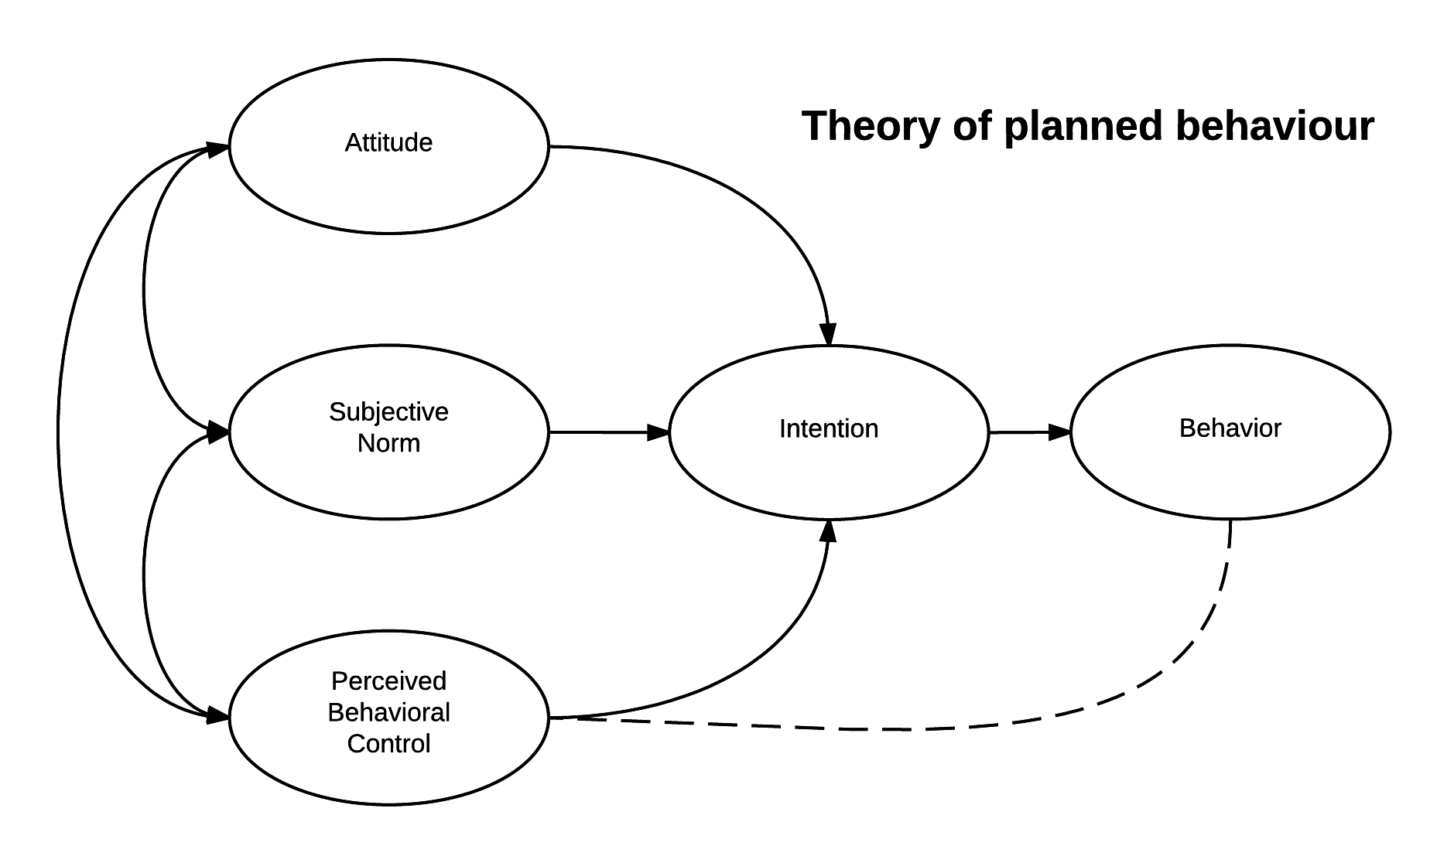
Cognition and addiction

Slide 18
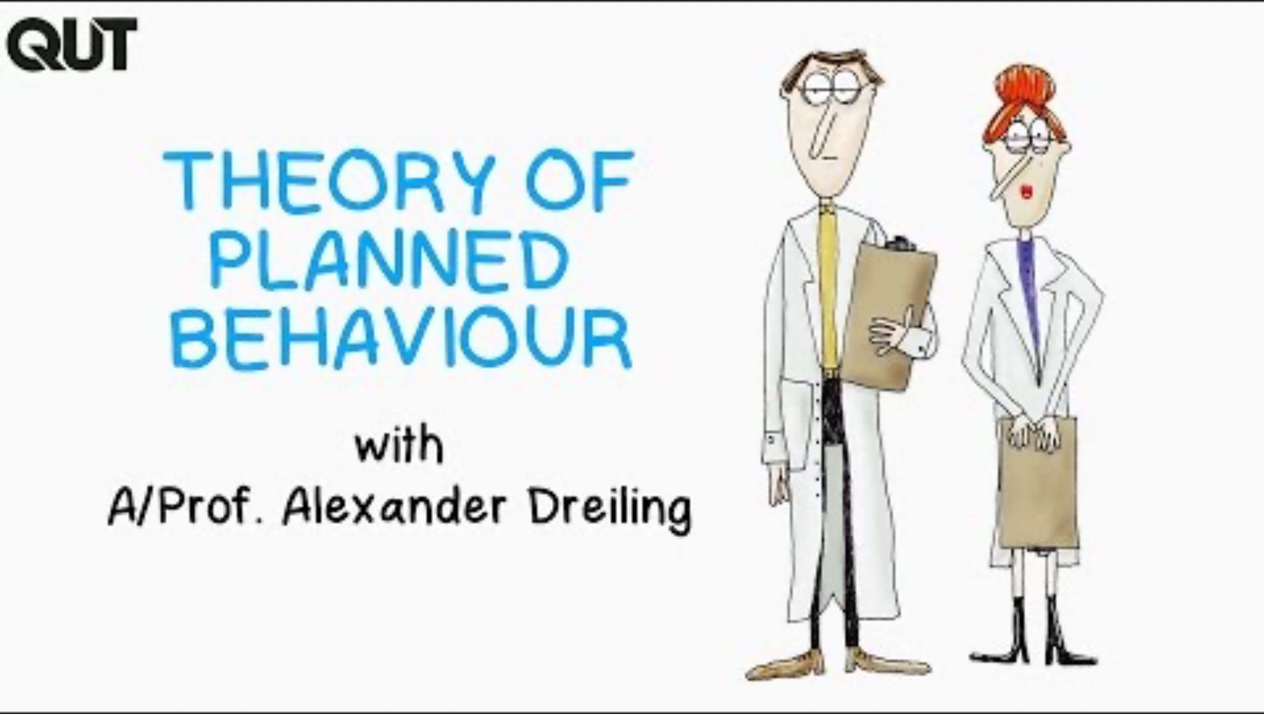
Cognition and addiction

Slide 19
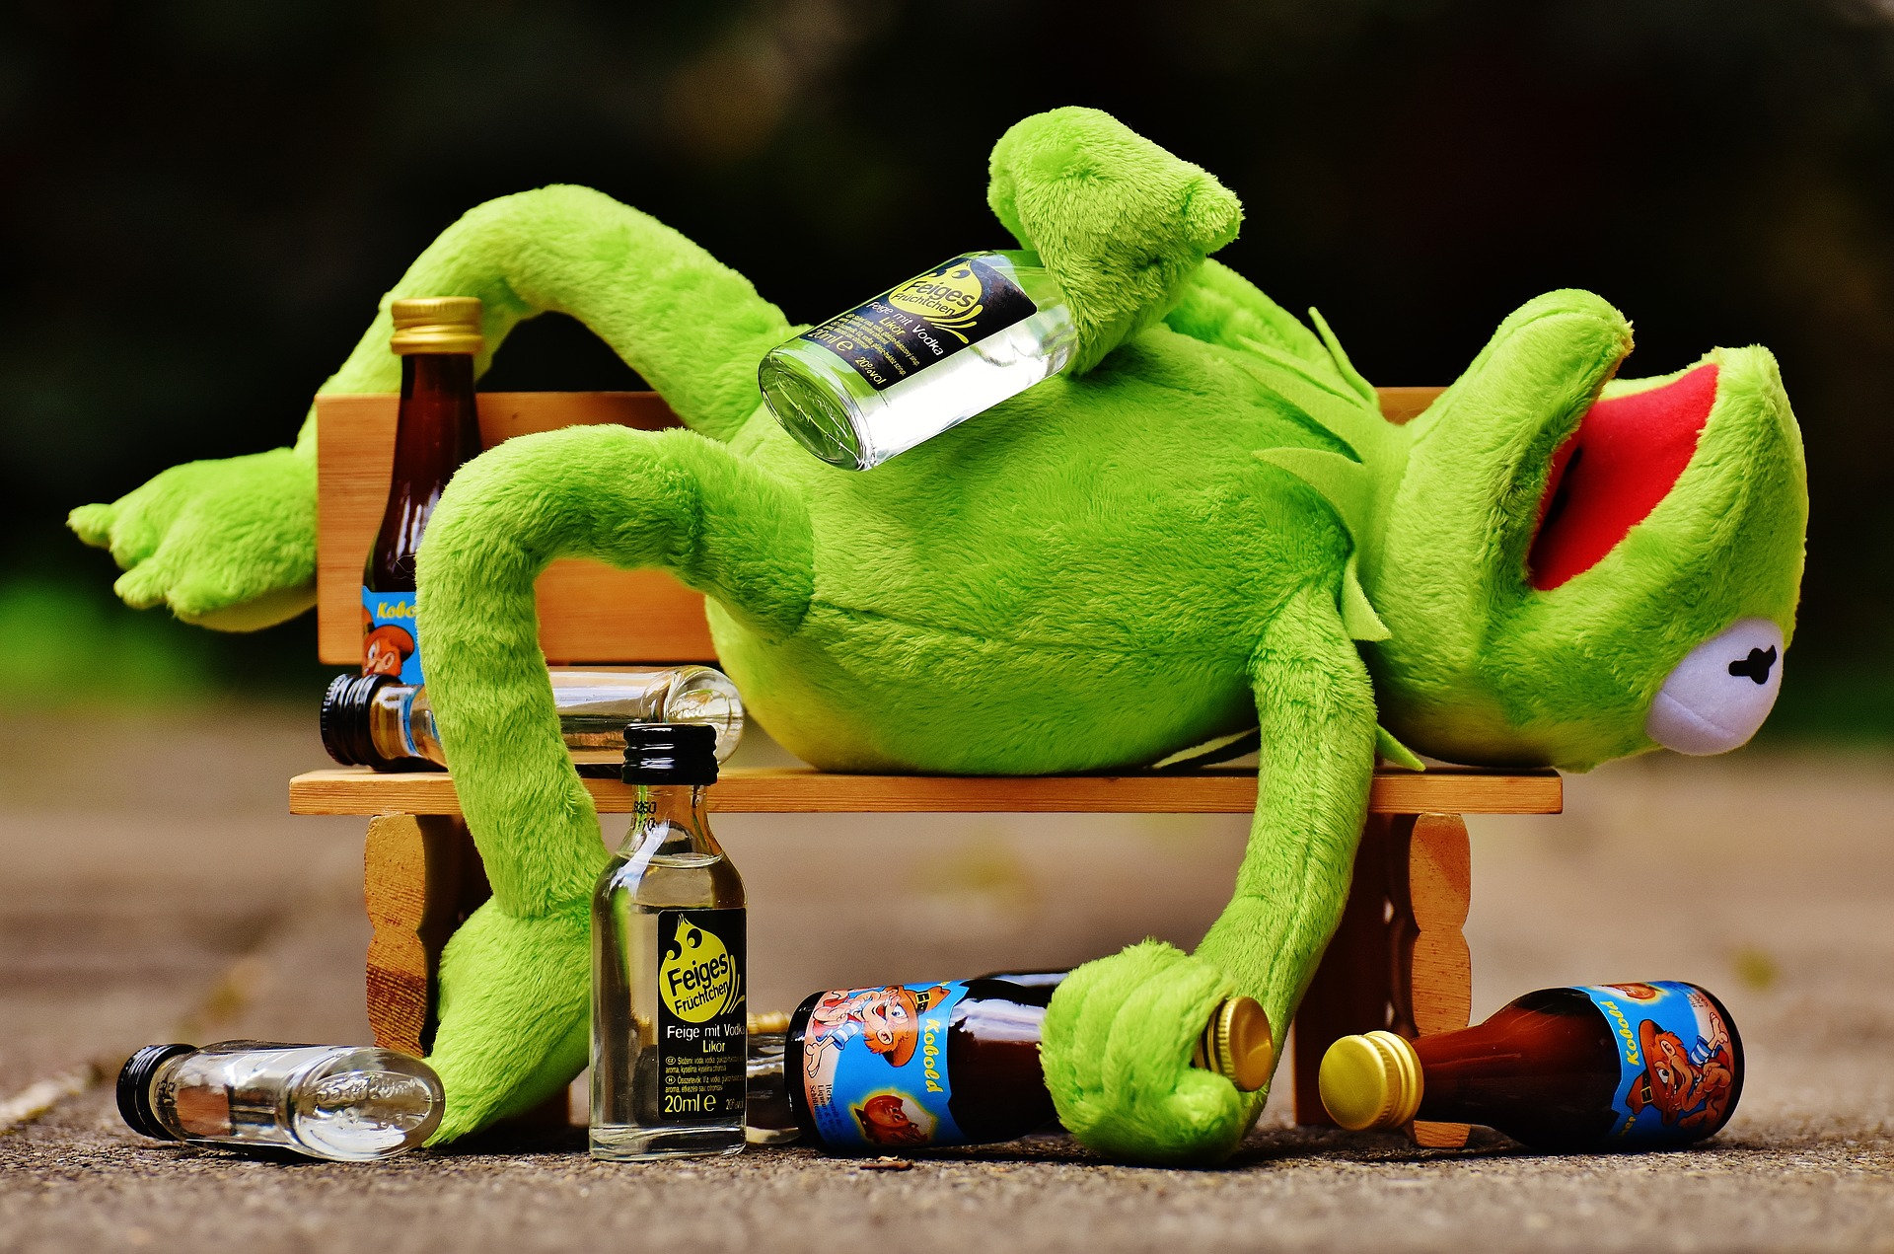
TASK
Read the summary of Johnston and White (2003) from teacher’s supplementary materials
How does TPB explain binge drinking?

Slide 20
TASK
Do the activity box “Applying the theory of planned behaviour” in Kognity 2.3.1
Apply TPB to your own health behaviour

Slide 21
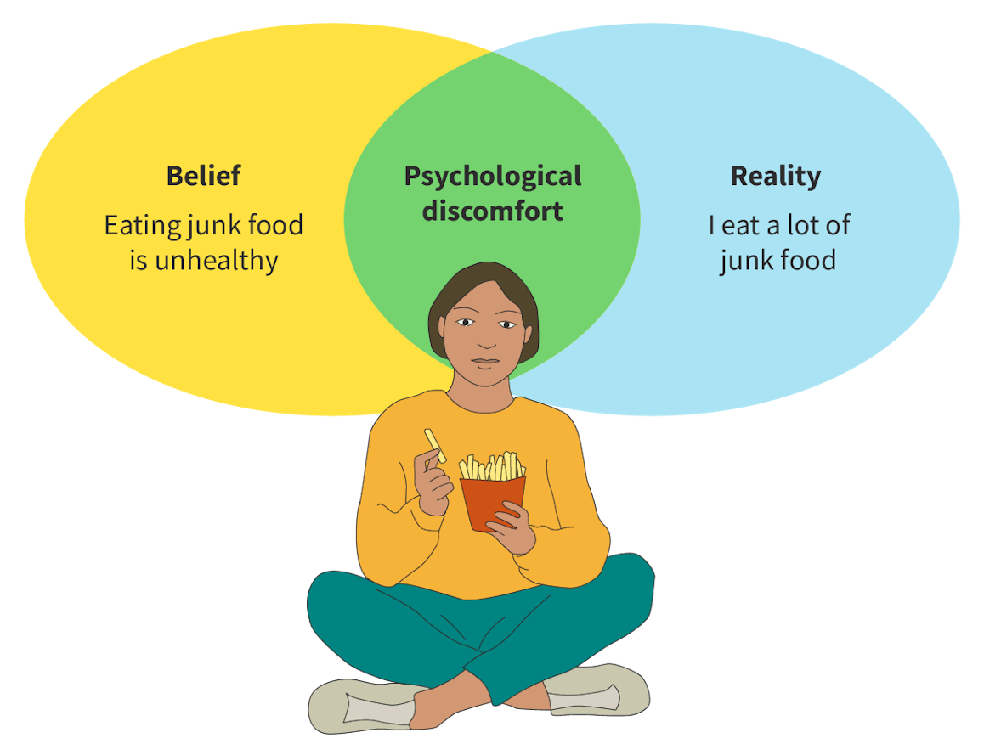
Cognition and addiction
Cognitive dissonance
Discomfort follows when behaviour does not align with values
Discomfort can be resolved by changing behaviour or rationalising beliefs

Slide 22

TASK
When was the last time you were stressed?
What caused the stress?
How did you experience stress at that time?
How did you relate to your experience of stress?

Slide 23
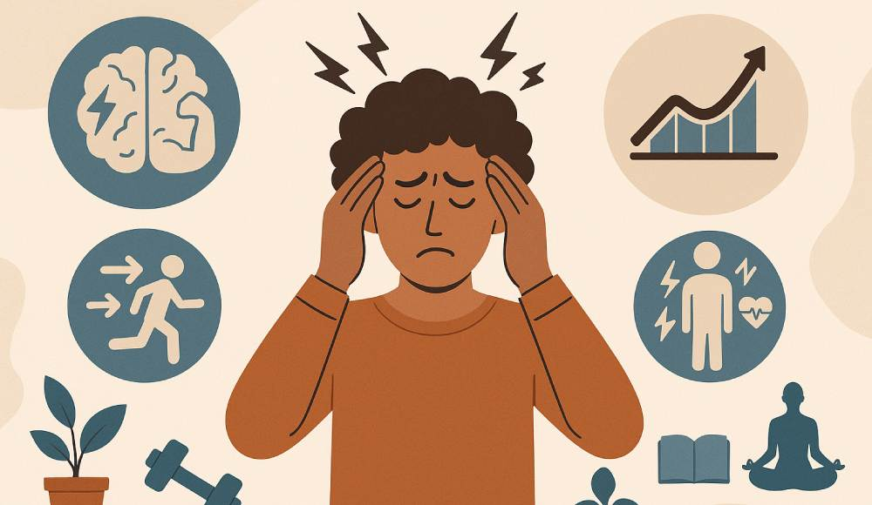
Stress and health
Stress is a response to demands that exceed our capacity to cope
Acute stress
Chronic stress

Slide 24
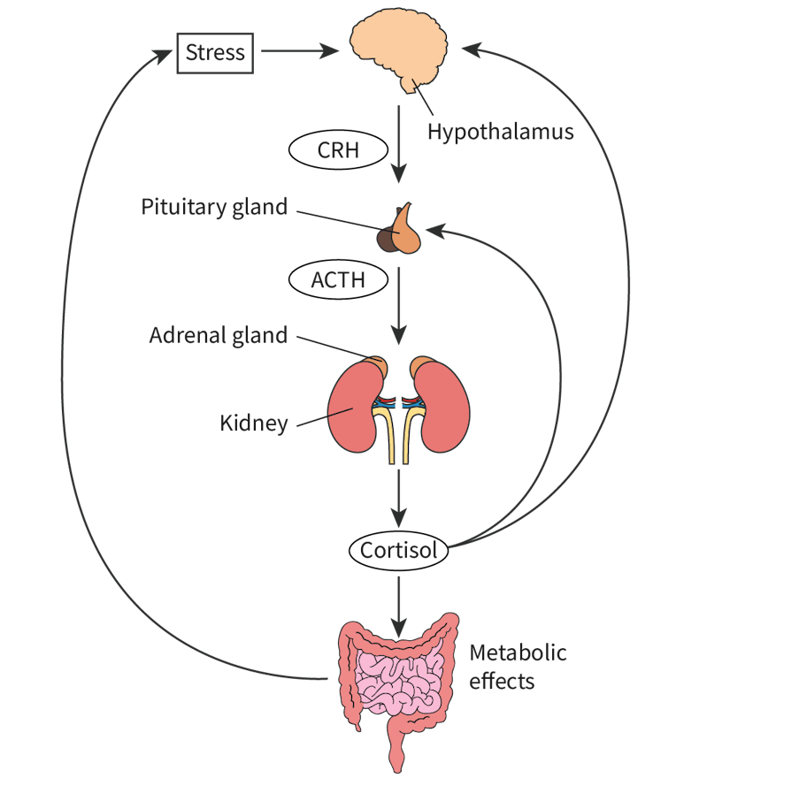
TASK
Read ”Physiological aspects of stress” AND ”Stress and brain” from Kognity 2.3.7 and summarize the main points in your own words

Slide 25
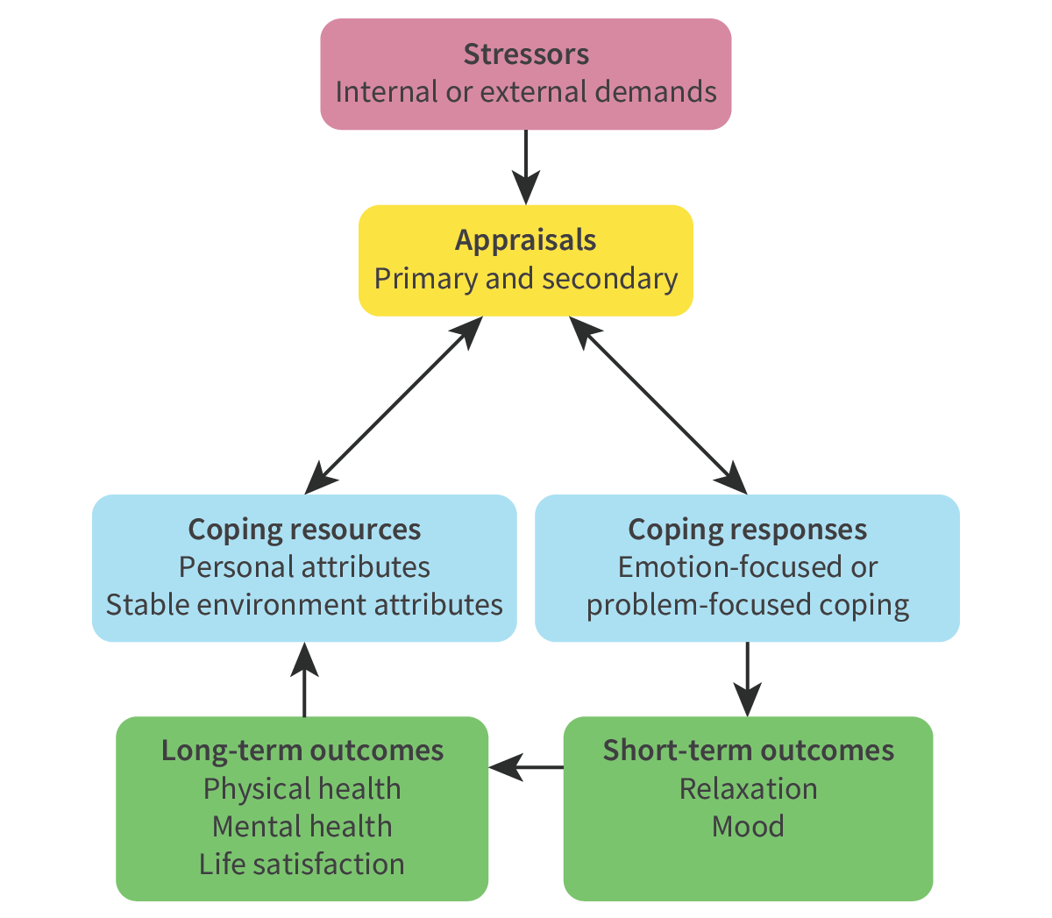
Stress and health
Transactional model of stress and coping (Lazarus & Folkman, 1984)
Stress is a bidirectional process between the person and their environment where cognitive appraisal plays a crucial role

Slide 26
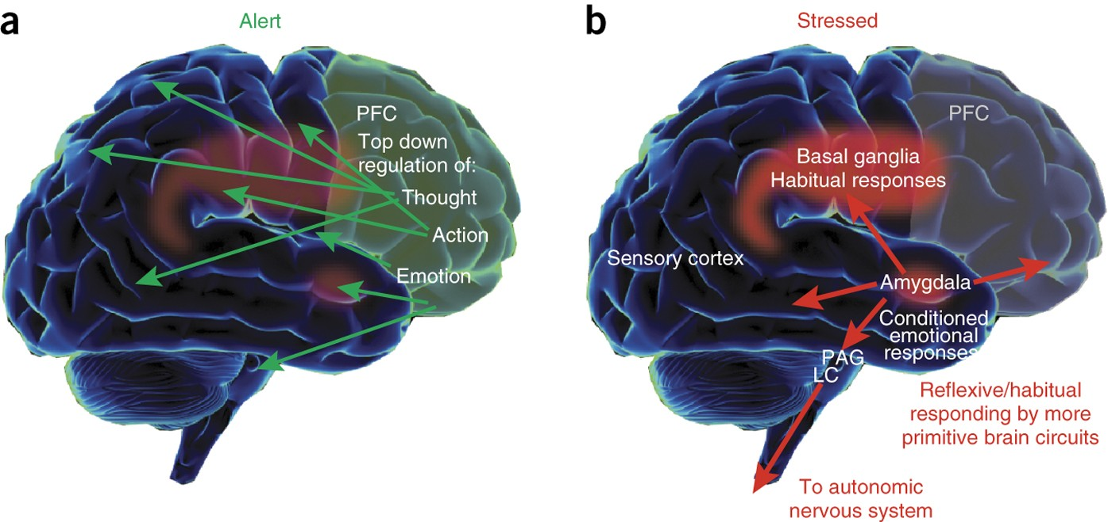
Stress and health
Chronic stress can be a risk factor for addiction
Stress can impair pre-frontal cortex resulting in impulsivity and lack of behavioural control

Slide 27
Stress and health
Does this video provide evidence that stress is not that bad?

Slide 28
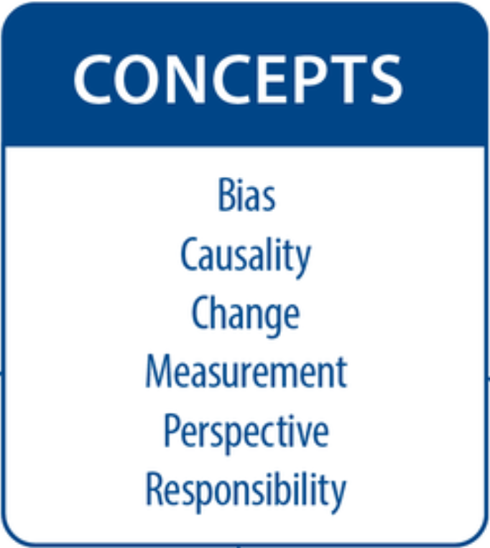
TASK
Teacher divides you into six groups and gives each group one basic concept from the syllabus
Each group makes a concept map based on the concept on health problems

Slide 29
Picture sources
Prevalence <https://stock.adobe.com/search?k=prevalence> Accessed 16th of March 2026.
Flaghand <https://psychology.iresearchnet.com/social-psychology/cultural-psychology/culture/> Accessed 11th of October 2017.
Brain images – Kognity.
Mouse party <https://learn.genetics.utah.edu/content/addiction/mouse/> Accessed 16th of March 2026.
Albert Bandura <https://stanford.edu/dept/psychology/bandura/bandura-bio-pajares/Albert%20_Bandura%20_Biographical_Sketch.html> Accessed 29th of August 2017.
Social learning theory diagram – Kognity.
Drinking parents <https://thinkib.net/psychology/page/52618/drug-abuse-social-learning> Accessed 17th of March 2026.
Binge drinking <https://www.livescience.com/59148-extreme-binge-drinking.html> Accessed 17th of March 2026.
Alcoholics anonymous <https://journey-magazine.com/alcoholics-anonymous/> Accessed 17th of March 2026.
Theory of planned behaviour (TPB) <https://en.wikipedia.org/wiki/Theory_of_planned_behavior> Accessed 28th of August 2019.
Kermit <https://thinkib.net/psychology/page/52617/cognitive-explanations-drug-abuse> Accessed 17th of March 2026.
Cognitive dissonance – Kognity.
Stress stone <https://kriisiapua.fi/stressi-ja-uni/> Accessed 13th of March 2026.
Stress drawing <https://www.centerformentalhealth.in/understanding-the-effects-of-stress-and-strategies-to-manage-it/> Accessed 13th of March 2026.
Stress physiology - Kognity
Transactional model of stress and coping – Kognity.
Prefrontal cortex and stress <https://www.nature.com/articles/nn.4087> Accessed 13th of March 2026.

