Slide 1



“Romulus Ladea” Fine Arts High School
Secondary – 125 students
High school – 360 students
Total 485- students
60 –teachers
2 teachers for special needs

Slide 2
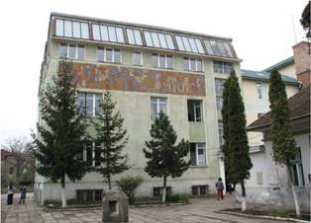
ROMULUS LADEA FINE ARTS HIGH SCHOOL Address:No.56 Dorobantilor Street, Cluj-Napoca Phone/Fax: ++0 264-431449, ++0 264-593006; liceulromulladea@yahoo.com, www.arteplasticecj.ro
1949

Slide 3
Mission
“Romulus Ladea” Fine Arts High School, being a modern and well-equipped school and having highly competitive teachers, offers its students the possibility of gaining exceptional artistic skills. Students learn new ways of seeing, thinking, and expressing themselves.
All of these will allow our students to follow a professional path and better express their maximum potential.

Slide 4
Our school promotes principles like tolerance, freedom, respect, professionalism, responsibility and team spirit.
It focuses on:
- identifying and forming future visual artists in an educational environment based on encouraging and supporting the originality and the artistic vision of the students.
- promoting the students’ skills and talents and getting them involved in the local, national, and international communities through a variety of events and exhibitions.

Slide 5
School facilities
In our high school there are: - 20 classrooms for theoretical subjects - 19 workshops for fine arts - 1 librarie with more than 20.000 books - an exhibition hall -1 gym and 1 sport field - 3 IT classrooms (information technology classrooms) - 1 medical lab - a psychological room
Notes:
5

Slide 6
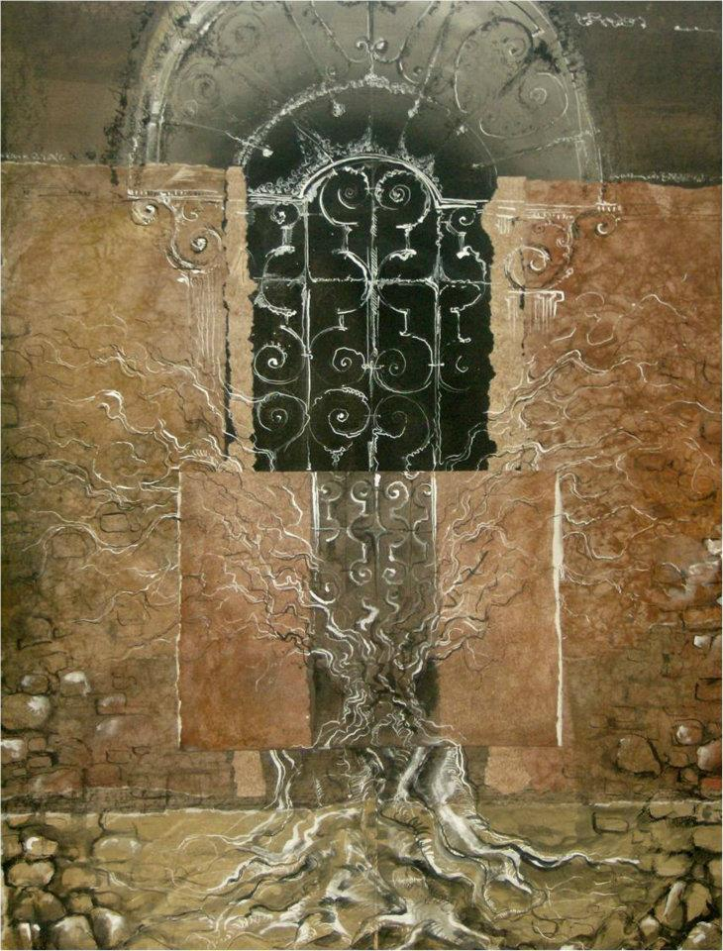
At high school we have only
vocational arts classes like:
Architecture, Industrial Design and Interior Design sections
Fine and Decorative Arts section
Easel painting - Graphics - Sculpture - Ceramics - Fashion design, textiles - Monumental painting (icons)
At High school most children go to school from Monday to Friday
School starts at 8 a.m. and finishes at 14-15p.m
Notes:
6

Slide 7
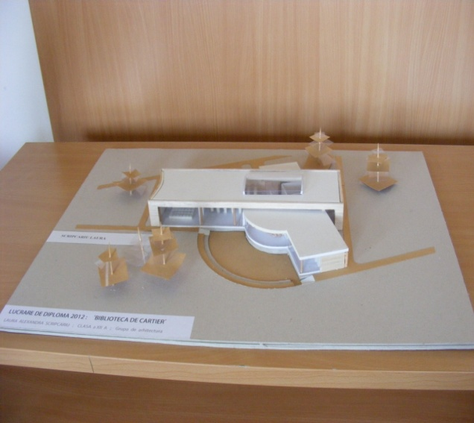
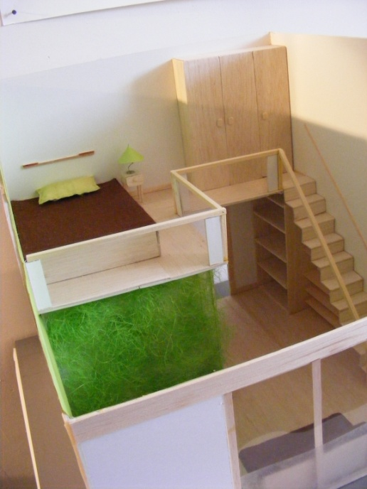
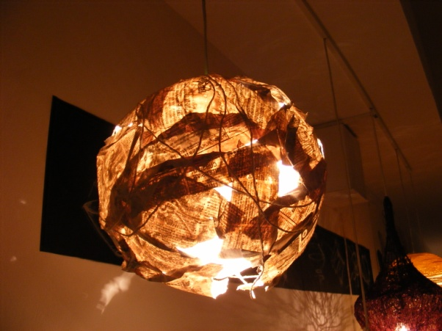
Architecture, Industrial Design and Interior Design sections

Slide 8
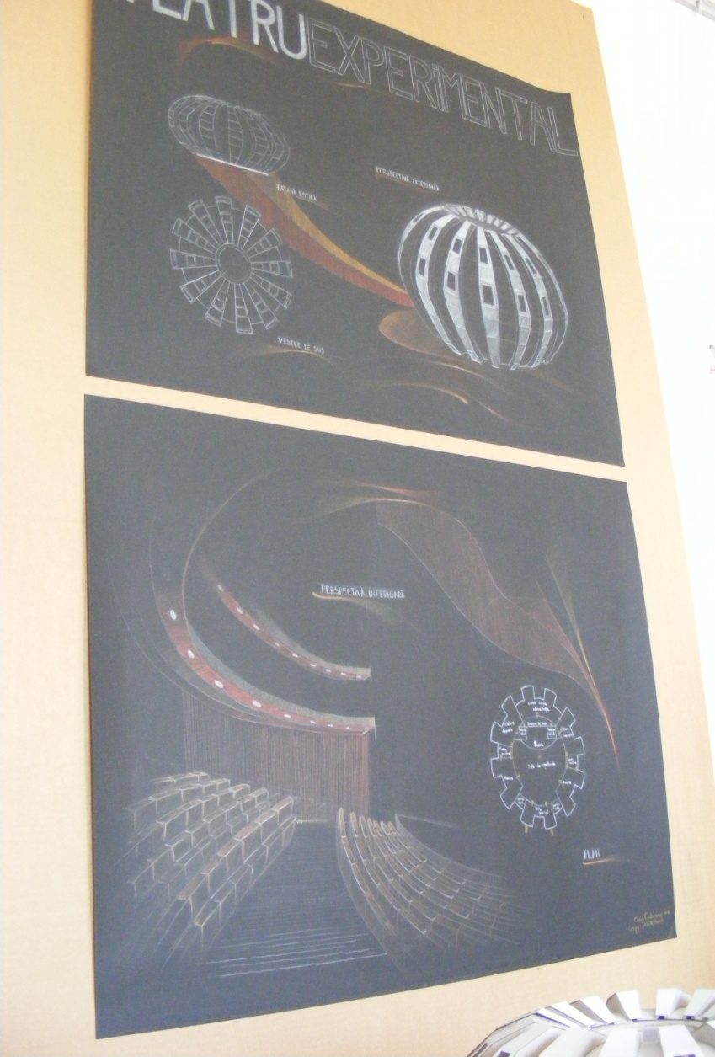
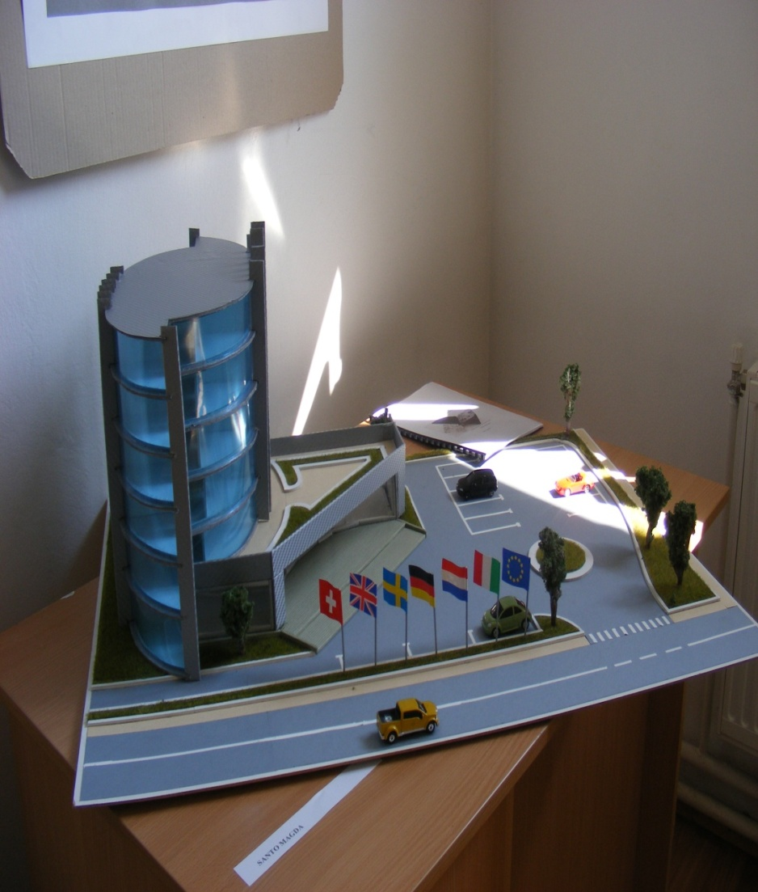
Architecture

Slide 9
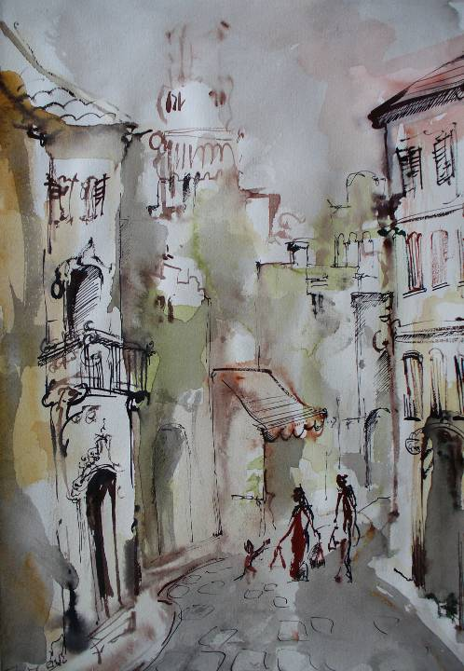

Slide 10
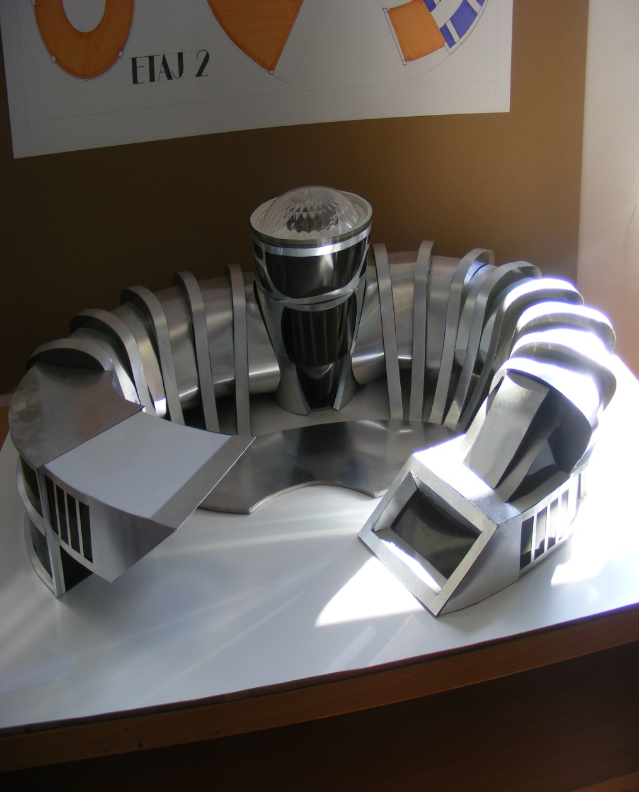
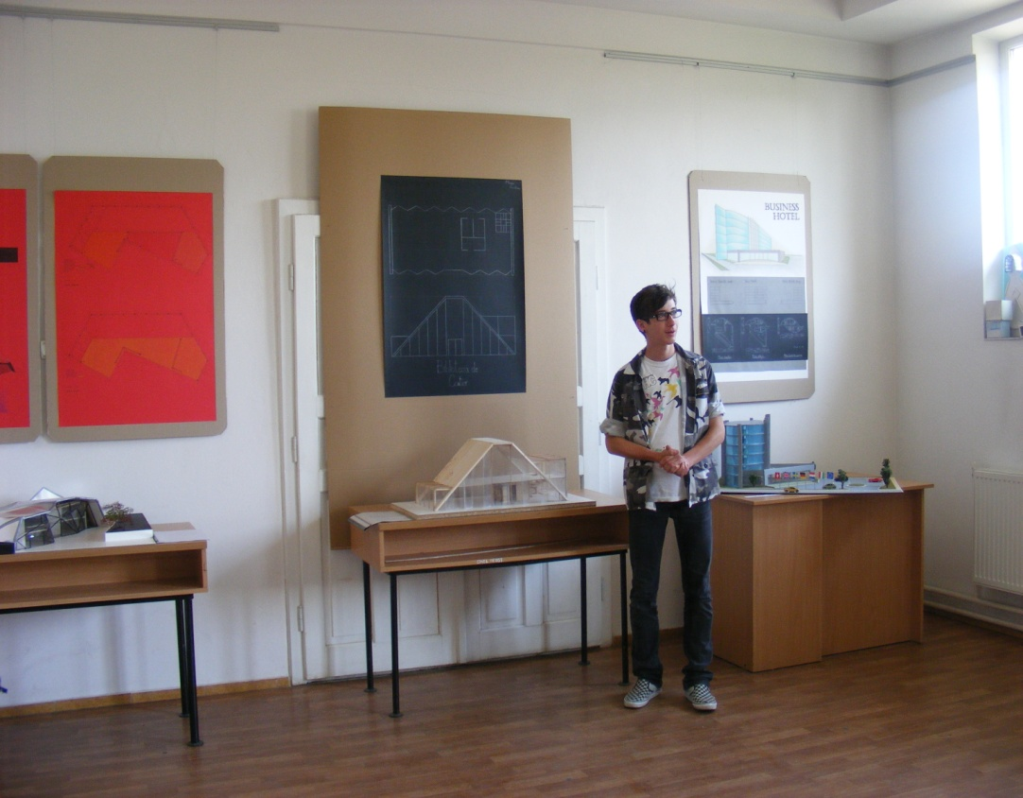

Slide 11
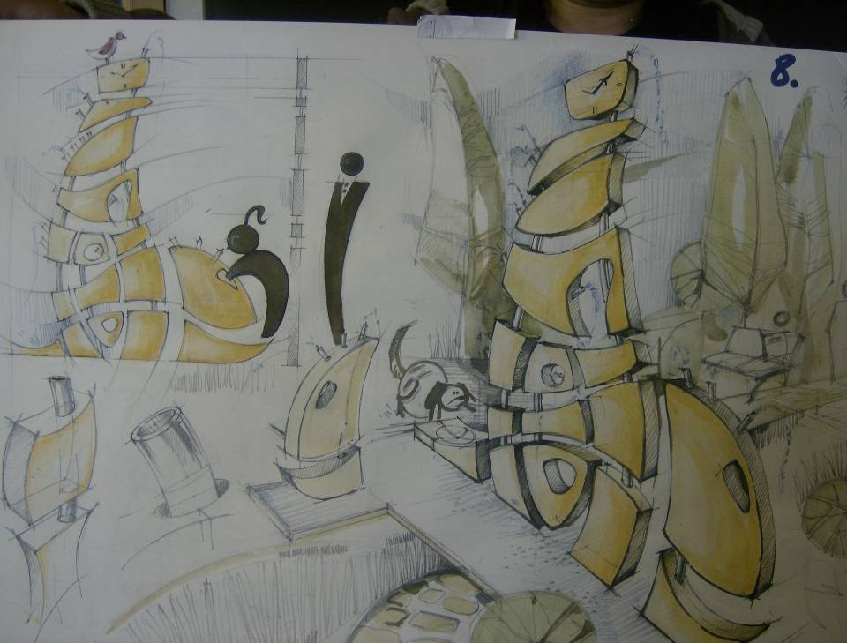

Slide 12
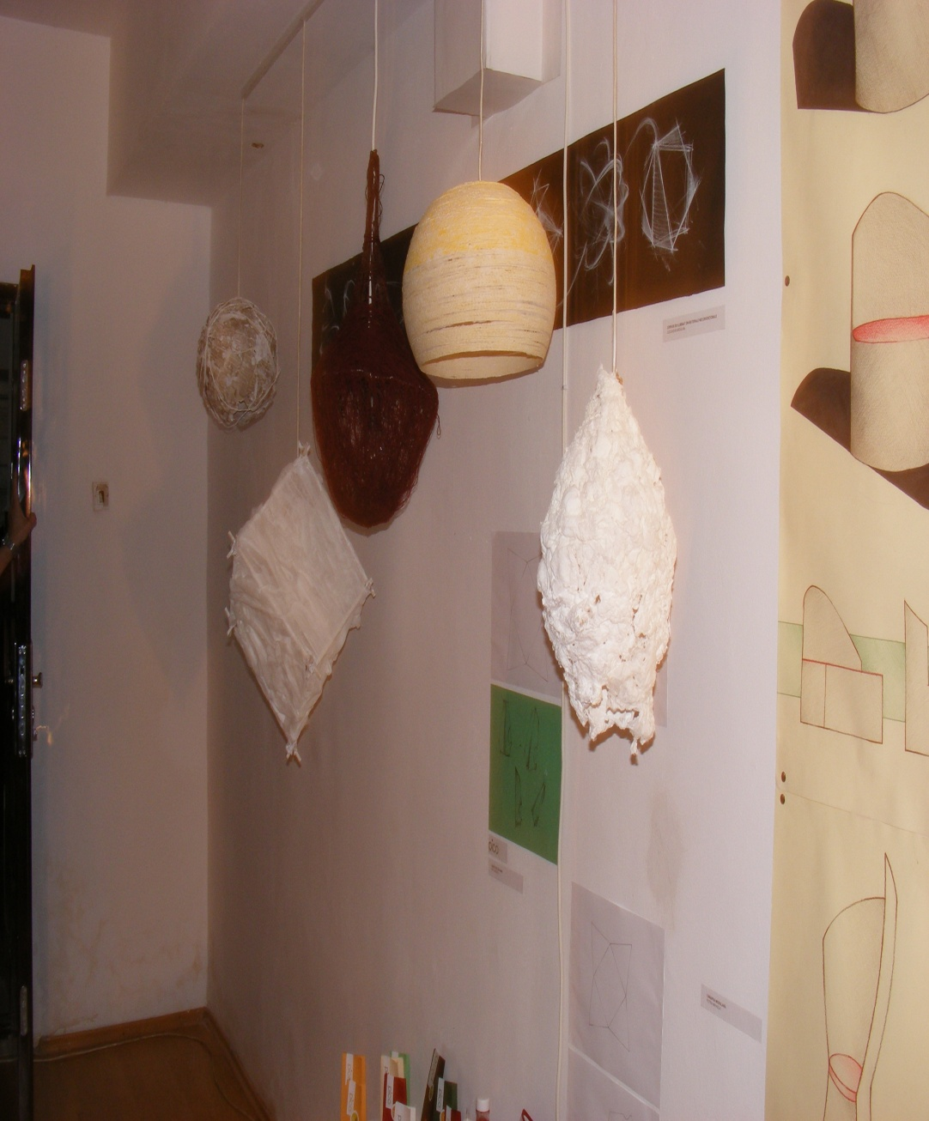
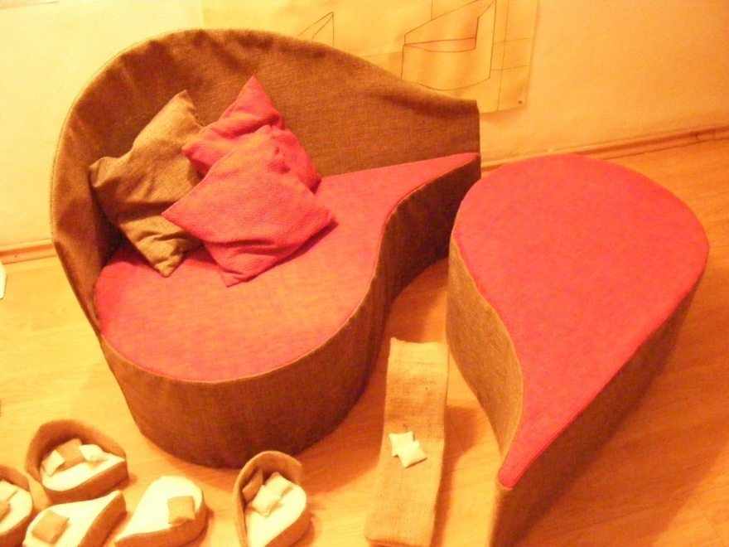
Industrial Design

Slide 13
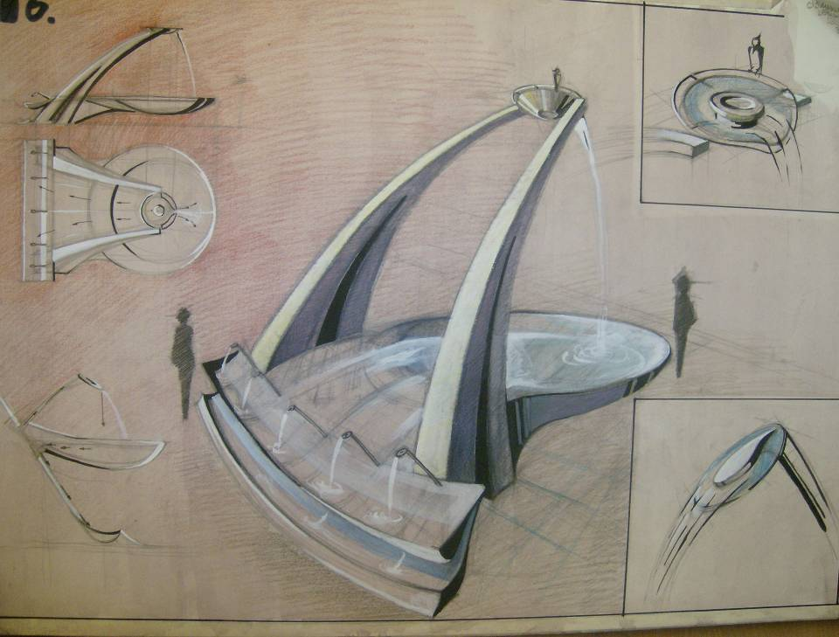

Slide 14
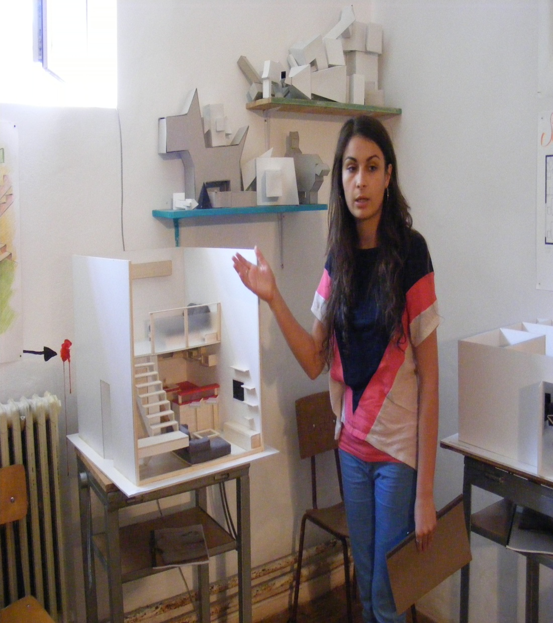
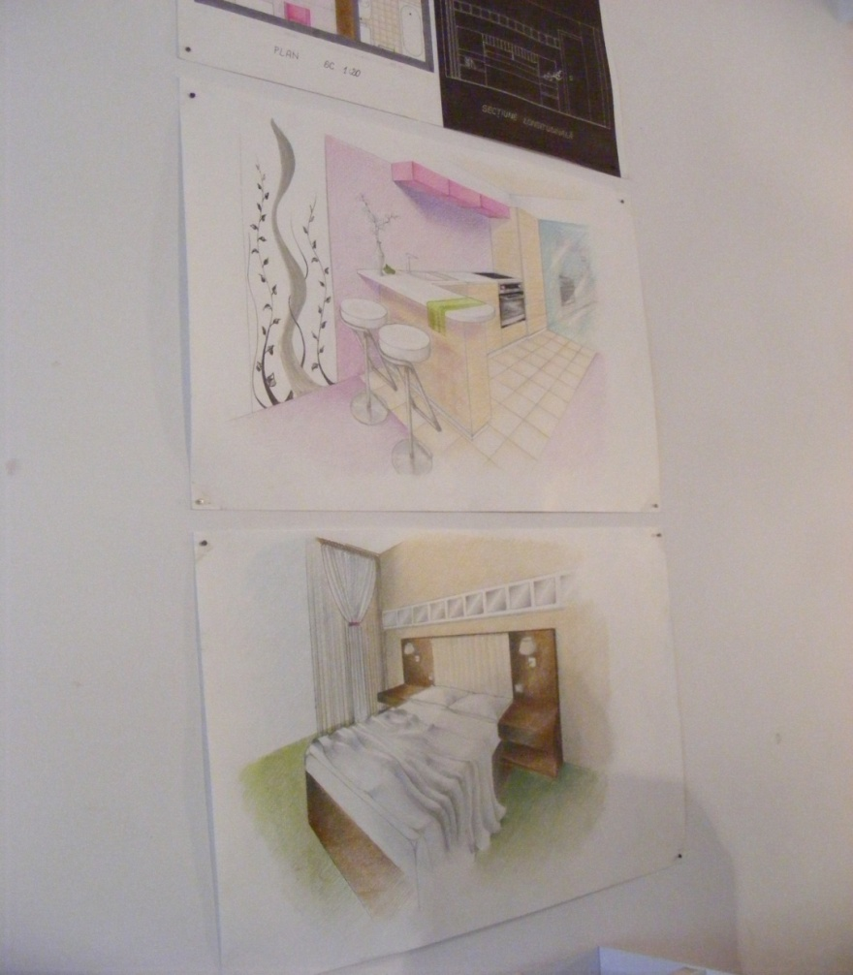
Interior Design

Slide 15
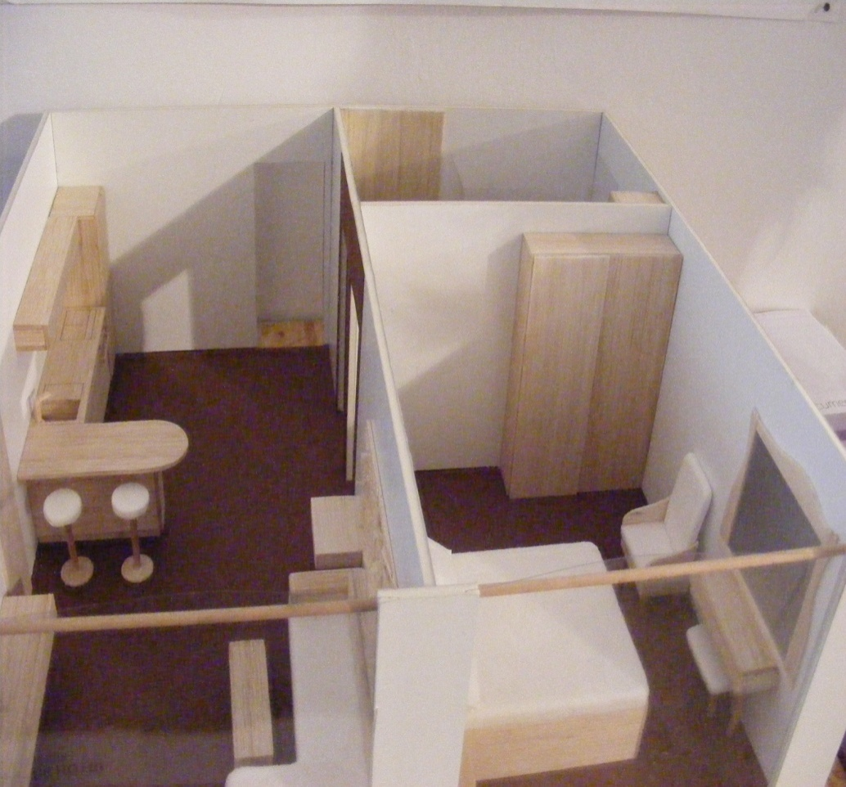
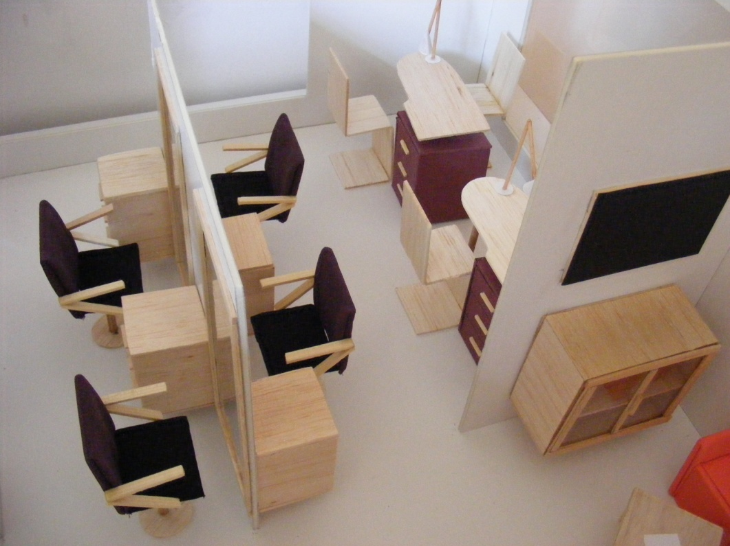
Models

Slide 16
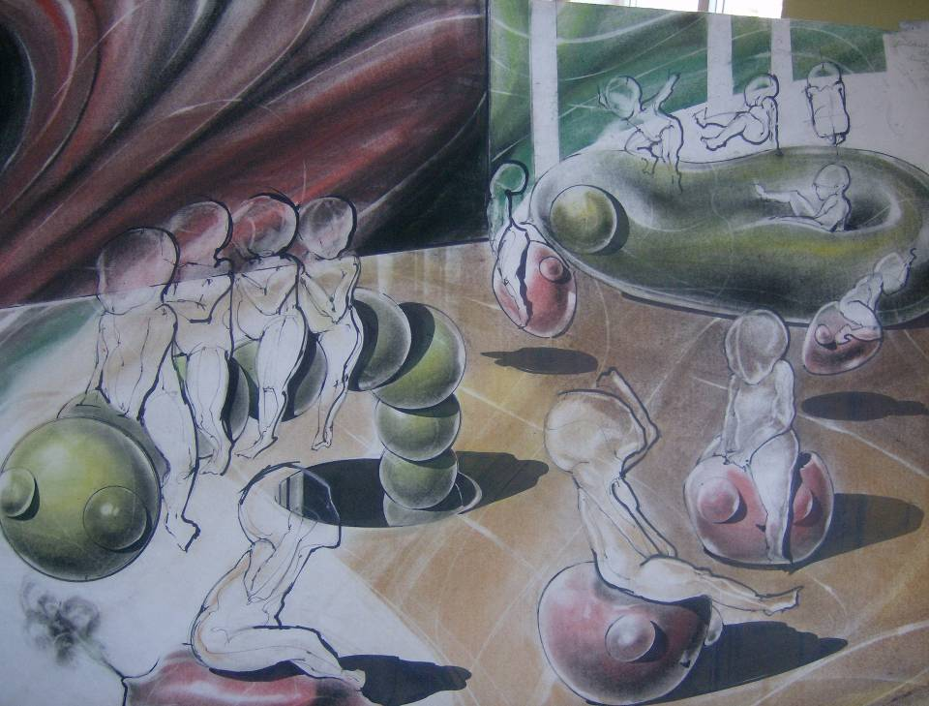

Slide 17
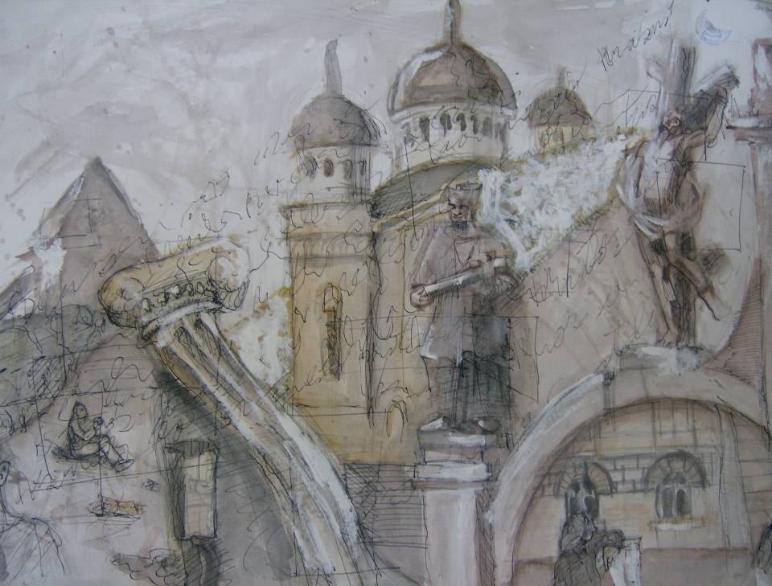
Fine and Decorative Arts section

Slide 18
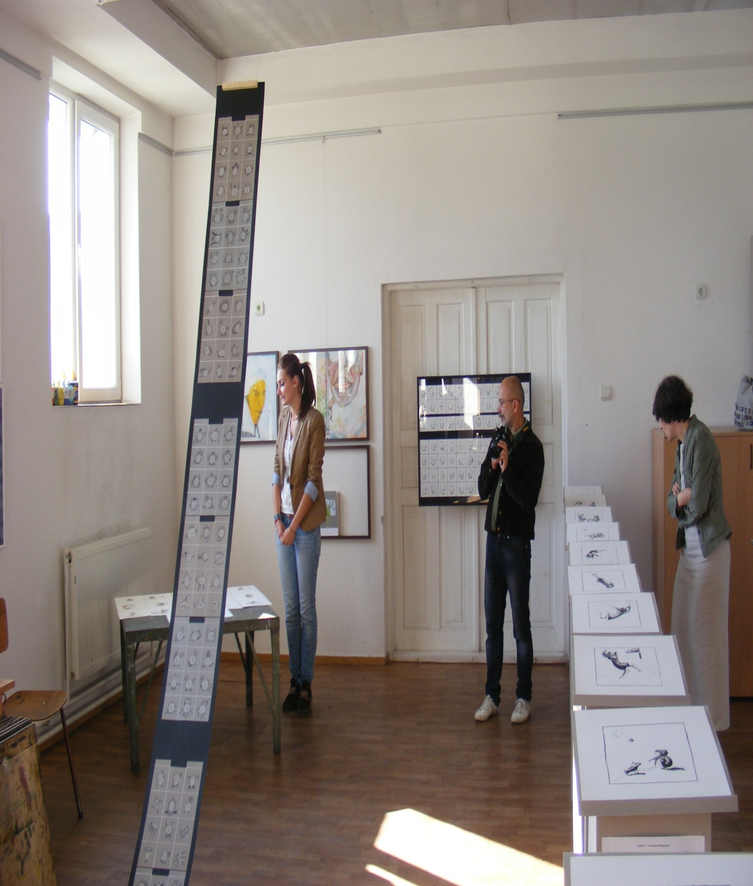
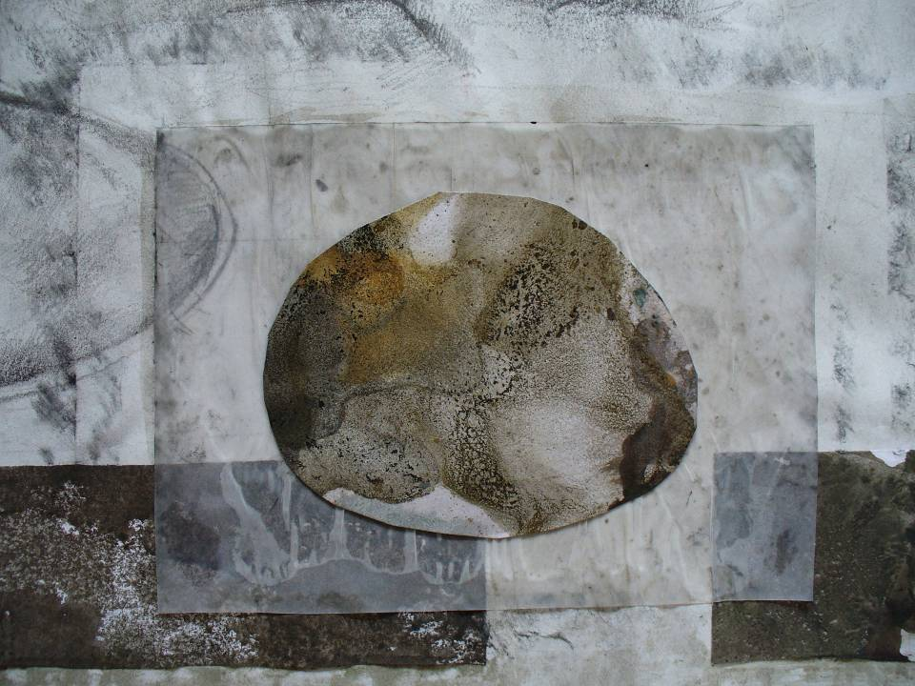
Graphics

Slide 19
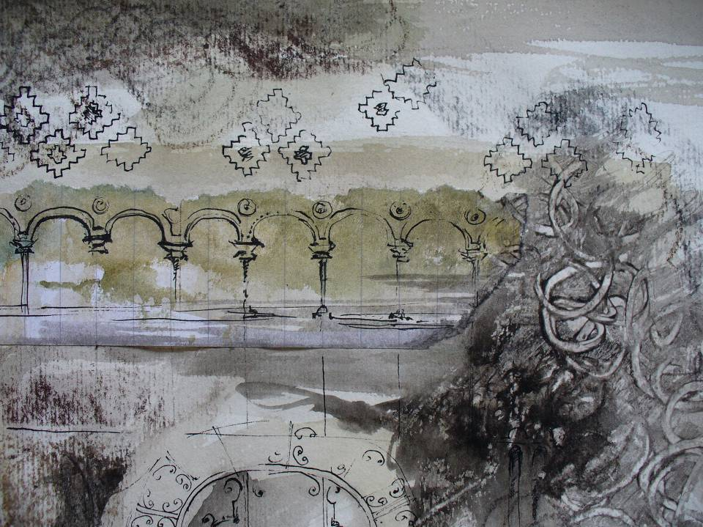

Slide 20
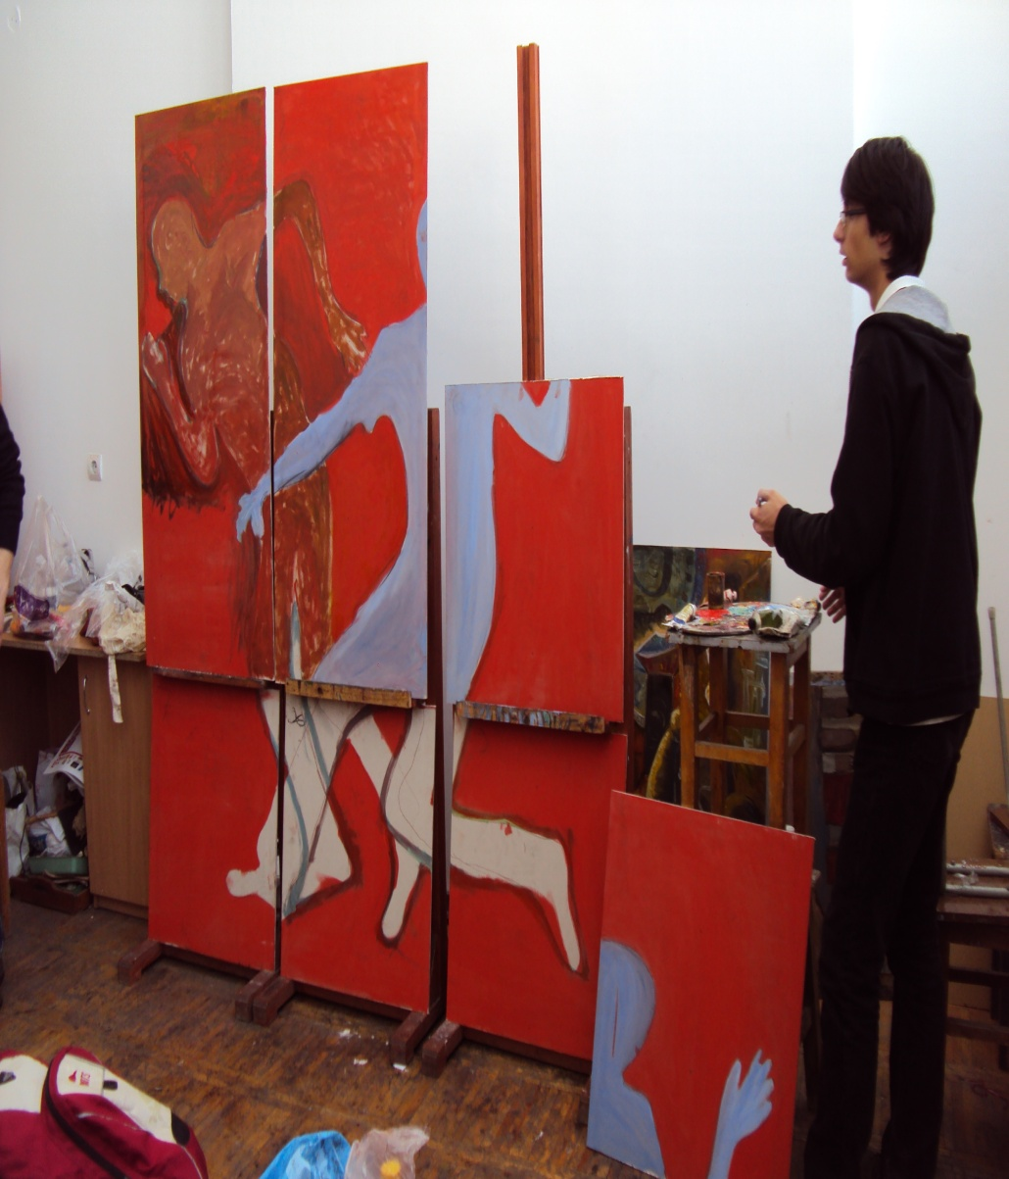
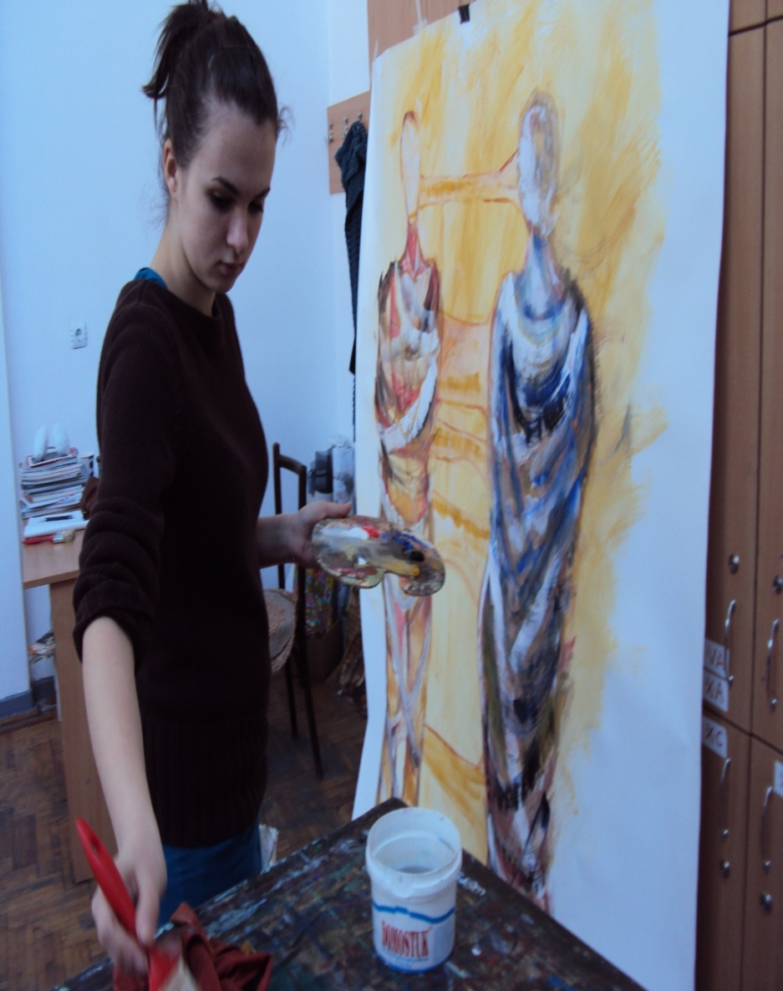
Easel Painting

Slide 21
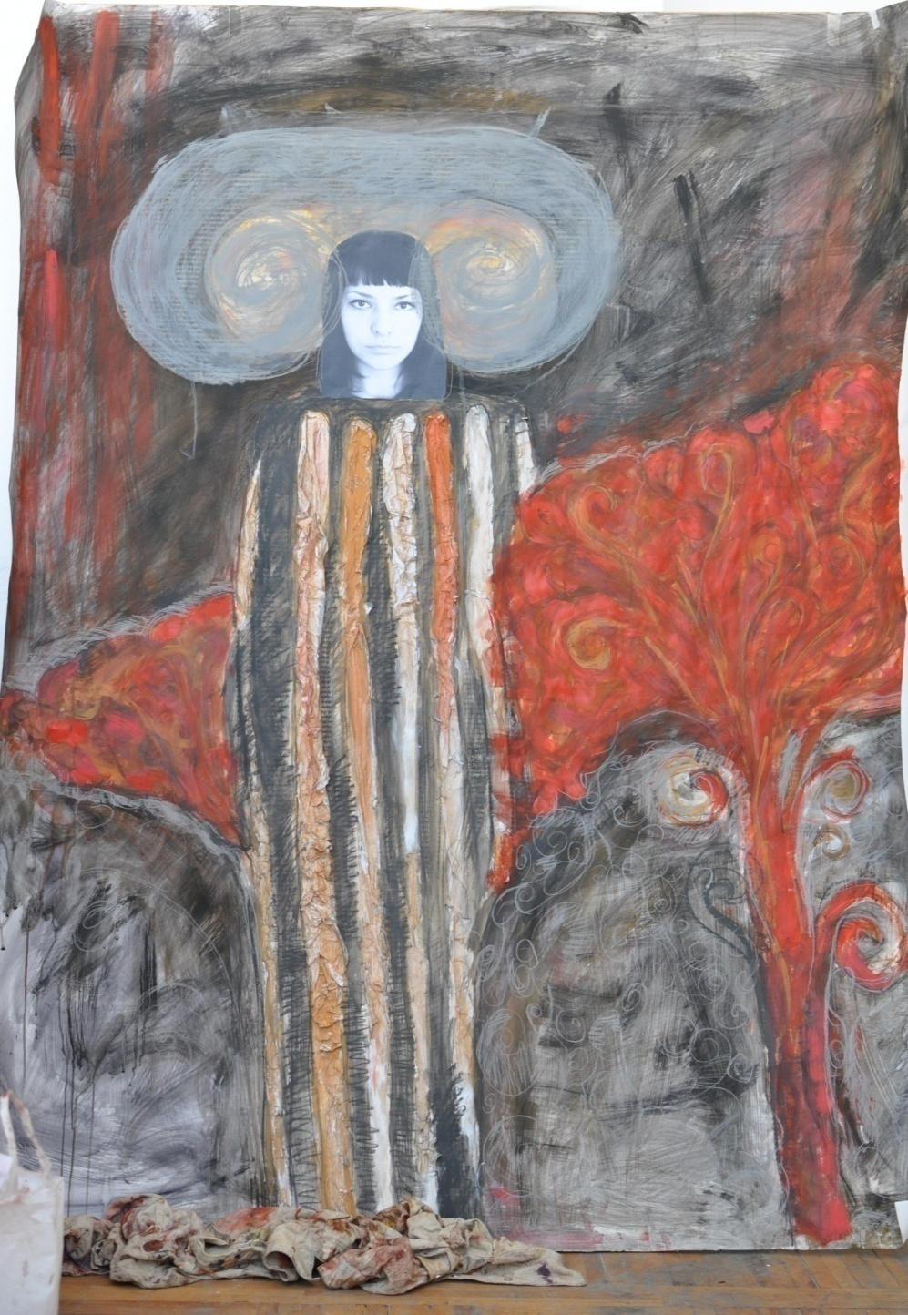
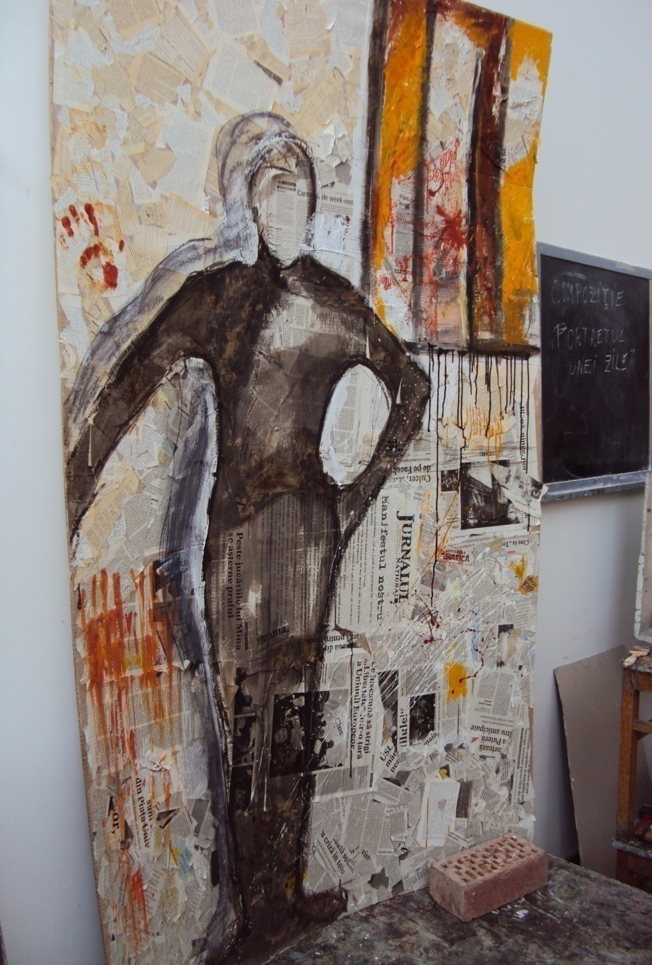

Slide 22
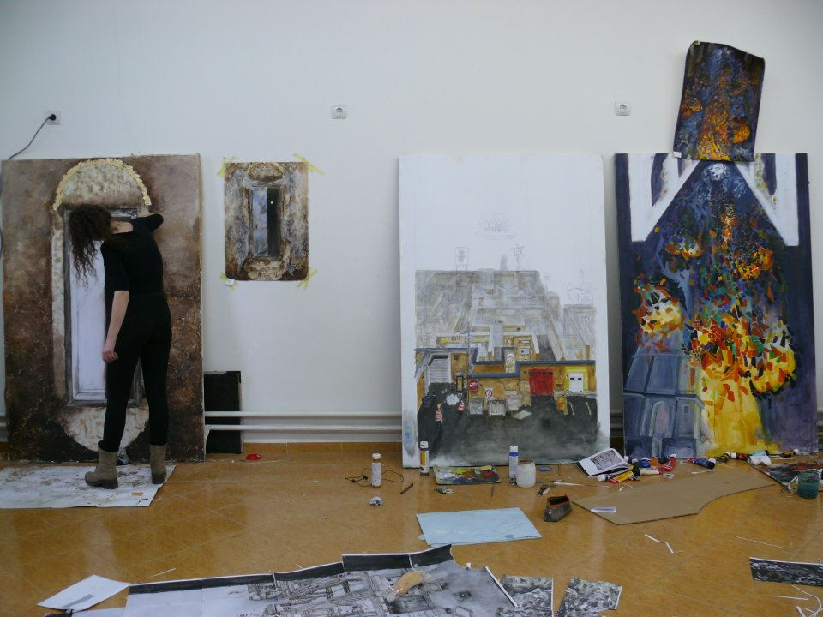

Slide 23
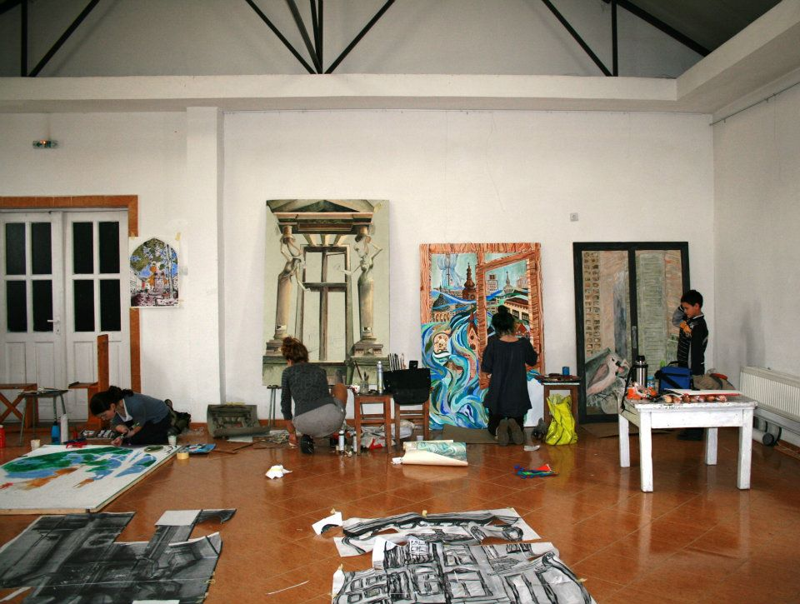

Slide 24
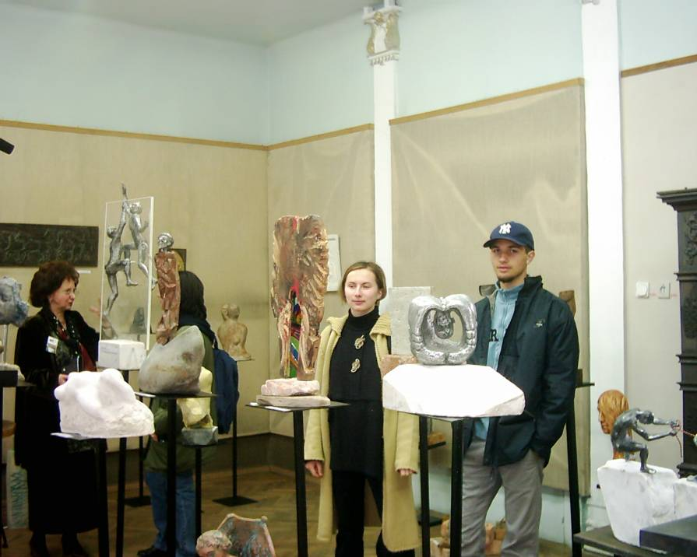
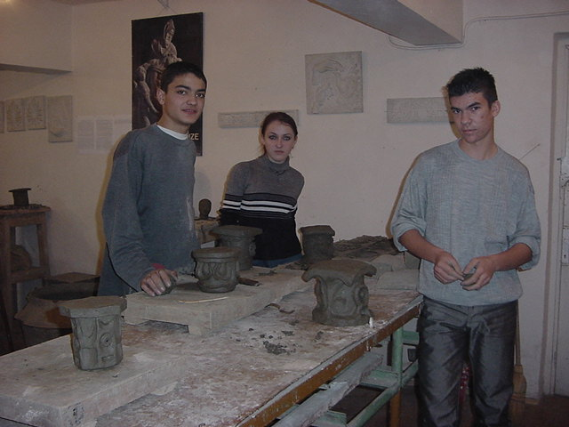
Sculpture

Slide 25
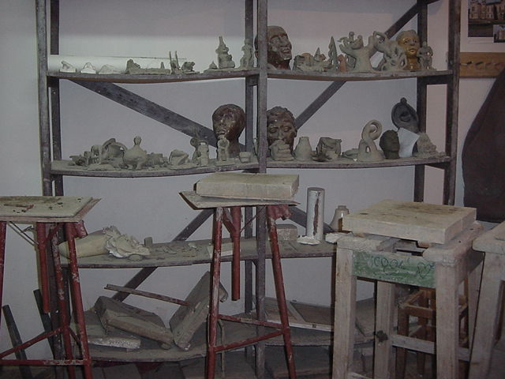

Slide 26
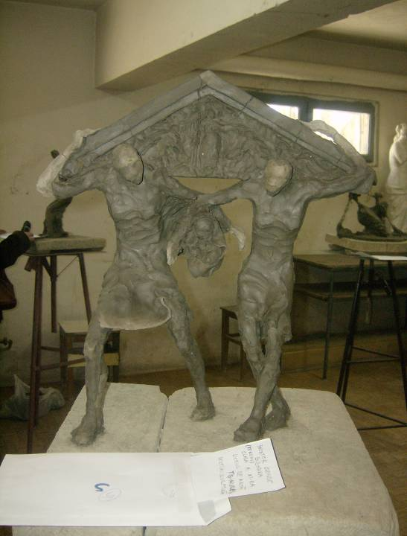

Slide 27
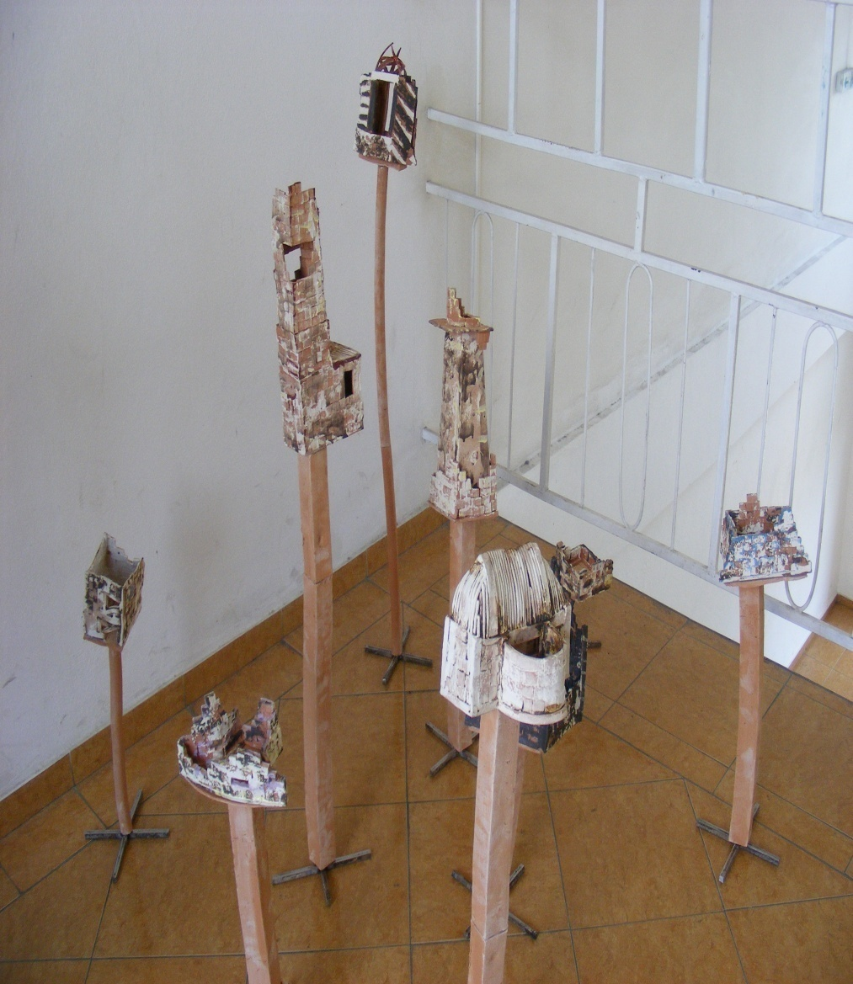
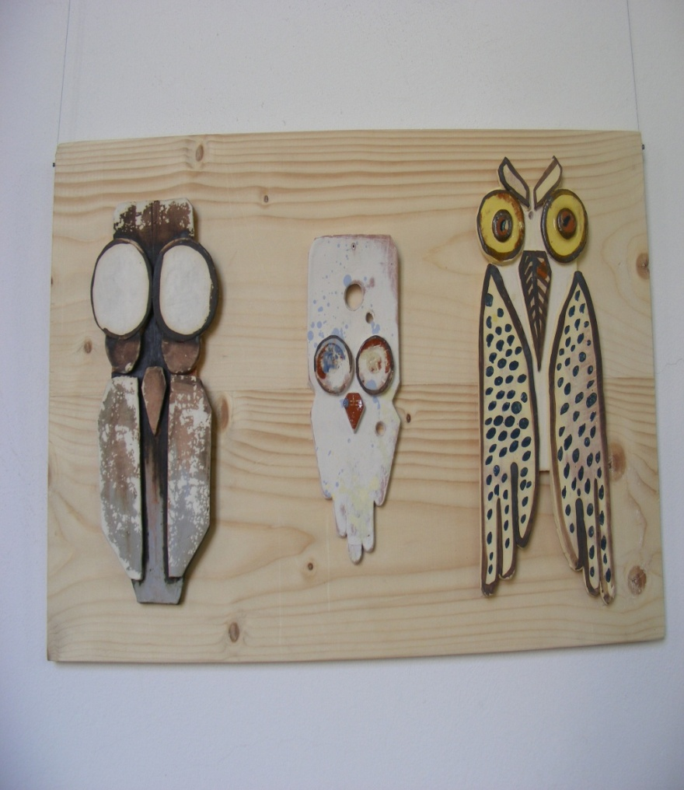
Ceramics

Slide 28
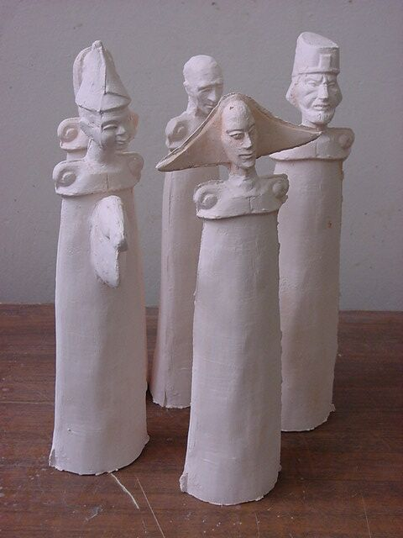

Slide 29
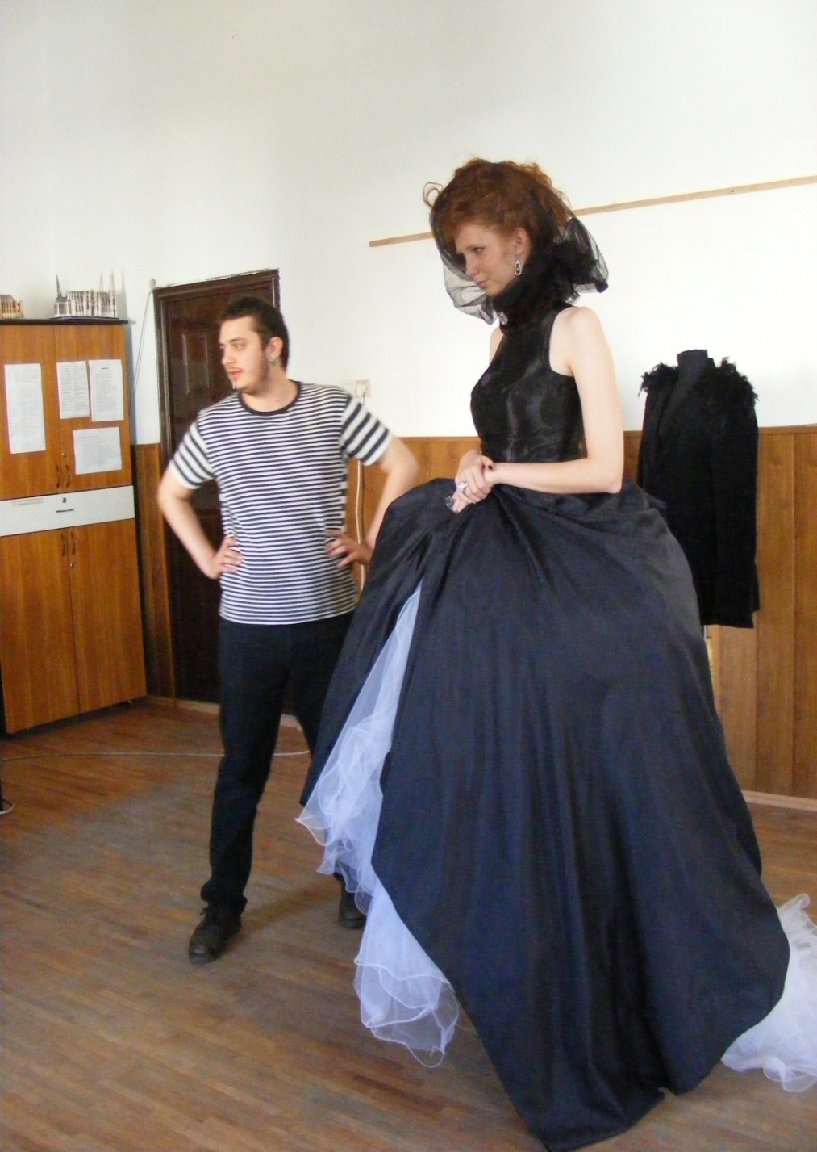
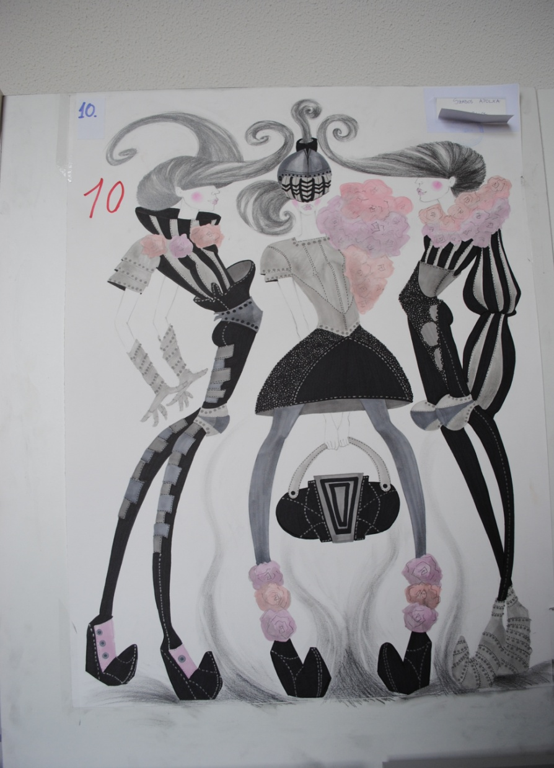
Fashion Design

Slide 30
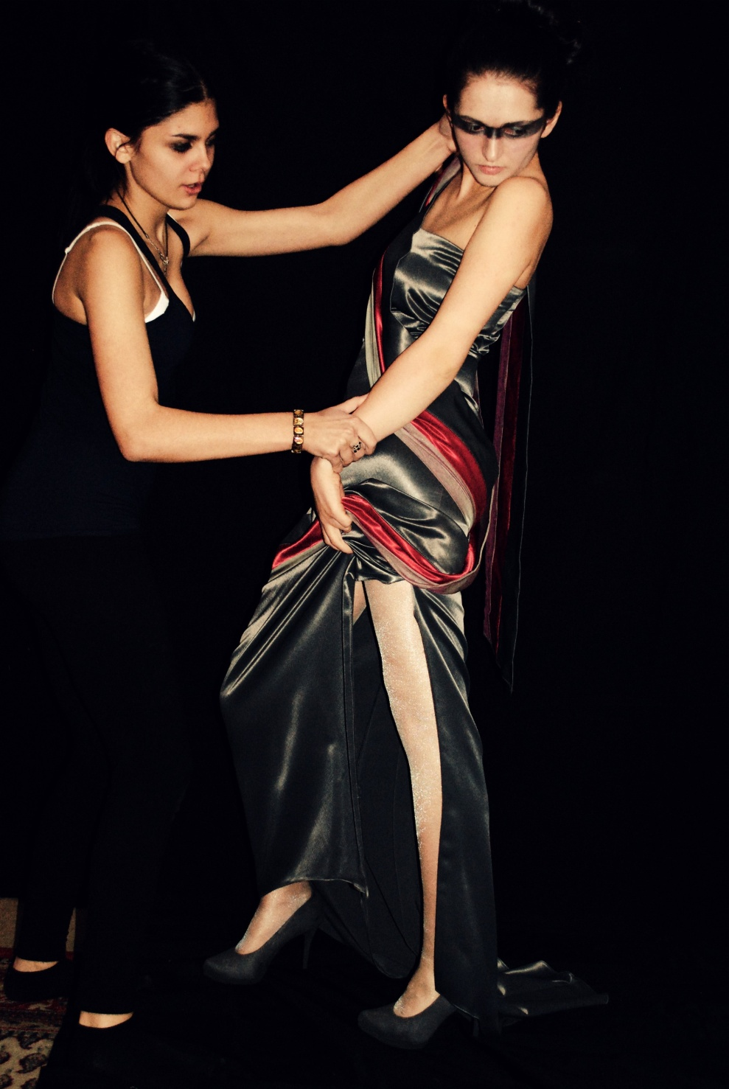
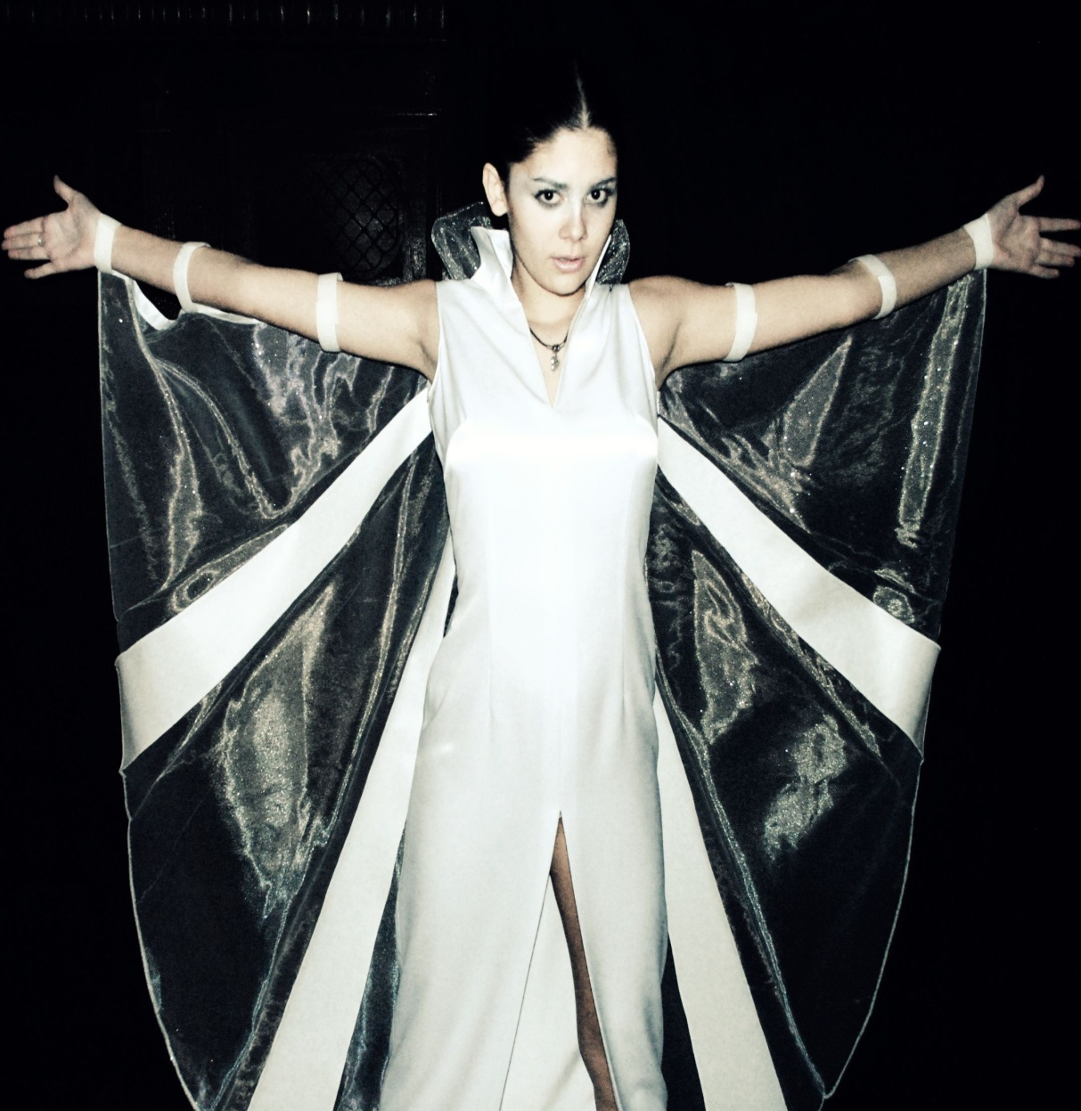
Universe collection

Slide 31
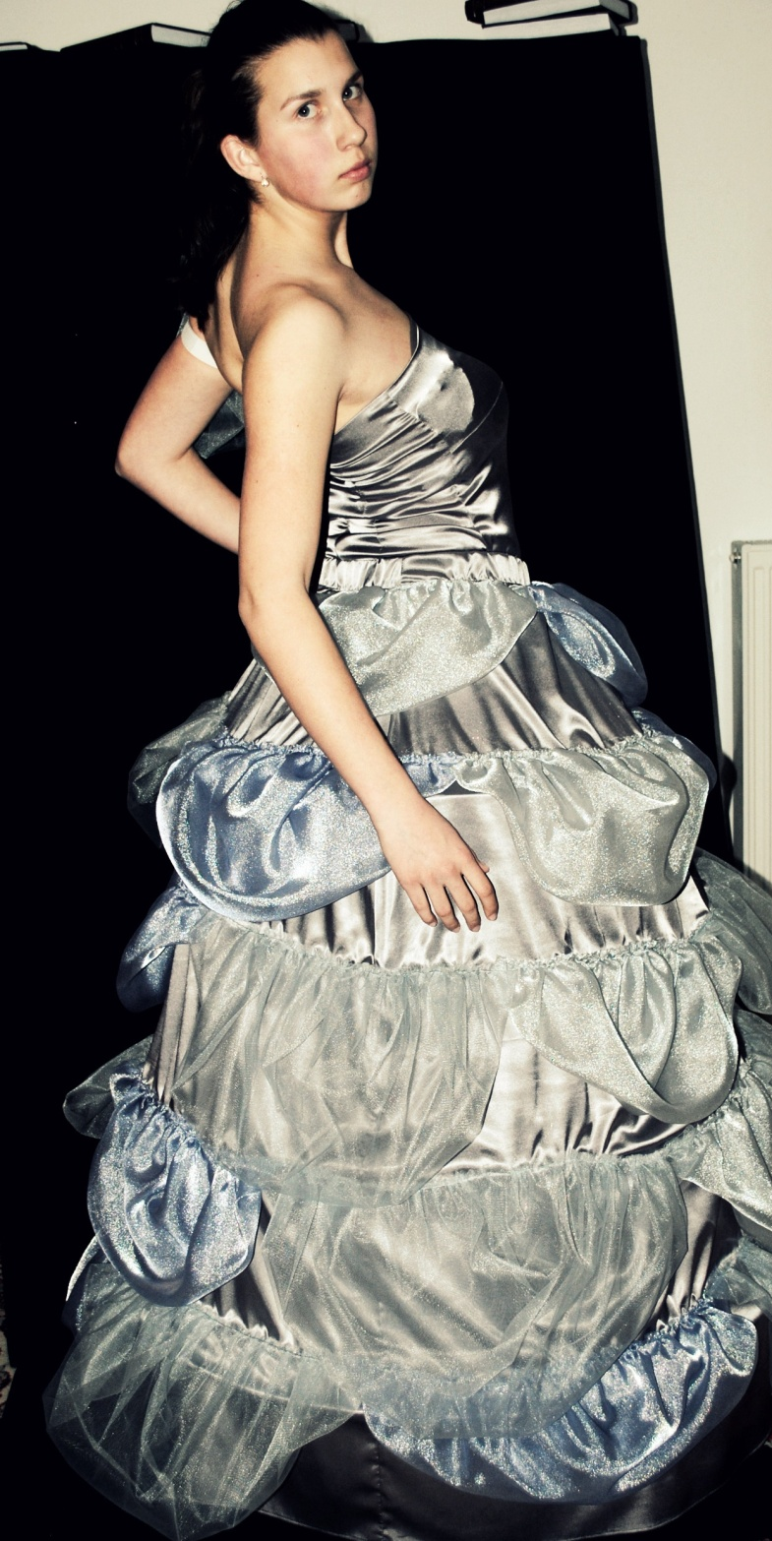
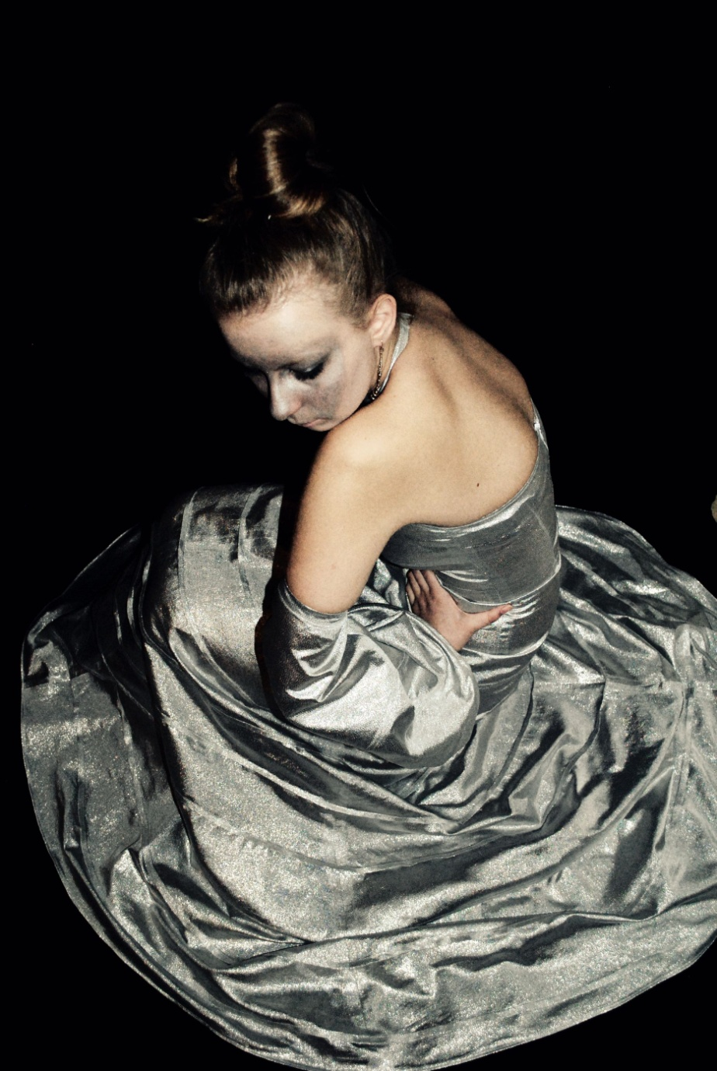

Slide 32
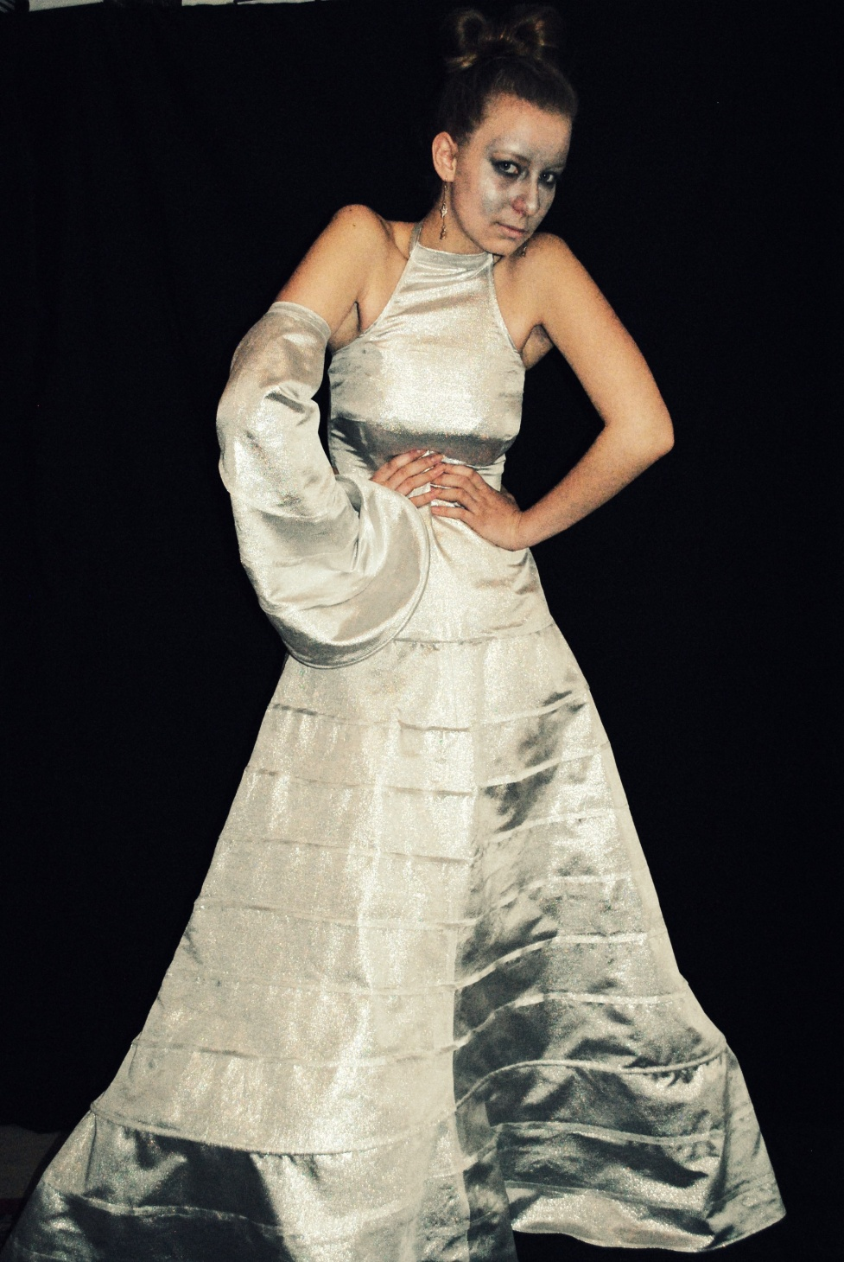
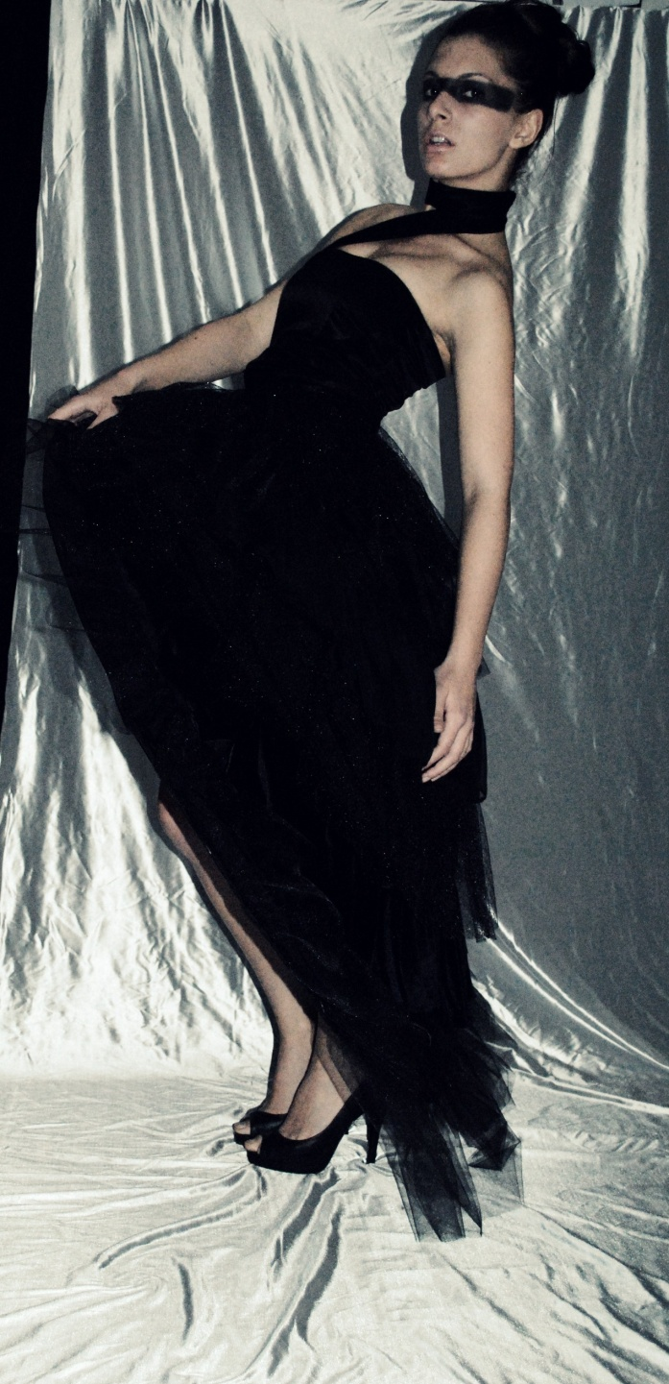

Slide 33
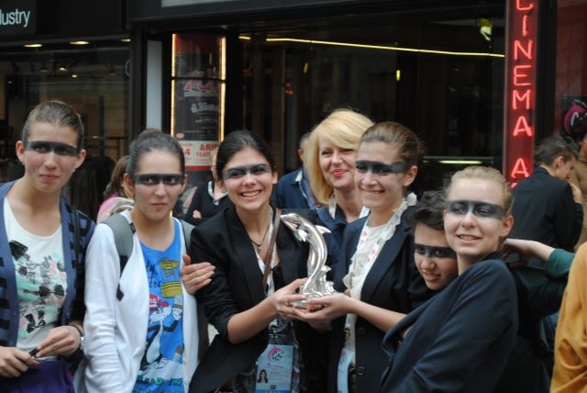
The great prize – Silver Dolphin at San Remo Creativity festival -2011

Slide 34
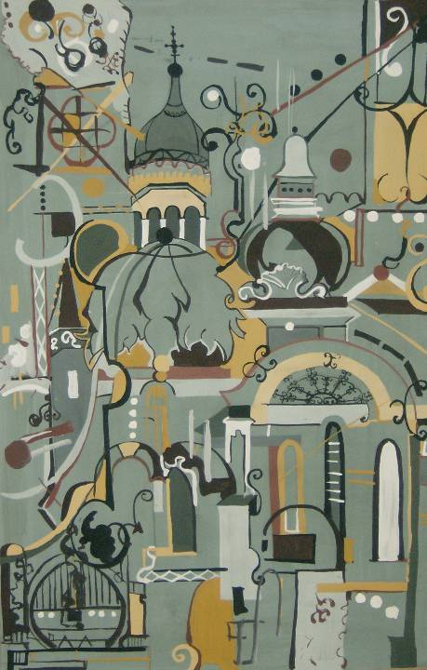
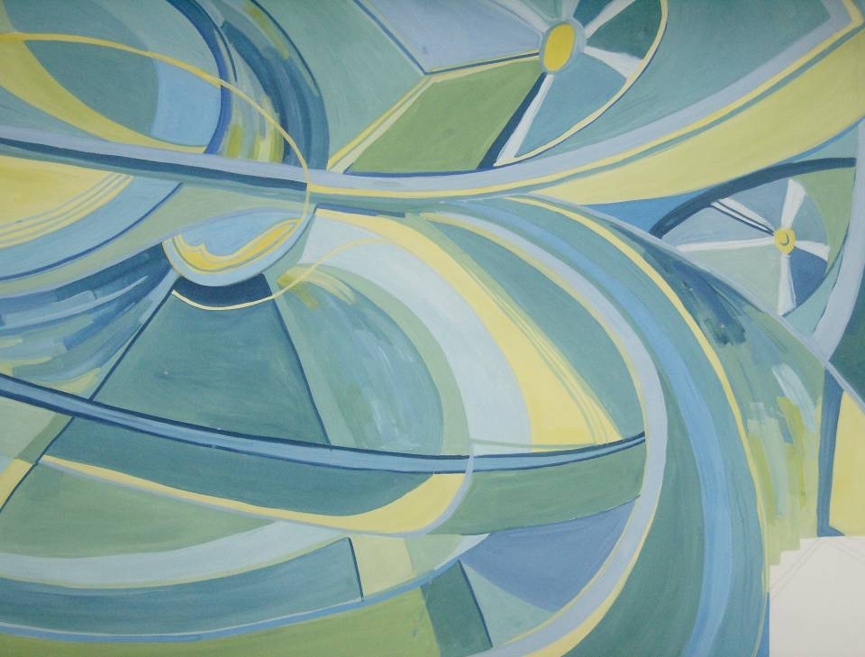
Monumental Painting

Slide 35
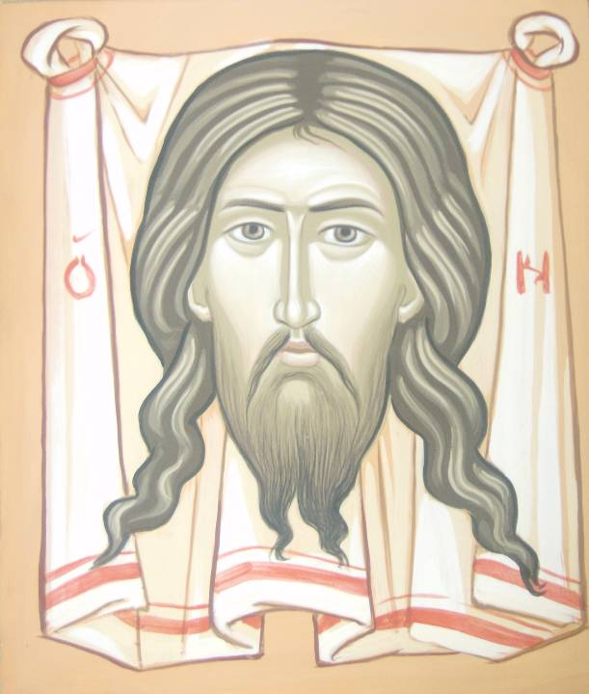

Slide 36
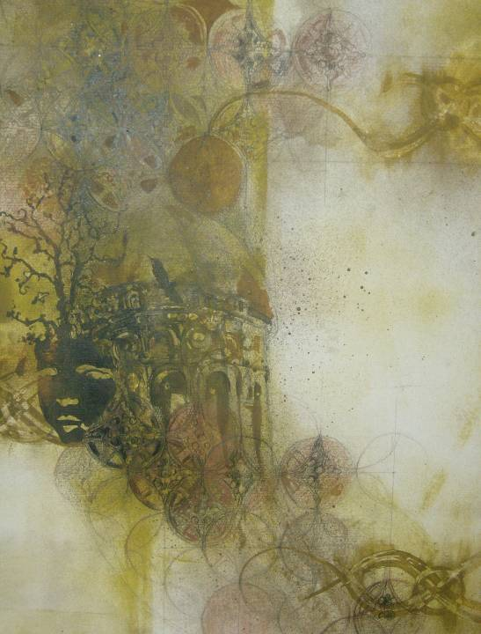
Students ’ Art Works
Notes:
36

Slide 37
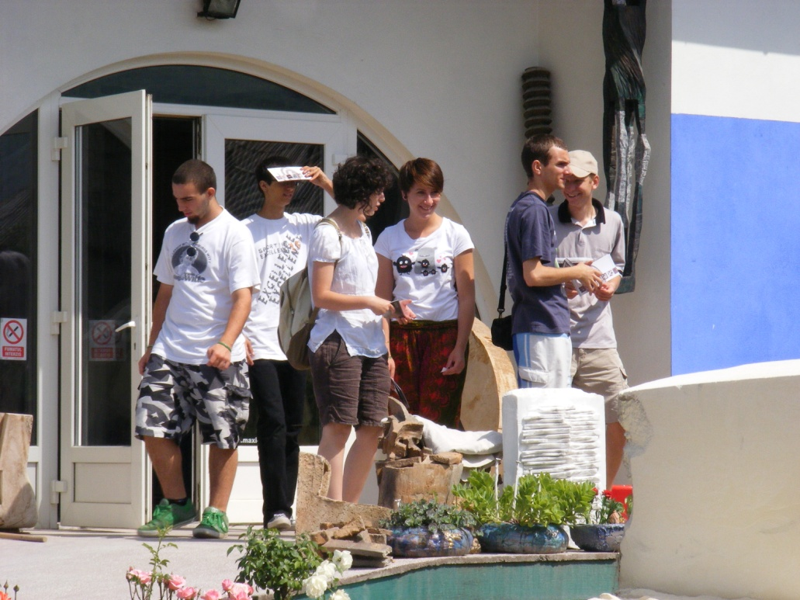




Slide 38




Str. Dorobanţilor 56, 400117 Cluj-Napoca, Tel./fax: 0264-593006, liceulromulladea@yahoo.com, www.arteplasticecj.ro

Slide 39


Slide 40



Slide 41



Slide 42


Slide 43



Slide 44



Slide 45



Slide 46





Slide 47


Slide 48





Slide 49


Slide 50


Slide 51
Festivals, projects and extracurricular activities “Ladea” School Festival
The spiritual master of our school is the great sculptor Romulus Ladea. In his honor and memory, every year in May, our high school organizes a small sculpture festival which has his name. This festival, together with the creative experiment opened to all the children from Cluj and all county of Romania, emphasizes the methodical preoccupations of the teachers, regarding the improvement of the artistic language.

Slide 52


Slide 53



Slide 54


Slide 55



Slide 56


Slide 57



Slide 58


Slide 59

Project “The Wall as a Window” – urban stories –
The stories of the city painted by the students

Slide 60

Exhibition “The Wall as a Window in the Art Museum courtyard

Slide 61


“The Wall as a Window” - Prizes

Slide 62


“The Wall as a Window” - Prizes

Slide 63

Project Civic Art Action Painting on the street

Slide 64



Slide 65



Slide 66


Slide 67


Slide 68


Slide 69





Slide 70
2017-1-FI01-KA219-034708_2
2017-1-FI01-KA219-034708_2
2017-1-FI01-KA219-034708_2
Erasmus+ Project
Signs of the times
2017-1-FI01-KA219-034708_2
2017-2020
The European Commission accepts no responsibility for the contents of the publication.

