Slide 1
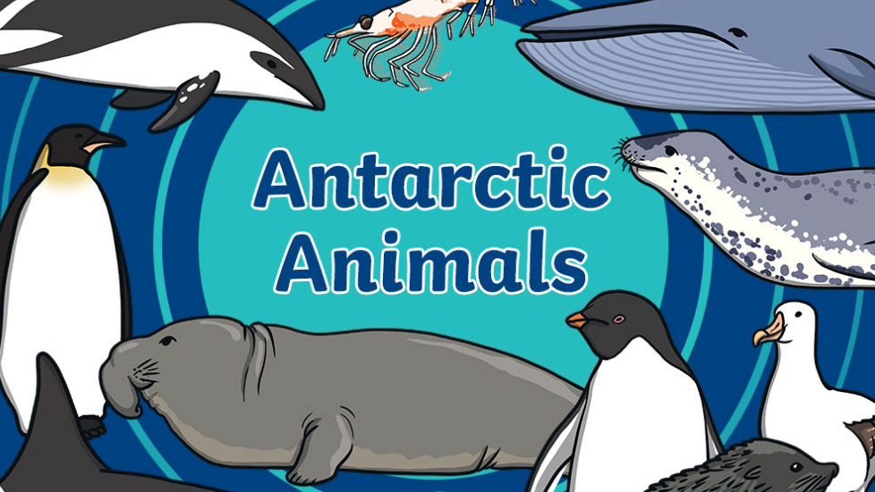

Slide 2

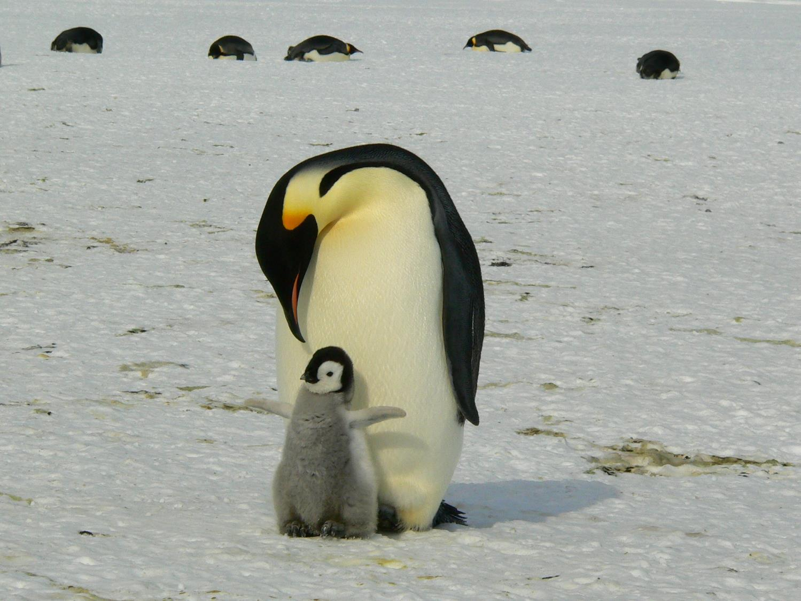
What Can You See?

Slide 3
Emperor Penguin

Slide 4
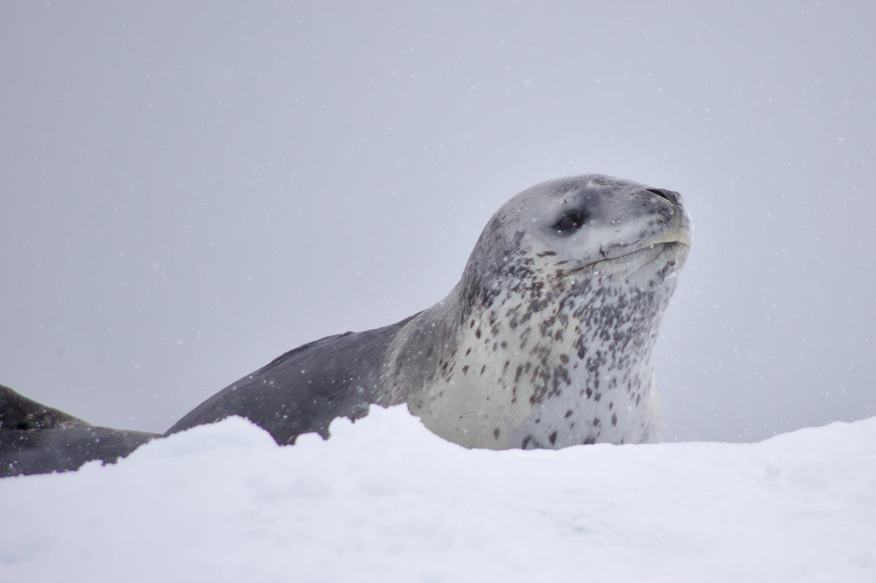
What Can You See?

Slide 5
Seal

Slide 6
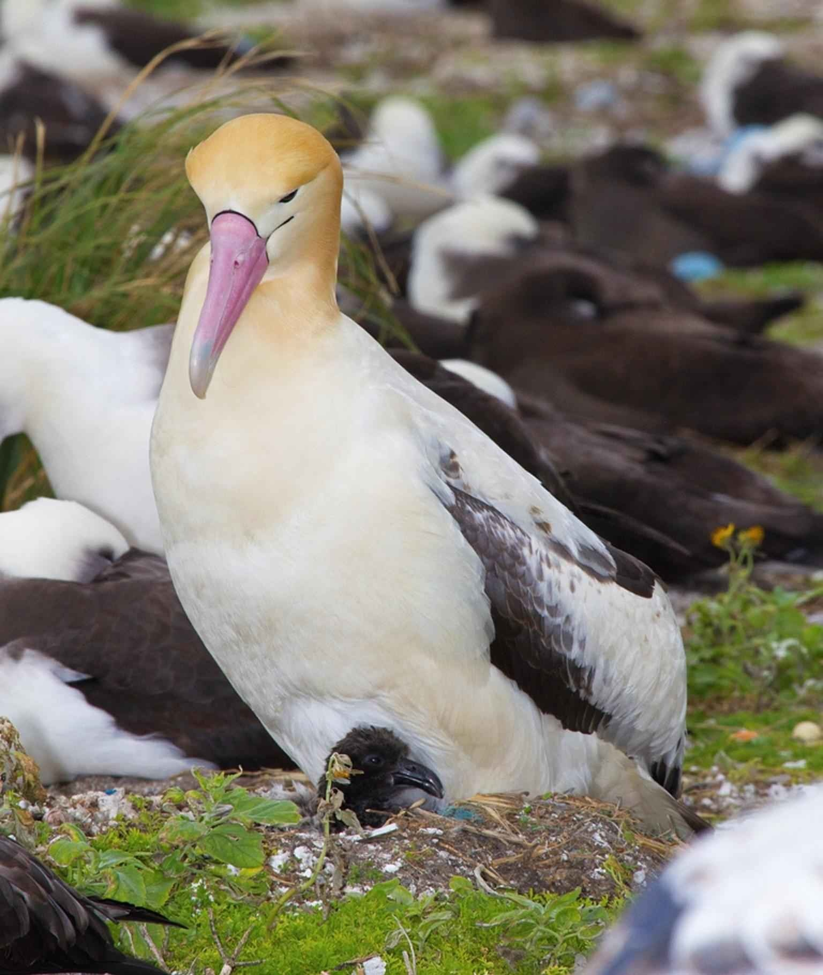
What Can You See?

Slide 7
Albatross

Slide 8
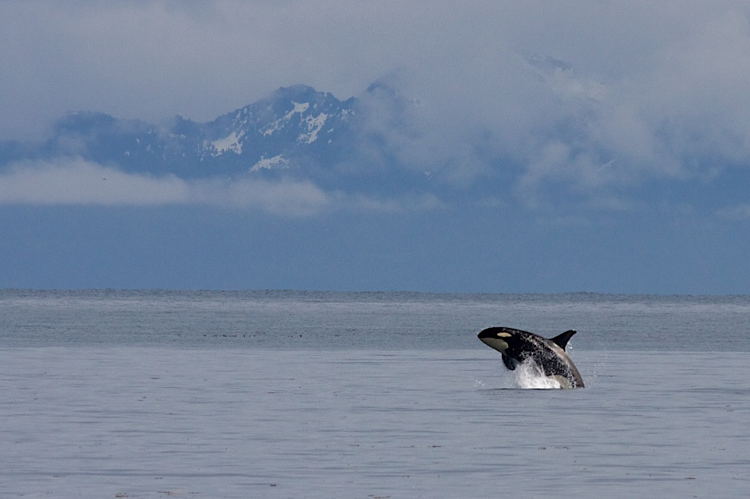
What Can You See?

Slide 9
Orca

Slide 10
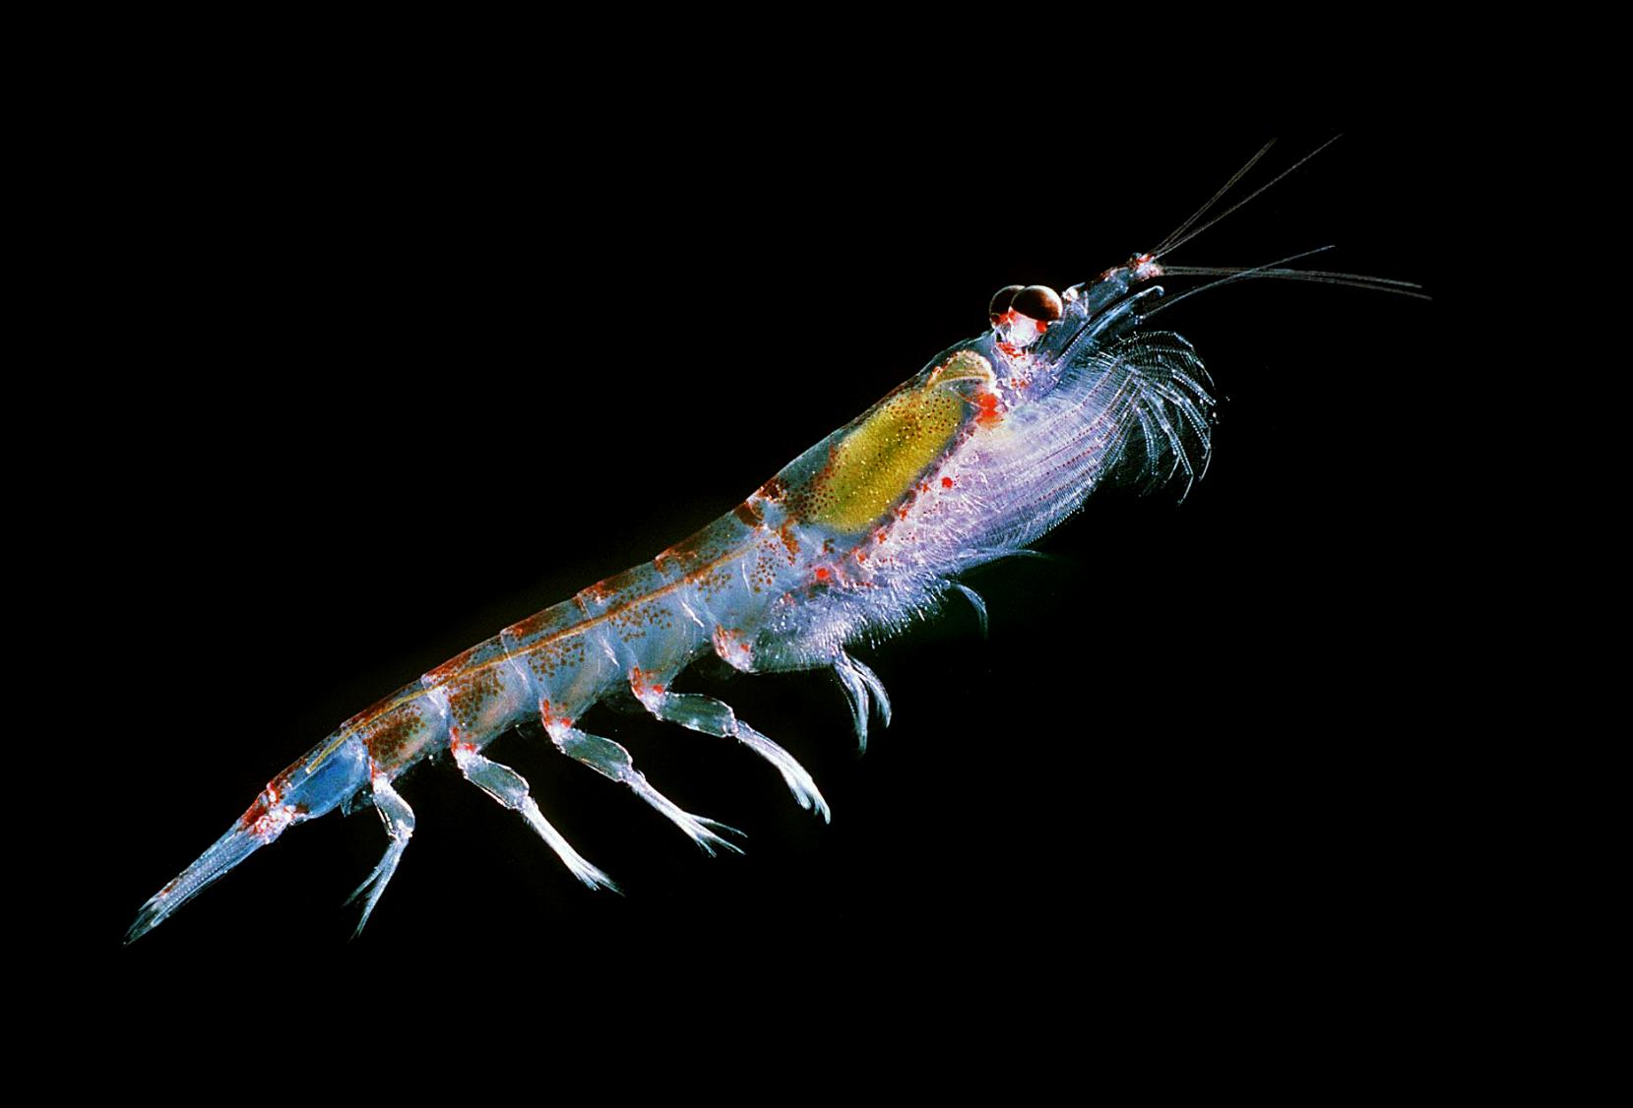
What Can You See?

Slide 11
Antarctic Krill

