Slide 1
Paikan prepositiot
New Insights
Module 4 Grammar

Slide 2
At, on, in
Tavallisia paikan prepositioita ovat at, on ja in.
Prepositioita on parasta opetella vähitellen samalla kun opiskelee sanastoakin.
Tässäkin asiassa harjoitus auttaa.

Slide 3
At
Mitä paikkaa nämä ilmaisevat?
Mitä nämä ilmaisevat?
Who lives at 10 Downing Street?
The suspect was detained at 123 Warrick Avenue.
Tarkkaa osoitetta.
We met at a concert.
Are there more than ten people at the office?
They gather together at breakfast, lunch and dinner.
Wasn't something new on at the theatre?
My best friend loves spending time at the cinema and at restaurants.
First we met at the station and then again at the airport.
Toimintaa, jossa on yleensä useita ihmisiä koolla.

Slide 4
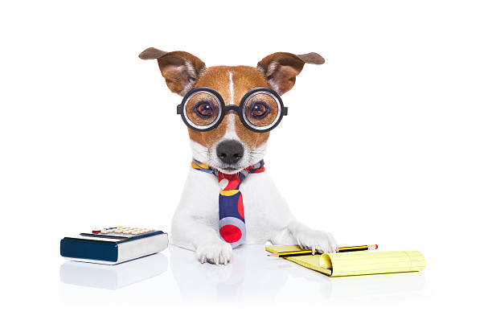
At
Mitä paikkaa nämä ilmaisevat?
I don't often work at my desk but rather at the kitchen table.
Our cat loves to sit at the window and watch the world go by.
We had a party at Mike's.
Luona tai äärellä.
iStock.com/damedeeso

Slide 5
On
Mitä paikkaa nämä ilmaisevat?
Mitä paikkaa nämä ilmaisevat?
There were lots of birds on the roof.
You'll find the answer on page 215.
We love to spend time on the beach.
Isn't their apartment on the seventh floor?
Pintaa.
Don't they have a house on the coast?
No, it's on the Rhine.
Can you name a city on the border of France and Germany?
You'll find the answer on line 25.
Aluetta, joka mielletään viivana (rannikko, joki, raja, rivi).

Slide 6
On
Mitä paikkaa nämä ilmaisevat?
Mitä nämä ilmaisevat?
There were lots of people on the bus.
There were fewer on the tram.
I wasn't able to get any sleep on the plane.
Julkista liikennevälinettä.
Don't walk here without your shoes on.
Is that a monkey on your back?
Tim slid a ring on Jim's finger.
Vaatteita ja ruumiinosia.

Slide 7
On
Mitä nämä ilmaisevat?
Mitä nämä ilmaisevat?
How much time do you spend on the net?
We saw it for the first time on Instagram.
My niece watches films on her tablet.
Mediaa. Vrt. in the novel, in this magazine.
You'll find the department store on your left.
It's not on the right hand side.
Oikealla tai vasemmalla.

Slide 8
In
Mitä paikkaa nämä ilmaisevat?
Mitä paikkaa nämä ilmaisevat?
They don't like to live in the countryside.
There's a fair in our village.
My sister bakes the best cookies in the world.
Who was the first human in space?
Isoa aluetta.
The children were playing football in the yard.
Are there apple trees in your garden?
Dogs are allowed in the park.
Rajattua aluetta, jota saattaa mm. rajata aita tai oja.

Slide 9
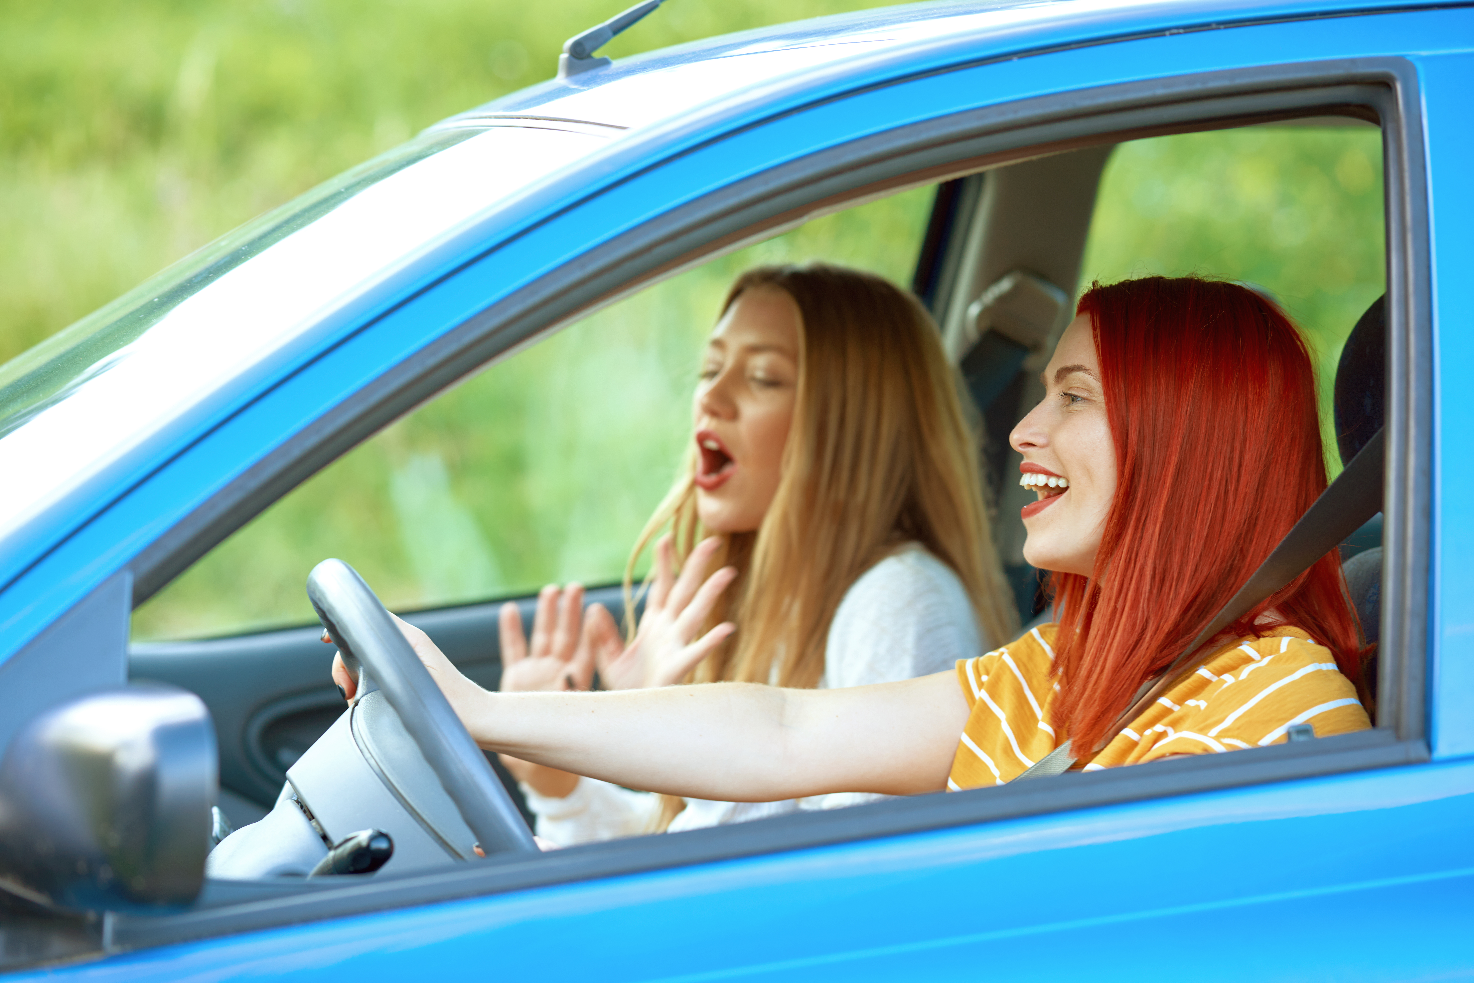
In
Mitä paikkaa nämä ilmaisevat?
How many inmates are there in this prison?
There are different colours in each room.
Do you sing in the car?
It's cold in here. Turn the heating on.
Rakennusta tai muuta suljettua tilaa.
iStock.com / stock_colors

Slide 10
Practise.
1. Onko sinulla kiire töissä?
Are you busy at work?
2. Junassa oli juhlatunnelma.
There was a party atmosphere on the train.
3. Luitko viestit puhelimestasi?
Did you read the messages on your phone?
4. Oletko koskaan asunut maalla?
Have you ever lived in the countryside?

Slide 11
Practise.
5. Autossa oli neljä matkustajaa.
There were four passengers in the car.
6. Keskellä huonetta oli iso pöytä.
There was a large table in the middle of the room.
7. Rannikolla oli paljon kalastusveneitä.
There were a lot fishing boats on the coast.
8. Voitko hakea minut asemalta?
Can you pick me up at the station?

