Slide 1
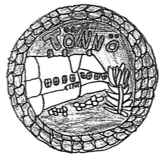
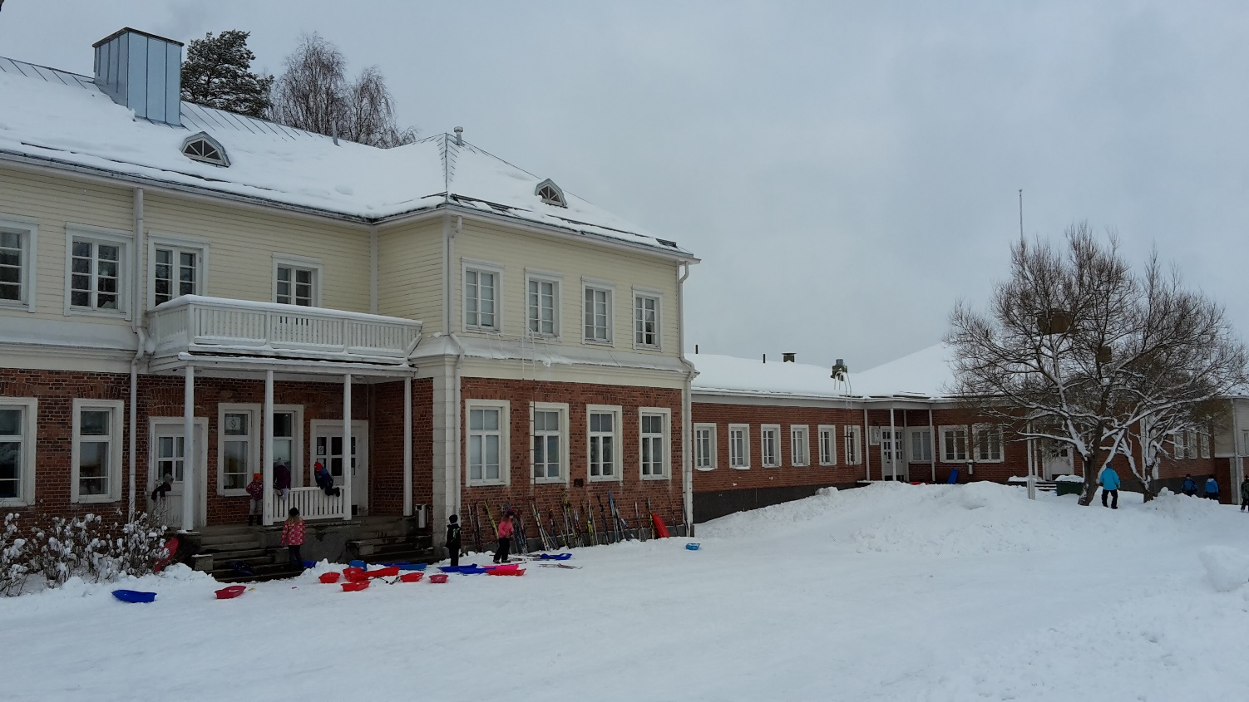
Tönnö primary school
in Orimattila, Finland
Our primary school is situated near the centre of the rural town of Orimattila in southern Finland, about 90 km north of the capital Helsinki and about 20 km south of the famous wintersports city of Lahti.

Slide 2
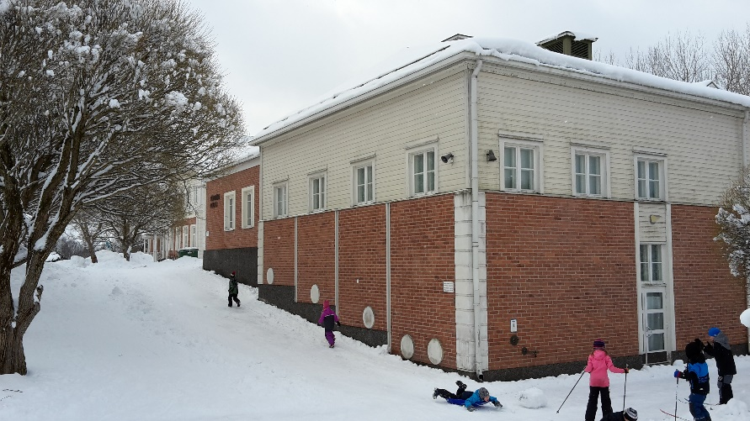
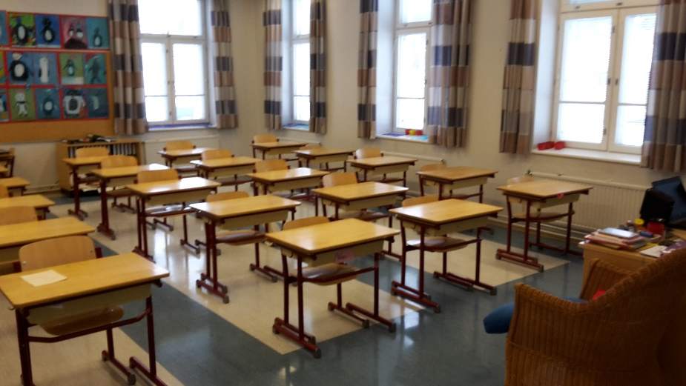
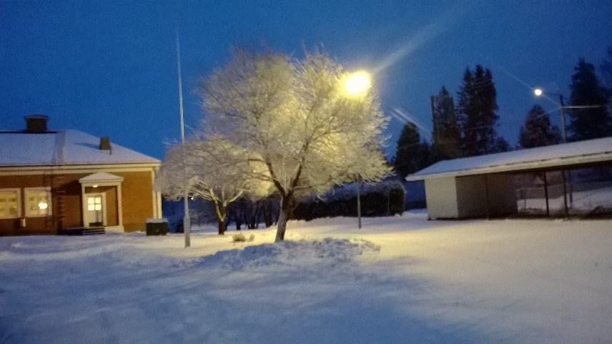
Tönnö school
Grades 1-6
Founded 1906. The new part built in 1989
122 pupils in grades 1-6 / age 7-13
Pupils in classes varies from 17 – 25

Slide 3
The staff (22-23)
6 class teachers
Music/crafts/headmasteri
English teacher
a special needs teacher
4 School assistants

Slide 4
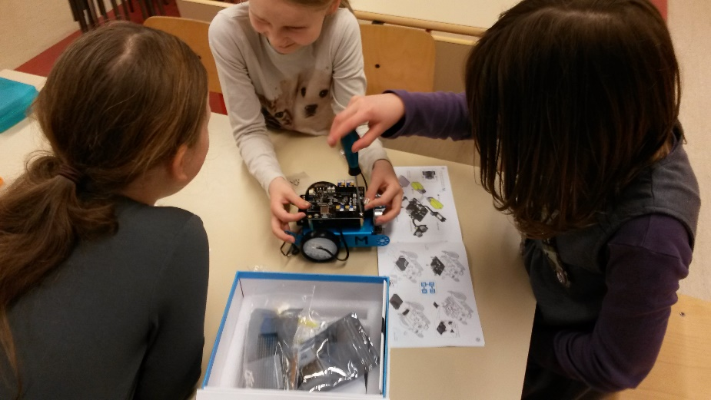
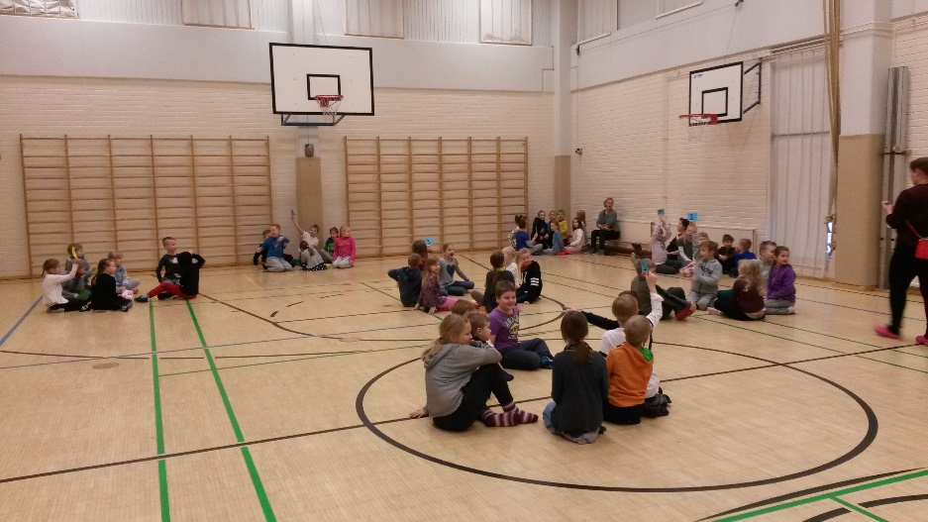
Three stages learning support:
Special needs teachier 15 h/week
Supportative teaching 1h/week/class
Planned together with parents and
the pupils support team
In transport(taxi/bus) 27 pupils.

Slide 5
General information
Schooldays usually start at around 8 o’clock and ends at 3 o’clock.
The youngest pupils have shorter days and then the number of weekly lessons gradually increases when they get older.
The pupils also have a free lunch at schools in Finland.
The food I prepared in a central kitchen and then it is delivered to us and we have lunch in our canteen with pupils.
All the books and other materials we give to our pupils are also free.
Most of the books are recycled and the pupils return them at the end of the school year.

Slide 6
The school year
The school year in Finland starts in the middle of August and the autumn term lasts until Christmas.
We have a short autumn leave at the end on October (usually a week).
The spring term starts after the Christmas holiday (about two weeks) and lasts until the end on May.
We have one-week winter holiday at the end of February.
Our summer holiday starts at the beginning of June.

Slide 7
School subjects
School subjects include:
Finnish,
English (starting from the 1 st grade, the first two years they learn basic words, then from 3 rd grade they start to learn how to read, write and speak in English),
Swedish (six-graders),
maths,
religion,
physical education,
history,
biology,
geography,
arts, crafts and music.

Slide 8

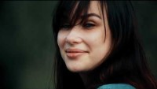
Videos about Tönnö ja Orimattila

Slide 9
THANK YOU !

