Slide 1
Theoretical Perspectives: Realism

Slide 2
Realism in Global Politics
Realism is a theoretical perspective in which power is seen as the currency of global politics
States are concerned with how much power they have and how much power they have relative to other states
Global Politics IS Power Politics

Slide 3
WHY DO STATES WANT POWER?
Structural Realist Theory
Classical Realist Theory

Slide 4
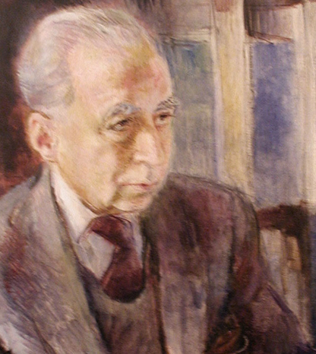
Classical Realism
Human nature to want power
States are led with by individuals with an innate need to dominate their rivals
Hans Morgenthau

Slide 5

Structural Realism
States pursue power because of the nature of the international system
‘States are trapped in an iron cage where they have little option but to compete with each other for power to ensure their own survival’
John Mearsheimer

Slide 6
What is the key difference between classical and structural realists?
Classical: Power is an end ‘sui generis’
Structural: Power is a means to an end. The end is the survival of the state itself

Slide 7
We will focus on structural realism
A state’s power comes from 2 sources:
The material capabilities a state controls: military resources such as armoured divisions and nuclear weapons
Latent power: based on a state’s wealth and size of it’s overall population

Slide 8
5 Key Assumptions of Structural Realism
States operate in an anarchic global system
All states possess some offensive military capability
States can never know the intentions of other states
The main goal of states is survival
States are rational actors

Slide 9
1. States operate in an anarchic system
Anarchy is an ordering principle
The is no central authority that stands above states in the system
The opposite of anarchy is hierarchy which is the ordering principle of domestic politics

Slide 10
2. All states possess some offensive military capacity
Each state has the power to inflict harm upon its neighbors
Capacity varies massively between states

Slide 11
3. States can never know the intentions of other states
States ultimately want to know whether other states are determined to use force to alter the balance of power (revisionist states), or whether they are satisfied enough with it that they have no interest in using force to change it (status quo states).
It is almost impossible to discern another state’s intentions with a high degree of certainty.
Unlike military capabilities, intentions cannot be empirically verified. Intentions are in the minds of decision-makers

Slide 12
4. The primary goal of all states is survival
States also have other goals - e.g. prosperity, protecting human rights
Survival is primary goal – if a state does not survive it will not achieve any of its goals

Slide 13
5. States are rational actors
States are capable of coming up with sound strategies that maximize their prospects for survival.
They may miscalculate from time to time. Because states operate with imperfect information in a complicated world, they sometimes make serious mistakes.

Slide 14
It gets more confusing…
Offensive Structural Realism
Defensive Structural Realism
It makes sense for states to pursue as much as power as possible
States should pursue hegemony where possible
Key writer: John Mearsheimer
Unwise for states to maximize their share of power as the global political system will punish them if they attempt to gain too much
Pursuit of hegemony is foolish
Key writer: Kenneth Waltz

Slide 15
What is the key difference between offensive and defensive structural realists?
HOW MUCH POWER IS ENOUGH?

Slide 16
Hegemony – Offensive Realism
Offensive realists argue that states should always be looking for opportunities to gain more power and should do so whenever it seems feasible.
States should maximize power, and their ultimate goal should be hegemony, because that is the best way to guarantee survival

Slide 17
Hegemony – Defensive Realism
While defensive realists recognize that the international system creates strong incentives to gain additional increments of power, they maintain that it is strategically foolish to pursue hegemony.
States should not maximize power, but should instead strive for what Kenneth Waltz calls an ‘appropriate amount of power’

Slide 18
Why show restraint? Reason 1
Defensive realists emphasize that if any state becomes too powerful, balancing will occur.
E.g. Napoleonic France (1792–1815), Imperial Germany (1900–18), and Nazi Germany (1933–45)
Otto von Bismarck’s genius, according to the defensive realists, was that he understood that too much power was bad for Germany, because it would cause its neighbors to balance against it.
So, he halted German expansion after winning stunning victories in the Austro-Prussian (1866) and Franco- Prussian (1870–1) Wars.

Slide 19
Why show restraint? Reason 2
There is an offence–defense balance, which indicates how easy or difficult it is to conquer territory or defeat a defender in battle.
The the offence–defense balance is usually heavily weighted in the defender’s favor.
Any state that attempts to gain large amounts of additional power is likely to end up fighting a series of losing wars.
Accordingly, states will recognize the futility of offence and concentrate instead on maintaining their position in the balance of power. If they do go on the offensive, their aims will be limited.

Slide 20
Why show restraint? Reason 3
Even when conquest is feasible, it does not pay: the costs outweigh the benefits.
Because of nationalism, it is especially difficult, sometimes impossible, for the conqueror to subdue the conquered.
The ideology of nationalism is all about self-determination, which virtually guarantees that occupied populations will rise up against the occupier

Slide 21
Conquest is not only difficult but, when it is successful, leads to many difficulties and few benefits

Slide 22
How do Offensive Realists respond?
Claim balancing is often inefficient, especially when it comes to forming balancing coalitions, and that this inefficiency provides opportunities for a clever aggressor to take advantage of its adversaries.
take issue with the claim that the defender has a significant advantage over the attacker, and thus offence hardly ever pays.
acknowledge that sometimes conquest does not pay but they also point out that sometimes it does.

Slide 23
Anything in common?
Both defensive and offensive realists agree, however, that nuclear weapons have little utility for offensive purposes, except where only one side in a conflict has them.
The reason is simple: if both sides have a survivable retaliatory capability, neither gains an advantage from striking first.
Moreover, both camps agree that conventional war between nuclear-armed states is possible but not likely, because of the danger of escalation to the nuclear level.

Slide 24
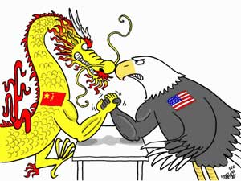
Case Study: Realism and the Rise of China
We are going to try and apply what we have learnt by comparing how defensive and offensive realists might view the recent rise of China as a world power
https://www.theguardian.com/world/2017/oct/18/xi-jinping-speech-new-era-chinese-power-party-congress

