Slide 1
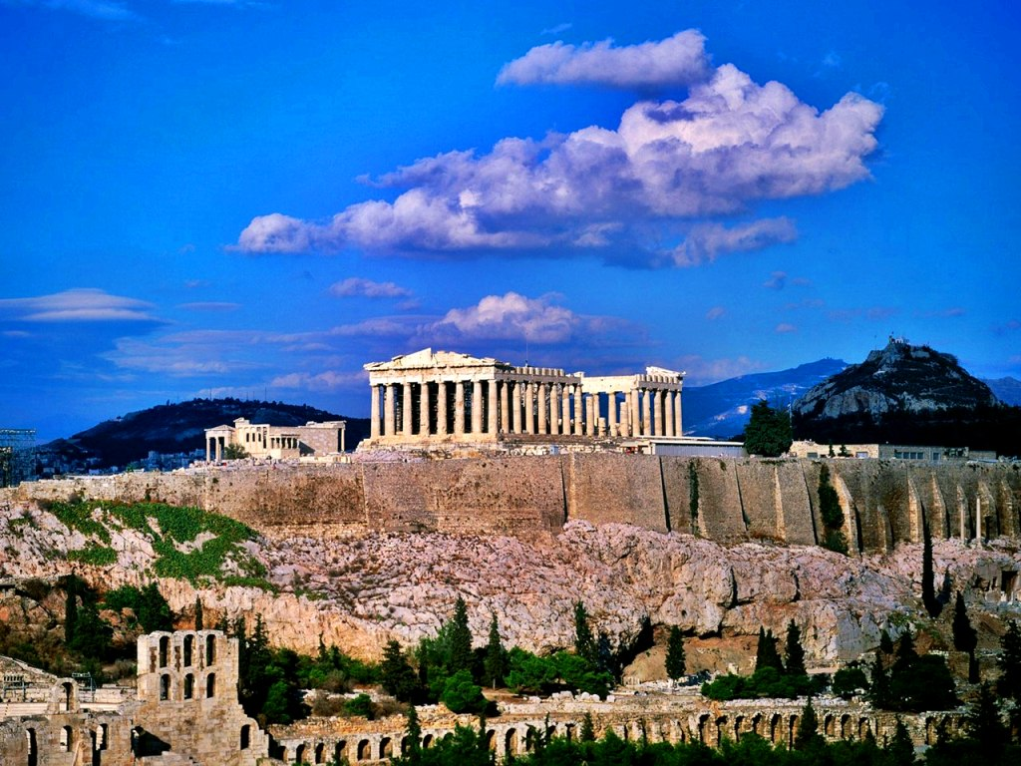

ΕΛΛΑΔΑ GREECE
Greece , Hellas is a country of great history and civilization. They say that it is the country of the sun and the sea. The history of Greece is one of the longest of any country, having been continuously inhabited since 270,000 BC. Greece is the birthplace of Democracy, Philosophy, Aristotle and Plato, Alexander the Great, the Olympic Games, Theatre and Drama. The birthplace of great Nobel laureates, Seferis, Elytis and famous composers like Theodorakis and Hatzidakis.
Notes:
In this picture we can see the landmark of the ancient Greek civilization , the Parthenon.

Slide 2
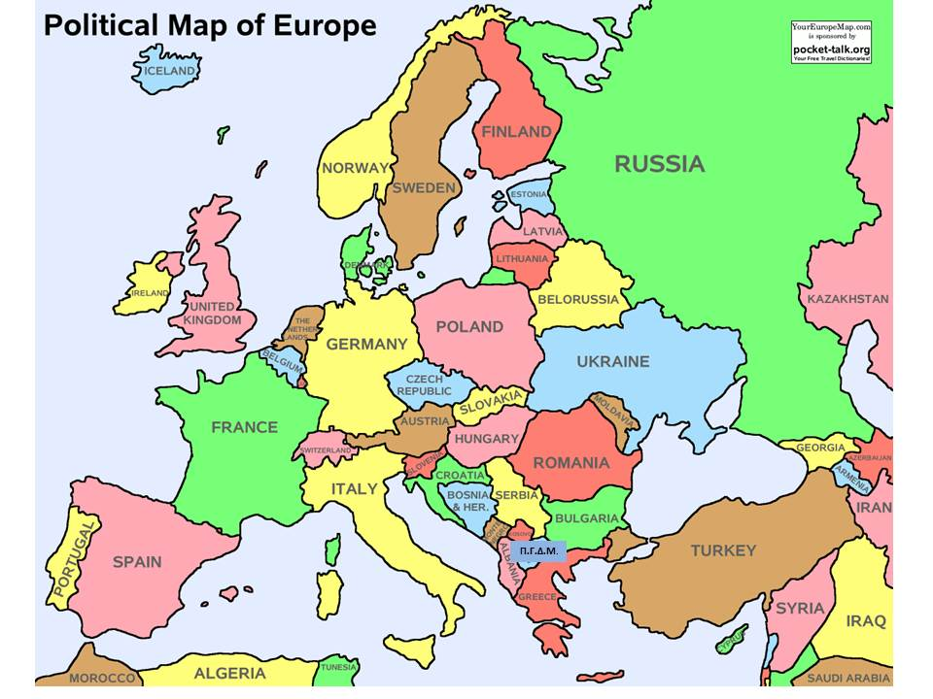
Greece is a Mediterranean country located in the southeast part of Europe.

Slide 3
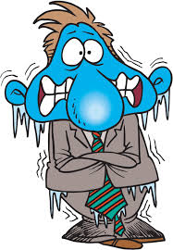


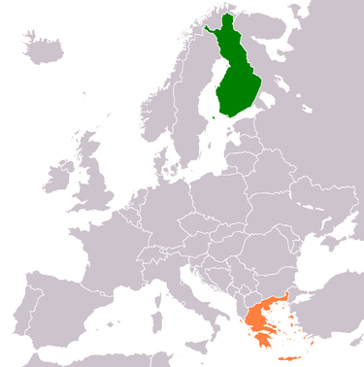
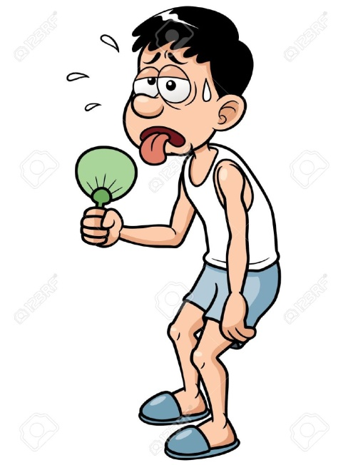


Notes:
Our countries are very far from one another, the one is in the north , the other is in the south .Greece is famous for its sunshine
Finland is famous for its extreme cold.
What’s common between Finland and Greece? The colours of our flags and we’ve got the same time !
North –south

Slide 4
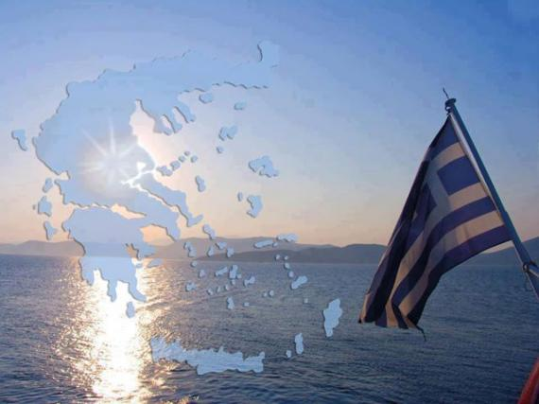
It is the country of the sun and the sea. The large number of the islands make it unique! The Greek flag :9 lanes~ 9 syllables~ Ελευθερία ή Θάνατος ~ Freedom or Death
Notes:
The Greek flag has got 9 lanes,5 blue and 4 white which correspond to the 9 syllables of the phrase Freedom or Death. We could say that this is our motto. The Greeks have sacrificed their lives to keep their country free and independent many times through history.
There is also a cross indicating our Orthodox faith.

Slide 5
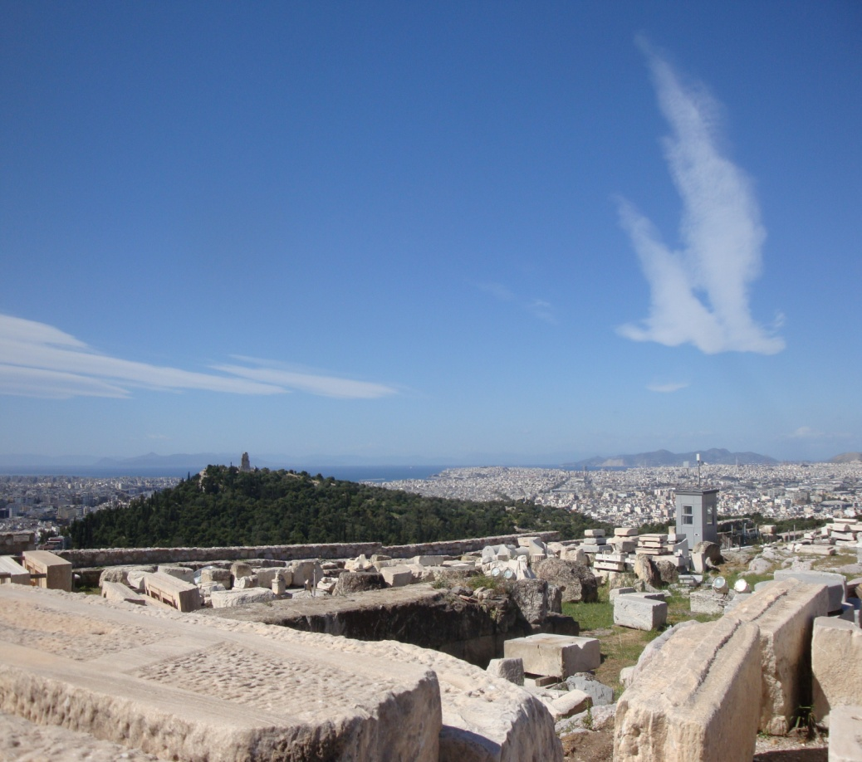
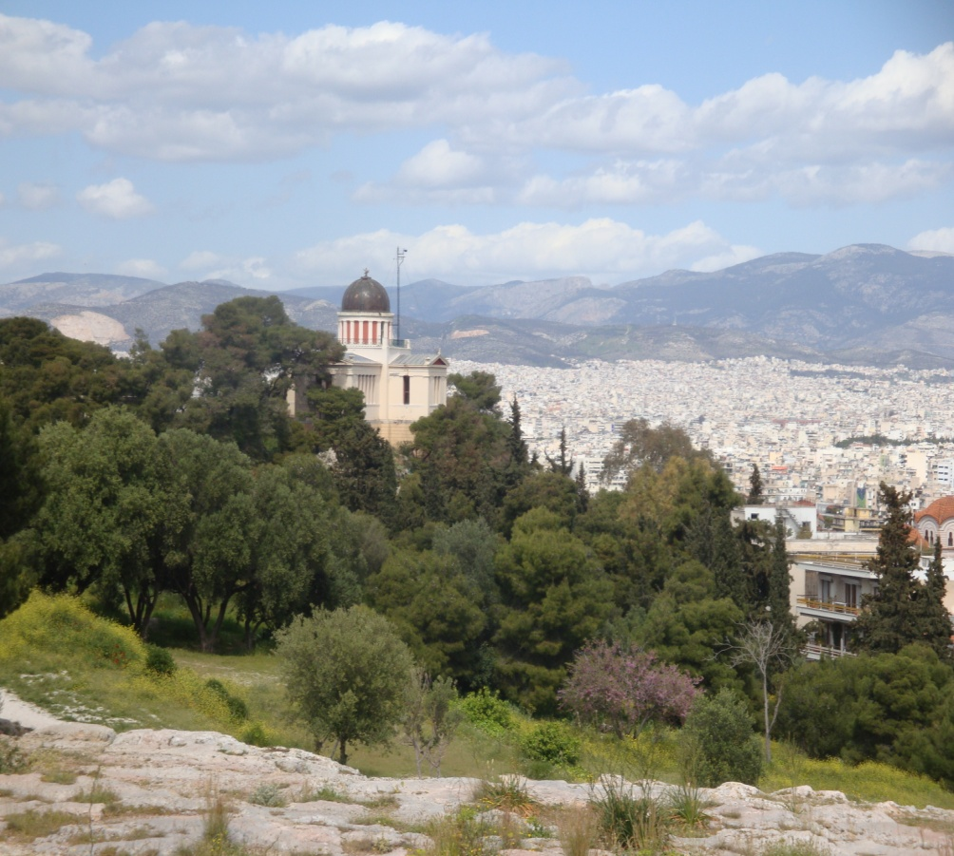
The city of Athens the capital of Greece

Slide 6
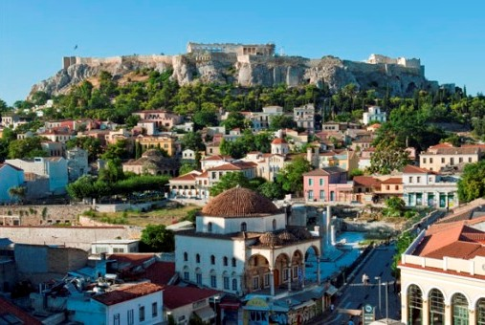
Monastiraki and Plaka, the heart of the city !

Slide 7
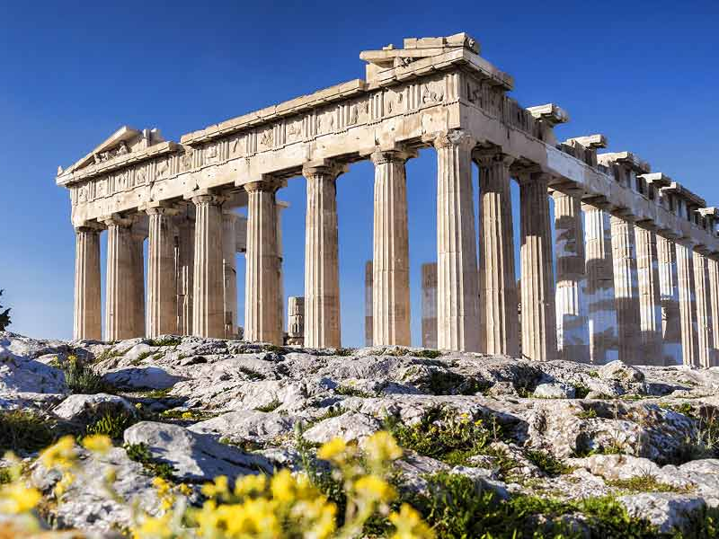
The Parthenon, an ancient temple dedicated to goddess Athena, the patron deity of the city of Athens (5th century B.C.)
The most important landmark of Greece, a World Heritage Cultural Monument standing on the sacred rock of the Acropolis for 2.500 .

Slide 8
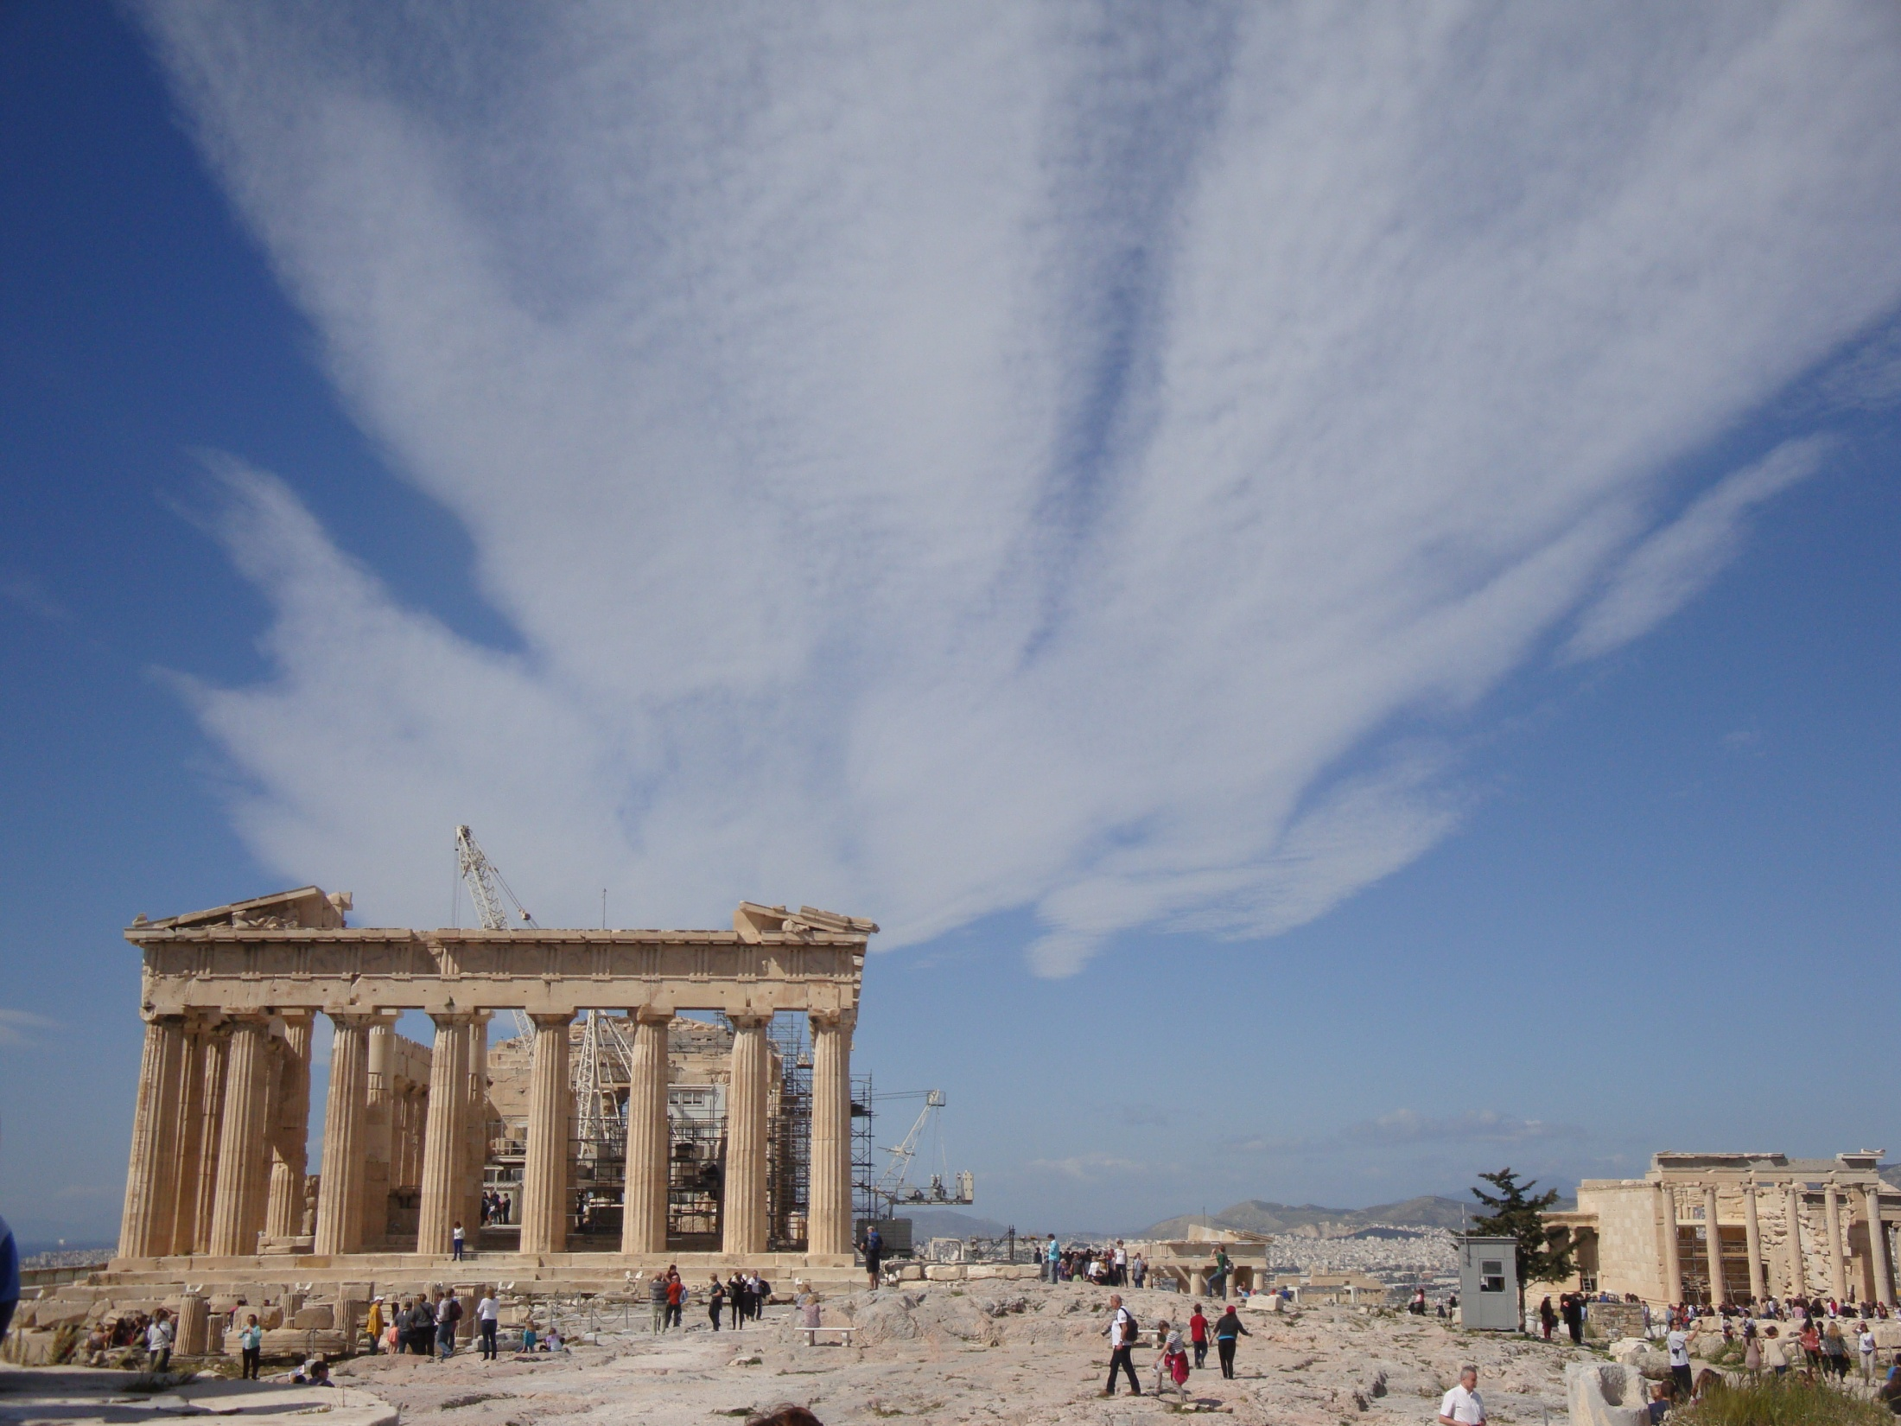
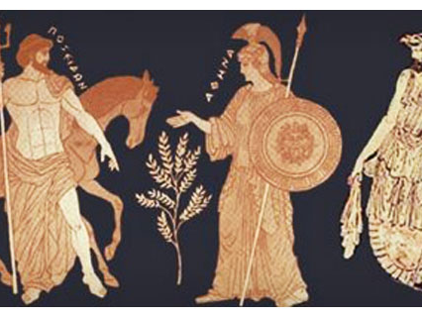
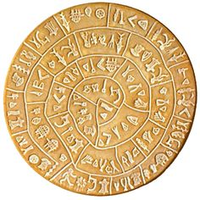
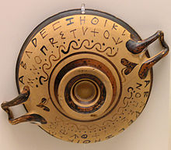
The Acropolis is one of the most favourite destinations for visitors from all over the world.
Notes:
The Parthenon has been standing on the holy rock of the Acropolis for almost 2.500 years (447 B.C-432 B.C). It is a magnificent temple dedicated to Athena, the patron goddess of the city of Athens.

Slide 9
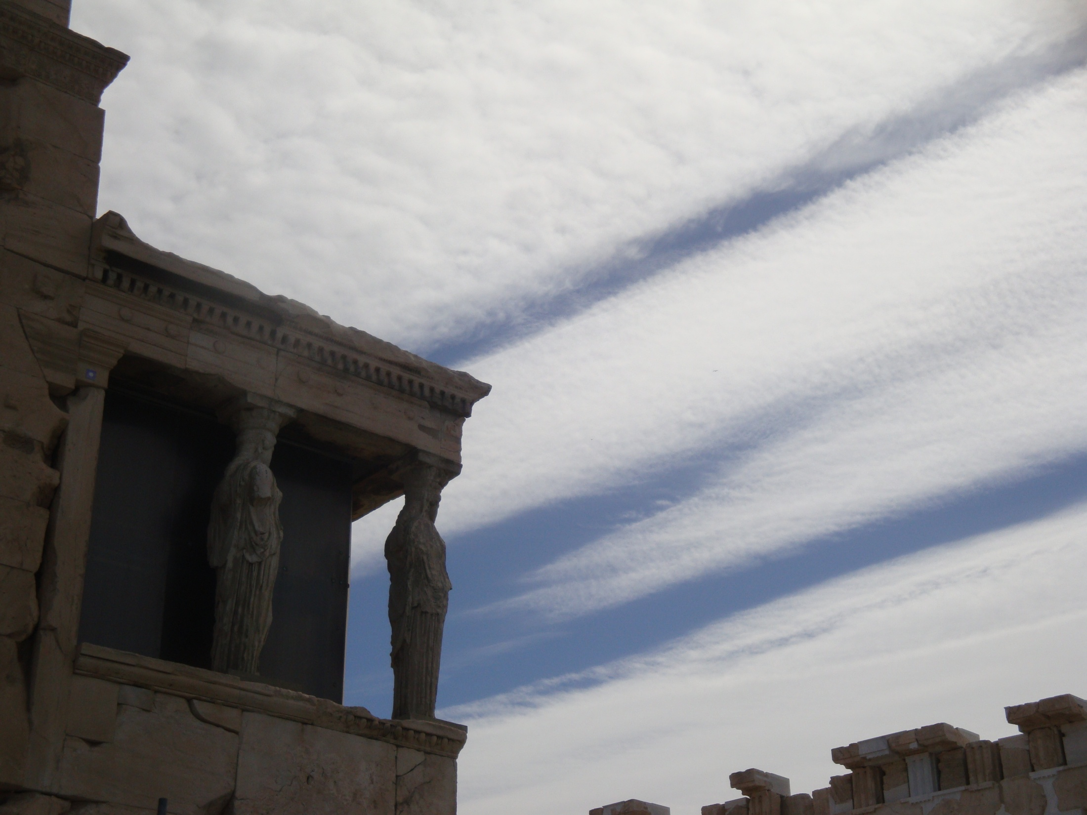
The Caryatids waiting for their sister to come back home with the Parthenon Marbles.
Notes:
A visitor can also see these beautiful female statues , the 5 Caryatids standing on the holy rock for centuries. There is one more , the 6th one which has been kept away from her sisters like many other Greek antiquities.

Slide 10
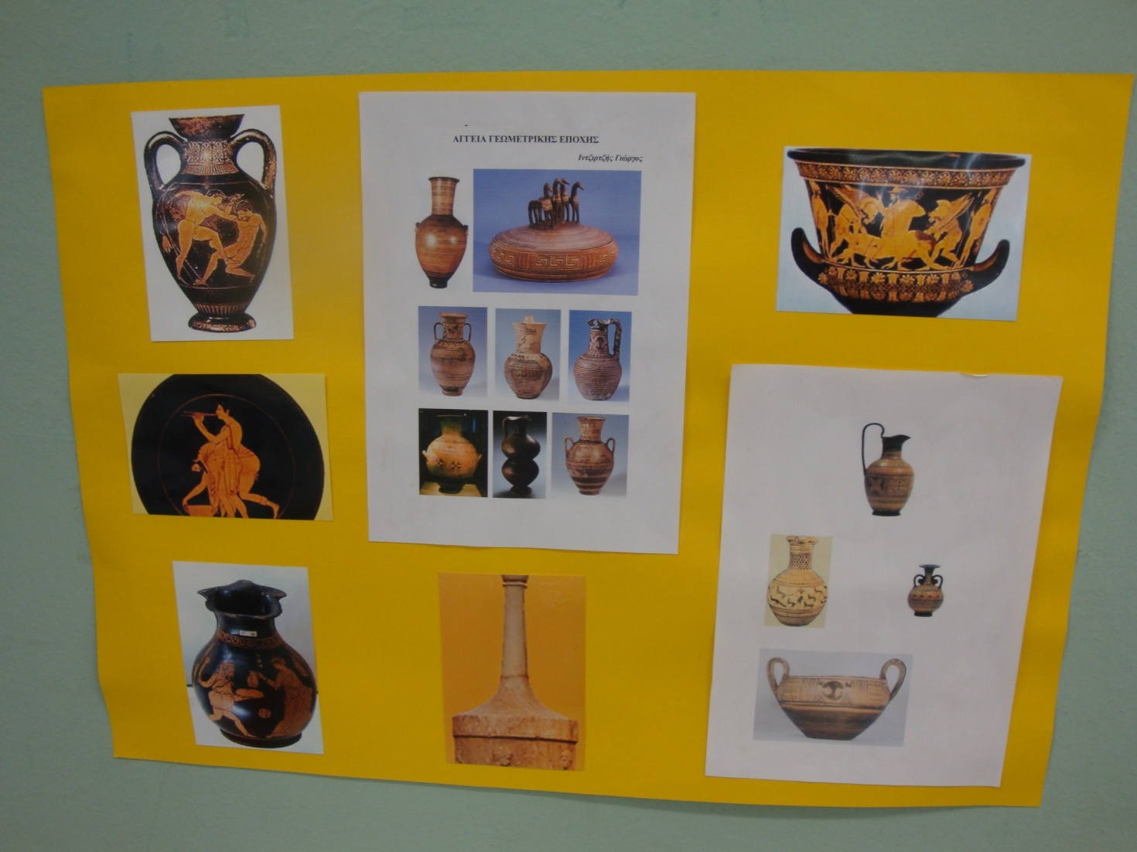
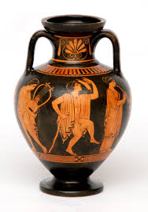
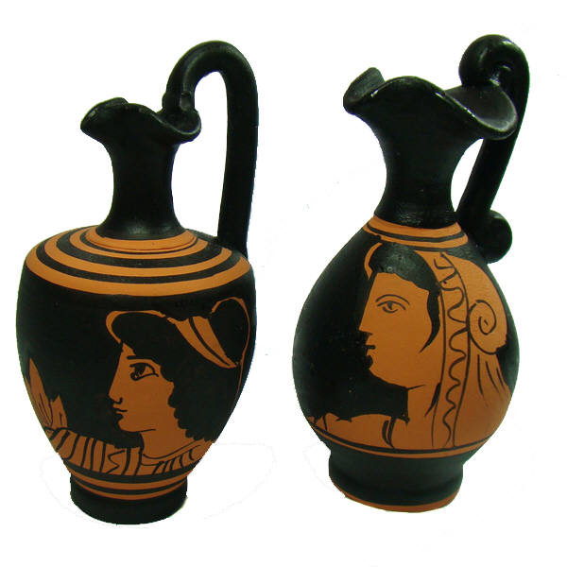
Ancient Greek vases
Notes:
History Class 4th grade

Slide 11
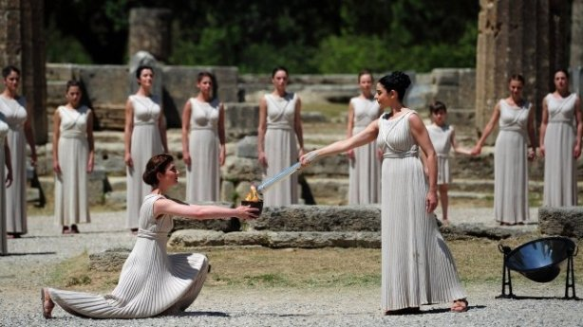
Greece is the birthplace of the Olympic Games
The Olympic Flame signals the beginning of the Olympic Games travelling
all around the world.
Notes:
The Finns are famous for their excellence in javelin !

Slide 12
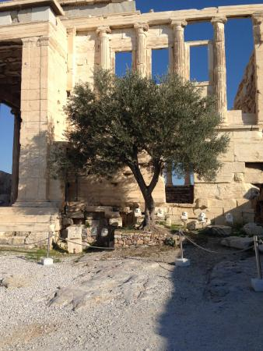
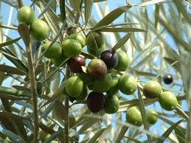
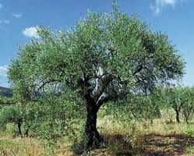
The sacred olive tree is the symbol of
friendship and peace.
Notes:
In the Olympic Games, the only award for the winners was a wreath made of the wild olive tree as a symbol of glory. The olive tree is considered to be a symbol of peace, longevity and prosperity, evergreen and everlasting. Olive trees are immortal!
It is considered to be the symbol of our city.

Slide 13
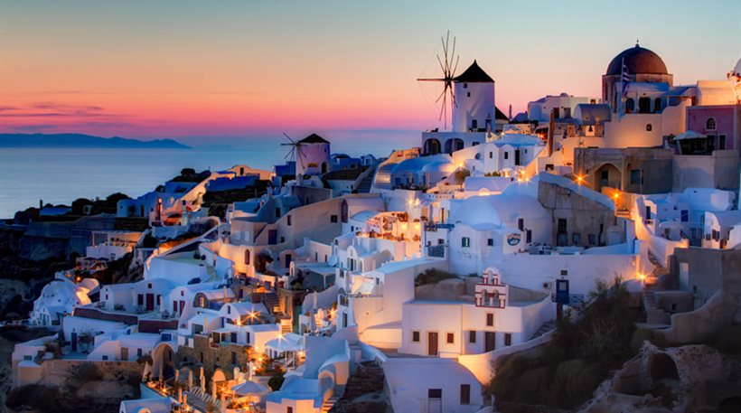
A country with beautiful islands of unique architecture…

Slide 14
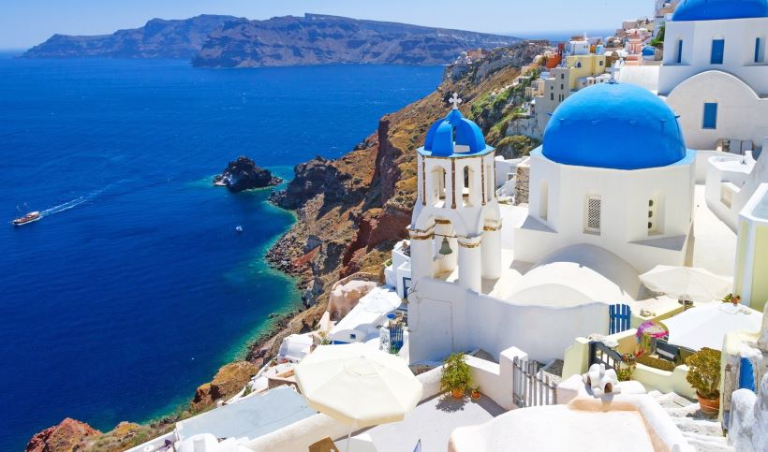
Santorini, blue and white light in the Aegean sea

Slide 15
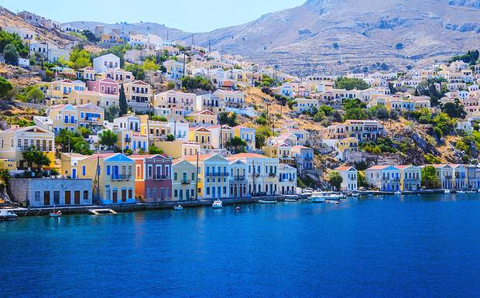
Symi in Dodecanese

Slide 16
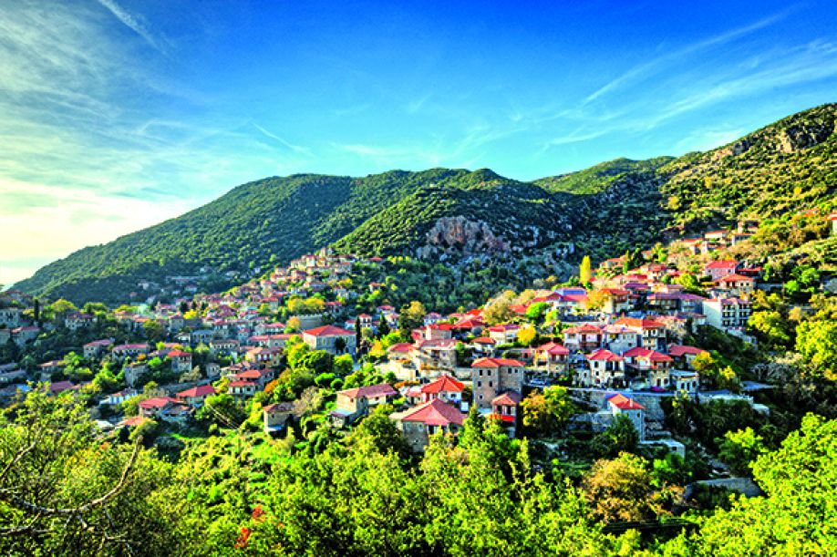
picturesque villages

Slide 17
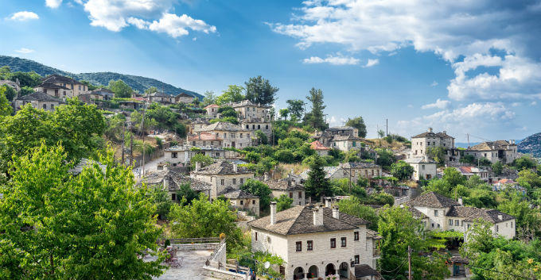

Slide 18
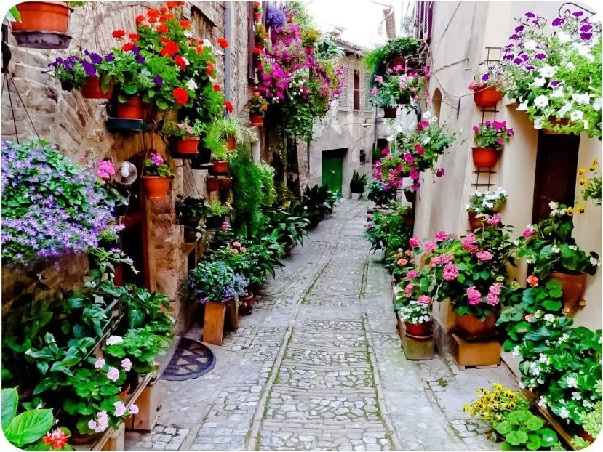
with blooming, old, narrow streets….

Slide 19
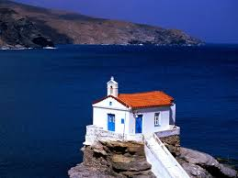
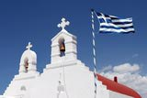
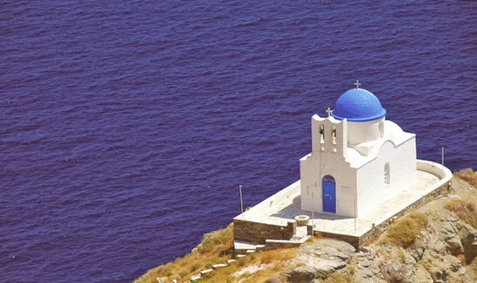
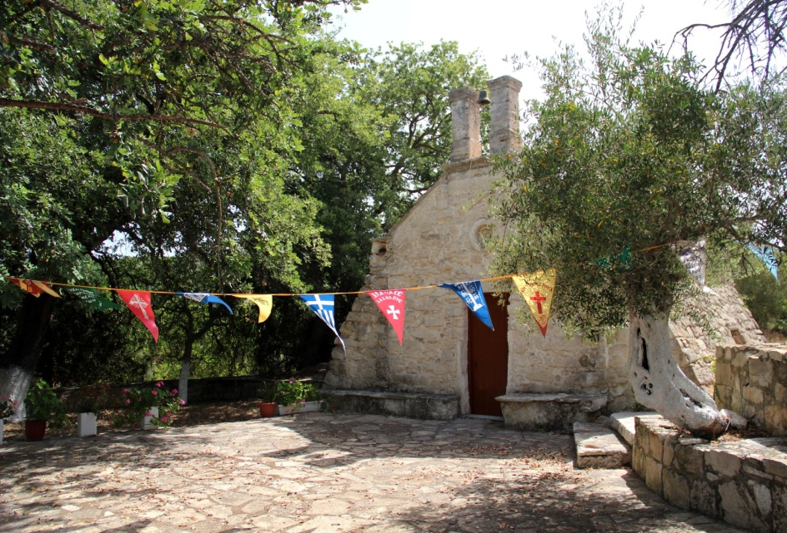
Small white churches
picturesque small churches
Notes:
There are thousands of churches all over Greece but the most beautiful are those built on the islands.

Slide 20
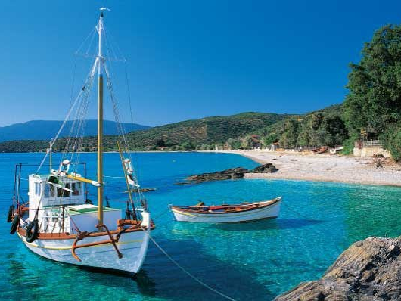
beautiful beaches with crystal clear waters

Slide 21
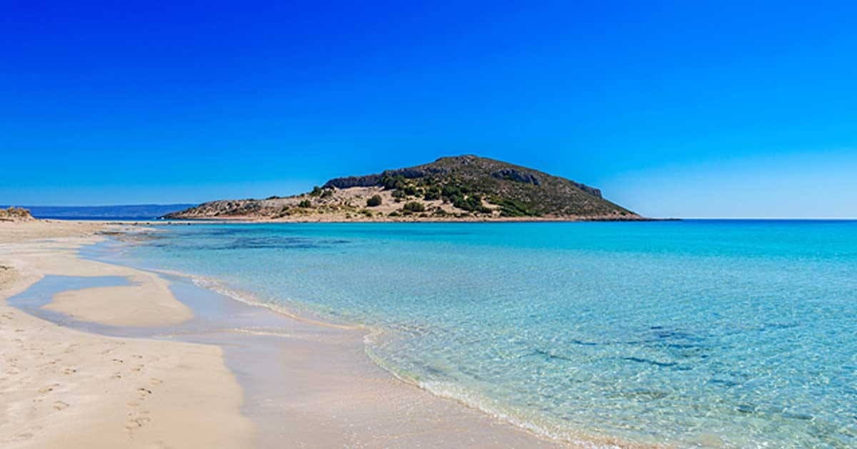
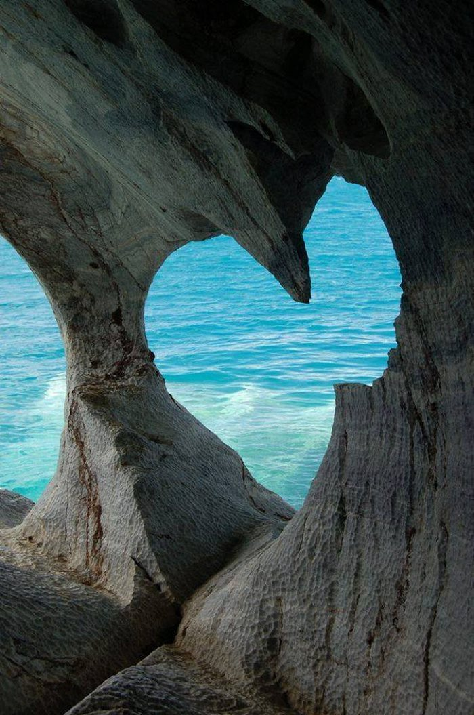
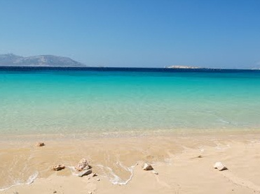
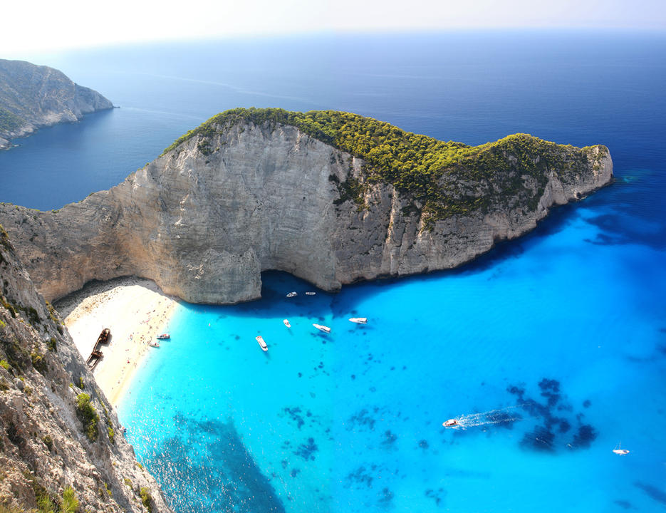
Summer is here!

Slide 22
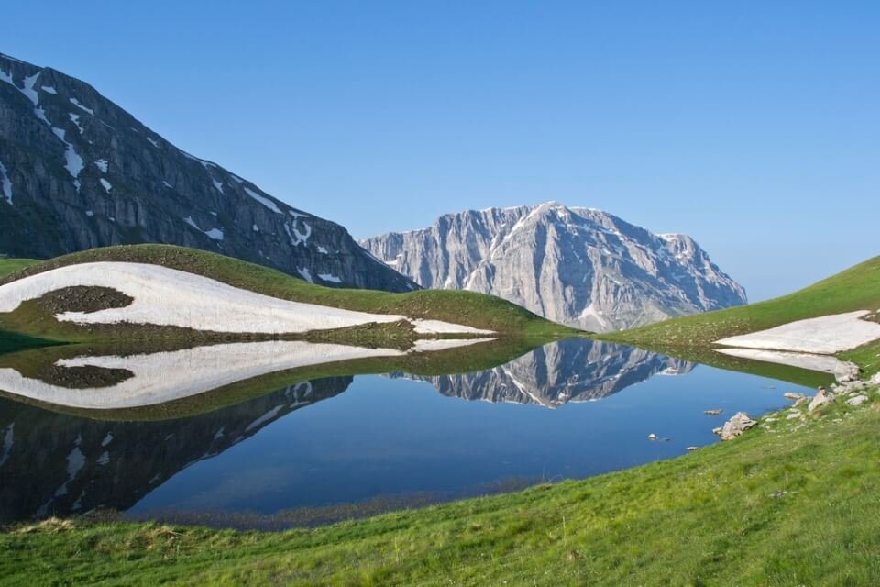
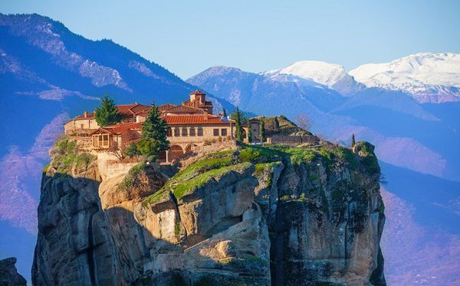
…unique landscapes
Notes:
Lakes in the mountains, remote monasteries for those who want to be closer to God

Slide 23
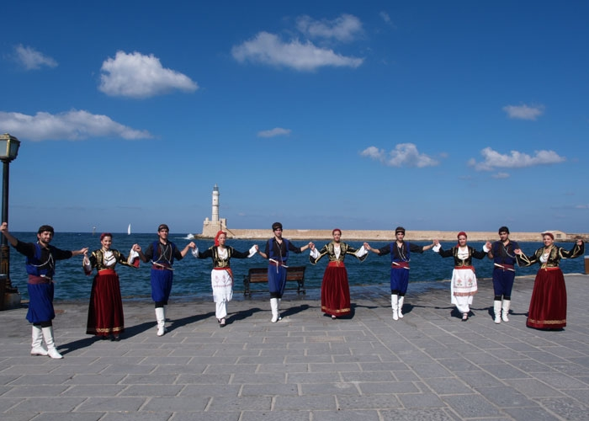
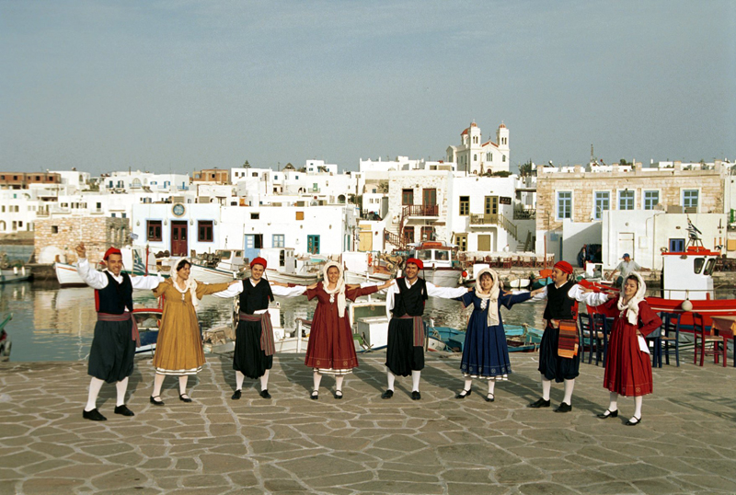
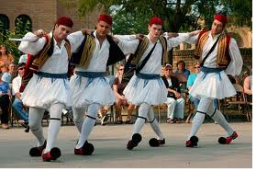
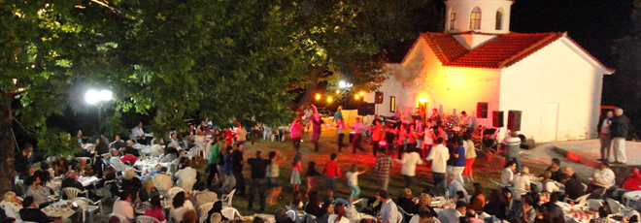
Greece is a country with friendly and hospitable people who have kept their customs and their traditions through time.

Slide 24
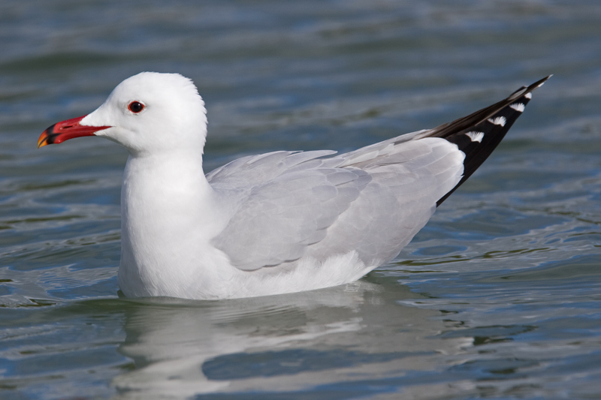
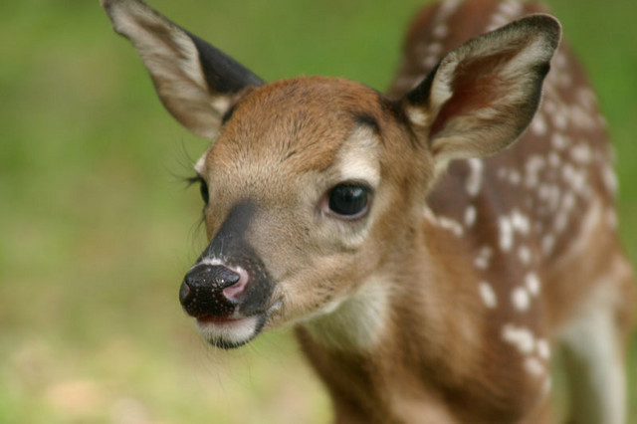
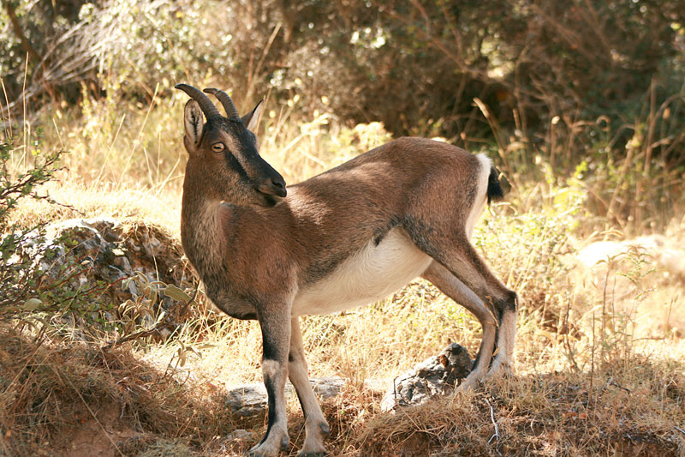
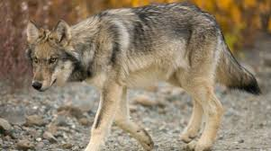
Animals of Greece
The red deer
The Aegean seagull
The Cretan wild goat: Kri-kri
The Greek wolf
Notes:
Greece offers a natural habitat for these unique species and more.

Slide 25
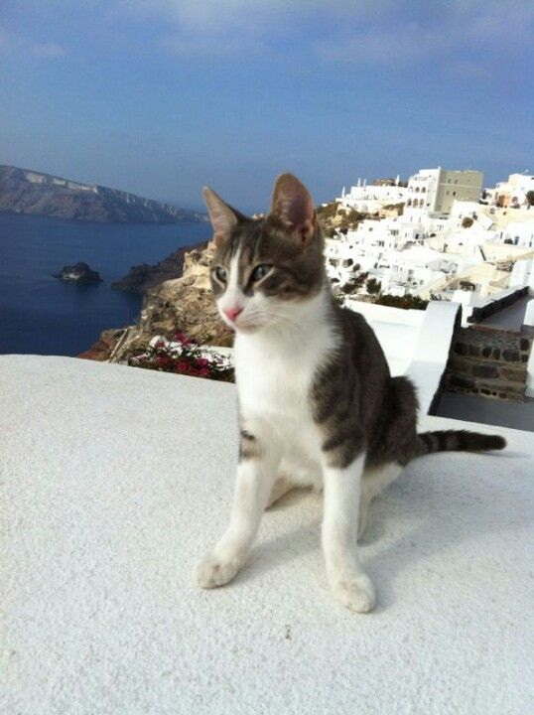
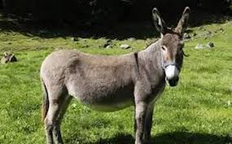
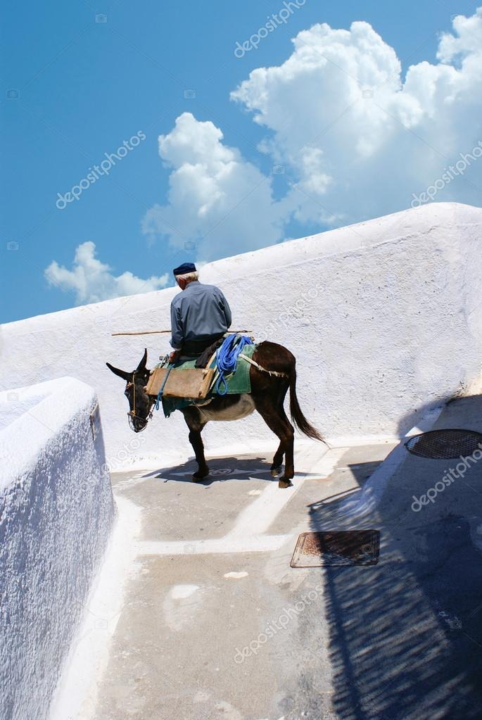

We love donkeys and cats!!!
The Aegean cat is a unique race of cat of Greek breed, appeared for the first time in the Cyclades.

Slide 26






The Plants of Greece
Thyme
Basil
Oregano
Mountain tea

Slide 27




Enjoy a good meal with pure Greek products like wine and olive oil

Slide 28





A warm “Goodbye” from our students from the city of Athens.

Slide 29

Thank you for watching!

