Slide 1
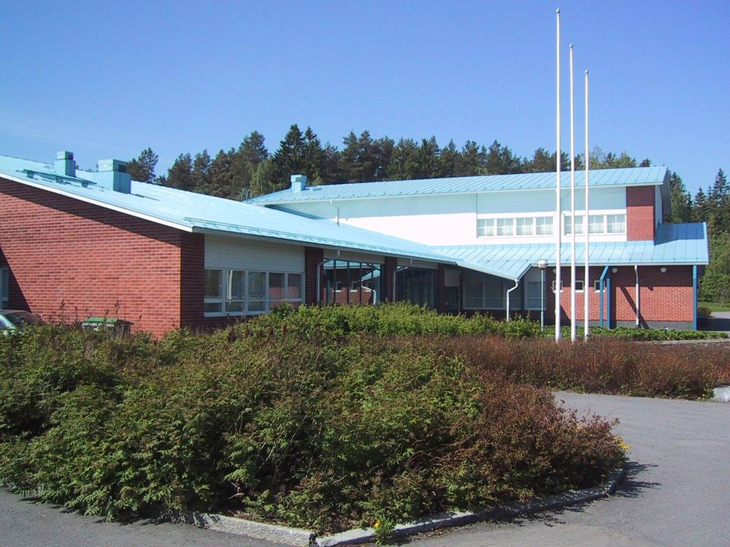

Welcome to Myllylä School

Slide 2
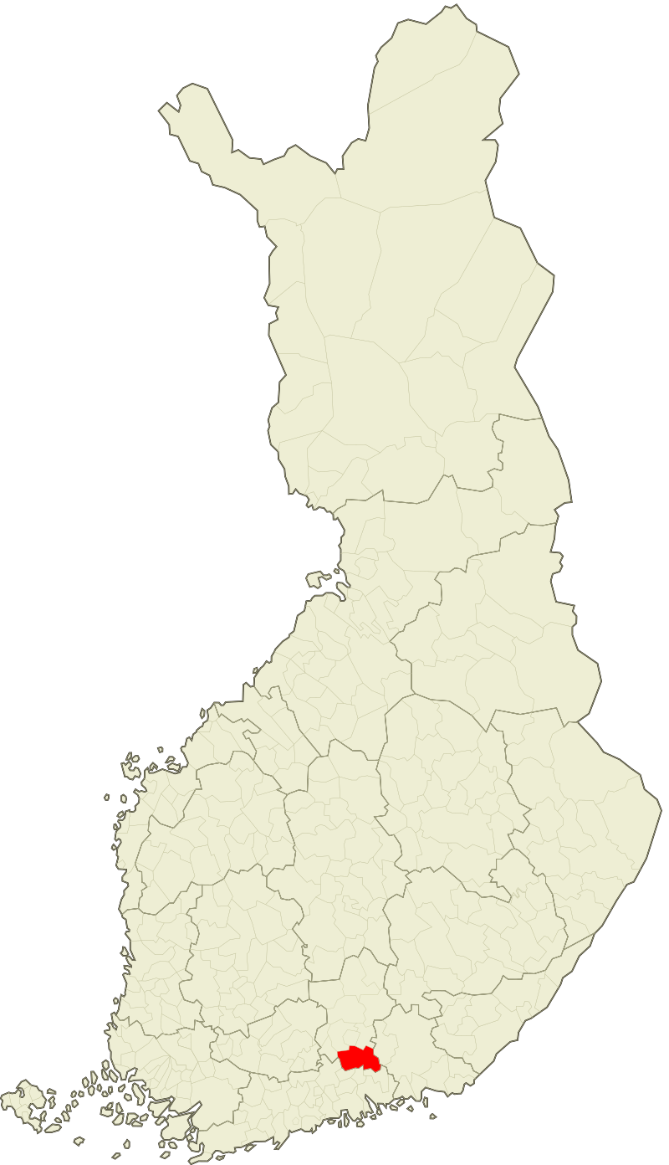
Orimattila
In Päijät-Häme Southern part of Finland
town of 16,000 inhabitants
good opportunities to practice physical activities and culture.
The nearest cities: Lahti (20 km), Helsinki (90km)

Slide 3
Education provider in Orimattila
Local education and culture committee (7 members, 4-5 officials)
Head of local education and culture department
Head of school development
10 schools of which two secondary schools
1 upper secondary school

Slide 4
Myllylä School
classes from 1 to 6
260 pupils
pre-primary unit, 35 children
Ca. 30 members of staff
The school was built in 1995
The school was renovated in 2019-2021
Also Preparatory Instruction
“A chance for every learner”
Working and learning together is important
Every adult is for all the pupils
Comenius/Erasmus+ projects during years 1998-2022
Erasmus Accrediated in 2021 among the first schools in Finland

Slide 5
Myllylä school staff
Headmaster and vice-principal
15 teachers
8 school assistants
school nurse, school psygologist, school social worker
cleaning and cooking staff
Pre-primary unit
Afternoon activities-group 12.00 am. – 5.00 pm. (pupils from 1th and 2th grade)

Slide 6
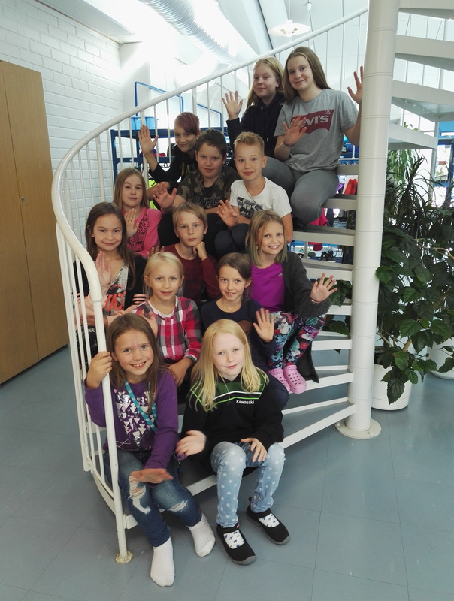
Pupils’ council
Children from each class
chosen in election
Can make proposals
Plan and organize activities in school
Take part in school evaluation

Slide 7
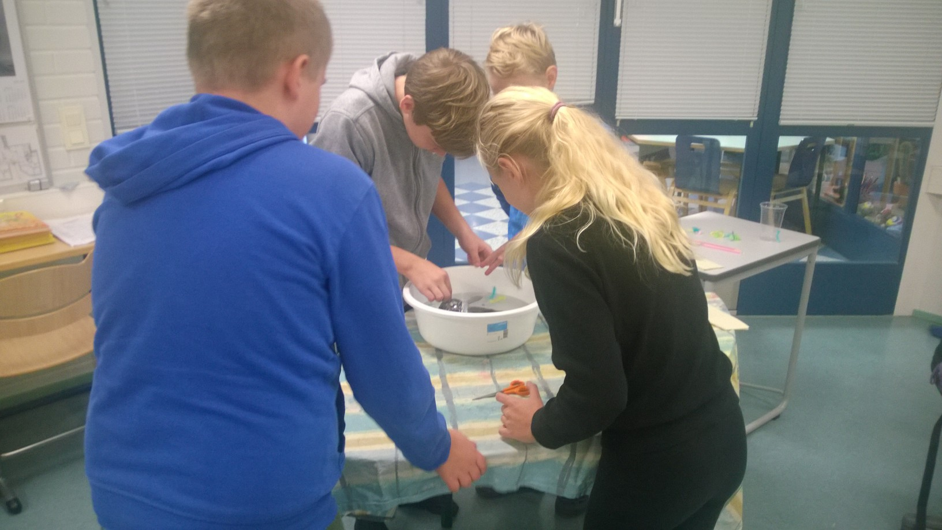
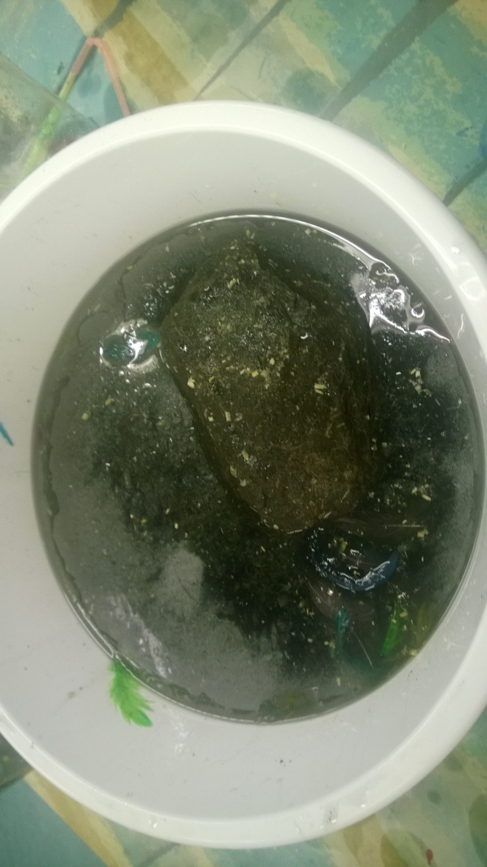
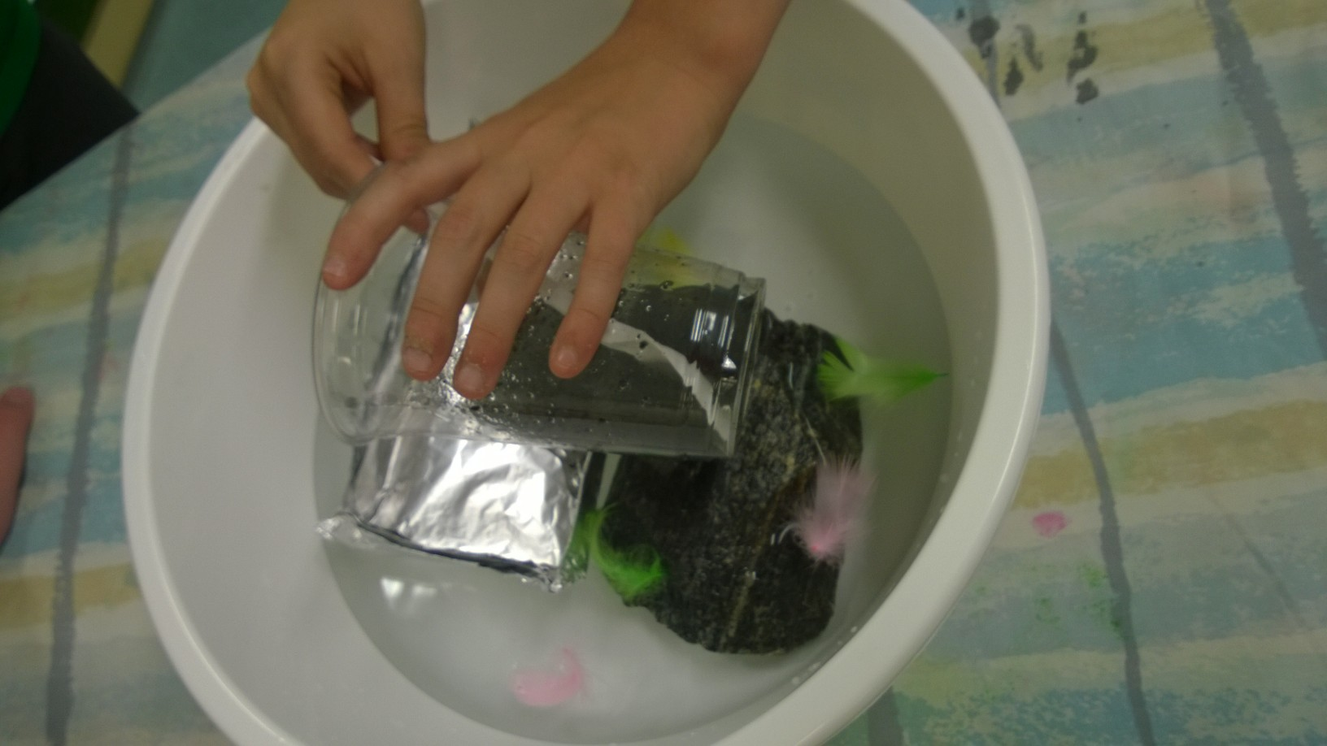
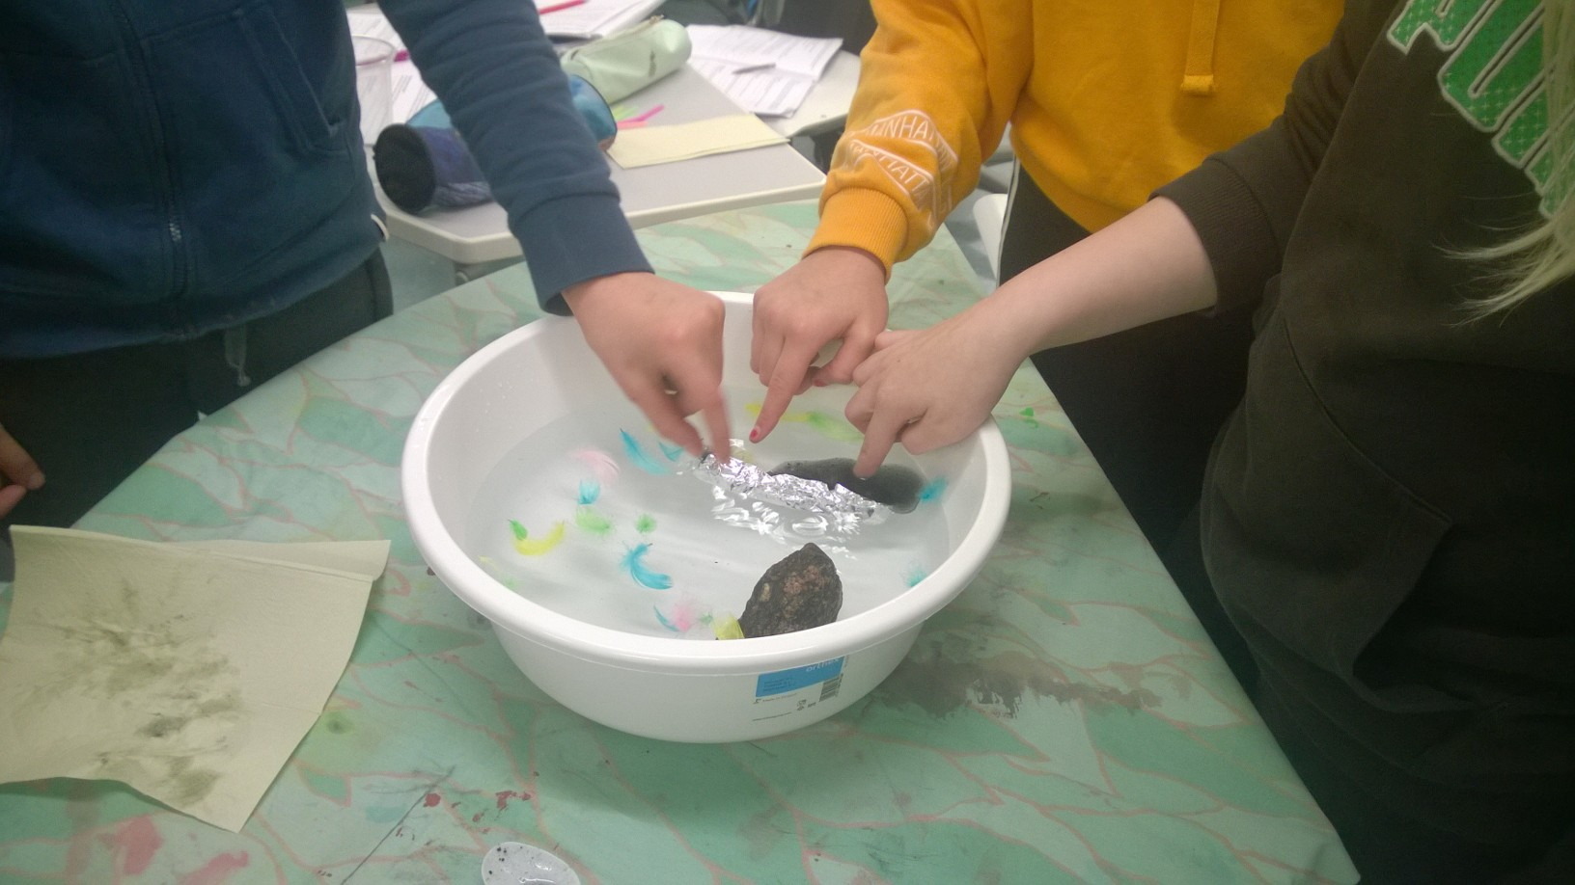
Let’s work together…
interdisciplinary learning modules: Water
oil catastrof

Slide 8
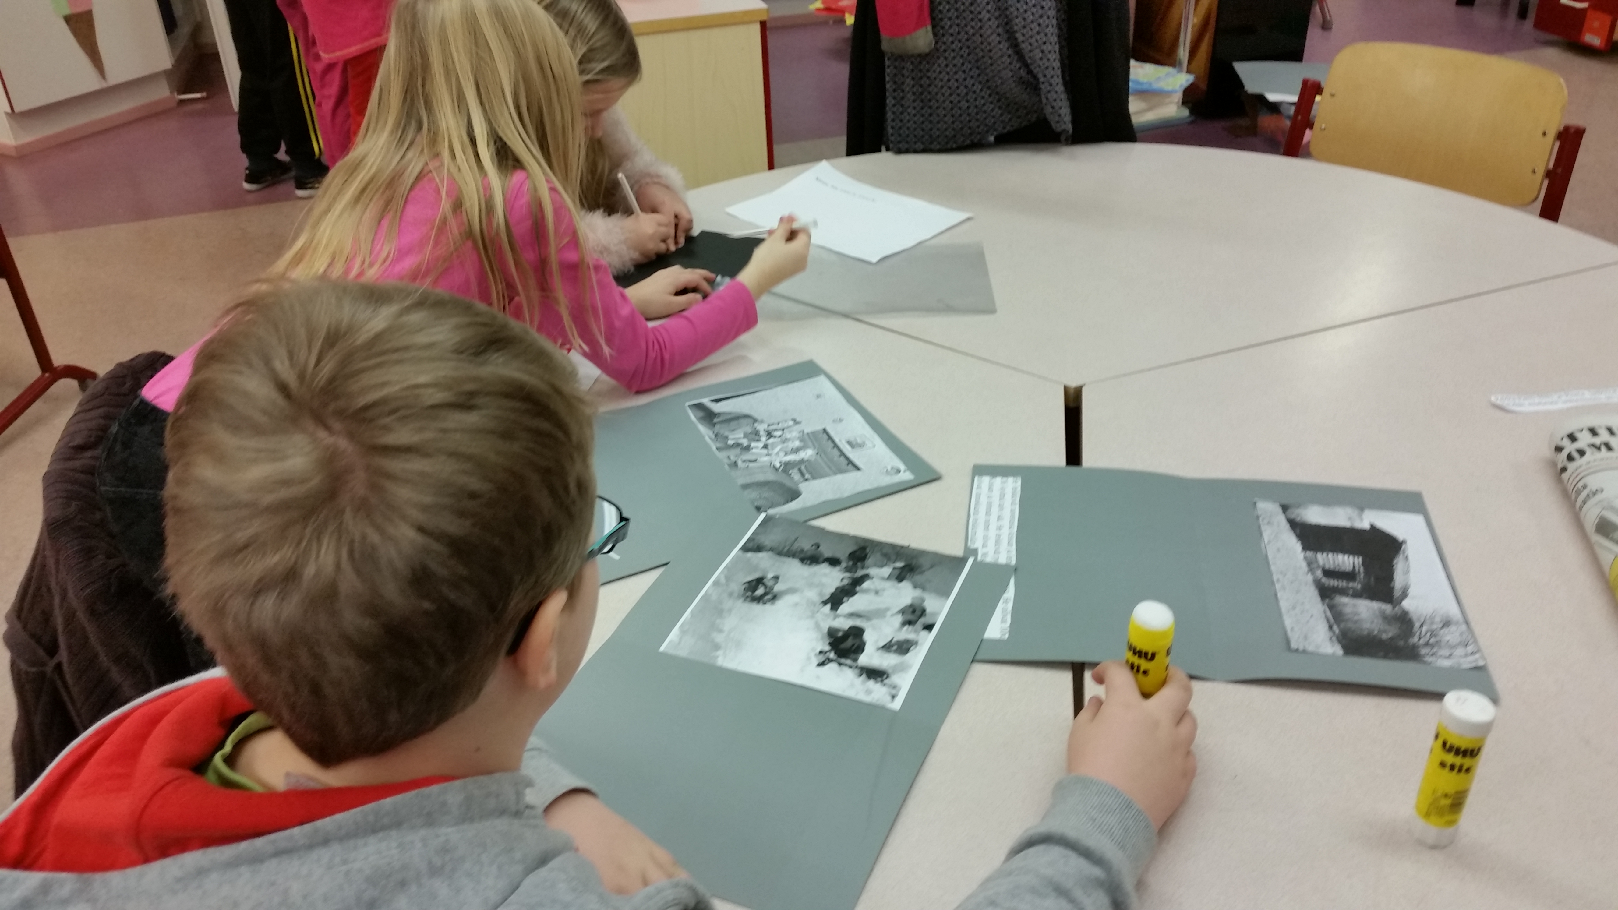
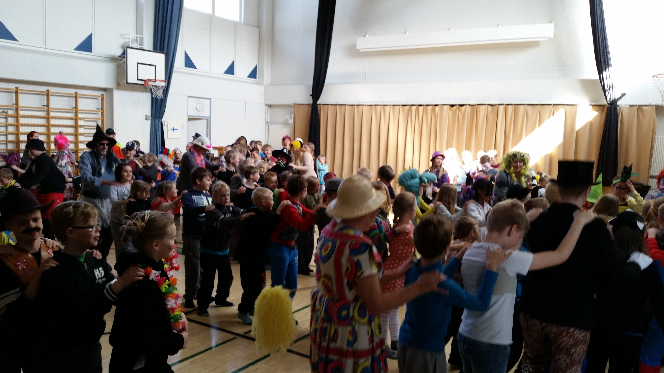
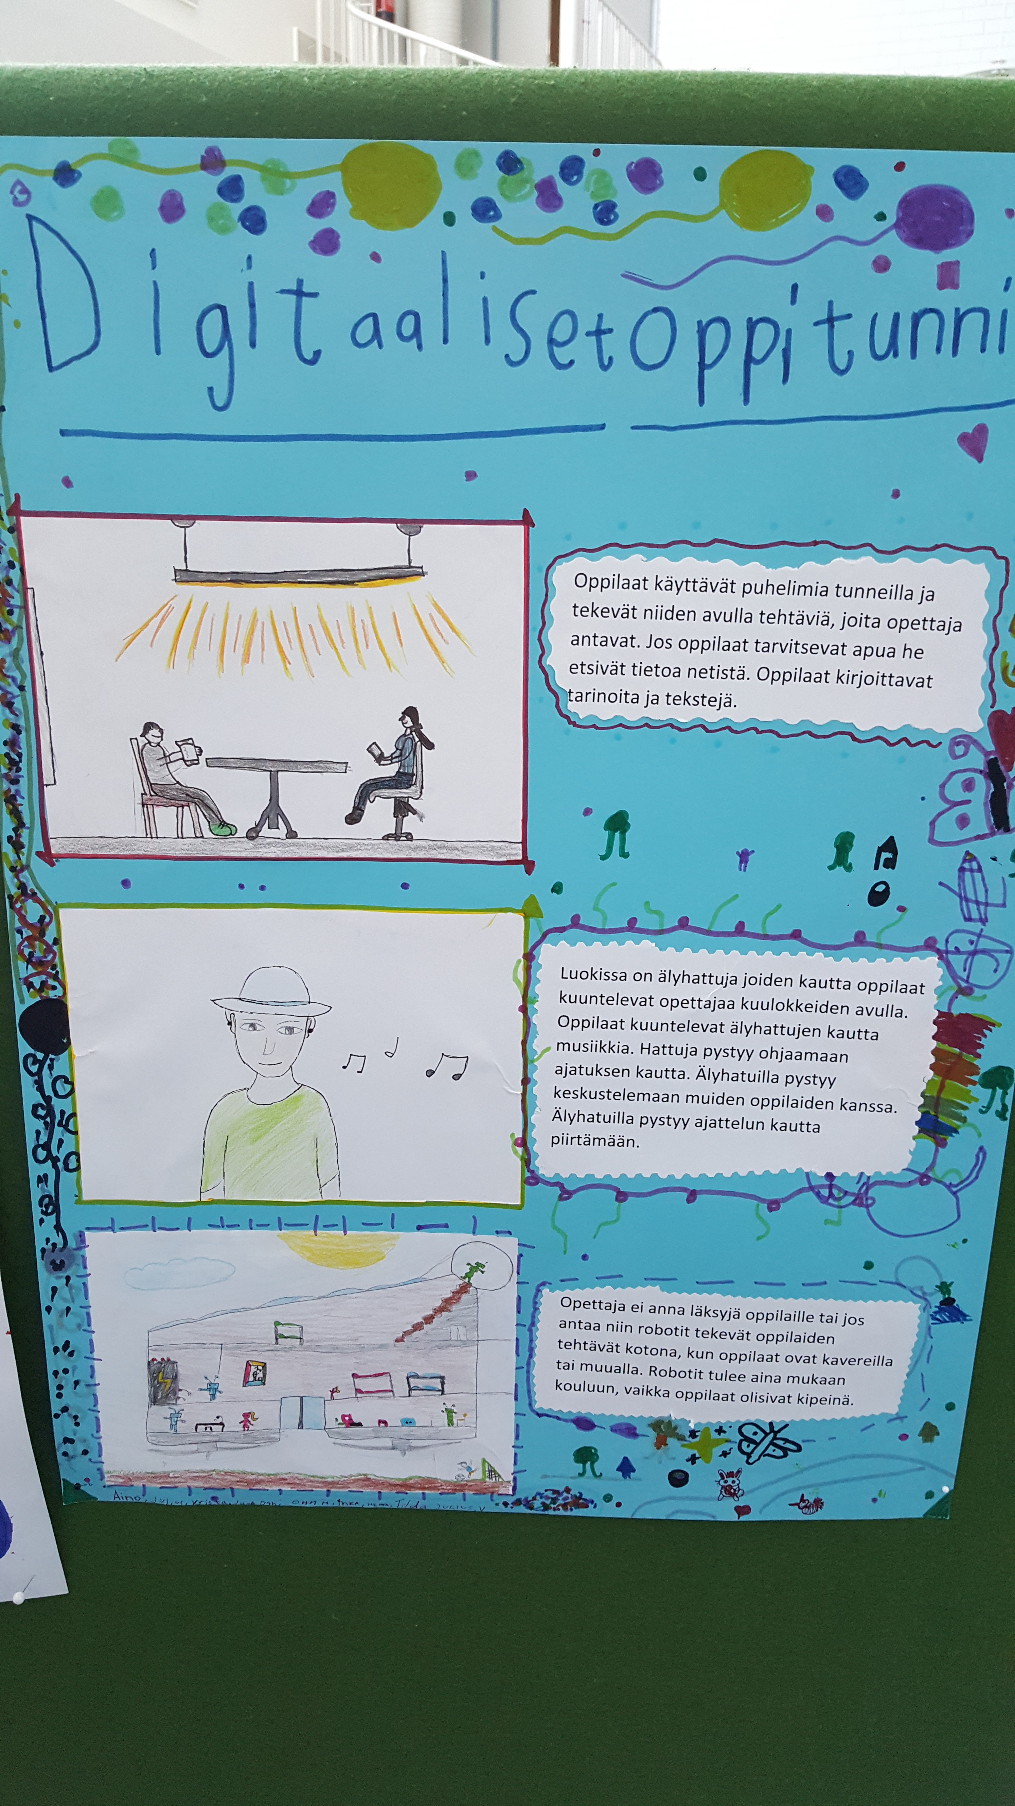
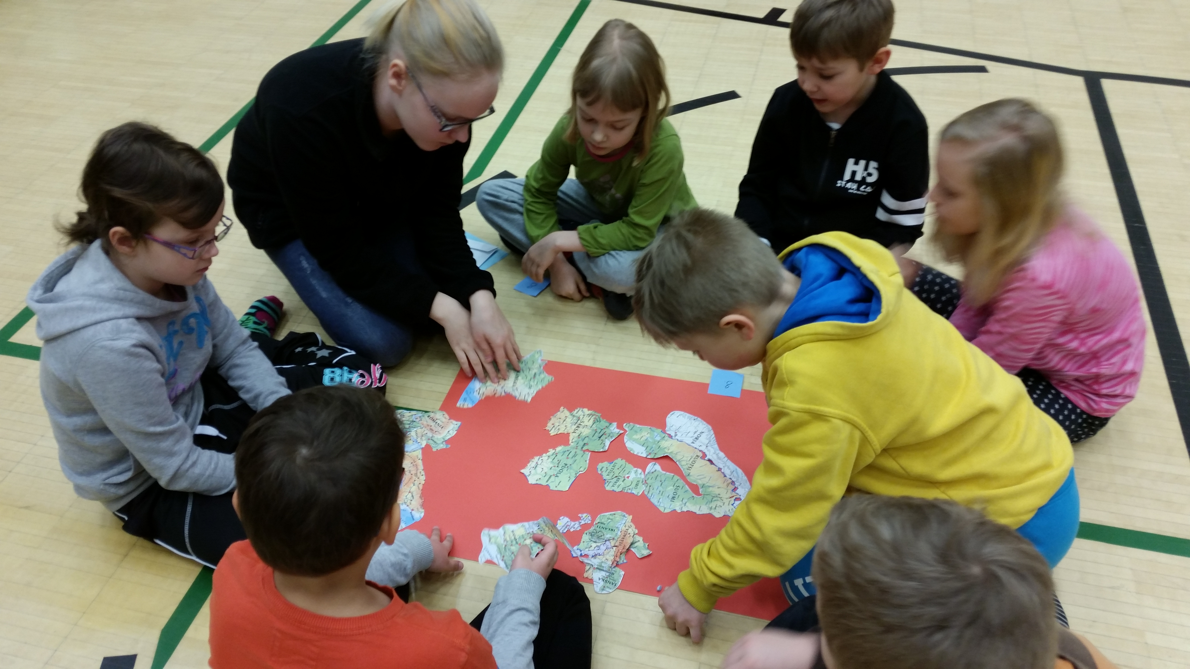
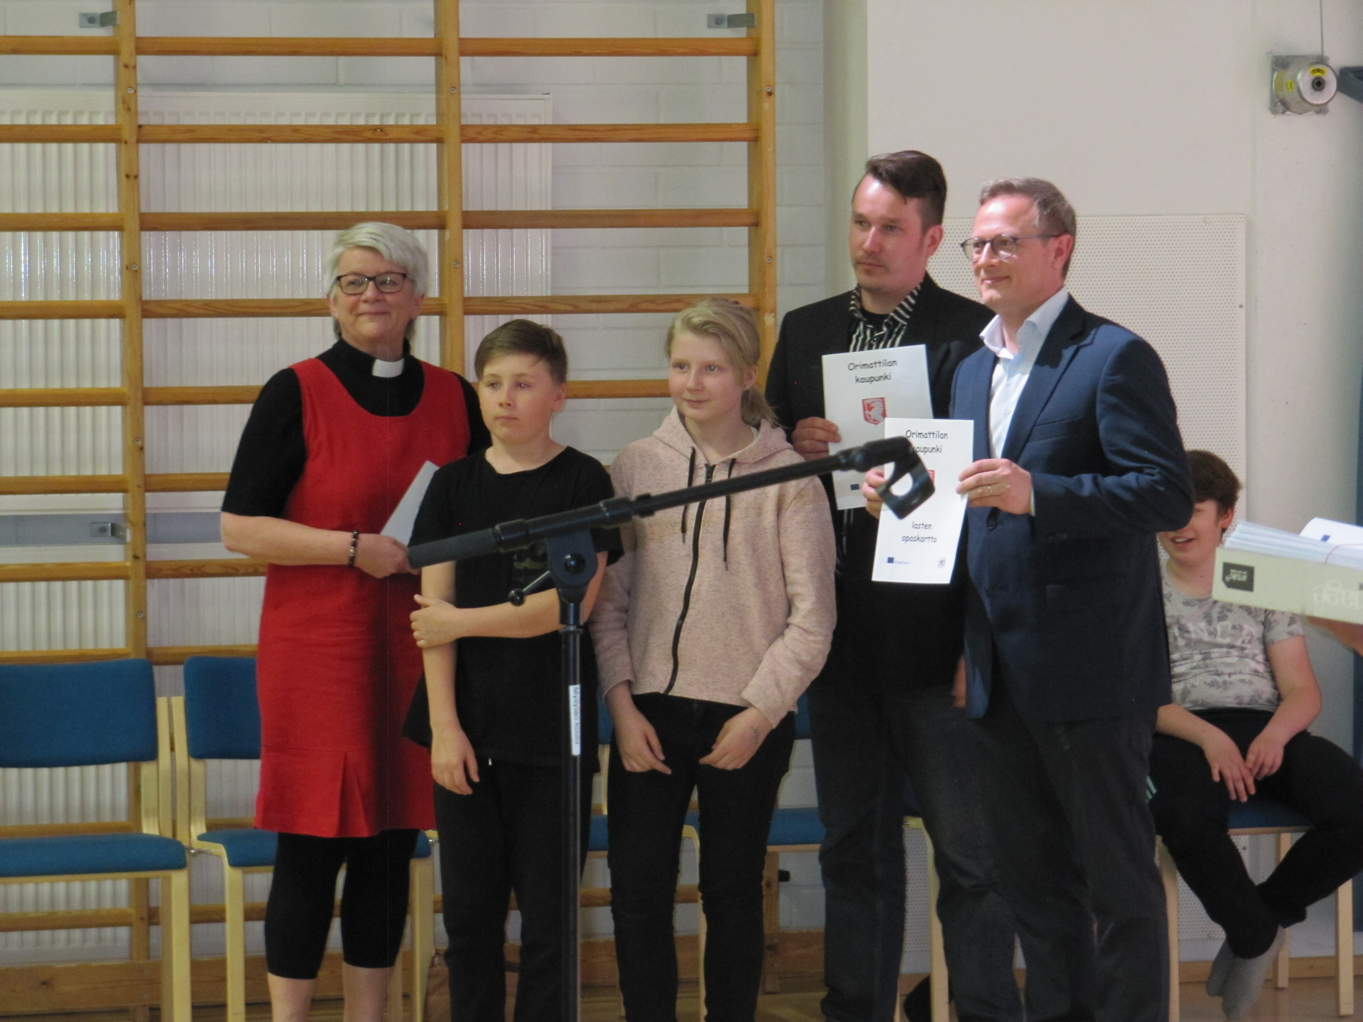
Erasmus-work during the years

Slide 9
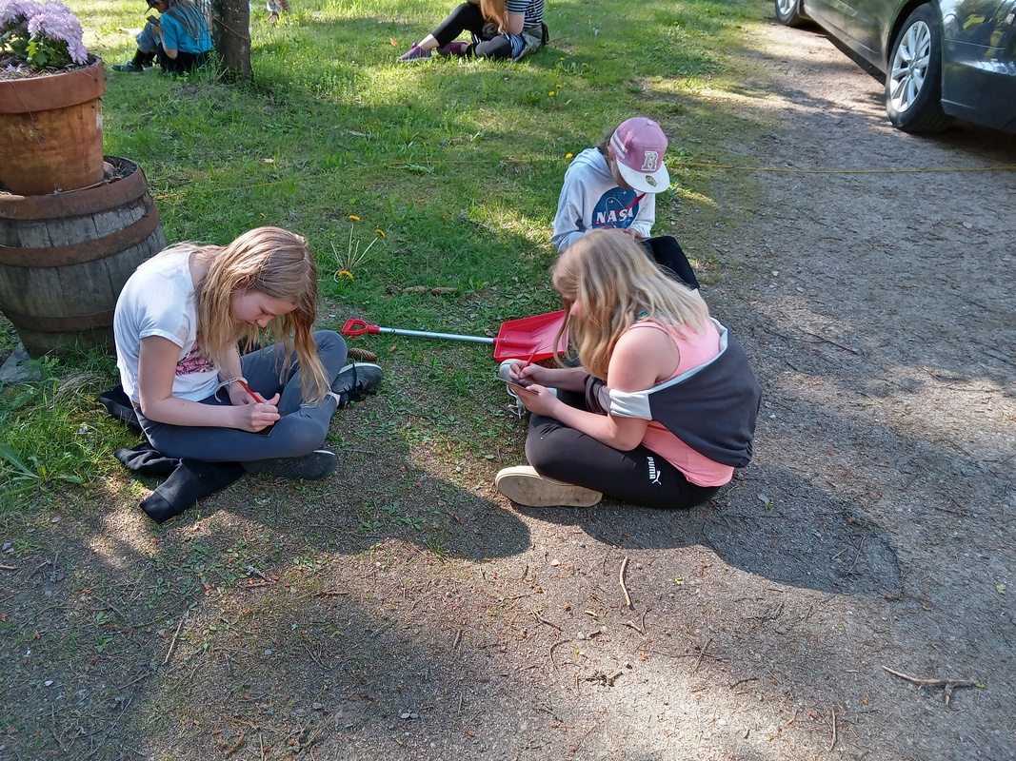
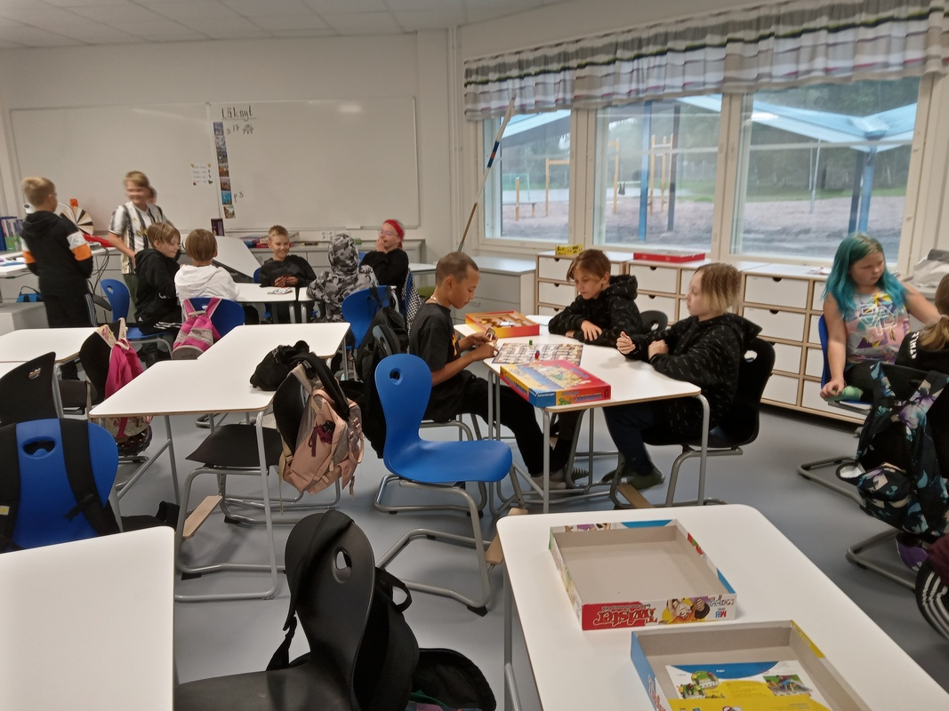
At school

Slide 10
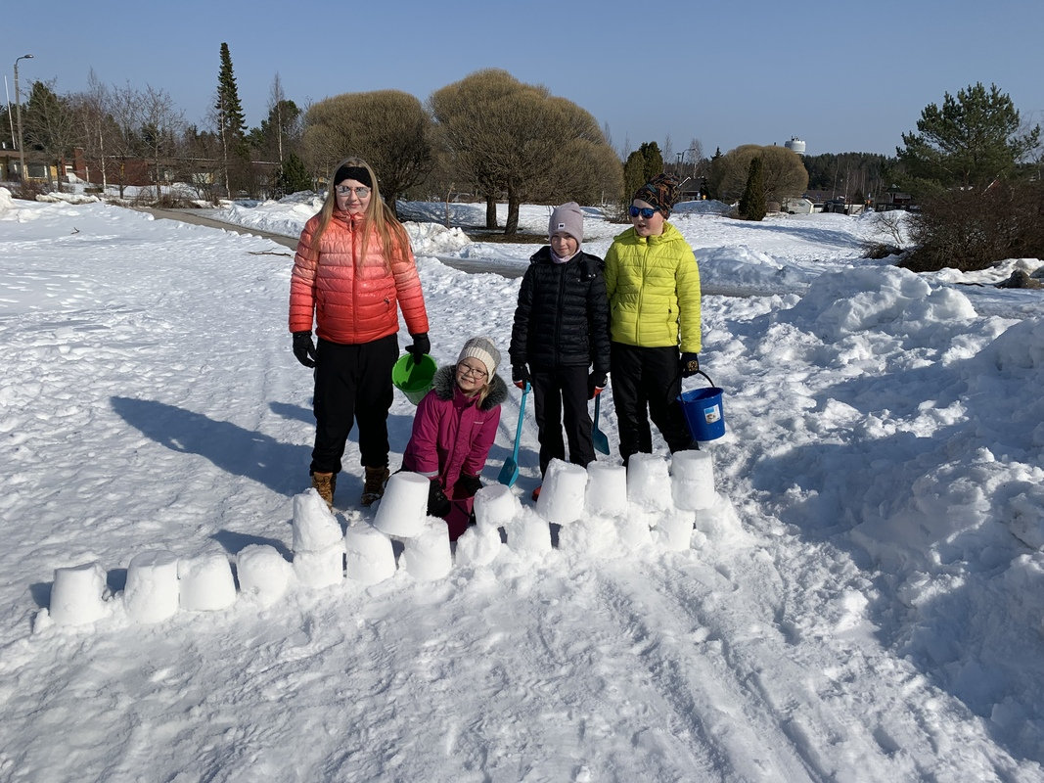
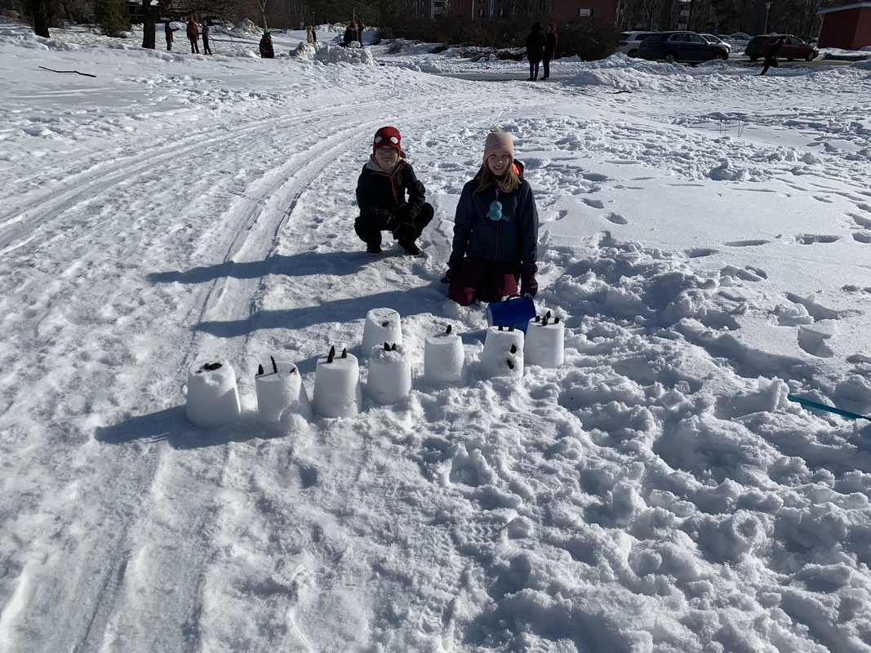
Winter fun!

Slide 11


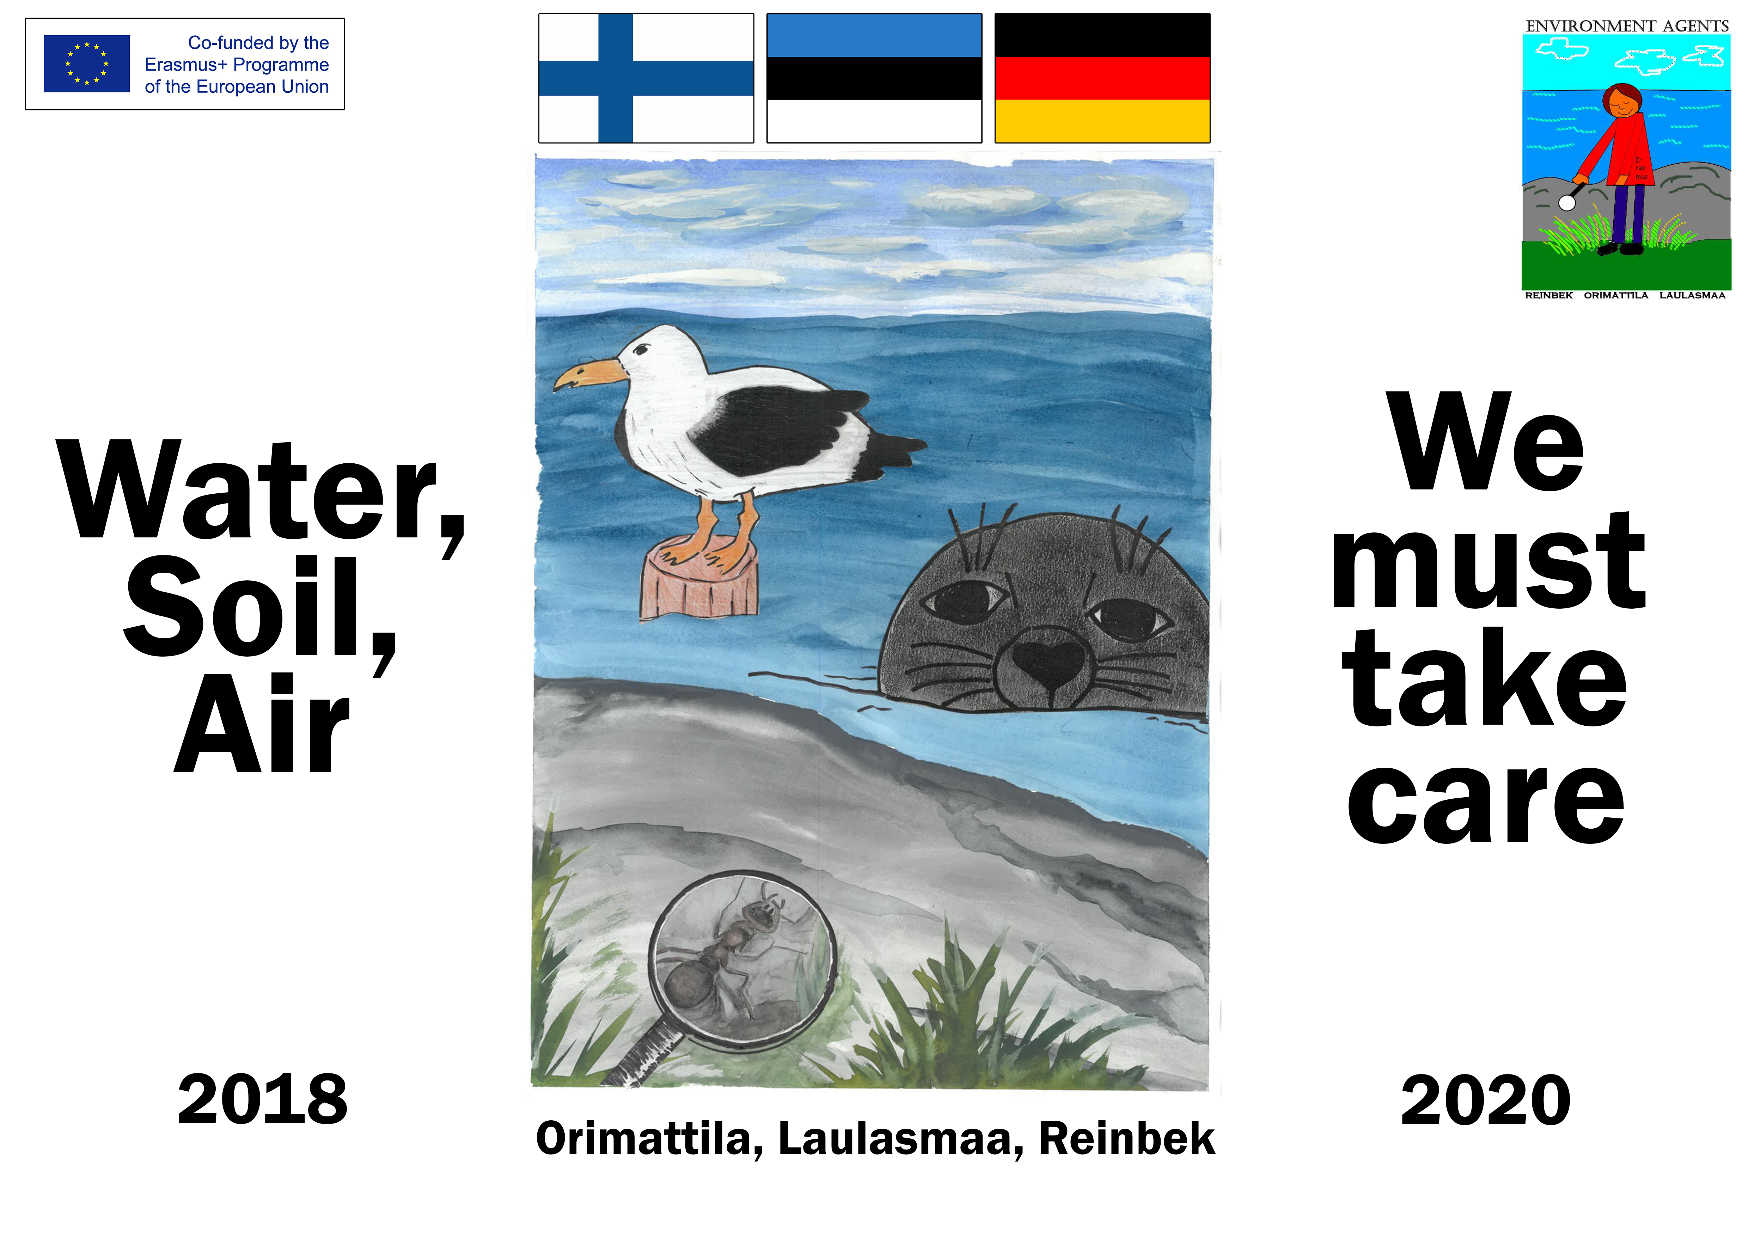



The final work of our previous Erasmus-project

