Slide 1

KTKP010 Learning and guidance
Sep 8, 2025
Josephine Moate & Nita Kuutila

Slide 2
Overall aims of the course
Opintojakson suoritettuaan opiskelija…
tuntee ihmisen kasvun ja kehityksen perusteet
tuntee keskeiset oppimisen teoriat ja oppimiskäsitykset ja osaa hyödyntää niitä käytännön tilanteissa
osaa tarkastella oppimisympäristöjä ja oppimisprosesseja oppijan näkökulmasta ja tuntee inklusiivisen pedagogiikan perusperiaatteet
tuntee oppimisen arvioinnin erilaisia periaatteita ja ymmärtää arvioinnin merkityksen oppimisen ohjaamisessa
ymmärtää ohjauksen laaja-alaisuuden oppijan oppimisen, identiteetin ja toimijuuden tukemisena
Asiasisältö
lapsen kokonaisvaltainen kasvu ja kehitys kehityspsykologian valossa
oppiminen eri oppimiskäsitysten ja oppimisteorioiden valossa (esim. motivaation ja vuorovaikutuksen merkitys oppimisessa)
erilaiset oppimiskäsitykset opetuksen käytännöissä ja inklusiivisten oppimisympäristöjen rakentamisessa
arviointikulttuurin rakentaminen ja erilaiset arviointitavat

Slide 3
Contact teaching (2 credits)
Exam (3 credits)
In Moodle on Oct 27, 2025 at 8.30-11.30
Jos sinulla on tenttiin liittyvä suositus yksilöllisiin järjestelyihin, ota yhteyttä hyvissä ajoin
Assessment: 0-5
Materials:
Woolfolk, A. (2016). Educational psychology. Pearson Education Limited.
N.B. Older editions ok too. Use the contents & search options to read the up on: behavioral views of learning, cognitive views of learning, social cognitive & constructivist views of learning, the learning sciences and constructivism
Atjonen, P. (2023). Formatiivinen arviointi perusopetuksessa. Itä-Suomen yliopisto. http://urn.fi/URN:ISBN:978-952-61-4784-0 Teoksesta luetaan seuraavat osat:
“1 Formatiivinen arviointi – palautetta laajempi oppimisprosessin tuki” (s. 8-18)
“2 Formatiivisen arvioinnin määritelmiä ja strategioita” (s. 19-25)
“3 Formatiivisen arvioinnin suhde summatiiviseen arviointiin” (s. 26-34
Pulkkinen, L., Ahonen, T. & Ruoppila, I. (2023). Ihmisen psykologinen kehitys. PS-kustannus. Teoksesta luetaan joko:
“Varhaislapsuus” (s. 22-76) ja ”Keskilapsuus (s. 77-141) TAI
“Keskilapsuus (s. 77-141) ja ”Nuoruus” (s. 142-177).
Demos + recorded lectures
Readings
Ongoing reflection
Assessment: pass / fail (hyväksytty / hylätty)
The demos provide a useful space for practically working with the course concepts & requirements.
The demo is a space for learning how to learn at JYU & as a group.
The demos prepare you for the exam.

Slide 4
Timeline
 | Demo – focus | Homework | Ongoing reflection
8.9. | Getting started | Orientation reading (Illeris) | Map learning pathway – key moments from own journey as a student
15.9. | Learning and guidance lecture (Jo) | Review lecture notes, reading (Woolfolk) | Choose two moments from journey and explore from the perspective of different theories of learning
22.9. | Visual methods workshop with additional insights from Woolfolk | Orientation to next week’s lecture: read PPs beforehand, reading (Pulkkinen et al.)
29.9. | Recorded lecture Oppiminen elämänkaaren eri vaiheissa: Start watching together, notes & discussion | Finish watching lecture & reading Orientation to next week’s lecture: read PPs beforehand, reading (Atjonen) | Choose one moment from pathway and explore from X perspective
6.10. | Recorded lecture Arviointi oppimisen tukena Start watching together, notes & discussion | Finish watching lecture & reading Orientation to next week’s lecture | Choose one moment from pathway and explore from assessment perspective
20.10. | Review and exam prep
27.10. | Exam (Moodle)

Slide 5
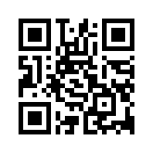
Pedanet
https://peda.net/id/95a46f927cc
Tilaa sivu

Slide 6
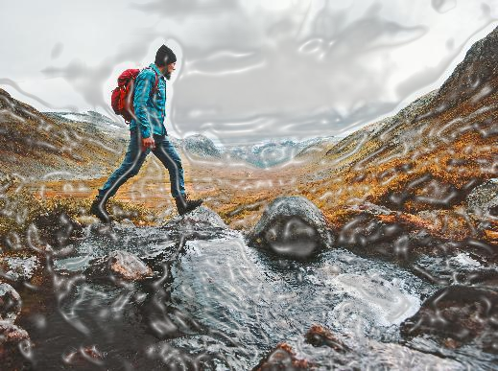
Stream of consciousness…
Think about something you consider yourself good at. Why is that? What led to this?
Think about something you consider yourself not so good at. Why is this? What led to this?
Think of a situation in which you found something challenging to learn. What caused the difficulty? What feelings arose? What did you end up doing in the situation?
Imagine the situation: You need to hand in a course assignment that requires you to dive deeply into the topic and spend a lot of time studying. However, you only have a limited amount of time available.
Do you try to hand in the best possible assignment, for example by using artificial intelligence?
Or would you use the limited time available to learn as much as you can with the resources at your disposal and submit coursework that you know may receive a low grade but truly reflects what you have learned?
Or something else?

Slide 7
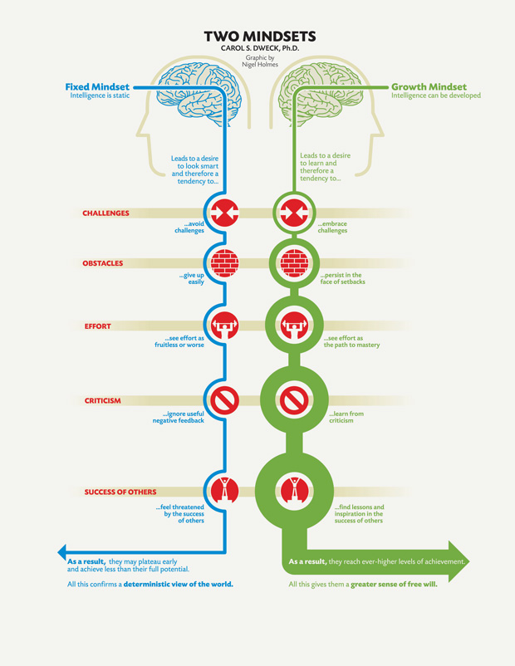
Growth Mindset
Carol Dweck, prof., Stanford University
Developing a growth mindset

Slide 8
The importance of learner’s mindset
Dweck et al., 2014: A key factor in learning is the learner's perception of intelligence and mindset (fixed vs. growth) → Interventions
Criticism: false growth mindset, excessive emphasis on the learner's own role without taking context into account
Current research partly conflicted, partly insufficient:
Interventions aimed at changing students' mindsets have little effect on academic performance (e.g., Macnamara & Burgoyne, 2022)
However, when interventions are well designed and targeted, they can have positive effects, particularly on mental health (Burnette et al., 2022)

Slide 9
The importance of a teacher’s mindset and behavior
Environment with instructional tasks and practices that foster a growth mindset → full potential of growth mindsets to affect motivation and learning by shaping the beliefs, values, and behaviors of the people in those environments (Murphy & Dweck, 2010)
However: “The proposal to focus on the mindset environment may have a ring of truth, but it is much easier said than done.” (Dweck & Yeager, 2019).
Current research:
Teacher support for a growth mindset is linked to students' own growth mindset, academic engagement, and better learning outcomes (Yu et al., 2023).
Teachers with a growth mindset are more likely to create a classroom culture where mistakes are seen as learning opportunities and effort is valued (Kroeper et al., 2022)
A teacher’s growth mindset is linked to other positive characteristics, such as joy in teaching, work engagement, and grit (Li et al., 2023).

Slide 10
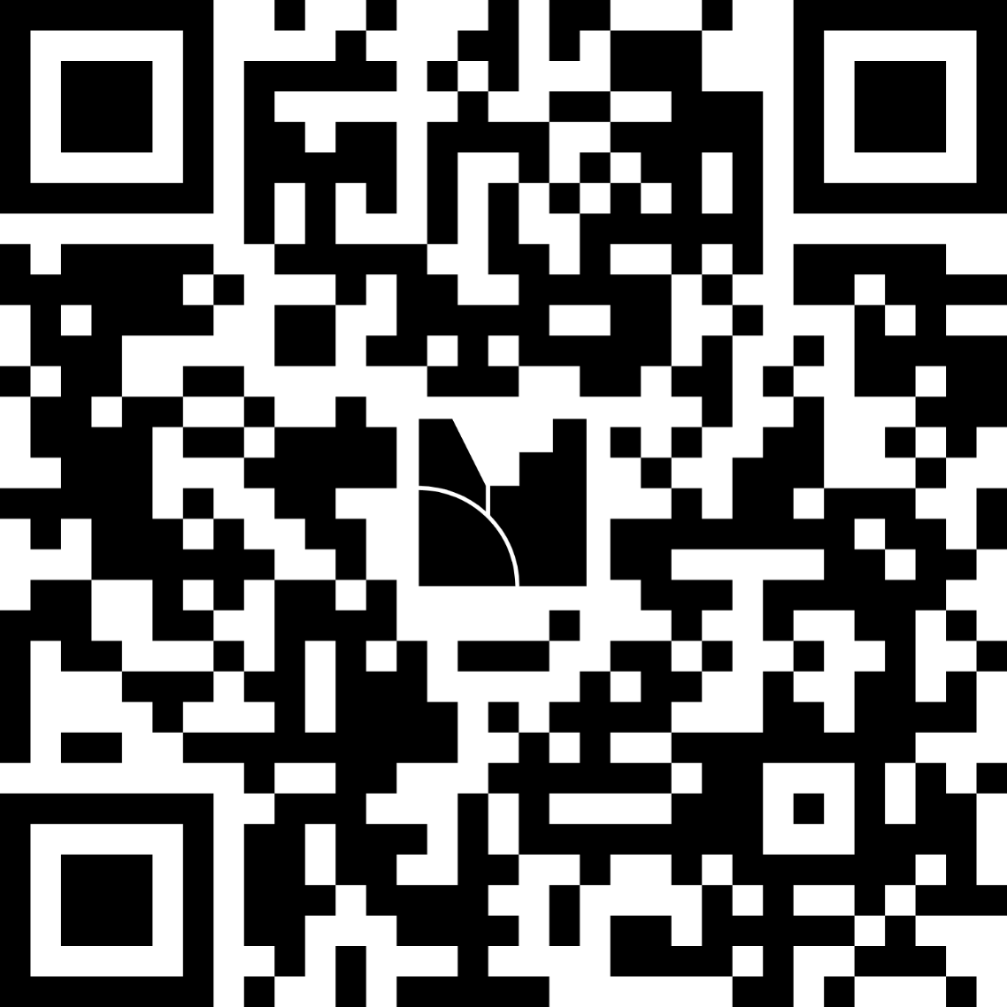
What is learning? How do different learning pathways take shape? Consider your own experience and the examples from Dweck ☺ First thoughts
https://www.menti.com/alaph17e5do3

Slide 11
Cultivating a growth mindset in your classroom Stanford Teaching Commons. (n.d.). Growth mindset and enhanced learning. Foundations of Course Design. Stanford University.
What can we do in our studies to strengthen a growth mindset together?
Be transparent about growth mindset with your class
Address fixed ideas about ability (lahjakas vs. taitava)
Model effort
Use questions that prompt thinking and learning
Praise and reinforce students for their hard work (but not only hard work)
Encourage a growth mindset through assessment
Help your students with their learning strategies and approaches

Slide 12
Related concepts
Self-efficacy (minäpystyvyys): Belief in one's own ability to perform tasks and achieve goals. Confidence in one's own competence.
Grit (sisu, sinnikkyys): Perseverance and passion for achieving long-term goals. The ability to keep trying despite setbacks.
Resilience (resilienssi): The ability to cope with and recover from setbacks and stress. Mental toughness.
Motivation (motivaatio): The force that drives us to act, focus our energy on specific goals, and keep going until we reach them.
Student Engagement (kiinnittyminen): Active participation, interest, and commitment on the part of students.

Slide 13
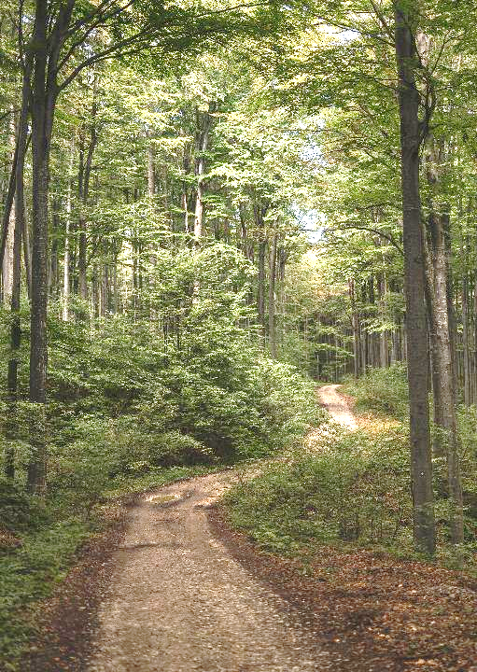

For next time
“Opintojakson jälkeen opiskelija tuntee keskeiset oppimisen teoriat ja oppimiskäsitykset ja osaa hyödyntää niitä käytännön tilanteissa.”
→ Begin building this understanding by reading: Illeris, K. (2018). An overview of the history of learning theory. European Journal of Education, 53(1), 86-101.
Draw your own illustrated learning journey of the significant learning experiences throughout your life span -> Make it in an editable format so we can format it next week

Slide 14
References
Burnette, J. L., Billingsley, J., Banks, G. C., Knouse, L. E., Hoyt, C. L., Pollack, J. M., & Simon, S. (2023). A systematic review and meta-analysis of growth mindset interventions: For whom, how, and why might such interventions work? Psychological Bulletin, 149(3-4), 174–205. https://doi.org/10.1037/bul0000368
Dweck, C. S., Walton, G. M., & Cohen, G. L. (2014). Academic tenacity: Mindsets and skills that promote long-term learning. Bill & Melinda Gates Foundation. https://eric.ed.gov/?id=ED576649
Dweck, C. S., & Yeager, D. S. (2019). Mindsets: A View From Two Eras. Perspectives on Psychological Science, 14(3), 481–496. https://doi.org/10.1177/1745691618804166
Kroeper, K. M., Fried, A. C., & Murphy, M. C. (2022). Towards fostering growth mindset classrooms: Identifying teaching behaviors that signal instructors’ fixed and growth mindset beliefs to students. Social Psychology of Education, 25(2–3), 371–398. https://doi.org/10.1007/s11218-022-09689-4

Slide 15
References
Li, L., Fathi, J., Allahveysi, S. P., & Kamran, K. (2023). A model of teachers’ growth mindset, teaching enjoyment, work engagement, and teacher grit among EFL teachers. Frontiers in Psychology, 14, 1137357. https://doi.org/10.3389/fpsyg.2023.1137357
Macnamara, B. N., & Burgoyne, A. P. (2023). Do growth mindset interventions impact students’ academic achievement? A systematic review and meta-analysis with recommendations for best practices. Psychological Bulletin, 149(3–4), 133–173. https://doi.org/10.1037/bul0000352
Murphy M. C., Dweck C. S. (2010). A culture of genius: How an organization’s lay theory shapes people’s cognition, affect, and behavior. Personality and Social Psychology Bulletin, 36, 283–296.
Vestad, L., & Bru, E. (2023). Teachers’ support for growth mindset and its links with students’ growth mindset, academic engagement, and achievements in lower secondary school. Social Psychology of Education: An International Journal. Advance online publication. https://doi.org/10.1007/s11218-023-09859-y

