Slide 1
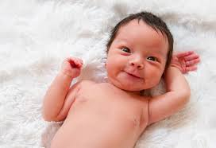
What is your name? Who chose the name? Why?

Slide 2
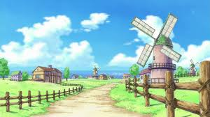
What is your home village like?

Slide 3

How many languages do you speak? Which level?

Slide 4

How and where do you study the best?

Slide 5

Are you single or in a relationship? Why?

Slide 6
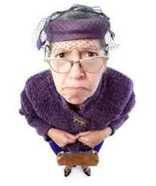
Who is your favourite relative? Why?

Slide 7
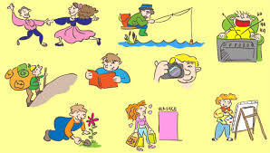
What are you interested in?

Slide 8
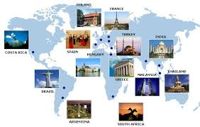
Do you like travelling?

Slide 9

What is your favourite colour? Why? How does it show?

Slide 10
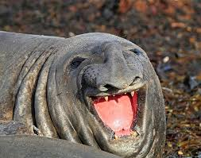
You and animals?

Slide 11

What kind of food do you like?

Slide 12

Are you hungry now? Why?

Slide 13
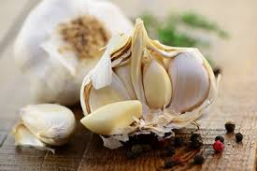
Do you like garlic?

Slide 14
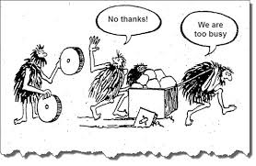
What have you done so far today?

Slide 15
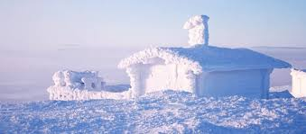
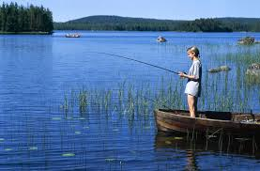
Talk about the Finnish weather!

Slide 16

What makes you happy?

Slide 17
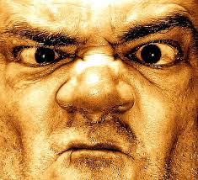
What makes you angry?

Slide 18

What kind of music do you like?

Slide 19
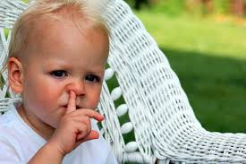
What are your bad habits?

Slide 20

What motivates you?

Slide 21

How do you use the social media?

Slide 22

What have you made for yourself?

Slide 23
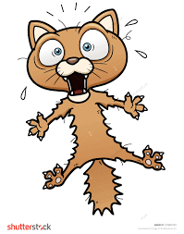
What are you afraid of?

Slide 24
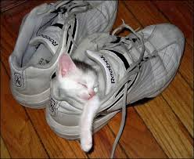
What is your favourite place?

Slide 25

Do you have good manners?

Slide 26

What will you remember most about 2015?

Slide 27

How is your future going to be?

