Slide 1
Détente
A. Origins of détente: Arms race and and a fear of a nuclear war
Truman 1945: The use of nuclear weapons should be a political decision, not a military one
Stalin adopted a similar policy regarding decision making after the successful detonation of atom bomb by the Soviet in 1949
Eisenhower’s ’New Look’: The US should adopt a much more confrontational and aggressive stance towards the USSR and China including the use of nuclear weapons (vs Truman Doctrine) → ’Massive retaliation’ (announced by Sect of State John Foster Dulles in Jan 1954) ← The US nuclear superiority would force concessions
→ increasing arms race (nuclear and conventional)
However, the fear of (nuclear) war convinced the superpower leaders to have periodic meetings
Khrushchev’s peaceful coexistence

Slide 2
The Geneva summit in July 1955 (the US, the USSR, Britain, France)
- the first meeting of the leaders since the Potsdam conference
nuclear weapons and Germany main items on the agenda
some results of the ’Geneva spirit’: The allied occupation in Austria ended and its neutrality was guaranteed; the Soviet returned the Porkkala naval base to Finland
no concrete decisions for disarmament

Slide 3
B. Nuclear agreements in the 1960´s
From the beginning of 1960´s: The strategies of Mutual Assured Destruction (MAD) and flexible response (formulated by R. McNamara vs Dulles’ Massive Retalliation) > ’nuclear deterrence’ based on the capacity for a true second-strike (’retaliatory strike’) after a first-strike made by an enemy
After the Cuban Missile Crisis (Oct 1962) the USA and the USSR signed (with the UK) the Nuclear Test Ban Treaty in 1963
the signatories agreed to cease underwater, space and atmospheric testing of nuclear weapons (underground detonations were not denied)
In 1963 four countries had atom bombs:
→The USA (since 1945), the USSR (1949), Britain (1952), France (1960)
Next year also the PRC detonated its first nuclear weapons
The Non-Proliferation Treaty (NPT) was made in 1968 to keep nuclear technology among these five countries, they promised not to share it

Slide 4
C. Détente, 1969-75
A PAIR WORK:
Assess the importance of the following to the beginning of superpower détente:
- The economic stagnation in the USSR
- Sino-Soviet border clashes on the Ussuri River in 1969 (On textbook pgs 154-155)
US-Chinese rapprochement, 1971-72 (On textbook pgs 155-156)
The Vietnam War (On textbook esp pg 180)

Slide 5
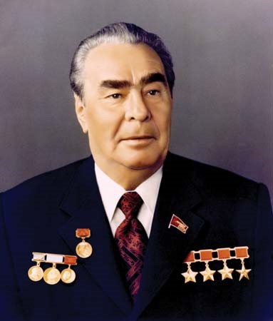
Leonid Brezhnev (b. 1906) replaced Khrushchev as Soviet leader in 1964
De-stalinization and limited liberalisation ended and economic policy became more conservative
The invasion of Czechoslovakia by the the Warsaw Pact against the ’Prague Spring’ in 1968 ← Brezhnev Doctrine (on textbook page 145)
However, the USSR began to pursue a policy of détente (which was essentially a continuation of the ’peaceful coexistence’)

Slide 6
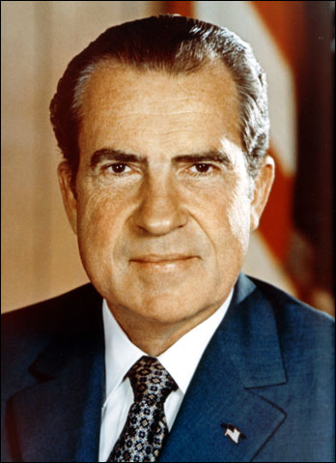
Richard Nixon (b. 1913) won the 1968 presidential elections
Eisenhower’s vice-president (1953-61) and a hardline anti-communist
However, was prepared to limit the US policy of containing communism if the overall consequences were beneficial to US interests
Détente and an acceptable withdrawal from Vietnam became the main focus of the US foreign policy

Slide 7
The Strategic Arms Limitation Talks (SALT) began formally in 1969 after Richard Nixon took office as US President → in May 1972 Brezhnev and Nixon signed the SALT I Treaty
→ more detailed about nuclear agreements (until the end of the Cold War) on textbook page 148.
A PAIR WORK (sources on textbook pgs 150-151):
A. Read about ’Germany and Ostpolitik’ and explain main points to your pair.
B. Read about ’The Middle East and détente’ and explain main points to your pair.
→ Consider together, how did superpower détente lead to peace overtures in Germany and the Middle East.

Slide 8
The Helsinki Accords
In the 1950’s the Soviet Union first proposed the creation of an all-European security conference. In the mid-1960s the Warsaw Pact renewed calls for such a conference. In May 1969, the Government of Finland sent a memorandum to all European countries, the United States and Canada, offering Helsinki as a conference venue. Beginning in November 1972, representatives from the original 35 nations met for nearly three years to work out the arrangements and the framework for the conference, concluding their work in July 1975.
On August 1, 1975, the leaders of the original 35 participating States gathered in Helsinki and signed the Final Act of the Conference on Security and Cooperation in Europe. Also known as the Helsinki Accords, the Final Act is not a treaty, but rather a politically binding agreement consisting of three main sections informally known as "baskets," adopted on the basis of consensus. This comprehensive Act contains a broad range of measures designed to enhance security and cooperation in the region extending from Vancouver to Vladivostok.

Slide 9
The categories (’baskets’) of the Helsinki Final Act, 1 August 1975
Basket I - the Security Dimension - contains a Declaration of Principles Guiding Relations between participating States, including the all-important Principle VII on human rights and fundamental freedoms. It also includes a section on confidence-building measures and other aspects of security and disarmament aimed at increasing military transparency.
Basket II - the Economic Dimension - covers economic, scientific, technological and environmental cooperation, as well as migrant labor, vocational training and the promotion of tourism.
Basket III is devoted to cooperation in humanitarian and other fields: freer movement of people; human contacts, including family reunification and visits; freedom of information, including working conditions for journalists; and cultural and educational exchanges. Principle VII and Basket III together have come to be known as the "Human Dimension.

