Slide 1
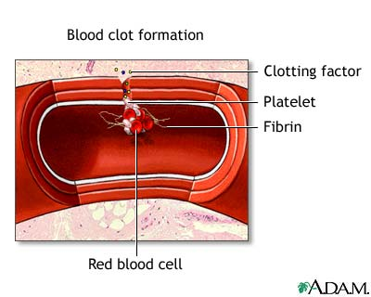
BLOOD CLOTTING
The clotting of blood is the result of platelets and other cells releasing clotting factors near the site of a cut or opening
Thrombin (a protein) is formed. Enzyme that converts fibrinogen to fibrin
Fibrinogen found in blood, fibrin is the active form
Fibrin works in that it captures RBC’s and immobilizes blood (acts like a net)
Platelets get caught in this gel-like substance and begin sticking to one another
This acts in two ways: preventing blood loss and preventing pathogenic entry
process of clotting p. 420

