Slide 1
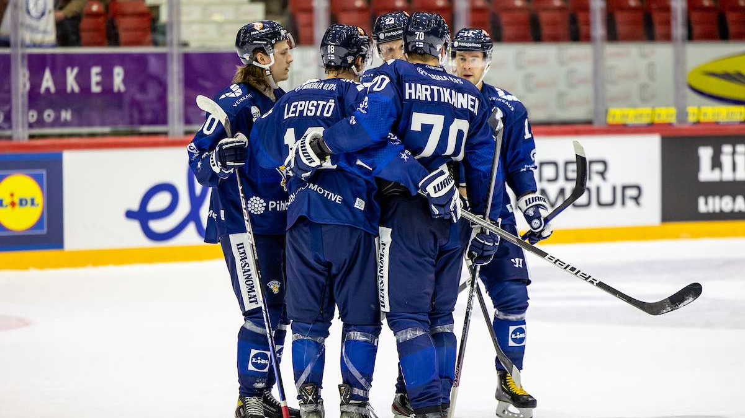
Finnish Ice Hockey

Slide 2
Hockey Vocabulary
Puck = Kiekko
Attacker = Hyökkääjä
Defender = Puolustaja
Pass = Syöttö
Stick = Maila
Rink = Kaukalo
Jersey = Pelipaita
Coach = Valmentaja

Slide 3
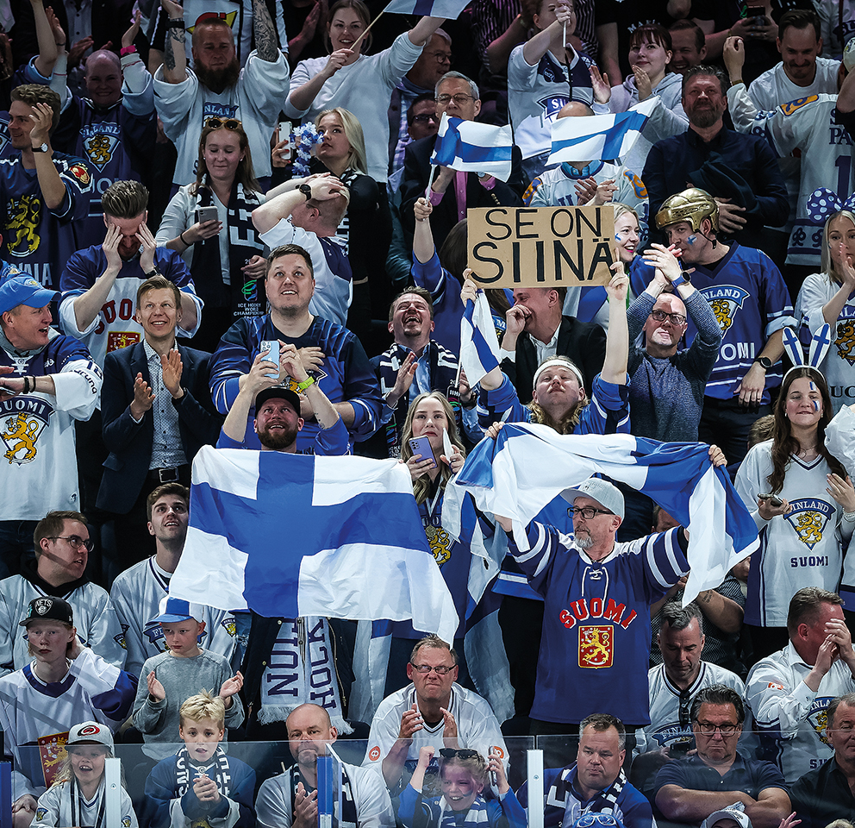
Overall info about ice hockey in Finland
Ice Hockey is the most popular sport in Finland
852 professional hockey players in 2019
Finland has won the world cup four times
In 1995 (never forget), 2011, 2018 and 2022.
Olympic gold in Beijing in 2022.

Slide 4

Finnish League (SM-Liiga)
15 teams playing
6 will go straight to play-offs
And 2 from other play-offs
At the end of the season 8 teams will chase the trophy
It started 24 May.1975
Before that there was a league called Sm-sarja (1928-1975)
In 2000 the league was closed
So the same teams play there every year
The league will be reopened next season in 2024

Slide 5

Some Finnish League Teams

Slide 6

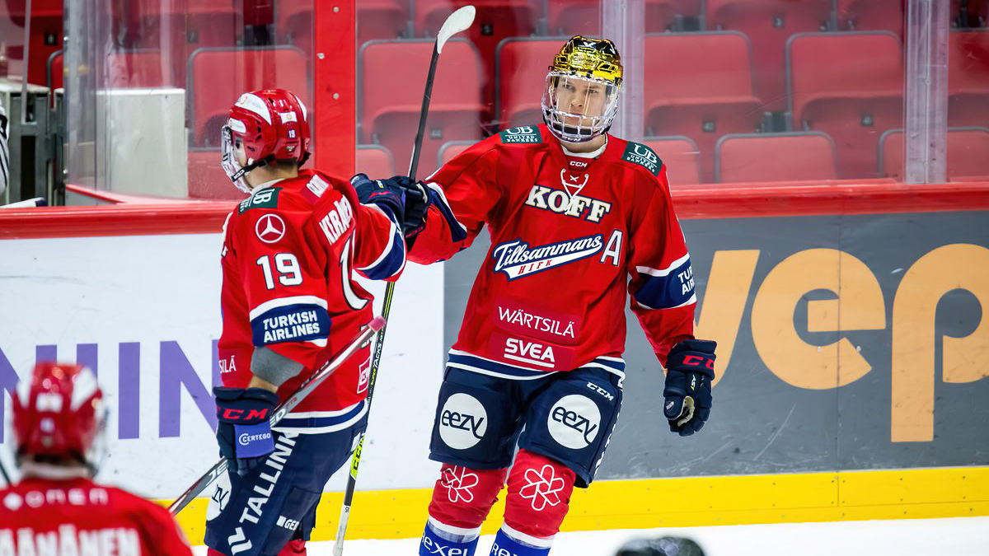
HIFK
HIFK (Idrottsföreningen Kamraterna, Helsingfors) is a team from Helsinki
Their designation is the red color
Red jerseys when playing home, white when playing away
Their home arena is at Helsingin Jäähalli
One of the four teams that have participated since the beginning (1975-1976)
Their head coach is currently Ville Peltonen
The best team in the Finnish League

Slide 7



TPS

Slide 8
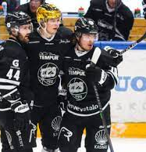
TPS
They come from Turku
Their home stadium is Gatorade center
Their main colors are black and white
They have won 11 times the Finnish champion
Their coach is Tommi Miettinen and captain Juhani Jasu
Tps is in the second place of how many champions they have won
The Best team in the league
Founded in 1937
Legends: Saku Koivu and Jukka Vilander

Slide 9


Ilves and Tappara
Both come from Tampere
Long time rivalry
Ilves' main color is green while Tappara's is orange
Ilves was founded in 1931, Tappara in 1955
They share the same home arena, the Nokia Arena

Slide 10

Finnish Ice Hockey legends

Slide 11
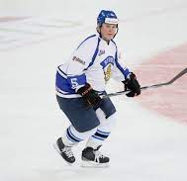
Timo Jutila
Won 5 Finnish championships
Played in Tappara 1980-88, 1992-99
Played as a defender
Was a captain for Tappara and in the national team
Won 1 WC gold medal as a player and 1 WC as a team leader
Was the first player in Finland to win 2 WC gold medals
Ended his career in 1999
Played 561 matches in the Finnish league

Slide 12
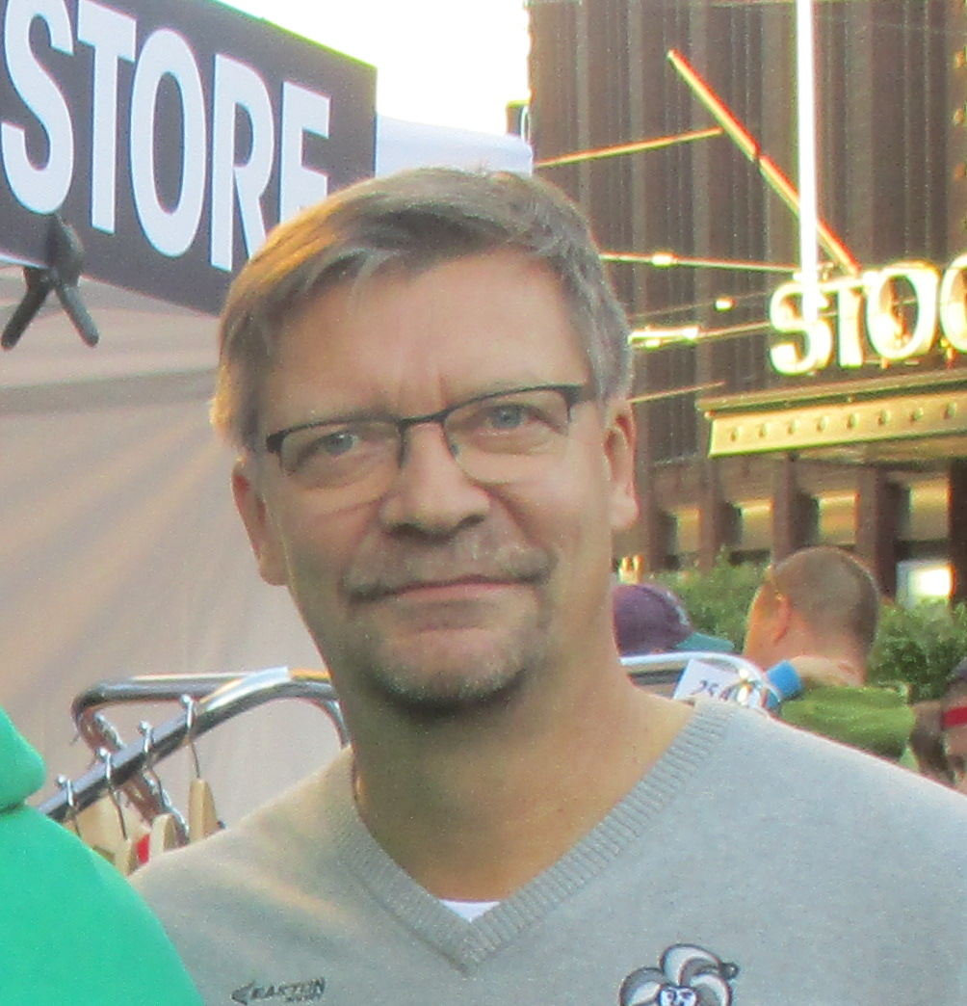
Jukka Jalonen
Renowned head coach of Leijonat in 2008-2013 and 2018-2022.
Under his coaching, Leijonat has won four gold medals. World Cups 2011, 2018, 2022 and the Beijing Olympics.
He has also coached teams such as Ilves, Lukko and HPK.
He was appointed the honorary degree of University of Jyväskylä in 2022

Slide 13
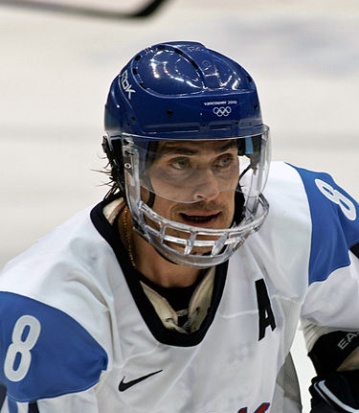
Teemu Selänne
He is said to be one of the best hockey players ever
Made a remarkable career in the NHL
Also played for Jokerit
Already retired
Played with Saku Koivu and Jere Lehtinen in the Nagano Winter Olympics 1998

Slide 14
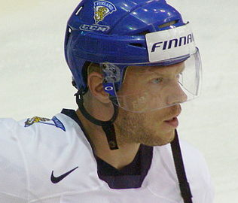
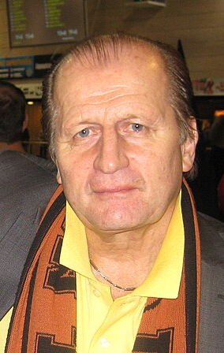
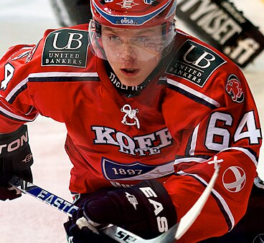
Honorable mentions
Mikael Granlund
Famous for his "airhook" in the 2011 World Cup
Juhani "Tami" Tamminen
Former hockey player and current hockey expert
Saku Koivu
Won a World Cup and a Finnish Championship in the same year, 1995

Slide 15
Finnish League legends
Pertti Lehtonen
23 seasons played (22 in IFK) (1973-1998)
230 goals scored as a defender
Arto Javanainen
20 seasons played, most of them in Porin Ässät
All time top scorer in the Finnish League
Janne Ojanen
Played 20 seasons, most of them in Tappara

Slide 16
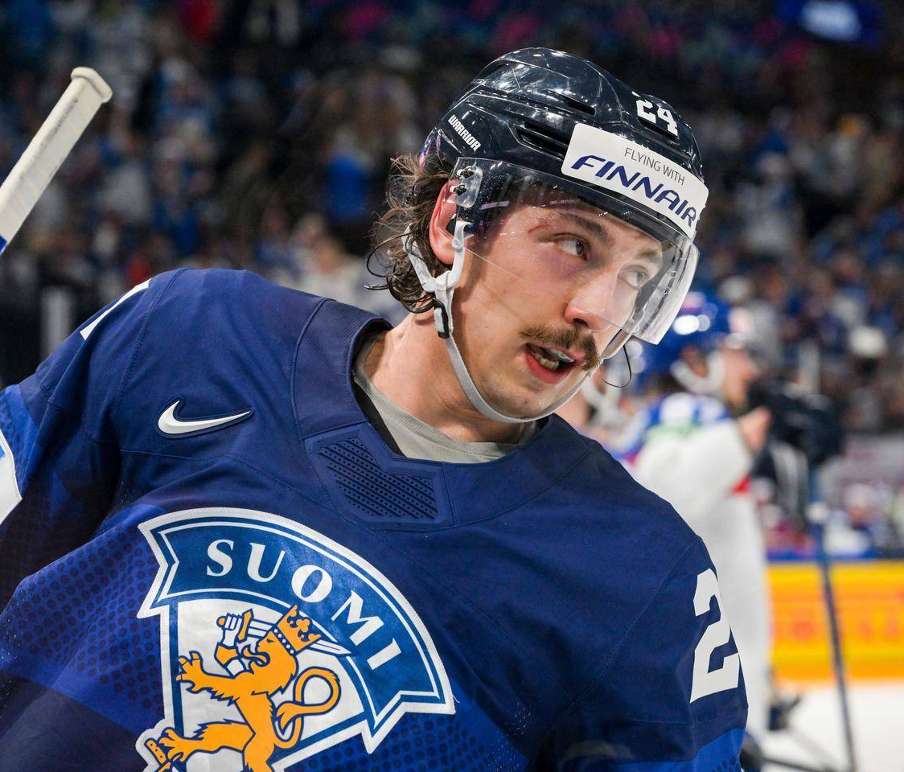

Leijonat (The Lions)
Leijonat is the national ice hockey team of Finland
Accepted as a member by the International Ice Hockey Federation (IIHF) on February 10, 1928.
Ranked second in the IIHF World Ranking
Legendary Leijonat players include Timo Jutila, Raimo Helminen, Teemu Selänne and Saku Koivu
WC Gold four times, WC Silver nine times, one Olympic gold and two Olympic silver rankings.
Some players in 2022 included Marko Anttila, Hannes Björninen and Valtteri Filppula
Legendary coach, Jukka Jalonen, the man of four golds.

Slide 17
Sources
Info
-IFK.com
https://hc.tps.fi/
https://www.leijonat.fi/
https://www.mtvuutiset.fi/artikkeli/top10-sm-liigakaukaloiden-legendat/3772406#gs.01gqow
https://liiga.fi/fi
https://www.tappara.fi/
https://www.ilves.com/
https://fi.wikipedia.org/wiki/Jukka_Jalonen
https://fi.wikipedia.org/wiki/Timo_Jutila
https://fi.wikipedia.org/wiki/Teemu_Sel%C3%A4nne
Images
-Wikipedia commons
-Leijonat Twitter
-Etelä Suomen Sanomat
-IFK.com

