Slide 1
Let’s have a little workout
Notes:
1

Slide 2
Polynomials and equations
7th grade
Notes:
2

Slide 3
Choose the right answer
Notes:
3

Slide 4
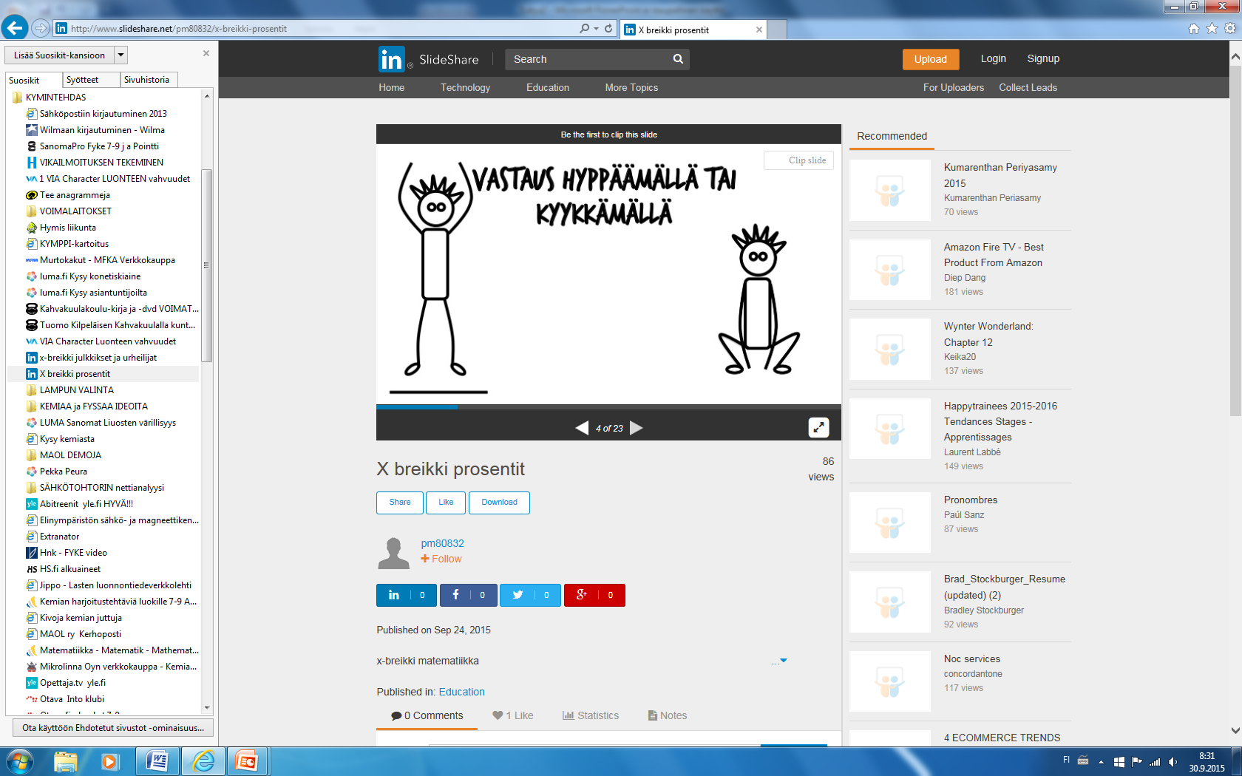
First answer by
jumping or crouching
Notes:
4

Slide 5
Warm-up
questions
Notes:
5

Slide 6
The capital city of Hungary is
Budabest
London
Notes:
6

Slide 7
The King of Spain is
Felipe VI
Kaarle XVI Kustaa
Notes:
7

Slide 8
Are you ready?
Be quick!
Notes:
8

Slide 9
The term is y.
What is the coefficient?
0 or 1
Notes:
9

Slide 10
The coefficient is 3 and variable x.
What is the term?
3x or x+3
Notes:
10

Slide 11
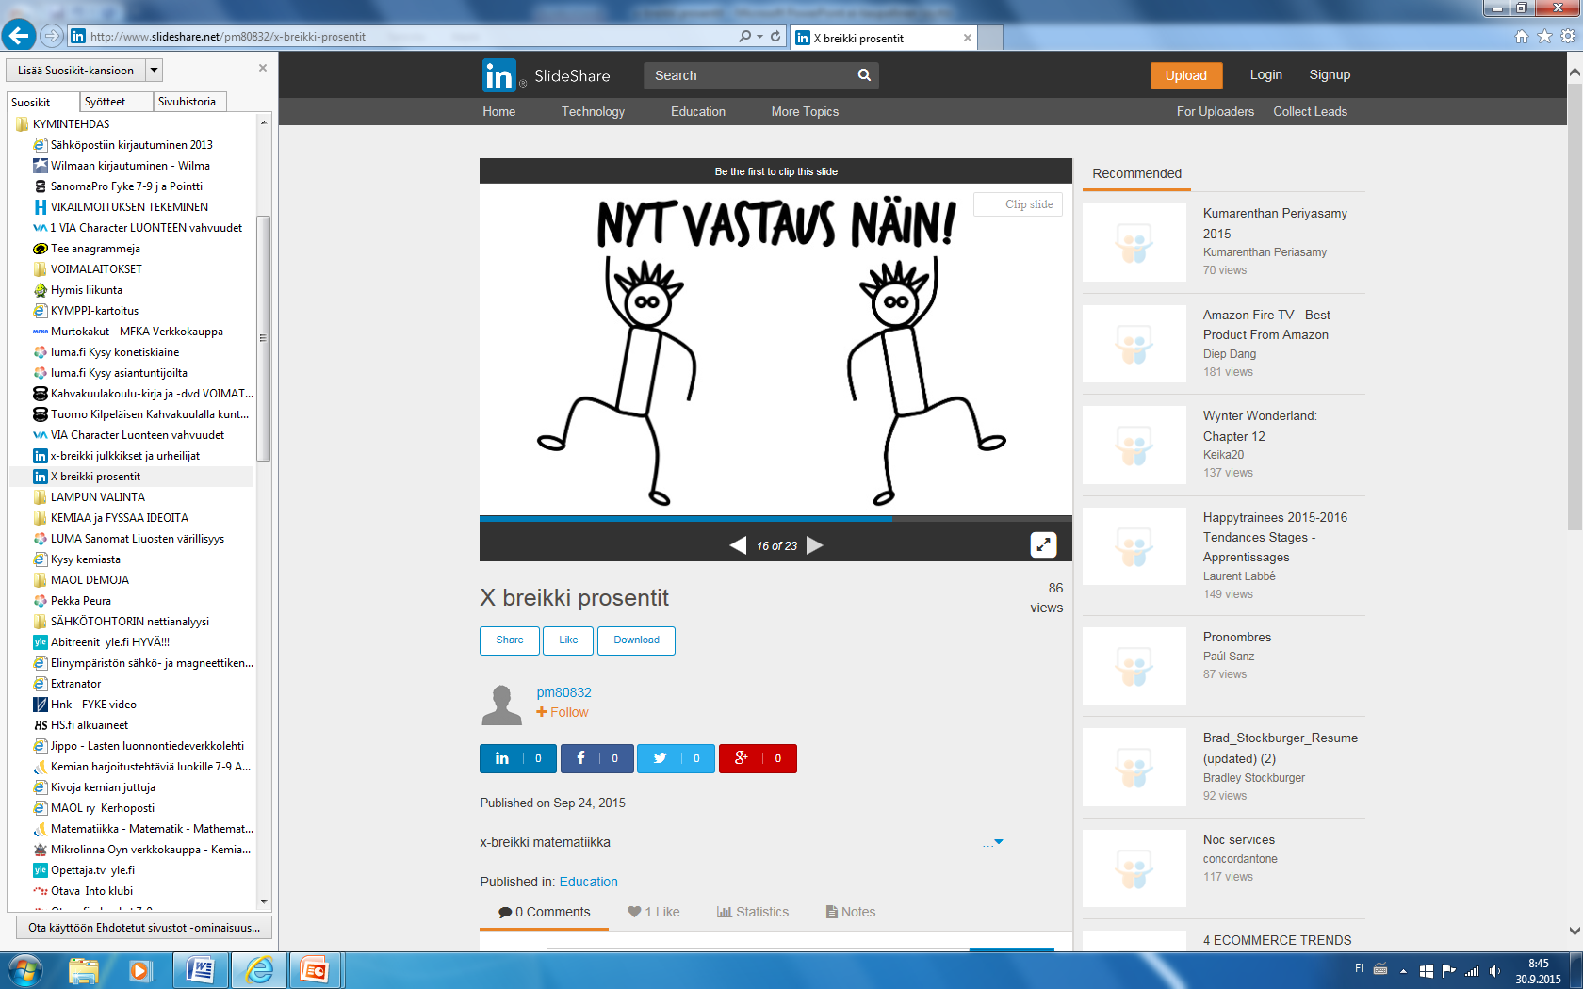
Now answer this way
Notes:
11

Slide 12
Calculate 2x-5 when x=4.
3 or -3
Notes:
12

Slide 13
Calculate -2x+6 when x=-3.
0 or 12
Notes:
13

Slide 14
Simplify 2a+4a-a=
5a or 6a
Notes:
14

Slide 15
Simplify -5y+1-3y-7 =
8y-6 or -8y-6
Notes:
15

Slide 16
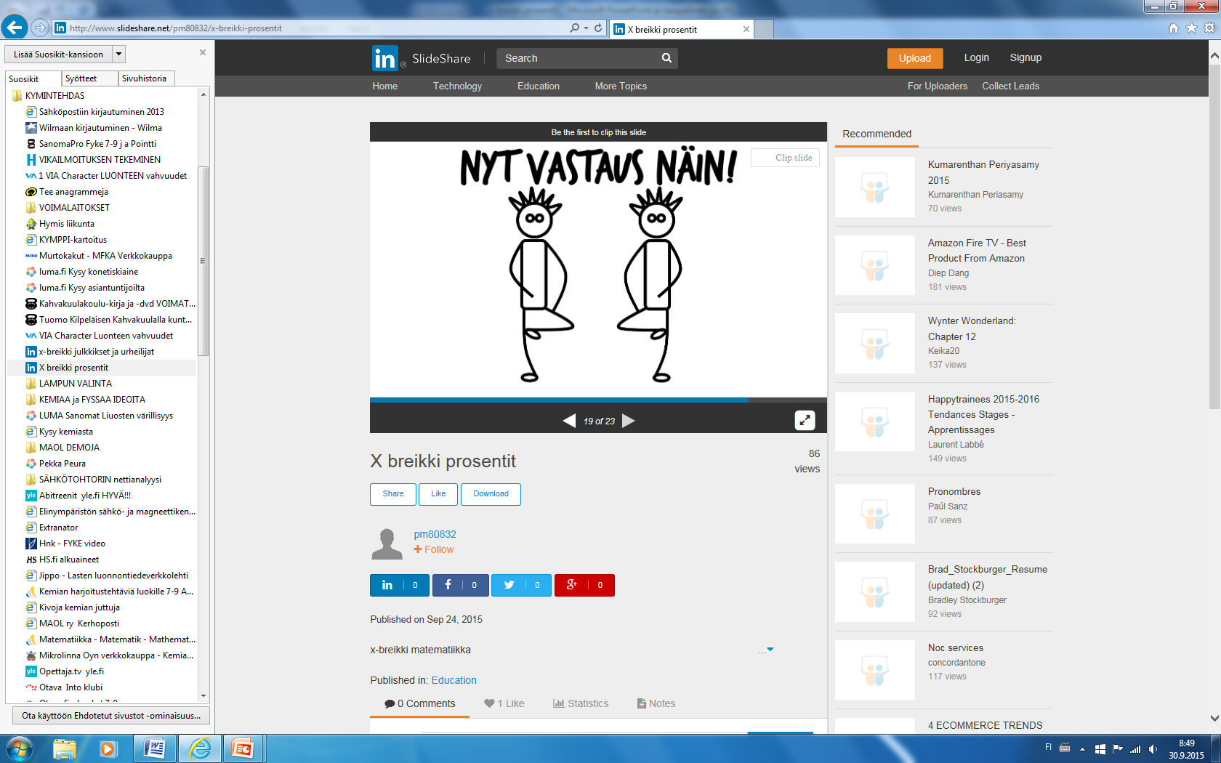
Now answer this way
Notes:
16

Slide 17
How long is the perimeter?
x
4x
5x or 10x
Notes:
17

Slide 18
How long is the perimeter?
10x
3
8x
18x+3 or 21x
Notes:
18

Slide 19
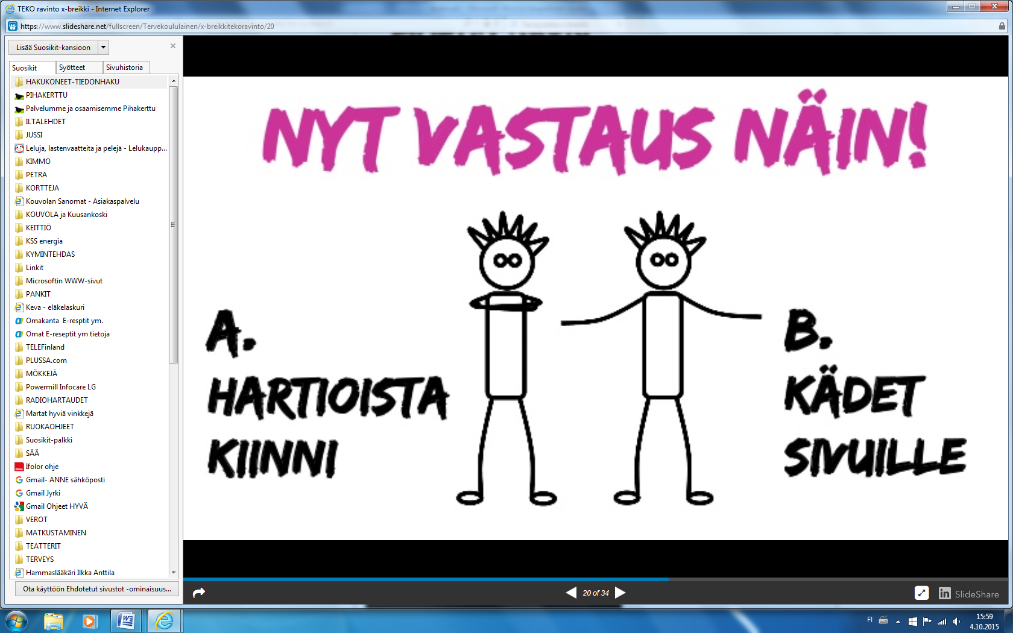
Now answer this way
Notes:
19

Slide 20
Find the missing term
4x – 6 + + 1 = -2x - 5
-6x or 2x
Notes:
20

Slide 21
Solve the equation
4x – 1 = 11
x=-3 or x= 3
Notes:
21

Slide 22
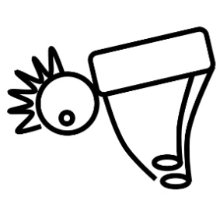
Thank you
and
a bow !
Notes:
22

