Slide 1
Analysis of the podzolic soil

Slide 2
Analysis of the podzolic soil: TThursday Field Trip (Pyhävuori)
The students are divided into five (1-5) groups.
There is 50 cm deep hole on the ground. They observe the typical podzolic soil of the northern coniferous forest. They also study the vegetation in groups. It is possible to make use of the Plantnet application. They take pictures of different situations.
Each group takes a sample, with a spoon, of one layer of the podzolic soil (Group 1. organic horizon, Group 2. humus horizon, Group 3. eluviation horizon, Group 4.accumulation horizon, Group 5. unweathered subsoil horizon). The samples are stored in numbered glass jars.
Also rock samples can be collected.

Slide 3
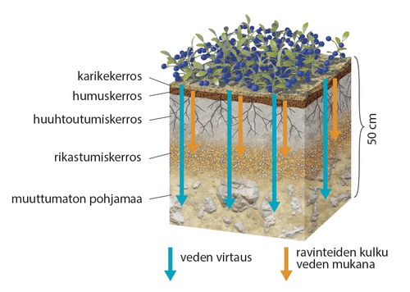
Structure of the podzolic soil
Group 1. Organic horizon Group 2. Humus horizon Group 3. Eluviation horizon
Group 4. Accumulation horizon
Group 5. Unweathered subsoil

Slide 4
Podzolic soil
Water that rains on the ground sinks through the soil and dissolves salts from the mineral soil, which plants use as nutrients. Sinking water also carries humus and clay particles with it → subsurface horizon with low nutrients is formed, which can be seen as a gray stripe.
Salts and fine-grained soil particles are transported with the water to a depth of a few tens of centimeters and accumulate in the accumulation horizon, which is visible as a rust-brown layer.
Beneath the enrichment layer is an unweathered subsoil. Some of the salts continue to sink into the groundwater.
Acid soil, that is not good for agriculture.

Slide 5
Analysis of samples from podzolic soil layers (on Thursday at school)
The students get into the five groups with the samples.
Each group has their own sample of a different layer of the soil.
They test the N (nitrogen), K (potassium), P (phosphorus) and pH (acidity) levels of the samples.

Slide 6
Analysis of samples from podzolic soil layers
Preparing the soil sample
Take new glass jar. Put in there one part soil and add four parts water (for example 50 ml soil and 200 ml water).
Seal the glass jar and shake for 30 seconds.
Allow sample set down 15-30 minutes (depending on soil type).
Prepare a test tube rack and four test tubes. Label the test tubes (pH, N, P or K).

Slide 7
Analysis of samples from podzolic soil layers
Carrying out the test
Use the pipette to draw up a sample of the clear liquid (it does not matter if the liquid is still cloudy).
Put 3 ml of sample in each clean test tubes.
Add 6 drops (0,5ml) of either ph, N1, P1 or K1 depending on the test being carried out.
Add one heaped scoop of pH, N, P or K powder.
Cap the end of the test tube with plastic glove on a hand & shake for 30 seconds.
Allow the powder to settle down over a 5 minute period allowing the colour to develop.
Then compare the colour of the liquid in the test tube by holding it against the appropriate colour chart.
Take a note of the reading.

Slide 8
While waiting for the results each group writes a short report on their findings during their research:
Cover page
Title: Analysis of samples from podzolic soil layers
Names, date and school
Introduction/ Background information
What is podzolic soil? Why we have this kind of soil in the northern coniferous forest zone?
Execution of the research
How the research was carried out? (sampling and analysis)
Results
What were the results of the analysis?
Discussion
What do the results tell us? How N (nitrogen), K (potassium), P (phosphorus) and pH (acidity) levels of the soil affect e.g. the vegetation in the area?
Sources

