Slide 1
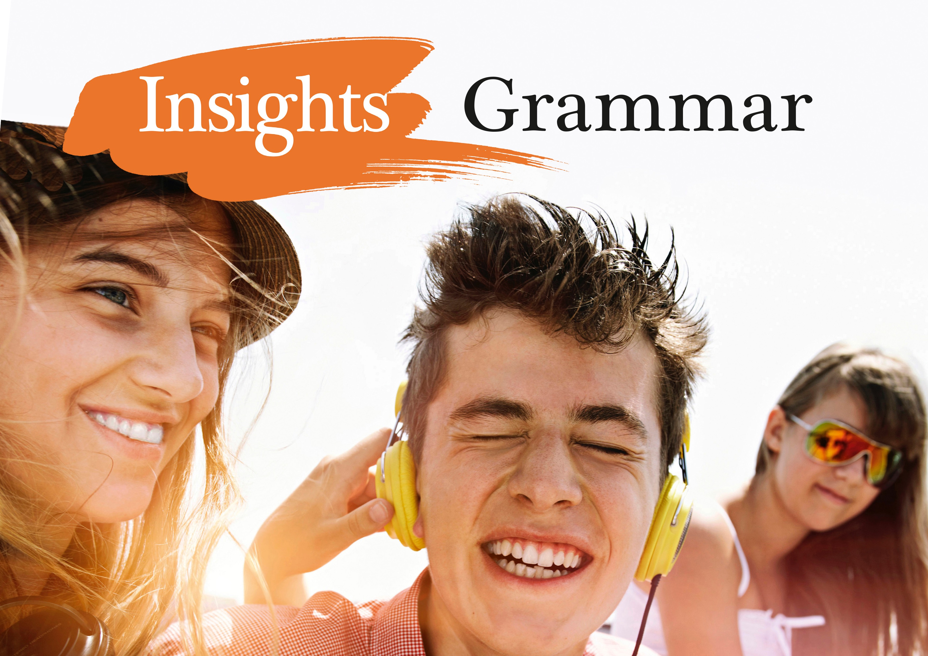

Slide 2
Väitelauseen sanajärjestys
Katso taulukkoa ja nimeä eri lauseenjäsenet.
Sam | wrote | a new song |  | at school | yesterday.
He | played | all the chords | perfectly | on stage.
Sophie | reads | sci-fi novels |  | online | in the evenings.
My kid brother | does | his chores | lazily | at home | on Saturdays.
⬇
⬇
⬇
⬇
⬇
⬇
SUBJEKTI
PREDIKAATTI
OBJEKTI
TAPA
PAIKKA
AIKA

Slide 3
Väitelauseen perussanajärjestys englannissa
Subjekti (Tekijä)
Predikaatti (Tekeminen)
Objekti (Tekemisen kohde)
Tavan määre
Paikan määre
Ajan määre
S P O T P A

Slide 4
SUBJEKTI – PREDIKAATTI – OBJEKTI
Näiden järjestys on tärkein.
Sam | wrote | a new song.
He | played | all the chords.
Sophie | reads | sci-fi novels.
My kid brother | does | his chores.

Slide 5
Mikä muutos SPOTPAAn on mahdollinen?
Yesterday | Sam | wrote | a new song |  | at school.
 | He | played | all the chords | perfectly | on stage.
In the evenings | Sophie | reads | sci-fi novels |  | online.
On Saturdays | my kid brother | does | his chores | lazily | at home.
A
S
P
O
T
P
Lauseen voi aloittaa myös ajan määreellä.

Slide 6
Activate
Translate.
1. Tapasimme toisemme kahvilassa eilen.
We met each other at a café last night / yesterday evening.
2. Käymme siinä kahvilassa joka viikko.
We go to that café every week.
3. Matkustimme viime kesänä Saksaan autolautalla.
We travelled by ferry to Germany last summer. / Last summer we travelled…

Slide 7
4. Aloimme matkan varhain eräänä aamuna satamassa Helsingissä.
We started the voyage early one morning at the
harbour in Helsinki. / Early one morning…
5. Lautta meni matkan alussa Suomenlinnan ohi hyvin
hitaasti.
The ferry went very slowly past Suomenlinna at the beginning of the voyage. / At the beginning of the voyage…

Slide 8
6. Sää oli täydellinen ja aurinko paistoi koko matkan ajan kirkkaasti.
The weather was perfect and the sun shone
brightly during the whole voyage/journey.

Slide 9
Mihin järjestykseen useampi paikan tai ajan määre tulee?
Sam | wrote | a song |  | in biology class at school | just before lunch yesterday morning.
He | played | all the chords |  | on stage at the town hall in Porvoo | after dinner at eight in the evening last Friday.

Slide 10
Mihin järjestykseen useampi paikan tai ajan määre tulee?
… in biology class at school
just before lunch yesterday morning.
… on stage at the town hall in Porvoo
after dinner at eight in the evening last Friday.
Tarkempi aika/paikka ennen epätarkempaa.

Slide 11
Activate
Muodosta lauseita.
1. opened / a hair salon / in Brighton / Maria / by the seaside
Maria opened a hair salon by the seaside in Brighton.
2. songs / sings / happily / in her salon / She / every morning / while working
She sings songs happily in her salon while working every morning.
OR Every morning (while working) she sings…

Slide 12
3. his moped / keeps / on his farm / James / in the summer / in the garden / behind the greenhouse
James keeps his moped behind the greenhouse in the garden on his farm in the summer.
OR
In the summer James keeps…
4. slowly / loves / he / along the seashore / whenever he has time / riding his moped
He loves riding his moped slowly along the seashore whenever he has time.
OR
Whenever he has time he loves…

Slide 13
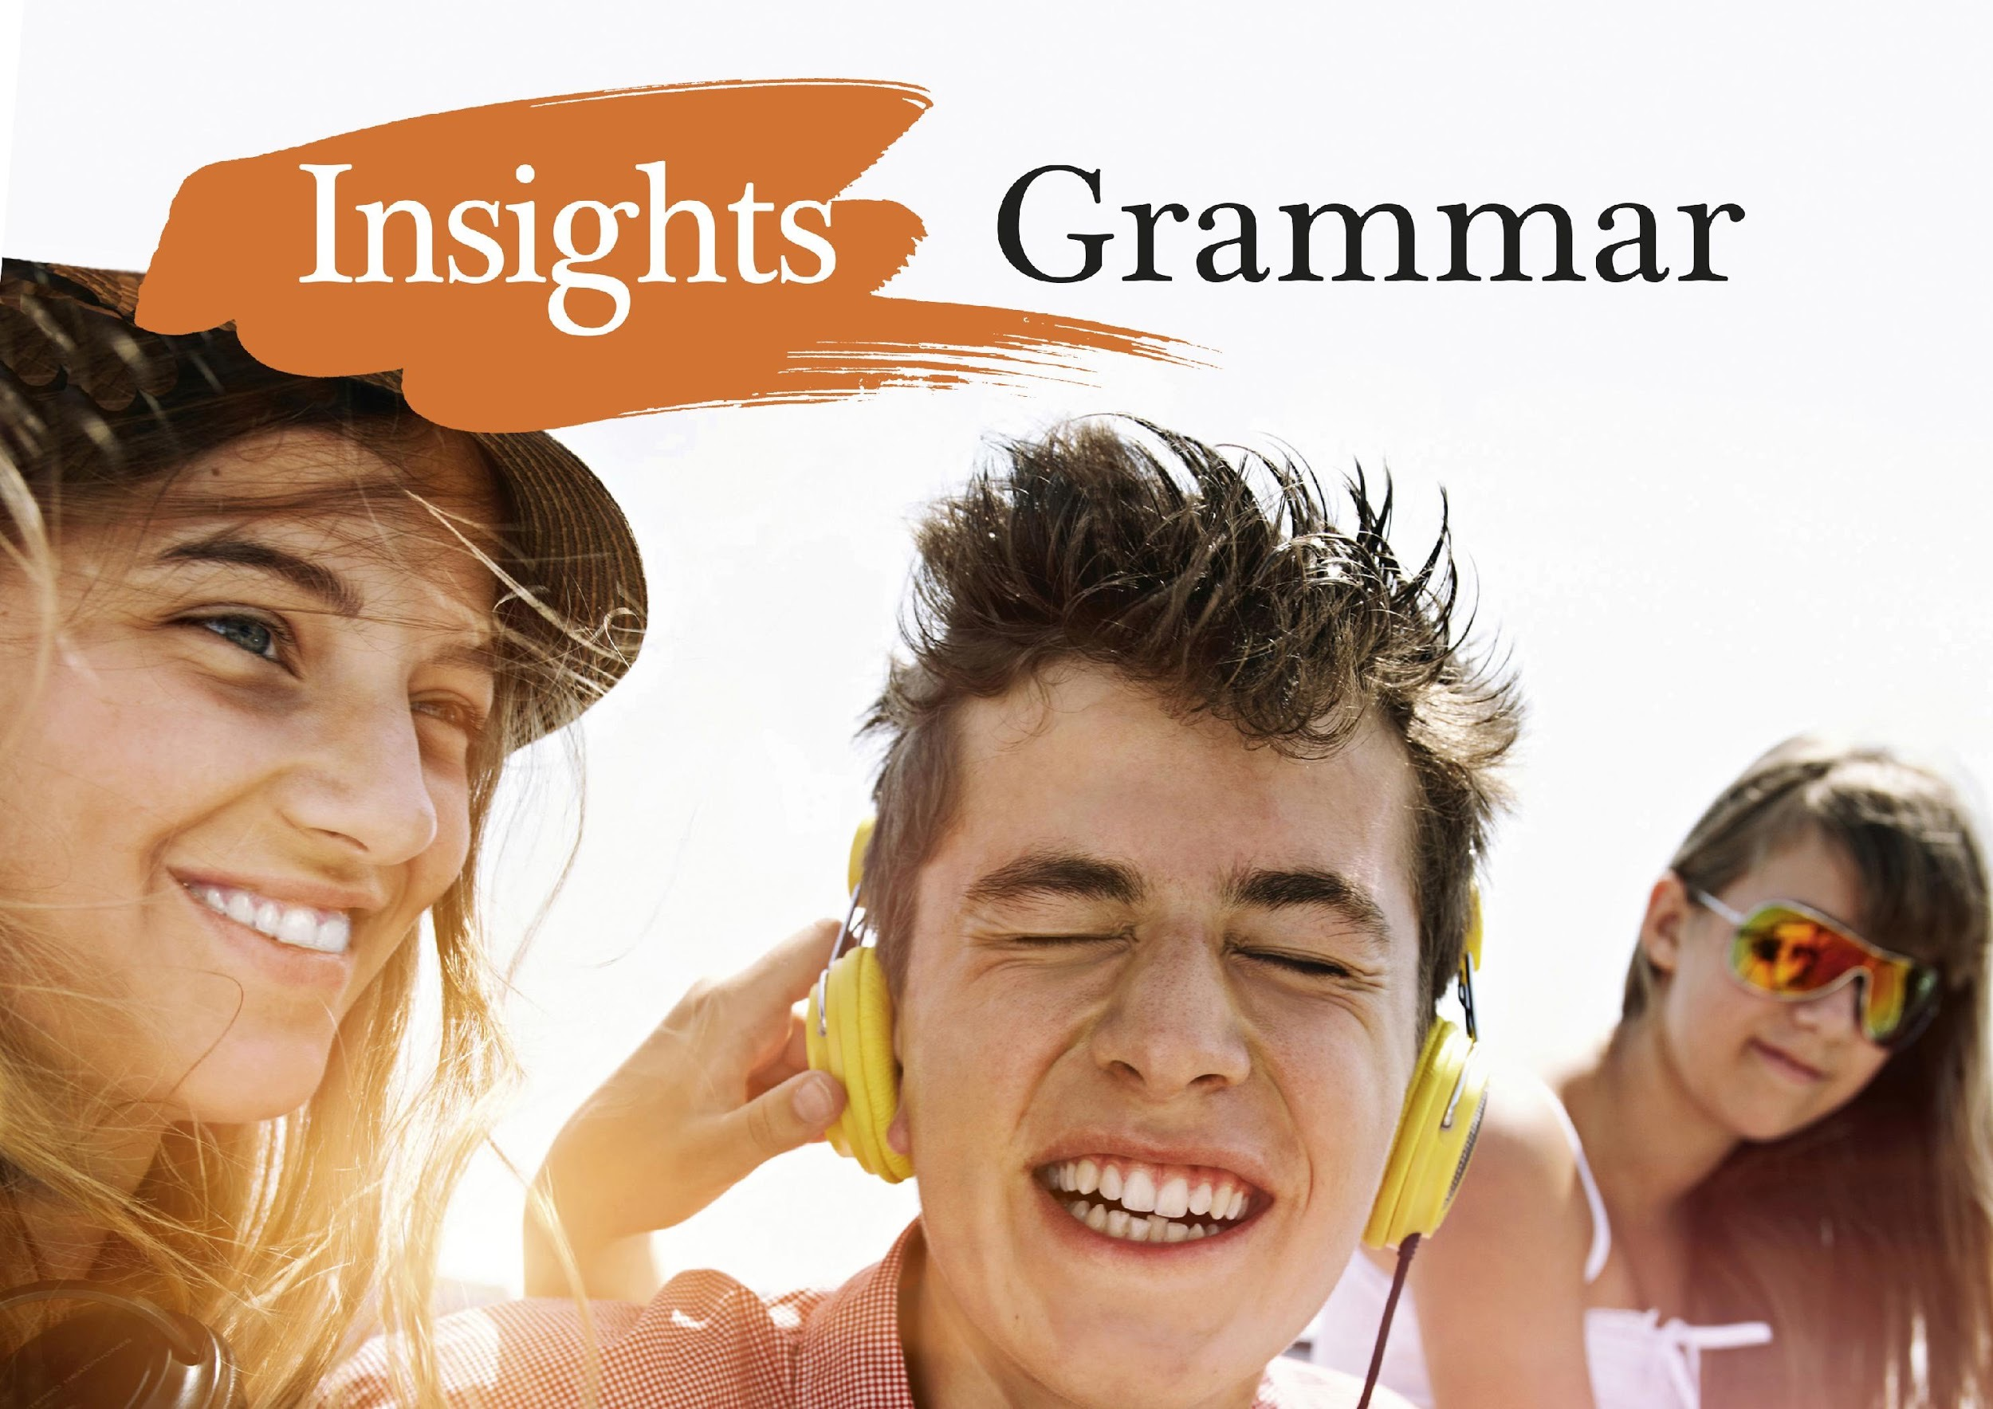

Slide 14
Kysymyslauseen sanajärjestys
 | You | like | rap music.
 | S | P | O
(Why) | Do | you | like | rap music?
(Kys.sana) | Apuverbi | S | P | O
 | They | come | here | tomorrow.
 | S | P | paikka | aika
Do | they | come | here | often?
Apuverbi | S | P | paikka | aika

Slide 15
Muistathan valita oikean: do / does / did
He supports his local team.
preesens (supports)
yksikön 3. persoona (he)
> Does he support his local team?
He went to see every match last season.
imperfekti (went)
> Did he go to see every match last season?

Slide 16
do / does / did + mikä muoto pääverbistä?
Does he support his local team?
Did he go to see every match last season?
> do / does / did + pääverbin perusmuoto

Slide 17
Väitelauseen apuverbi toistuu kysymyslauseen alussa
 | People | should | trust | their friends.
 | S | apuverbi | pääverbi | O
Should | people |  | trust | their friends?
apuverbi | S | - | pääverbi | O

Slide 18
Jos väitelauseessa on be-verbi, sitä käytetään kysymyslauseen alussa.
 | Finns | are | ice hockey enthusiasts.
 | S | be-verbi
Are | Finns |  | ice hockey enthusiasts?
be-verbi | S | -

Slide 19
Jos väitelauseessa on be-verbi, sitä käytetään kysymyslauseen alussa.
 | Joe | is | planning | a surprise party.
 | S | be-verbi
(When) | is | Joe | planning | a surprise party?
(Kysymys- sana) | be-verbi | S | -

Slide 20
Kysymyslauseen sanajärjestys on siis:
(Kysymys-sana) | Apuverbi / Be-verbi | Subjekti | Pääverbi | Objekti | määreet

Slide 21
Mitä huomaat apuverbin käytöstä seuraavissa kysymyksissä?
Näissä kysymyksissä ei ole apuverbiä.
Miksi ei?
Who | called | you | yesterday evening?
Kysymyssana / Subjekti | P | O | määreet
What | gives | you | hope | on a bad day?
Kysymyssana / Subjekti | P | O | O | määreet

Slide 22
Activate
Käännä.
Milloin konsertti alkaa?
When does/will the concert start/begin?
2. Onko lippuja vielä jäljellä?
Are there still tickets left?
3. Kuinka paljon sinun piti maksaa lipuista?
How much did you have to pay for he tickets?

Slide 23
4. Millainen uusi laulusolisti on?
What is the new vocalist like?
5. Onko bändillä uutta levyä julkaistuna (=out)?
Does the band have a new album out?
6. Kävitkö katsomassa bändiä viime vuonna?
Did you go and see the band last year?

Slide 24
7. Mitkä laulut haluat kuulla?
Which songs do you want to hear?
8. Mitkä laulut koskettavat sydäntäsi eniten?
Which songs touch your heart (the) most?
9. Aiotko laulaa mukana?
Are you going to sing along?

Slide 25
10. Voitko näyttää minulle heidän viimeisimmän musiikkivideonsa?
Can you show me their latest music video?
11. Pitäisikö minunkin ostaa lippu?
Should I buy a ticket, too?
12. Mitä mieltä sinä olet?
What do you think?

Slide 27

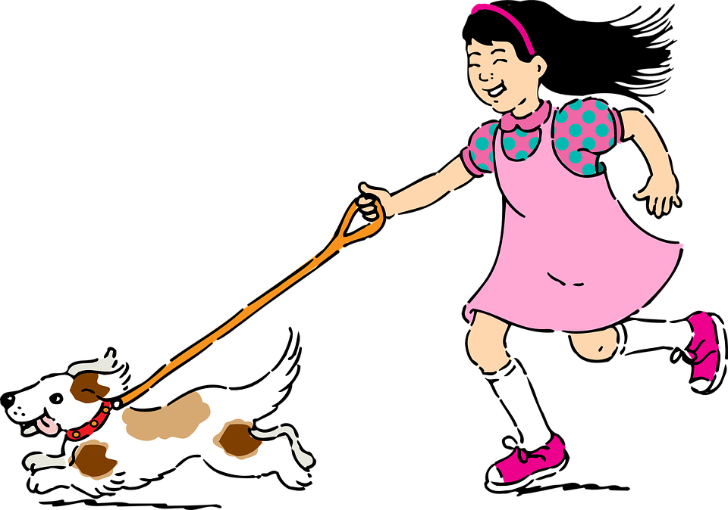
OLLA-verbit
Olla-verbejä on englannin kielessä kaksi: ’be’ ja ’have’.
Be-verbillä ilmaistaan olemista.
I want to be a dog.
Have-verbillä omistamista.
I want to have a dog.
CC0 Public Domain

Slide 28
Activate
Be or have?
1. I am/have sleepy.
am
2. I am/have cold.
am
3. I am/have a cold.
have
4. You haven’t been / haven’t had much luck.
haven’t had
5. I’ve/I’m awfully hungry now.
I’m

Slide 29
Activate
6. There is/has a problem.
is
7. She is/has interested in physics.
is
8. Alan is/has an interest in chemistry.
has
9. It is/has over.
is
10. They weren’t/didn’t have happy with their results.
weren’t

Slide 30
’Be’ on epäsäännöllinen verbi, joka taipuu aikamuodon ja tekijän mukaan
PREESENS | IMPERFEKTI | PERFEKTI | PLUSKVAM-PERFEKTI
I am | I was | I have been | I had been
you are | you were | you have been | you had been
he/she/it is | he/she/it was | he/she/it has been | he/she/it had been
we are | we were | we have been | we had been
you are | you were | you have been | you had been
they are | they were | they have been | they had been

Slide 31
Be-verbi kiellossa
be-verbin kieltomuoto tehdään sanalla not tai lyhennetyllä muodolla -n’t.
Emme ole valmiita lähtemään.
We are not / aren't ready to go.
En ollut siellä eilen.
I was not / wasn't there yesterday.
He eivät olleet olleet siellä aiemmin.
They had not / hadn’t been there before.

Slide 32
Be-verbi kysymyksessä
Be-verbillä muodostetussa kysymyksessä ei käytetä do-apuverbiä.
Oletteko te valmiita lähtemään?
Are you ready to go?
Onko hän ollut kanssasi koko ajan?
Has he been with you the whole time?
Enkö minä ollut se, joka kertoi sinulle tämän?
Wasn’t I / Was I not the one who told you this?

Slide 33
’Have’ on epäsäännöllinen verbi, joka taipuu aikamuodon ja tekijän mukaan
PREESENS | IMPERFEKTI | PERFEKTI | PLUSKVAM-PERFEKTI
I have | I had | I have had | I had had
you have | you had | you have had | you had had
he/she/it has | he/she/it had | he/she/it has had | he/she/it had had
we have | we had | we have had | we had had
you have | you had | you have had | you had had
they have | they had | they have had | they had had

Slide 34
Have-verbi kiellossa
have-verbin kieltomuoto tehdään käyttämällä apuverbiä ’do’ tai perfektissä/pluskvamperfektissä omaa apuverbiä ’have’
Meillä ei ole aikaa tuhlattavaksi.
We do not / don't have time to waste.
Frankillä ei ole ollut onnea viime aikoina.
Frank has not / hasn't had any luck lately.

Slide 35
Have-verbi kysymyksessä
Kuten kiellossa myös kysymyksessä ’have’ tarvitsee tuekseen apuverbin.
Miksi Joannalla ei ole lainkaan oppitunteja tänään?
Why doesn’t Joanna have any lessons today?
Oliko teillä hauskaa?
Did you have a good time?
Onko Ethanilla ollut paljon huolia?
Has Ethan had a lot of worries?

Slide 36
Huom!
Jos käytetään rakennetta ’have got’, ei toista apuverbiä ’have’-osan lisäksi saa käyttää.
Onko Freddiellä yhtä hyvä puhelin kuin sinulla?
Has Freddie got as good a phone as you?
Minulla ei ole riittävästi rahaa uuteen.
I haven’t got enough money for a new one.
Miksi kissalla on yhdeksän elämää eikä kymmenen?
Why has the cat got nine lives and not ten?

Slide 37
Activate
Translate.
1. Oi, teillä on ihastuttava puutarha!
Oh, you have a lovely garden!
2. Onko teillä täällä luumupuita?
Do you have / Have you got plum trees here?
3. Mutta teidän ruusupenkkinne on pilalla!
But your rose bed is ruined.
4. Teillä on todennäköisesti kirvoja (= an aphid) puutarhassa.
You probably have aphids in your garden.

Slide 38
5. Meillä oli paljon lunta Suomessa viime talvena.
We had a lot of snow in Finland last winter.
6. Suomessa oli paljon lunta viime talvena?
There was a lot of snow in Finland last winter?
7. Mirandalla on ollut hauskaa hiihtämässä.
Miranda has had a lot of fun skiing.
8. Hänellä oli ollut monta vapaapäivää töistä.
She had had many days off from work.

Slide 39
9. Eikö Maryllä ole liian monta harrastusta?
Doesn’t Mary have /
Hasn’t Mary got too many hobbies.
10. Eikö seitsemän harrastusta ole liikaa opiskelijalle?
Isn’t seven hobbies too much for a student?
11. Onko hänellä aikaa tehdä mitään muuta?
Does she have /
Has she got time to do anything else?
12. Maryllä on aina ollut niin monta kiinnostuksen kohdetta.
Mary has always had so many interests.

Slide 41
Englannin perusaikamuodot
Etsi predikaattiverbi eli tekeminen ja suomenna se.
1. I study advanced maths.
2. I studied Italian last year.
3. Maryann has studied
Chinese for five years.
4. Joe had studied a lot before
his military service.
5. He will study physics at the
university next year.
1. study – opiskelen
2. studied – opiskelin
3. has studied – on opiskellut
4. had studied – oli opiskellut
5. will study – opiskelee

Slide 42
Englannin perusaikamuodot
Mikä aikamuoto?
1. I study advanced maths.
2. I studied Italian last year.
3. Maryann has studied Chinese for five years.
4. Joe had studied a lot before his military service.
5. He will study physics at the university next year.
1. opiskelen, PREESENS
2. opiskelin, IMPERFEKTI
3. on opiskellut, PERFEKTI
4. oli opiskellut, PLUSKVAMPERFEKTI
5. opiskelee, FUTUURI

Slide 43
Activate
1. Syön paahtoleipää joka aamu.
I eat toast every morning. PREESENS
2. Leo söi kanaa ja riisiä lounaaksi.
Leo ate chicken and rice for lunch. IMPERFEKTI
3. Me olemme syöneet ravintolassa tänään.
We have eaten at a restaurant today. PERFEKTI
4. Caleb oli syönyt liikaa suklaata.
Caleb had eaten too much chocolate. PLUSK.PERF.
5. Huomenna syön vain vihanneksia.
Tomorrow I will eat only vegetables. FUTUURI

Slide 44
Miten muodostetaan kielteinen muoto?
I don’t eat toast every morning. PREESENS
Leo didn’t eat chicken and rice for lunch. IMPERFEKTI
We haven’t eaten at a restaurant today. PERFEKTI
Caleb hadn’t eaten too much chocolate. PLUSK. PERF.
Tomorrow I won’t eat only vegetables. FUTUURI

Slide 45
Kielteinen muoto
Preesensissä ja imperfektissä
DON’T / DOESN’T /DIDN’T + verbin perusmuoto
I don’t eat toast every morning. PREESENS
Leo didn’t eat chicken and rice for lunch. IMPERFEKTI
Muissa aikamuodoissa
lisätään apuverbiin NOT / -N’T
We haven’t eaten at a restaurant today. PERFEKTI
Caleb hadn’t eaten too much chocolate. PLUSK. PERF.
Tomorrow I won’t eat only vegetables. FUTUURI

Slide 46
Kielteinen muoto
PREESENS
IMPERFEKTI
PERFEKTI
PLUSKVAMPERFEKTI
FUTUURI
eat
don’t eat / doesn’t eat
didn’t eat
haven’t eaten / hasn’t eaten
hadn’t eaten
won’t eat

Slide 47
Muistathan BE-verbin kieltomuodot?
am not / aren’t / isn’t PREESENS
wasn’t / weren’t IMPERFEKTI
haven’t been / hasn’t been PERFEKTI
hadn’t been PLUSKVAMPERFEKTI
won’t be FUTUURI

Slide 48
Activate
Muuta lauseet kielteisiksi.
1. Mark works on Saturdays and Sundays.
Mark doesn’t work on Saturdays and Sundays.
2. Leo worked late yesterday evening.
Leo didn’t work late yesterday evening.
3. My Mom has worked here for eight years.
My Mom hasn’t worked here for eight years.

Slide 49
4. Some of us had worked hard before.
Some of us hadn’t worked hard before.
5. Next year Andrew and I will work together.
Next year Andrew and I won’t work together.
6. It is difficult to work together with someone.
It isn’t difficult to work together with someone.

Slide 50
Miten muodostetaan kysymys?
Does Jonathan watch horror movies? PREESENS
Did they watch the film on TV last night? IMPERFEKTI
Has Pauline watched you play tennis? PERFEKTI
Had Kim watched that soap too many times? PLUSK. PERF.
Will she watch yet another episode today? FUTUURI

Slide 51
Miten muodostetaan kysymys?
Preesensissä ja imperfektissä
DON’T / DOESN’T /DIDN’T + S + verbin perusmuoto
Does Jonathan watch horror movies? PREESENS
Did they watch the film on TV last night? IMPERFEKTI
Muissa aikamuodoissa
APUVERBI sijoitetaan SUBJEKTIN eteen
Has Pauline watched you play tennis? PERFEKTI
Had Kim watched that soap opera too many times? PLUSK.PERF.
Will she watch yet another episode today? FUTUURI

Slide 52
Miten muodostetaan kysymys?
Does Jonathan watch …? PREESENS
Did they watch … ? IMPERFEKTI
Has Pauline watched … ? PERFEKTI
Had Kim watched … ? PLUSKVAMPERFEKTI
Will she watch … ? FUTUURI

Slide 53
Activate
Muodosta kysymyksiä. Aloita annetulla kysymyssanalla.
1. My Dad makes us pancakes every Friday night. (Why…?)
Why does your Dad make you pancakes every Friday night?
2. My brother made me breakfast this morning. (Why…? )
Why did your brother make you breakfast this morning?
3. Mel has made her bed every morning this week. (Why…?)
Why has Mel made her bed every morning this week?

Slide 54
4. They had made the machine work so well. (How…?)
How had they made the machine work so well?
5. I will make a speech next week. (Where…?)
Where will you make a speech next week?
6. I am really nervous because of that. (Why…?)
Why are you really nervous because of that?

