Slide 1
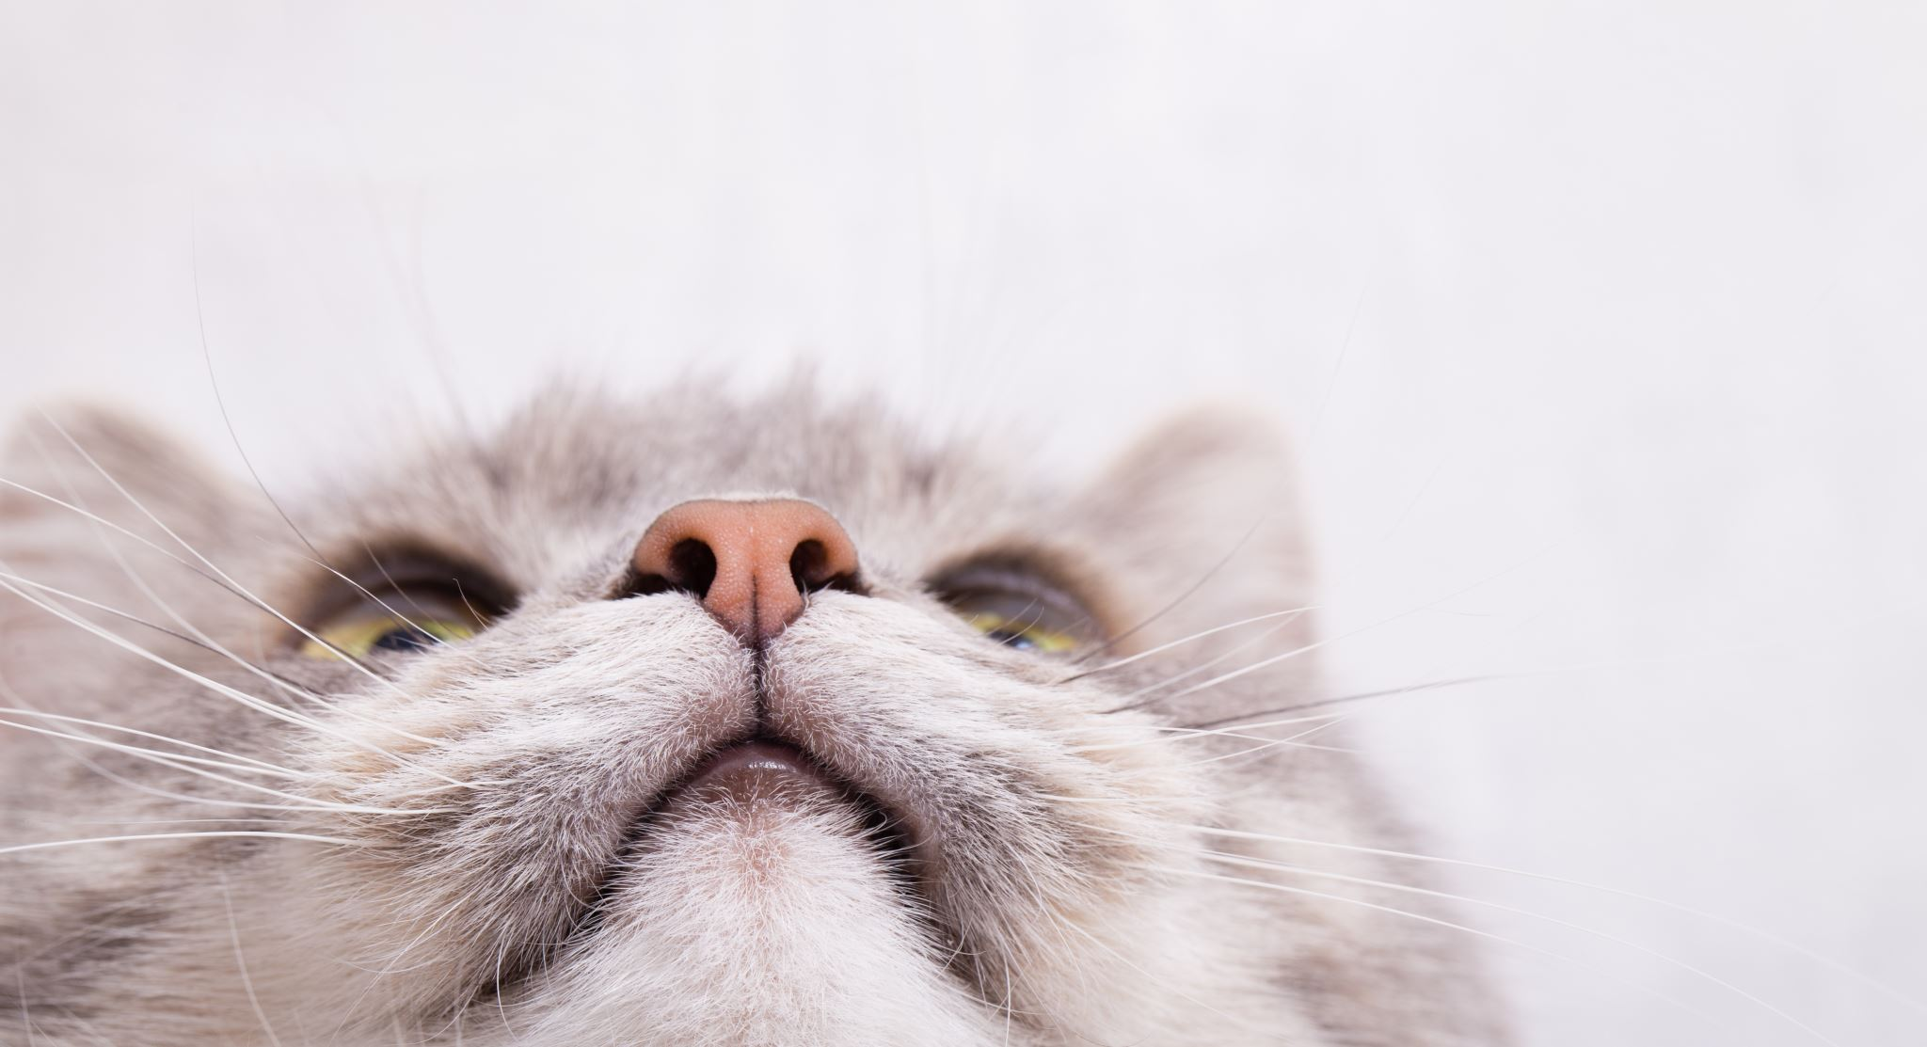
Cats presentation
Unna & Nelli

Slide 2

Common things
Indoor cats generally live 12-18 years.
There are 40-70 different cat breeds, depending on the site. The CFA recognizes 42 breeds and TICA recognizes even 71 breeds.
Cats have been domesticated for almost 10 000 years.
Very independent animals
Name ''cat'' is also used for felines (lion, tiger, puma, jaguar, lynx..)
Cats are nearsighted because of the size of their eyes, but they see pretty clearly and great in dark
The most common things cats hate:
Having too much attention, Competition, Strong smells, Medicine,
Change, Baths, Low temperature, Belly rubs

Slide 3
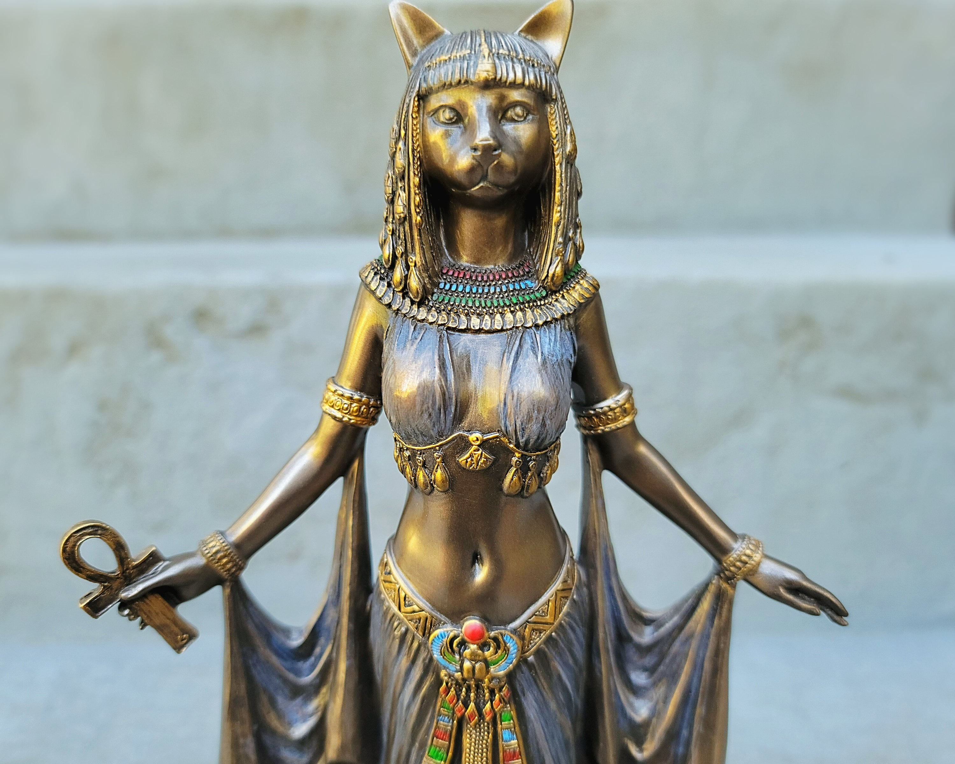
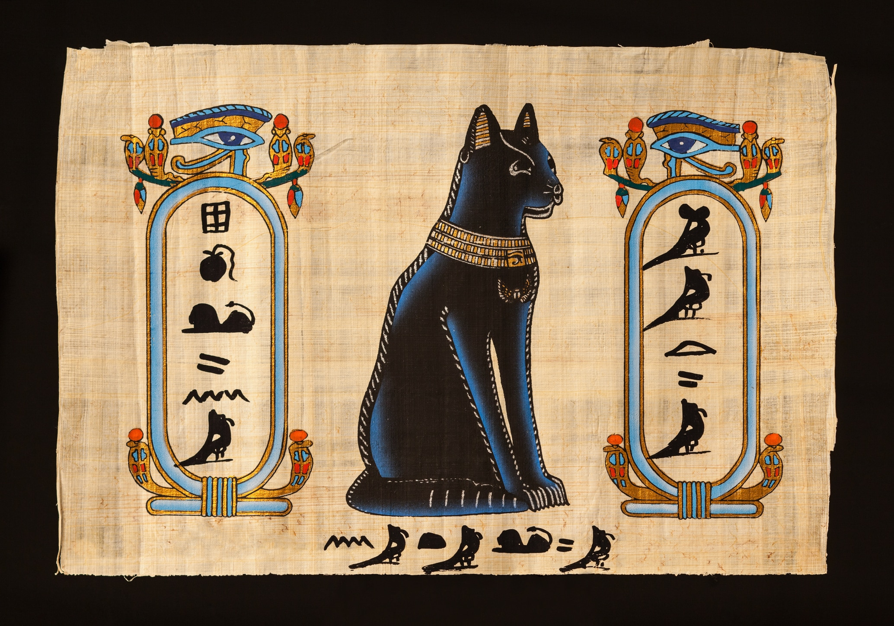
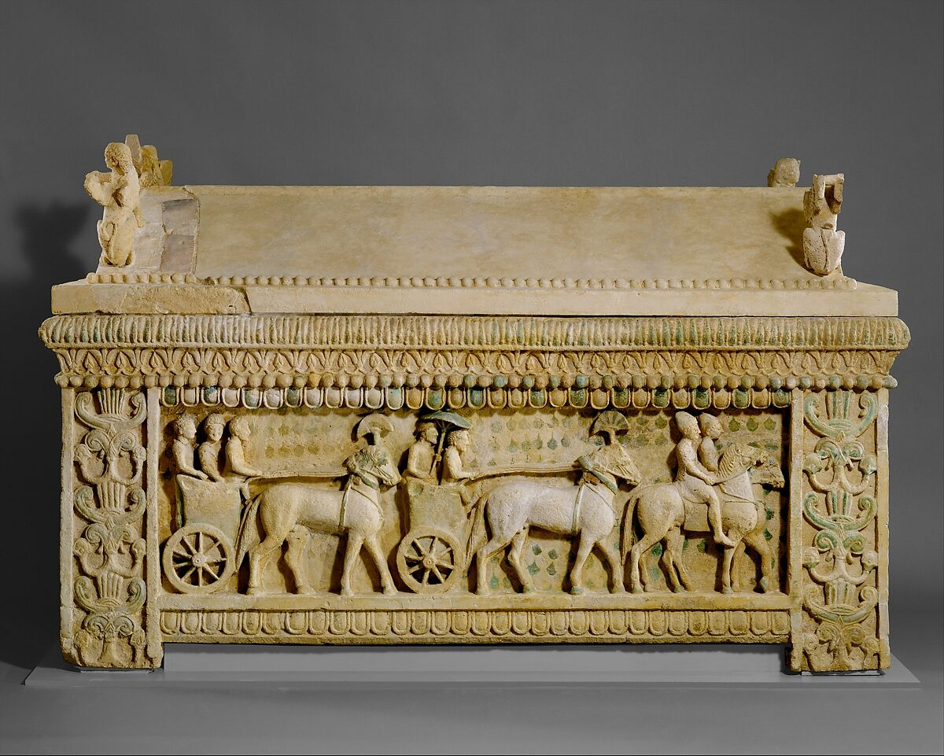
Cats history
Egyptians used to believe that cats were magical creatures
They would dress them in golden jewerly to indicate the status of their owners
Cats were used in the art
Rised from rodent killer to pet to god
People worshipped ''cat goddess'' named Bastet, which symbolized protection of the family, home, Pharaoh, childbirth, pleasure and sexuality.
Bastet's head was a cat and had body of a woman
Other ancient Egyptian deities were sculptured as cats, such as Mafdet and Sekhmet, representing justice, fertility, power and respect.
The first found mummified cat was found in the limestone sarcophagus, carved in detail.
This cat is assumed to belong for one of the Pharaos oldest son.
In Europe, cats boarded ships to the Americas tagging along with Christopher Columbus

Slide 4
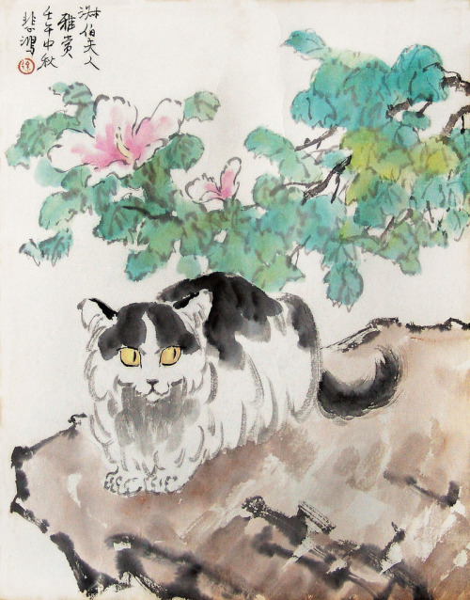
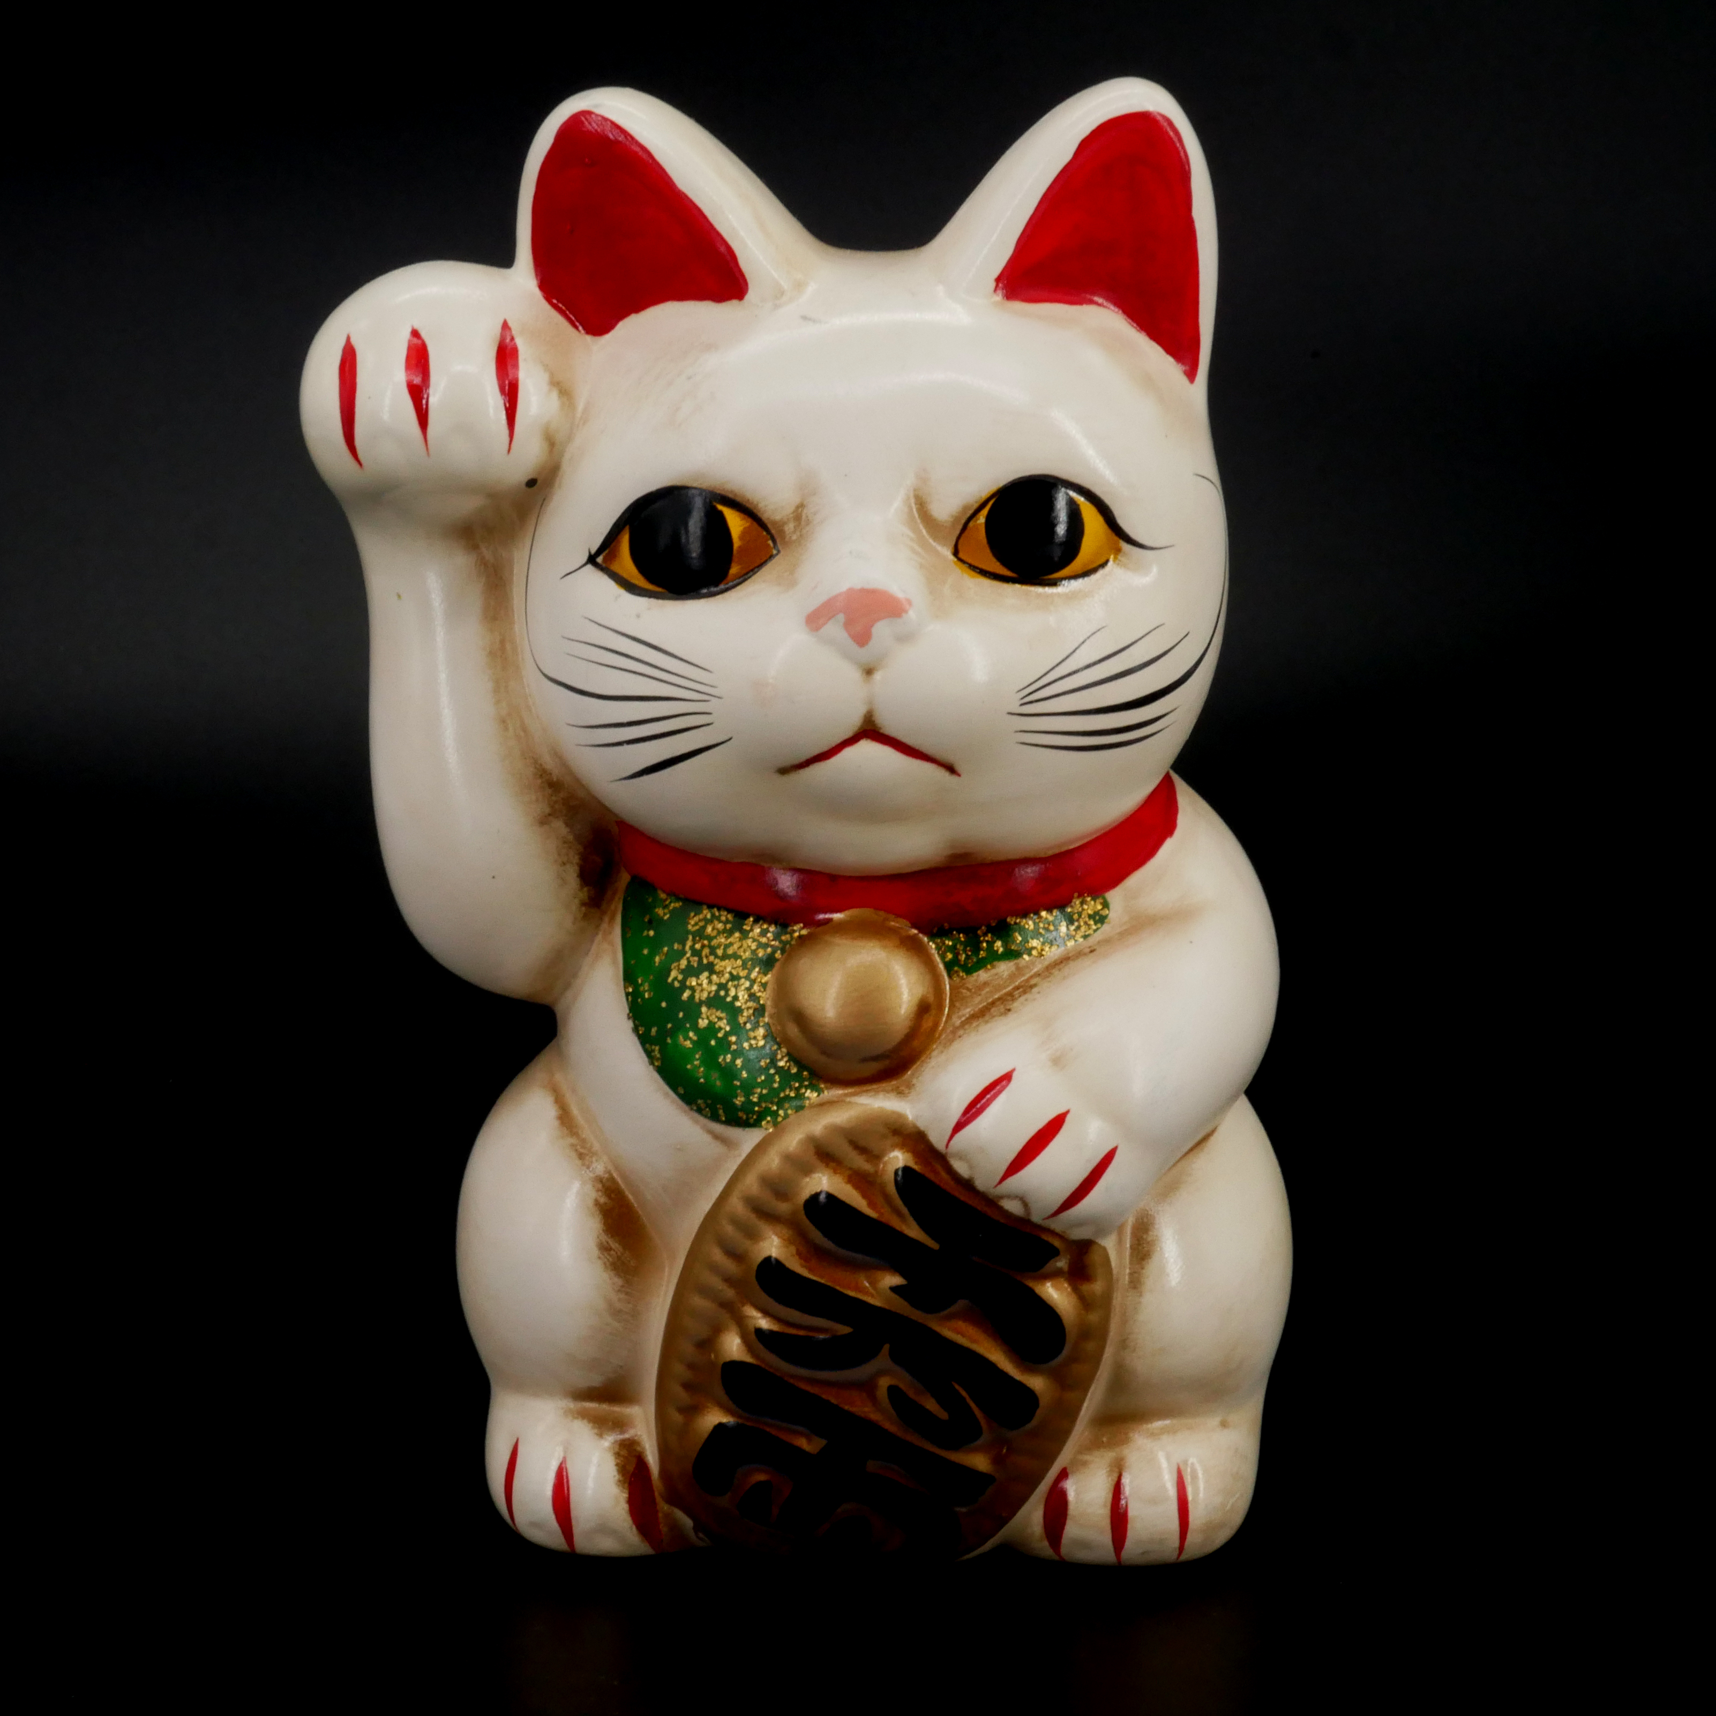
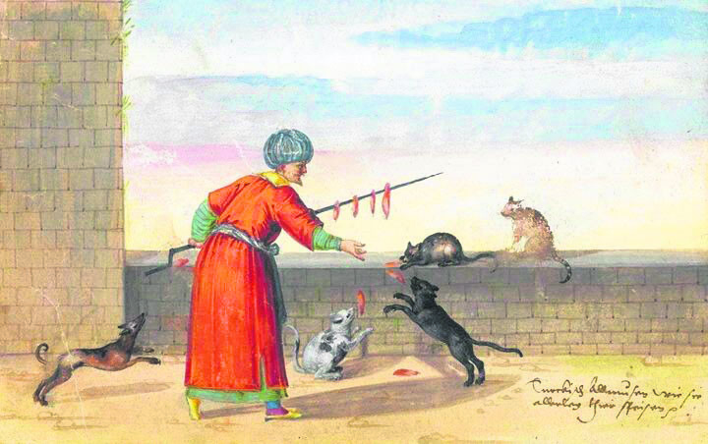
Cats history
Cats in China
People worshipped cats also in China.
In ancient China, farmers would worship cat goddess Li Shou.
Li Shou was a fertility goddess and said to possess the
extraordinary ability to communicate with the celestial
forces.
Different cultures
Cats in Japan
In Islam, cats are admired for being clean creatures and were allowed to mosques
They are believed to protect homes from evils.
Maneki-Neko is a popular cat deity from Japan.
Many assume the cat's waving, but it's beckoning. (viittaa)
Beckoning is in fact done with the paw forward and pointed down just like in the decoration.
Cats in Islam

Slide 5
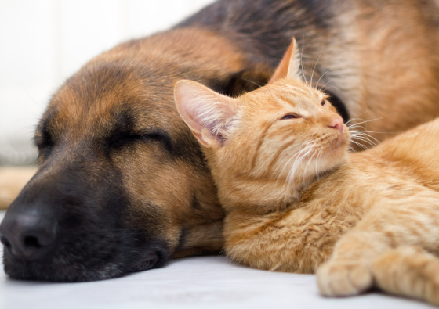
Differences between cats and dogs
cats
dogs
Independent
Cleans herself with rough tongue
Chill
Doesn't need to be trained
More loyal
Needs washes
Needs more love and care
Needs regural outdoor activity
Must be trained
Obeys its owner

Slide 6
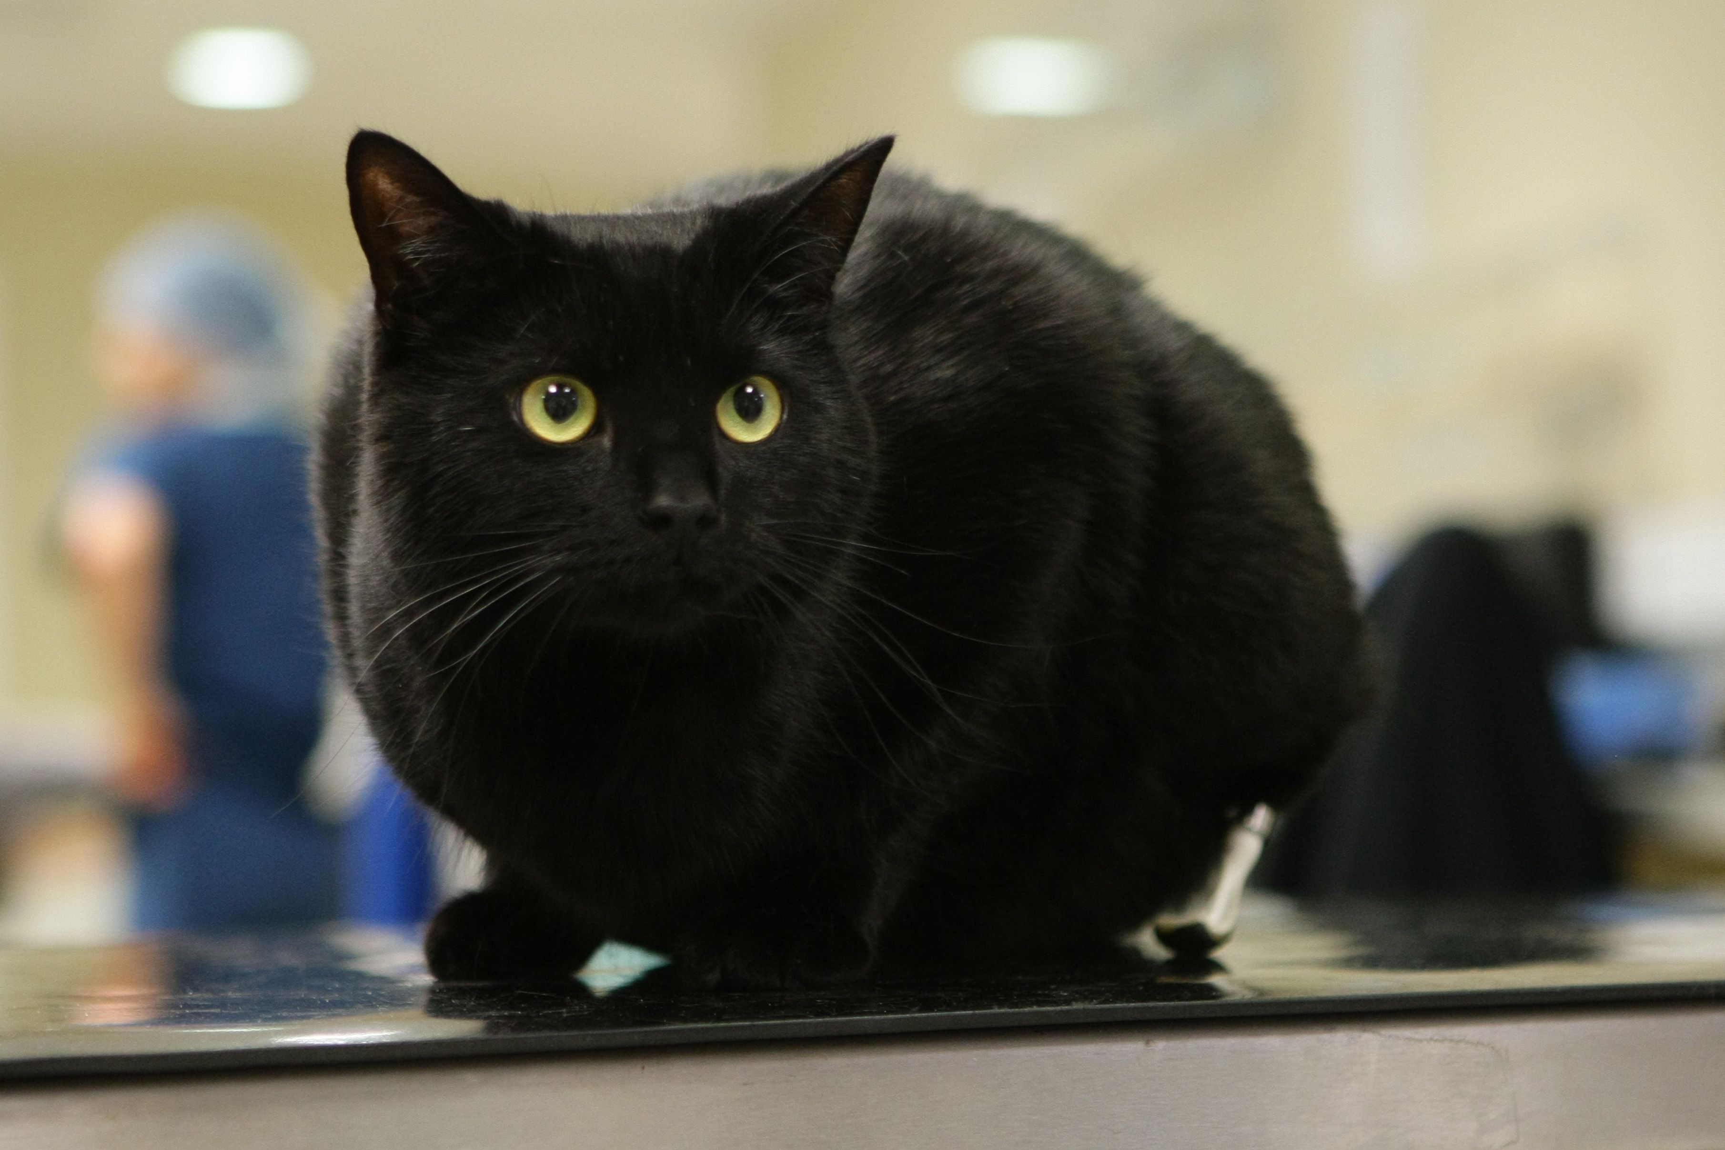
Facts about cats you probably didn't know
Cats are believed to be only mammals who don't taste sweetness
Cats are supposed to have 18 toes (5 toes on each front paw, 4 toes on each back paw) also some cats have even more
Cats have 230 bones, when humans have 206
It's believed that catnip produces an effect similar to LSD or marijuana in cats
Maria Assuna who died in 2011, left her cat her fortune, which was 13 million dollars.
A cat's learning style is almost same as a 2-3 years old child's
A green cat was born in Denmark 1995.

Slide 7
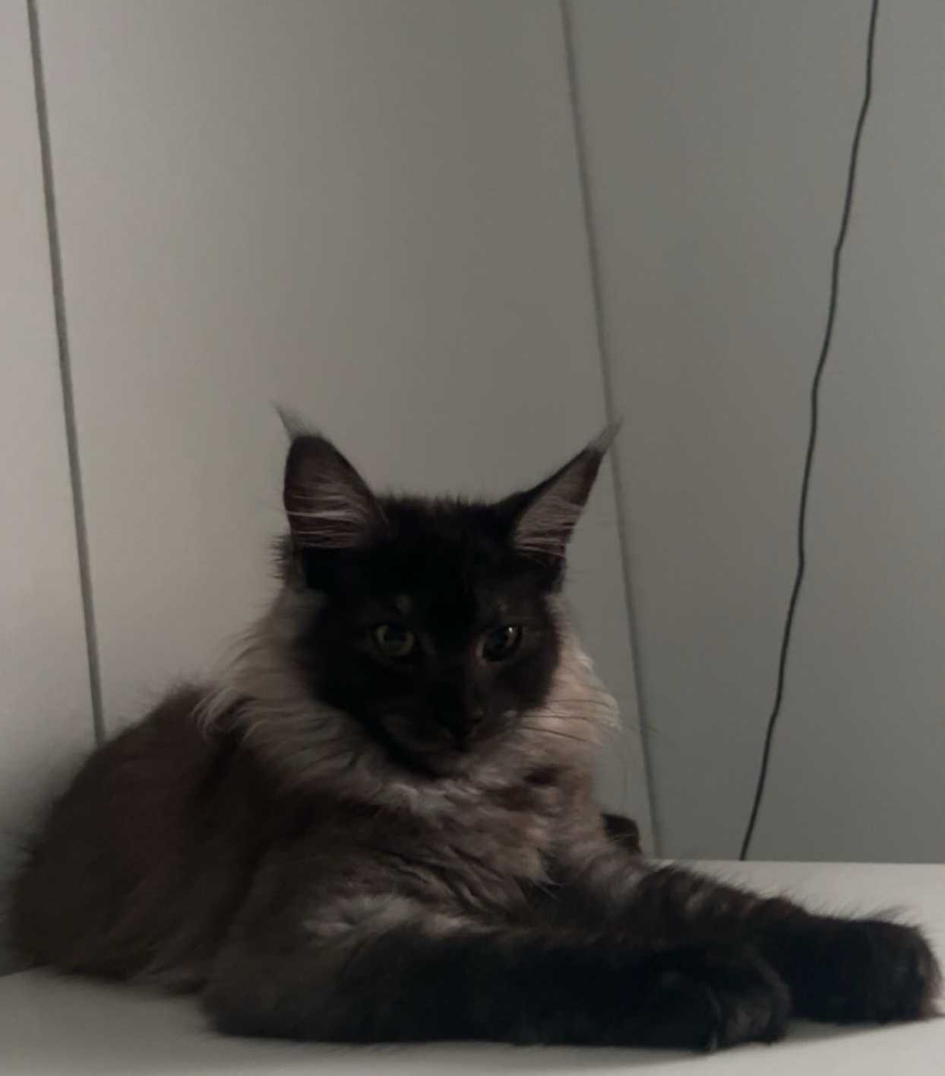
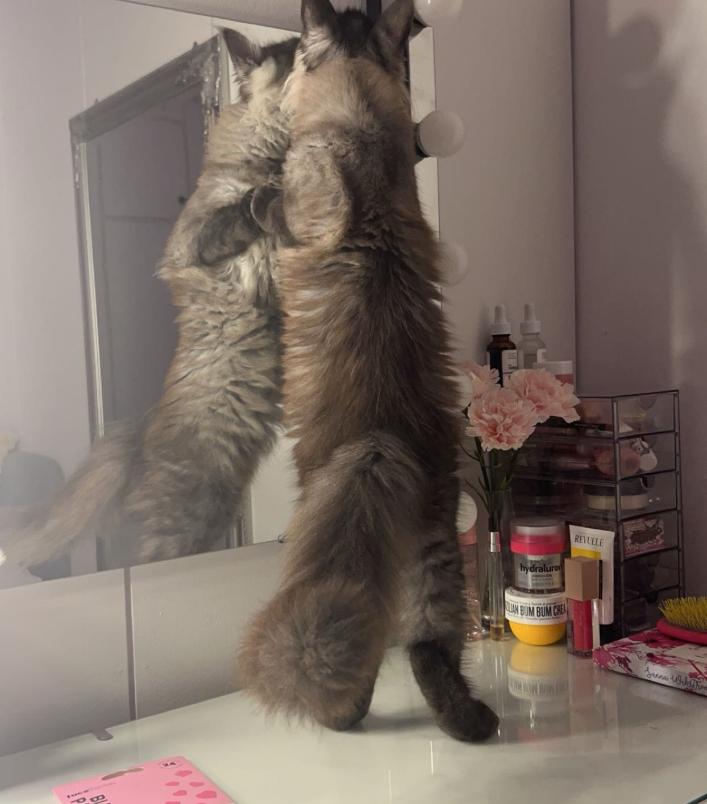
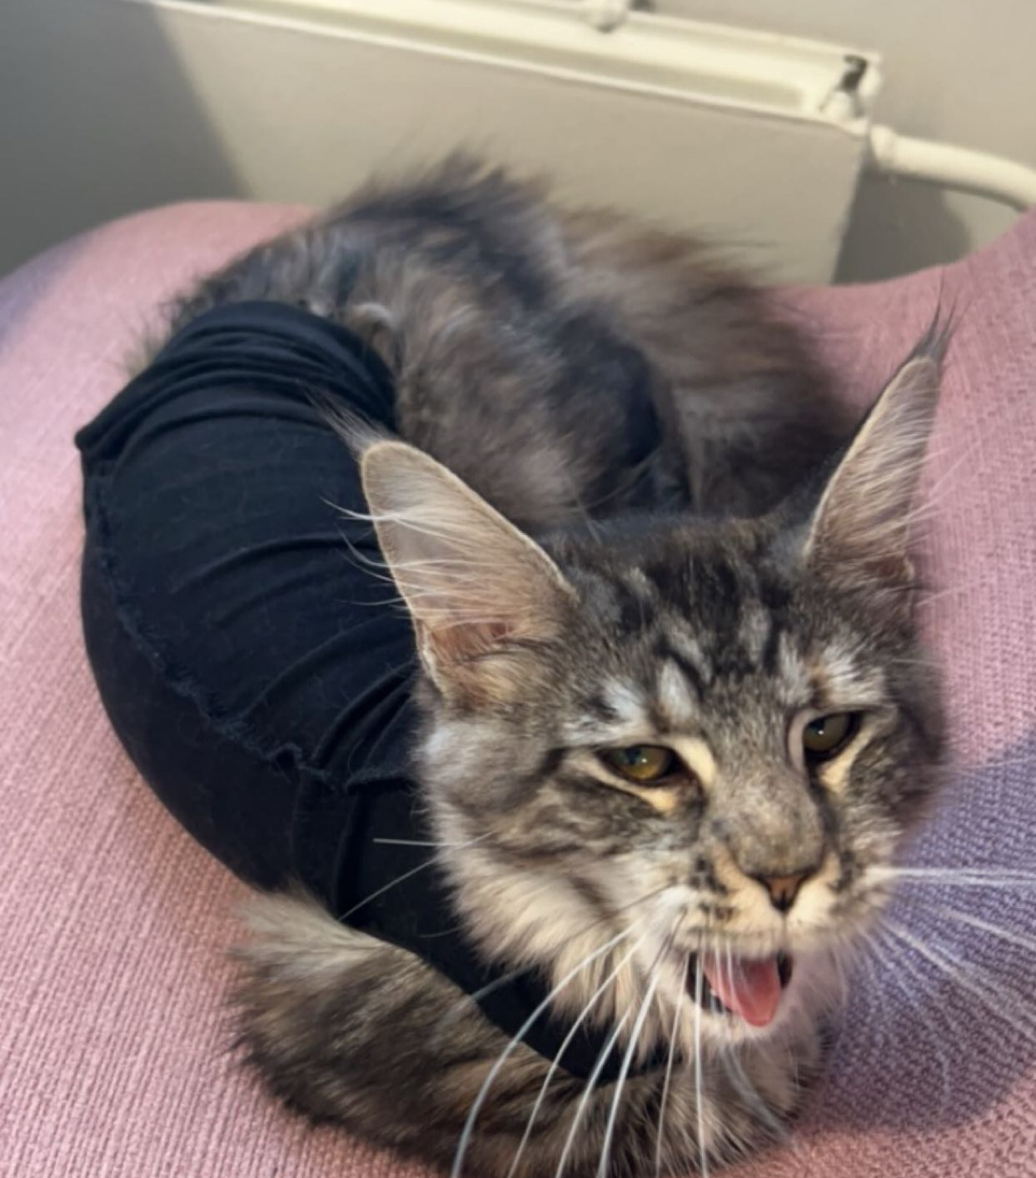
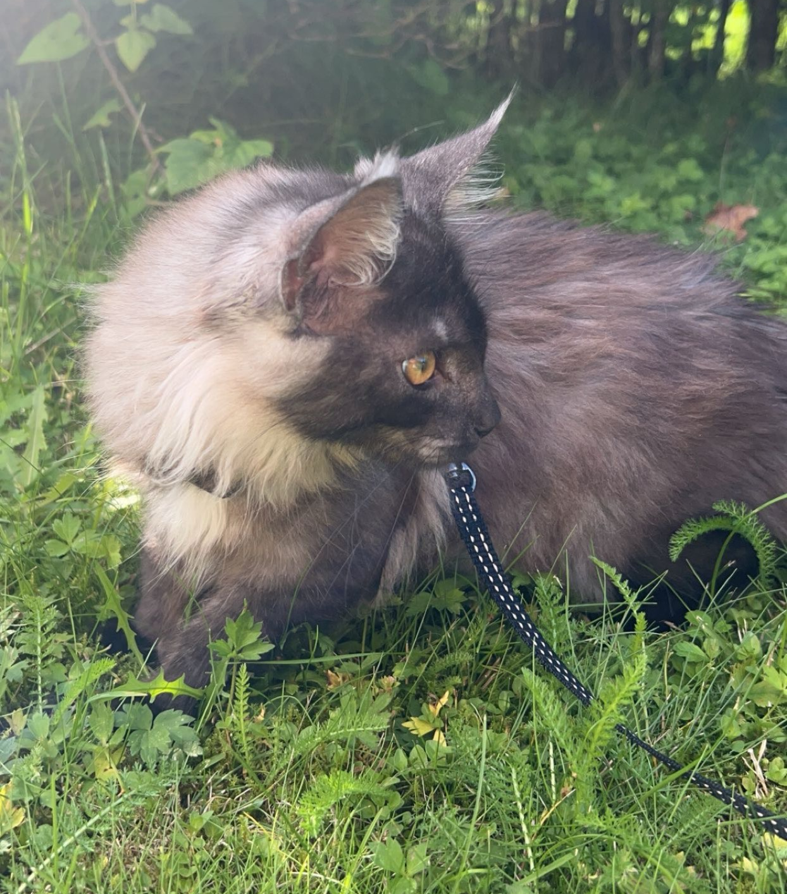
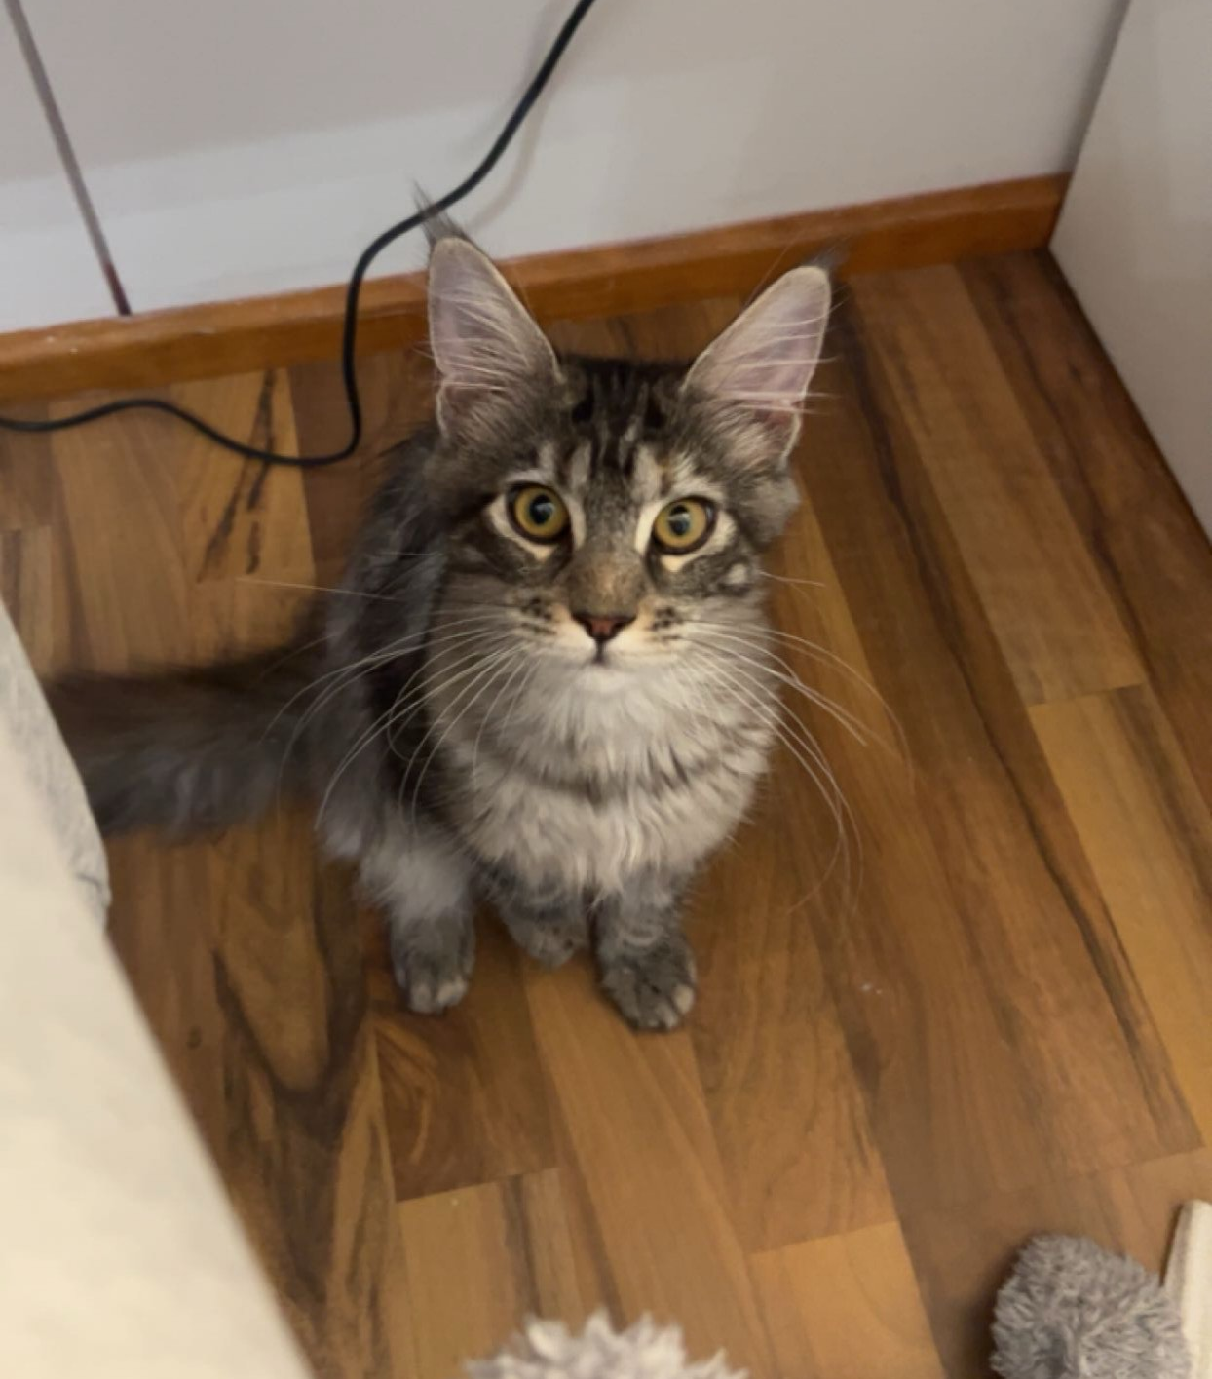
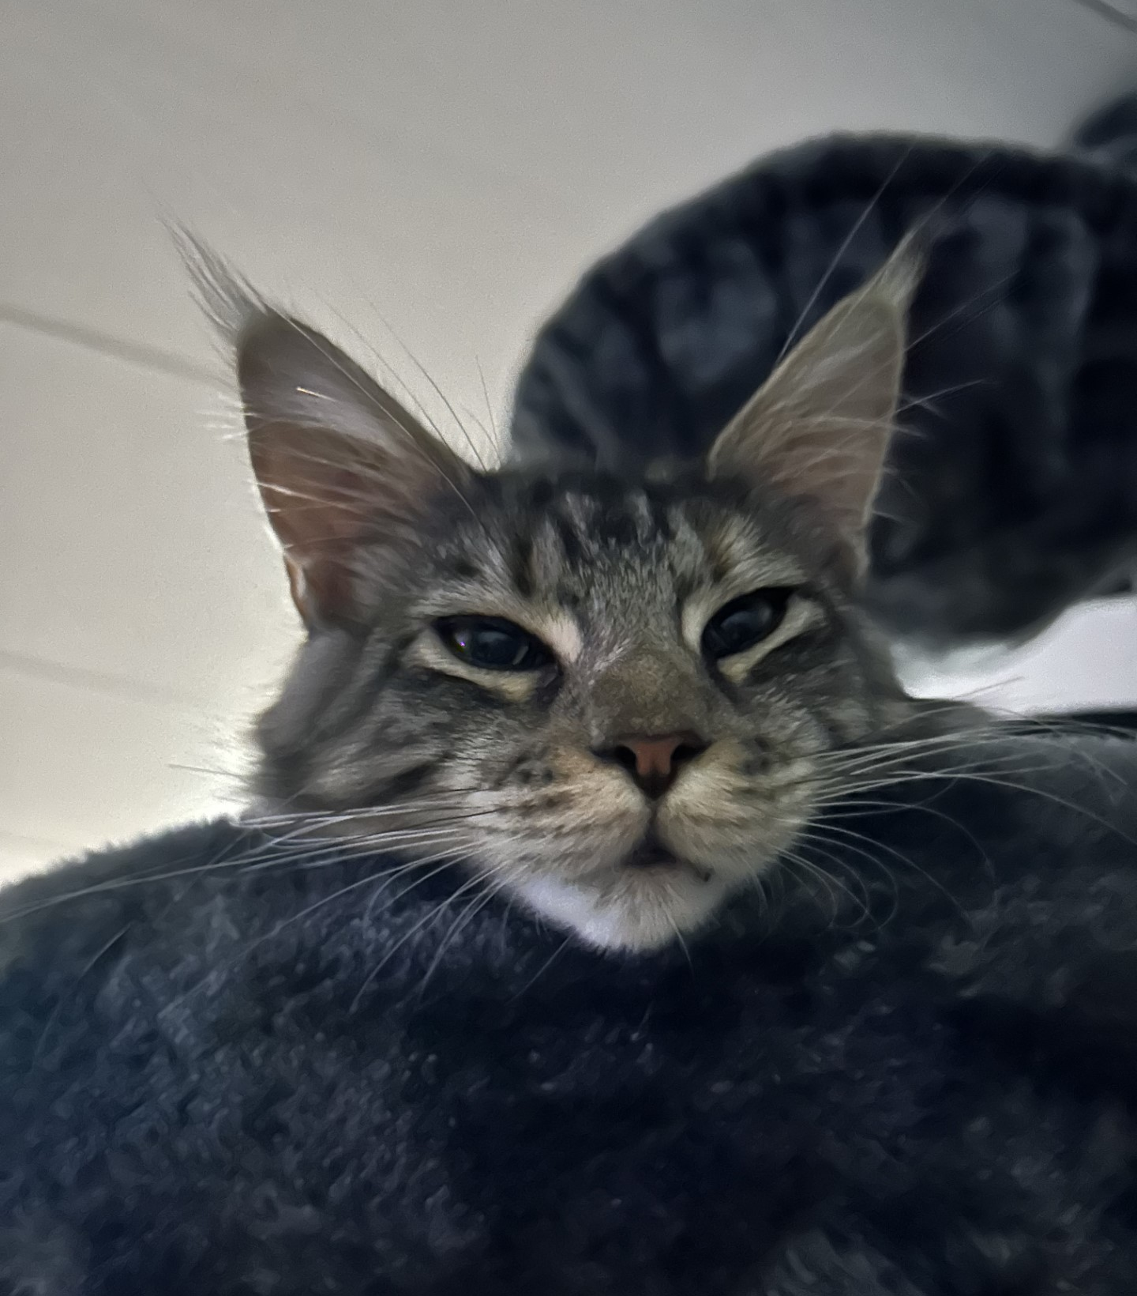
Mistika & Miranda

Slide 8
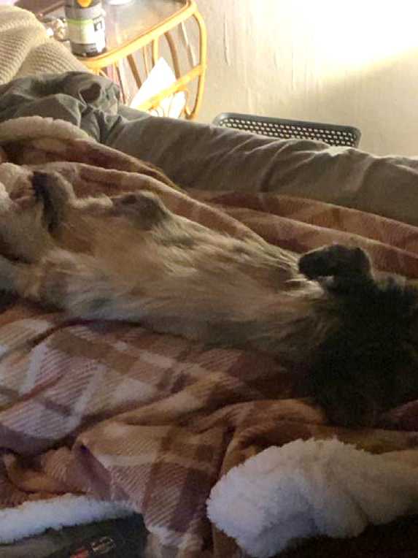
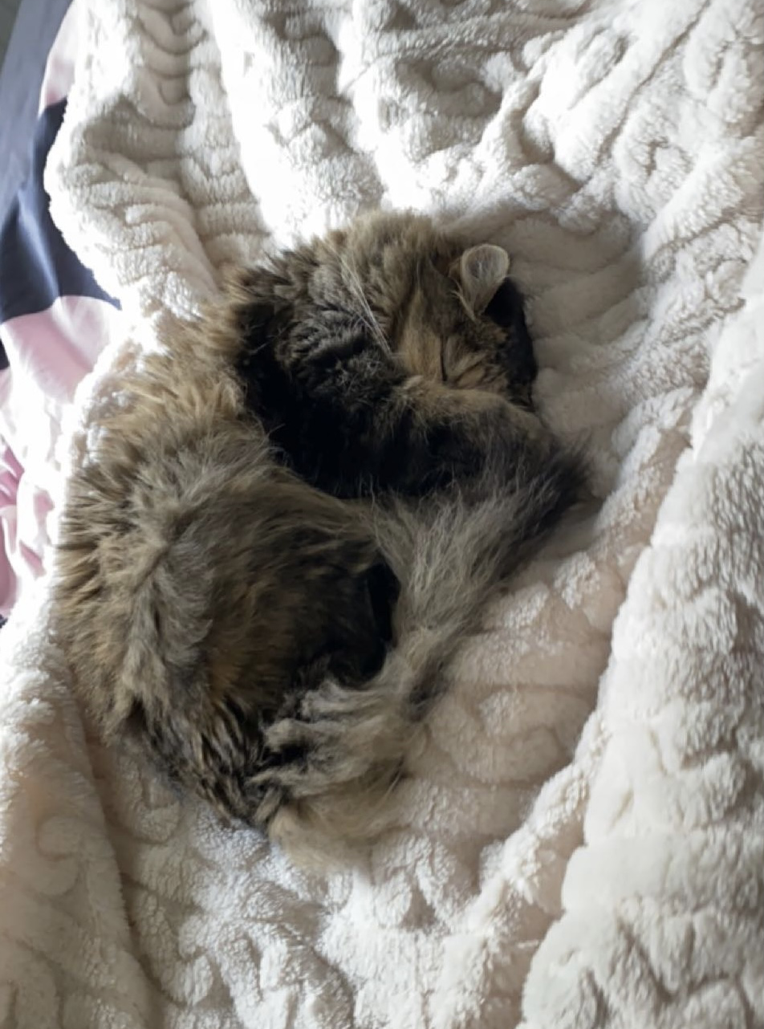
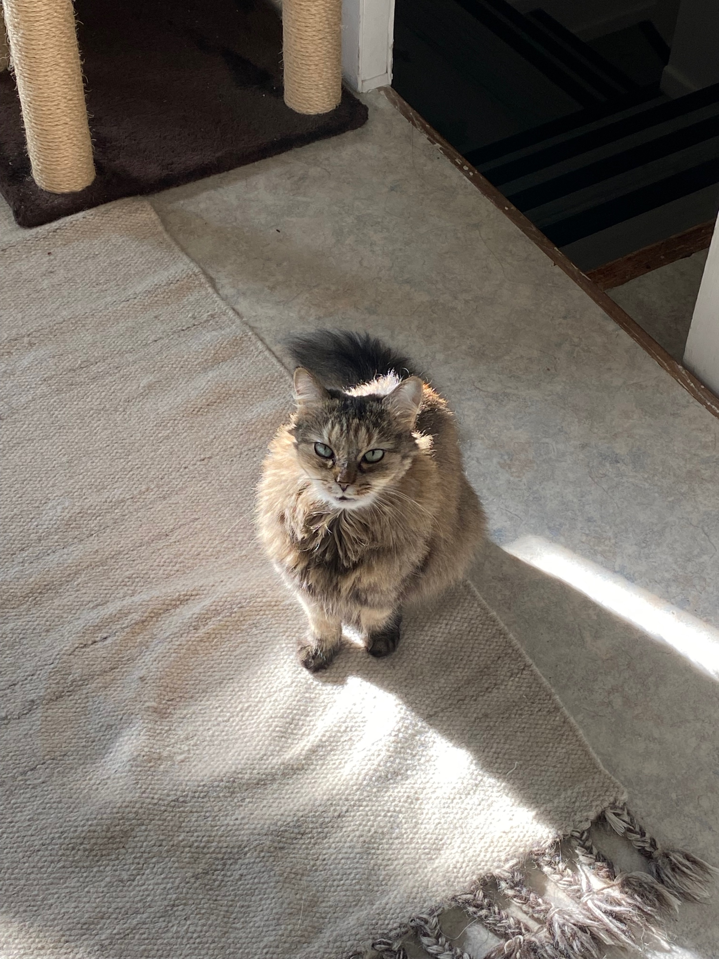
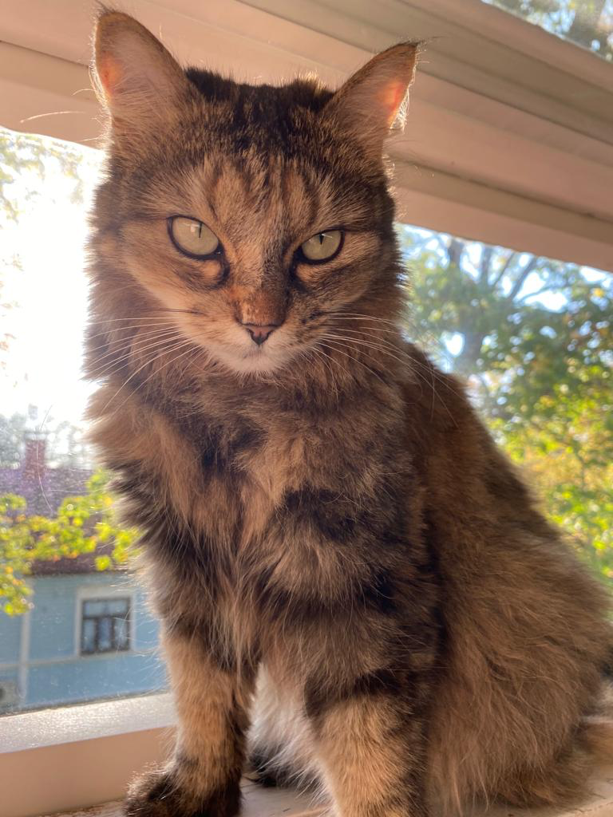

Naava

Slide 9
Sources
https://www.alleycat.org/resources/the-natural-history-of-the-cat/
https://myanimals.com/fi/elaimet/kissan-ja-koiran-suurimmat-erot/
https://artsandculture.google.com/story/cats-throughout-culture/fQVxV01wEyhyXQ
https://animaldreamboat.com/paws-of-good-fortune-embracing-the-magic-of-li-shou-the-chinese-mythological-feline/
https://kittehkats.tumblr.com/post/100115334571/the-wonderful-myth-of-chinese-cat-goddess-li-shou
https://cvillecatcare.com/veterinary-topics/101-amazing-cat-facts-fun-trivia-about-your-feline-friend/

