Slide 1
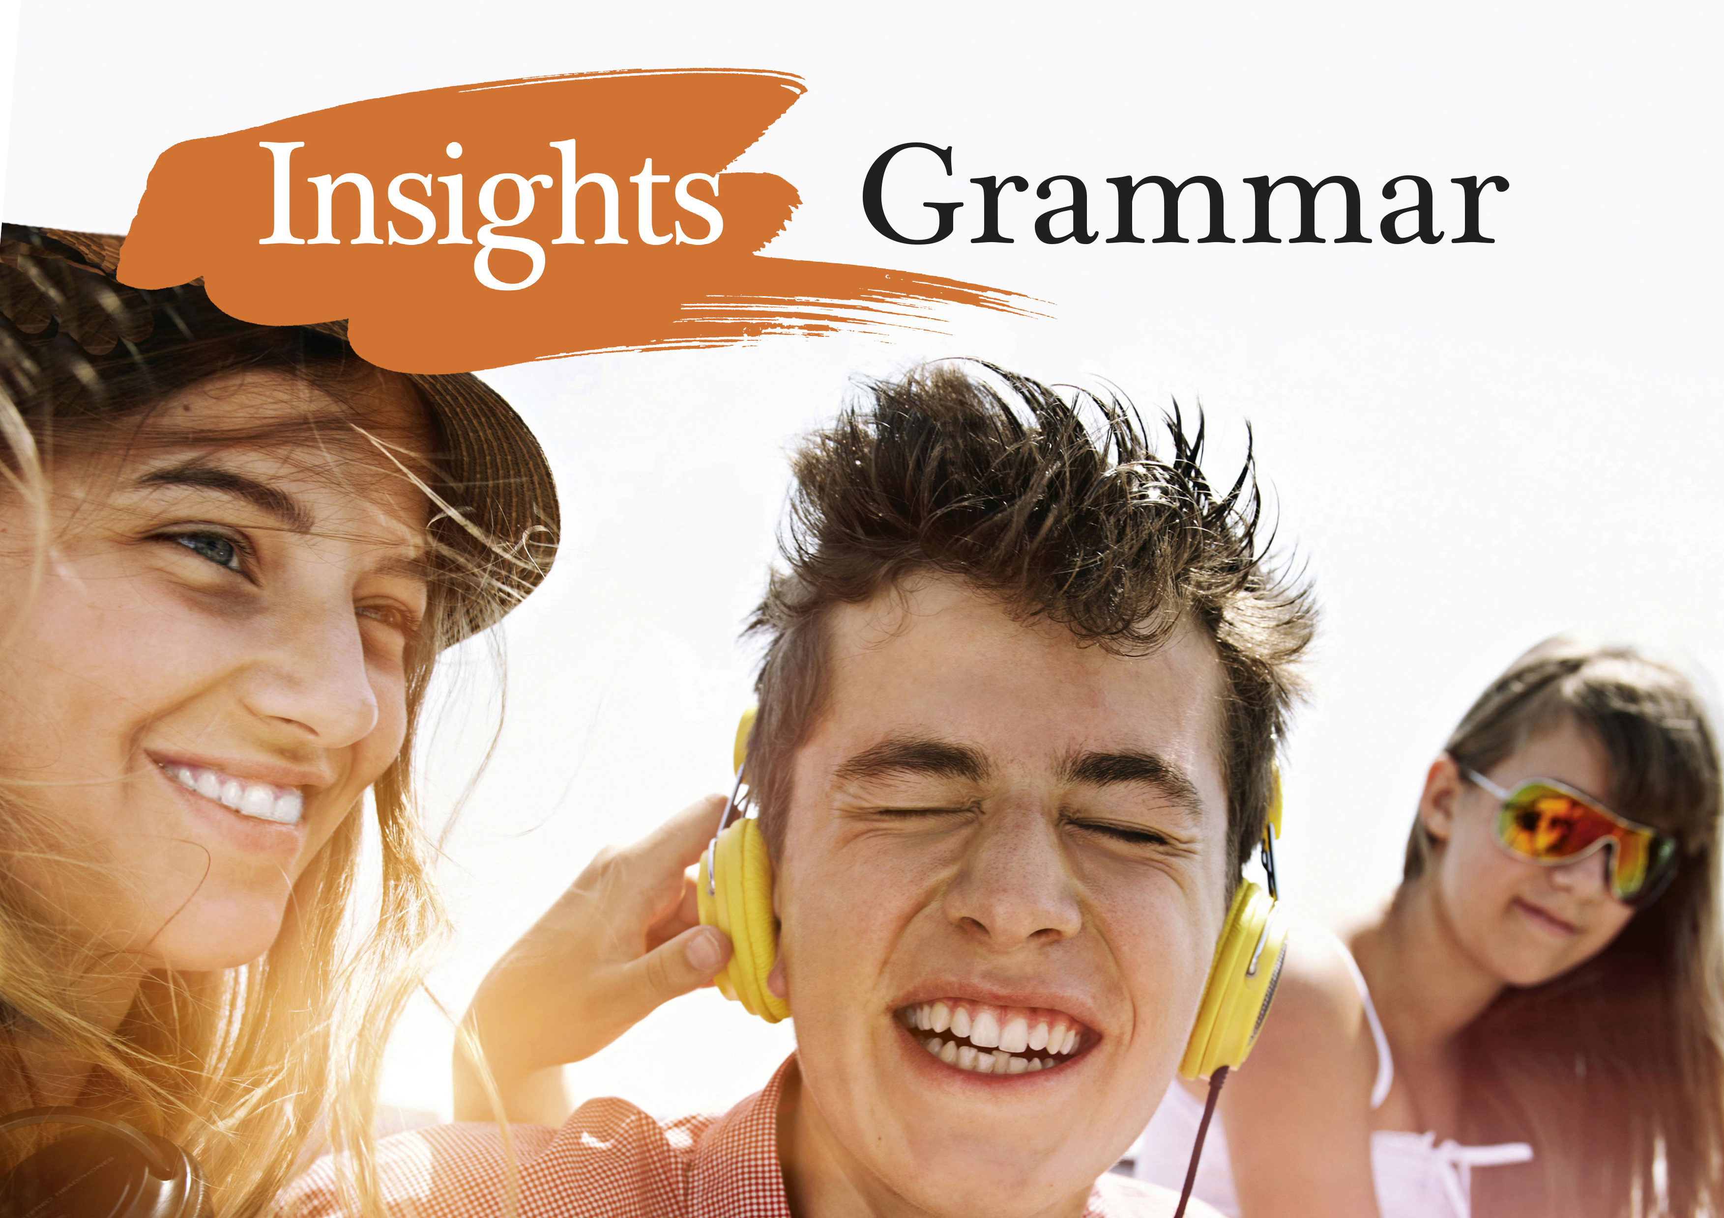
Notes:
<numero>

Slide 2
Lauseenvastikkeista
Lisäksi

Slide 3
LAUSEENVASTIKKEISTA LISÄKSI
Kaksi rinnasteista lausetta voidaan yhdistää käyttäen ing-muotoa:
June read the book and enjoyed it thoroughly.
June read the book enjoying it thoroughly.
I went to the café and hoped to meet you there.
I went to the café hoping to meet you there.
Alison walked home and whistled happily.
→ Alison walked home whistling happily.
Notes:
<numero>

Slide 4
LAUSEENVASTIKKEISTA LISÄKSI
Lauseenvastike voi olla myös kielteinen. Kieltosana not on silloin rakenteen edessä:
Not noticing the speed limit, Ann-Catherine got a speeding ticket.
Not wishing to offend her, I didn’t say anything about her driving.
Not wanting to be late for school, she had felt rushed and tense.
Notes:
<numero>

Slide 5
LAUSEENVASTIKKEISTA LISÄKSI
Lauseenvastikkeella voi olla myös oma subjekti:
It was a sunny day. The Smiths decided to go to the beach.
→ It being a sunny day, the Smiths decided to go to the beach.
There was no time to lose. We decided to take off straight away.
→ There being no time to lose, we decided to take off straight away.
As Grandma’s condition was getting worse, they decided to call for an ambulance.
→ Grandma’s condition getting worse, they decided to call for an ambulance.
Notes:
<numero>

Slide 6
LAUSEENVASTIKKEISTA LISÄKSI
Sanontoja:
ottaen huomioon
yleisesti ottaen
päätellen
edellyttäen, että
olettaen, että
sään salliessa
considering
broadly/generally speaking
judging from/by
providing / provided (that)
supposing (that)
weather permitting
Notes:
<numero>

