Slide 1

1. Elements of a good speech/presentation: make a plan!
RAKENNE:
INTRODUCTION I would like to talk about…
MAIN BODY (itse asia, mistä puhut perusteluineen)
CONCLUSION (yhteenveto) Finally...

Slide 2

2. Elements of a good presentation: practice!
Write down short notes, the key points, to help you along the way. Don’t write everything down!
Practice your presentation alone or with your friend/parent/cat/dog.
If possible, record yourself and listen to your presentation. If you can’t record yourself, ask a friend to listen to you. Does your friend understand you? Ask for feedback.
Practice in front of a mirror.

Slide 3
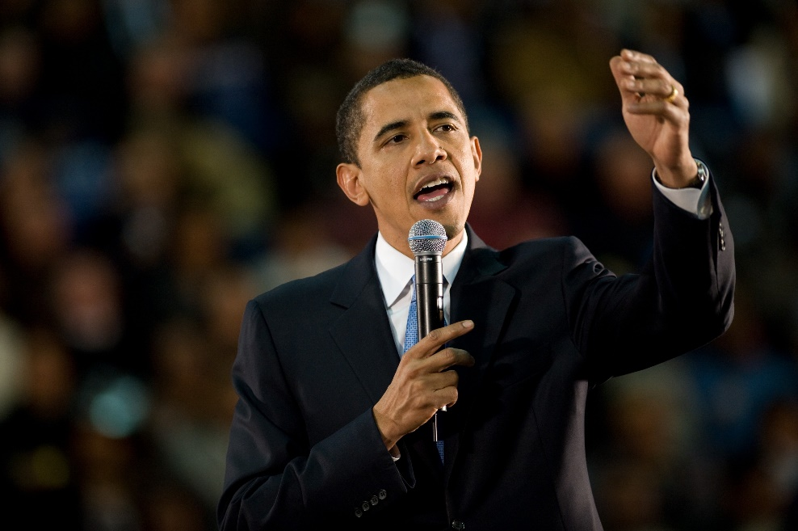
3. Elements of a good speech/presentation: talk
Write short notes, bullet points on paper (ranskalaiset viivat).
When speaking use short, simple sentences to express your ideas clearly.
Pause from time to time and don’t speak too quickly. This allows the listener to understand your ideas. Include a short pause after each idea.
Speak clearly and at the right volume.
Make your opinions very clear.
Look at the people who are listening to you.

Slide 4
USEFUL EXPRESSIONS
1. Explain what your presentation is about at the beginning:
I’m going to talk about ... I’d like to talk about ... The main focus of this presentation is ...
Use these expressions to order your ideas: First of all, ... Firstly, ... Then, ... Secondly, ... Next, ... Finally, ... Lastly, ...
2. Use these expressions to add more ideas from the same point of view:
In addition, ... What’s more, ... Also, ... Added to this, ...
To introduce the opposite point of view you can use these words and expressions:
However, ... On the other hand, ... Then again, ...
3. Finish your presentation To sum up, ... In conclusion, ...

Slide 5
SPEECH TOPICS: examples
Violent computer games should be banned.
The sale of cigarettes should be made illegal.
Homework should be limited to just two nights a week.
Should school students be required to wear a school uniform?
How to become the most popular teen in school.
Suggest a topic of your own!

Slide 6
Form a group of 2-3 people or work independently
PLAN YOUR SPEECH 15 min
WRITE KEY WORDS + MAKE SOME VISUAL AID (POWER POINT OR A POSTER) 1 H
PRACTICE 30 MIN
GIVE YOUR SPEECH / PRESENTATION
MAKE 1-3 QUESTIONS TO OTHERS ABOUT YOUR TOPIC
ALL INFORMATION + HELPFUL VIDEOS IN PEDANET: Helilän koulu – luokkien ja opettajien sivut – Hertta Oksanen – 8th grade optional English
Homework: watch the video from Pedanet – no sign in needed.

