Slide 1
Creativity is our activity!
Ideas about brain, learning and creativity by Jim Kwik and others
Collected by Tapani Lakaniemi

Slide 2
BE FAST, MOM!

Slide 3
BELIEVE
B – BELIEVE
What You believe, You can;
What You believe, You cannot!
- Henry Ford

Slide 4
BELIEVE
Our brain is
a SUPERCOMPUTER
and our self talk is the program it will run!
- Jim Kwik

Slide 5


Slide 6


Slide 7
E - EXERCISE
E – EXERCISE
When Your body moves,
Your brain grooves!

Slide 8


Slide 9


Slide 10
F - FORGET
F - FORGET
Forget what You have learnt. Don’t be too satisfied with Yourself! When the cup is full already, You cannot fill it anymore…
Forget the obstacles of Your recent situation.
Forget Your own personal limits!

Slide 11
F - FORGET
“You won’t learn if you think you already know everything.”
- Robert T. Kiyosaki

Slide 12
A - ACTIVE
A – ACTIVE
Be active! Ask questions, because good questions are a port to good answers!
Be active like a child – they are the most creative and fastest learners!
Leaders are readers!

Slide 13
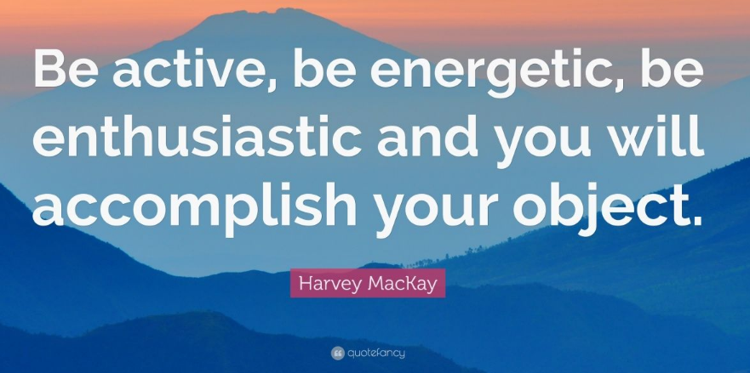

Slide 14
S - STATE
S – STATE
What’s Your state of mind? Who’s in control of it?
All learning is state related.
It’s impossible to learn anything when You are bored, but in a state of FLOW everything is possible!

Slide 15
S - STATE
Success is a state of mind.
If you want success, start thinking of yourself as a success.
-Joyce Brothers

Slide 16
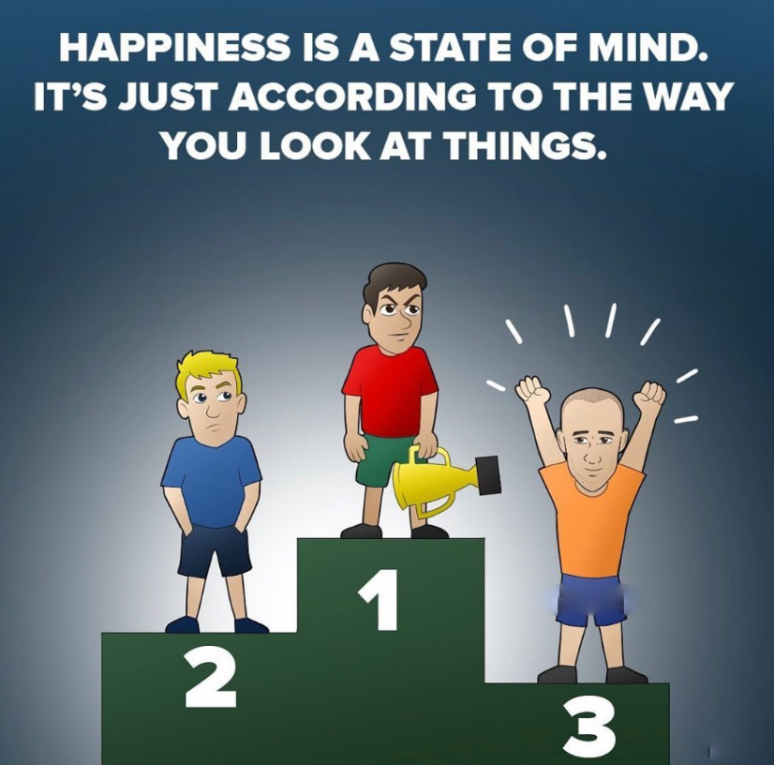

Slide 17
T - TEACH
T – TEACH
The best way to learn something is to teach it to others!
“Those who can, do; those who can’t, teach.” — George Bernard Shaw
But that’s great, because in that way also we teachers will learn!

Slide 18


Slide 19
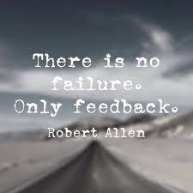

Slide 20
M - MOTIVATION
M – MOTIVATION
Motivation is the key!
If I promised You 1000 euros if You could remember the names of the persons beside You… - Would You remember them?!

Slide 21
M - MOTIVATION
"Success is not final;
failure is not fatal:
It is the courage to continue that counts."
- Winston S. Churchill

Slide 22
O - OBSERVATION
O – OBSERVATION
When You cannot find the house of Your new friend …
Were You really awake? Did You really observe the way when You last time visited him??

Slide 23


Slide 24
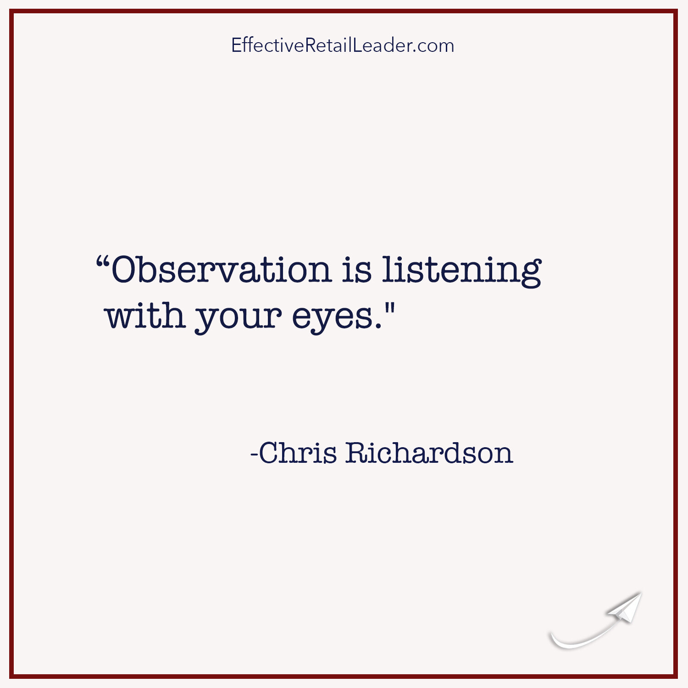

Slide 25
M - METHOD
M – METHOD
Behind every miracle there’s a method!

Slide 26
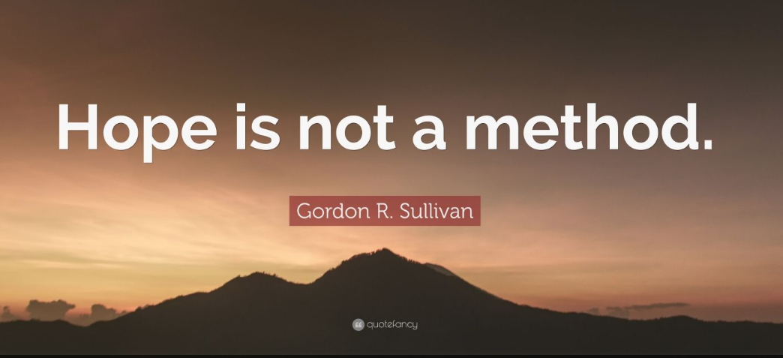

Slide 27
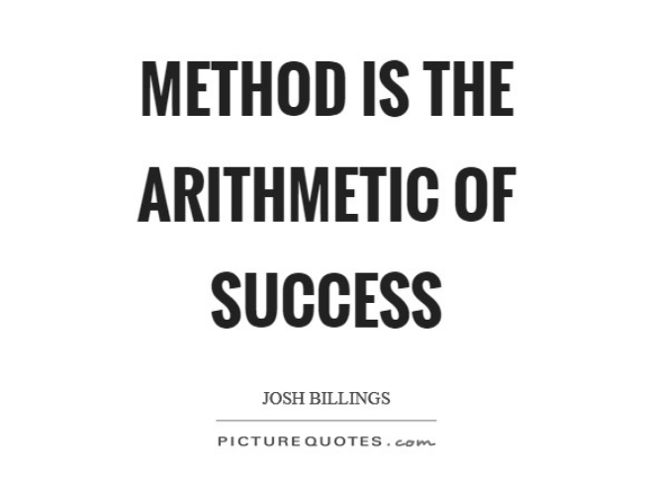

Slide 28
BE FAST, MOM!
Be creative!!
Creativity is not something we HAVE, but something that we DO!

